Slide 1
Hydrodynamic models of the Great Barrier Reef region
Frank Colberg, Gary Brassington, Paul Sandery, Pavel Sakov
Acknowledgements:
Narendra Tuteja, Richard Laugesen, et al., Bureau Water Information
Richard Brinkman, Hemerson Tonin, AIMS
Michelle Devlin, Robin Beaman et al., JCU
Mike Herzfeld, Emlyn Jones et al., CSIRO
QLD Govt
John Wilkin, Rutgers University
Notes:
An operational coastal ocean forecasting system for the Great Barrier Reef region
1-5 slide 5 minutes

Slide 2
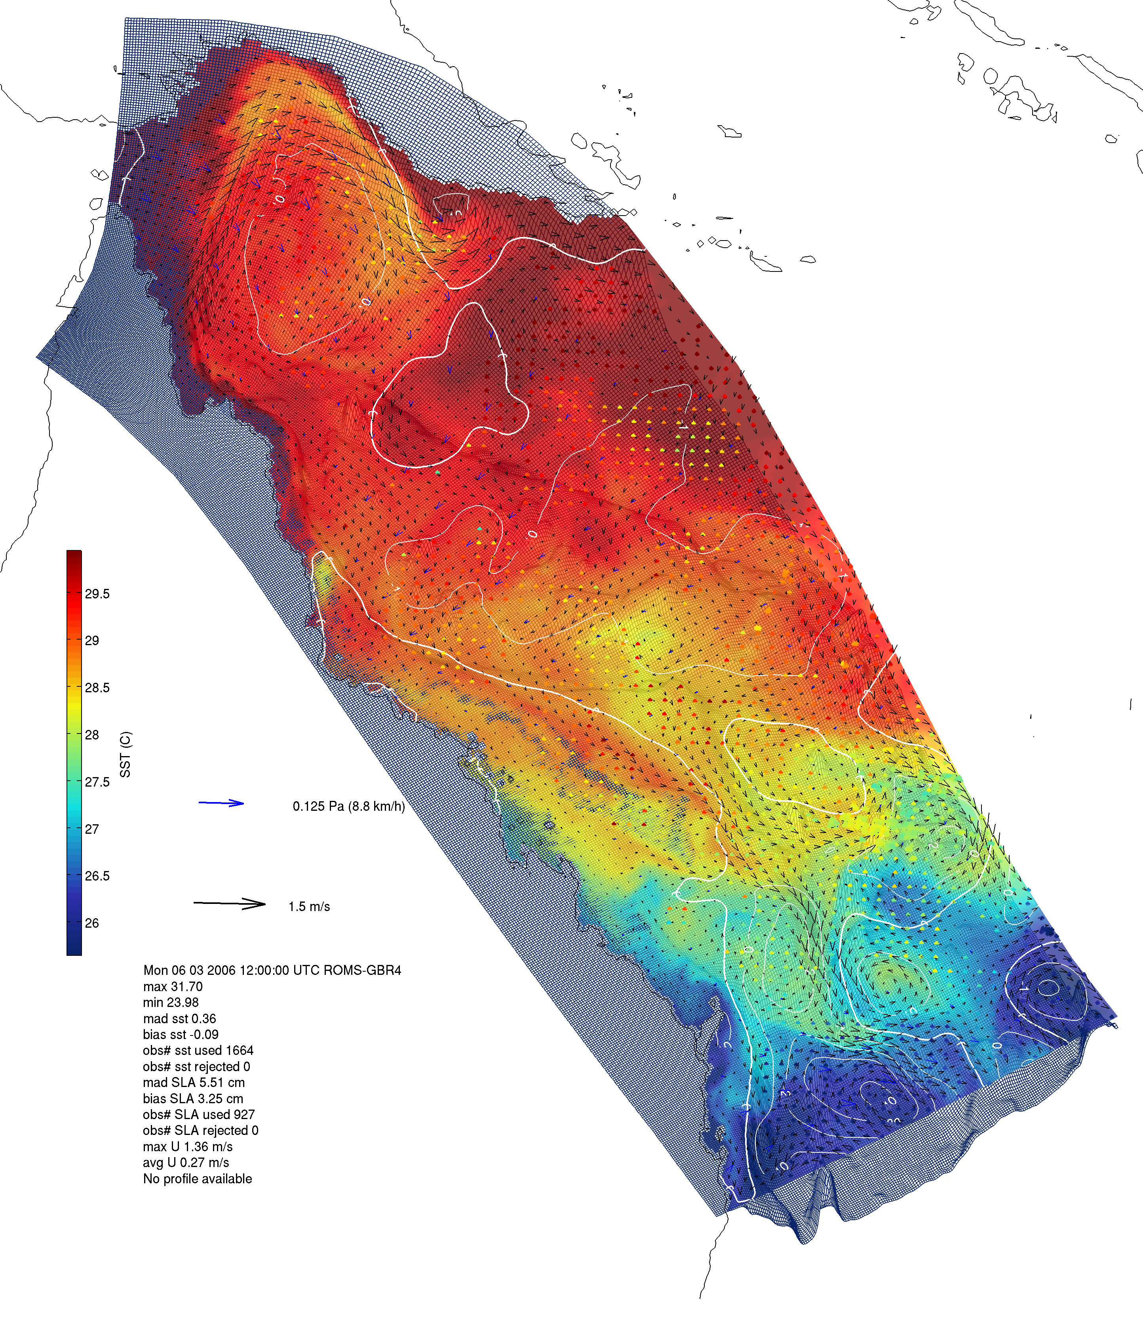
Forecasting system
  Numerical Models
    ROMS
      Tides, Wetting drying
  Data Assimilation
    EnOI/ EnKF
  Observations (for assimilation and validation)
    SST
    Altimeters
    Argo
  River Tracing component
    Age tracers
    River input
Notes:
Main motivation
Main components
Highlight talk briefly about the others
EnOI (sub-optimal) analogous to BLUElink system and provides a baseline
Observations delayed mode (initially analogous to BLUElink)
Key
EnOI is same approach is same as 10year, well konw as suboptimal approach
Initlllay make use of that system utilizing our knowledge,
Explore how much constrain we are getting compared to bluelink
But move to EnKF

Slide 3
4km/ 500m simulations
BRAN3 open boundary conditions
  Temp, Salt, U, V, SSH
  10km resolution
CFSR atmospheric forcing
  Hourly, 0.5deg SLP and Humidity
  0.3deg winds, fluxes, rain
  → 2011 0.2deg
TPXO7.2 tidal forcing
  8 Tidal constituents
Bathymetry – blended product
  GBR 100 (Rob Beaman, JCU)
  GA Plus 250m (James Daniell)
  GA 250m (Whitewell)
ROMS-FC
  River forcing: BoM, 25 Catchments
  5 tracers + 5 age tracers
ROMS-HR
  River forcing, 1 tracer + age
Notes:
The other point is
(a) great effort has been placed on developing a good bathymetry underpinning both models

Slide 4
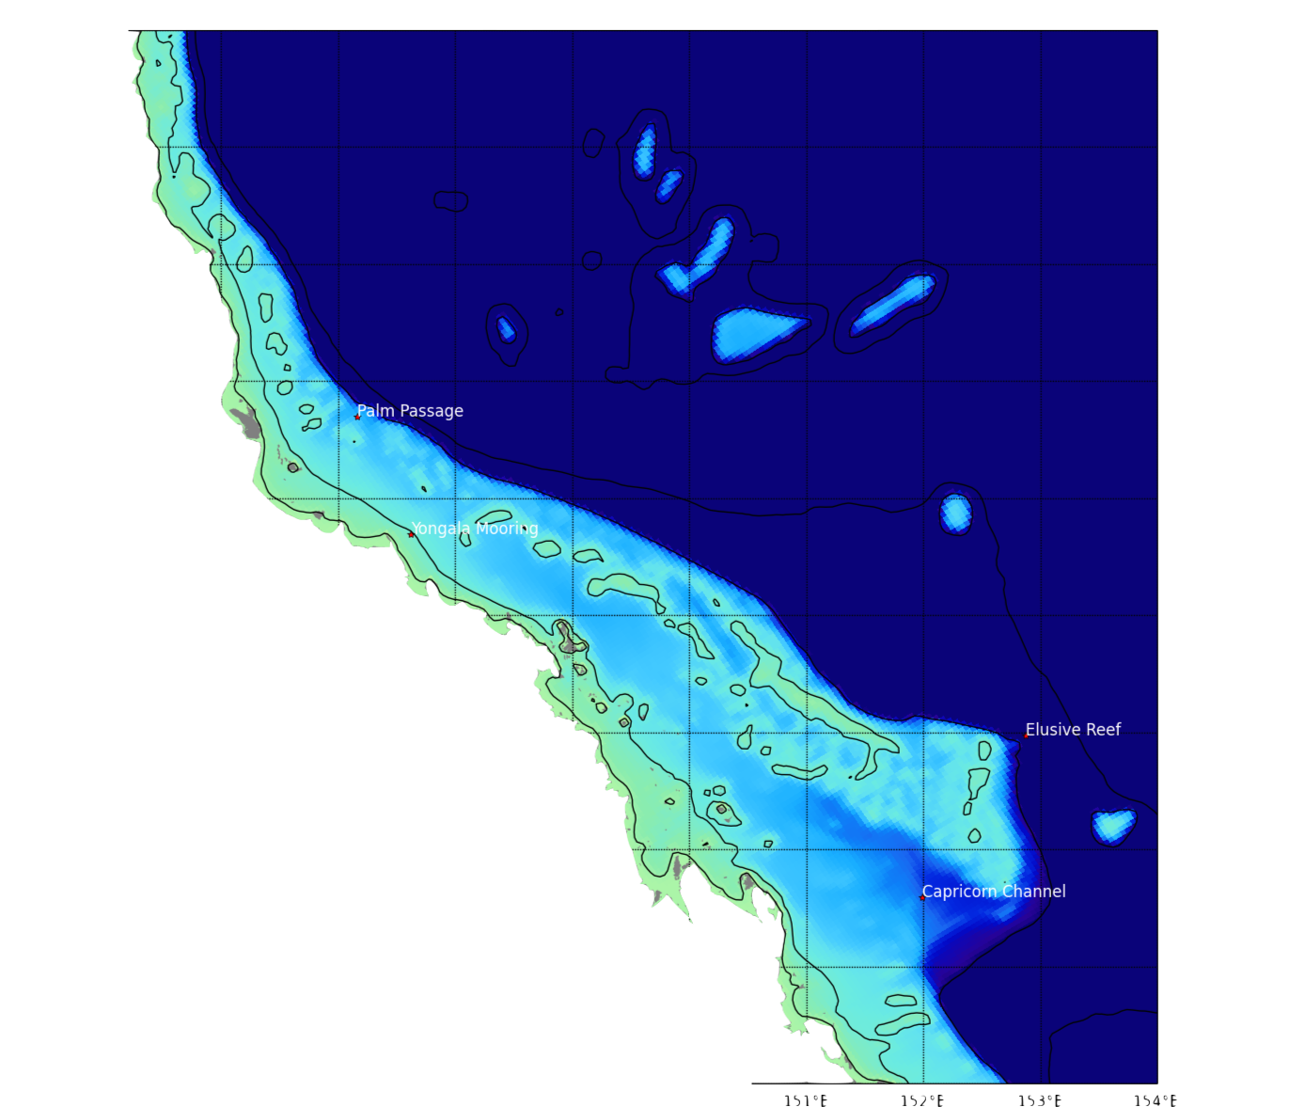
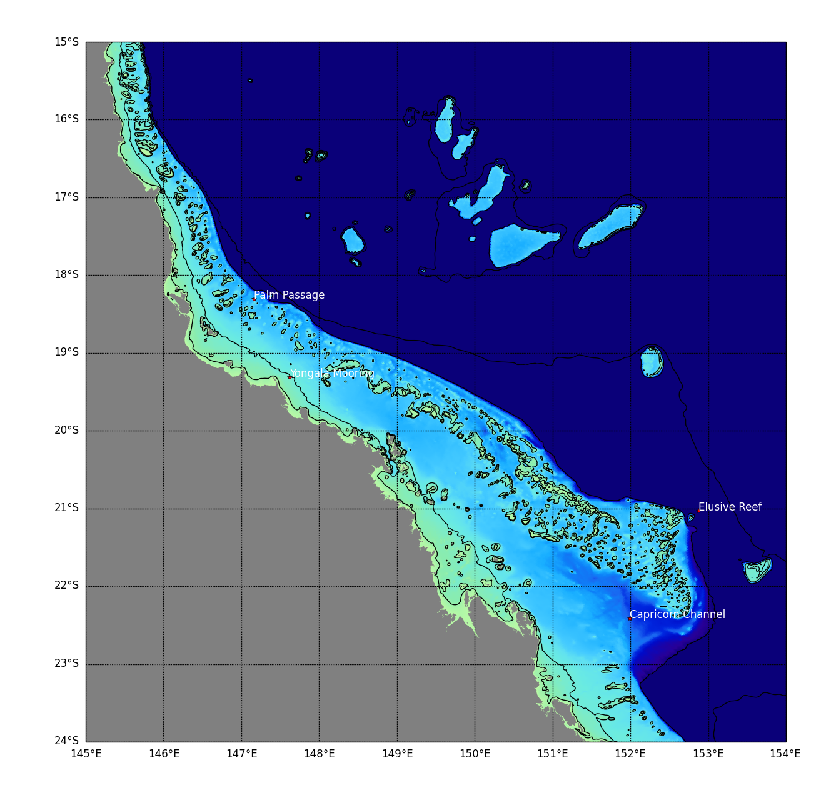
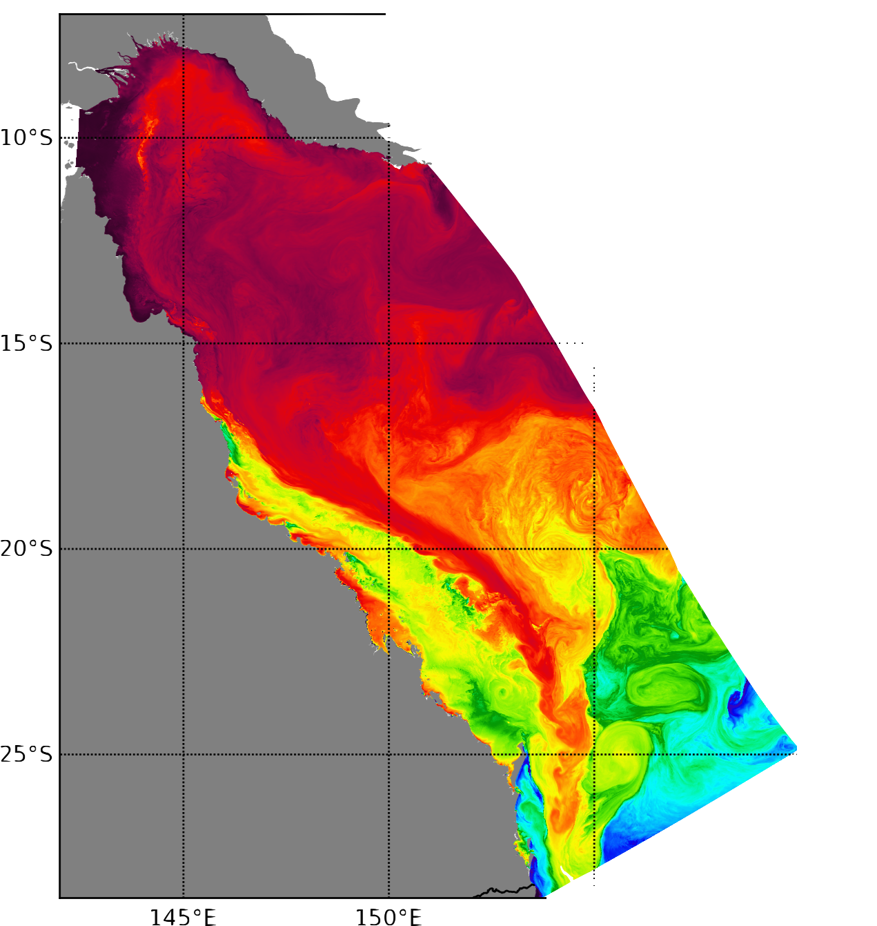
Model setup
ROMS-FC:
  4km: 512x128x30 ~2,000,000
ROMS-HR:
  500m: 4327x1565x25 ~ 170,000,000
Bathymetry – blended product
  GBR 100 (Rob Beaman, JCU)
  GA Plus 250m (James Daniell)
  GA 250m (Whitewell)
Simulations:
  Hindcast (2006 -2011)
  Nature run (2009-2011)
  Reanalysis EnOI/ EnKF (2006 -2011)
Palm Passage
Swaines
Elusive Reef
4km
500m
SST
Notes:
Main points
As part of the ereef project we are aiming to operationally forecast the circulation around the GBR, this requires a good ocean model.
2 model developed covering area shown
Challenge reef matrix
Main focus on transport/ velocities over the reef → hence 500m model
Reefs matrix better resolved → transport better modeled → aim to improve fc model assuming hr model is closer to the truth
Zoom to see differences, showing 10,30,150,550, isobaths
Last: example files size, challenges for storage

Slide 5
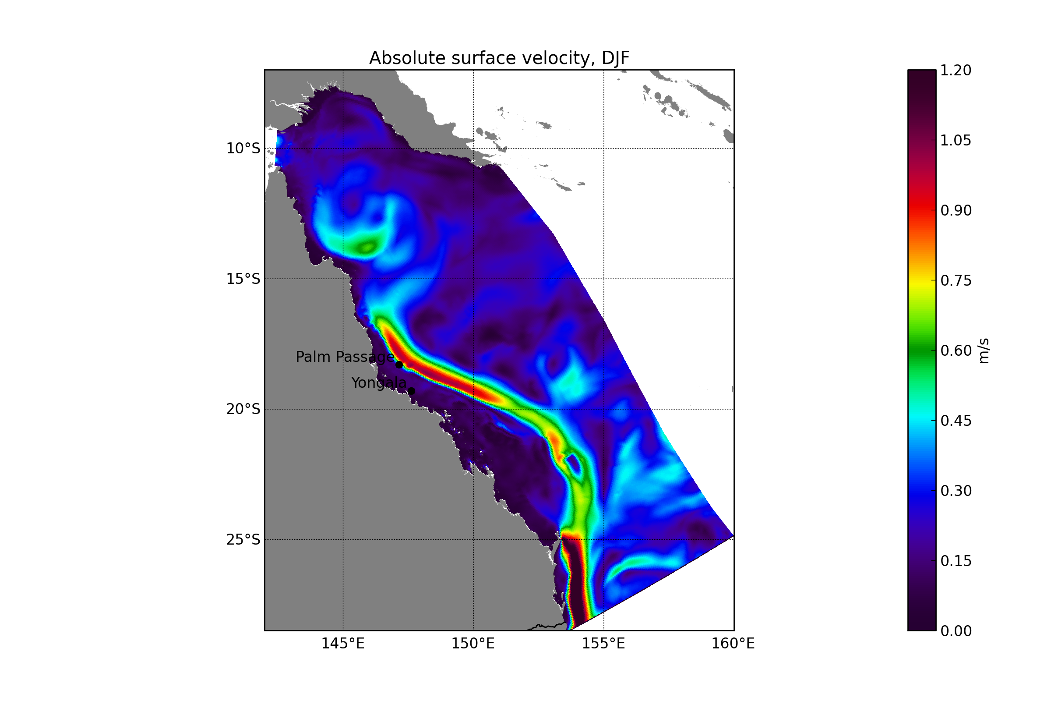
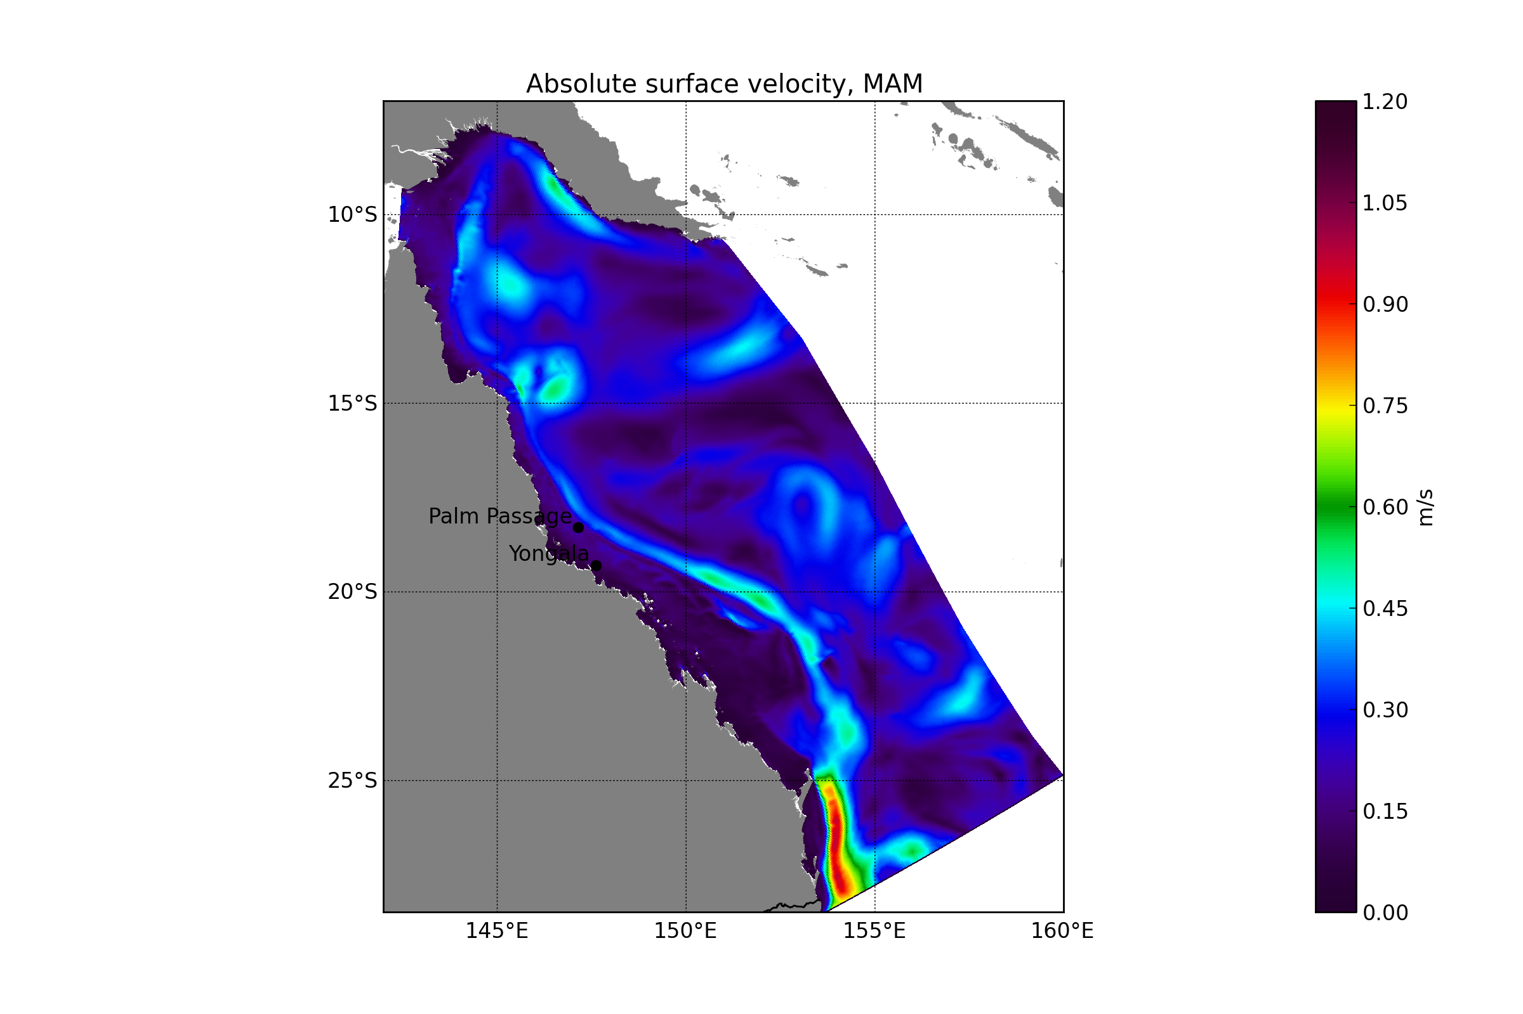
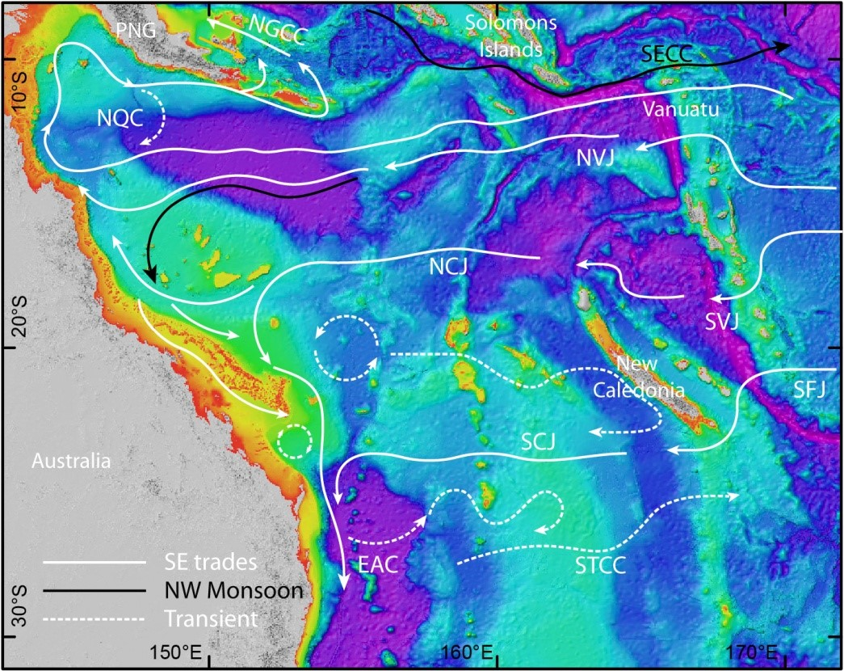
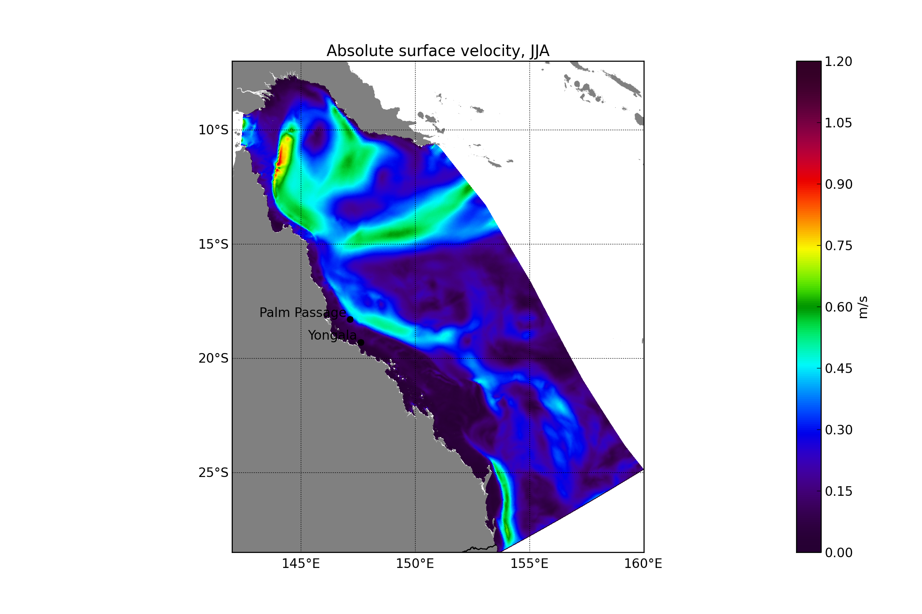
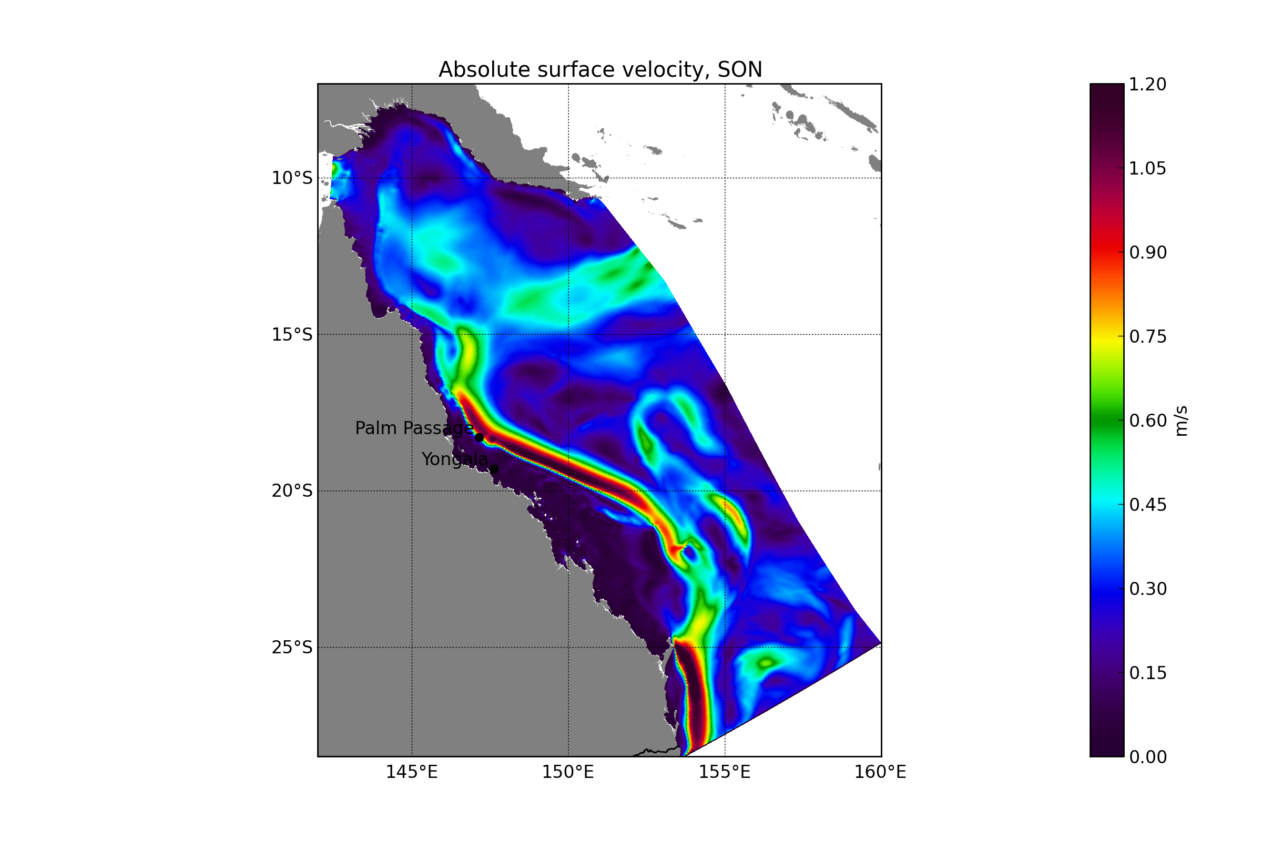
Main circulation
Coral Sea, GBR
DJF
MAM
Model velocity, 2009
JJA
SON
Shelf: Narrow in North 40-60lm
Reefs cover 90% of the shelf leaving only little channels of oceanic and tidal flows to pass
Inside the reef matrix complex circulation
  interaction of currents from tide
  Winds, pressure
  continental shelf waves
  River discharge
Atmospheric variability
  SE Trades in APR-NOV→ impact on EAC, flow reversal, weakening
  SW-Monsoon, DEC-MAR
Ocean current variability
  SEC strong in winter/ spring
  EAC weak in autum/ winter
^{Schiller et al, 2015}
Main Currents SEC, EAC, NQC (Papua Gyre)
Key outflow from GBR area
North: via Papua Gyre
South: EAC
Notes:
SEC and EAC display seasonal variability driven by the atmospheric circulation with SE trades strong in winter weakening the EAC then.
Few interesting points for example Palm Passage which is one of the deeper channels in the north and where large amount inflow happens.
To the south there is the Capricorn channel which separates the outer and inner reef matrix with the Capricorn Gyre which partially triggers upwelling
The Great Barrier Reef northern regions - long ‘ribbon’ reefs are oriented along the shelf, and in the southern region where the outer half of the wide shelf is occupied by a ‘barrier’ reef matrix. The reefs cover over 90 percent of the outer shelf leaving only narrow channels for oceanic and tidal flows to pass
The central region is characterised by a more open reef matrix and together with a change in orientation of the shelf from north to south to a south-easterly orientation at a latitude around 19° S, allows the southward flowing EAC to penetrate directly into the GBR lagoon7
The Capricorn channel at a depth of 90 metres extends from the southeast where the shelf narrows just south of the Swains, forming a trough in the lagoon separating the inner and the outer half of the shelf where there Swains and Pompey reef complexes are situated.

Slide 6
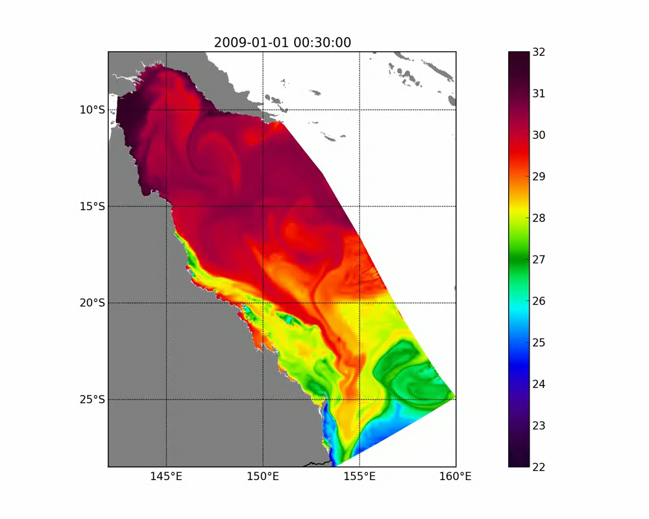
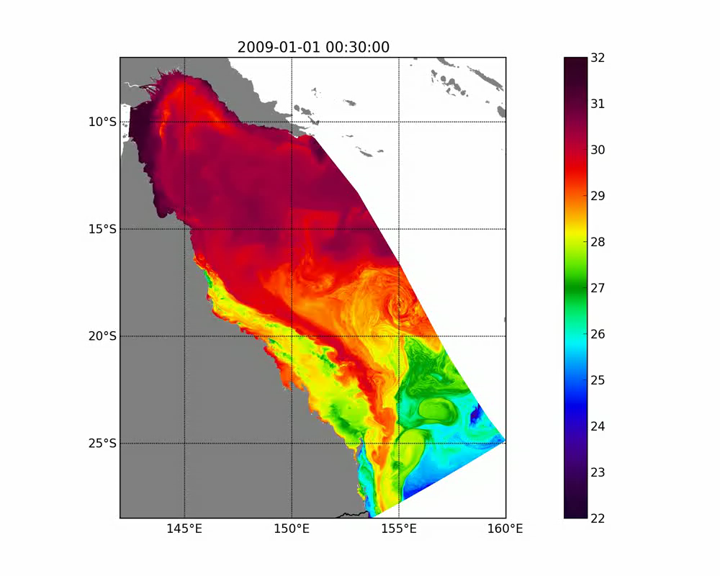
Comparing Surface Temperature, JAN-FEB 2009
ROMS-FC
ROMS-HR
Notes:
Plays during JAN when the EAC is still very dominant
Summer strong EAC/ Includow from SEC mainly over southern domain
Difference between models
width EAC, boundaries, southern part cooler/ warmer, Gyre circulation more pronounced in FC, Upwelling signiture stronger in FC (in south of Fraser Island)
ROMS-HR stronger gradients in the field,EAC seems more pronounced, Some instabilities visible
During run
Focus on upwelling in north (around Townsville)
Tidal pumping/
Diurnal heating/ warming
Frontal eddies
Localised weather driven temp changes

Slide 7
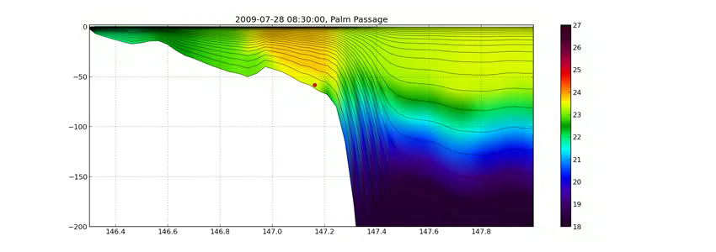
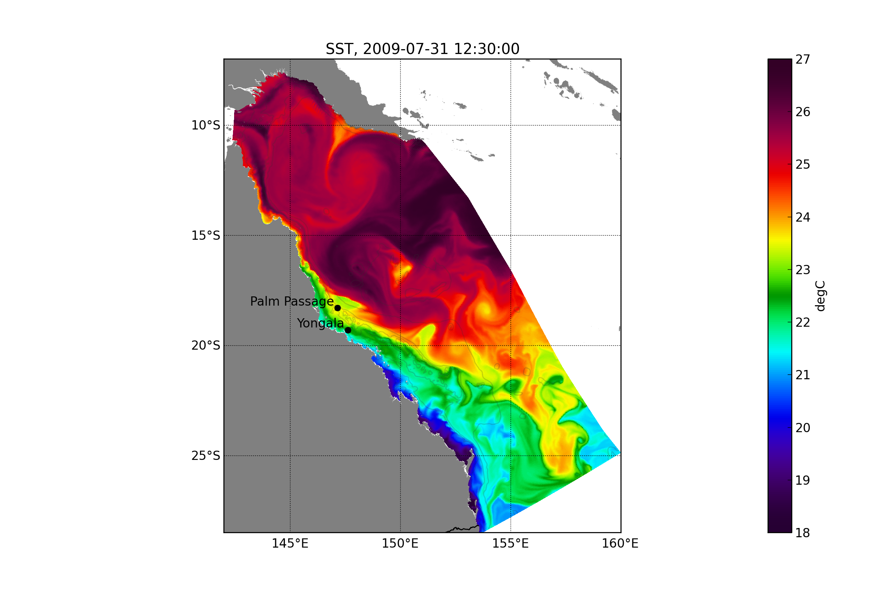
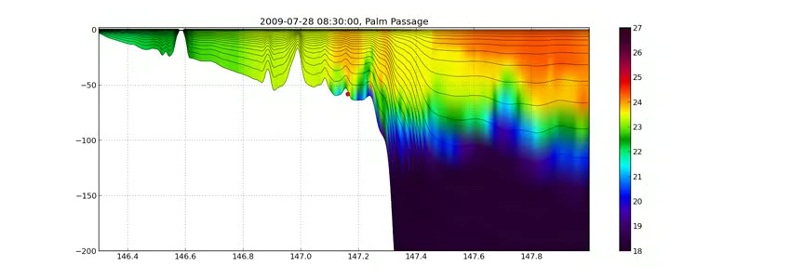
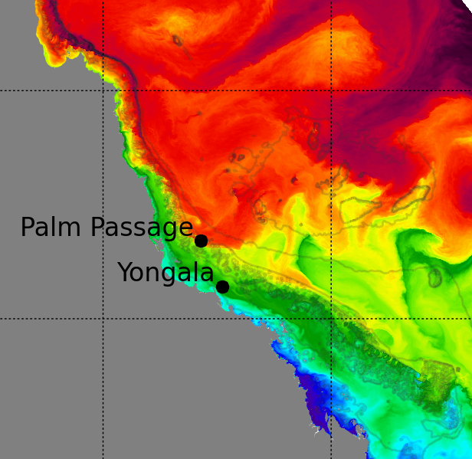
Comparing Temperature profile/section: JUL-AUG 2009
ROMS-FC
ROMS-HR
Notes:
Having a nature truth while having litle observations
Give case that highlight differences between the model.
(a) Note difference in temperature spatial fields
Note difference in bathymetry
Note difference in vertical structure
Note well stratified off the shelf, well mixed on the shelf
During play
(a) Point out vertical coordinates changing every timestep
(b)Note tidal mixing, internal tides
(C) Upwelling event, spreading into the reef matrix
LEADS to QUESTION CAN WE NEST A 500M MODEL in 10KM DONOR

Slide 8
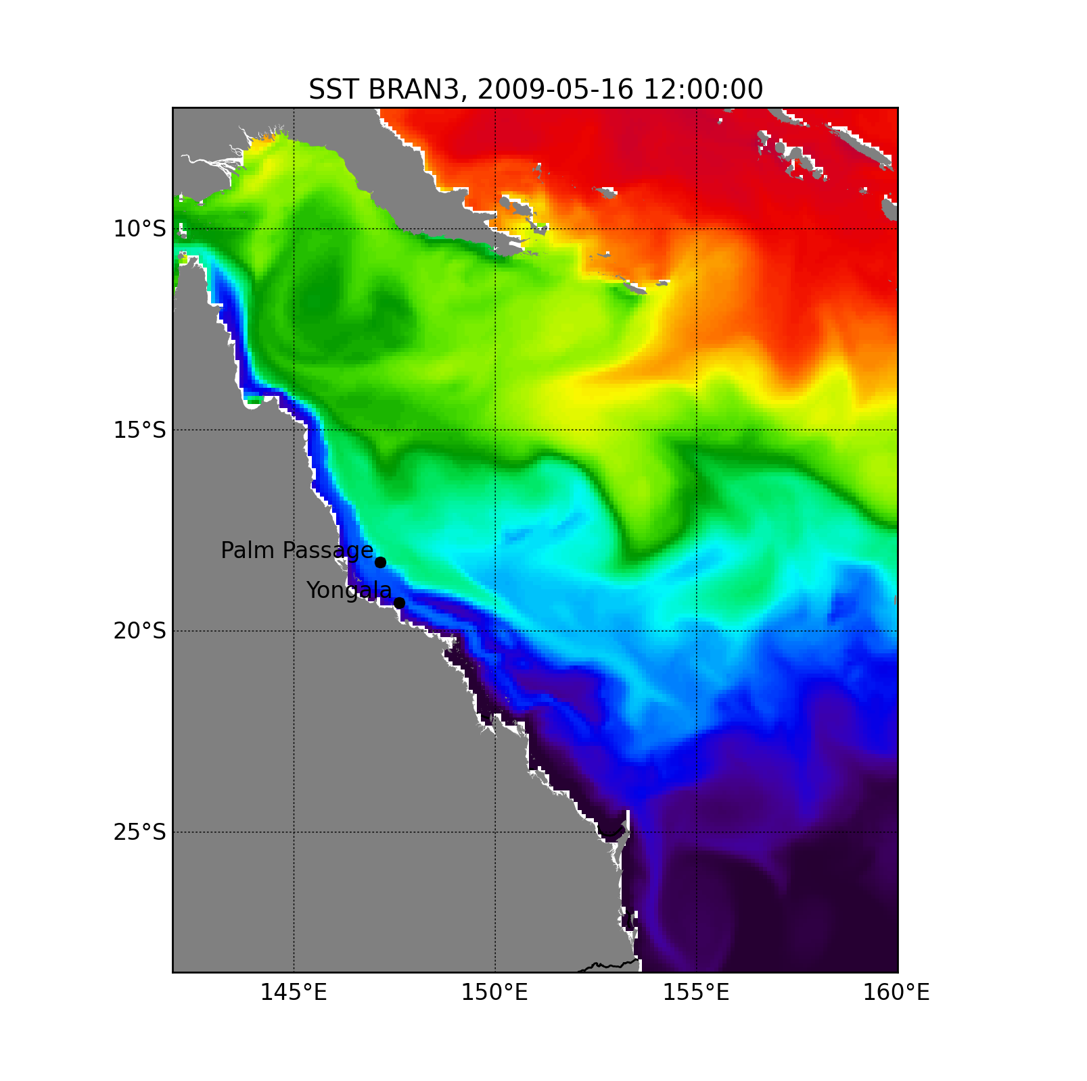
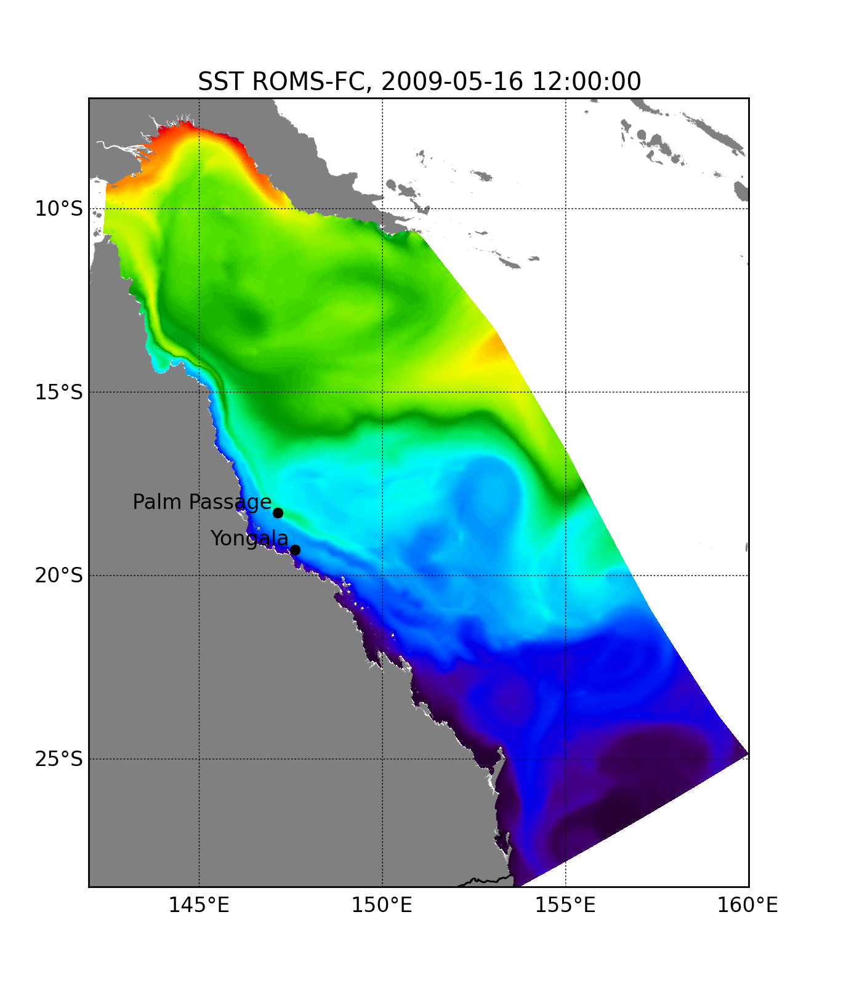
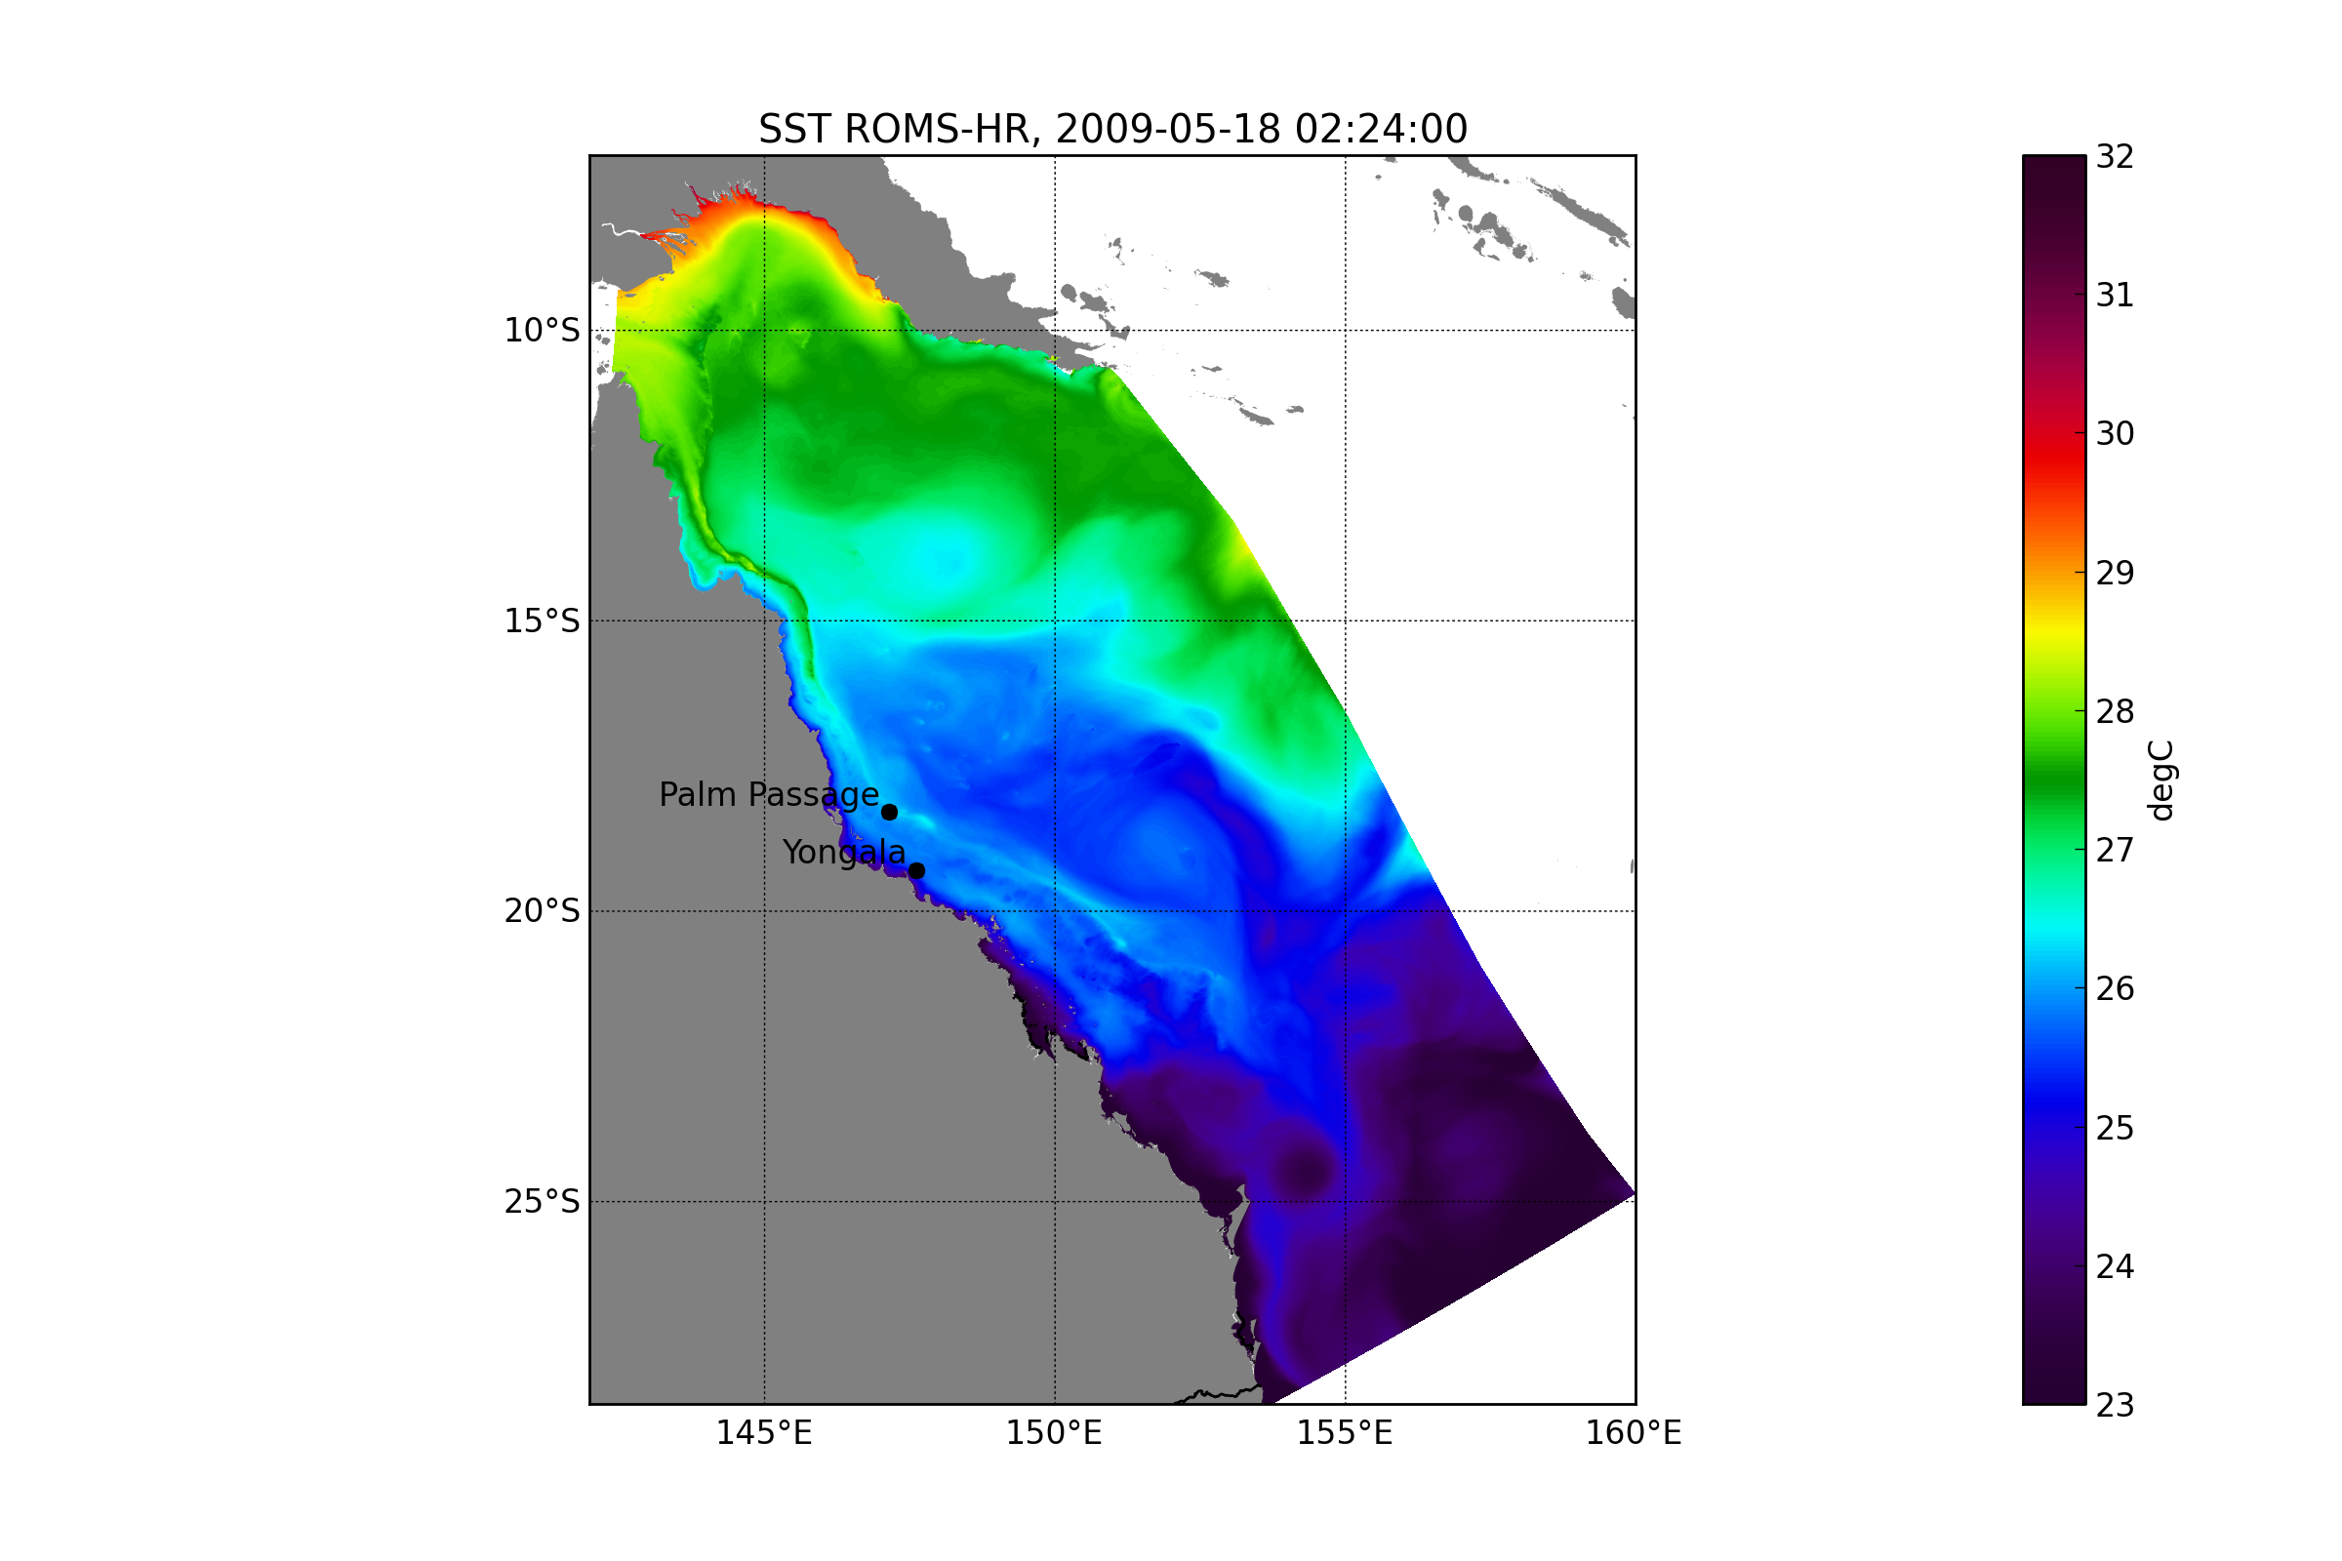
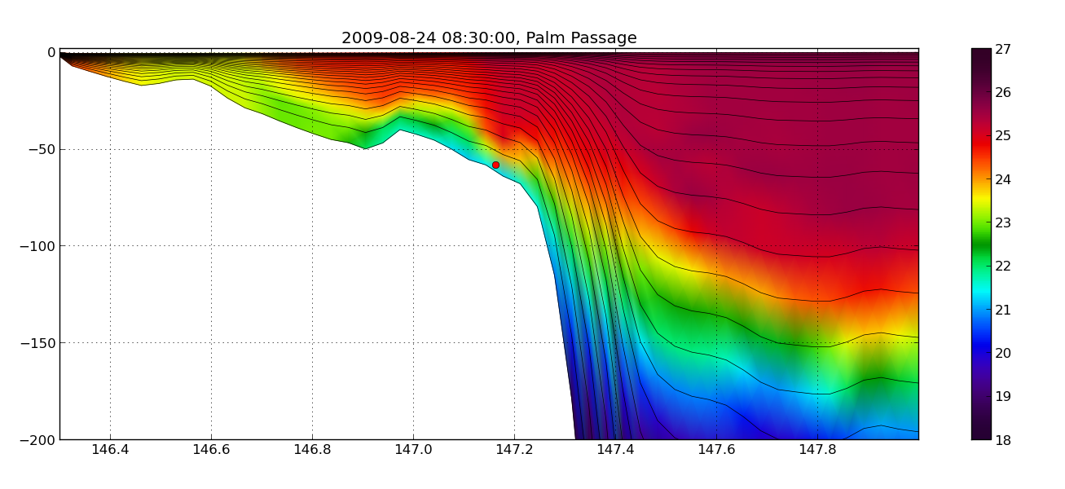
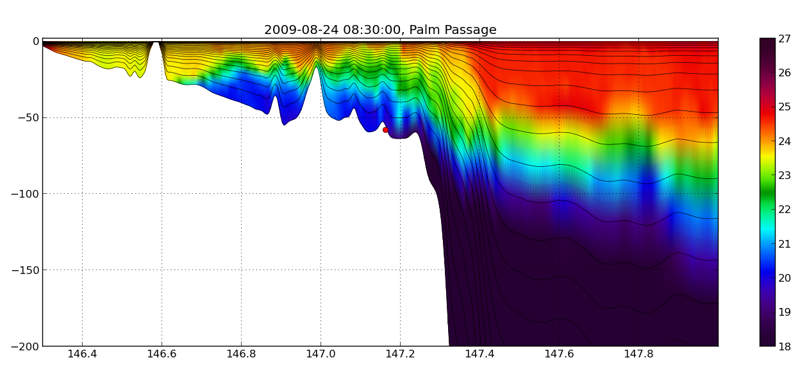
Monthly mean SST. Month: MAY 2009
SEC
BRAN
ROMS-FC
ROMS-HR`
ROMS-HR
ROMS-FC
ROMS-HR

Slide 9
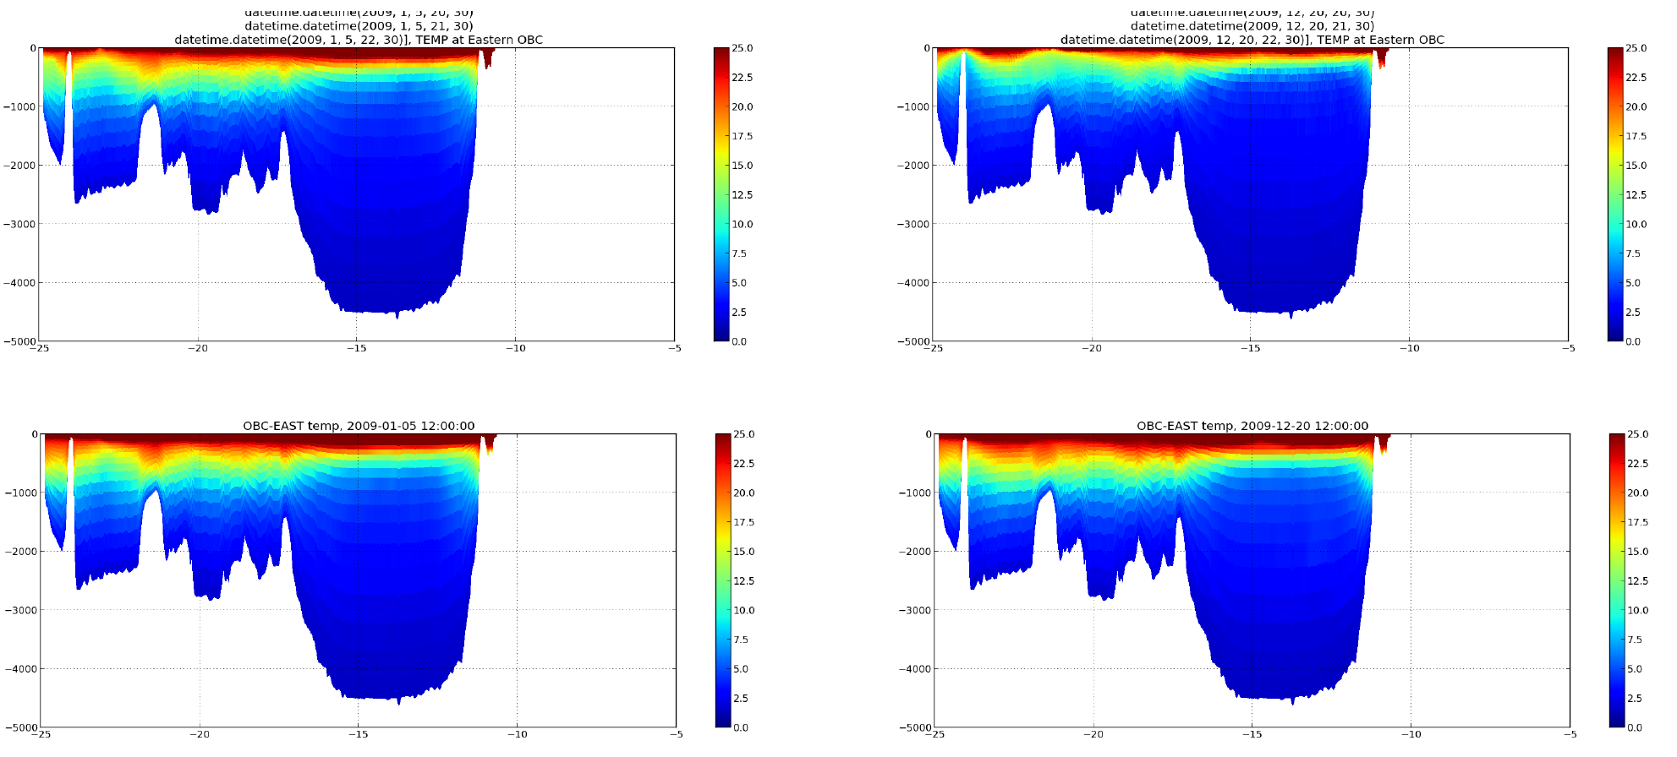
Temperature - Open boundaries and model at eastern boundary
Vertical temperature profile disconnected from open boundary after 1 year. Model cooling apparent.
01-05-2009
12-20-2009
ROMS-HR -16
ROMS-HR-16
OBC - BRAN
OBC - BRAN
Notes:
Problem with active passive OBC and difference in grid resolution of donor and receiver grid
Pinned it down to the strength and width of the sponge layer

Slide 10
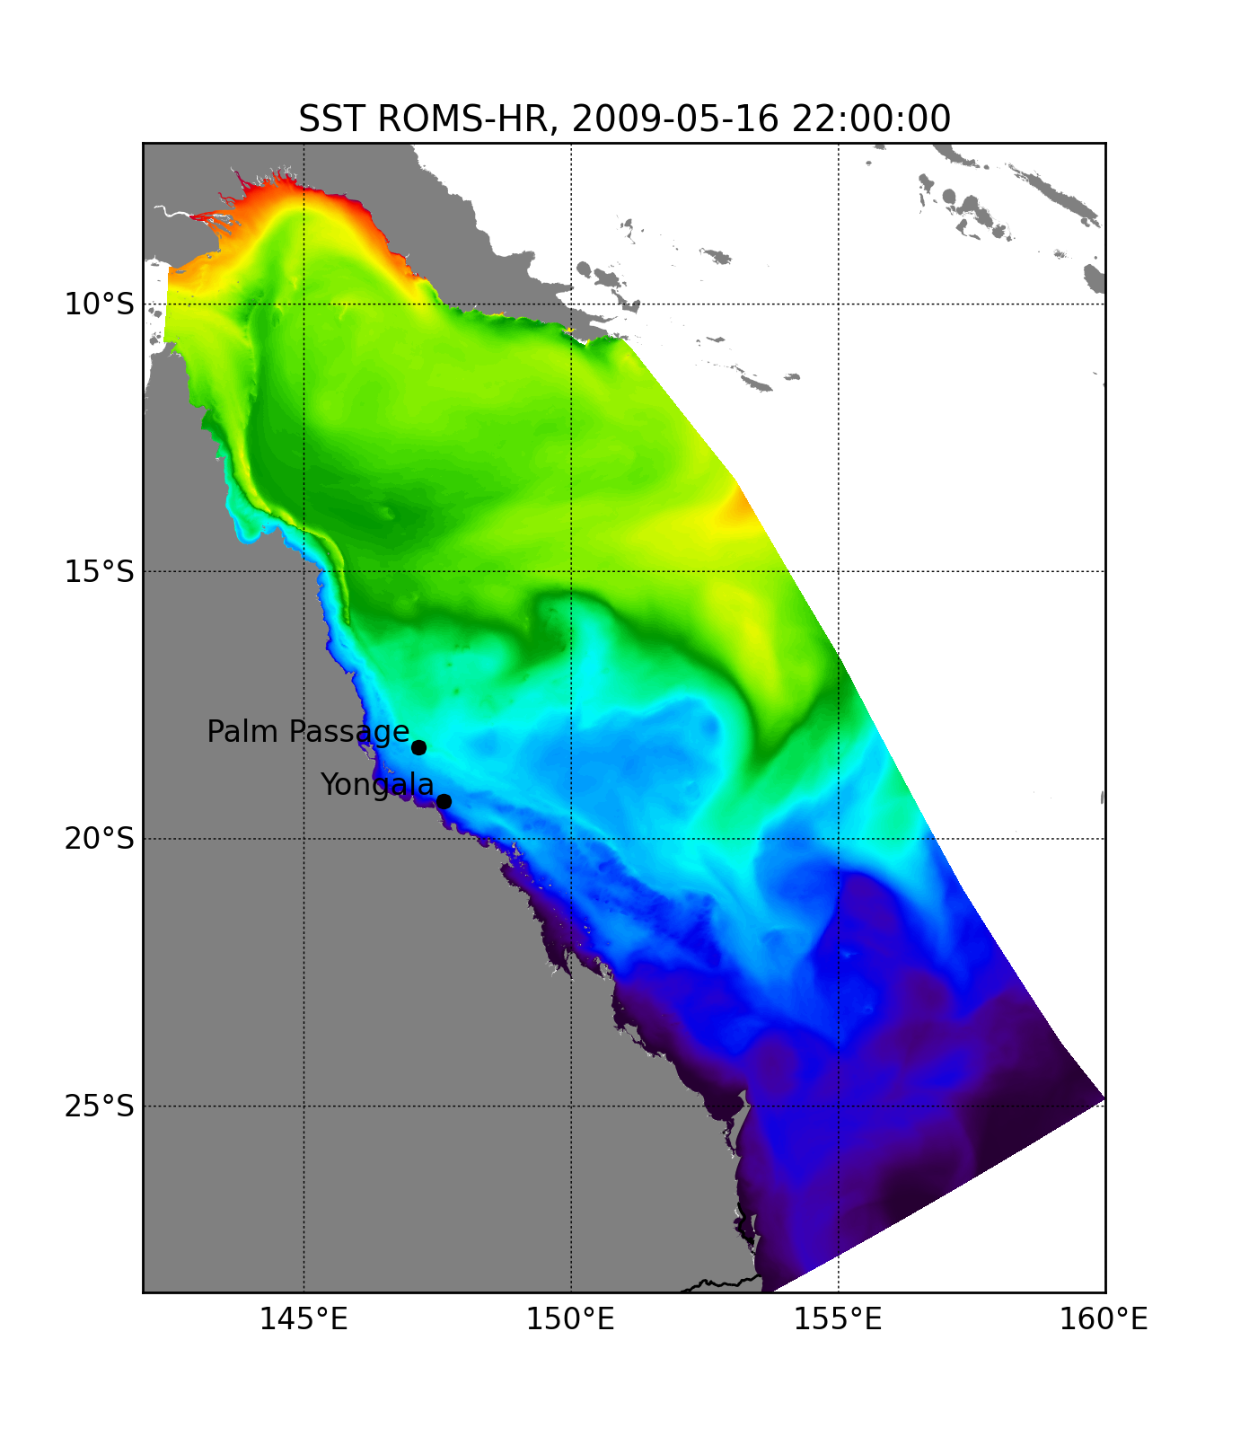
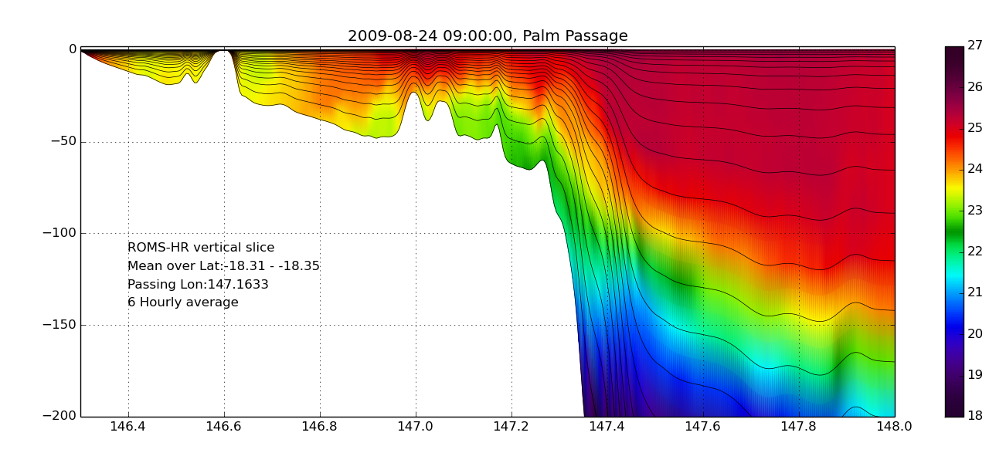
Sponge layer
500m model
Heat flux depends on:
OBC
Sponge layer width and strength
BRAN
ROMS-FC
ROMS-HR
ROMS-HR
ROMS-FC
ROMS-HR V2
Notes:
SPONGE LAYER 100km width
Diff_factor 1:150
Visc_factor: 1:75
OBC choice strongly influences solution up to stratification on/ before the shelf.
LuvSponge == F ! horizontal momentum
LtracerSponge == F F ! temperature, salinity, inert

Slide 11
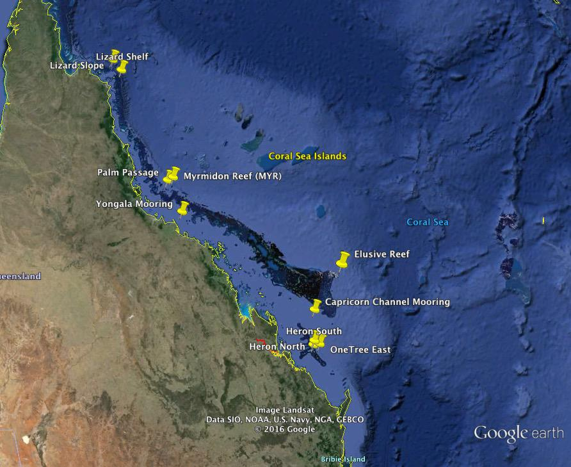
Model vs Q-IMOS GBR – Moorings

Slide 12
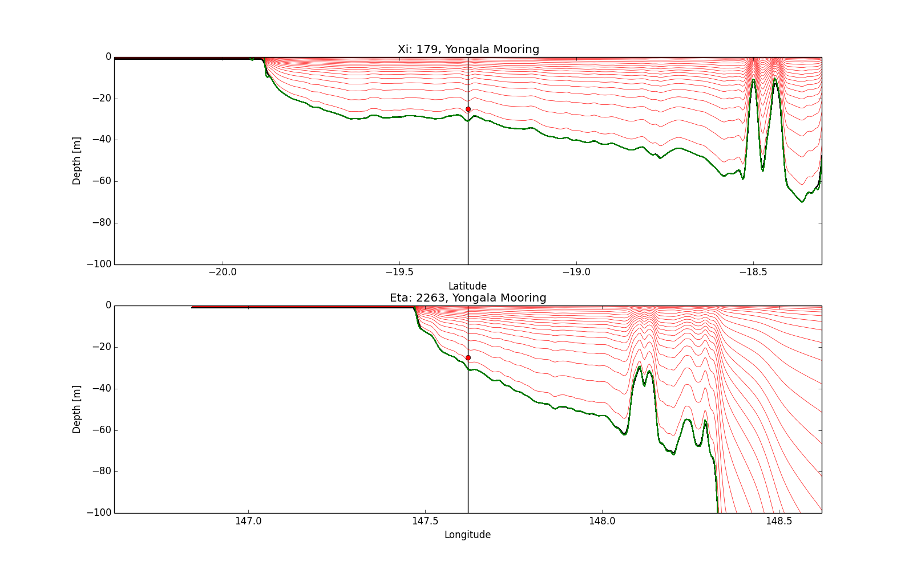
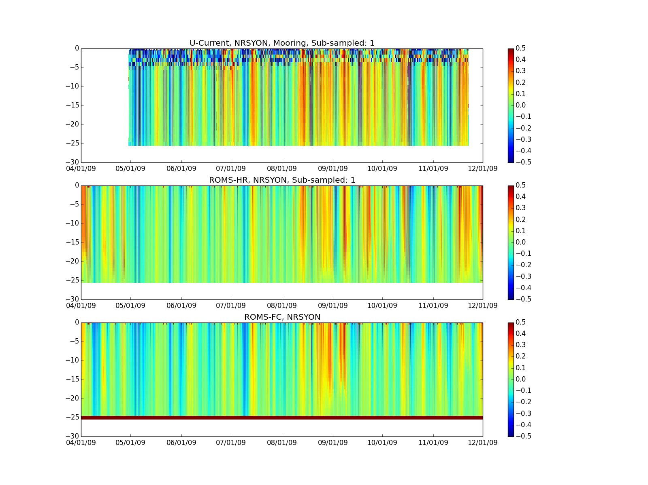
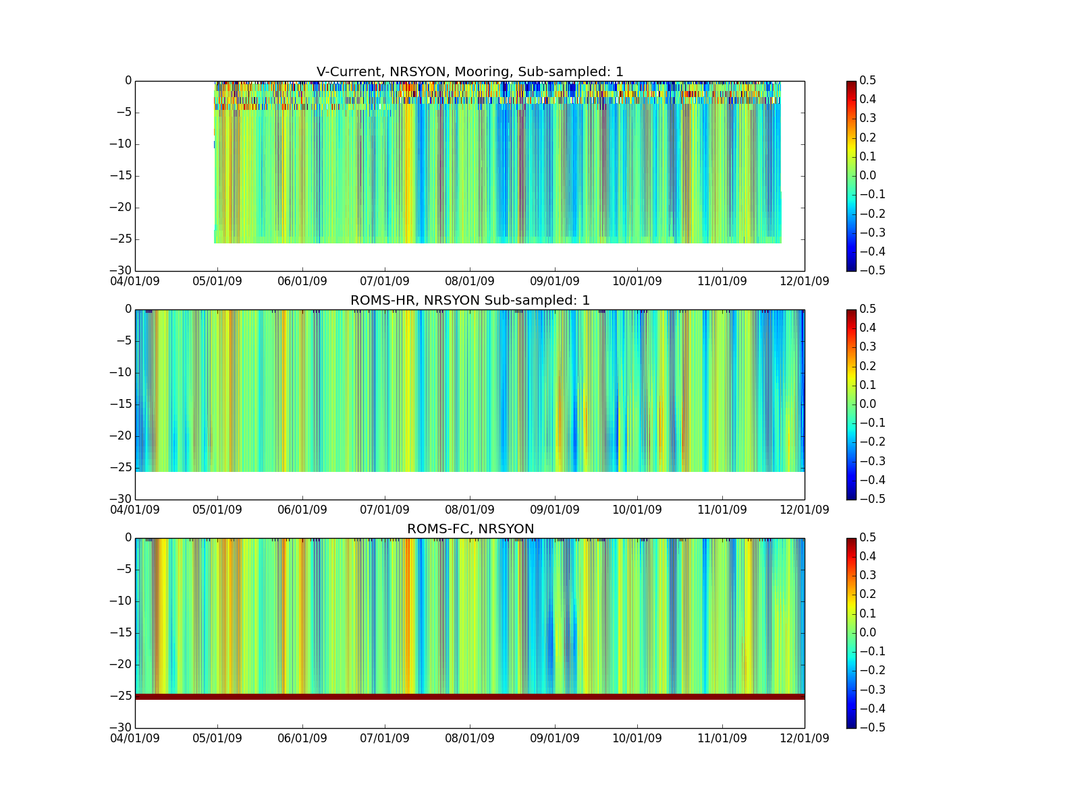
Yongala
U/V Currents
No DA
r~0.8
~7month
U-Velocity
V-Velocity
OBS
500m
4km
Notes:
Main Points: add values for r
Good comparison between model and observations
Station is over shallow water → mostly wind driven → dependency on atmospheric forcing
Tidal signal quite large and well resolved.
U:ROMS-HR seems to do a better job between 08/01 – 10/01 better representation of velocity near the bottom
V;ROMS-HR seems to do a better during that phase in terms of sign and strength compared to ROMS-FC

Slide 13
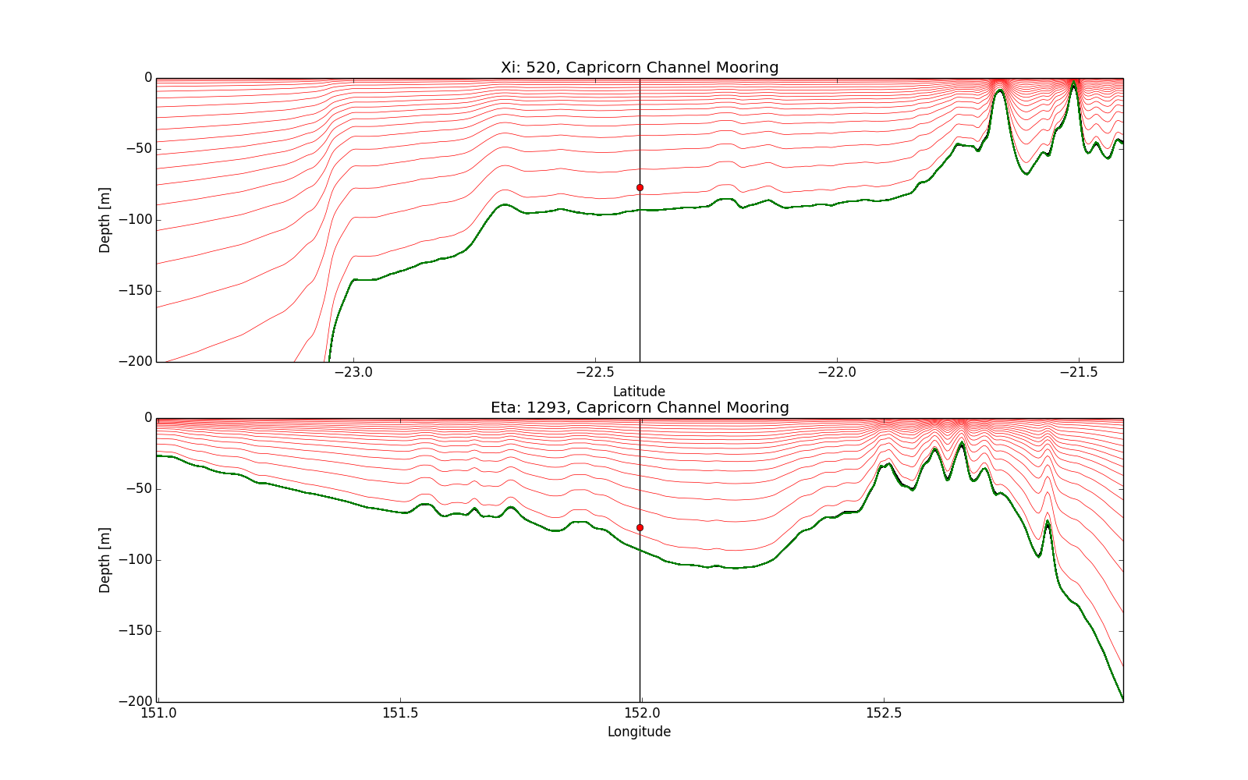
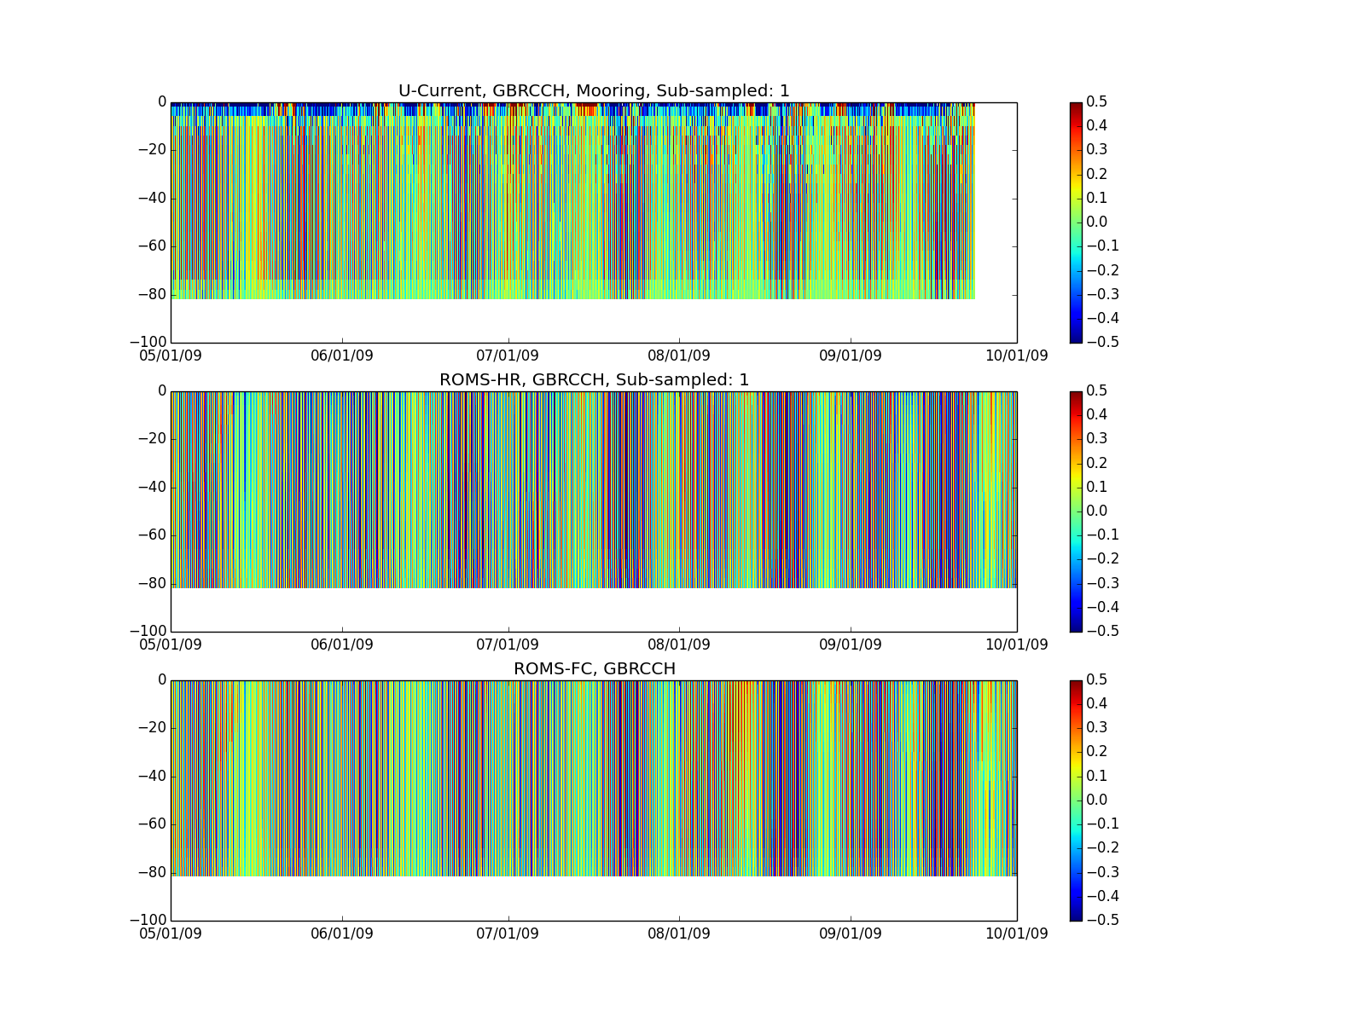
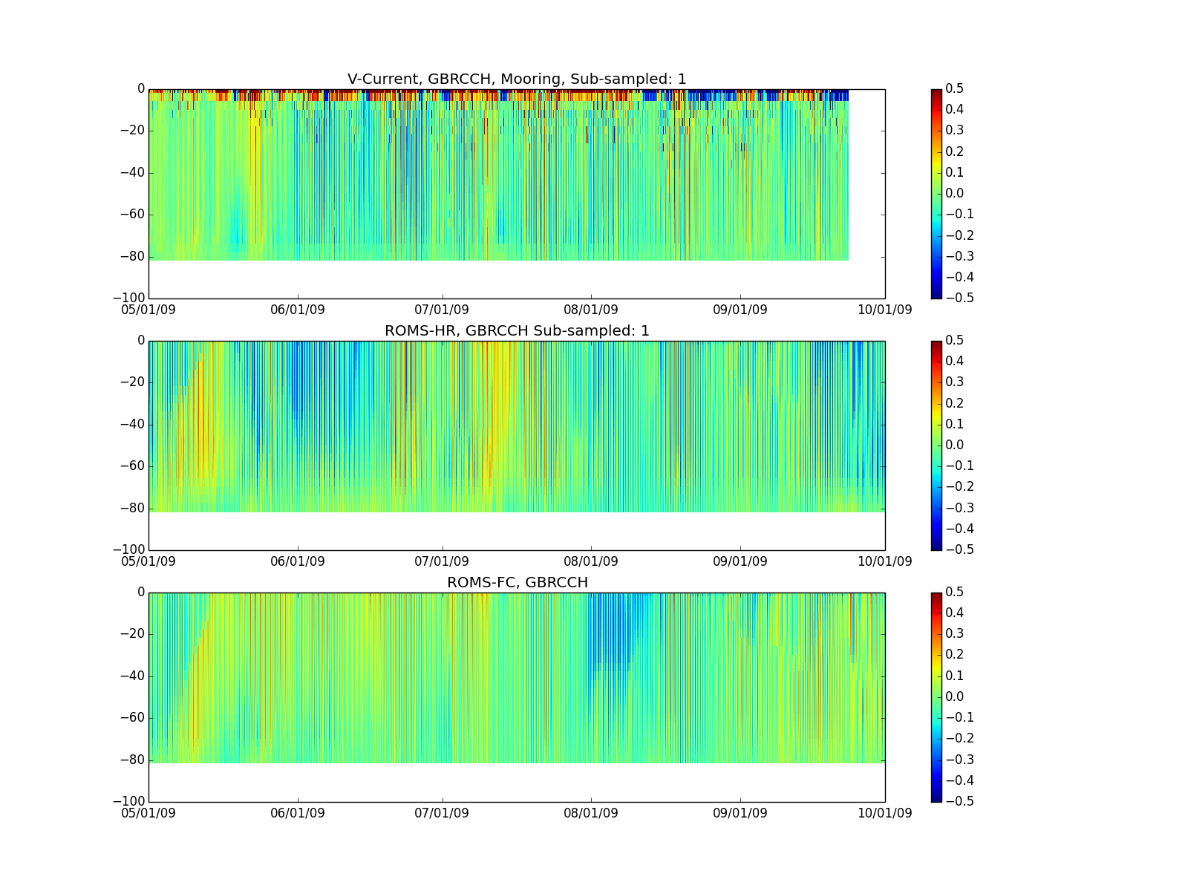
Capricorn Channel
U/V Currents
No DA
5month
U-Velocity
V-Velocity
OBS
500m
4km
Notes:
Main point
Large tidal signal, U component larger than V
ADCP shows strange signal over upper 5m – not sure about reliability (AMOS report leaves this out)
Model mooring comparison not so good in terms of strength, tidal phase well resolved
Mooring: greater uncertainty of ADCP derived current measurements near the ocean surface from deeply moored ADCP’s due to both lean and surface scattering and interference of the acoustic measurement signal (AIMS report)

Slide 14
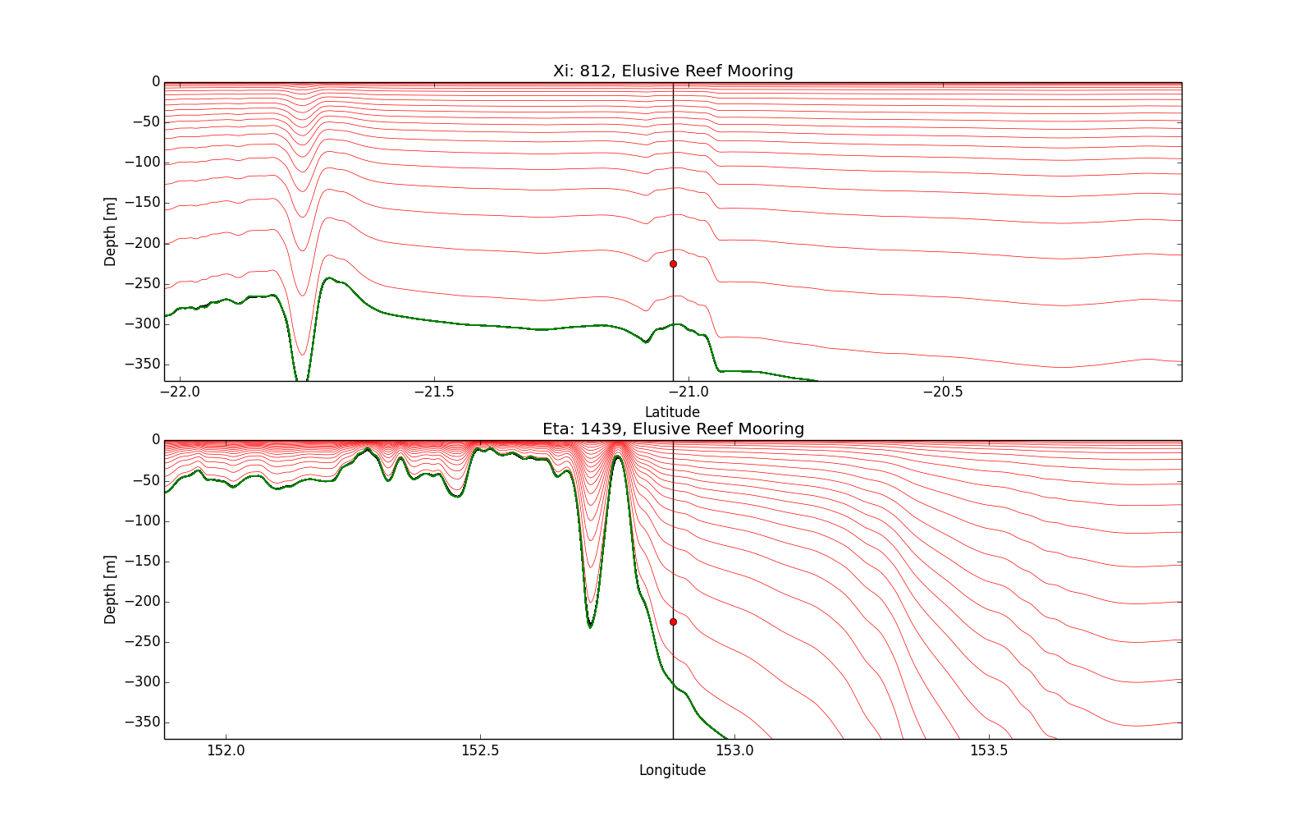
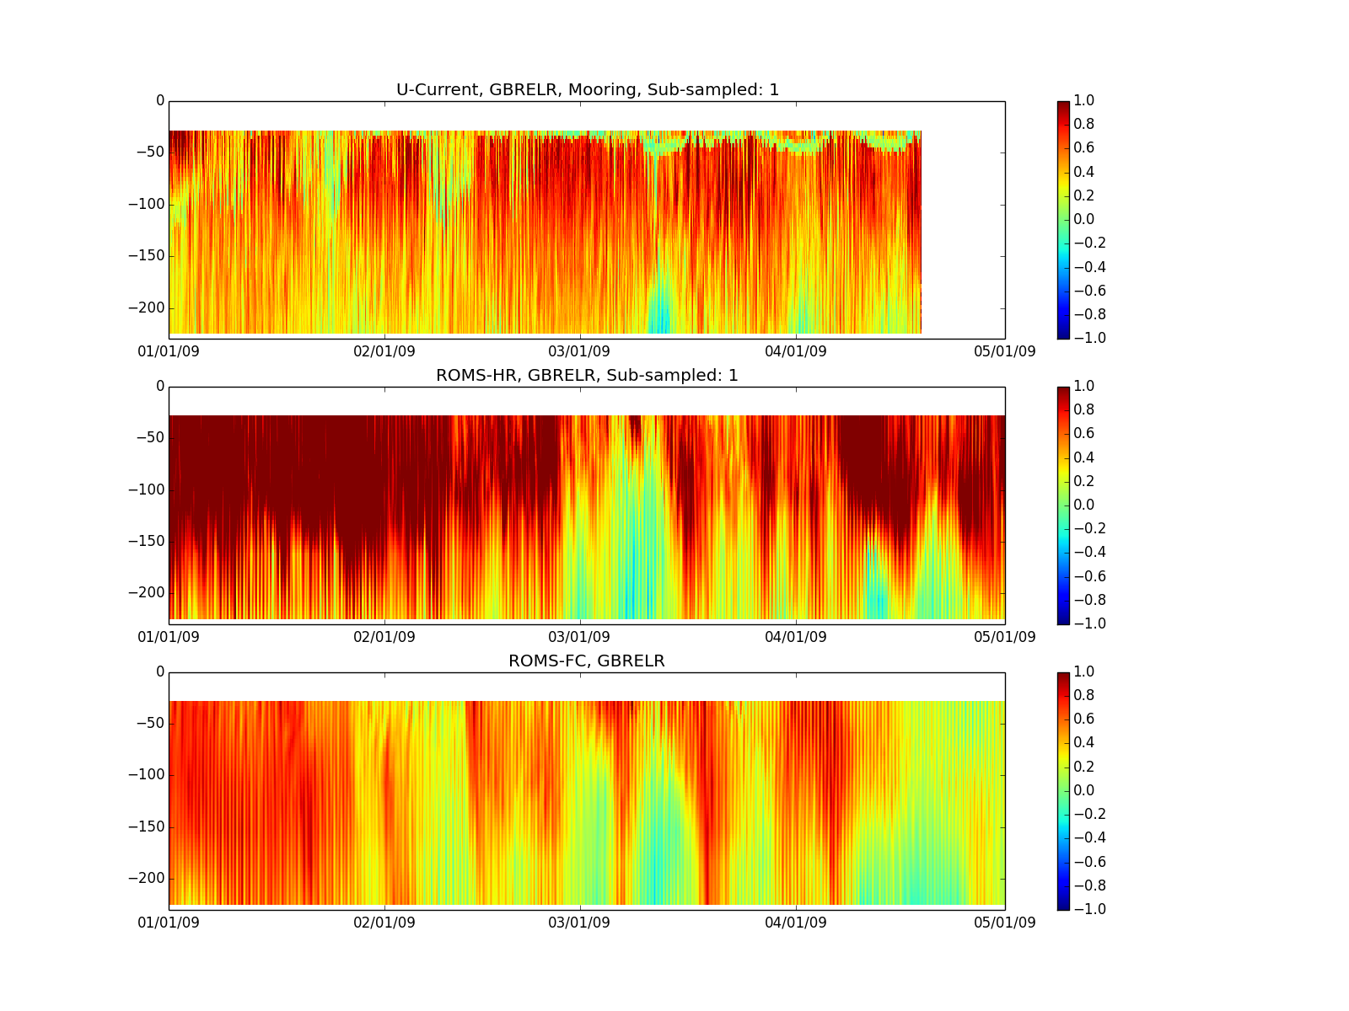
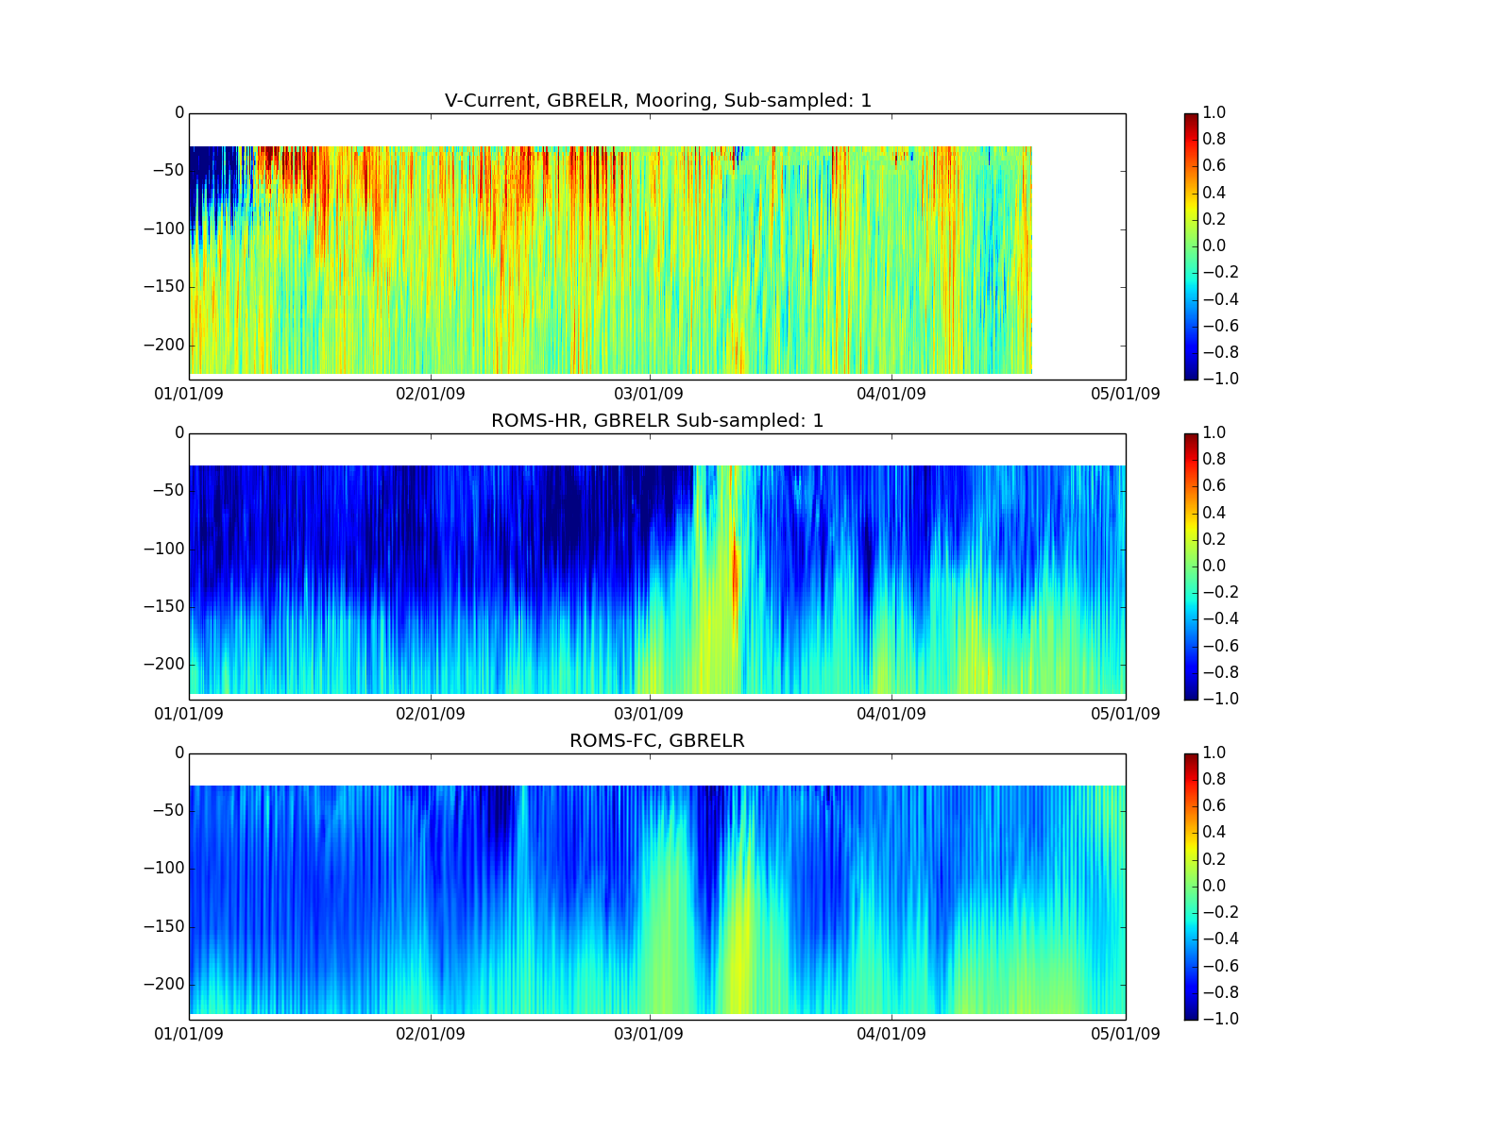
Elusive Reef
U/V Currents
No DA
4month
r~0.7
U-Velocity
R~-0.4
V-Velocity
OBS
500m
B ~0.2m/s
4km
B ~0.01m/s
Notes:
Main points:
Situation of mooring close to EAC
Positive bias in 500m model – latest version reduces this bias.
U-Components stronger than V in obs
Model compares sort of OK in terms of direction for the U component.
ROMS-HR too strong
ROMS-FC more favorable in terms of strength
V-Component; not good
Indicating fact that EAC is strongly non linear and not very predictable.
No DA
Potentially something not quite with the observations. We know there is an EAC

Slide 15
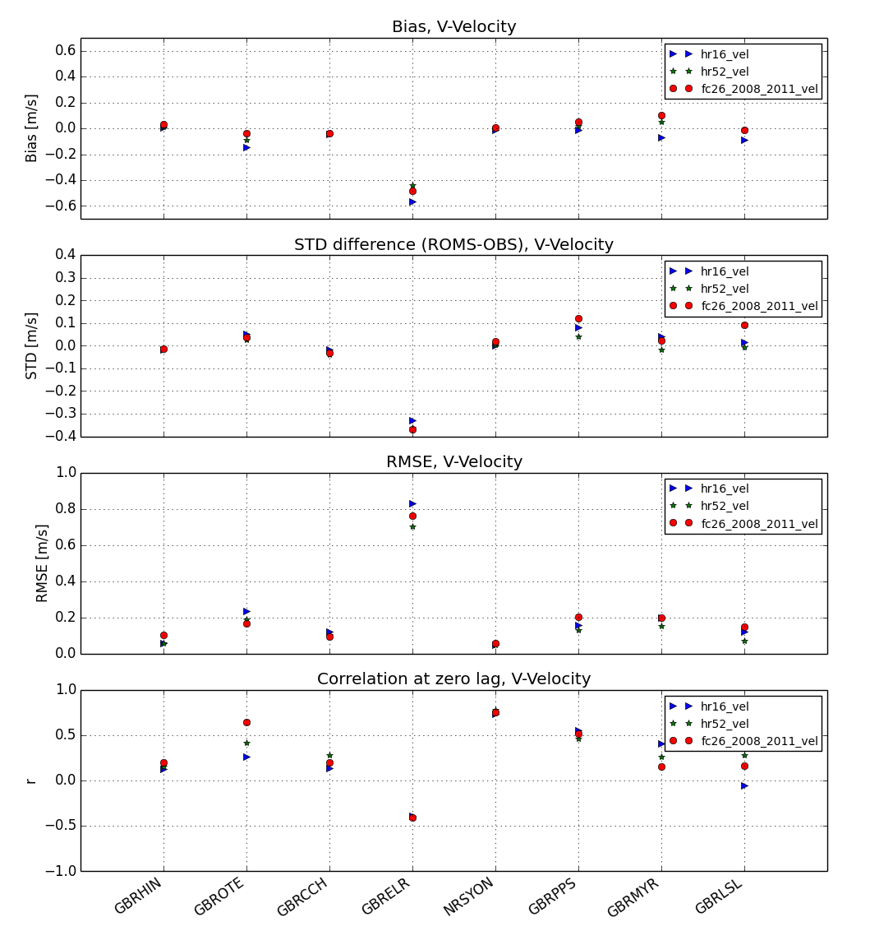
Elusive Reef
U/V Currents
No DA
BIAS
V-Velocity
U-Velocity
STD difference
RMSE
OBS
500m
r<0
4km
Notes:
Main points:
Situation of mooring close to EAC
Positive bias in 500m model – latest version reduces this bias.
U-Components stronger than V in obs
Model compares sort of OK in terms of direction for the U component.
ROMS-HR too strong
ROMS-FC more favorable in terms of strength
V-Component; not good
Indicating fact that EAC is strongly non linear and not very predictable.
No DA
Potentially something not quite with the observations. We know there is an EAC

Slide 16
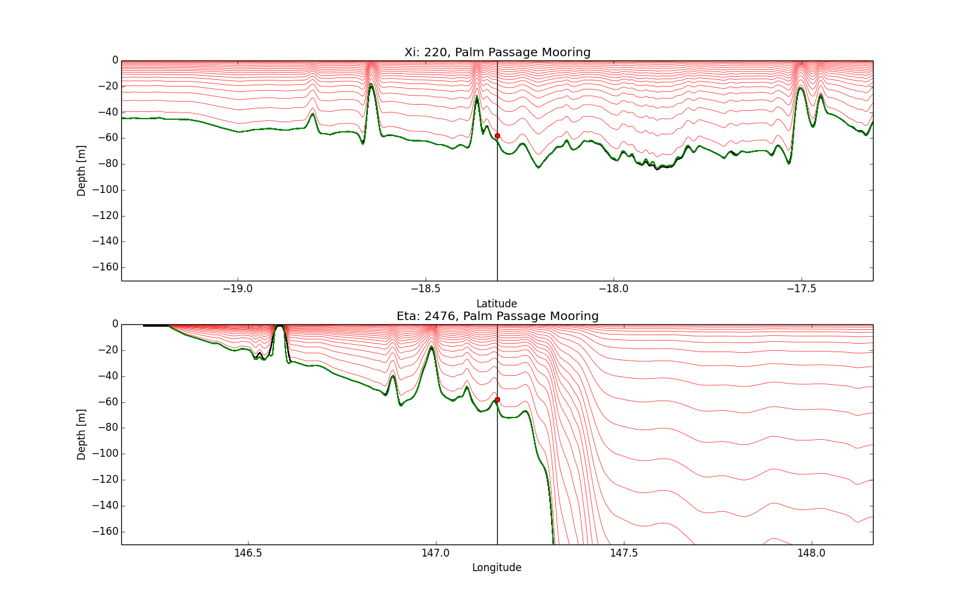
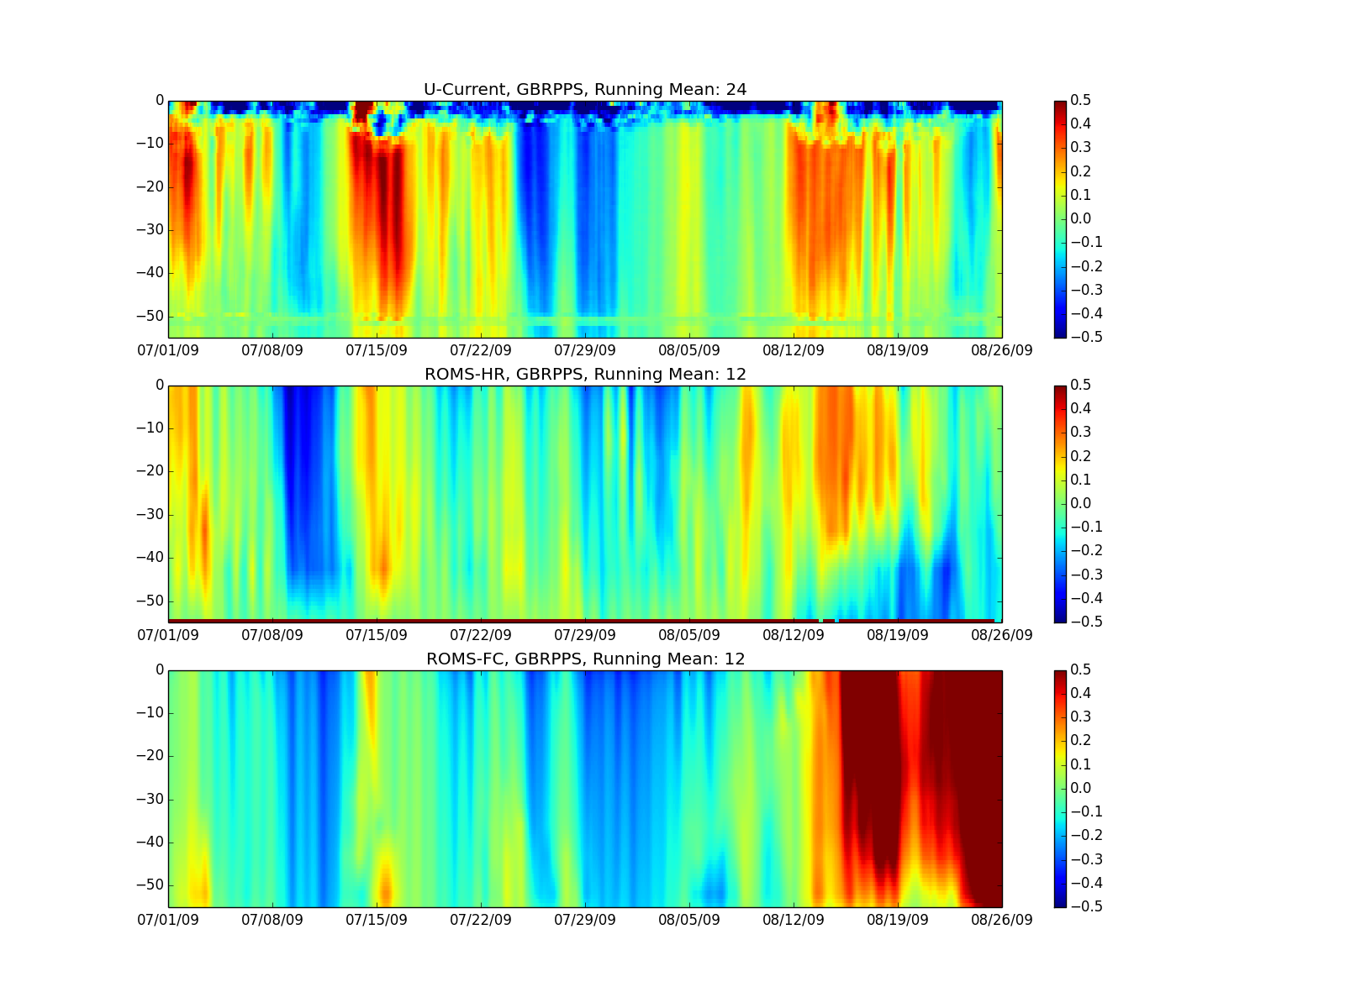
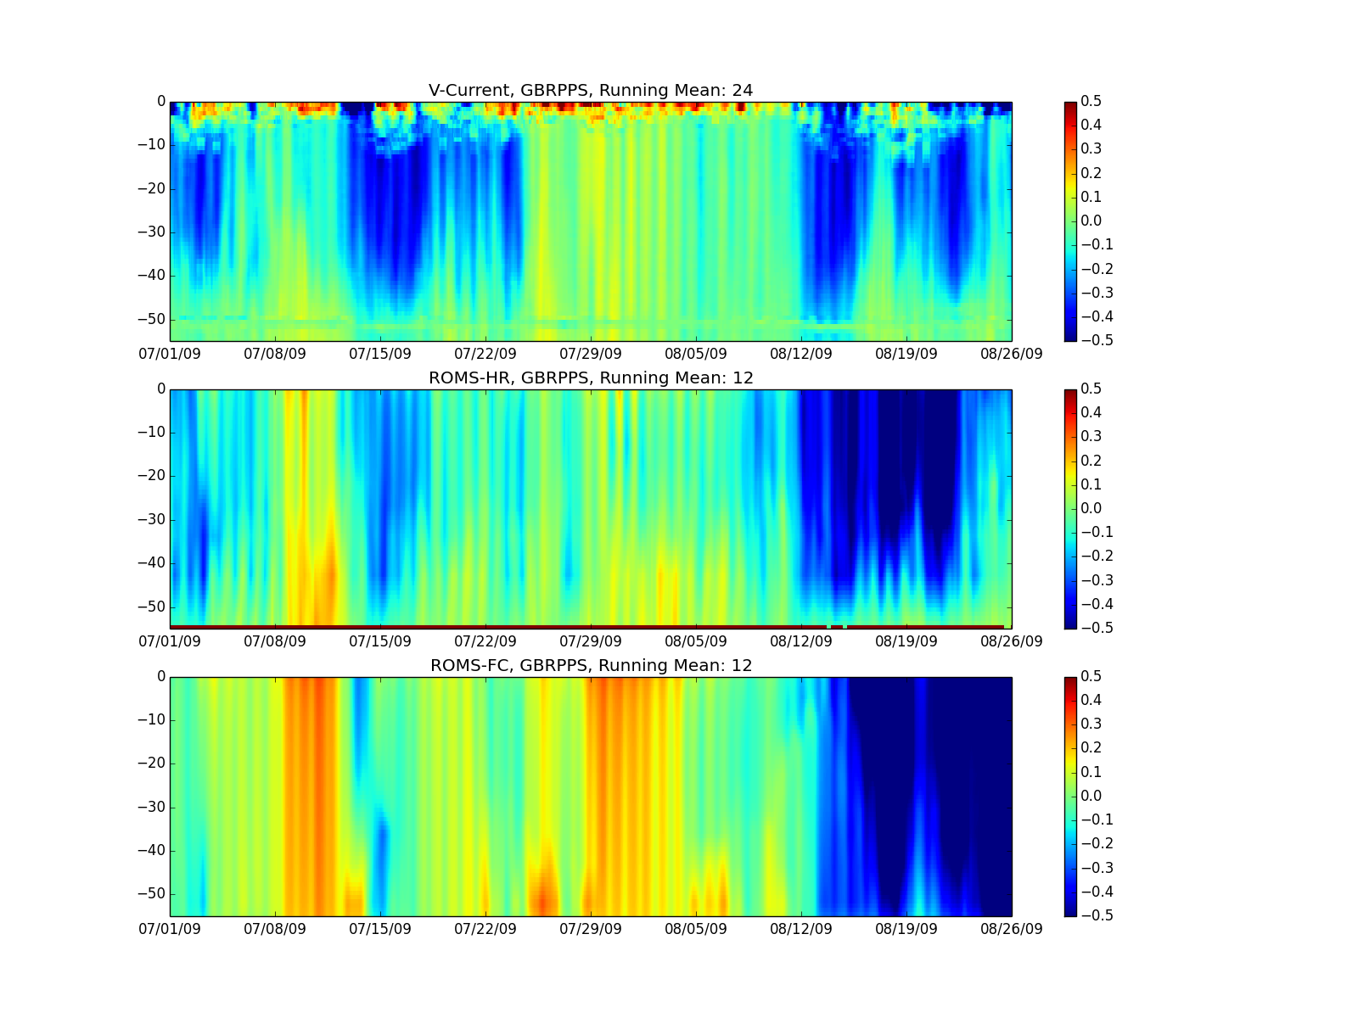
Palm Passage
U/V Currents
No DA
~2month
U-Velocity
V-Velocity
OBS
500m
4km
Notes:
Main ponts
ROMS-HR compares better to obs than ROMS-FC
Provides baseline for tuning roms-fc

Slide 17
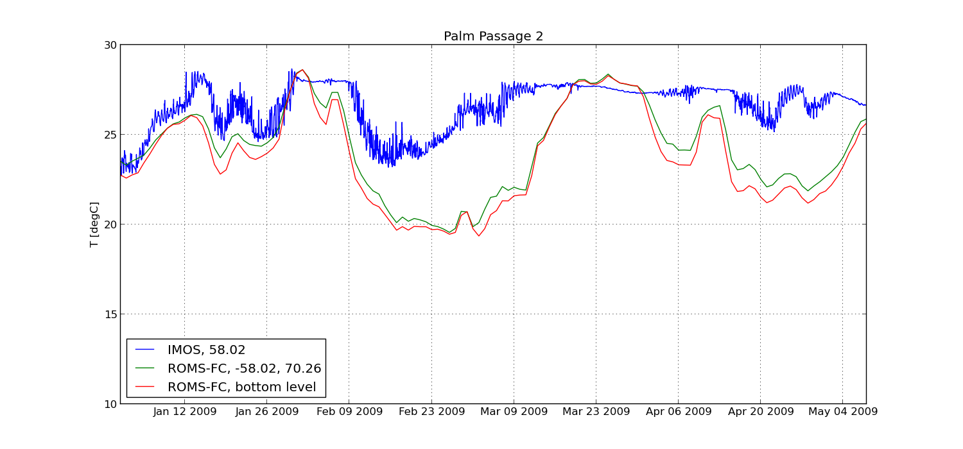
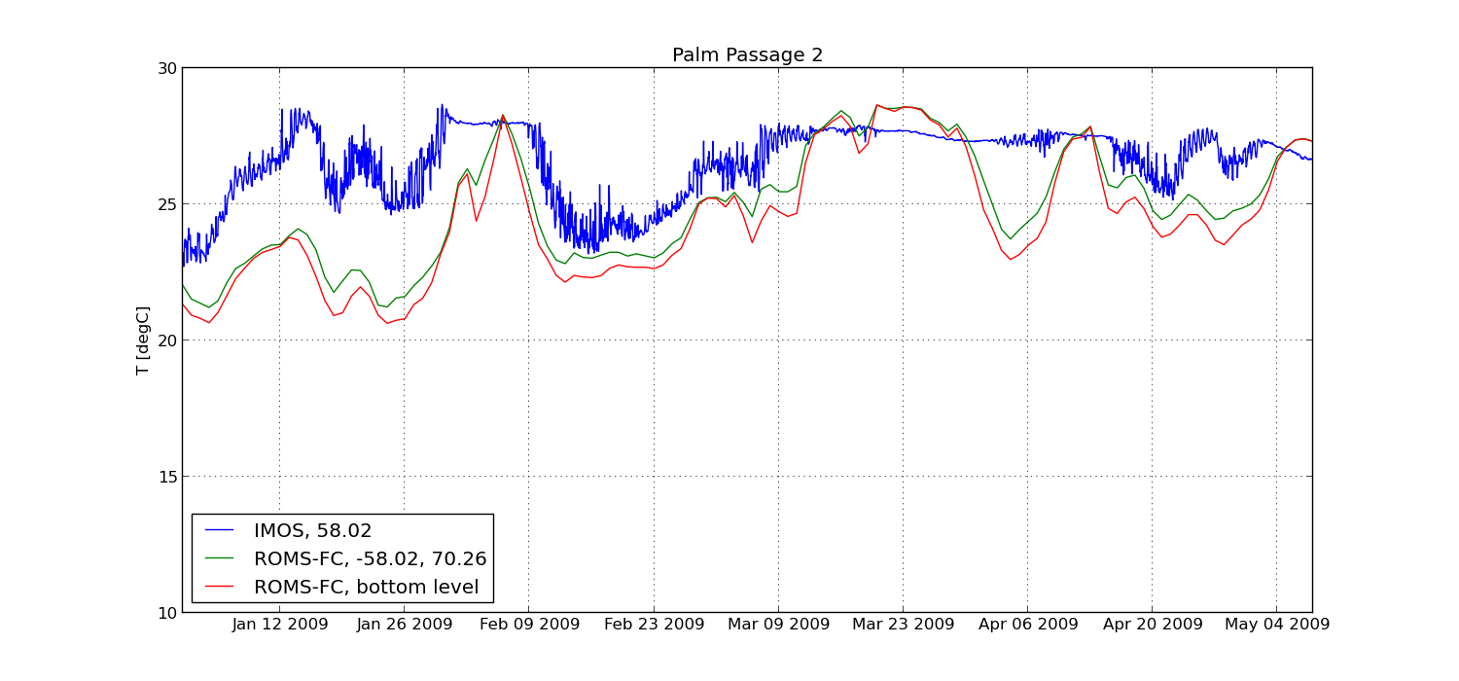
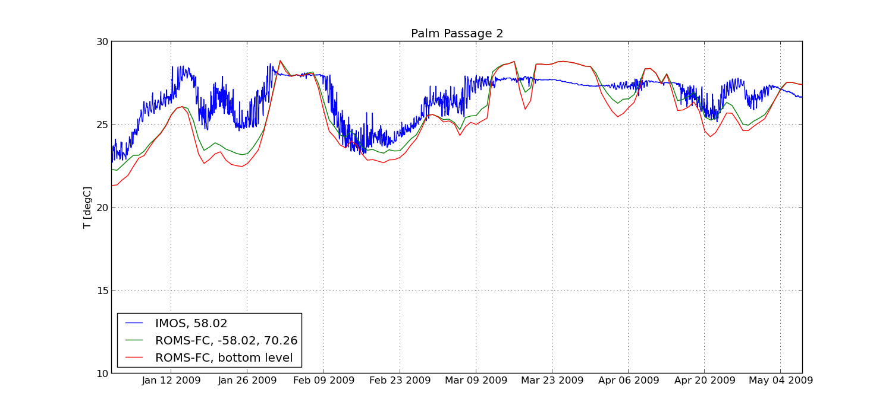


Temperature: ROMS vs Mooring
Palm Passage, JAN-MAY 2009
Fc17, UP3
Fc31 Varying Drag
Fc26, OBCFAC
Fc32 ERA INT
Figure:
Model (green/ red) Observations (blue)
Temperature change driven by:
  Influence of EAC
  Tidal pumping
  Upwelling
Fc27, Upwind Lim
Notes:
Main points
Temperature at station level displays fair amount of sensitivity
Baseline experiment fc17 shows some large discrepancies
Changes in OBCFAC alleviate some of these
Upwind limiter, reduce comparison
Varying drag reduce further
Localized sensitivity

Slide 18
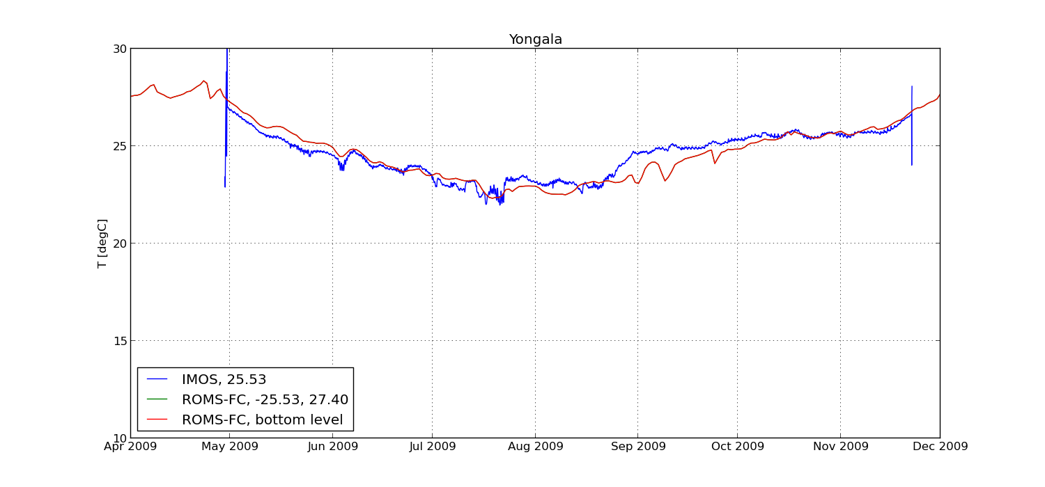
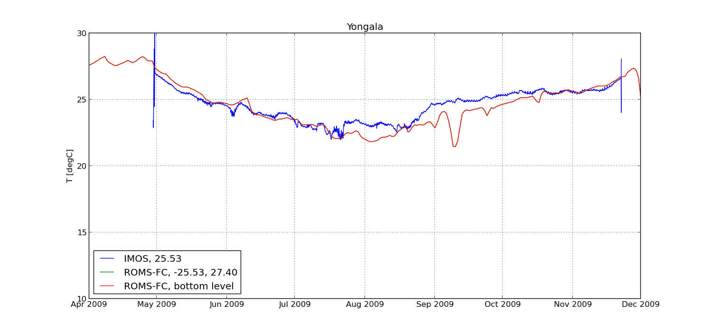
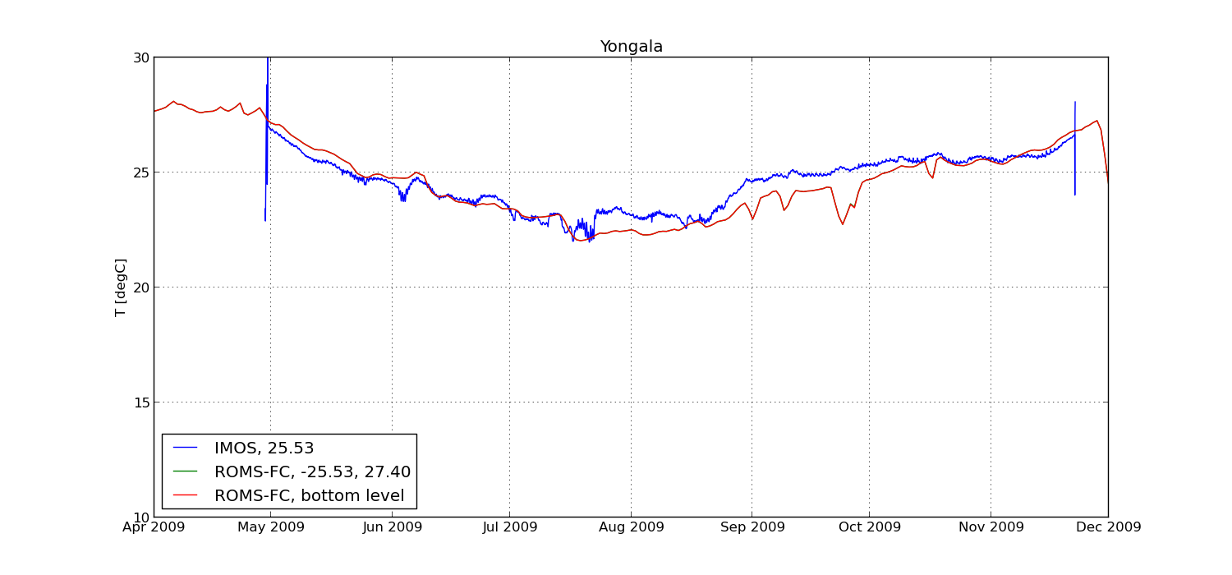
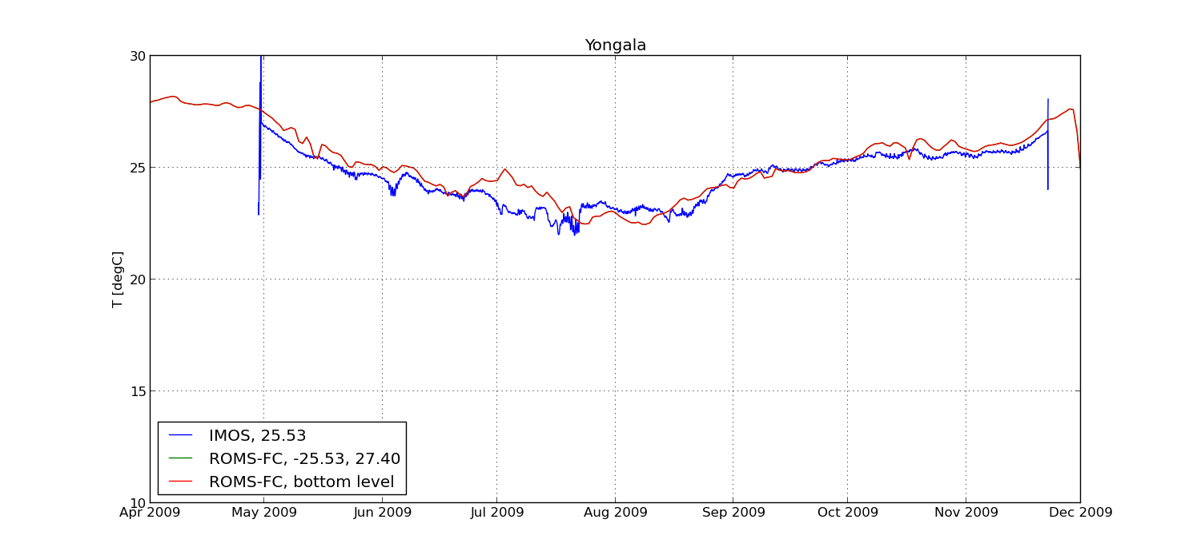

Temperature: ROMS vs Mooring
Yongala, 8Month, APR-DEC 2009
Fc17, UP3
Fc31 Varying Drag
Fc26 OBCFAC
Fc32 ERA INT
Figure:
Model (green/ red) Observations (blue)
Temperature change driven by:
  Advection, upwelling events emanating from PPS
  Local weather → vertical mixing
Fc27 Upwind Limiter
Notes:
Main points
General all simulations compare well
ERA INT forced a bit better over 2nd half
Well mixed shallow area

Slide 19
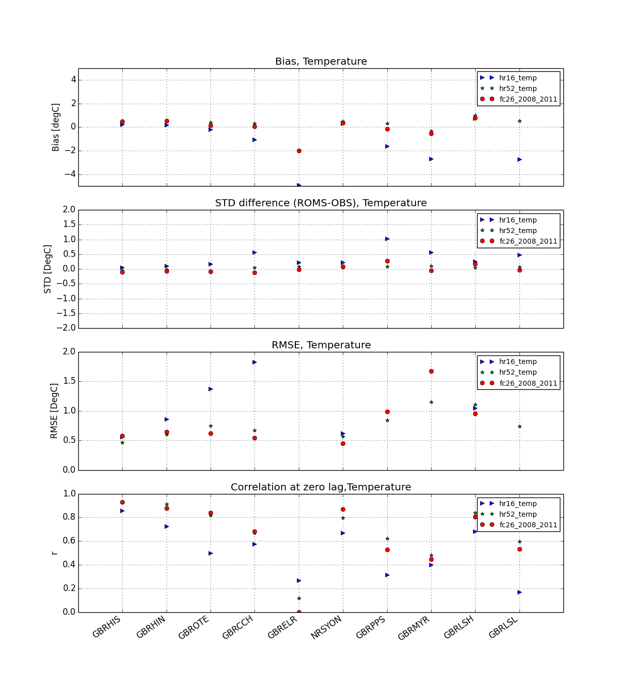
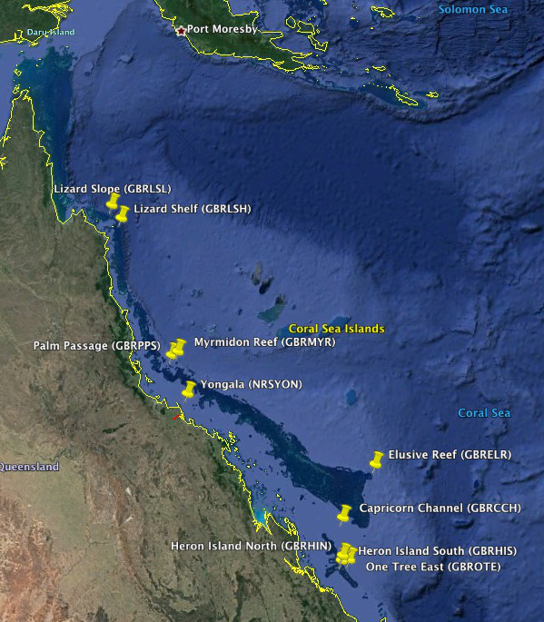
Summary statistics QIMOS vs ROMS, Temperature, JAN 2009-JUL 2009
POSSIBLE ERROR IN OBS AT 282m depth
r ~ 0.6-0.9
60 Trips
4447 data points (daily averaged)
Notes:
Main points:
Analysis restricted over JAN 2009 – JUN 2009
60 Trips
4447 data points (daily averaged)
ELR shows strongest bias due to obs error (probably)
High resolution model with sponge is performing very well. Generally outperforming the hr16 simulation. On par with roms-fc
High correlation over Yongala

Slide 20
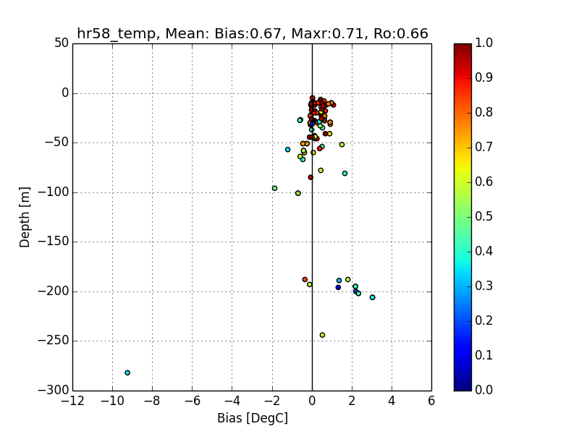
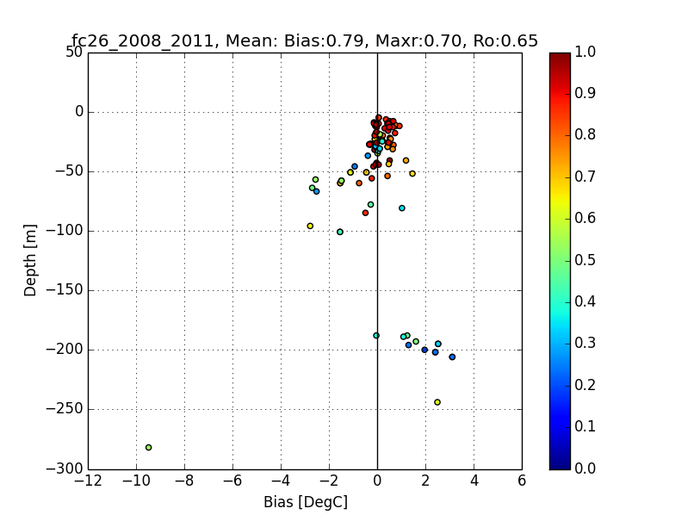

Slide 21
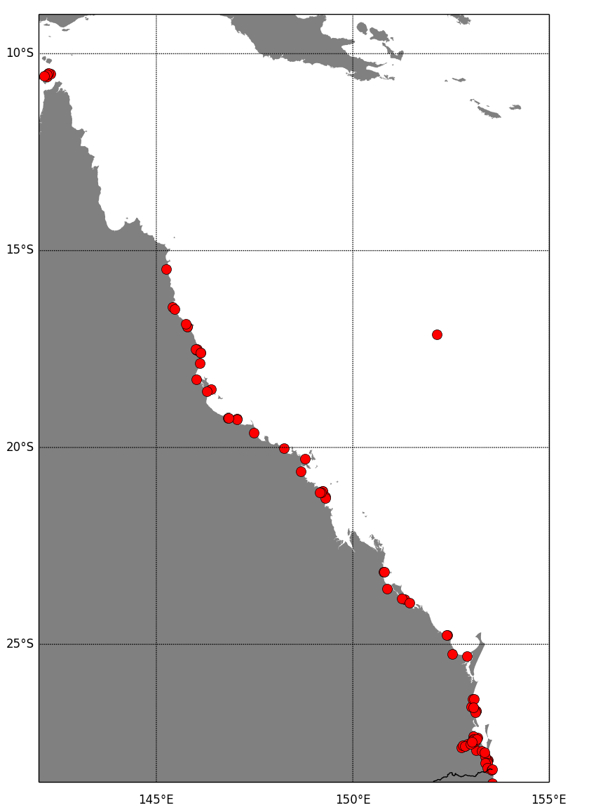
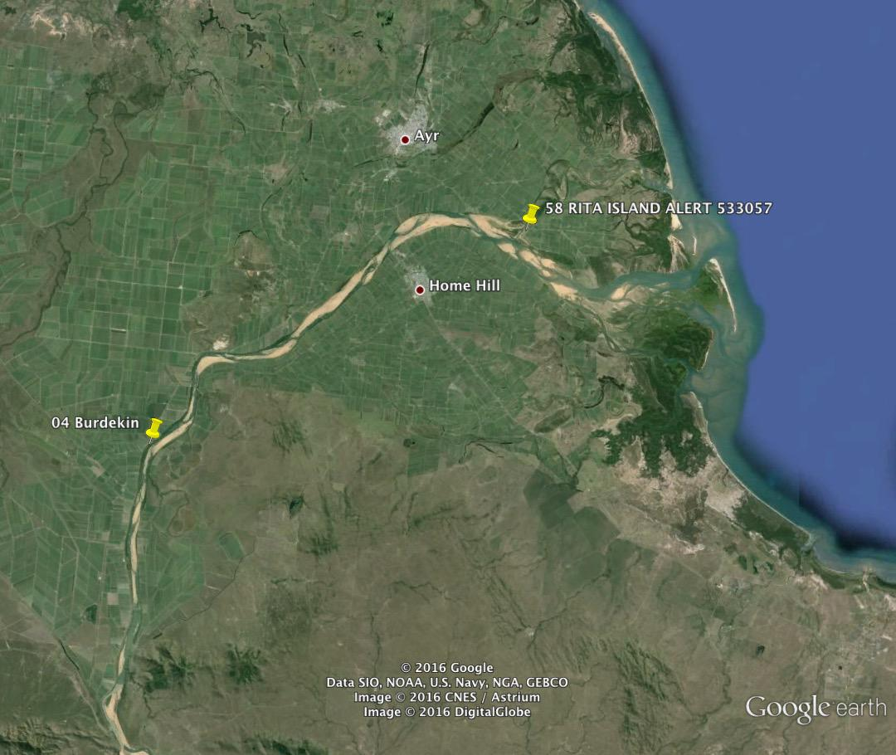



Tides
88 Tide gauges in model domain area/ 16 have no signal
Gauge concentration dominant in south
Locations vary from open ocean to estuary to harbor to land based
Gauge suffer from noise/ peaks
→ not all are optimal to compare to modelled sea level
8
Rita Island Alert, r=0.08
Moggill Alert, r=0.38
13
17
Rosslyn Bay, no signal
Coomera Shores Alert
r=0.6
40
Notes:
Jane Warne -
Main points:
Show gauge locations
Mention Distributions
Not all locations even when on water are useful to compare with model
0.9-1.0 stations evenly distributed over coast most stations in south (show picture)
0.8-0.9: 8 stations mostly southern GBR, 1station in estuary (Mackay, 533060), 1 in estuary, 531014, Mossman Tide
0.7-0.8: 11 station mostly southernGBR near boundary, 1 station in ocean at Lihou Reef, 200880
0.6-0.7: 3 inland evenly distributed over coast
0.5-0.6: 5 stations, 3 station in estuary, joHnstone north, south, 1 in pine RM, 1 in estuary Coomera Shores Alert 540293 (show this one)
0.4-0.5: 5 stations at northern boundary, 3 inland
0.3-0.4: 1 station in land (Bremner catchment), 1 station inland (Dunething Rock Alert, 62, 540095), 1 station on beach (Noosa Bar alert, 76, 540311)
0.2-0.3: 1station inland (540200), 1station in harbour (Townsville,532033), 1 station next to harbour wall (Dalrymple Bay tide 533010)
0.1-0.2: 1 stationnear river mouth (558059, 1 station in esturay 540684, Brisbane Port Office Alert, 1 station esturay, cairn airport alert, 531049
0-0.1: 1 station Cairns esturay (no reason why bad corelation, 53150, 1 station next to pier, Cape ferguson, 32182, 1station in land (Burdekin, Riate Island Alert 533057), 1 station in Rosslyne Bay Harbour, 33208, 1 station in land Pacific Haven Alert 40903 in land , 1 station inland 540192, Jindalee alert
40 tidegauge south of 25S
57 tidgauges south of 20S
80 tidegauges south 15S
Tidal observations in tpxo8
Increased resolution over certain areas, Australia and toras strait may be one

Slide 22











Comparing Tides
8
13
17
R=0.9-1
R=0.8-0.9
R=0.7-0.8
R=0.6-0.7
R=0.5-0.6
40
Upper: Histogram of main statistics using all tide gauges that display a signal. Right: Spatial distribution of gauge according to correlation values
R=0.4-0.5
R=0.3-0.4
R=0.2-0.3
R=0.1-0.2
R=0-0.1
R=0.4-0.5
Notes:
Main points:
3 simulations
HR, FC, FC augmented with spatially varying drag
All models do a pretty good job with bulk of stations in 0.9-1 xcorr bracket. RMSE between.
Main gain from having high resolution model is improvement in lag. → model get timing right.
However, by applying spataially varying drag this is also improved for the high resolution model.
Roms-hr/fc display similar stats
Roms-hr has advantage in lag, RMSE
STD appears to be better modelled for ROMS-FC. This needs to be investigated further. Position of station when gauges on land/ may be important
Reiforcing point from previous slide: gauge location important
Basically all gauge locations are near river/ in estuary
0.9-1.0 stations evenly distrubuted over coast most stations in south (show picture)
0.8-0.9: 8 stations mostly southern GBR, 1station in estuary (Mackay, 533060), 1 in estuary, 531014, Mossman Tide
0.7-0.8: 11 station mostly southernGBR near boundary, 1 station in ocean at Lihou Reef, 200880
0.6-0.7: 3 inland evenly distributed over coast
0.5-0.6: 5 stations, 3 station in estuary, joHnstone north, south, 1 in pine RM, 1 in estuary Coomera Shores Alert 540293 (show this one)
0.4-0.5: 5 stations at northern boundary, 3 inland
0.3-0.4: 1 station in land (Bremner catchment), 1 station inland (Dunething Rock Alert, 62, 540095), 1 station on beach (Noosa Bar alert, 76, 540311)
0.2-0.3: 1station inland (540200), 1station in harbour (Townsville,532033), 1 station next to harbour wall (Dalrymple Bay tide 533010)
0.1-0.2: 1 stationnear river mouth (558059, 1 station in esturay 540684, Brisbane Port Office Alert, 1 station esturay, cairn airport alert, 531049
0-0.1: 1 station Cairns esturay (no reason why bad corelation, 53150, 1 station next to pier, Cape ferguson, 32182, 1station in land (Burdekin, Riate Island Alert 533057), 1 station in Rosslyne Bay Harbour, 33208, 1 station in land Pacific Haven Alert 40903 in land , 1 station inland 540192, Jindalee alert
40 tidegauge south of 25S
57 tidgauges south of 20S
80 tidegauges south 15S
Tidal observations in tpxo8
Increased resolution over certain areas, Australia and toras strait may be one

Slide 23



Tide example – Rosslyn Bay
R=0.97
R=0.67
Notes:
Main point:
Gauge in good position for comparing with model
However, correlation low
Reason for this is noise/ artificial peaks in the tide gauge during September
If removed r=0.97
→ QC very important

Slide 24



Tides example – Cooktown
R=0.98
ROMS-HR
R=0.98
ROMS-FC
R=0.68
ROMS-HR
R=0.7
ROMS-FC
Notes:
Main points:
Example tide gauge time series for roms-hr/ fc (focus on upper images)
Couple of points obs:
Observations (blue) in the raw signal has a datum that needs to be adjusted
Point out missing values in the obs
In this example model correlated well for raw signal, no phase error
Differences between model become apparent for detided time series (lower)
Roms-fc in this case corrlates better although having a larger RMSE and STD difference
Both model simulations simulating events that are not observed pointing towards model faults

Slide 25



River channels
Example: Moreton Bay
Methodology
  Explicit modelling of estuaries
  (1) Aim to preserve river volume
  Balance between model stability and (1)
ROMS-HR
Yellow: Catchment locations
Red: River mouth locations
ROMS-FC
Notes:
One of the mein bits of the work is including
More complex a large amount of rivers flows into the bay
At times leading towards the same river mouth

Slide 26



River channel – Burdekin
Methodology
  Explicit modelling of estuaries
  (1) Aim to preserve river volume
  Balance between model stability and (1)
Depth [m]

Slide 27


Example: Burdekin, negative salinity
Notes:
Example of river discharge event and how it affects the salinity distribution (vertically) at the river mouth
Why negative salinity ?
Large amount of freshwater → front
gravity current
discontinuity
Numerical schemes overshoots
Possibilities to overcome ?
ROMS is equipped with a variety of advection schemes 2,4, upwind, mpdata.
2,4 are more noisy
MPDATA – positive definite advection scheme - slower, less accurate
Upwind Limiter in tracer advection one possibility

Slide 28


SALINITY>0
SALINITY<0
Depth [m]
Umax ~ 20 m/s
W
Notes:
Umax = tidally around 17m/s

Slide 29

Upwinding limiters
#define UPWIND_LIMITER
#define UPL_MASK
Changes:
pre_step3d.F
step3d_t.F
ULTRA-SHARP (Leonard and Mokhtari, 1990), scheme which is an adaptation of TVD applied to third-order upwinding. Specific numerical implementation is guided by (Norris, 2000).
Wu and Zhu (2010)
Notes:
Increase model resolutioin
Decrease timestep
Use MPDATA positive definite scheme
Implement limiters
Advection scheme with 3rd high-order spatial interpolation at the middle temporal level and its application to saltwater intrusion in the Changjiang Estuary
Wu and Zhu ,2010 Ocean Modelling 33(1-2):33-51, DOI: 10.1016/j.ocemod.2009.12.001

Slide 30

Catchments
2009 Flooding event.
A series of moderate to heavy rainfalls during January 2009 saturated the Burdekin catchment. Subsequently, the first heavy rainfall event in February lead to moderate flooding.
Notes:
Main points:
River forcing included in model
Collaboration with hydrology group in BOM providing catchment information to us (in term of flow rate, volume transport)
25 catchments have been selected. Locations are shown in Figure 1
For the hindcast model river information is on a daily basis
Challenges:
Catchment locations inland → understimation of flux, due to additional rainfall over catchments downstream (John Brody)
model does not include estuaries → time lag not accounted for
Histogram gives overview of volume transport accumulated over period of time. (indicating importance of catchments)
Blue over 2006-2011 period.
Points: largest river output Burdekin, Fitzroy Herbert,
Red: overr 2009-01-01 2009-03-01
Leading up to the 2009 flooding event. With burdekin and herbert discharging (TC Ellie ?)

Slide 31

2009 river discharge, ROMS-FC
Upper: Modelled surface passive tracer (left) and associated age (right) are shown.
Lower: Surface salinity (left) and SST (right) during flooding period.
Movement over reef northward. Further to the east southward movement within the EAC.
River plumes tend to turn left hence moving northward over the southern hemisphere
During this event, 2 westerly wind burst occur that advect the plume to the east
Notes:
Main points:
Showing example of how we model the previous discussed event
Map over northern QLD
Showing: Tracer, Tracer age, Salinity and Temperature
Movie runs from 2009-01-01 2009-03-01
Movie:
FirstL tidal movement can be seen
Over reef matrix northward movement apparent (wind driven)
Further out is EAC moving southward
2 episodes of strong westerly wind bursts apparent
These have strong influence on plume advection
Tracer; tend to move northward due to coriolies. Both wind burst tend to advect tracer/ sediment to the east onto the reef.
After each burst, plume tends to reorganize to move northward

Slide 32



2009 River discharge – Compare to observations
ROMS-FC
ROMS-HR
2009/02/16-2009/02/22
Upper: Modelled tracer (left), Modelled tracer age (right),
Lower: Plume maps, from observations (MODIS)
e.g. Devlin et al.,2015 (left), Cholorphyl-a Marine Water Quality Dashboard (right)
Notes:
By the end 22/02
river plume has moved towards the east due to the wind westerly wind burst.
This can be seen very well in the river plume maps,
less so in the Cholorophyl.
Model reproduces this quite well.
Particularely areas of new plumes are well captured

Slide 33



2009 River discharge – Compare to observations
ROMS-FC
ROMS-HR
2009/02/23-2009/03/01
Upper: Modelled tracer (left), Modelled tracer age (right),
Lower: Plume maps, from observations (MODIS)
e.g. Devlin et al.,2015 (left), Cholorphyl-a Marine Water Quality Dashboard (right)
Notes:
By 2009-03-01
Only weak river plume deteted in river plume maps
Good agreement with model
Plume has moved northward, all maps agree on that
The model does not capture any plumes in the south (check on configuration)
Main message: First results look OK. Robustness/ sensitivity needs to be tested
HR mixing more effective

Slide 34
Summary and conclusions
Possible to nest 500m with 10km donor grid ?
  Role of the open boundaries !
Strong fresh water flux affecting numerics
  Limiters possible solution
Limits to our knowledge: e.g. Bathymetry, Forcing resolution
Model assessment: Observations are important → collaborate with AIMS and JCU and others
What have we learnt about modeling the GBR?
  GBR is one of the more complex regions to model in the world
  Shelf break is chaotic with a transition between shelf and Coral sea (intra model differences)
  Specific verification of moorings highlights that local/fine scale processes matter (model sensitivity)
  Both models compare reasonable well with observation (tide gauge and QIMOS)
In process to make data available on NCI and welcome feedback
Notes:
Scratching on a few topics/ questions
Need to include these processes in our model if we want a good prepresnetaion of the circulation
What have we learnt so far about GBR circulation?

Slide 35


Example: Elusive Reef mooring
Reasonable comparison between model and mooring at 188m
Mooring temperature increases by ~10degC from 188 to 282m depth
Suggesting observations may be wrong/ other explanations ?

Slide 36

Reanalyses and Data assimilation
  Data Assimilation
    EnOI and EnKF systems applied to 4km model
    EnKF provides us with ensemble → probabilistic river plume forecast
    Re-analyses from 2006-2012
  Observations (for assimilation and validation)
    SST (AMSRE, AVHRR, WindSat, Pathfinder)
    Altimeters (Jason1, Jason2, Cryosat-2,
    Profiles (Argo, gliders)
Daily mean from 3-day forecast with overlay of unassimilated super observations
Notes:
One component within the project is the reanalyses and DA
As part of the project deliveries We are producing a renalyses over 6 years using EnOI
But try to move towards EnKF. This will provide us with ensemble
The main points is to show how the MAD of the data assimilated
system is adding value but requires more work as not all are better
than OceanMAPS.

Slide 37




Temperature; ROMS vs Mooring
Fc27, Upwind Lim
Fc26, UP3
Fc21, BKPP
Fc26.1, UP3
Fc31, varying drag
Fc34. varying drag
Fc18, UP3
Fc23
Fc32 era_int
Fc17

Slide 38





Slide 39
Maximum grid stiffness ratios: HR
rx0 = 3.918769E-01 (Beckmann and Haidvogel)
rx1 = 6.076817E+00 (Haney)
Maximum grid stiffness ratios: FC
rx0 = 9.746151E-01 (Beckmann and Haidvogel)
rx1 = 4.526679E+01 (Haney)

Slide 40
coef=hanning_smoother(coef); % coef is a smoothed bathy
end
coef=0.125*(coef./max(max(coef))); % rescale the smoothed bathy
%
for i=1:n_filter_deep_topo;
h=hanning_smoother_coef2d(h,coef); % smooth with avariable coef
h(maskr==0 & h>hmax_coast)=hmax_coast;
end
end
%
% Apply a selective filter on log(h) to reduce grad(h)/h.
%
disp(' Apply a selective filter on log(h) to reduce grad(h)/h :')
if hmin<0, h=h-hmin+1; end
h=rotfilter(h,maskr,hmax_coast,rmax);
if hmin<0, h=h+hmin-1; end
%
% Smooth the topography again to prevent 2D noise
%
if n_filter_final>1
disp(' Smooth the topography a last time to prevent 2DX noise:')
disp([' ',num2str(n_filter_final),' pass of a hanning smoother.'])
for i=1:n_filter_final
h=hanning_smoother(h);
h(maskr==0 & h>hmax_coast)=hmax_coast;
end
end

