Slide 1
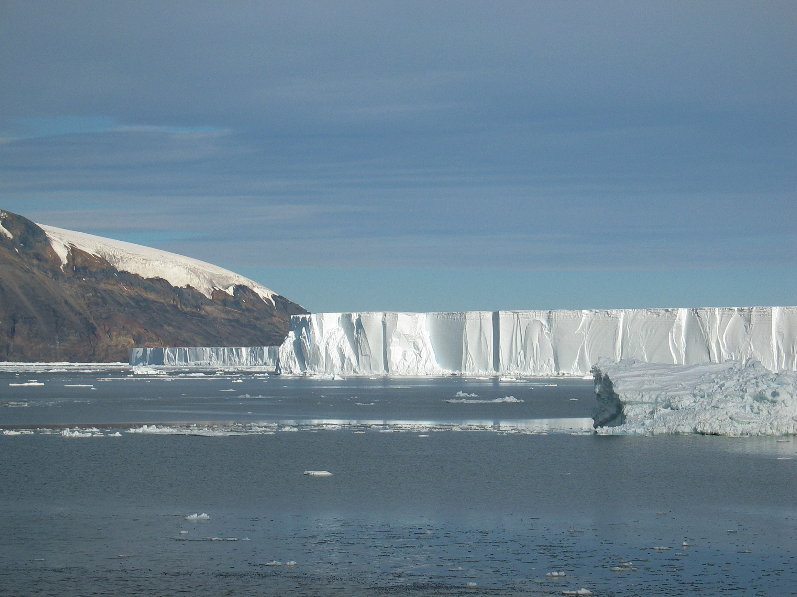

Transport pathways and consequences for Antarctic ice shelf basal meltwater
Mike Dinniman, John Klinck
Center for Coastal Physical Oceanography
Old Dominion University
Laurie Padman
Earth and Space Research
October 18, 2016

Slide 2
Outline
Introduction: What is an ice shelf and how might its melting affect the ocean?
The effect of resolution in a circum-Antarctic ocean/sea-ice/ice shelf model on ice shelf basal melt
Transport of meltwater from different sectors around the continent
Conclusions

Slide 3
Introduction
Nearly 40% of the Antarctic continental shelf ocean is covered by the floating extensions of land based ice sheets
Believed that most of the mass loss from the ice shelves comes from basal melting rather than iceberg calving
Ice shelf basal melt water may be related to freshening on the Antarctic continental shelves and changes in Antarctic Bottom Water (AABW) formation
Melt water proposed as source of dissolved iron for ocean primary production
Notes:
Make point about looking here more at what the ice shelves do to the ocean vs. the other way around (re: SLR).

Slide 4
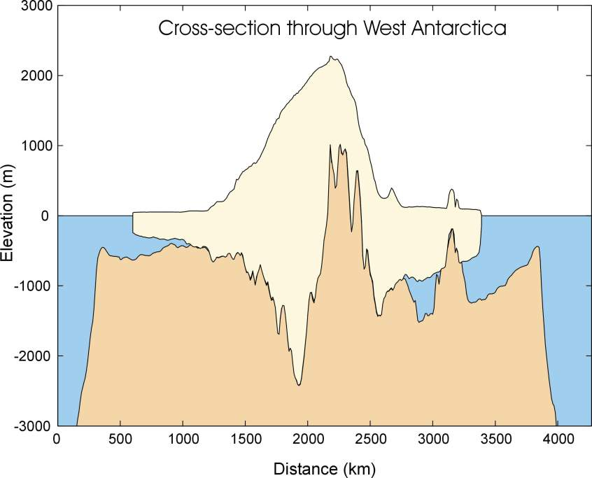
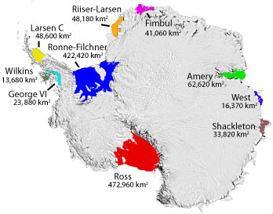
Courtesy: A. Jenkins, BAS (left)
and NSIDC (right)
Ice shelves are primarily associated with “marine ice sheets”, which rest on a bed that lies below sea level
Ice shelves form where the ice sheet margins are not thick enough to remain grounded on the seabed
Notes:
Show where cross section is (Ross (left) and Ronne-Filchner) and size of Ross (Spain).

Slide 5
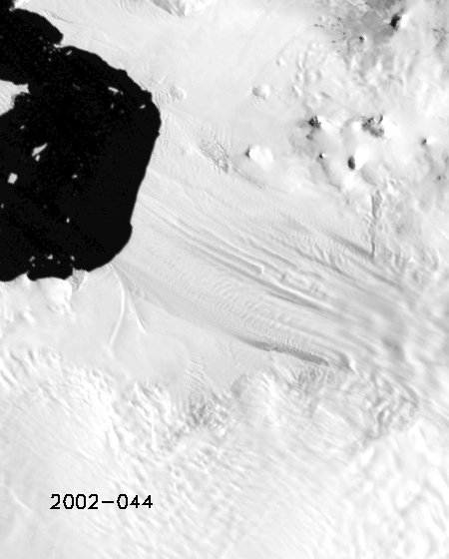
MODIS satellite imagery of Pine Island Glacier
Rignot et al., 2014
Notes:
Fast moving ice area is ~ 40km across, groundling line near right edge

Slide 6
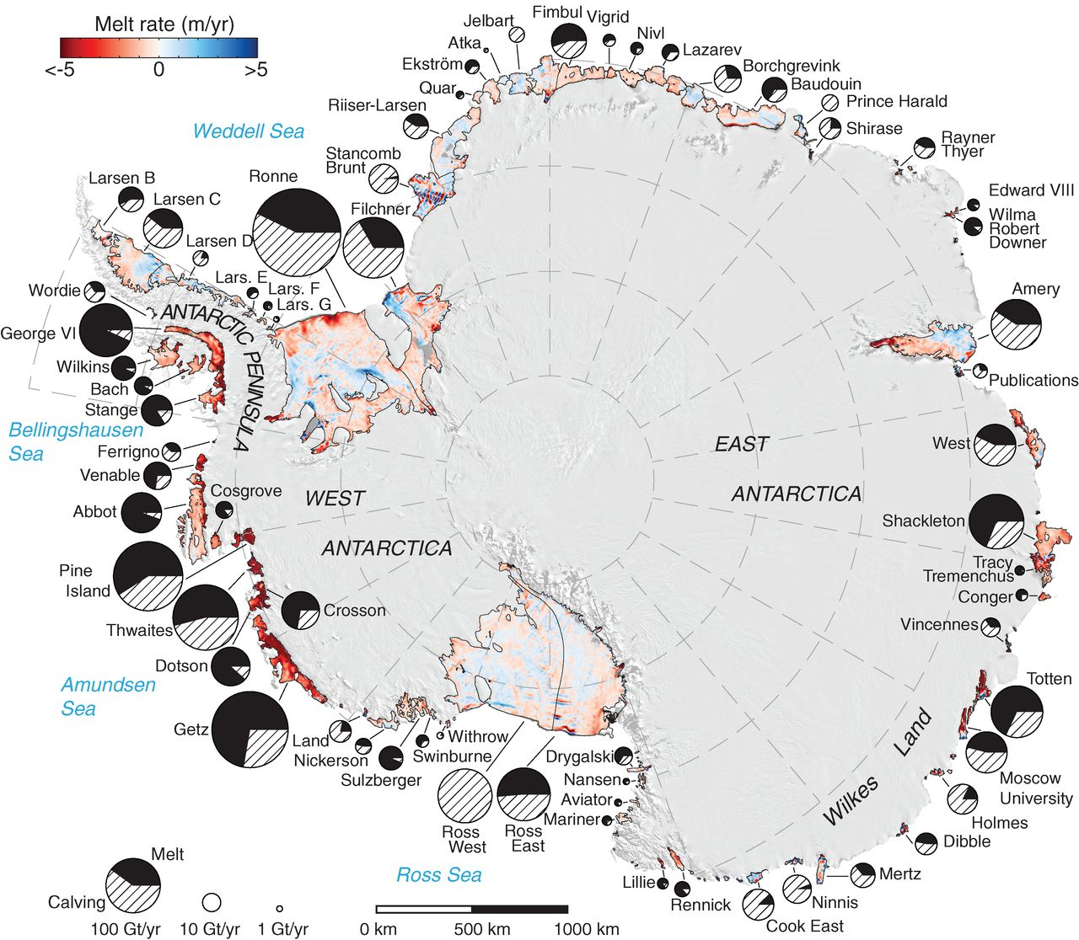
Basal melt: 1325 ± 235 Gt/year
(other estimates: 750-1450 Gt/year)
Calving flux: 1089 ± 139 Gt/year
(Liu et al. (2015): 755 ± 24 Gt/year)
Ross and Ronne-Filchner cover 2/3 of the ice shelf area, but are only ~15% of net melting
1/2 of the net melting comes from 10 small warm-cavity ice shelves in the SE Pacific covering 8% of the area
Rignot et al., 2013
Notes:
Now thought that basal melt exceeds calving flux. Ice shelf thickening = net surface mass balance – basal melt – lateral divergence of volume flux.

Slide 7
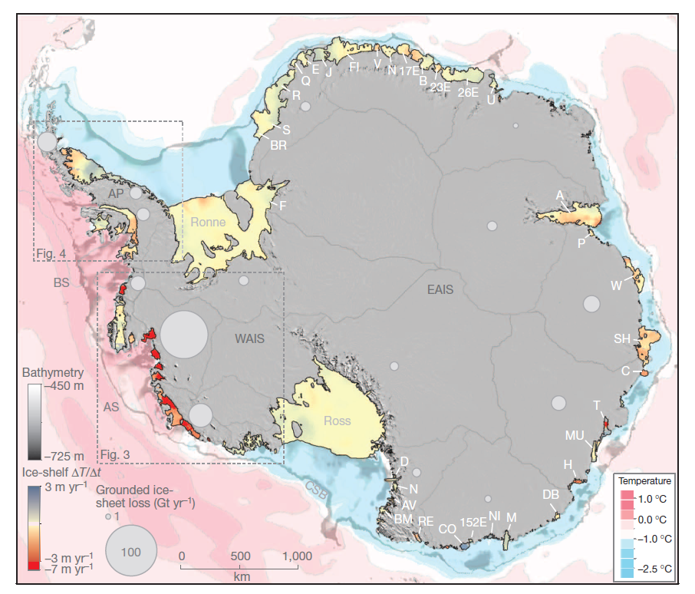
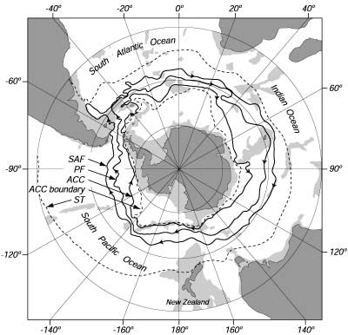
Pritchard et al., 2012
Orsi, 1995
Notes:
Mention ice sheet drainage basins and ice shelves. Amundsen and AP ice shelves can melt faster due to the proximity of relatively warm CDW. Southern ACC boundary defined by the southern extent of the UCDW. Warm vs. Cold shelves. WAIS vs. EAIS (and WAIS is ~5m of sea level).

Slide 8
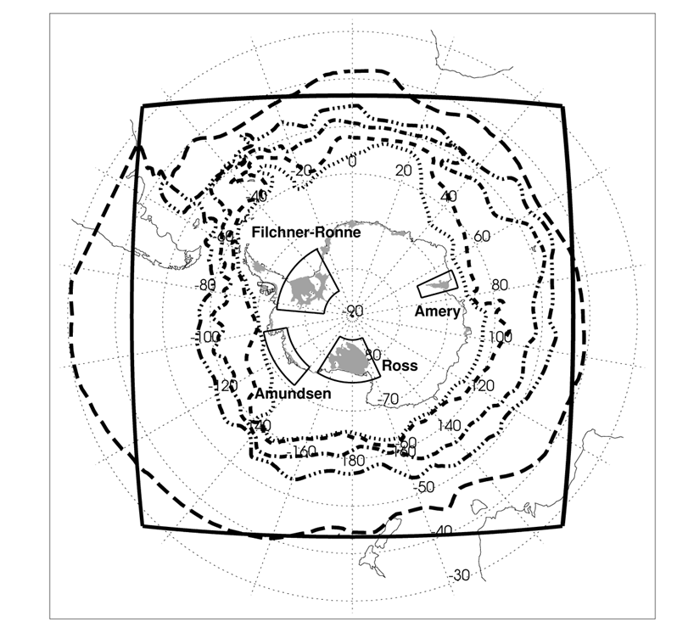
10 km and 5 km resolution circum-Antarctic ROMS ocean/sea-ice models with ice shelves
Ocean extends into cavities underneath the ice shelves and mechanical (pressure, drag) and thermodynamic interactions (ice melt/freeze) between the ice shelf base and the ocean are simulated
Ice shelves do not change in time (simulations are only a few years long)
Model well simulates Drake passage transport (143 ± 10 Sv. (10 km), 141 ± 11 Sv. (5 km)) compared to observations (134 ± 11 Sv. (Cunningham et al., 2003), 141 ± 13 Sv. (Koenig et al., 2014))
Notes:
Note ACC fronts and ice shelves in the model.

Slide 9
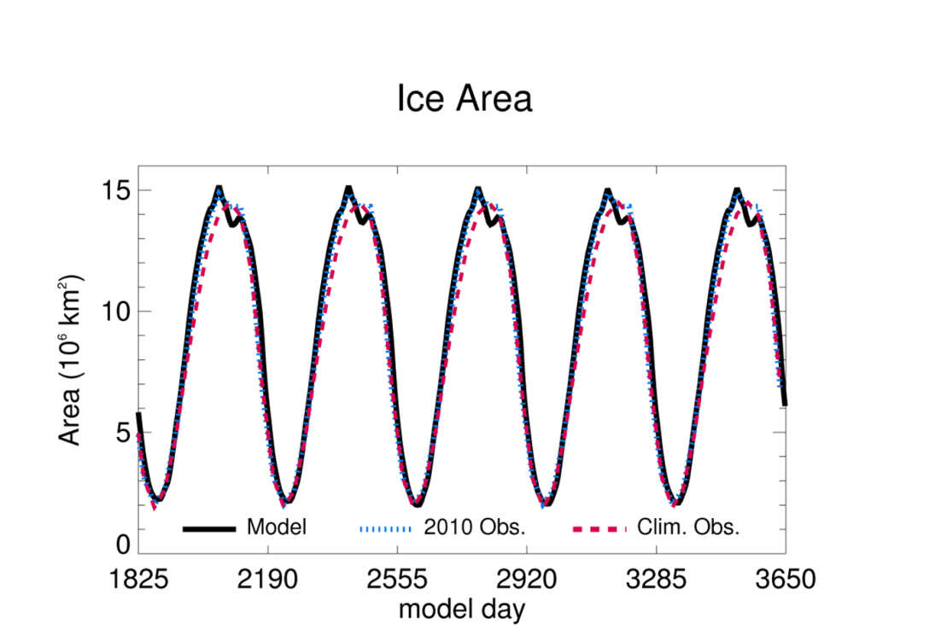
Model accurately simulates sea ice extent with ERA-Interim winds
(top row: Feb. and Sep. model
bottom row: Feb. and Sep. obs.)
Notes:
Explain that it’s a run with repeating 2010 winds (to look at spin-up vs. interannual variability in the wind forcing)

Slide 10
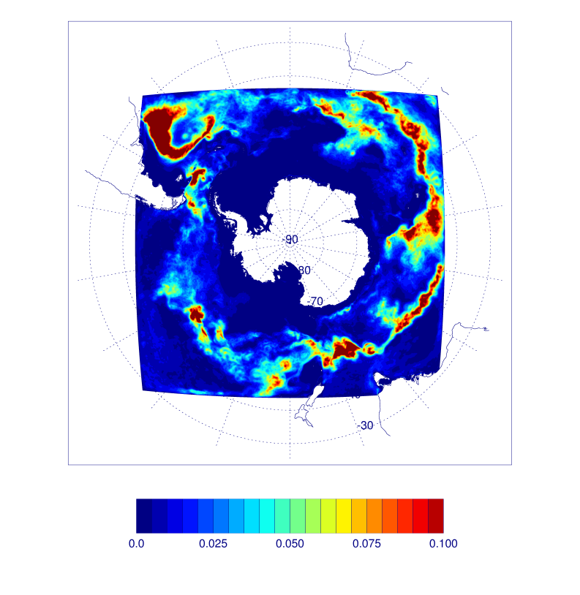

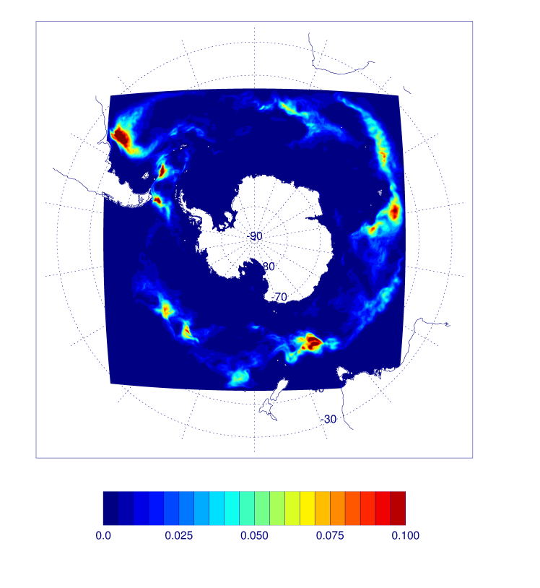
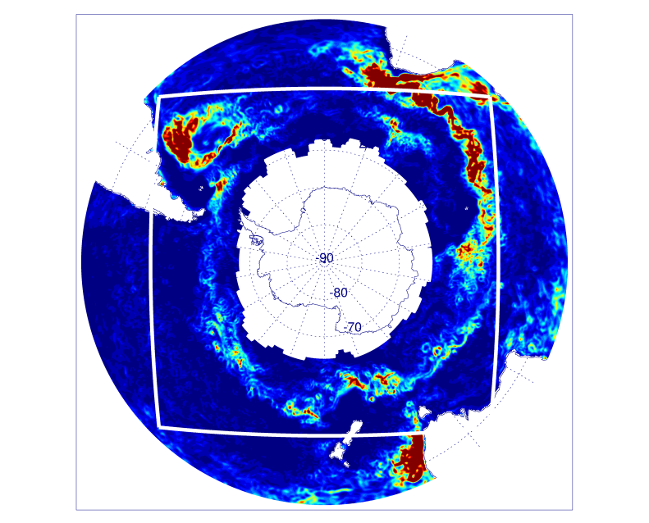
EKE: 5km grid
(mean: 0.0218 m²/s²)
EKE: 10km grid
(mean: 0.0180 m²/s²)
EKE: 20km grid
(mean: 0.0074 m²/s²)
From AVISO estimates of geostrophic velocity anomalies for 2010.
Notes:
Not much of a gain in EKE from 10 to 5km…10km is probably fine for eddying out in the open ocean and 5km still isn’t likely good enough on the continental shelf.

Slide 11
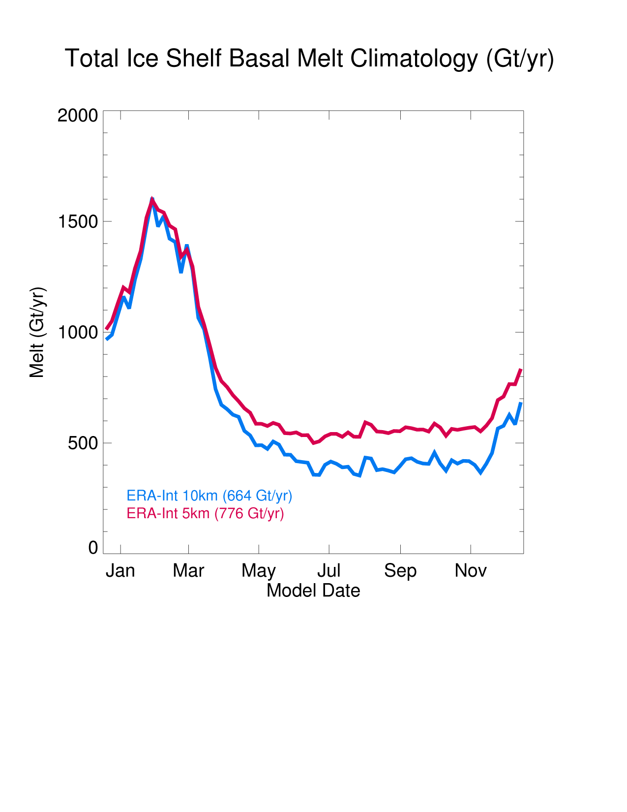
Total modeled basal melt rate is slightly low compared to observational estimates (750-1450 Gt/yr)
Total basal melt increases by
17% just by increasing the horizontal resolution from 10 to 5 km
Increase in melt is not spread evenly: Not much change for “cold” water ice shelves, but dramatic improvement for “warm”
10 km model (m/yr) 5 km model (m/yr) Observations (m/yr)
Ross 0.14 ± 0.06 0.16 ± 0.07 0.00 - 0.20
Filchner-Ronne 0.19 ± 0.02 0.22 ± 0.02 0.03 – 0.44
Getz 0.66 ± 0.30 1.36 ± 0.37 1.1 – 4.7
George VI 1.19 ± 0.18 4.08 ± 0.54 2.1 – 4.8
Pine Island 1.62 ± 0.97 7.31 ± 1.07 14 - 33
Notes:
More heat getting onto the continental shelf with higher resolution along the Amundsen/Bellingshausen coast. Mention PIG is still poor, but is much better than before.

Slide 12
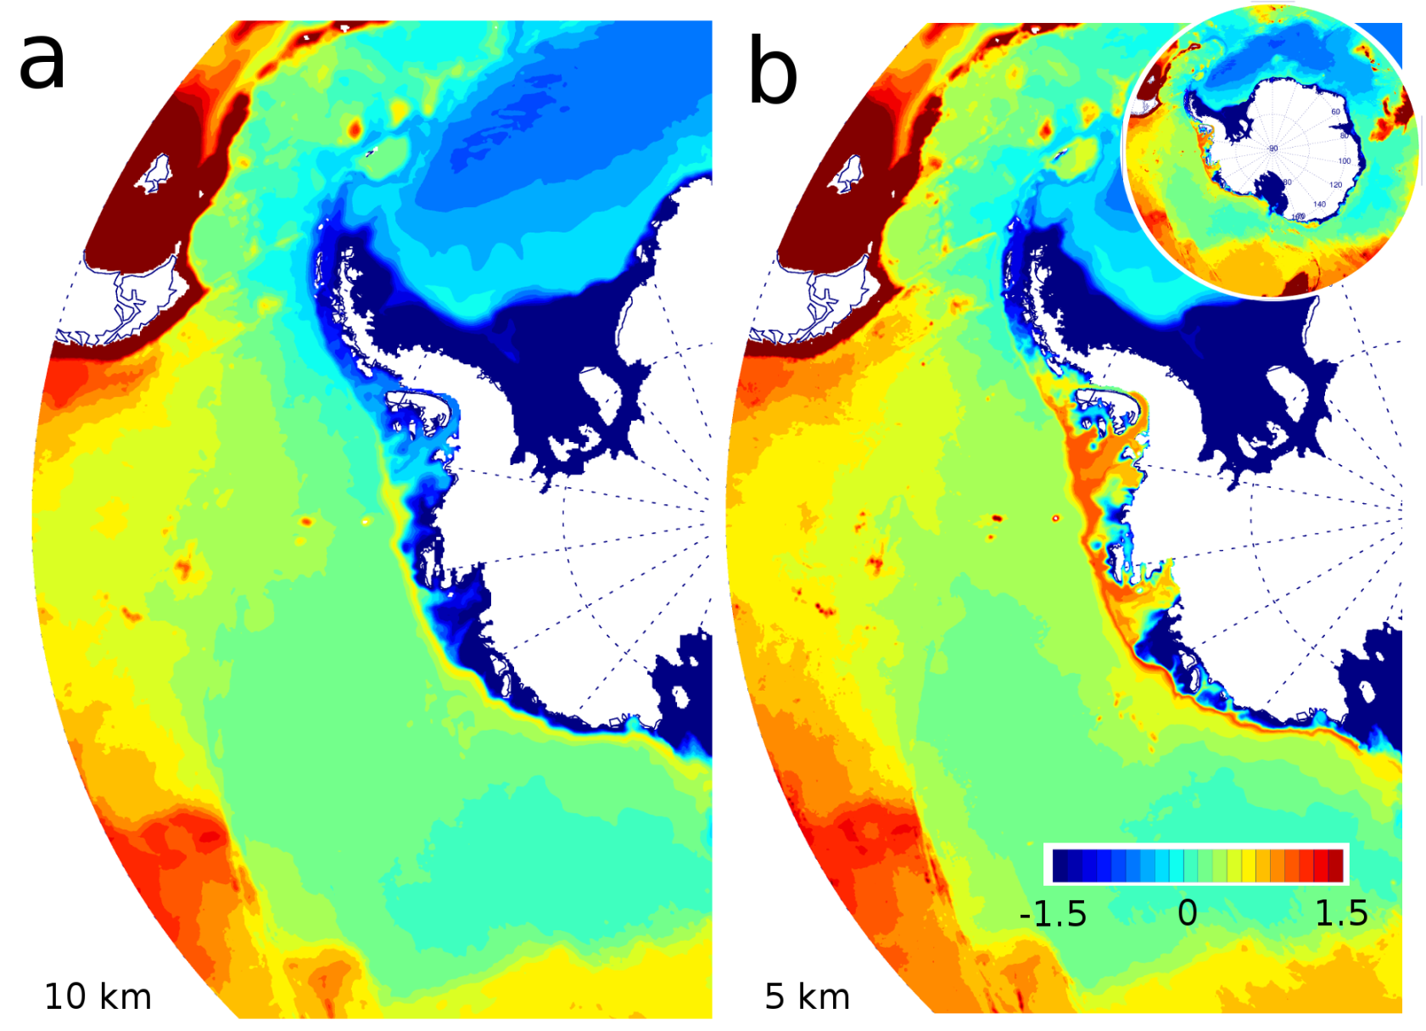
Model bottom layer temperature for West Antarctica
Notes:
5km model better represents mean flow/topography interactions along the Amundsen continental slope. Suspect we could do even better if we were eddy resolving on the continental shelf.

Slide 13
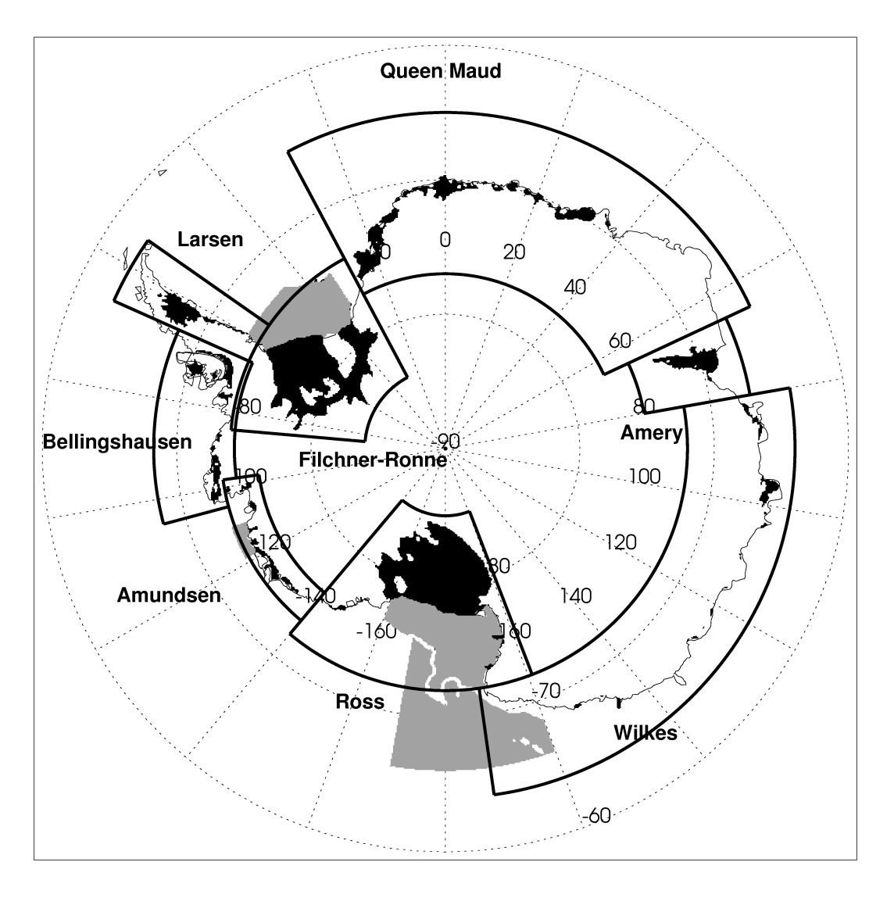
Divide Antarctic ice shelves into eight regions (same as Paolo et al., 2015)
Separate ice shelf meltwater tracer for each region
Three simulations starting from same point:
  Seven years continuously pumping dye into the ocean
  Two years with a 60 d dye release during summer
  Two years with a 60 d dye release during winter
Notes:
Mention sectors/ice shelves/four areas

Slide 14
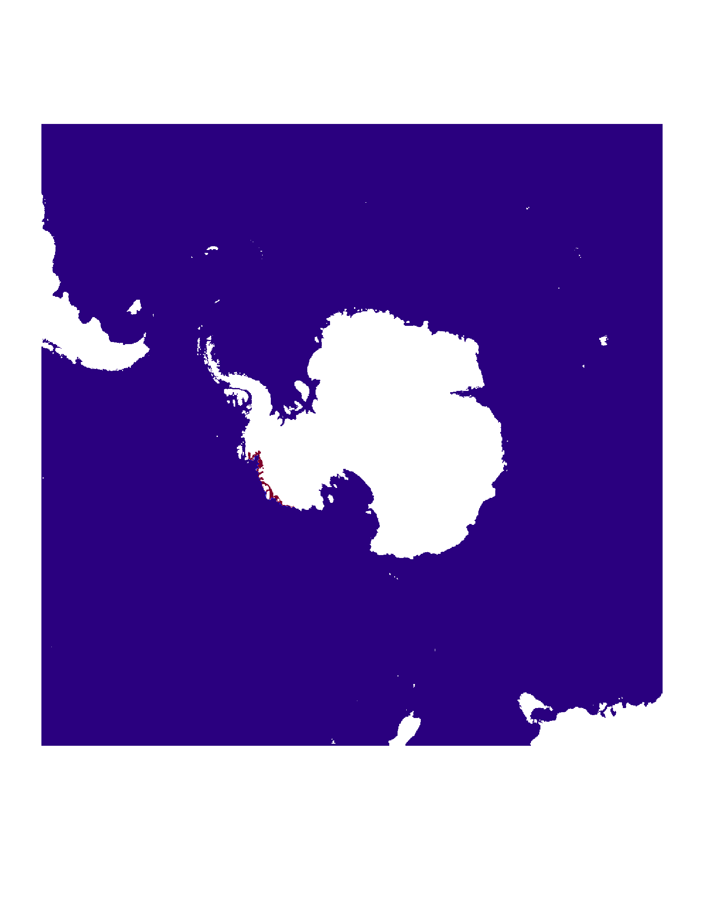
Ice shelf meltwater surface tracer from the Amundsen sector (three years)

Slide 15
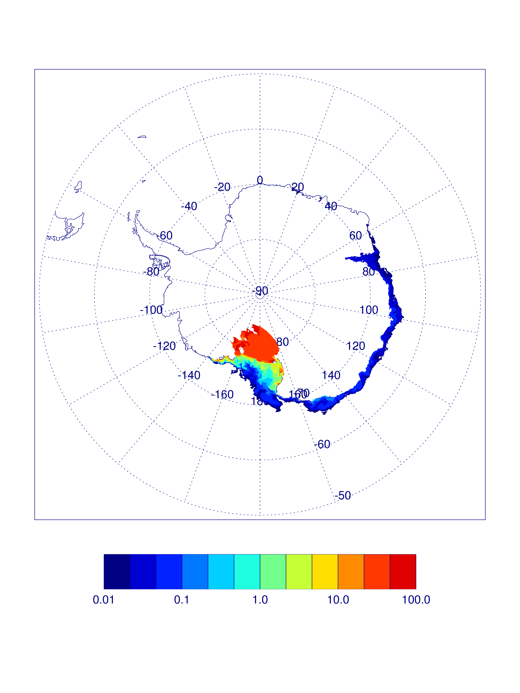
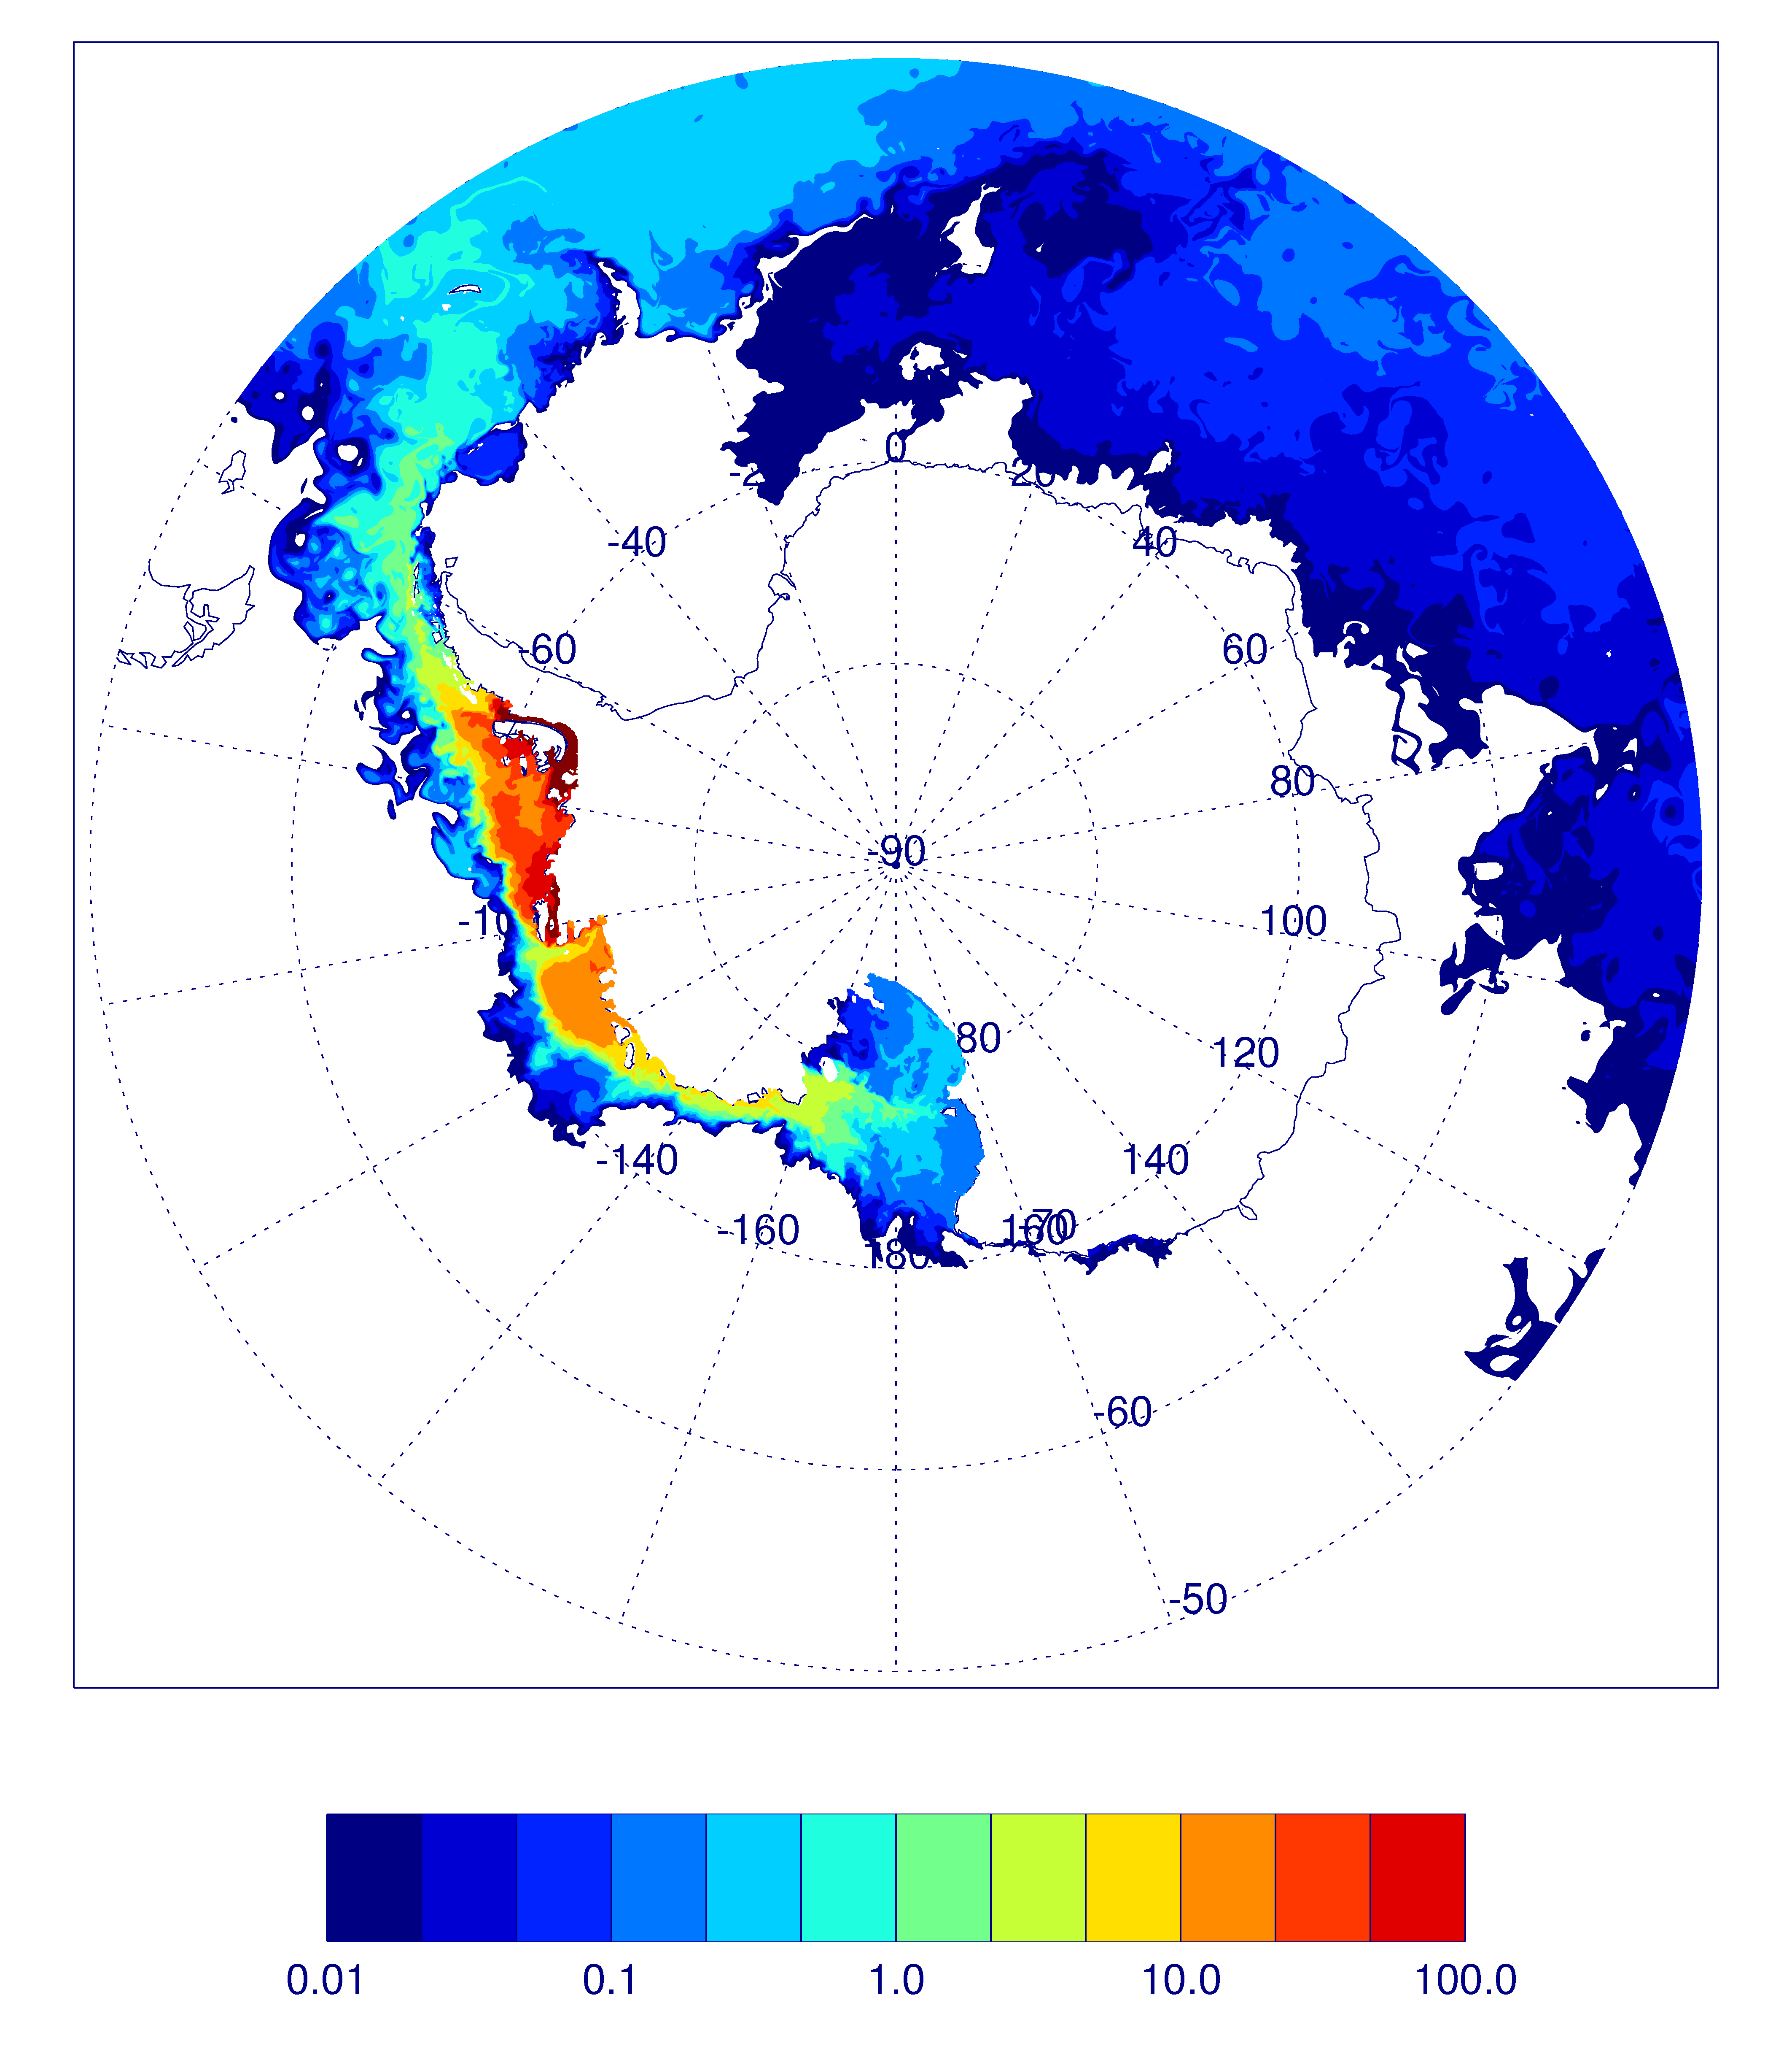
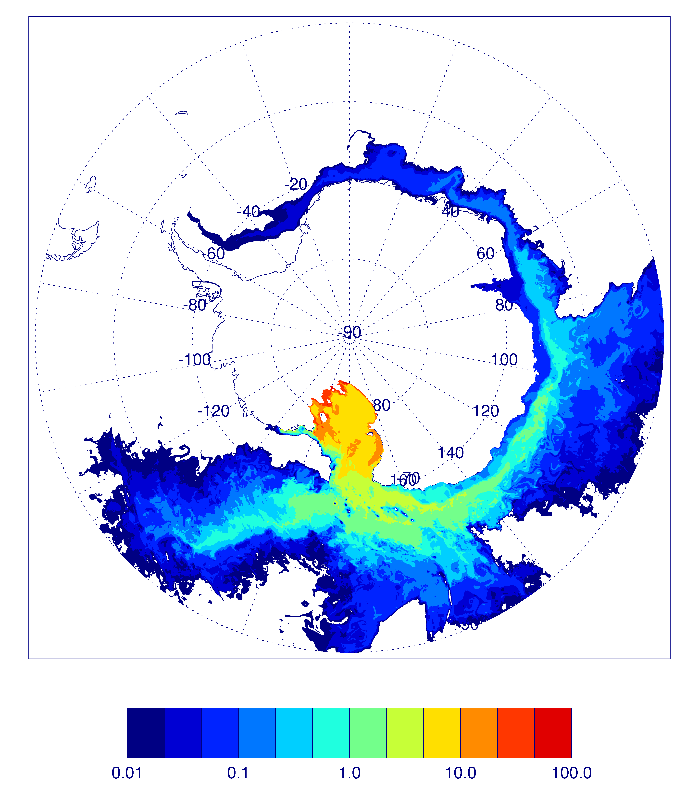
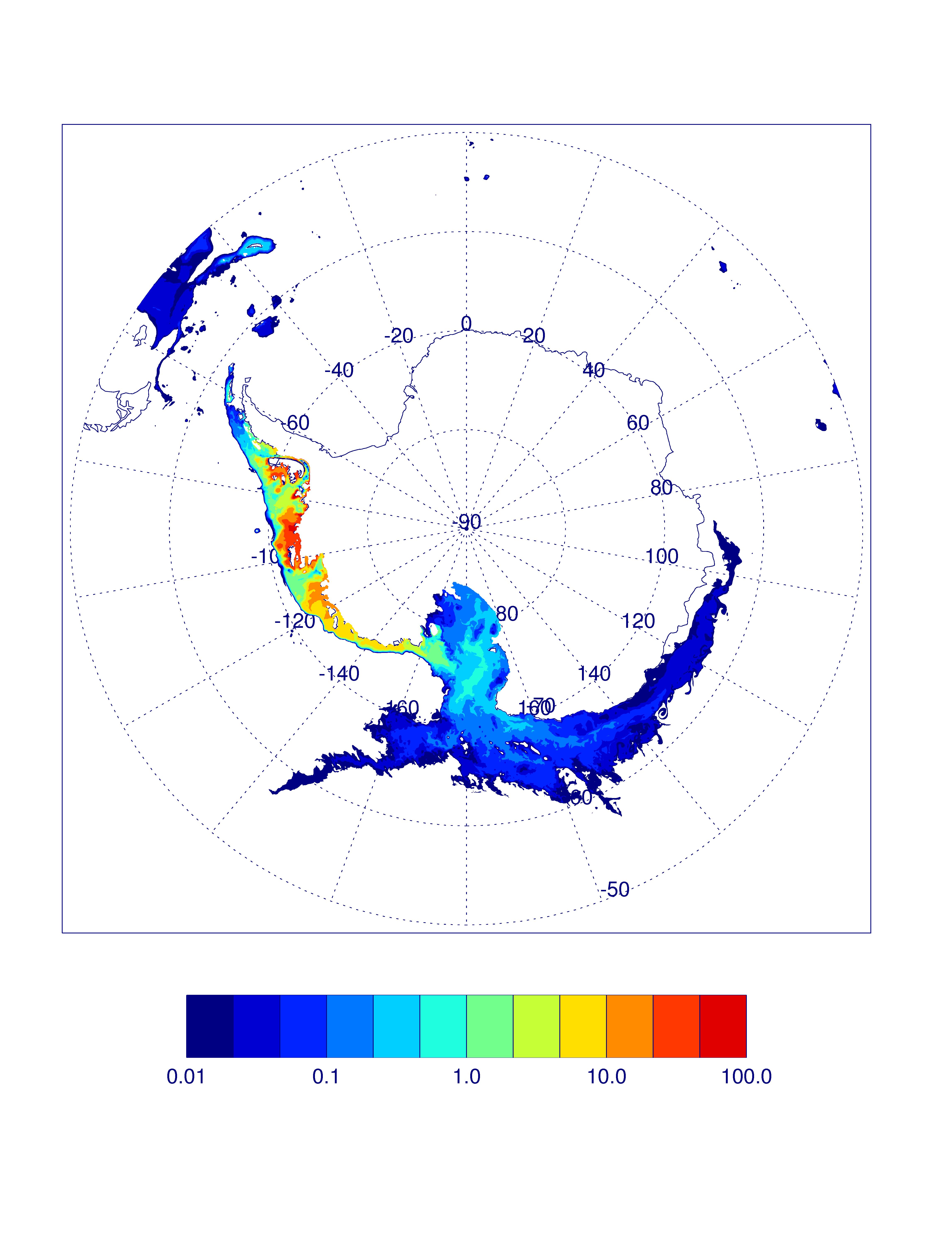
Ice shelf meltwater tracers after seven years at surface (top) and bottom model layers (bottom) for a “cold” shelf (Ross Sea: left) and a “warm” shelf (Bellingshausen Sea: right)
Notes:
Good sanity check to show that the model seems to be working as one would expect. Bottom water formation site: Ross Sea. Not a bottom water formation site: Bellingshausen Sea. Log scale (and 1 dye unit is 10^-4 parts melt water).

Slide 16
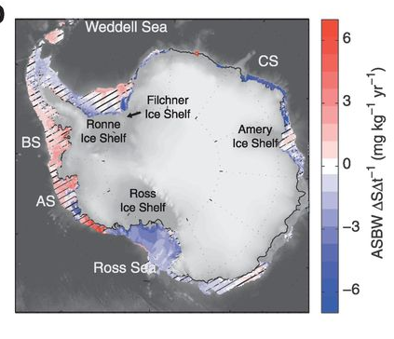
Jacobs and Giulivi, 2010
Schmidtko et al., 2015
Observed freshening in the Ross Sea over the last 50+ years may not be due to local processes but rather a signature of increased basal melt from “upstream” ice shelves in the Amundsen Sea
Could lead to changes in Antarctic Bottom Water (AABW) formation
Notes:
Note that AASW is freshening more than the other water types and this is the water coming upstream from the Amundsen.

Slide 17
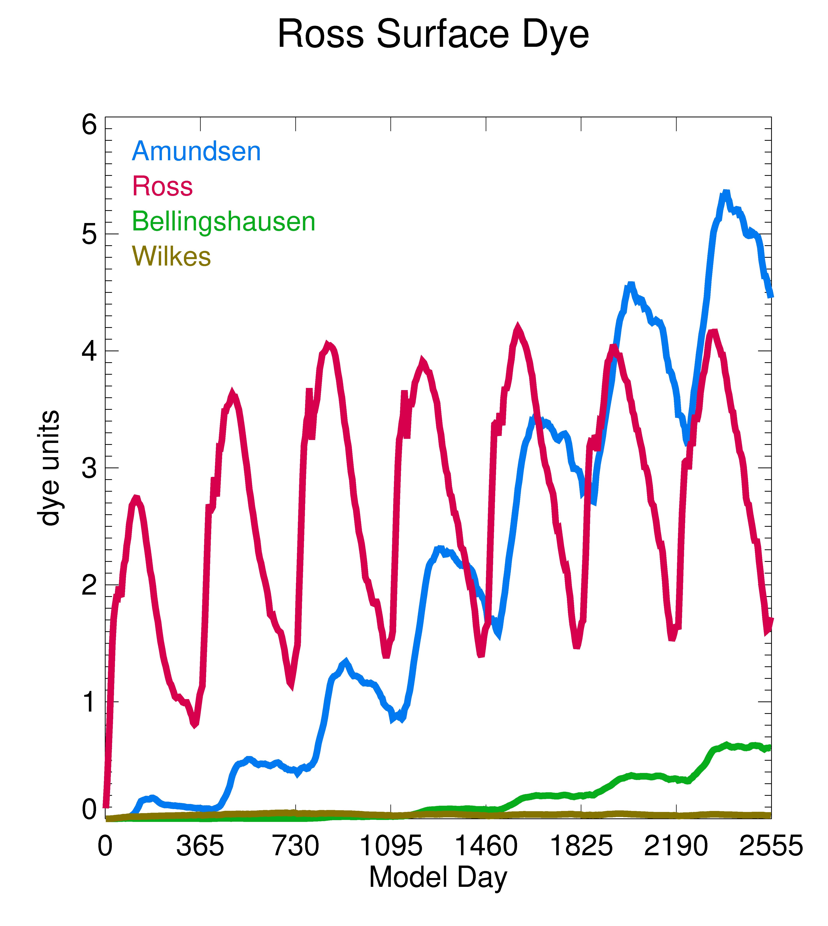
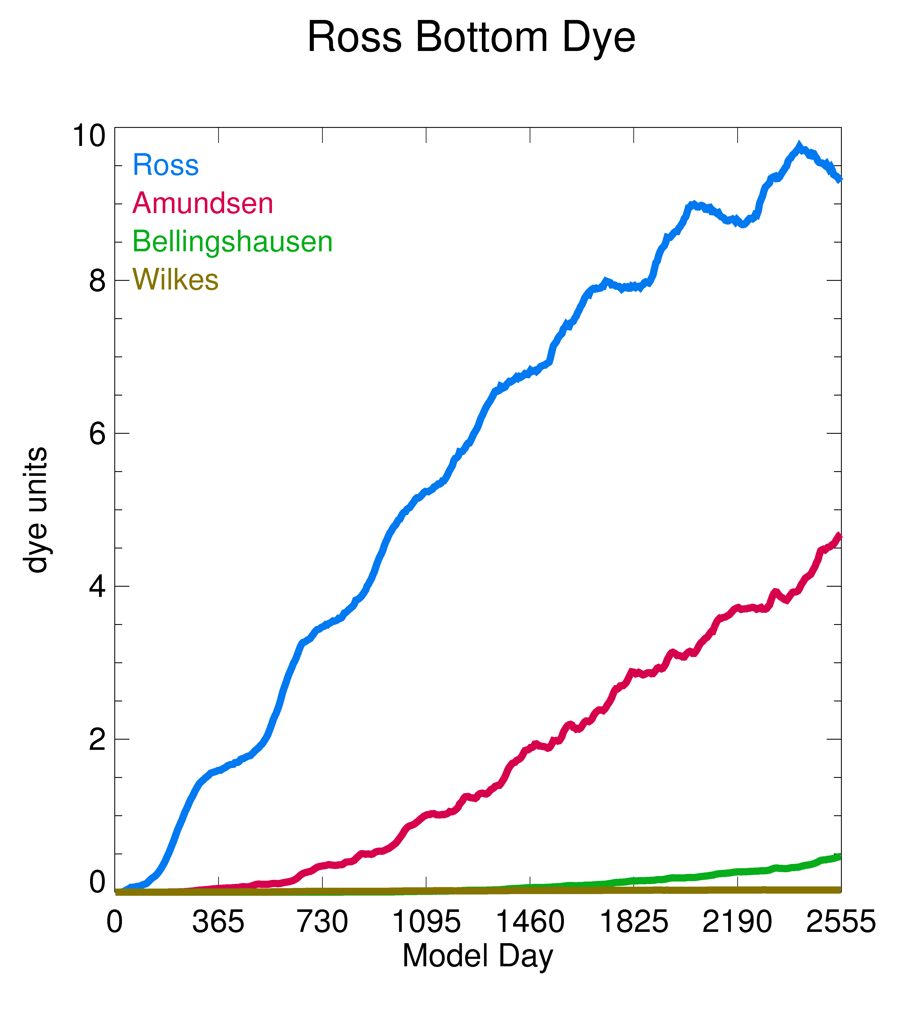
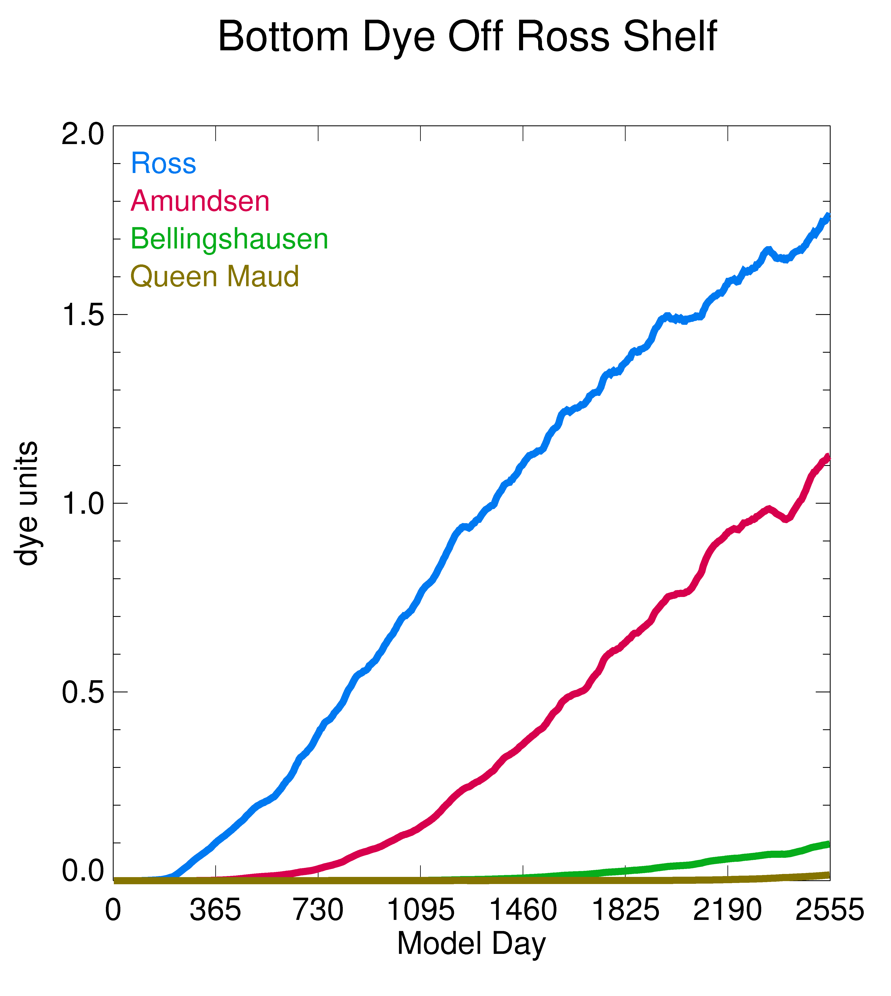
Significant fraction of the meltwater in the Ross Sea continental shelf comes from the Amundsen sector and contributes (37% of the total meltwater contribution after 7 years) to AABW formation
Notes:
Mention: top four sources, note changes in y-axis, Ross sourced bottom dye > sfc dye over shelf. Note that 1 dye unit is 10^-4 parts melt water

Slide 18
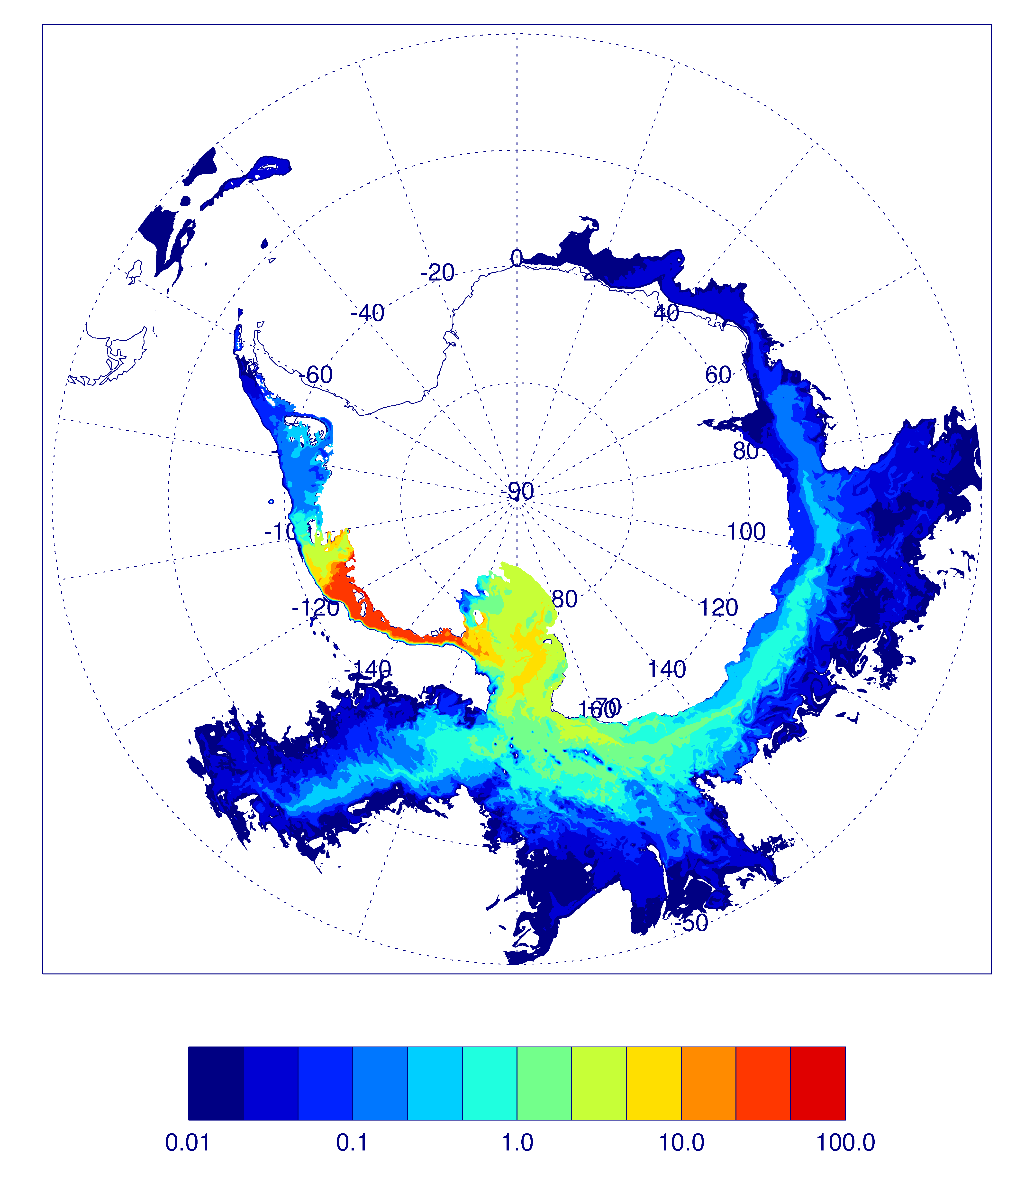
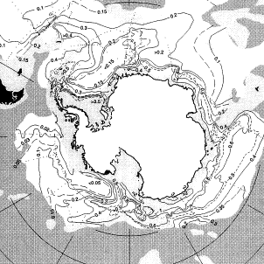
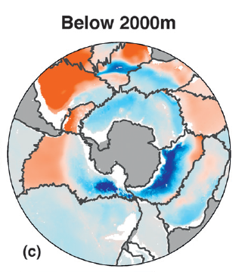
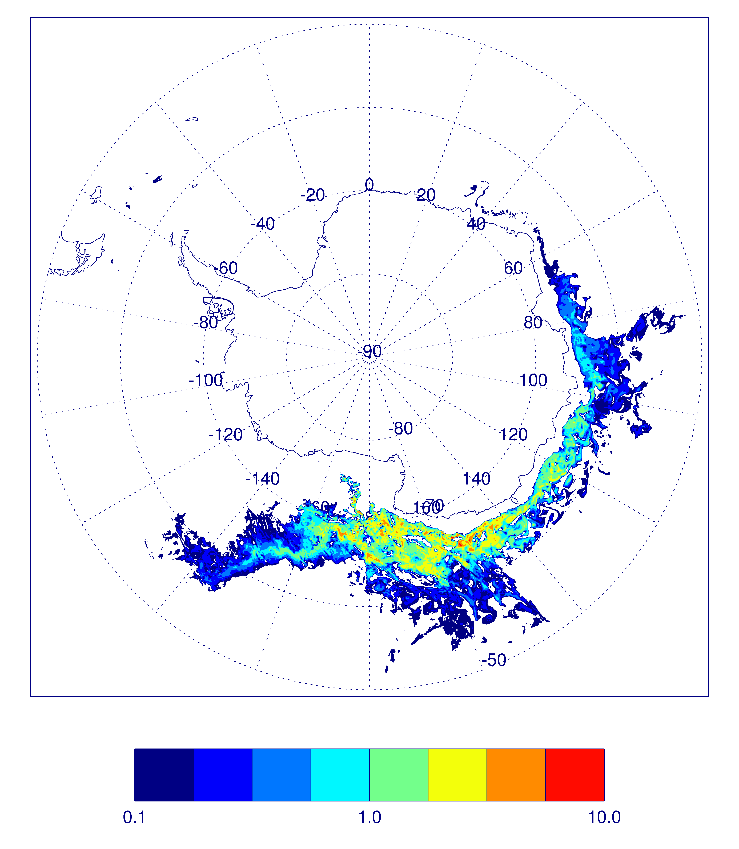
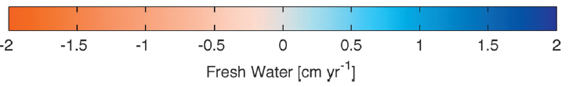
Top: AABW layer CFC-11 (left: Orsi et al., 1999) and model meltwater tracer (dye units) at bottom originated from the Amundsen sector (right)
Bottom: Recent deep freshwater flux (right: Purkey and Johnson, 2013) and model estimate of Amundsen melt contribution to freshwater flux (cm/yr) computed in same manner
Notes:
Show two pathways from CFC concentrations. Show pathways of Amundsen meltwater and mention where AABW formed. Mention scales in both model plots (and that this is only last year of a seven year run (probably not steady-state). It’s at least conceivable that Amundsen sector meltwater could be significantly contributing to the estimated AABW freshening.

Slide 19
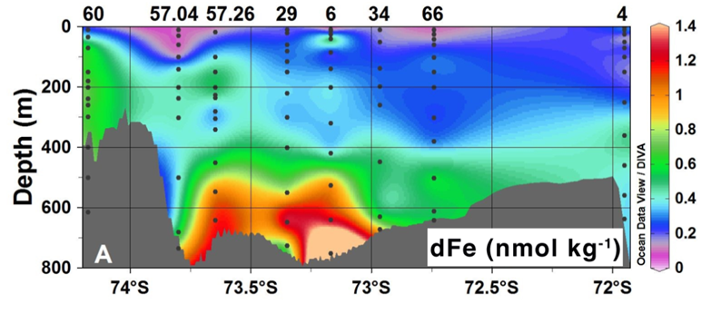
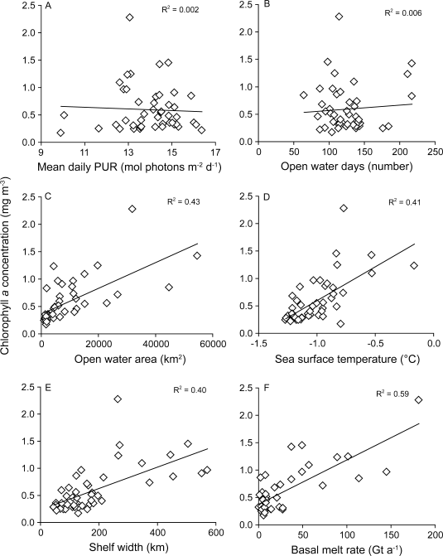
Iron in a transect approaching Dotson (on left) Ice Shelf
(Sherrell et al., 2015)
(Note: Iron source in meltwater may be other than directly injected from ice shelt melt (e.g. subglacial melt drainage, entrainment of benthic sources into meltwater plume via “ice pump” mechanism))
Strong correlation between Chl a concentration and ice shelf basal melt (Arrigo et al., 2015)
Notes:
Mention highly productive Ant CS and that dFe is a limiting micro-nutrient.

Slide 20
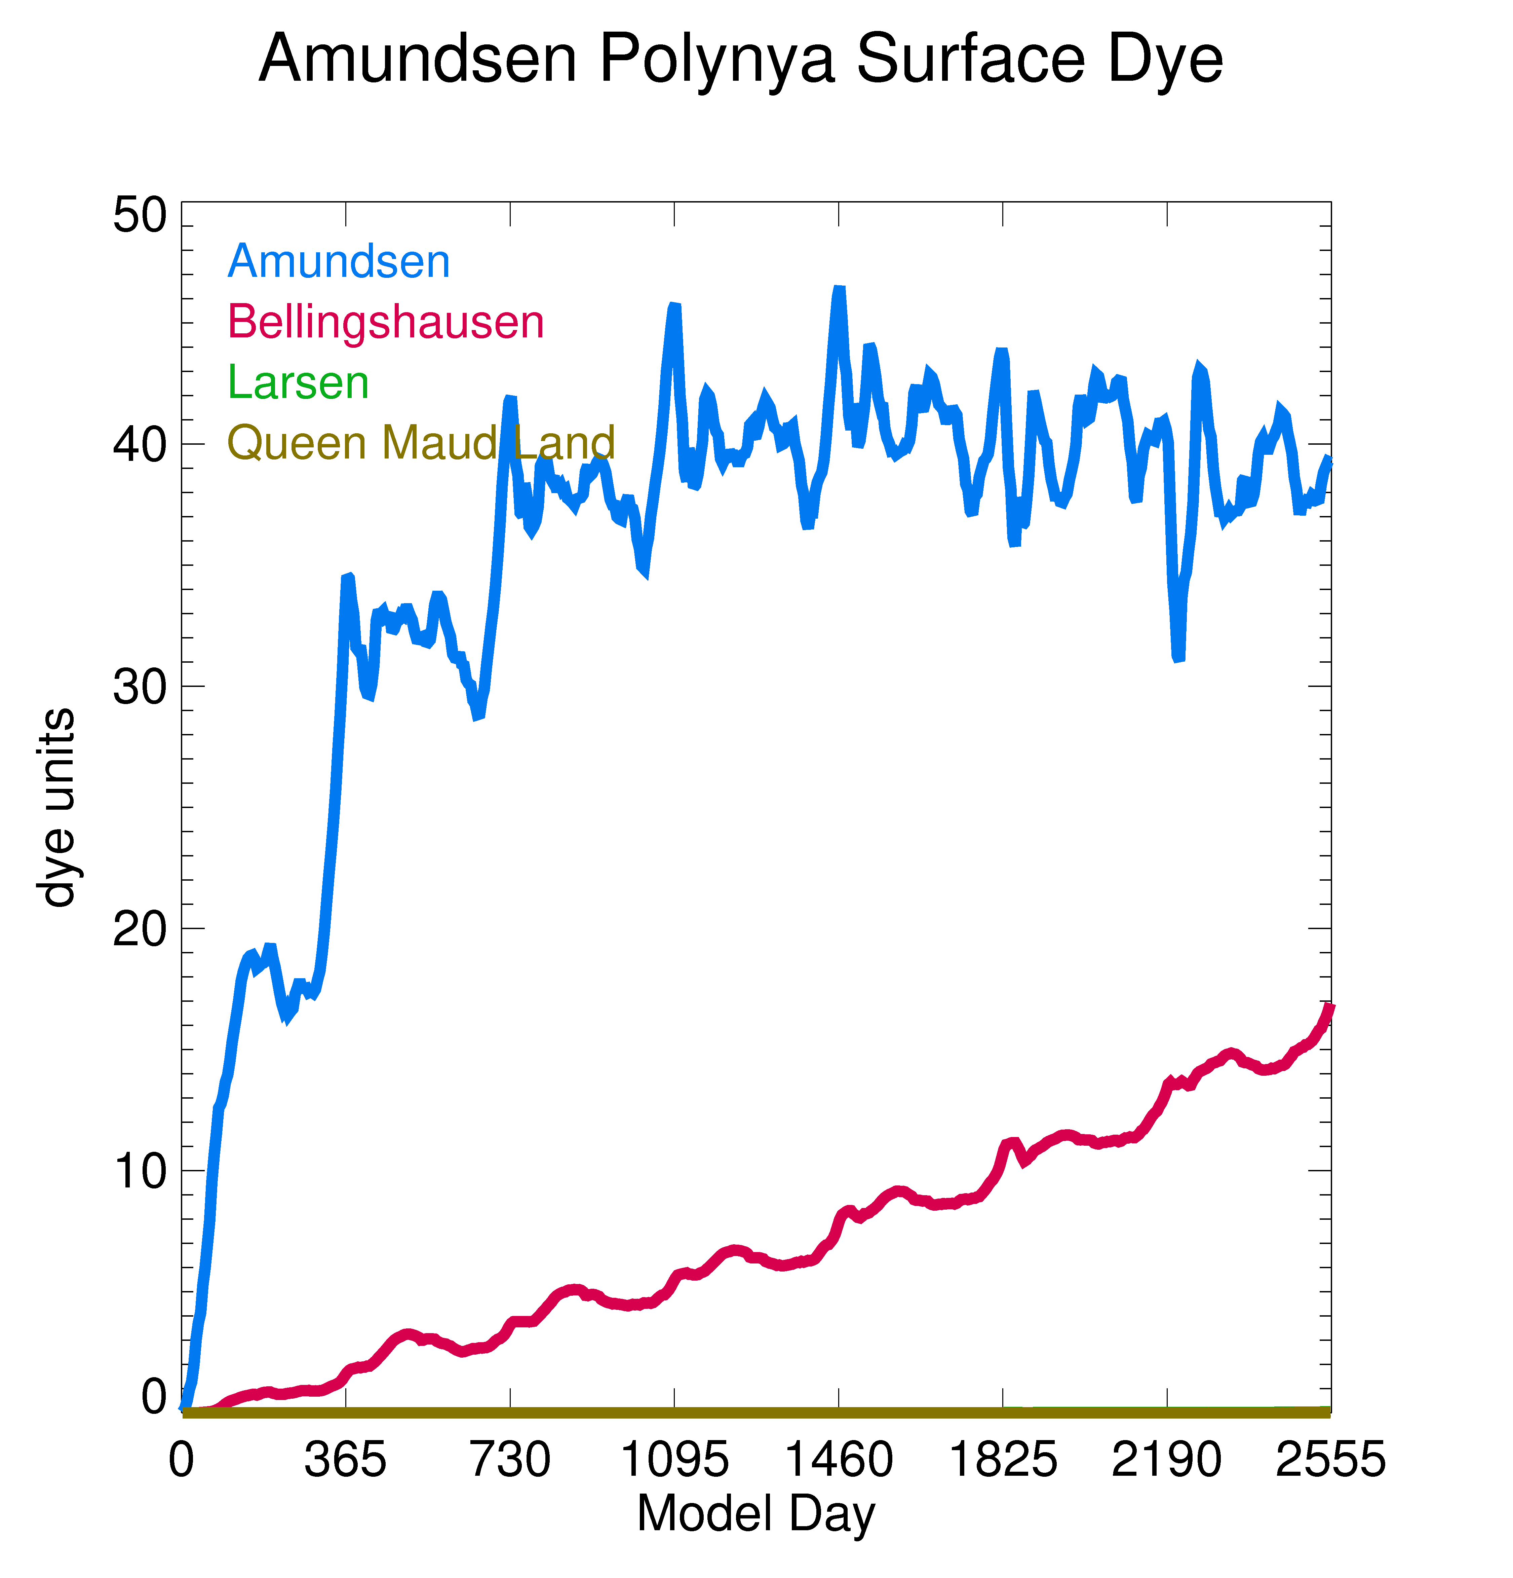
Amundsen Polynya: ~27% of the meltwater in the polynya is from non-local sources after seven years
Notes:
Amundsen is thought to be the productive coastal polynya (per unit area).

Slide 21
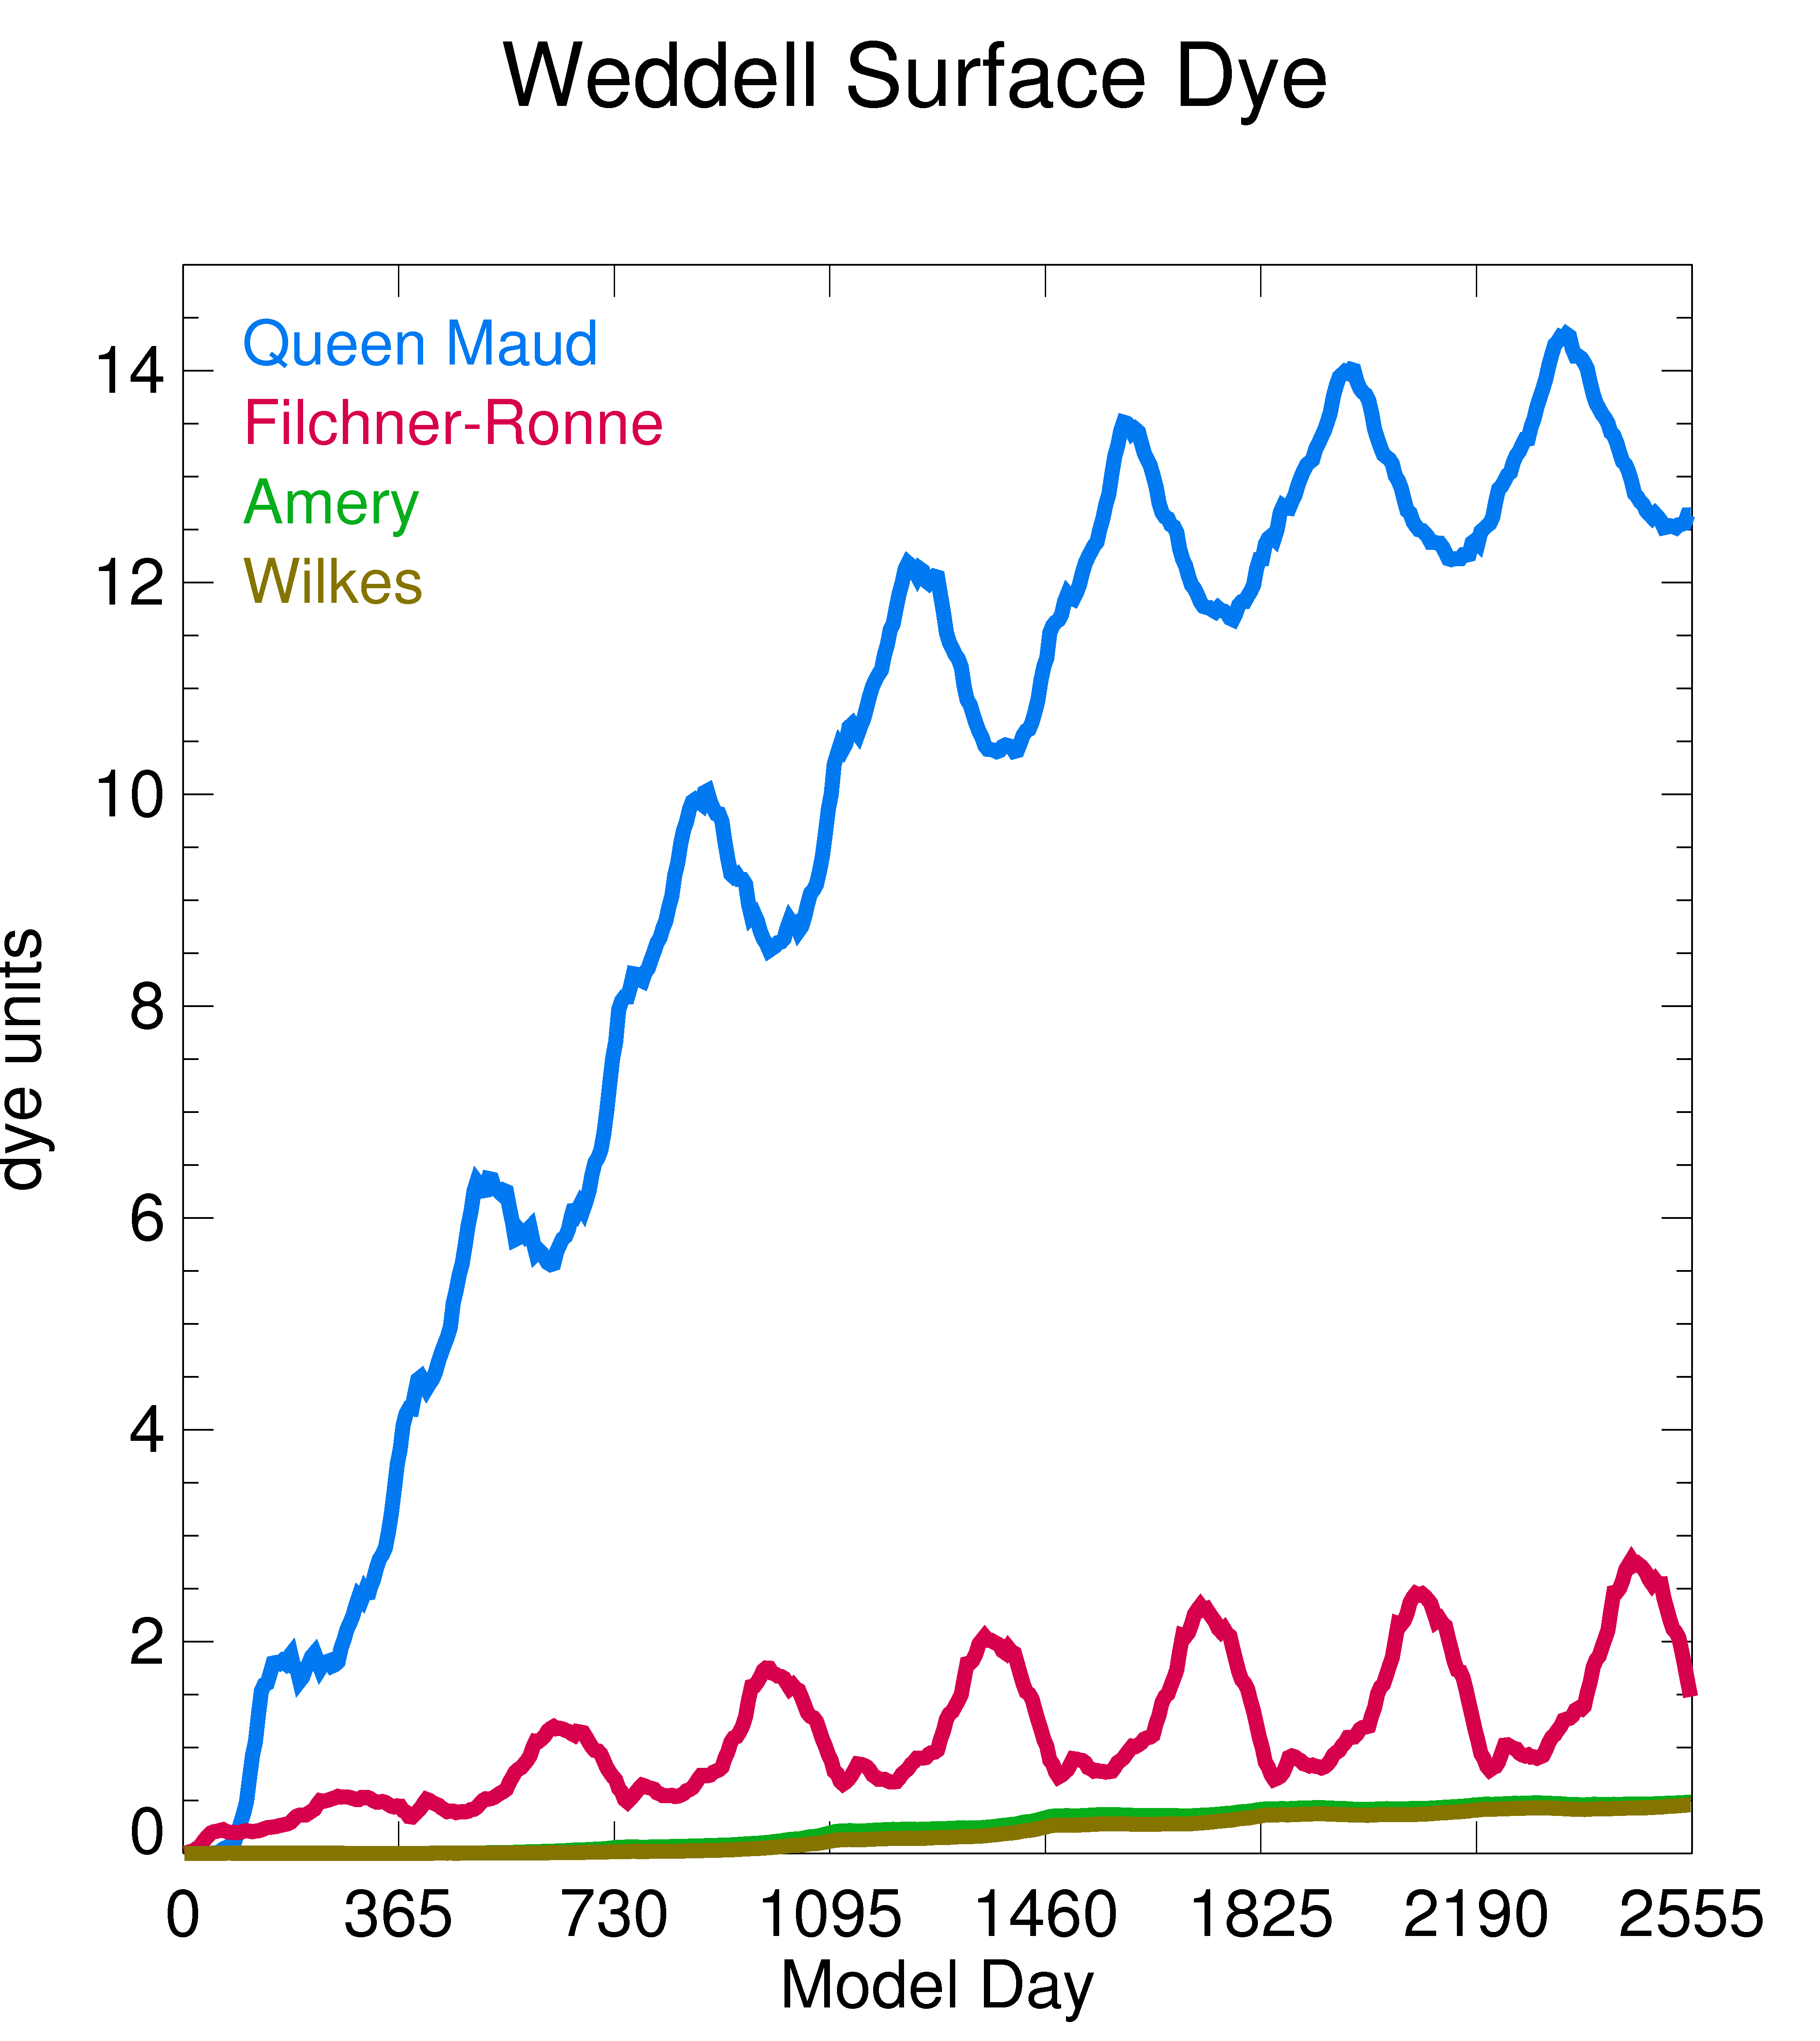
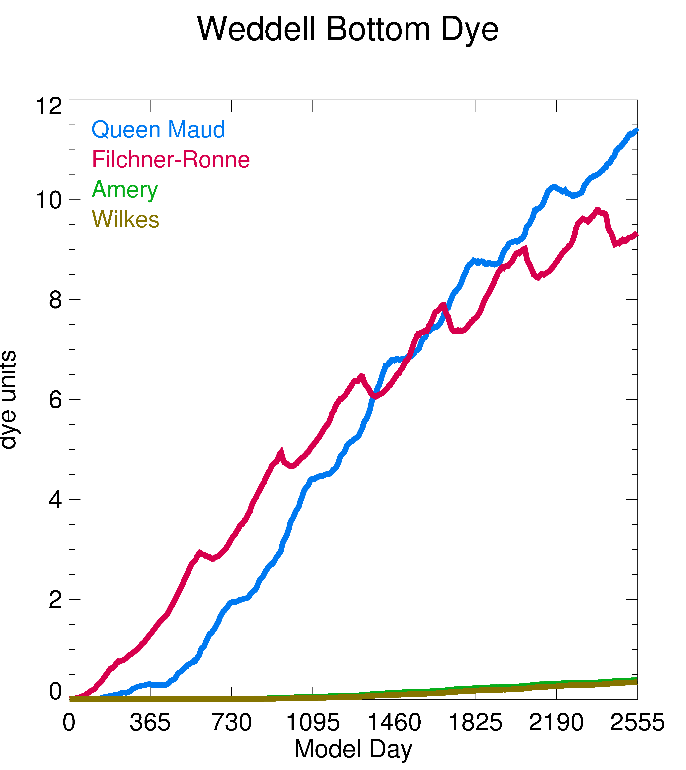
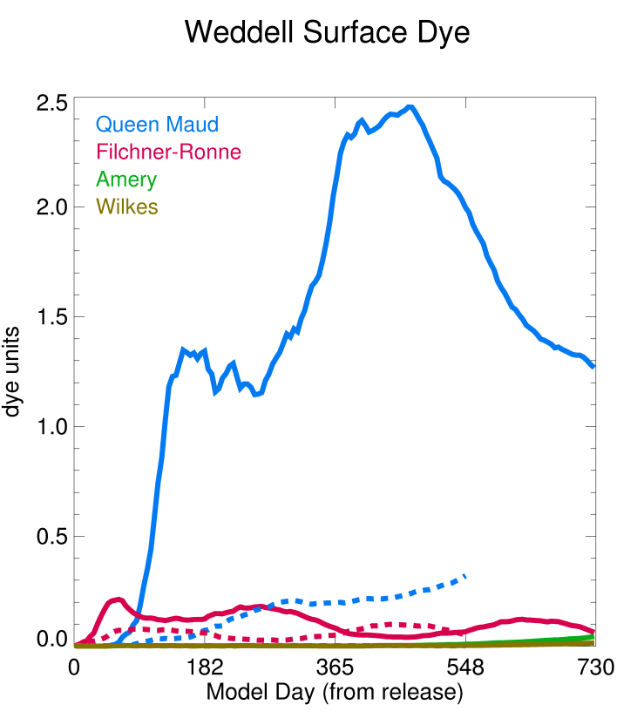
Weddell Sea continental shelf: meltwater from Queen Maud sector is a much larger contributor than local Filchner-Ronne at the surface
However, note that the Queen Maud summer contribution is much larger than winter: much of the QM melt dFe may be stripped out by summer production enroute and thus might not be a significant source of dFe to polynyas on the Weddell shelf
Solid line: summer release
Dashed line: winter release
Notes:
Mention: top four sources, note changes in y-axis. Filchner-Ronne MW gets mixed into the bottom, QM MW comes in more at the surface. Takes well over a year for full effect.

Slide 22
Conclusions
Resolution of the ocean model is critical in delivering ocean heat to the base of the floating ice shelves
Meltwater tracking simulations support the idea that the observed freshening of AABW formed in the Ross Sea could be due to increased melt of the Amundsen ice shelves
Much of the meltwater over certain areas of the Antarctic continental shelf is from non-local sources which will need to be accounted for in trying to figure out the impact of ice shelf melt on phytoplankton nutrient supply (and the timing will be important)

Slide 23
Acknowledgements
Thanks to all the ROMS developers over the years and to everyone who supplied the different computer codes and data bases (ocean and ice shelf bathymetry, atmospheric forcing, ocean conditions) needed
Computer facilities and support provided by the Center for Coastal Physical Oceanography and the High Performance Computing group at Old Dominion University
Financial support from the U.S. National Science Foundation (ANT-0944174 and ANT-1049089)

Slide 25
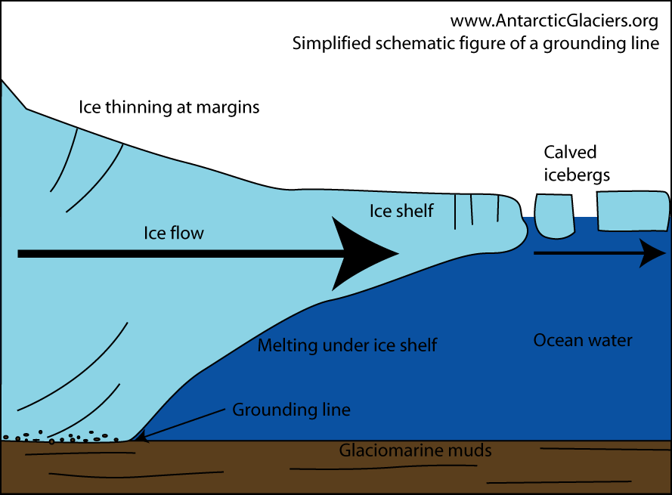

Slide 26
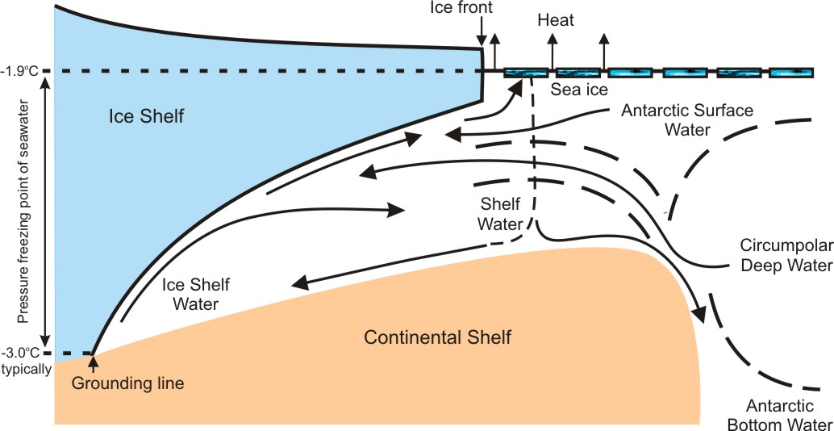
Ice shelf basal melting modes
Mode 1: Melt due to cold (-1.9°C) salty SW formed by sea ice creation
Mode 2: Melt due to warm (> 0 °C ) CDW transport onto shelf
Mode 3: Melt due to seasonally warmed surface water
All three modes controlled (at least somewhat) by interaction between winds and sea ice!
(schematic courtesy: A. Jenkins, BAS)
Notes:
Mode 1: winter-time coastal polynyas. Mode 3: summer-time coastal polynyas.

Slide 27
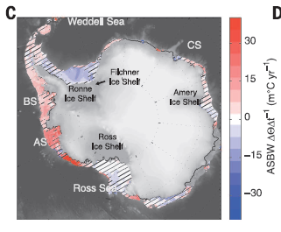
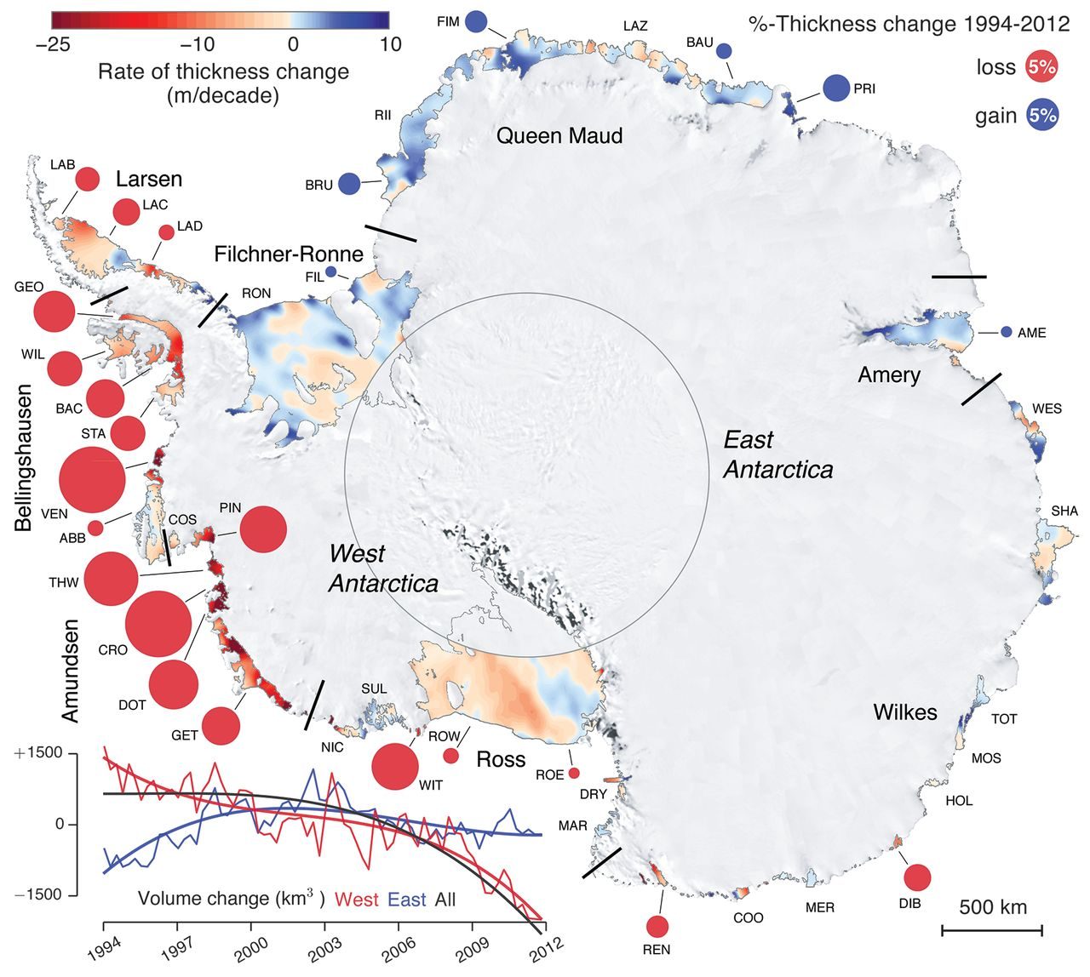
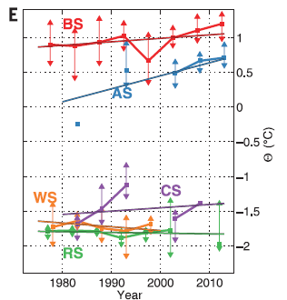
Schmidtko et al., 2014
Paolo et al., 2015
Ice shelf volume loss now thought to be increasing (at least 2012-2003 vs. 2003-1994) and this could be related to increasing ocean temperatures over the Antarctic continental shelves

Slide 28
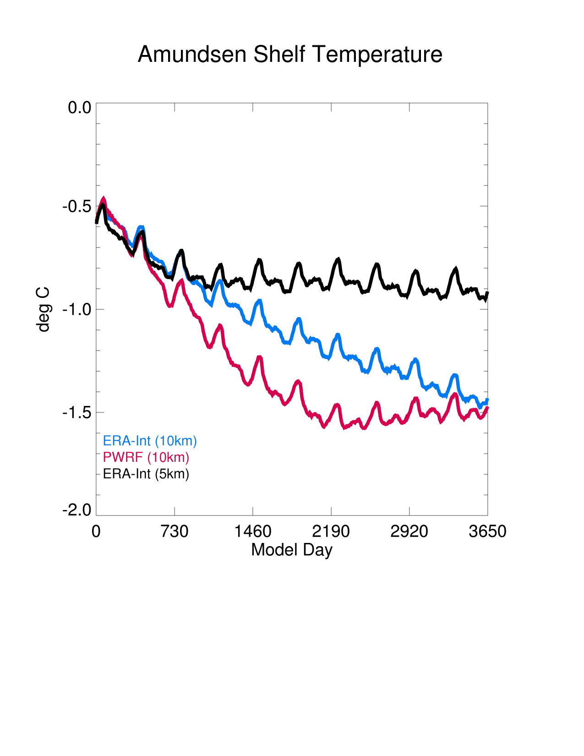
Cold Amundsen shelf is a common problem in models with 10-20km shelf resolution
Average temperature over the entire Amundsen shelf is much too cold in our 10km model
Stronger near shore winds remove heat more rapidly but reach a similar steady state
Higher ocean model resolution improves temperatures dramatically due to greater advection of heat onto the shelf (see also Nakayama et al., 2014)

Slide 29
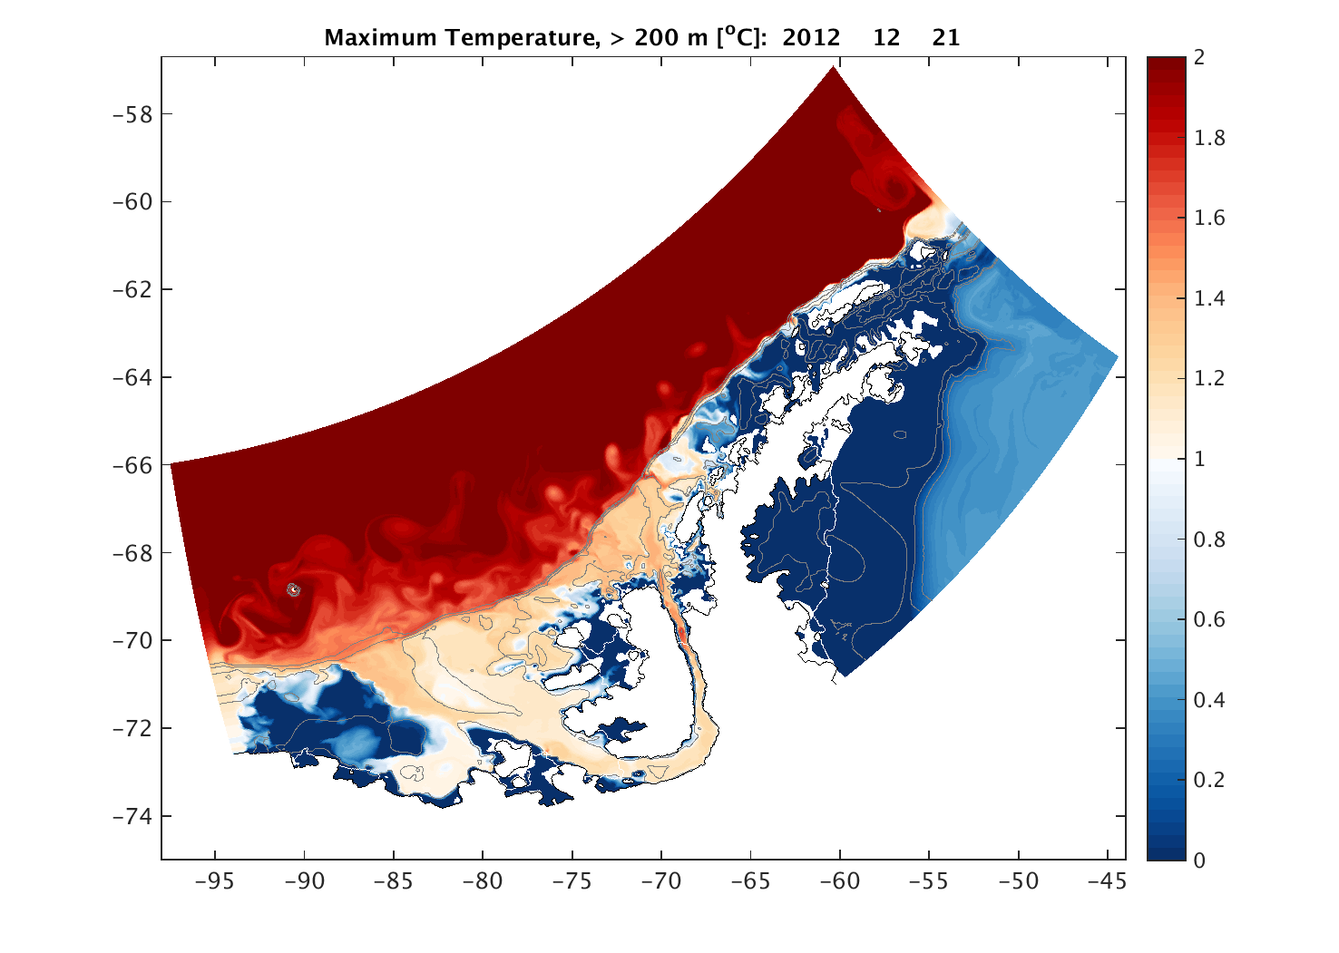
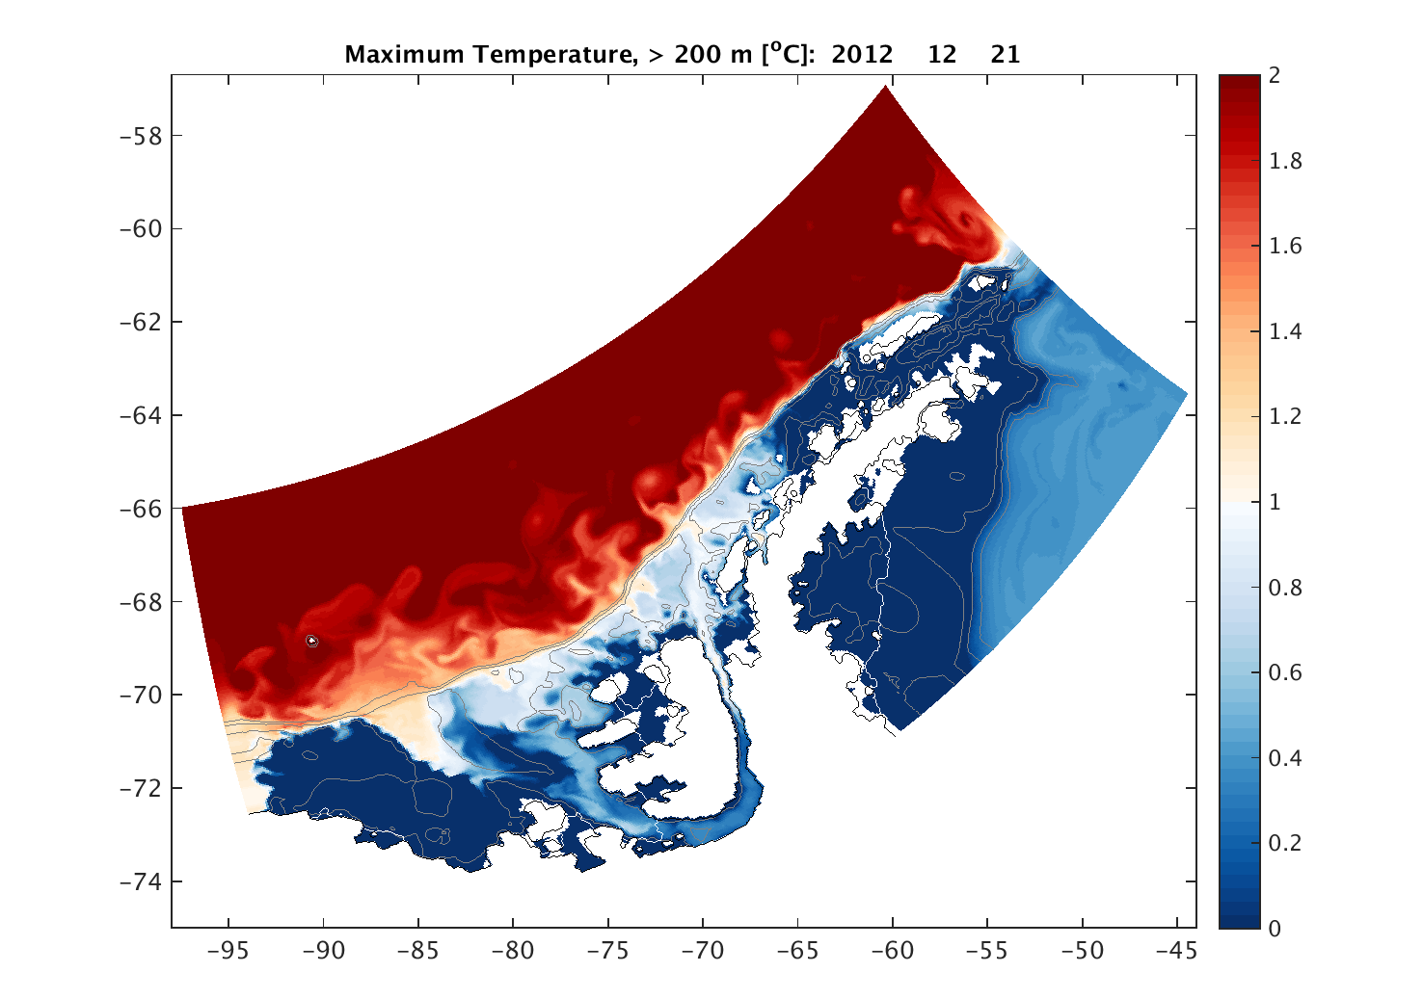
Shelf temperatures are much warmer for 1.5 km resolution (top) vs. 4.0 km resolution (bottom) model of the Bellingshausen Sea, indicating stronger CDW transport along the length of the shelf
(Jenny Graham, et al., JGR, in press)

Slide 30
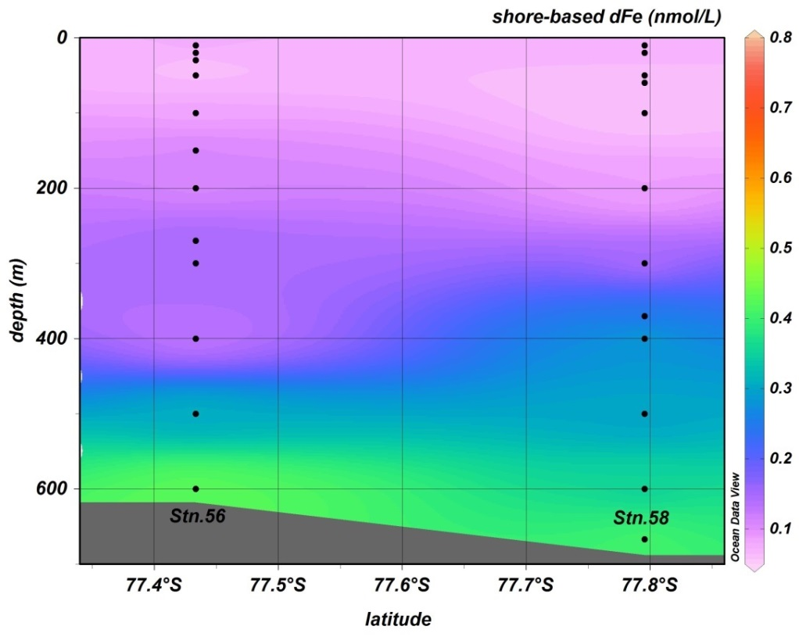
Iron in a transect approaching Dotson (on left) Ice Shelf
(Sherrell et al., 2015)
Abundant melt water (Dotson basal melt: 7-8 m/yr)
Iron in a transect approaching Ross (on right) Ice Shelf (courtesy Pete Sedwick and the PRISM project):
Little melt water (RIS basal melt: 0.02-0.20 m/yr)
(Note: Iron source in meltwater may be other than directly injected from ice shelt melt (e.g. subglacial melt drainage, entrainment of benthic sources into meltwater plume via “ice pump” mechanism))

Slide 31
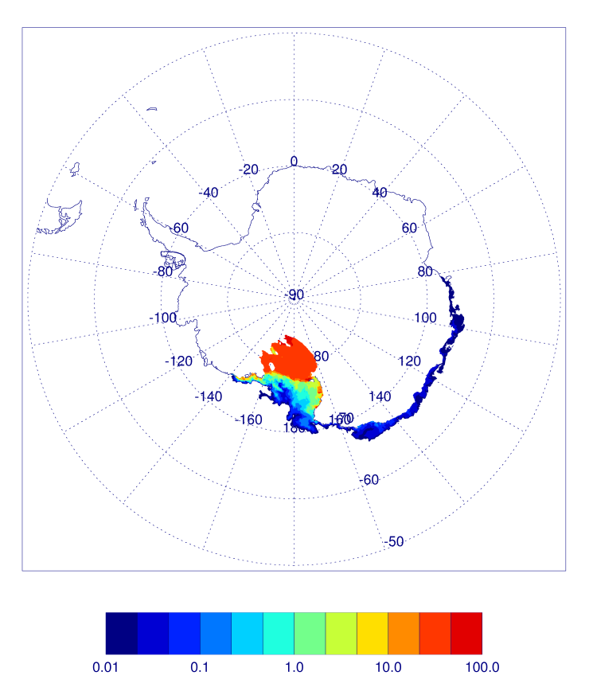
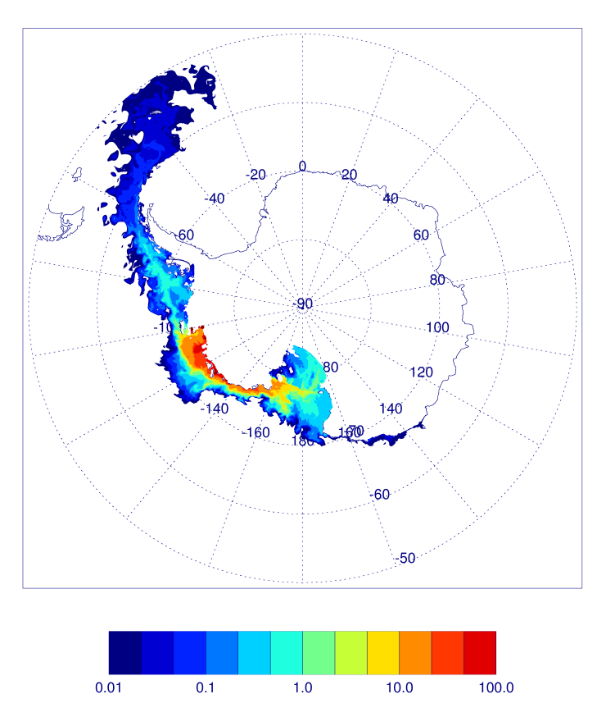
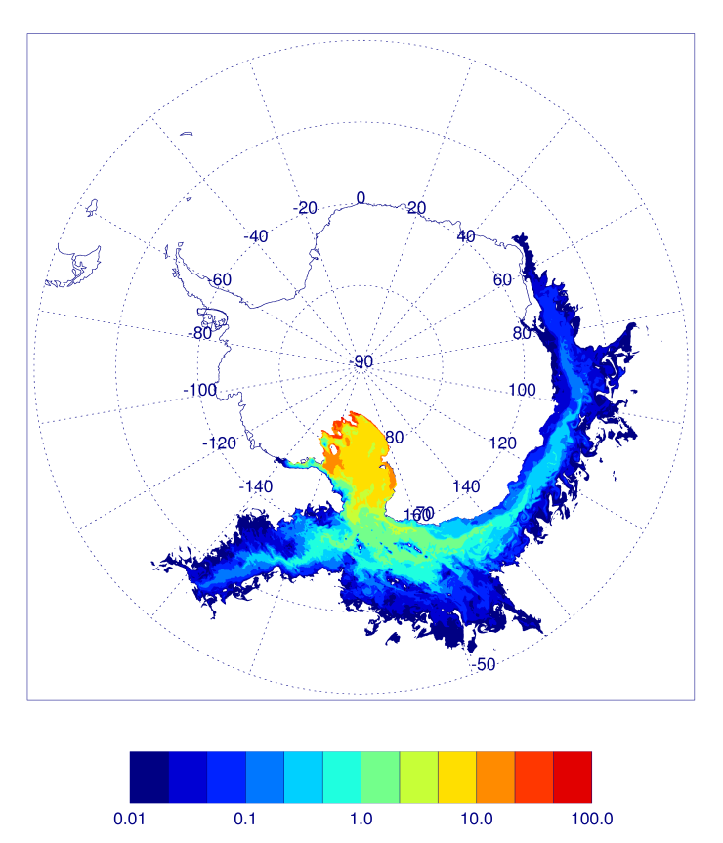
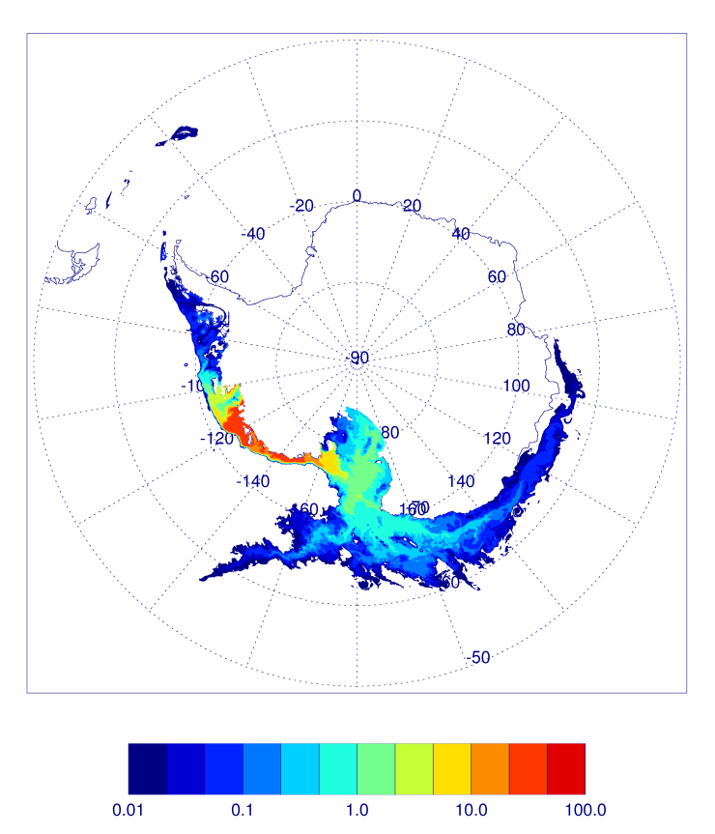
Ice shelf melt water tracers at surface (top) and bottom model layers (bottom) for the Ross (left) and Amundsen (right) sectors after four years

Slide 32
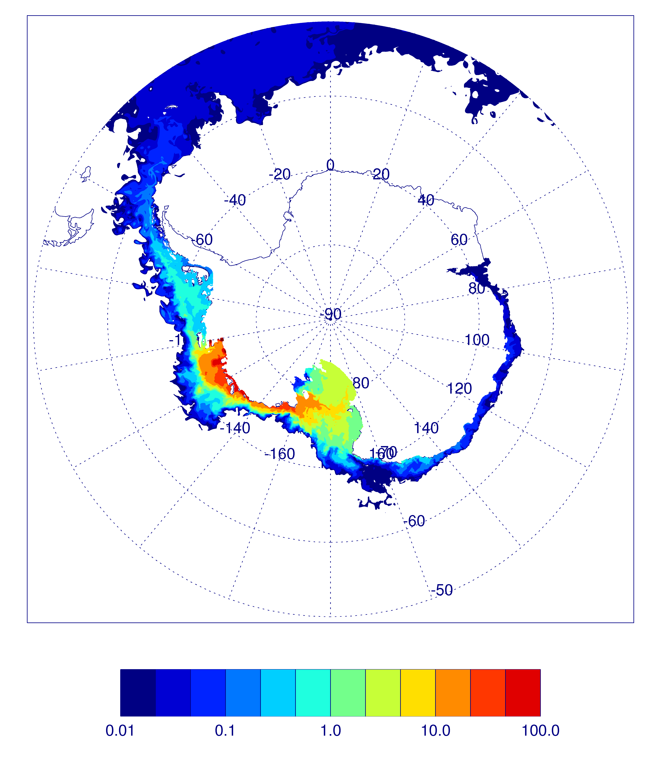
Ice shelf melt water tracers at surface (top) and bottom model layers (bottom) for the Ross (left) and Amundsen (right) sectors after seven years

Slide 33
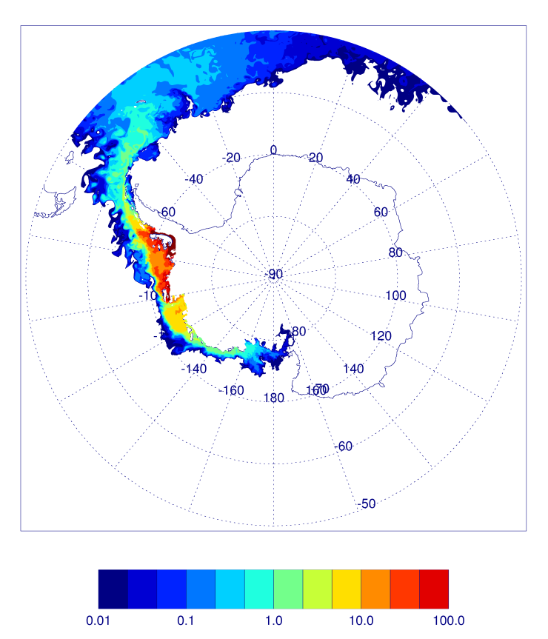



Ice shelf melt water tracers at surface (top) and bottom model layers (bottom) for the Bellingshausen (left) and Larsen (right) sectors after four years

Slide 34


Ice shelf melt water tracers at surface (top) and bottom model layers (bottom) for the Bellingshausen (left) and Larsen (right) sectors after seven years
Notes:
Seven years

Slide 35




Ice shelf melt water tracers at surface (top) and bottom model layers (bottom) for the Filchner-Ronne (left) and Queen Maud (right) sectors after four years

Slide 36




Ice shelf melt water tracers at surface (top) and bottom model layers (bottom) for the Filchner-Ronne (left) and Queen Maud (right) sectors after seven years

Slide 37




Ice shelf melt water tracers at surface (top) and bottom model layers (bottom) for the Amery (left) and Wilkes (right) sectors after four years

Slide 38




Ice shelf melt water tracers at surface (top) and bottom model layers (bottom) for the Amery (left) and Wilkes (right) sectors after seven years

