Slide 1
Velocity and sea level wavenumber spectra in the coastal ocean: Observations from moorings and HF-radar compared with nested high-resolution model
John Wilkin Eli Hunter, Julia Levin, Hernan Arango
Marine and Coastal Sciences Rutgers, The State University of New Jersey
jwilkin@rutgers.edu
http://marine.rutgers.edu/wilkin
ROMS User Workshop, Hobart, Australia 17-20 October 2016

Slide 2
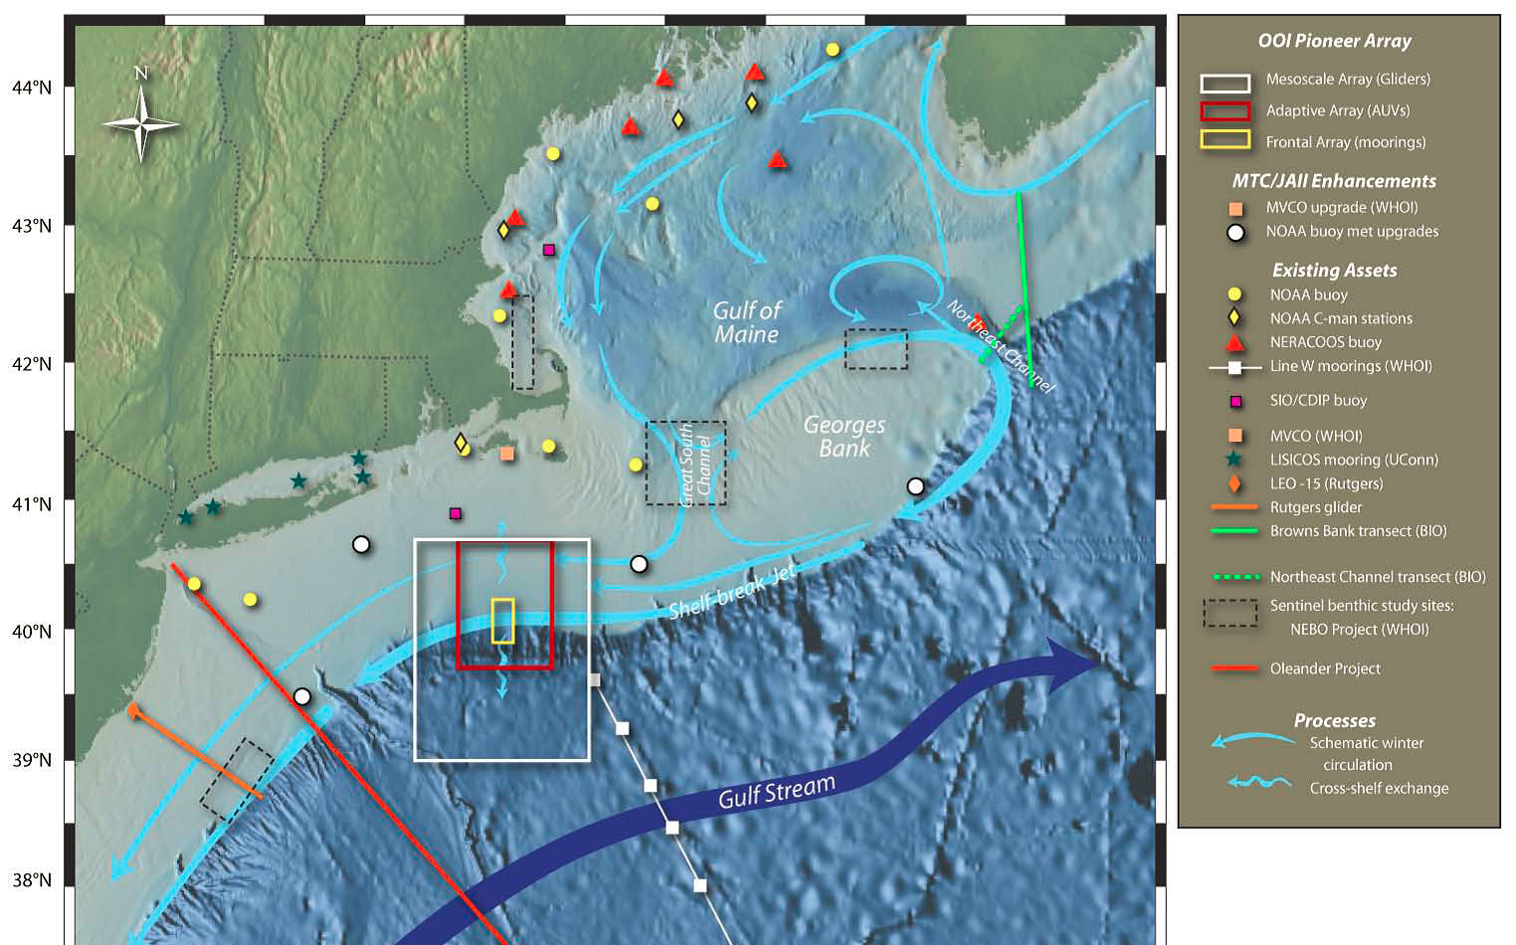
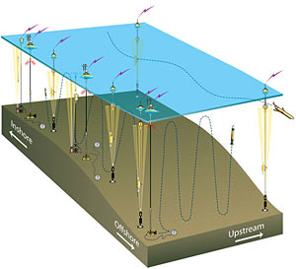
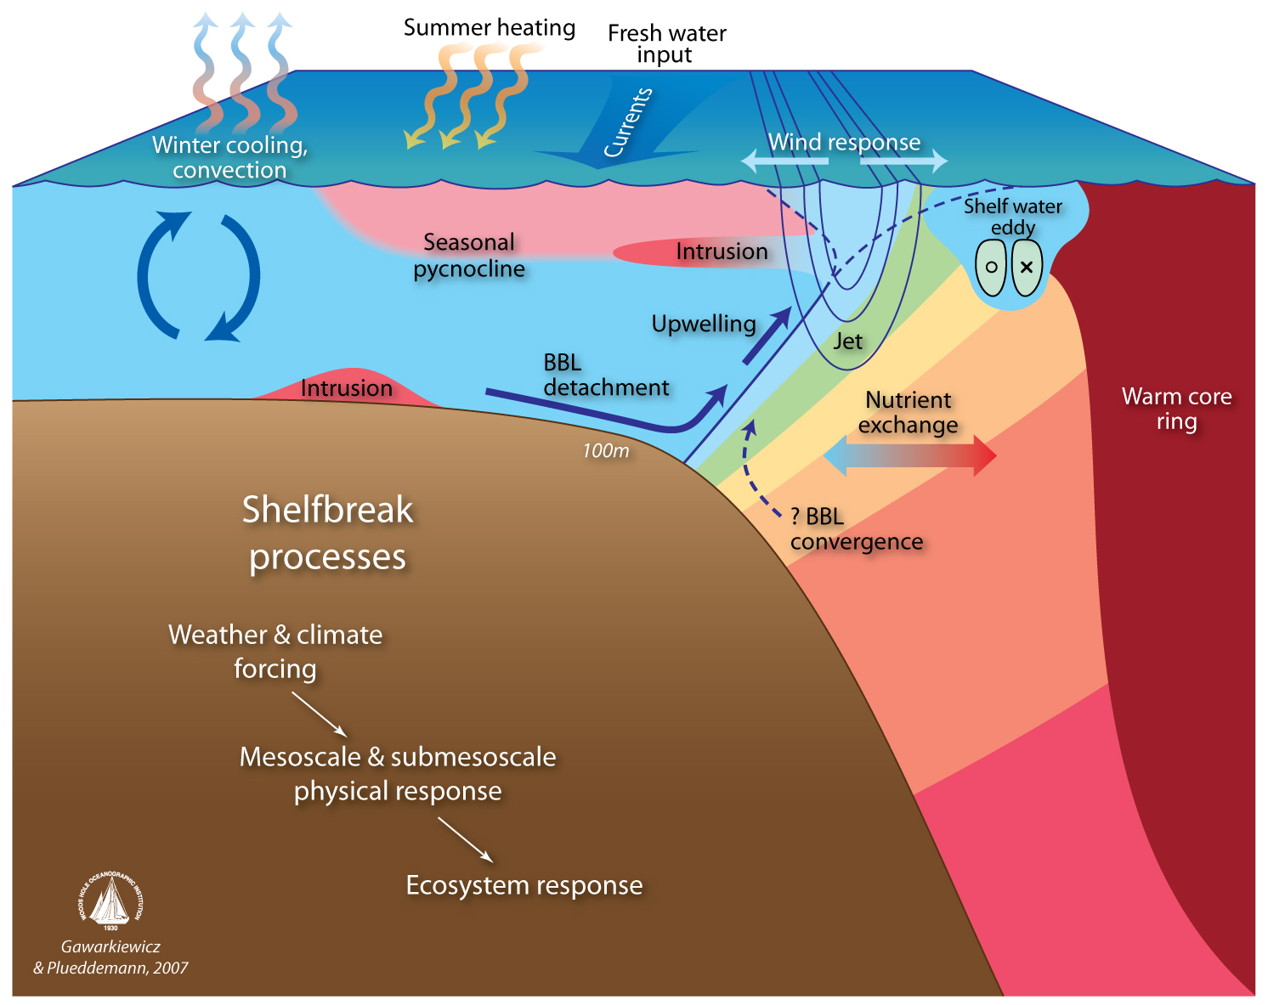
NSF Ocean Observatories Initiative Pioneer Array
OOI Pioneer Array focuses on shelf-sea/deep-ocean exchange at the shelf-break front

Slide 3
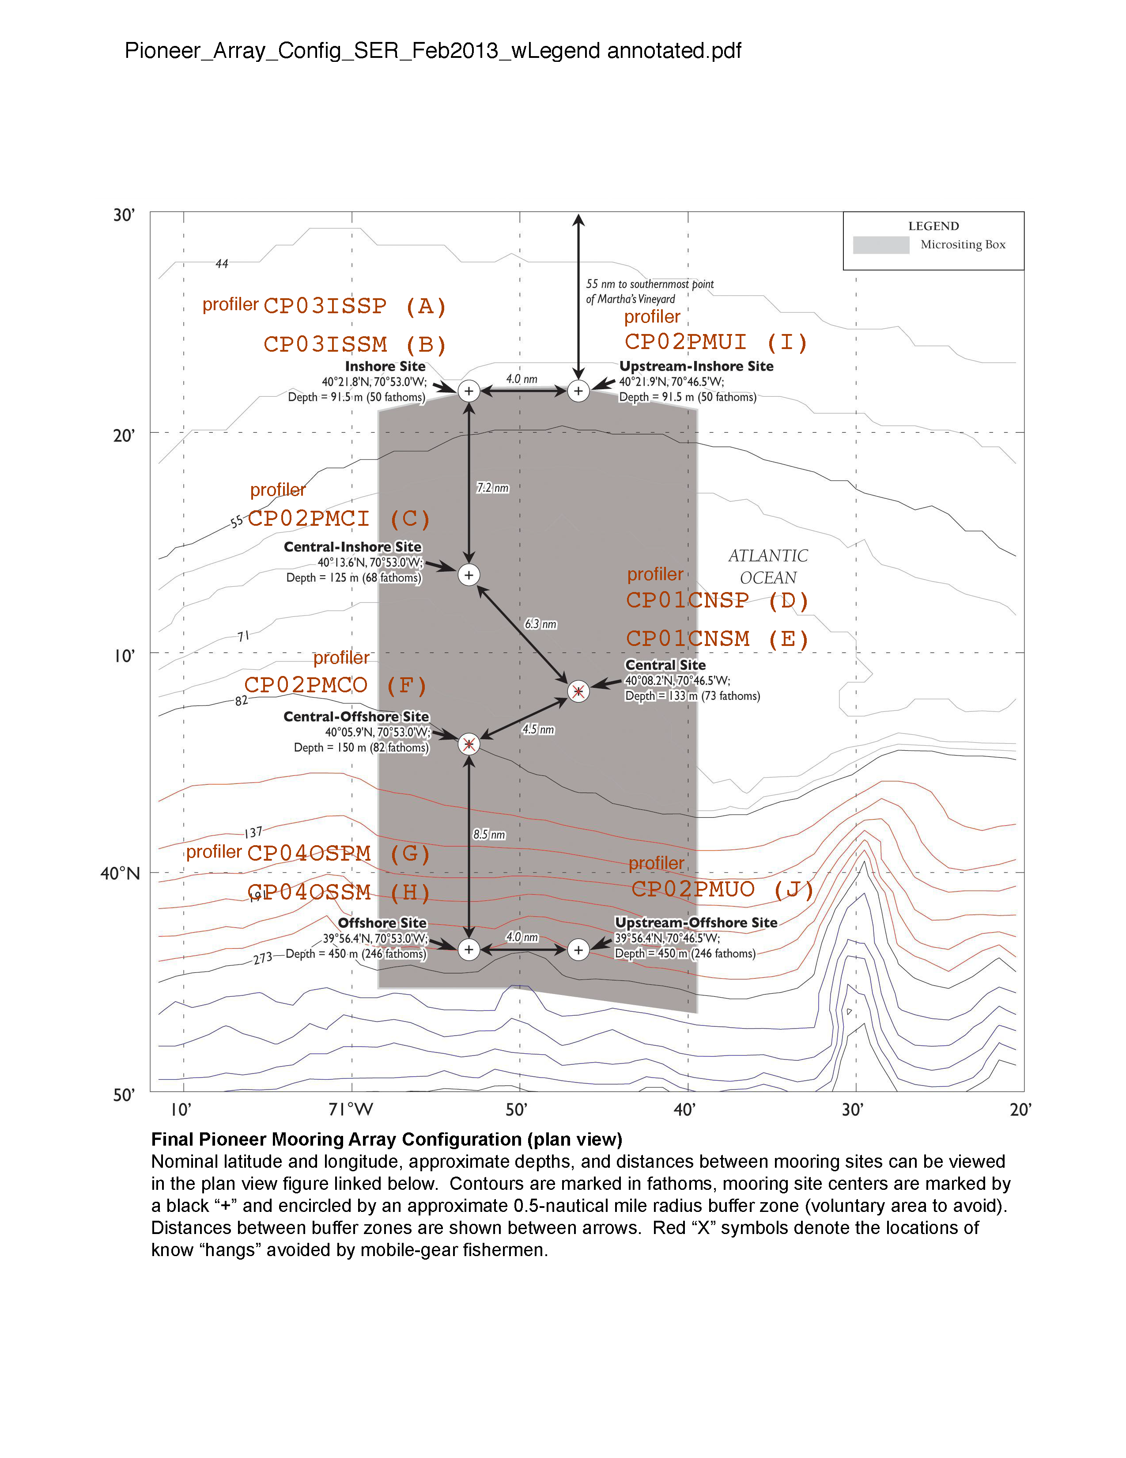
NSF Ocean Observatories Initiative Pioneer Array
Final Pioneer Array mooring configuration

Slide 4
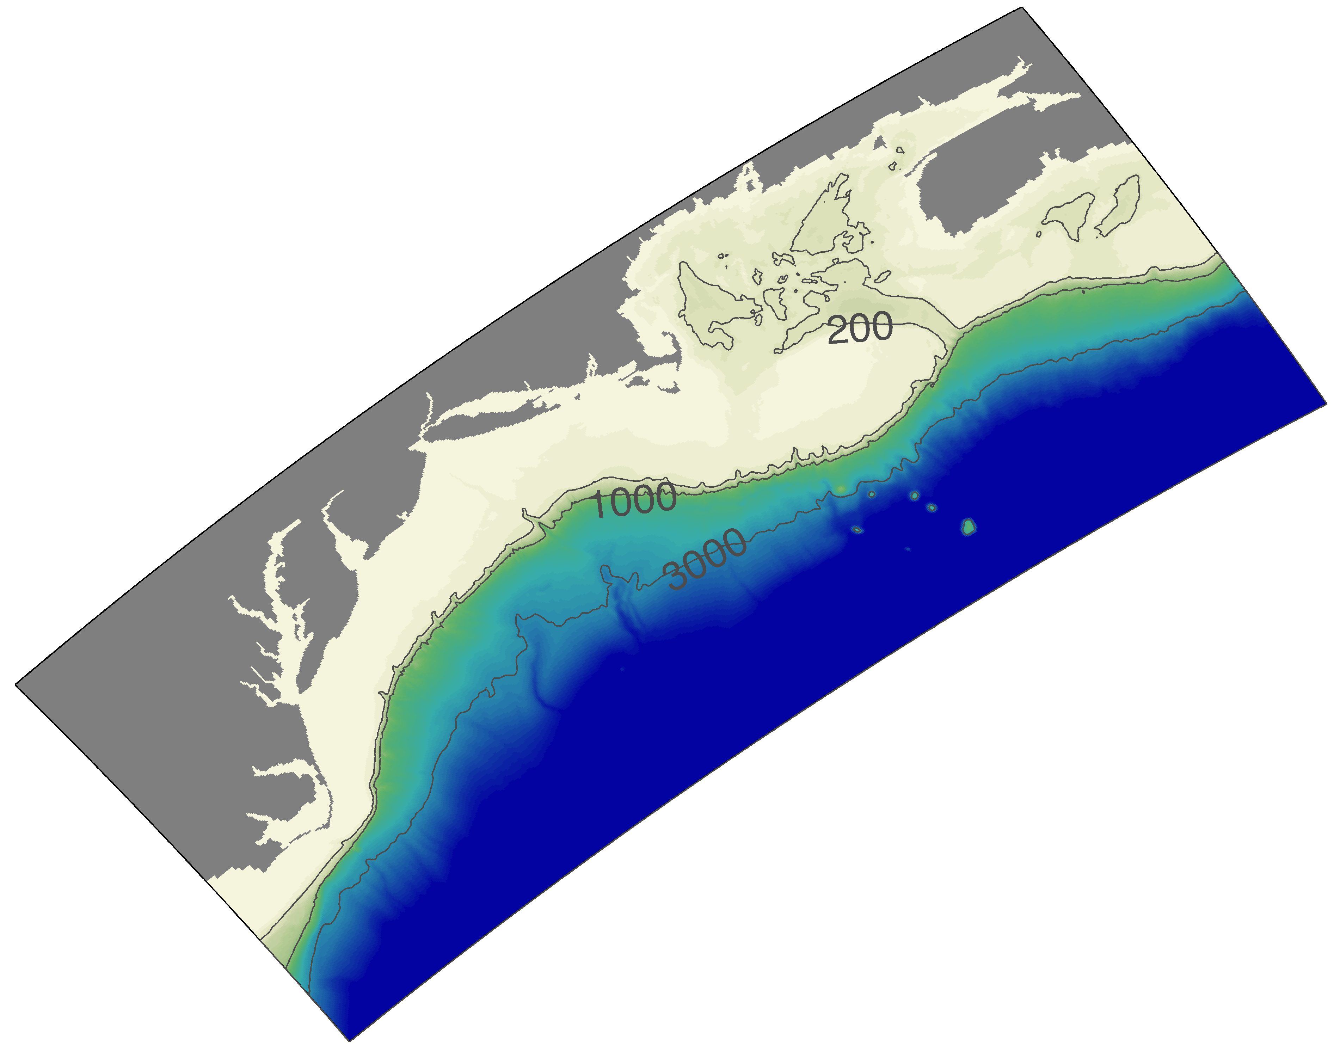
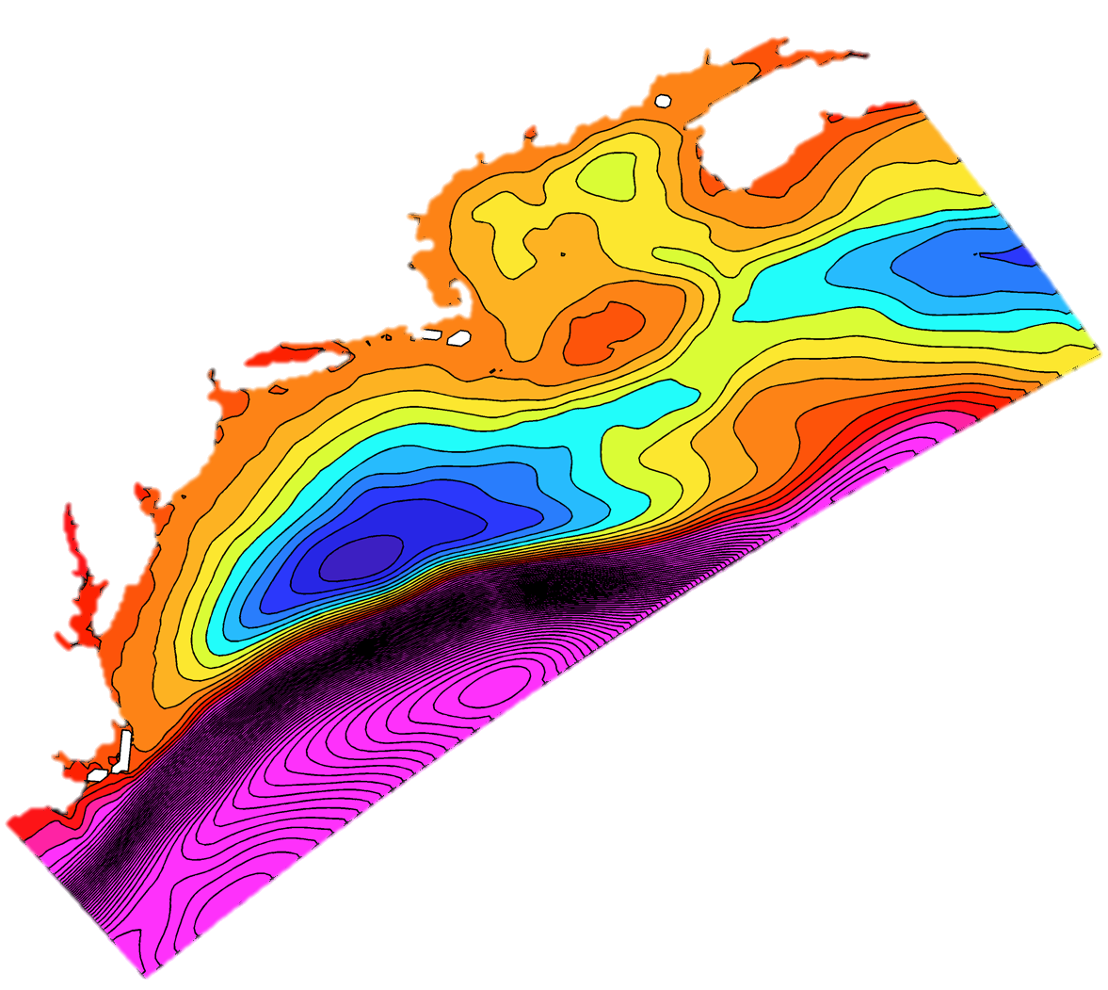
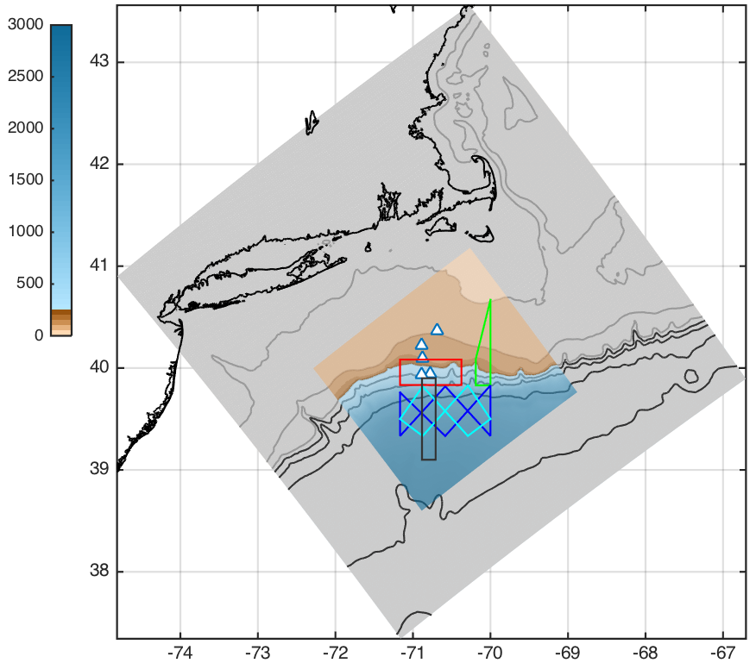
Doppio – Pioneer – Array
3-level 2-way nested grids
Resolutions:
7 km Doppio (242 x 106 x 40)
2.3 km Pioneer (722 x 314 x 40)
700 m Array (252 x 276 x 40)
Forcings:
NCEP NARR & NAM atmospheric forcings
USGS and WSC river gauge discharges
OTPS harmonic tidal forcing at open boundaries
Open Boundary Data from Mercator-ocean daily average with bias correction to annual mean; mesoscale variability is retained. Corrections based on T & S regional climatology and Mean Dynamic Topography and velocity from 4DVAR climatological analysis on Doppio grid.
Mean
Dynamic Topography

Slide 5
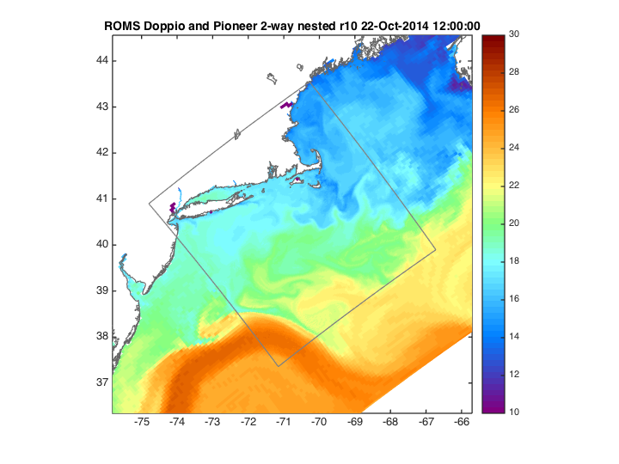

Slide 6
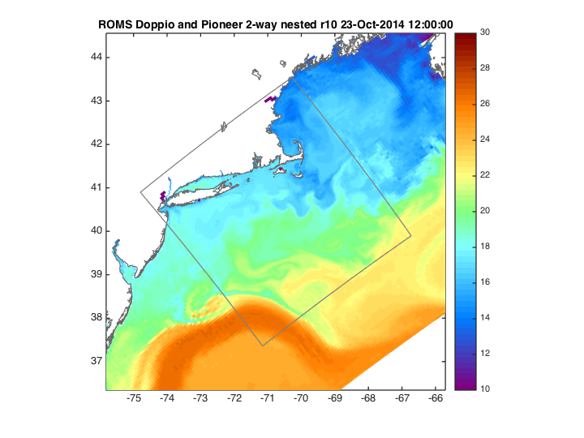

Slide 7
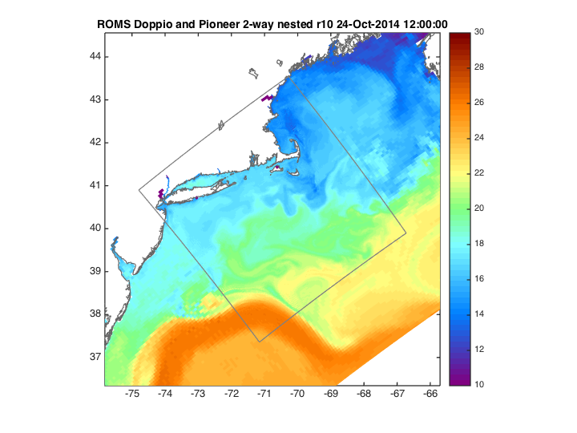

Slide 8
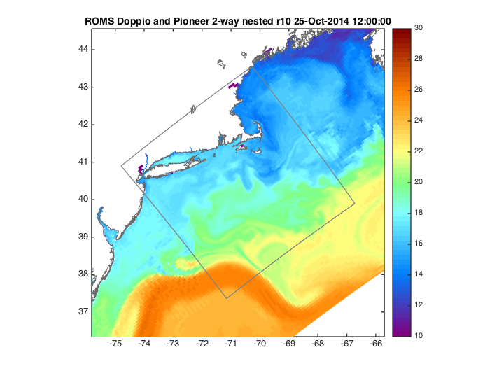

Slide 9
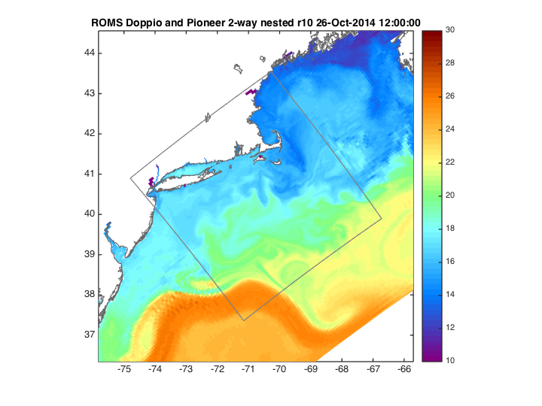

Slide 10
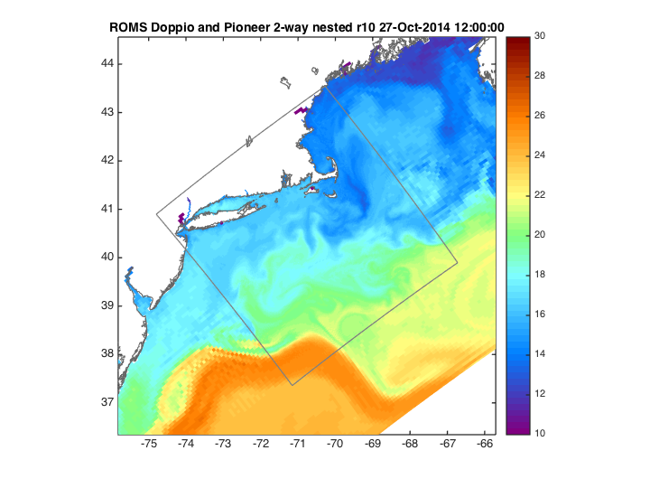

Slide 11
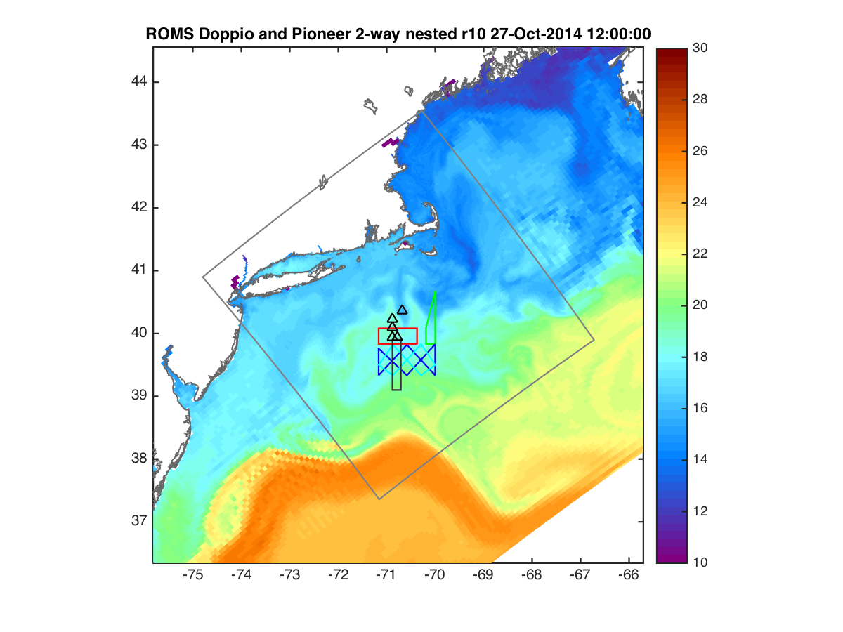

Slide 13
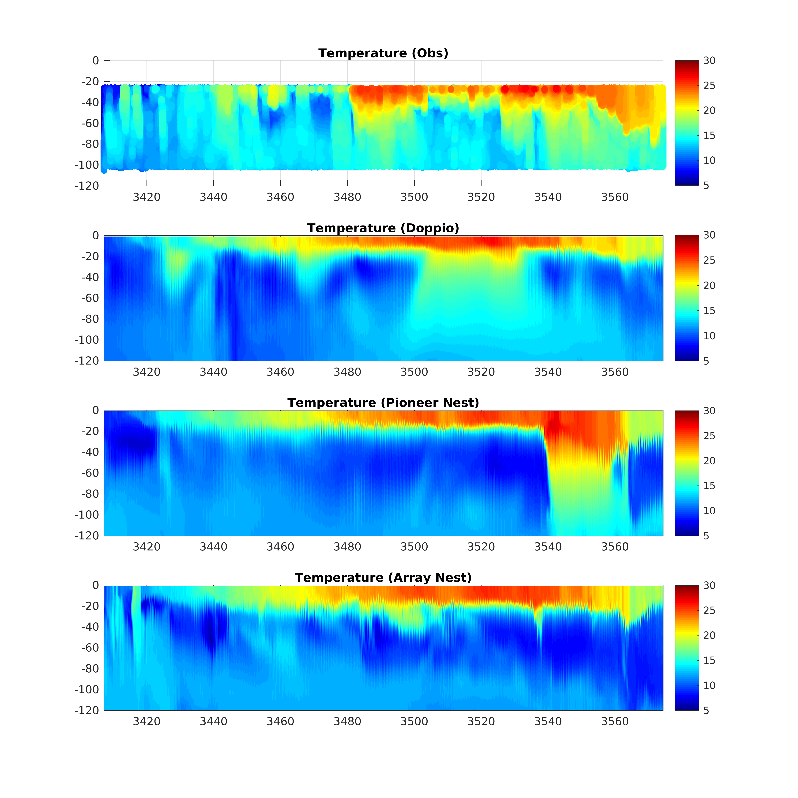
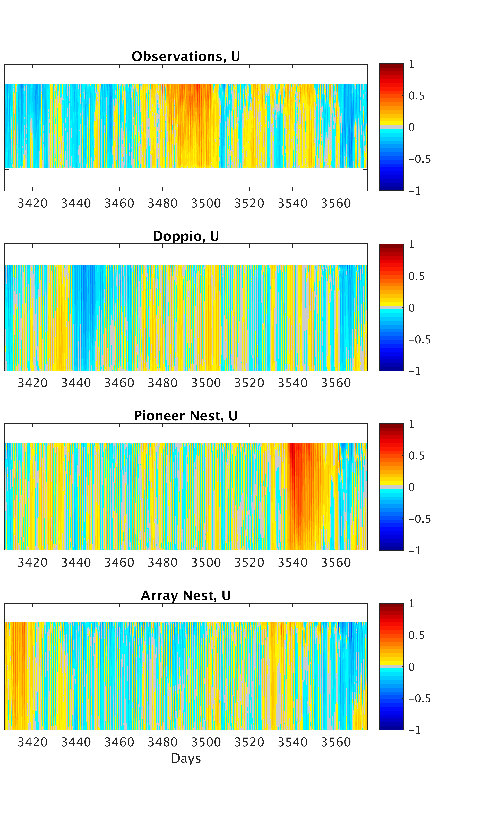
Notes:
Pioneer_obs_models_U_CP02PMCI_v2

Slide 14
Doppio – Pioneer – Array
3-level 2-way nested grids
Resolutions:
7 km Doppio (242 x 106 x 40)
2.3 km Pioneer (722 x 314 x 40)
700 m Array (252 x 276 x 40)
Forcings:
NCEP NARR & NAM atmospheric forcings
USGS and WSC river gauge discharges
OTPS harmonic tidal forcing at open boundaries
Open Boundary Data from Mercator-ocean daily average with bias correction to annual mean; mesoscale variability is retained. Corrections based on T & S regional climatology and Mean Dynamic Topography and velocity from 4DVAR climatological analysis on Doppio grid.
Data assimilated in Doppio reanalysis include:
SST: AVHRR, WSAT, TRMM, GOES, AMSR-E, AMSR-2
Currents from CODAR HF Radar
SSH anomaly from Jason-1/2, CryoSat, AltiKa
In-situ XBT and CTD data from ships, gliders, moorings, Argo floats
Mean
Dynamic Topography

Slide 15
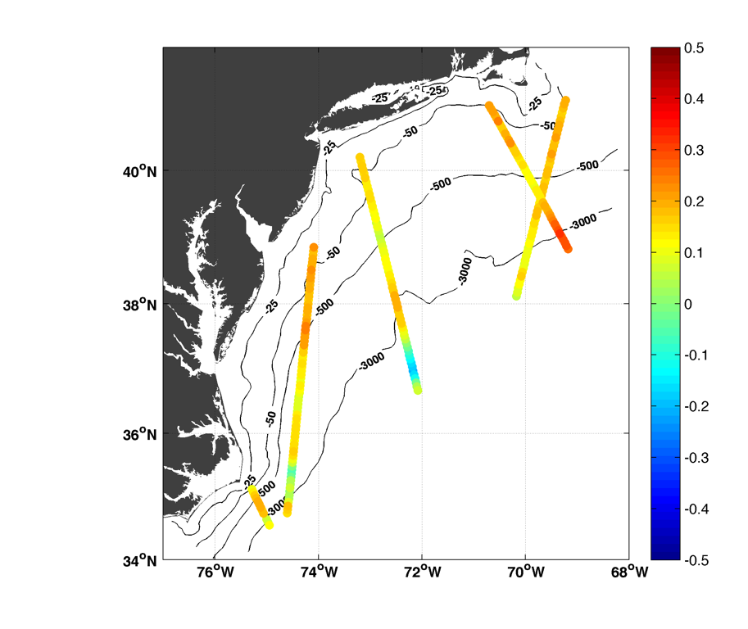
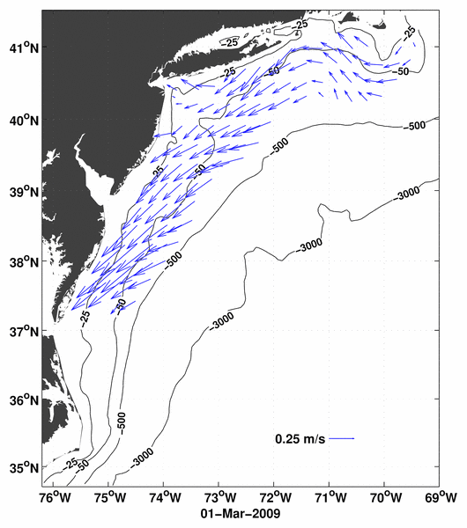
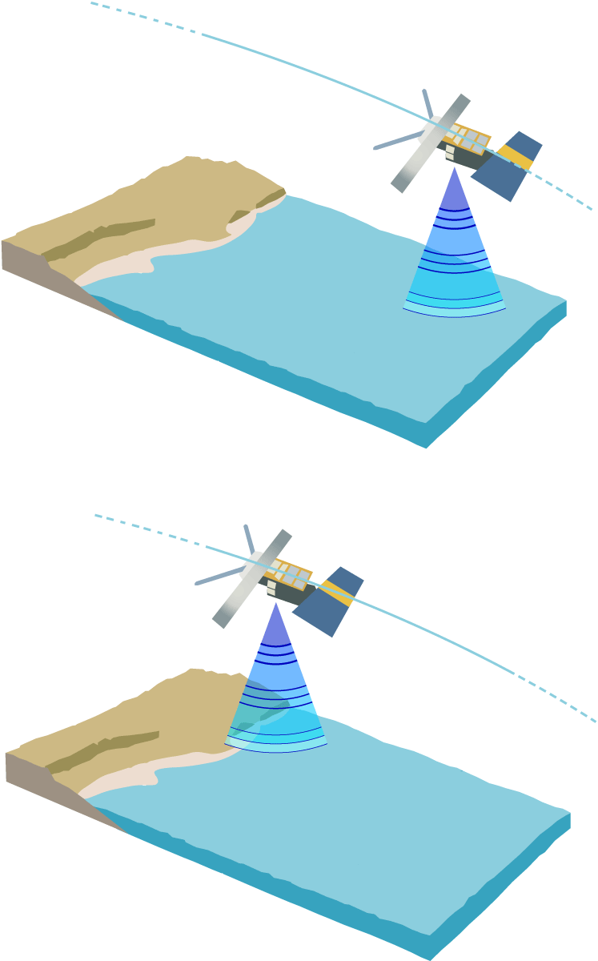
Jason
Oct 2
AltiKa
Oct 1
AltiKa
Oct 2
Jason
Oct 3
Cryosat
Oct 1
Example of CODAR data after quality control, binning and decimation to a set of independent observations.
Example of along-track altimeter sea level anomaly data during a single 3-day analysis window.

Slide 16
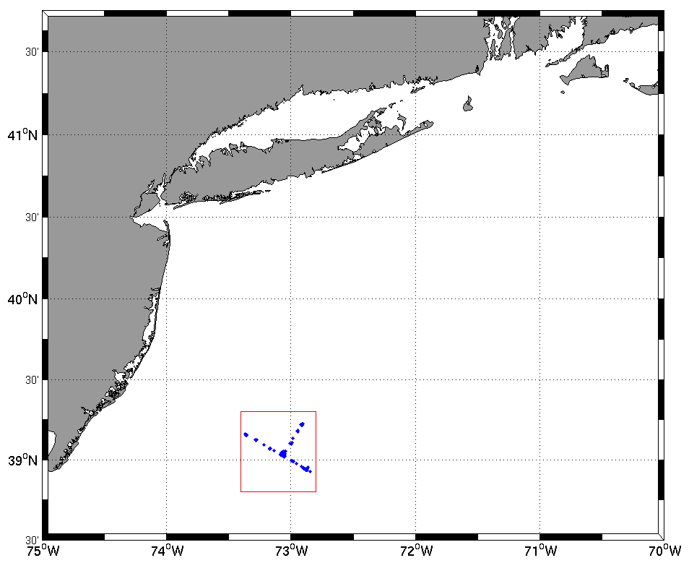
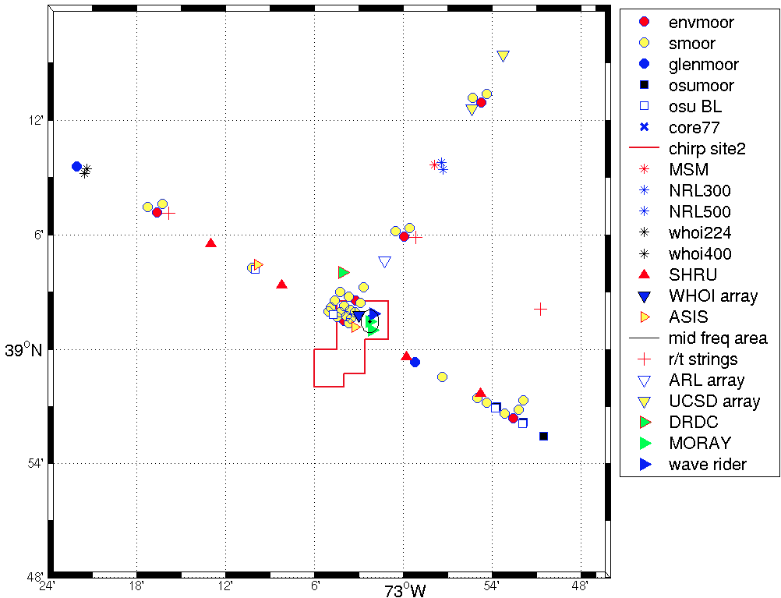
Sub-surface velocity analysis skill
Shallow Water 2006
SW06 mooring 32 N-S velocity
skill scores
R (corr. coeff.) BIAS (m s⁻¹)
CRMS (m s⁻¹)
Raw (hourly) Lowpass (33-hr cutoff)
SW06 mooring
Raw
ROMS model
Lowpass

Slide 17
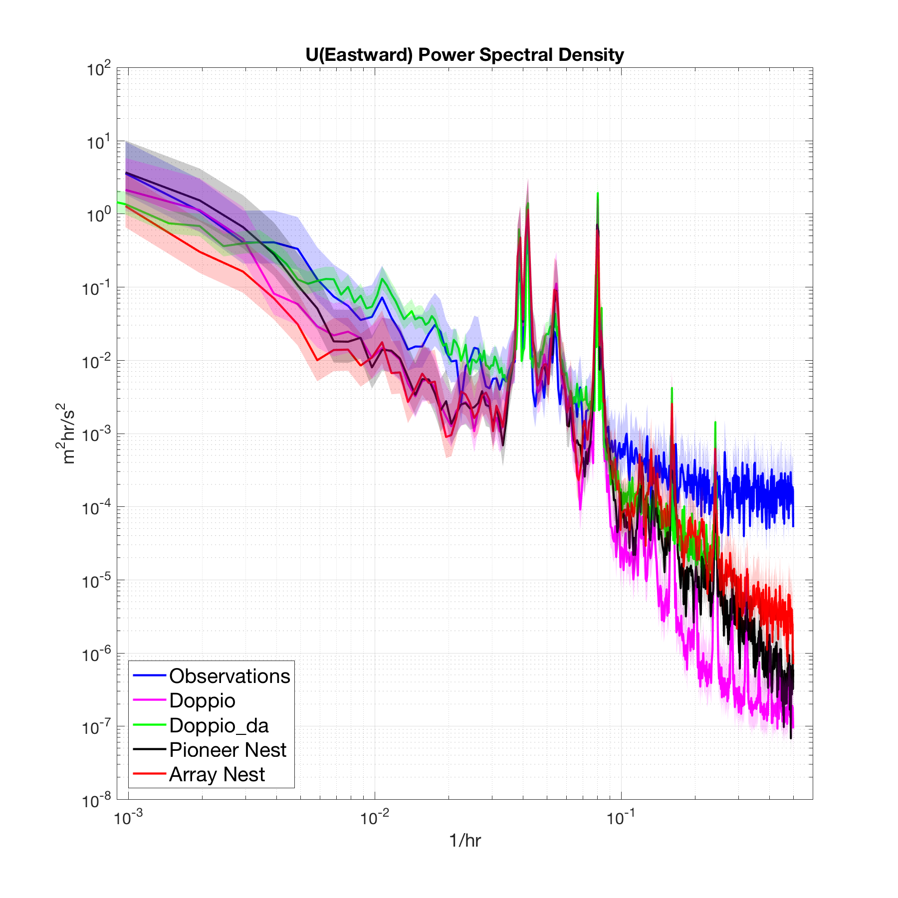
Power spectrum for along-shelf velocity at central inshore site:
3-level nested model
DA model
current-meter obs.
Notes:
Pioneer_obs_models_Uspectra_CP02PMCI_v4

Slide 18
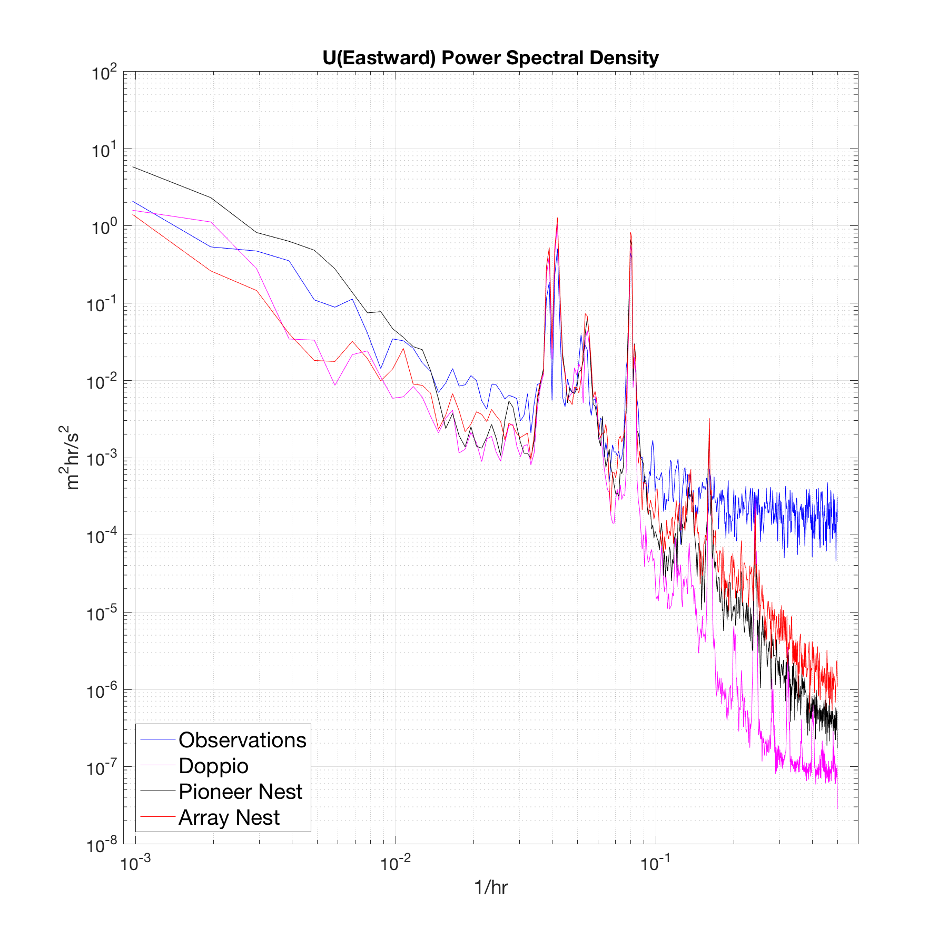
Power spectrum for along-shelf velocity at central site:
3-level nested model
current-meter obs.
Notes:
Pioneer_obs_models_Uspectra_CP01CNSM_v2

Slide 19
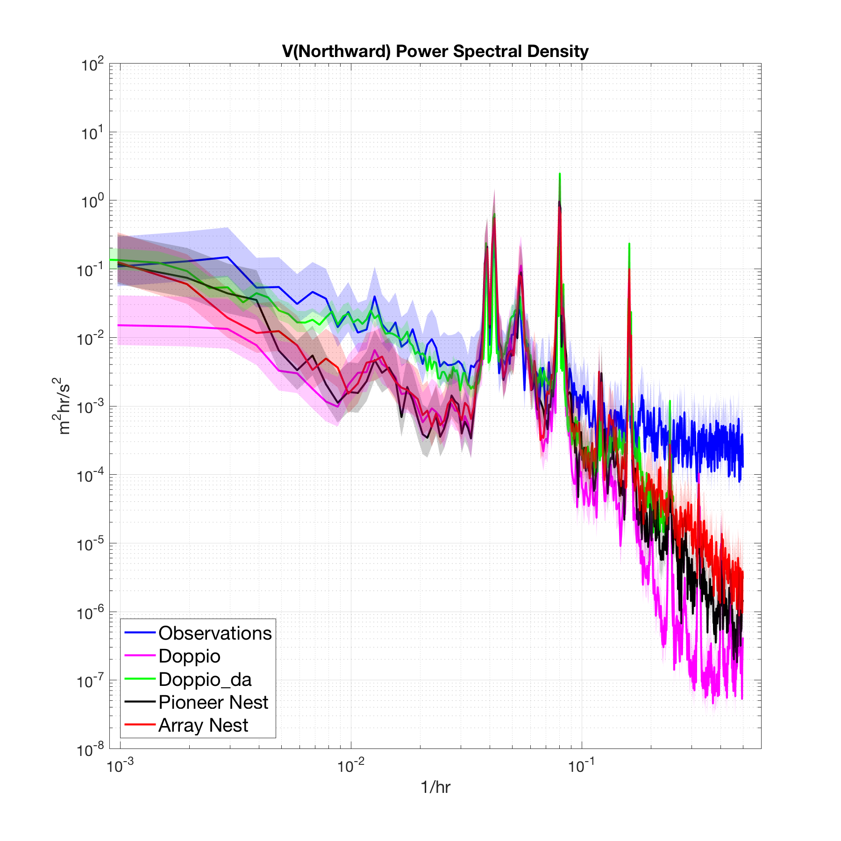
Power spectrum for cross-shelf velocity:
3-level nested model
DA model
current-meter obs.
Notes:
Frequency spectra for nested grids
Compare to current-meter mooring
Low frequencies < 0.035 h⁻¹ (T > 30 hours) all nests are in agreement, but have less energy than observed
DA lifts this energy level – presumably introducing variability that was not represented in the open boundary conditions (presumes low frequencies in the local met forcing are resolved)
From 30 hours through diurnal (0.042 h⁻¹) and inertial (18 hours) 0.055 h⁻¹ down to about semi-diurnal 12 hours (0.083 h⁻¹) all nests agree and match obs.
Above diurnal frequency doppio begins losing power compared to the nests (except for tides OK)
M₄ at 6.2 hours (0.156 h⁻¹) seems overly energetic compared to obs.
Pioneer and Array are comparable to about 5 hours (0.2 h⁻¹)
At 4.1 hours (0.24 h⁻¹) (near M₆) the obs. hit a noise floor and it is not possible to judge whether there is a discrepancy in energy for the nests w.r.t. observed
Doppio appears to hit a noise floor at 3 hours
Pioneer and Array maintain their spectral slope to the resolution of the obs (Nyquist 2 hours)
So we see the nests departing in modeled energy density going to very high frequencies, which presumably

Slide 20
For f < 0.035 h⁻¹ (T > 30 h) nests are in agreement, but have less energy than observed
DA lifts this energy level

Slide 21
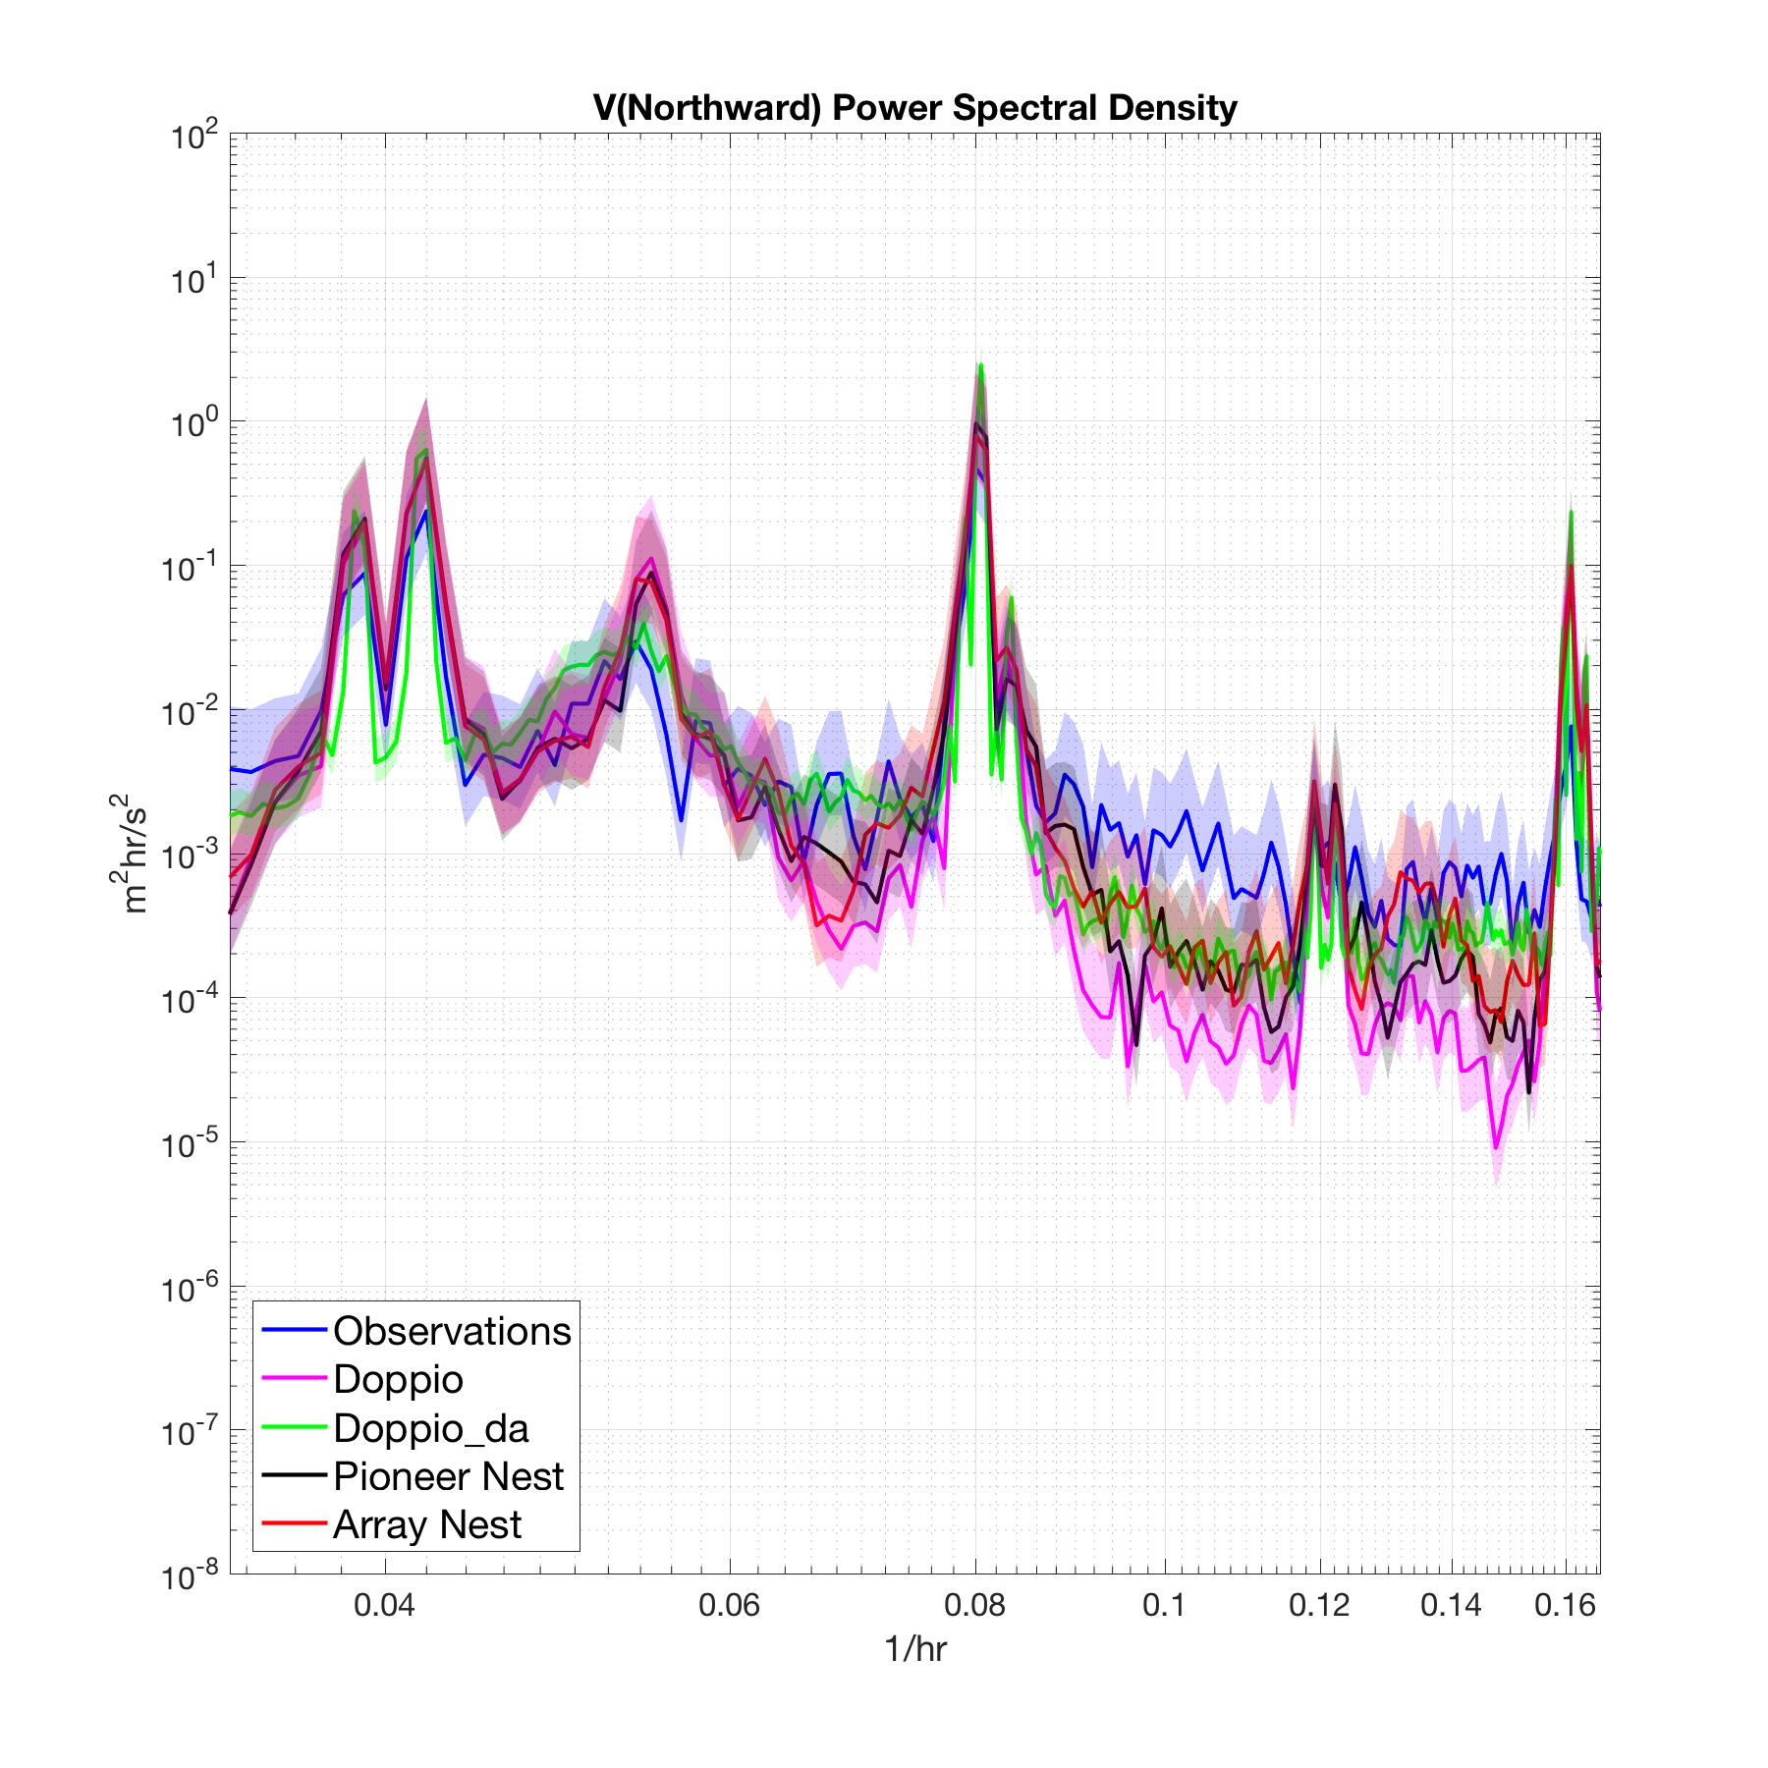
At diurnal 0.042 h⁻¹, inertial and semi-diurnal 0.083 h⁻¹ nests agree & match obs.
Doppio loses power (~tides)
M₄ at 6.2 hours (0.156 h⁻¹) seems overly energetic
Pioneer and Array comparable until 5 hours (0.2 h⁻¹)

Slide 22
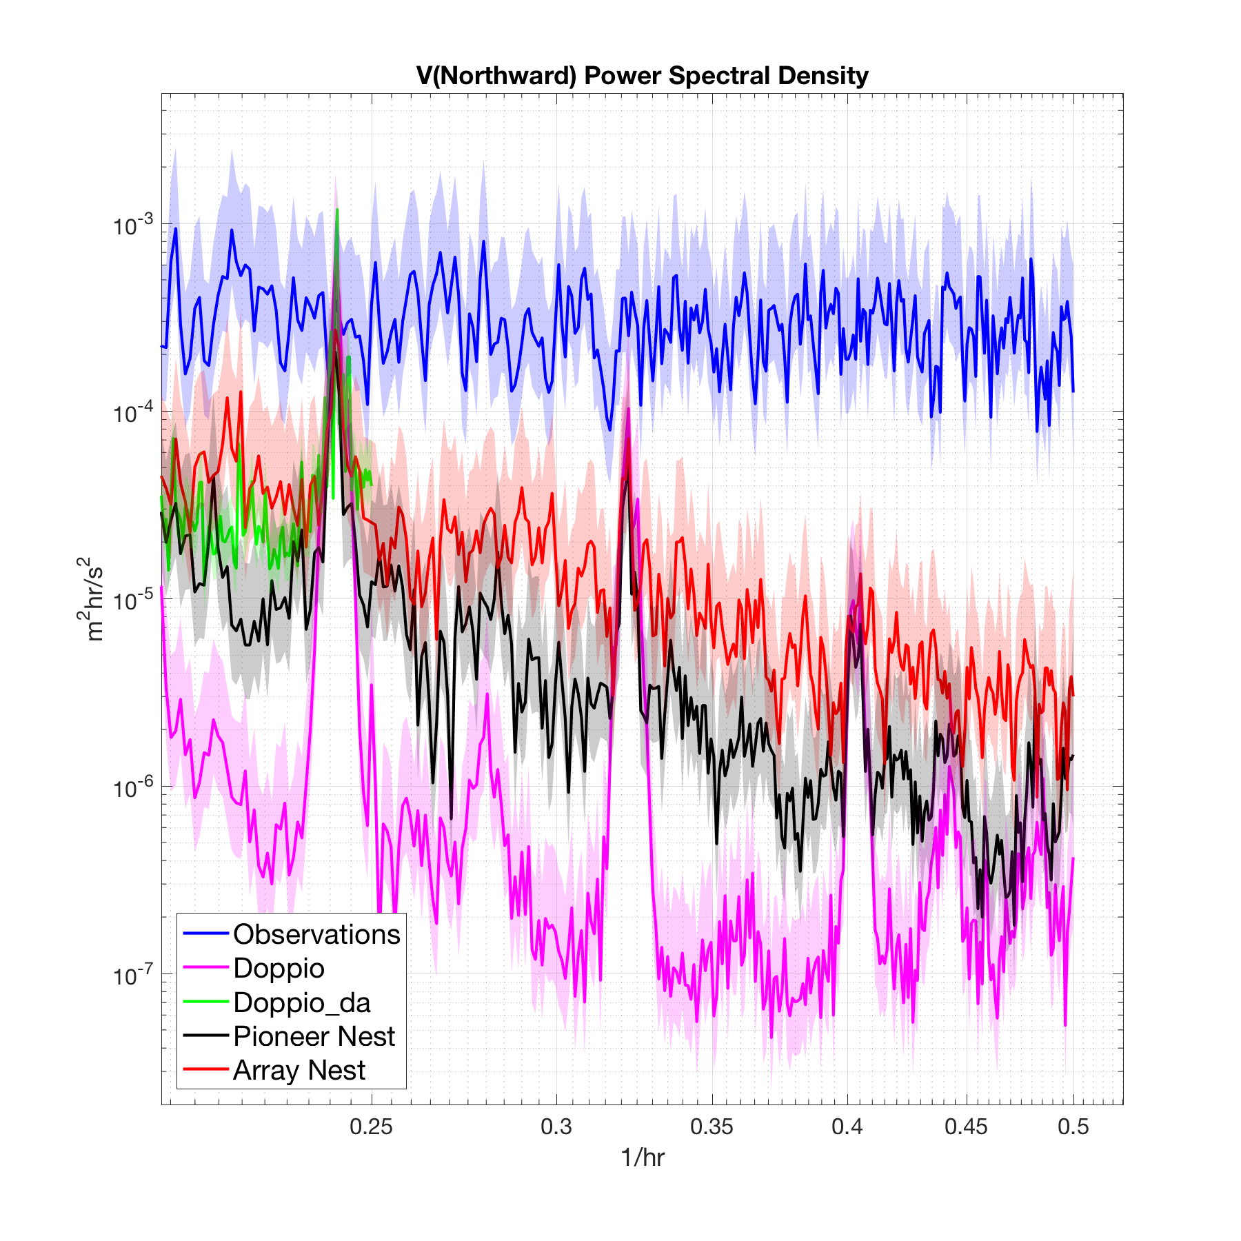
At 4.1 hours (0.24 h⁻¹) (near M₆) the obs. hit a noise floor. It is not possible to judge model energy with the current-meter data

Slide 23
Doppio appears to hit a noise floor at 3 hours

Slide 24
Pioneer and Array maintain constant spectral slope to obs. resolution
Array is 5x more energetic than Pioneer, which is 10x more energetic than Doppio.

Slide 25
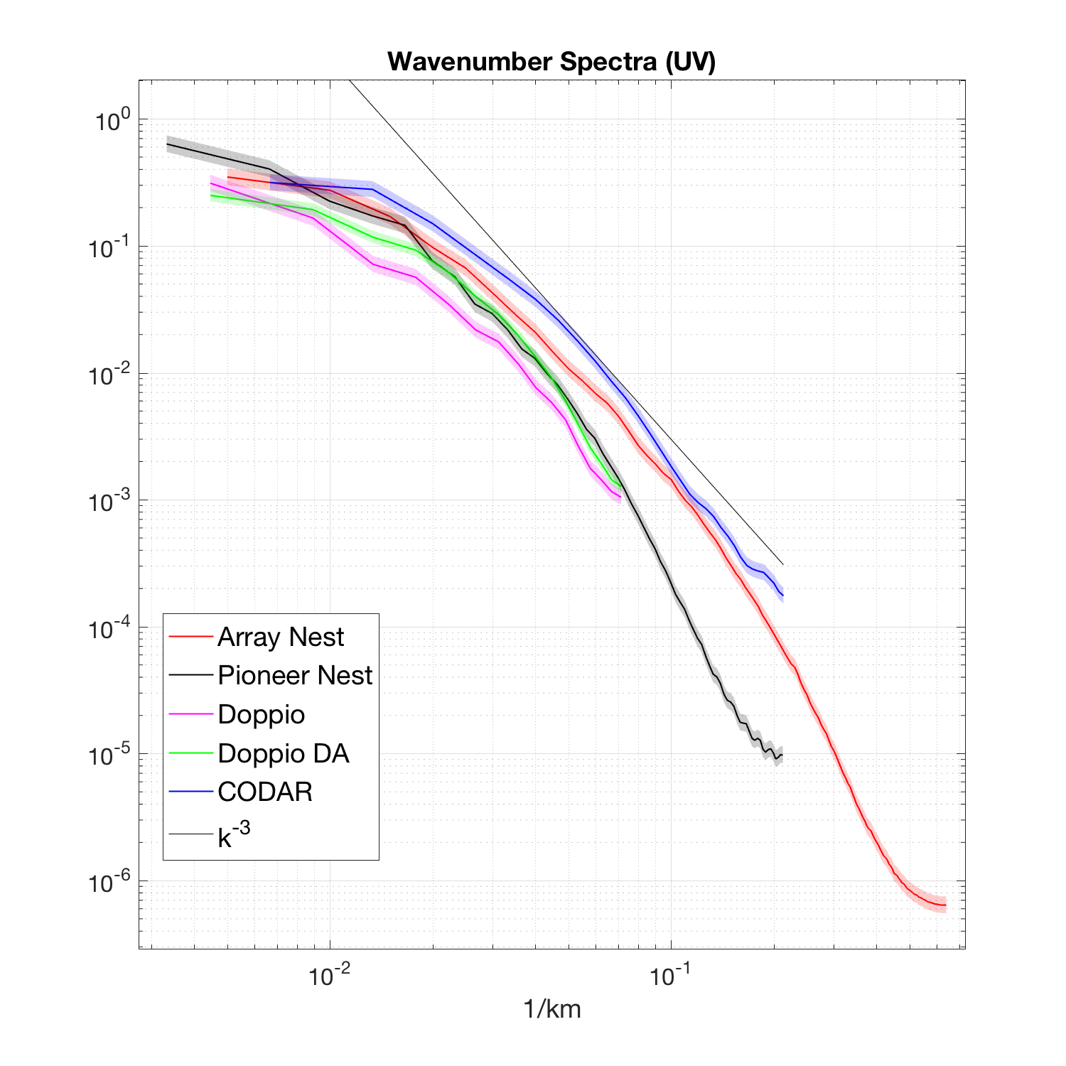
Nested model resolution is more naturally thought of in terms of spatial resolution (wavenumber spectrum)
Theories of submesoscale turbulence emphasize spectral properties

Slide 26
Array is more energetic than Pioneer by a decade

Slide 27
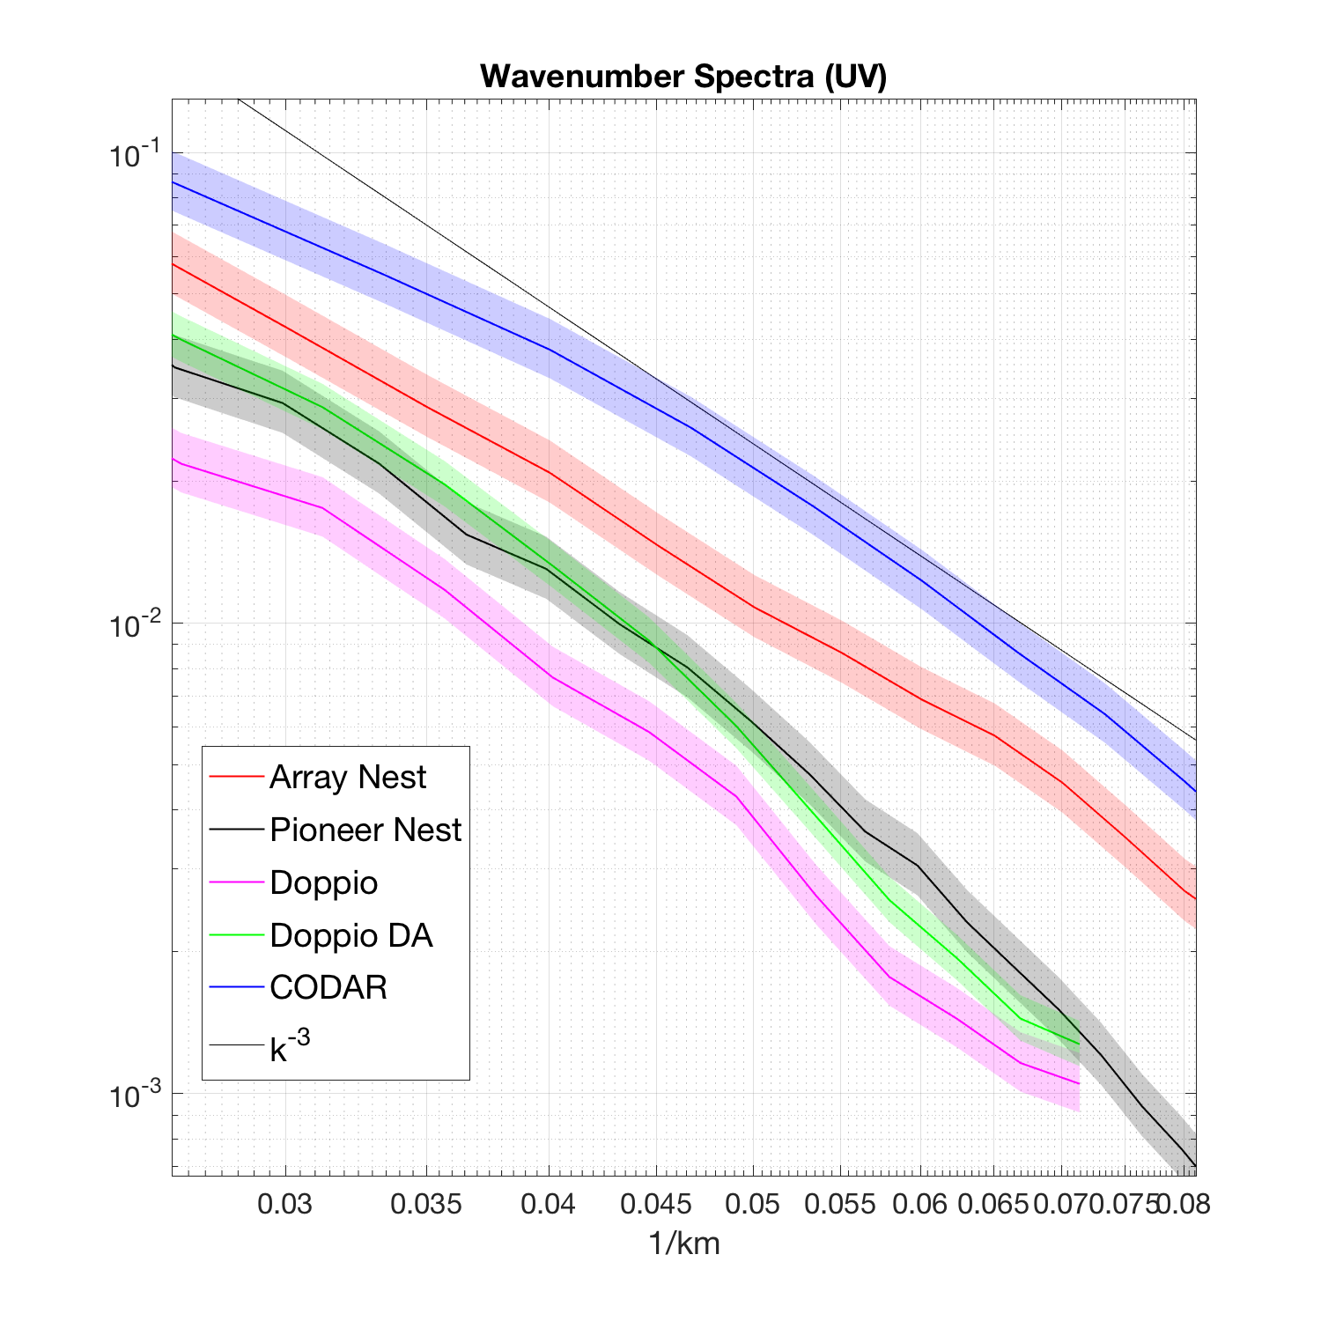
Array is more energetic than Pioneer by a decade
At mesoscale ~20 km energy levels are closer, but differ by factor o(1.5) including to obs.

Slide 28
Array is more energetic than Pioneer by a decade
At mesoscale ~20 km energy levels are closer, but differ by factor o(1.5) including to obs.
All models show noise at high wavenumbers – arguably the actual resolution of the model

Slide 29
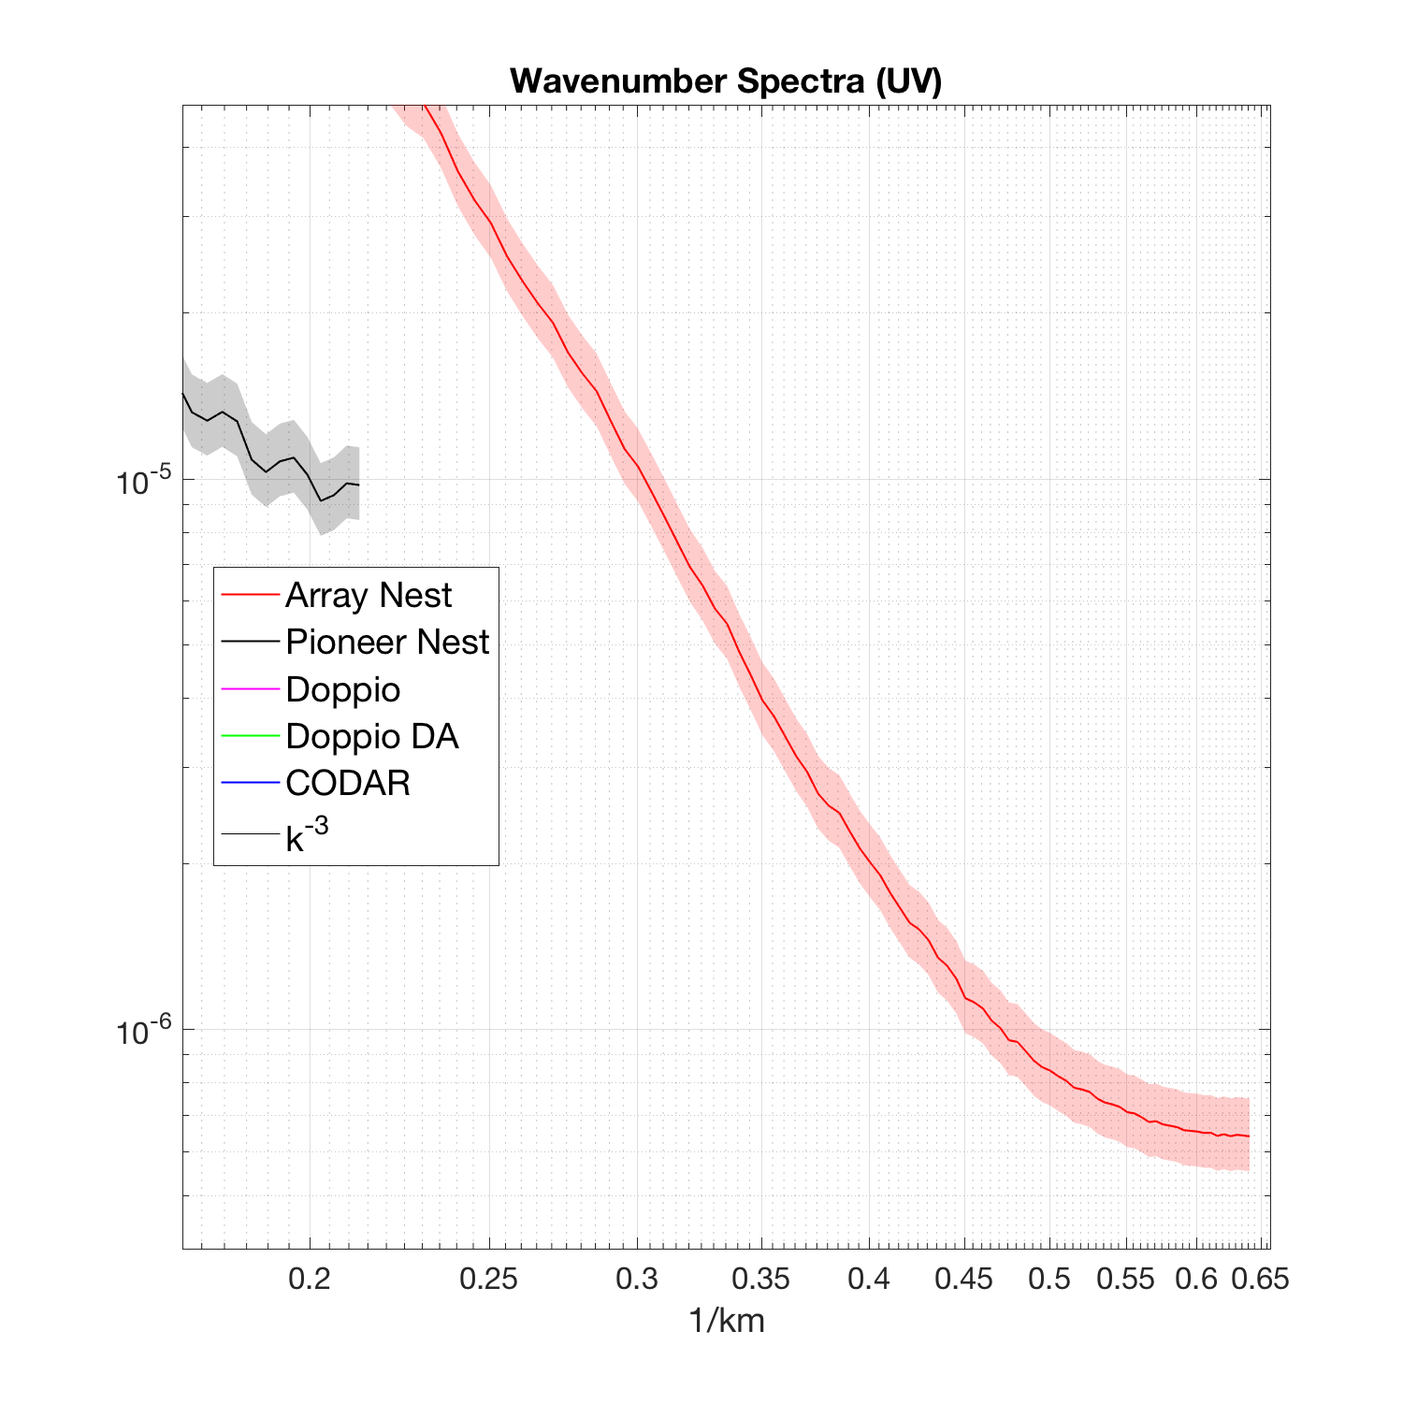
Array is more energetic than Pioneer by a decade
At mesoscale ~20 km energy levels are closer, but differ by factor o(1.5) including to obs.
Noise limit arises at ~3Δx to ~5Δx
1.5 km = 2Δx
3.5 km
= 5Δx

Slide 30
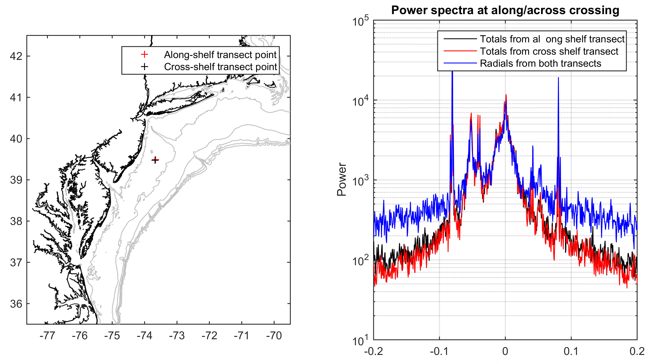
Should we believe CODAR surface current spectra?
A cautionary tale.
CODAR total vectors are derived by combining (by Optimal Interpolation) the radial components measured by multiple antenna.
Form vector time series from separate orthogonal radials, and compare to OI totals spectra.
There is a significant loss of power at frequencies higher than semi-diurnal

Slide 31
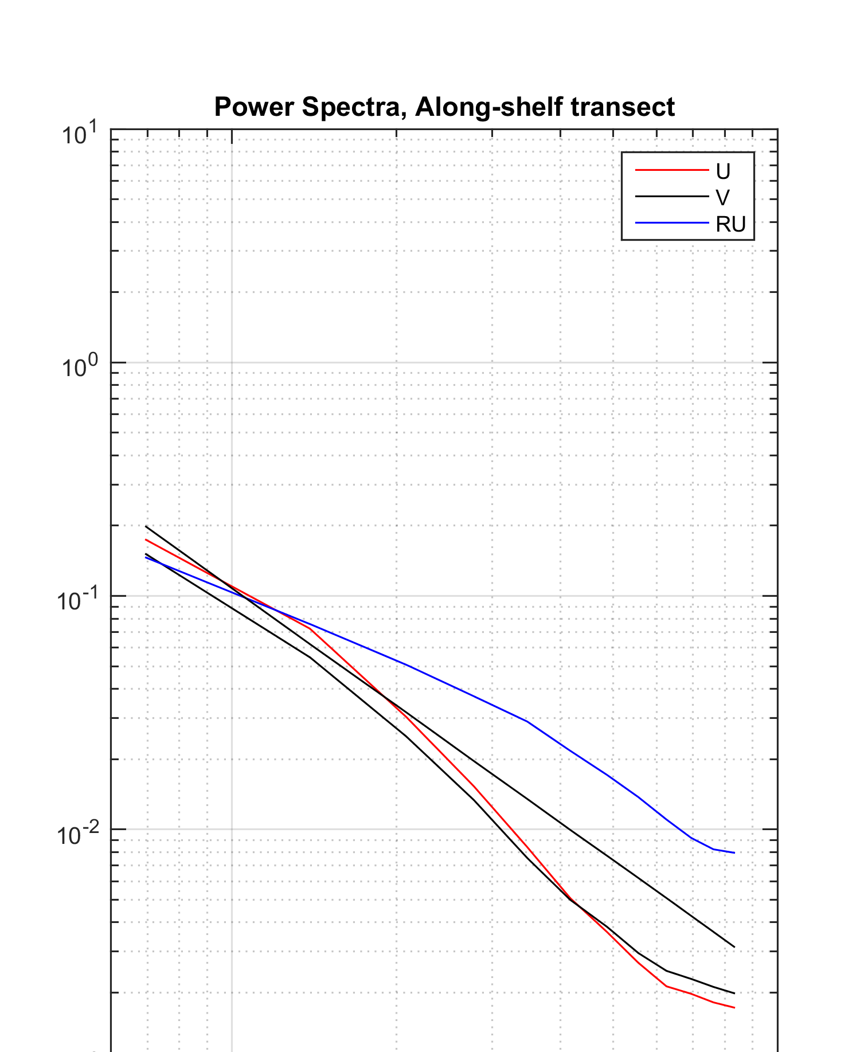
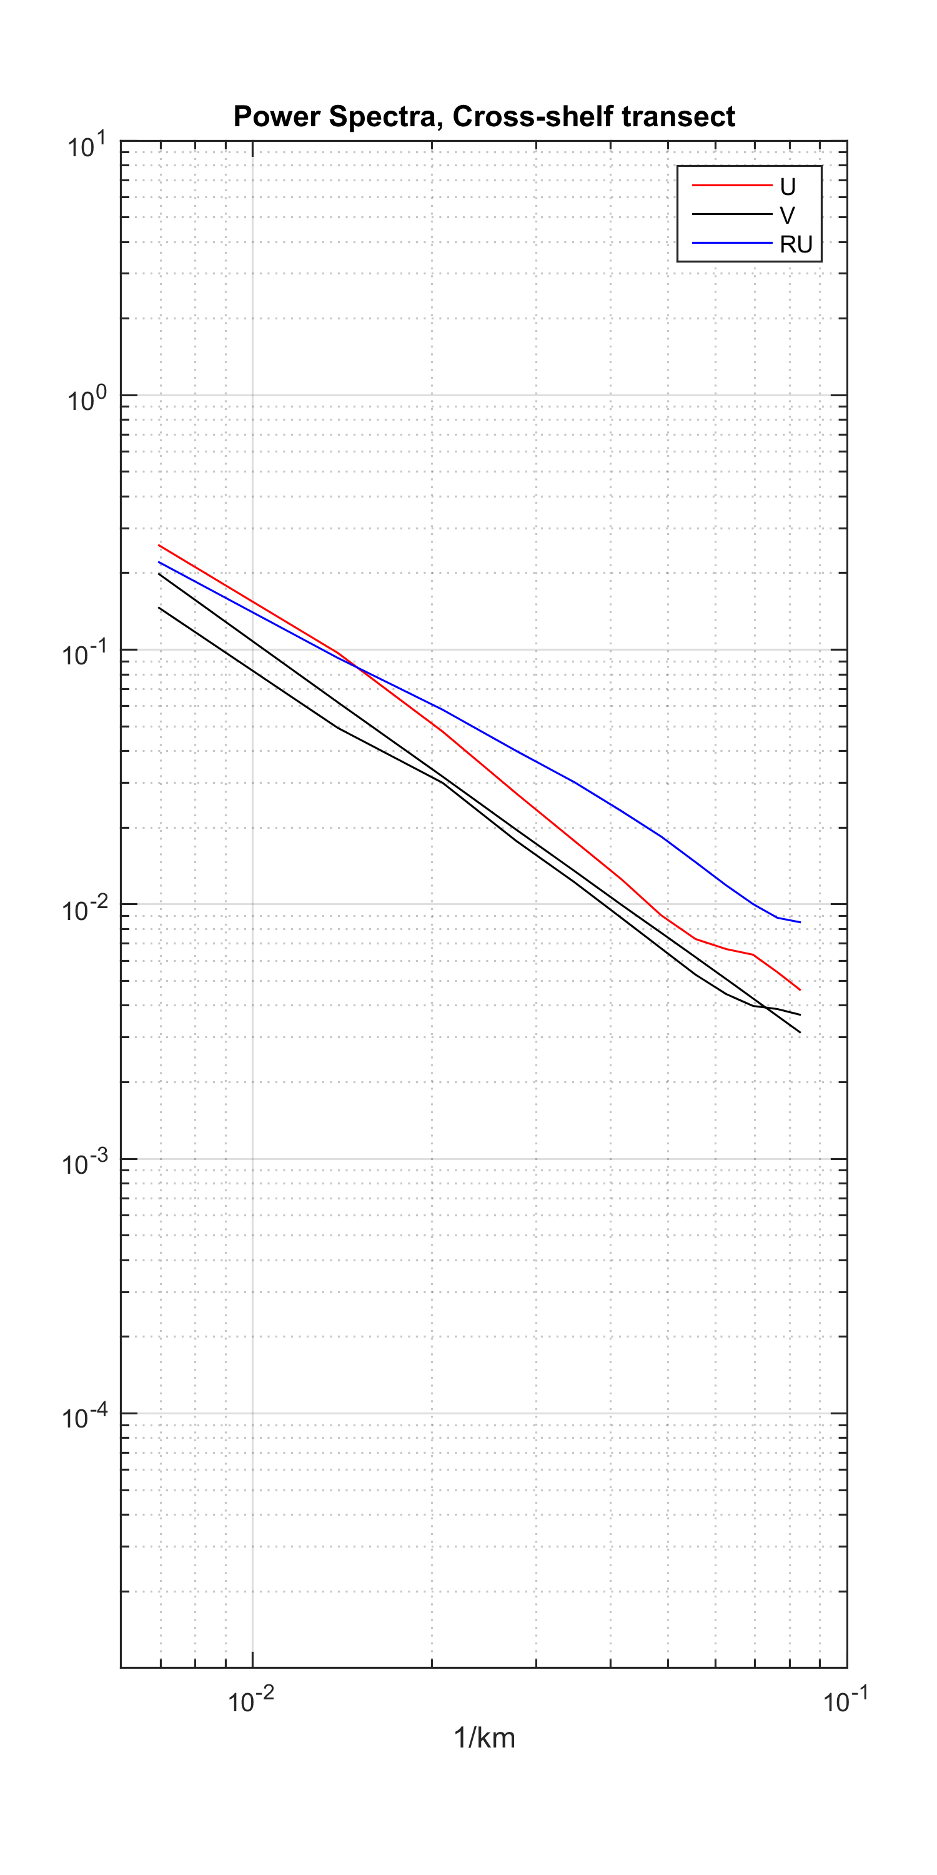
Should we believe CODAR surface current spectra?
A cautionary tale.
0.02 km⁻¹
(50 km)
0.02 km⁻¹
(50 km)
There is a significant loss of power at wavenumbers greater than 0.02 km⁻¹
10⁻² km⁻¹ 10⁻¹ 10⁻² km⁻¹ 10⁻¹

Slide 32
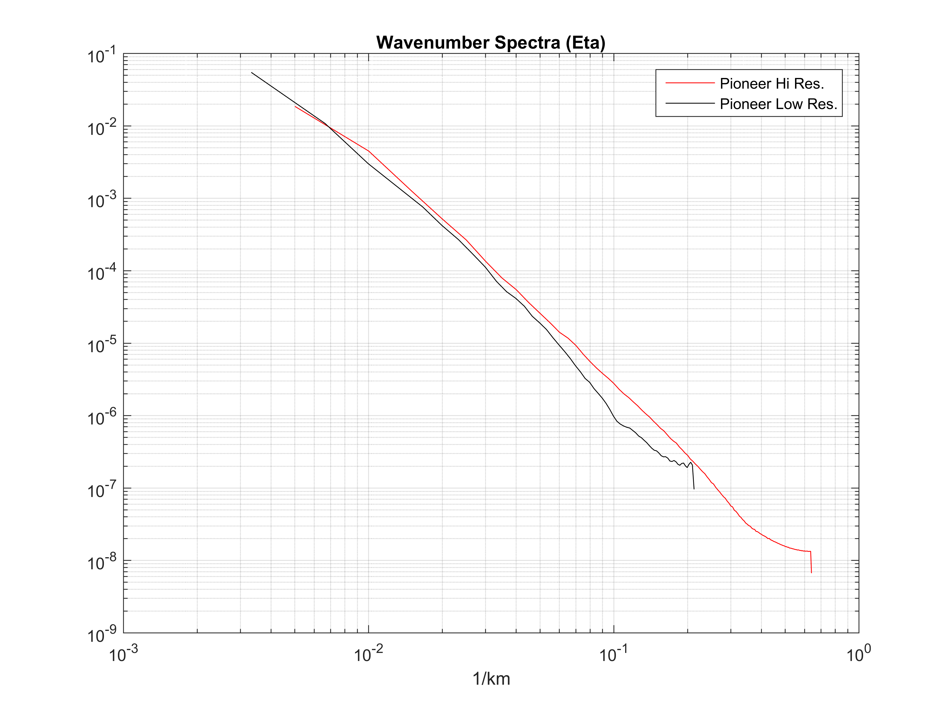
Sea Level Anomaly wavenumber spectra from Cryosat altimetry and nested ROMS Pioneer and Array
k⁻³

Slide 33
Velocity and sea level wavenumber spectra: Observations compared with nested model
At periods > 30 hours models under-estimate variability
DA restores this energy level
Down to semi-diurnal periods the nests largely agree
Divergence begins at around 6 hours
But tides are always represented approximately equally.
Energy levels differ by a decade at highest frequencies
Noise is observations limits high frequency comparison
Wavenumber spectrum tail also shows o(decade) energy differences between parent and child grids
Effective resolution (in terms of energy spectrum) is at best 5Δx
Smoothing in CODAR OI-combiner steps limits the true spectral resolution of the assimilated CODAR velocity data
ROMS User Workshop, Hobart, Australia 17-20 October 2016

