Slide 1
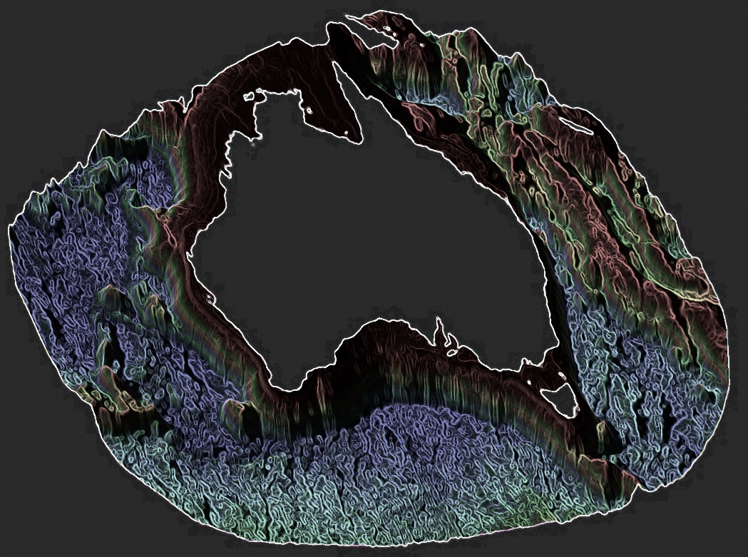
Real-time/hindcast modelling system
Central Western Australia

Slide 2
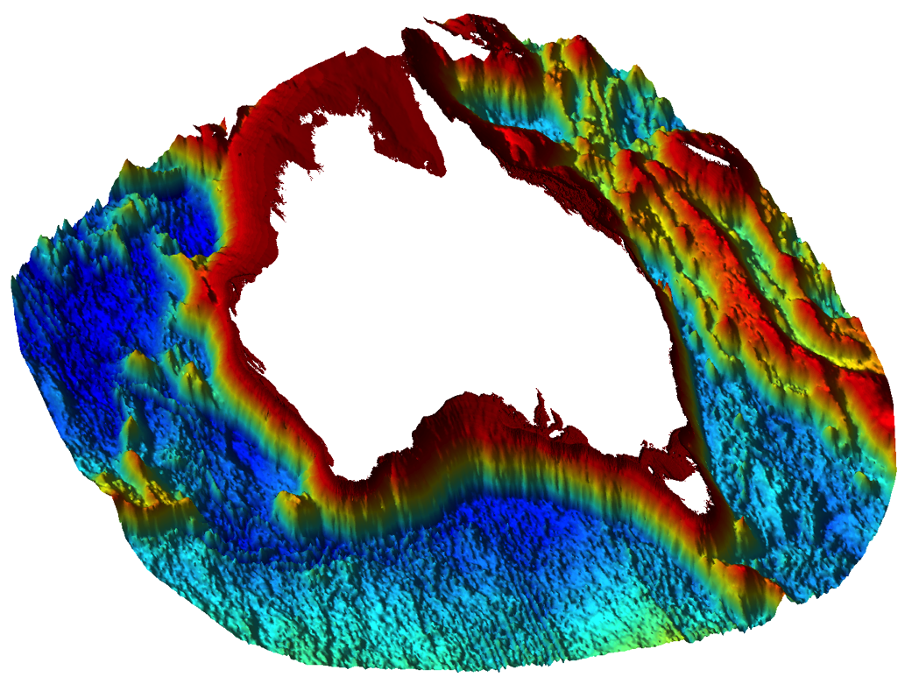
Australia

Slide 3
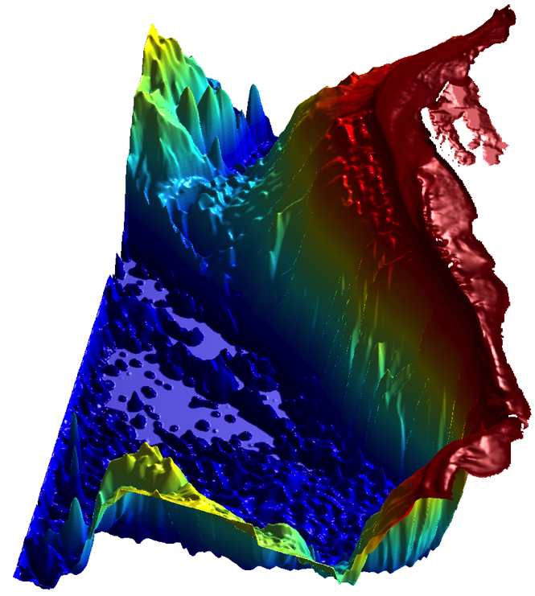
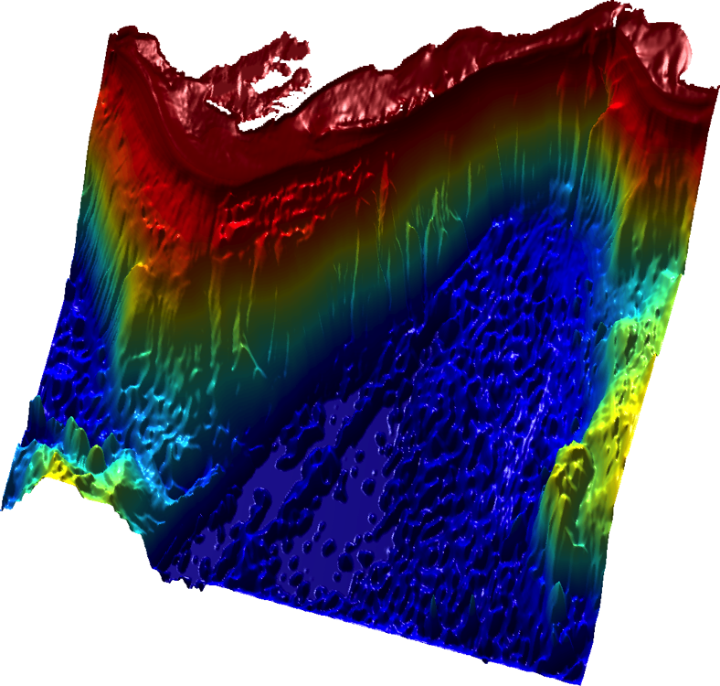
Western Australia

Slide 4
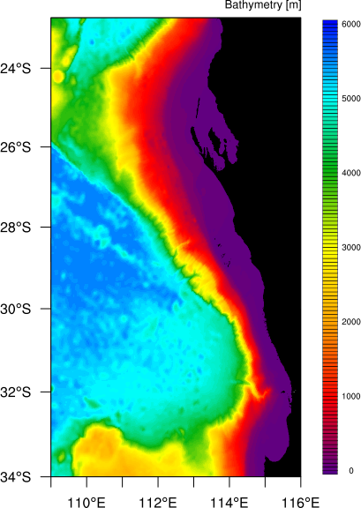
ROMS model setup CWA
Complex topography
Higher res. along the coast
~ 2.5 km – 4 km
Smooth as little as possible for long run
  LP, iterative, point wise
Keep rx1 small (HPGE)
NDTFAST = 32, DT=120s
Perth 500 m child, DT=100s (!)
DA is expensive (~ 30 x NLM)
  15 TLM/ADJ (back/forth)
Correcting atmo, ini, bc
DA with tides -- mixing, HF, many obs
Optimize for HPC
  Optimize the grid size 640x480
  IVEC Pawsey Magnus (Cray XC40)
  4hr wall clock for DA → 4 day cycle

Slide 5
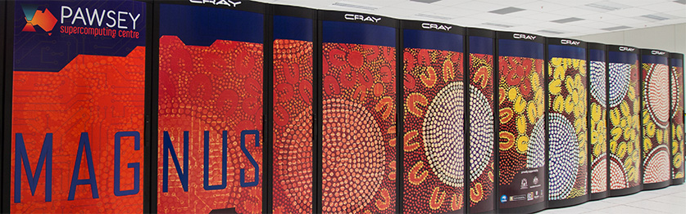
Magnus Pawsey HPC
Magnus Cray XC40
1488 nodes (35,712 cores)
2 x 2.6GHz E5-2690 v3 "Haswell”
Cray Aries interconnect Dragonfly
Cray Sonexion 1600 Storage
(3PB r/w 70GB/s)
LUSTRE FS using stripes -> DA

Slide 6
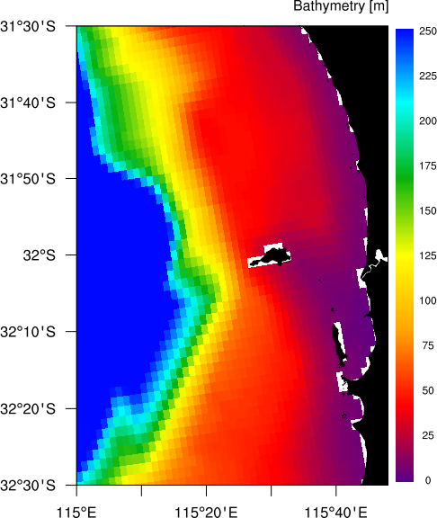
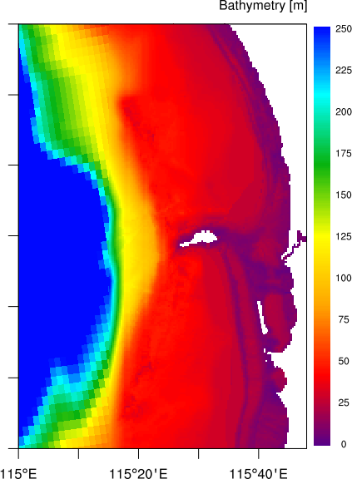
Parent/child nesting

Slide 7
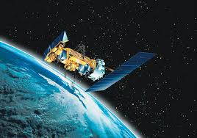

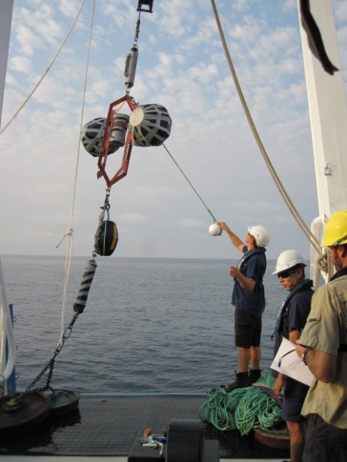
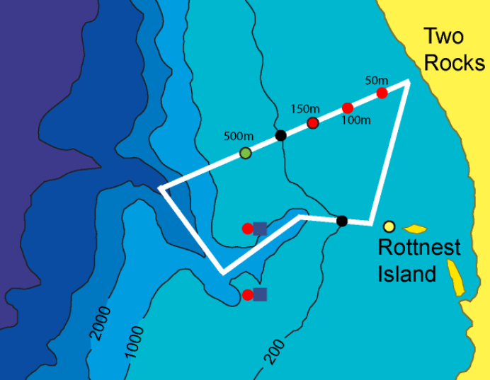
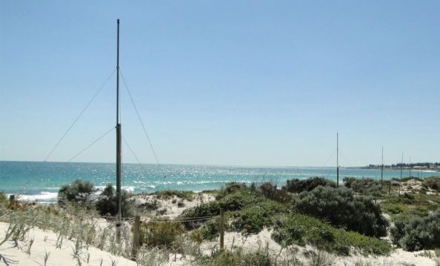
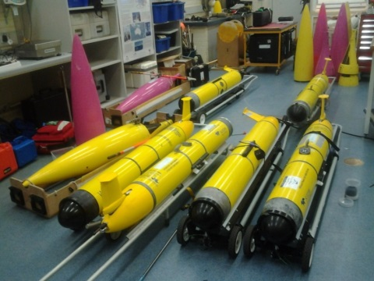
Data Assimilation: Observations
~ 2,5 million observations (4 day window from 21/Jan)
PLATFORM OBS
NOAA_15 297420
NOAA_16 588766
NOAA_18 734152
NOAA_19 699573
ROT_HF 117618
AVISO 4768
ADCP_WATR10 1536
ADCP_WATR20 2880
ADCP_WATR50 2880
ADCP_WACA20 2880
TZ_WACA20 3591
TZ_WACASO 5433
TZ_WATR10 3586
TZ_WATR20 3753
CTD_WATR20 1026
ARGO_R59 160
Notes:
In total for 3 months I used ~ 30 mil of observations

Slide 8
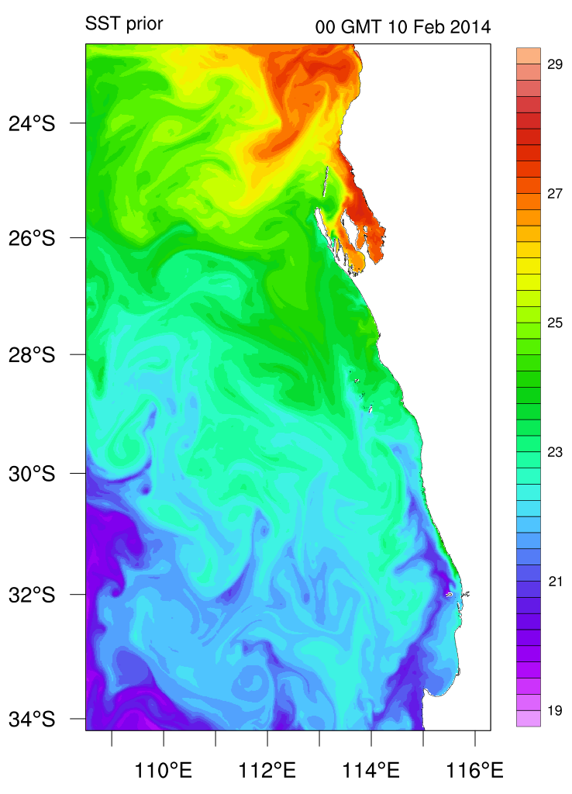
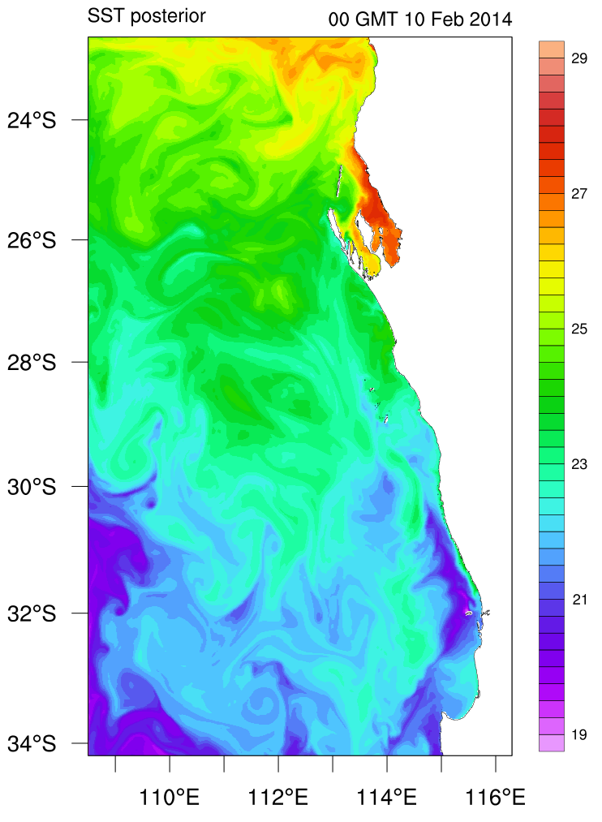
Data Assimilation: WA (4 days)

Slide 9
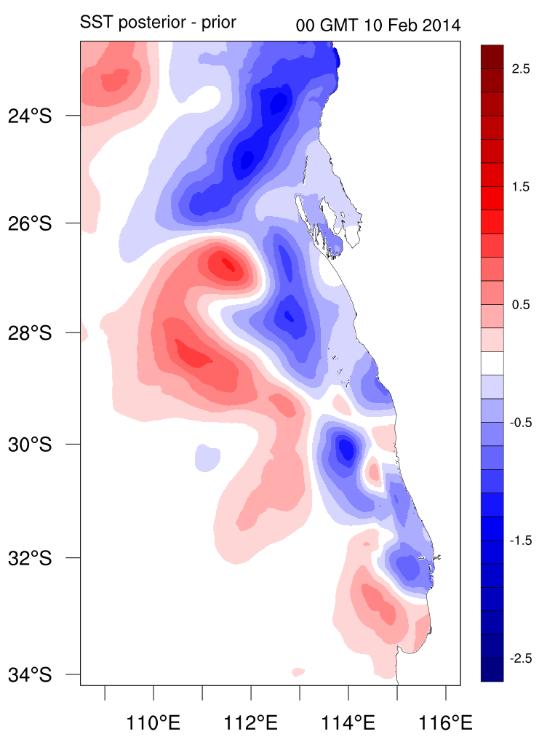
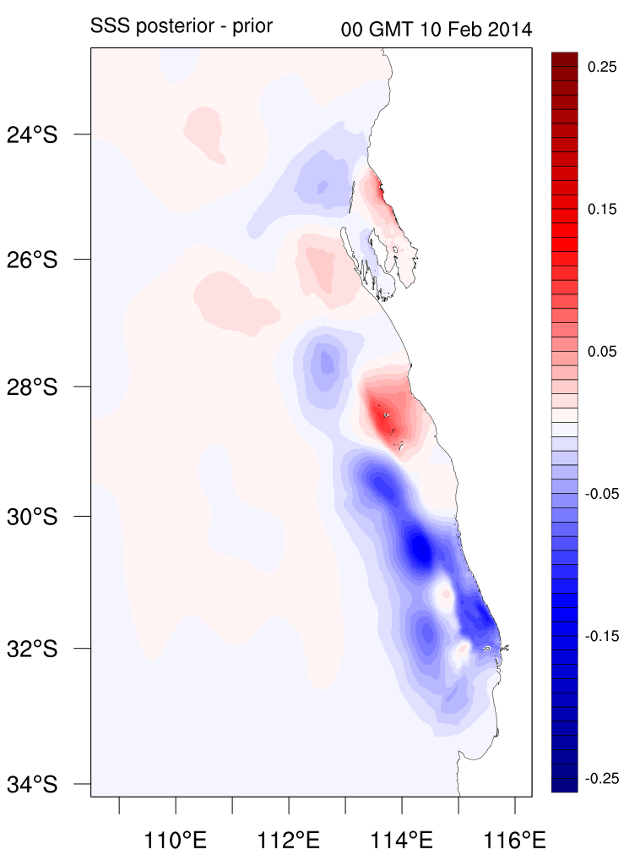
Data Assimilation: WA (4 days)

Slide 10
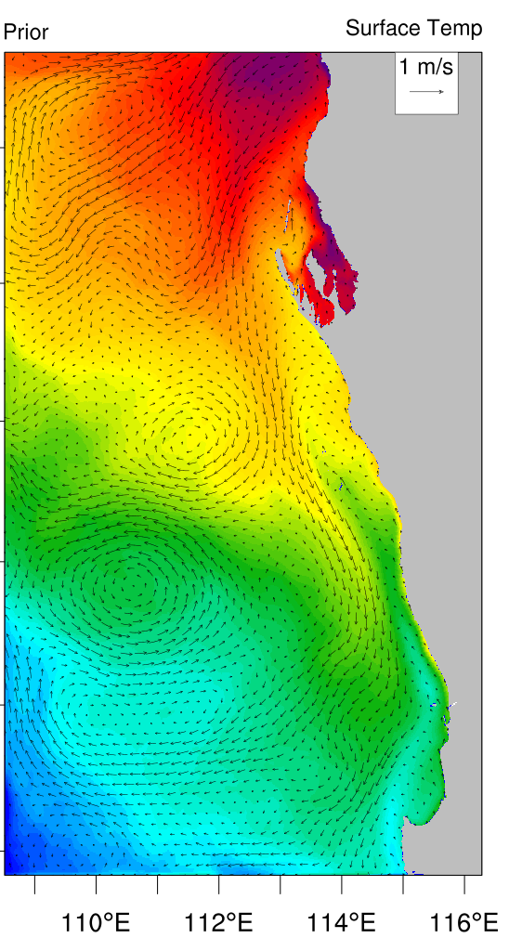
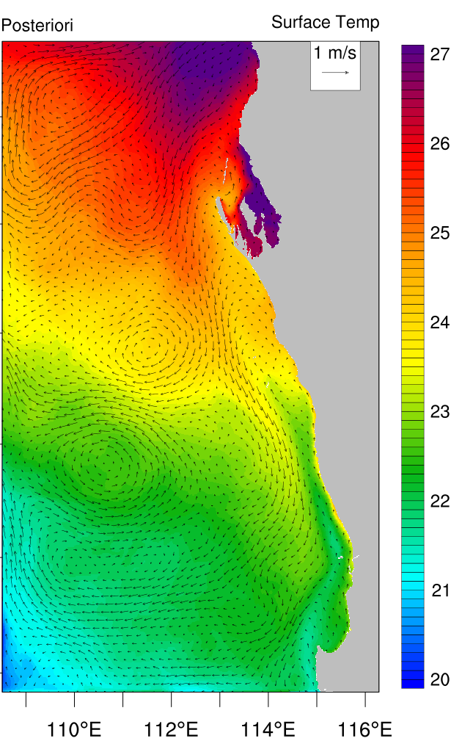
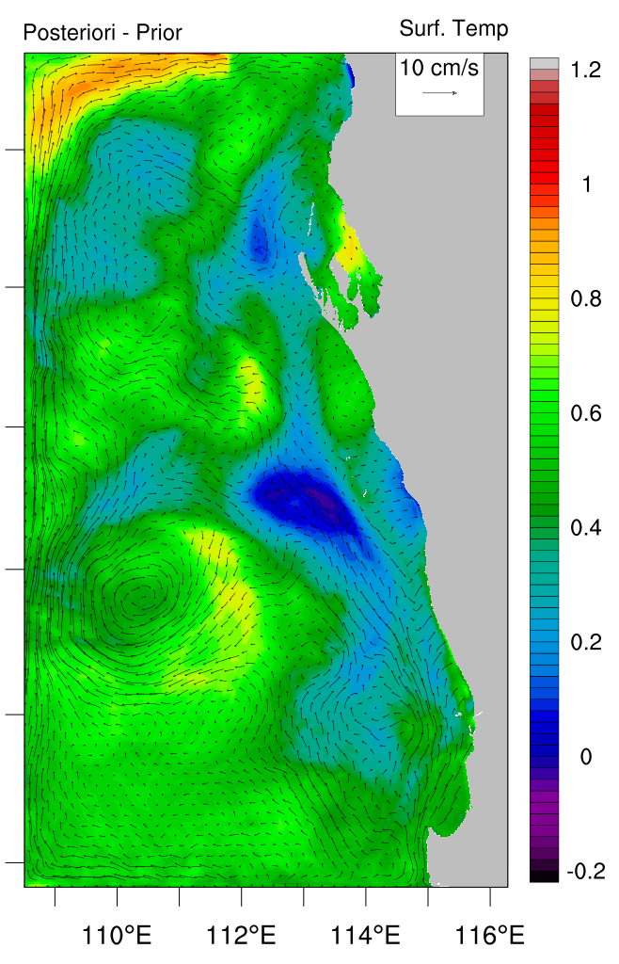
Data Assimilation: WA (3 months)

Slide 11
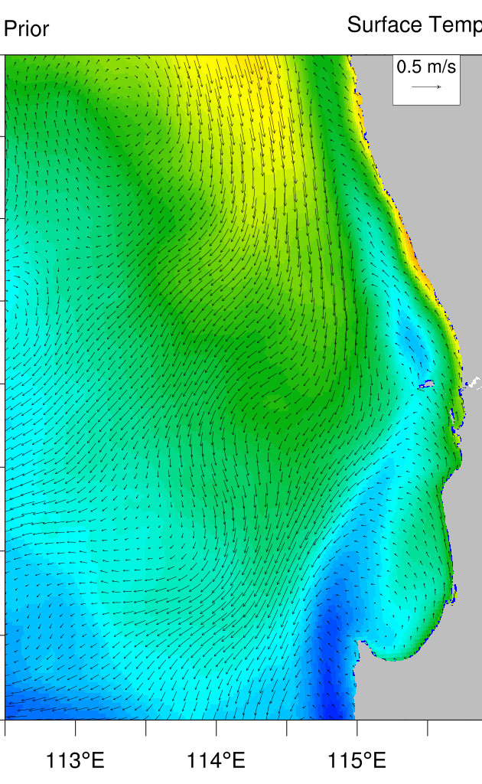
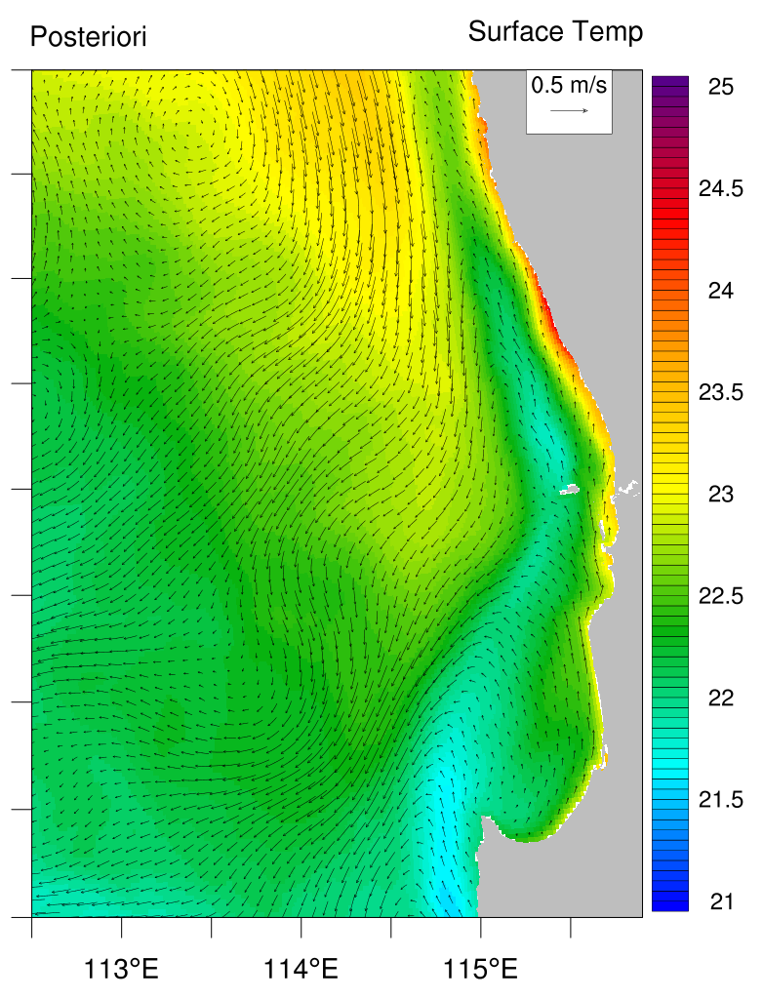
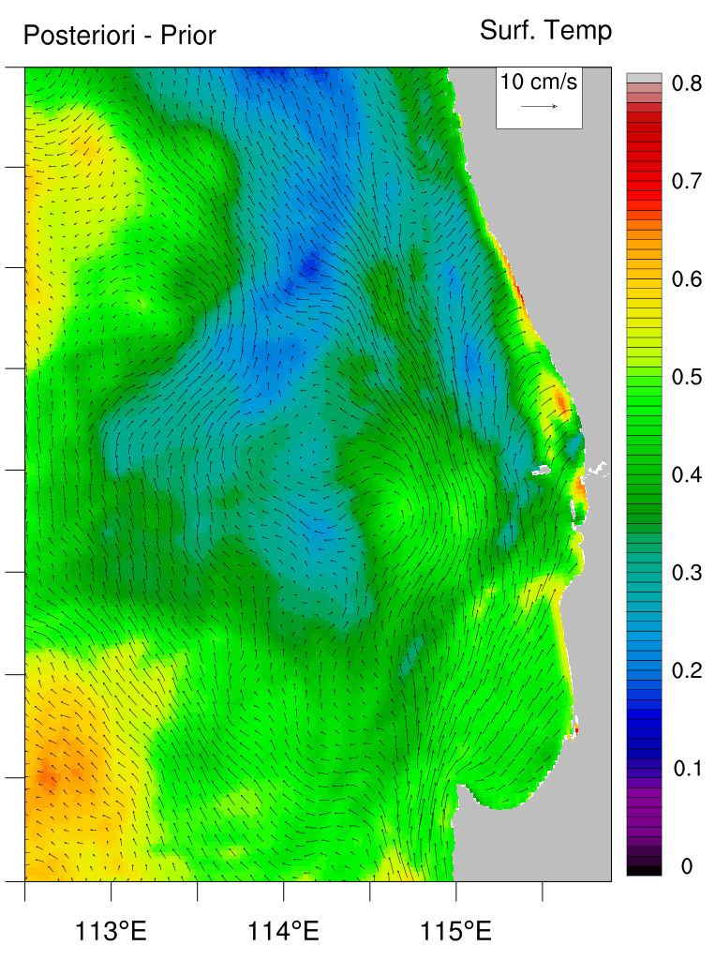
Data Assimilation: WA (3 months)

Slide 12
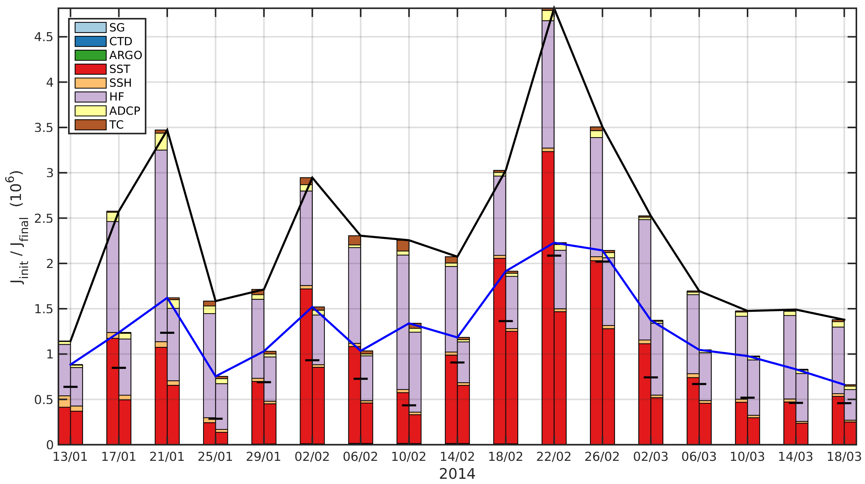
Data Assimilation: WA (3 months)
~30 million data points assimilated

Slide 13
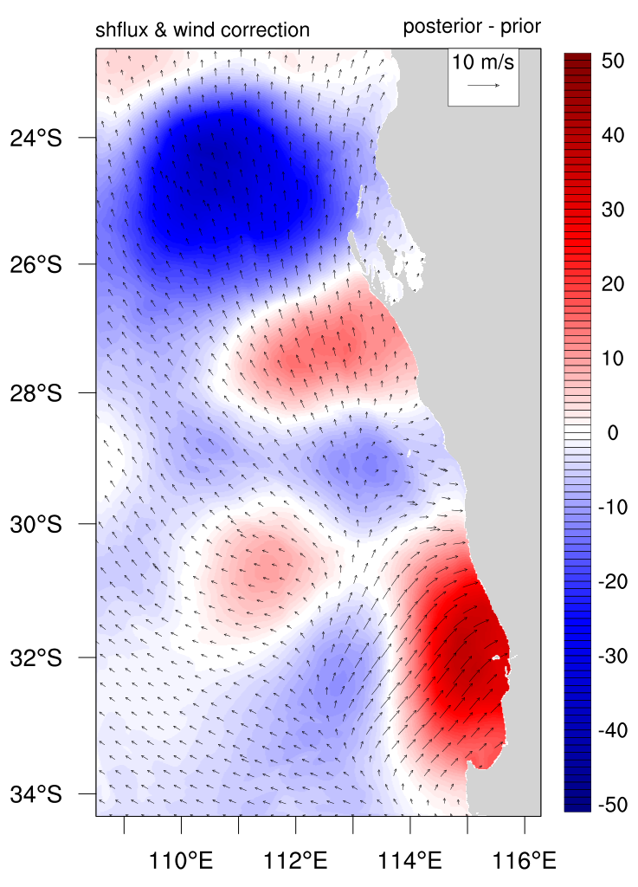

Slide 14
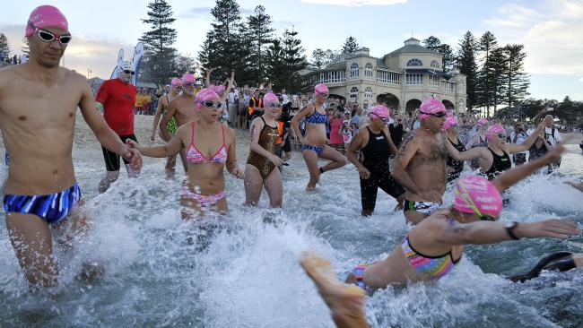
Real-time CWA/Perth system

Slide 15
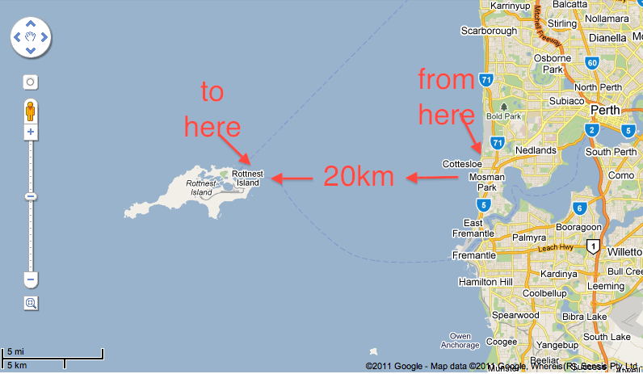

Slide 16

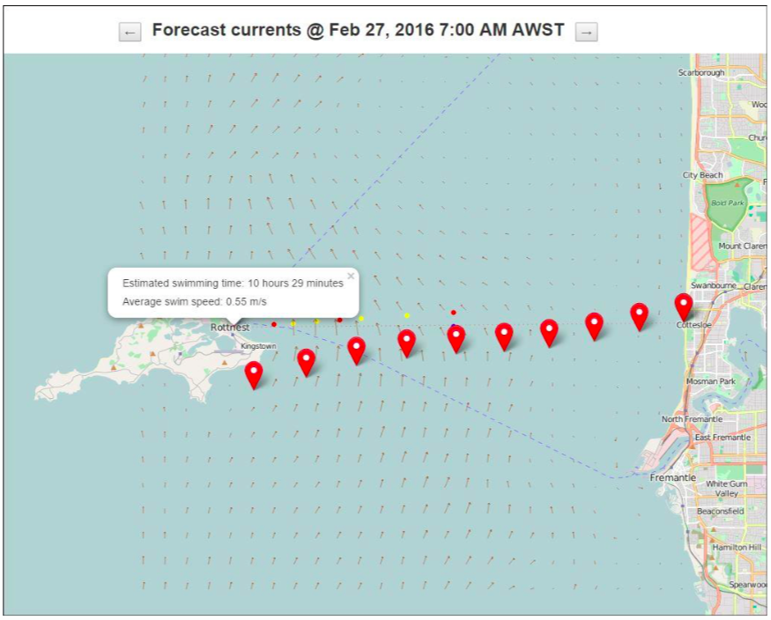
Real-time CWA/Perth system

Slide 17
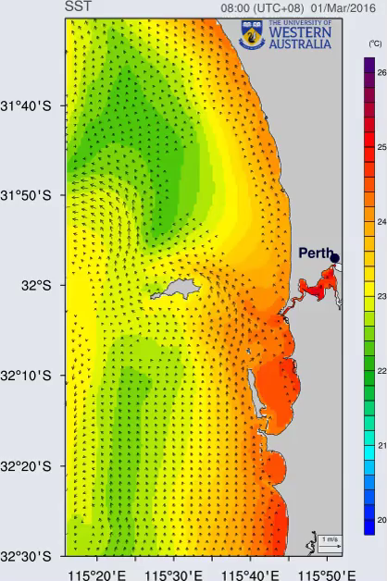

Slide 18
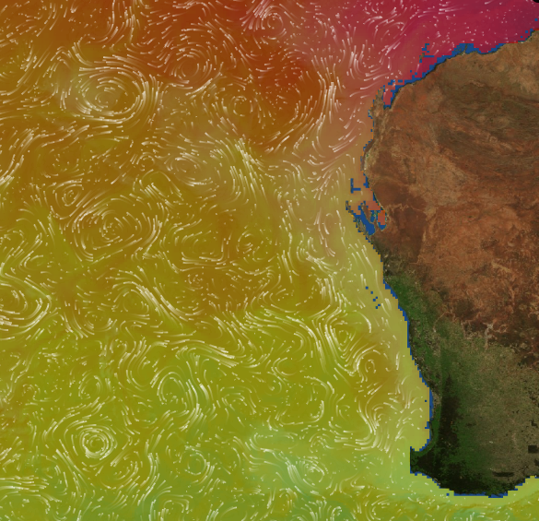
Real-time CWA/Perth system
HYCOM GL
nco tools

Slide 19
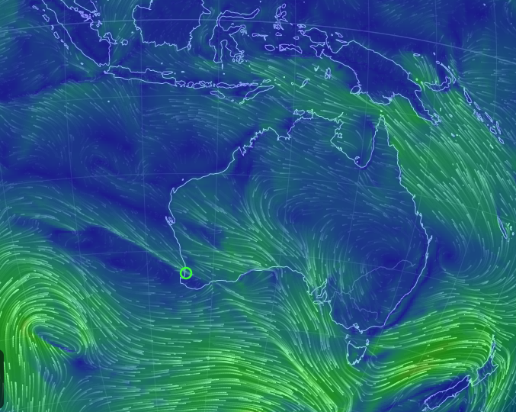
Real-time CWA/Perth system
GFS 0.25
nco tools

Slide 20
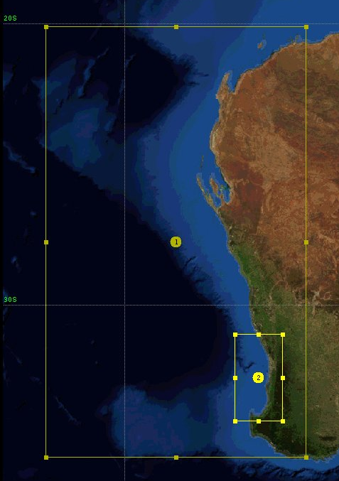
Real-time CWA/Perth system
WRF – ARW
2-way nested 10 <-> 2 km
Hourly outputs
“TS” files 6s (like station files)
Automatically via cron
Python pre/post processing
  Make forcing
  Make plots
  Archive
  Serve via openDAP / ncWMS

Slide 21
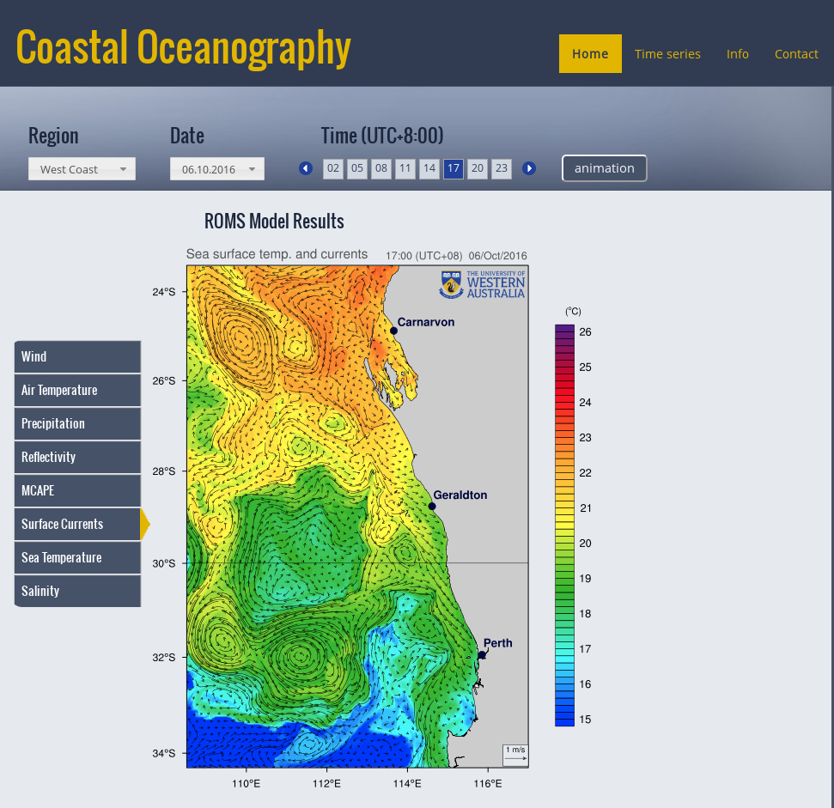
Real-time CWA/Perth system
ROMS – CWA
2-4 km, tilted and stretched
M2,S2,N2,K2,K1,O1,P1
HYCOM bry
WRF/GFS forcing
3-hourly & daily outputs
station file along the Perth bry (10min)
Automatically via cron
Python pre/post processing
  Make bry for child
  Make plots
  Archive
  Serve via openDAP / ncWMS

Slide 22
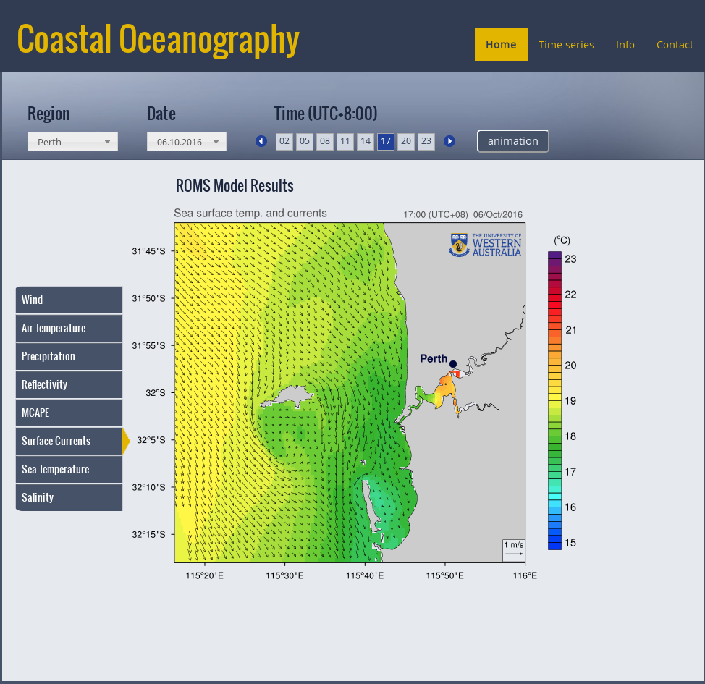
Real-time CWA/Perth system
ROMS
Perth 500m
parent bry @ 10min
WRF hourly forcing
1-hourly & daily outputs
station file (5min)
Automatically via cron
Python pre/post processing
  Make plots
  Archive
  Serve via openDAP / ncWMS

Slide 23
Real-time CWA/Perth system
HYCOM
GFS 0.25
GLOBAL MODELS
Python (seapy) + shell
WRF
10/2 km
ROMS bry
ROMS bry
ROMS frc
ROMS frc
ROMS
sta
ROMS
sta

Slide 24
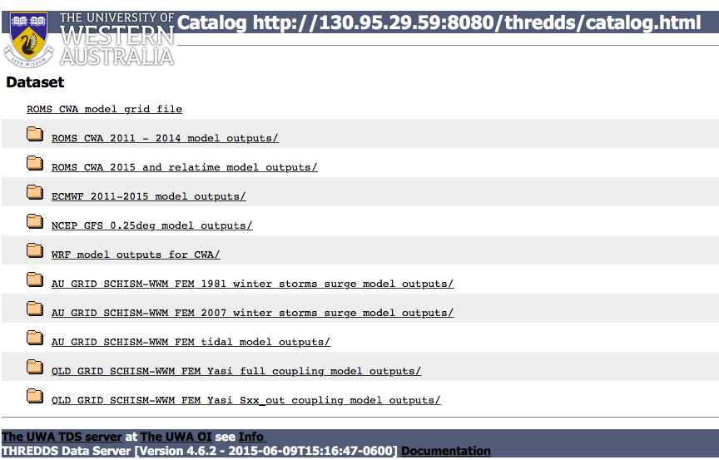
Real-time CWA/Perth system

Slide 25
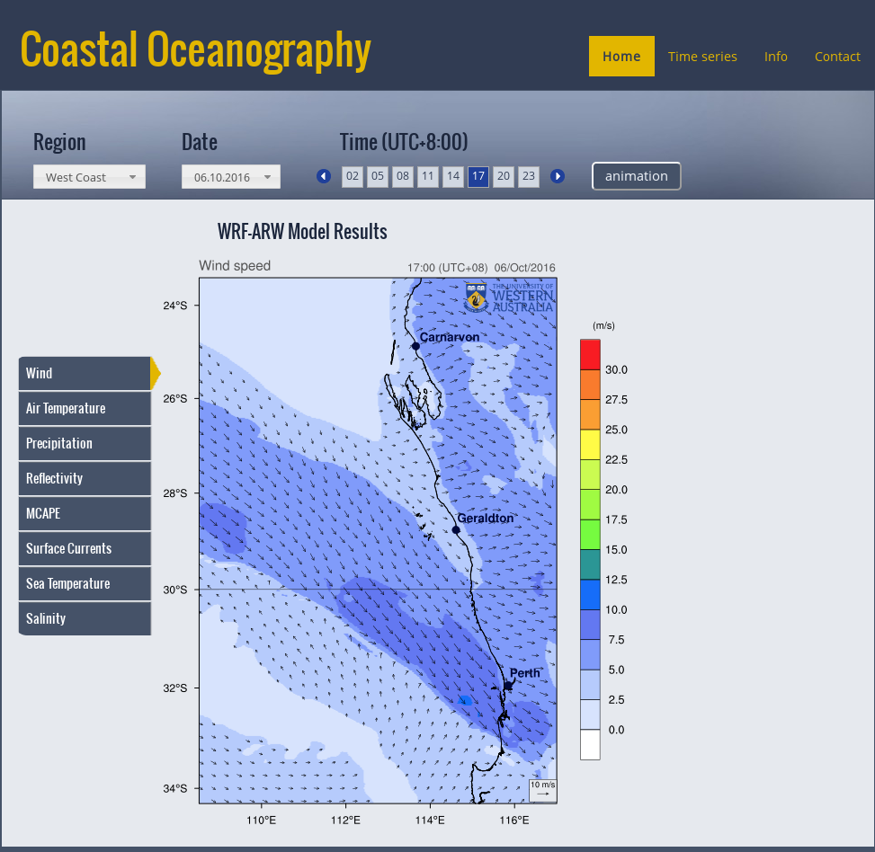
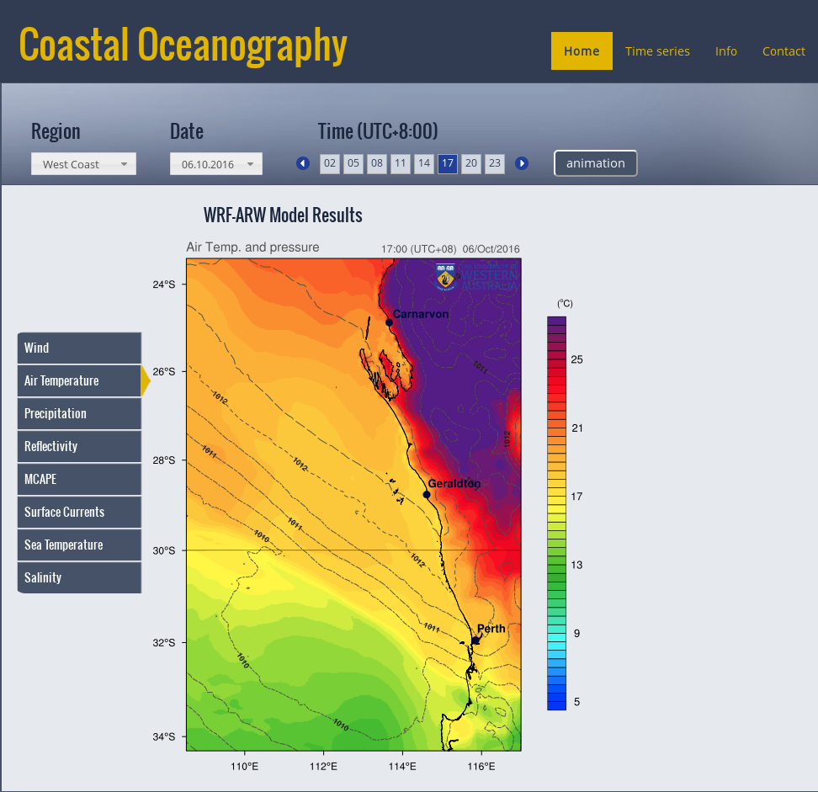
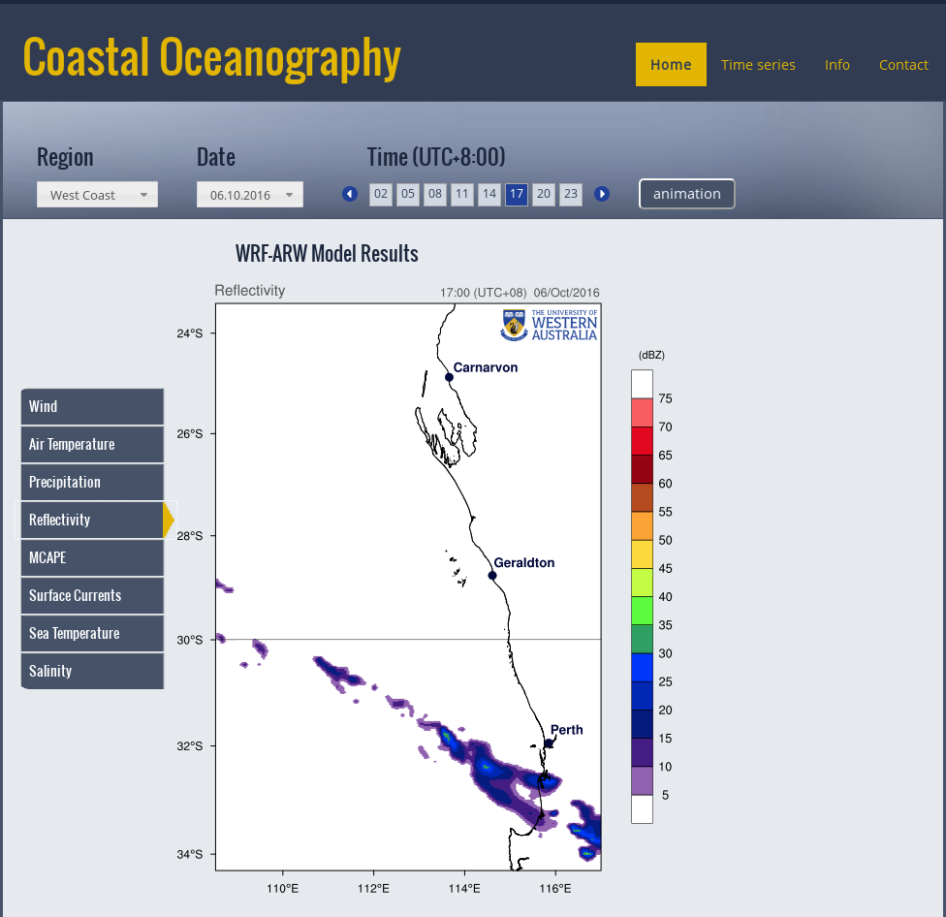

Slide 26
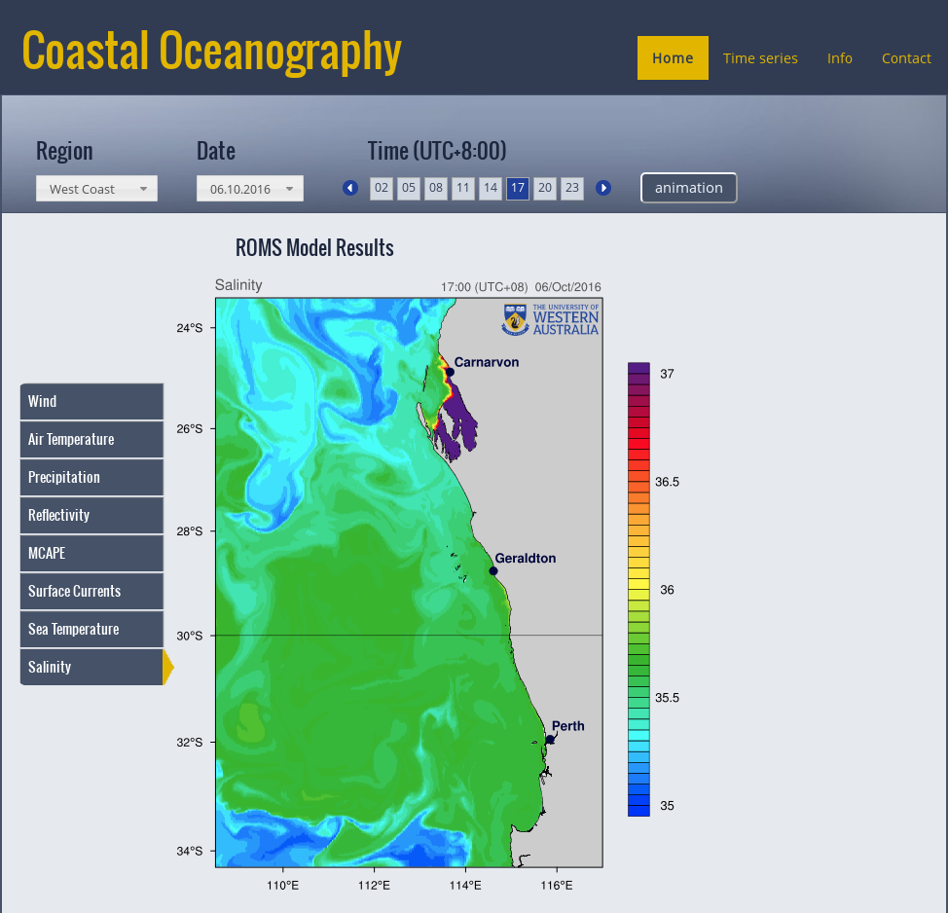
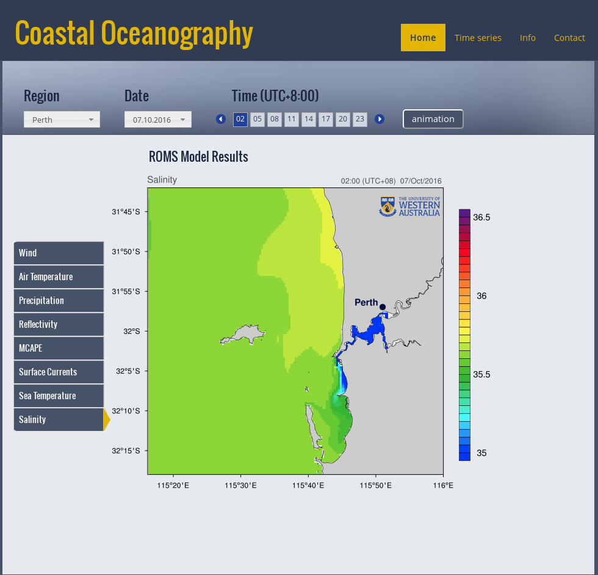

Slide 27
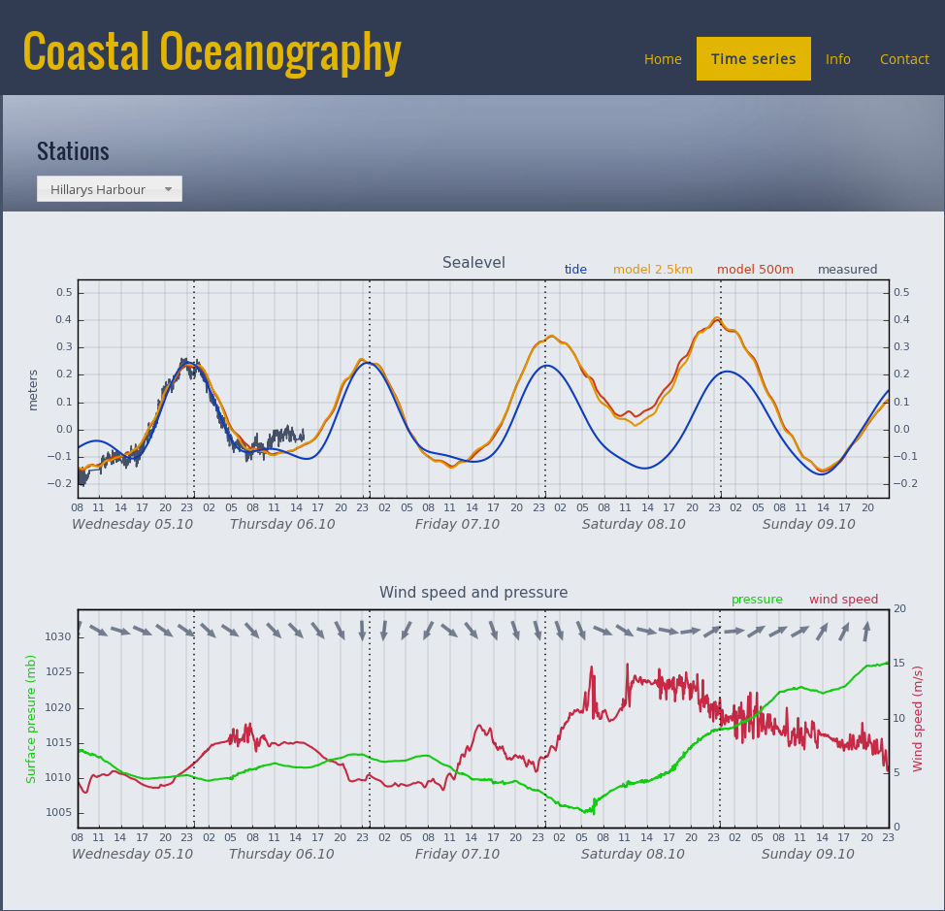

Slide 28
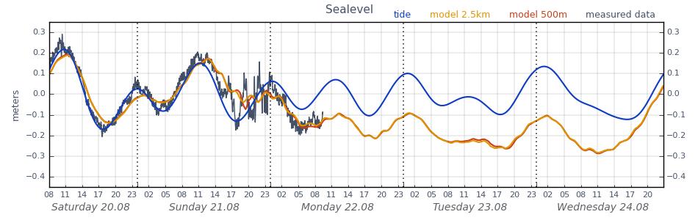
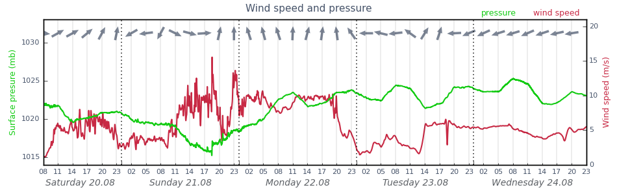

Slide 29
Final thoughts
Specific problem should be addressed specifically (grid, smooth)
  One time investment, used many times
When planning modelling system, think of hardware
  Small grids run fast on the WS
Python can speedup gridding for DA
  using in parallel, fork time independent processes
  prepare bry, forcing, start model, plot …
DA using tides / not ?
  Tidal mixing, internal tides, bottom friction and bottom mixing
  No need for LP & mean state within assimilation (3DVar)
Data dissemination, openDAP, TDS, ncWMS, free software

Slide 30
url=’http://130.95.29.59:8080/thredds/dodsC/realtime/agg_avg.ncml’
nc = netCDF4.Dataset(url)
lon_rho = nc.variables['lon_rho'][:]
lat_rho = nc.variables['lat_rho'][:]
temp= nc.variables[‘temp'][itime, -1, :, :]

