Slide 1
Numerical simulation of internal tides in the Sicily and Messina Straits
Jihene Abdennadher and Moncef Boukthir
Institut Preparatoire aux Etudes d’Ingenieur de Tunis - Tunisia
1
ROMS WORKSHOP- ROVINJ 2014

Slide 2
Objectives
Characterize the internal tides distribution in the region covering the Sicilian and Messina straits
Energetics of the M₂ and K₁ internal tides
Evaluate the contribution of the internal tide into the mixing
2

Slide 3
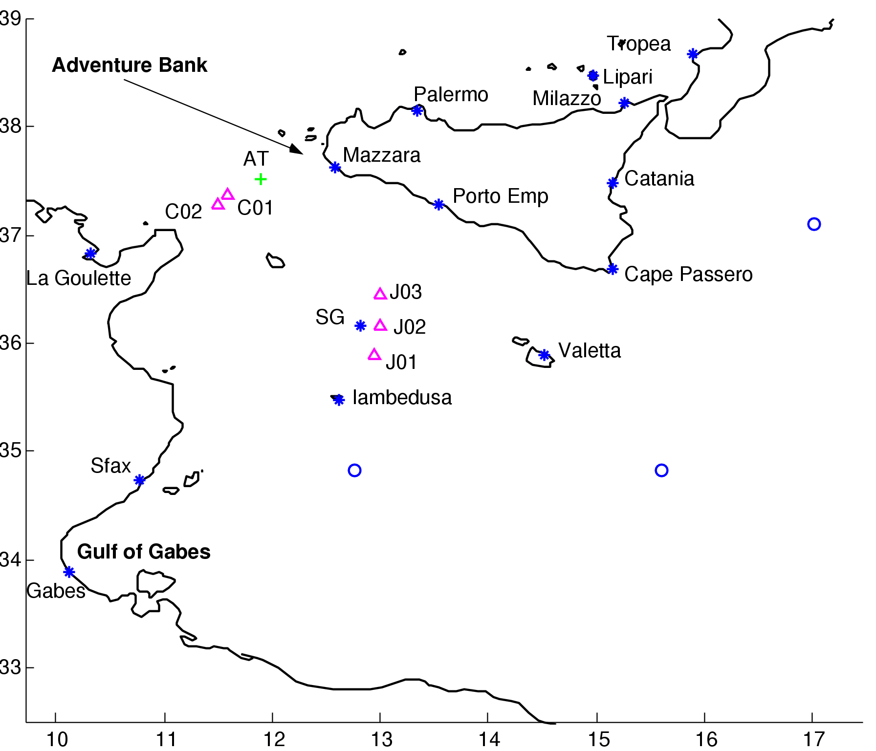
Validation of the barotropic solution
1/64° x1/64°
Tidal forcing (M₂, S₂, K₁, O₁) at the 4 open boundaries (MOG2D)
*
tide gauges
Topex
currentmeter stations Gasparini et al.(2004)
+ AT:artale et al.(1986)
3

Slide 4
Comparison of model results with tide-gauge and TOPEX data
 |  | ROMS | Mog2d
M2 | Rms(cm) | 2.5 | 5.1
 | Rms(°) | 16.3 | 18.3
 | RMSN | 4.2 | 7.5
K1 | Rms(cm) | 0.8 | 0.9
 | Rms(°) | 17.3 | 44.1
 | RMSN | 0.8 | 1.3
Our local solution is much closer to the data than that of Mog2d
4

Slide 5
Baroclinic Tides
5

Slide 6
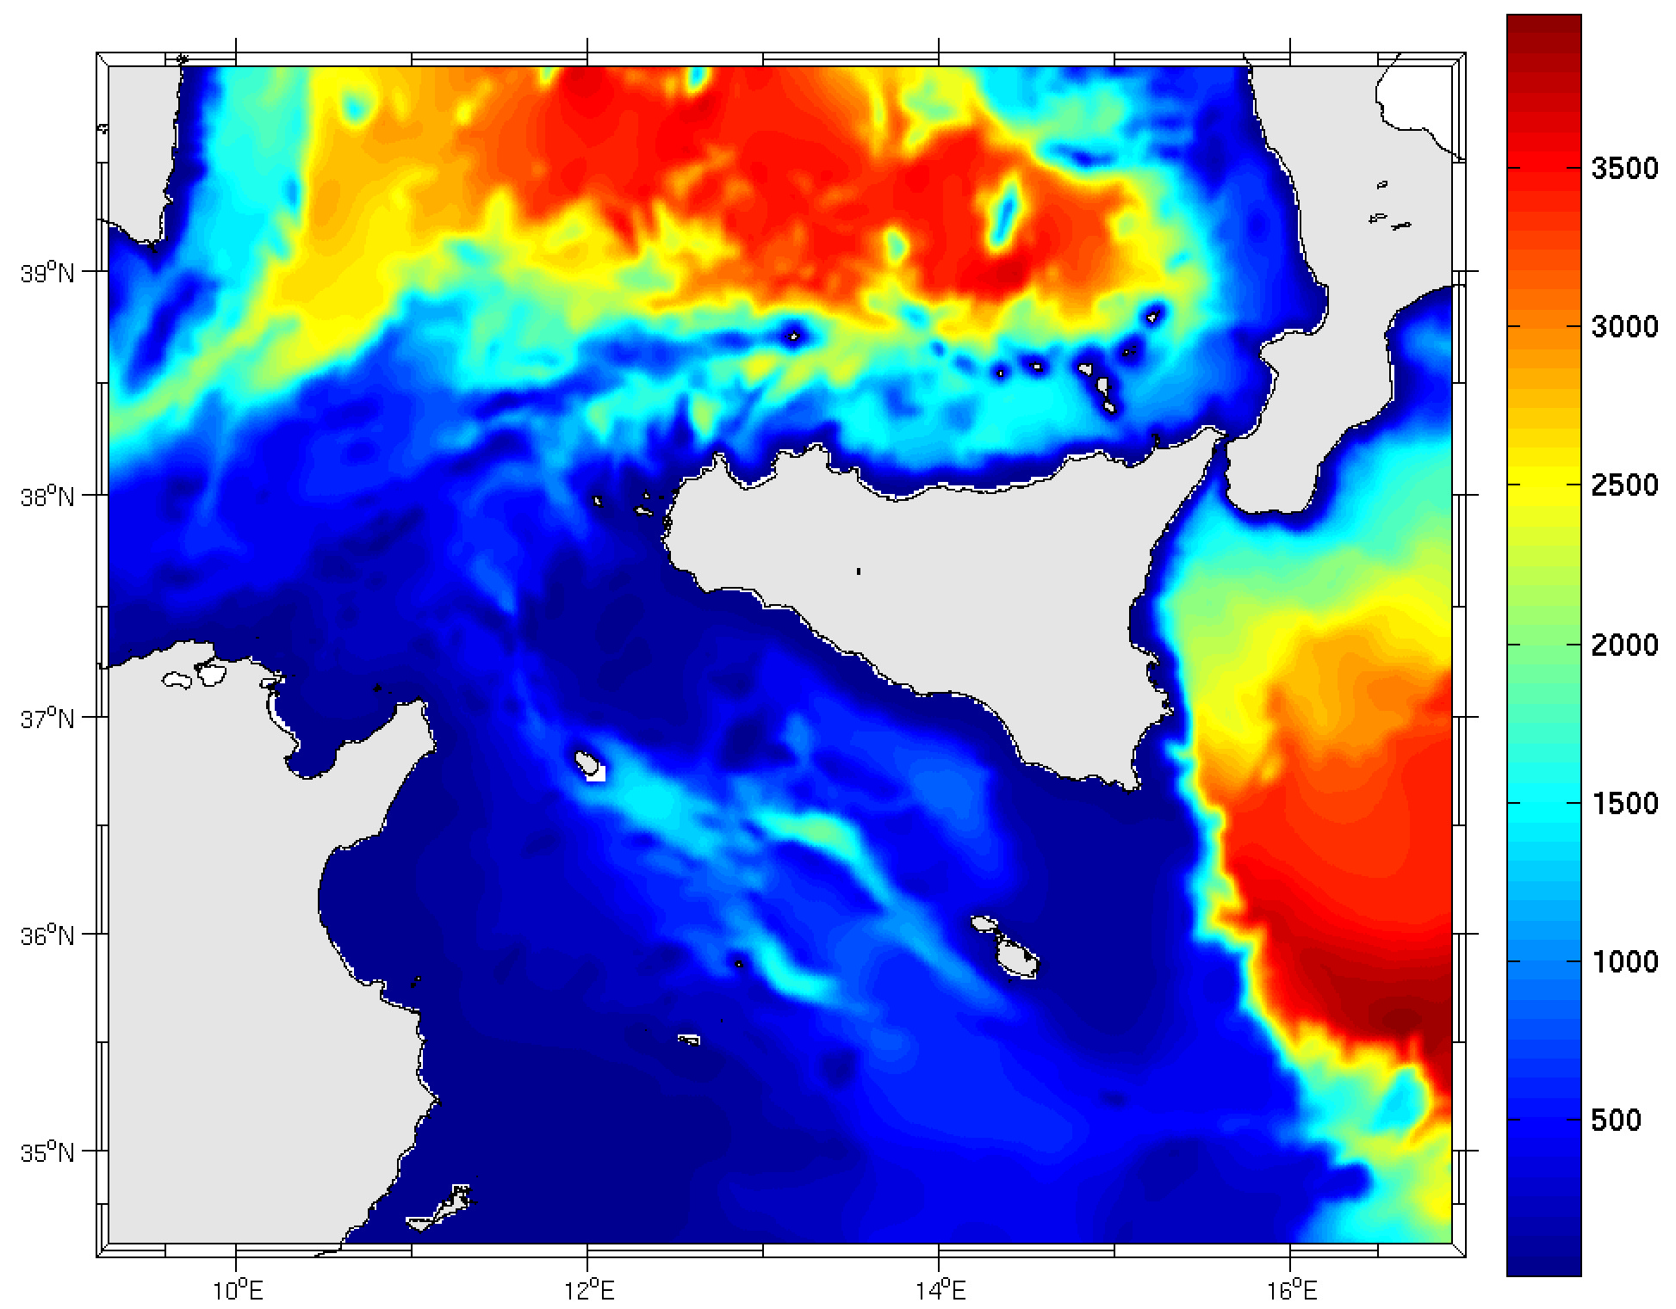
Model Domain - ROMS CONFIGURATION
1/64° x1/64°
30 vertical levels
Summer realistic stratification (Medar)
Tidal forcing (M₂, S₂, K₁, O₁) at the 4 open boundaries (MOG2D)
Mellor turbulent closure scheme
0.5° sponge layer
Sicily
Tunisia
Model bathymetry deduced from Gebco (1’ resolution) database
6

Slide 8
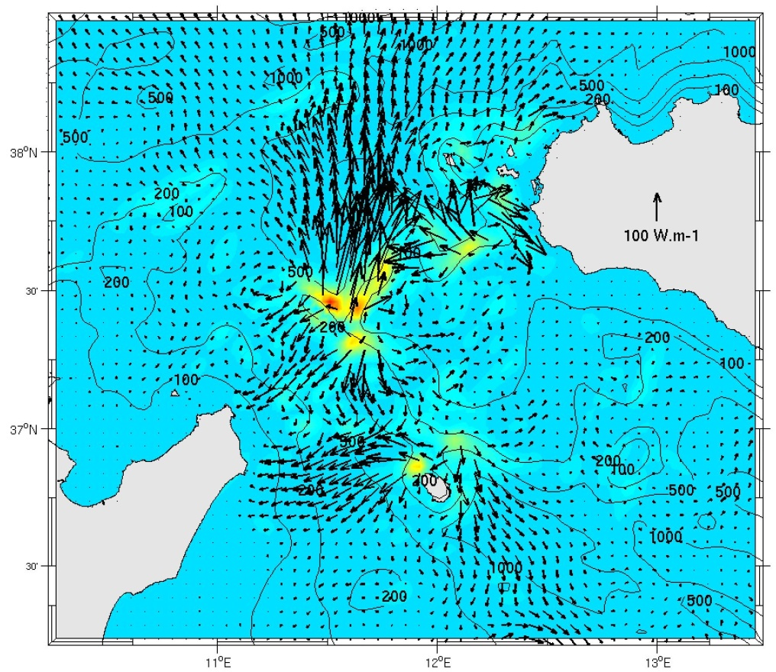
M₂ internal tide
The Adventure Bank, the western Sicilian Shelf and in the NW of Pantelleria isle are the three main generation sites of the M₂ internal tide.
Propagation toward the north and to the Tunisian coast from the most efficient generation site
TUNISIA
M₂ internal energy conversion rate(10⁻⁴ W.m⁻²).
Sureimposed is the M₂ internal energy flux.
8

Slide 9
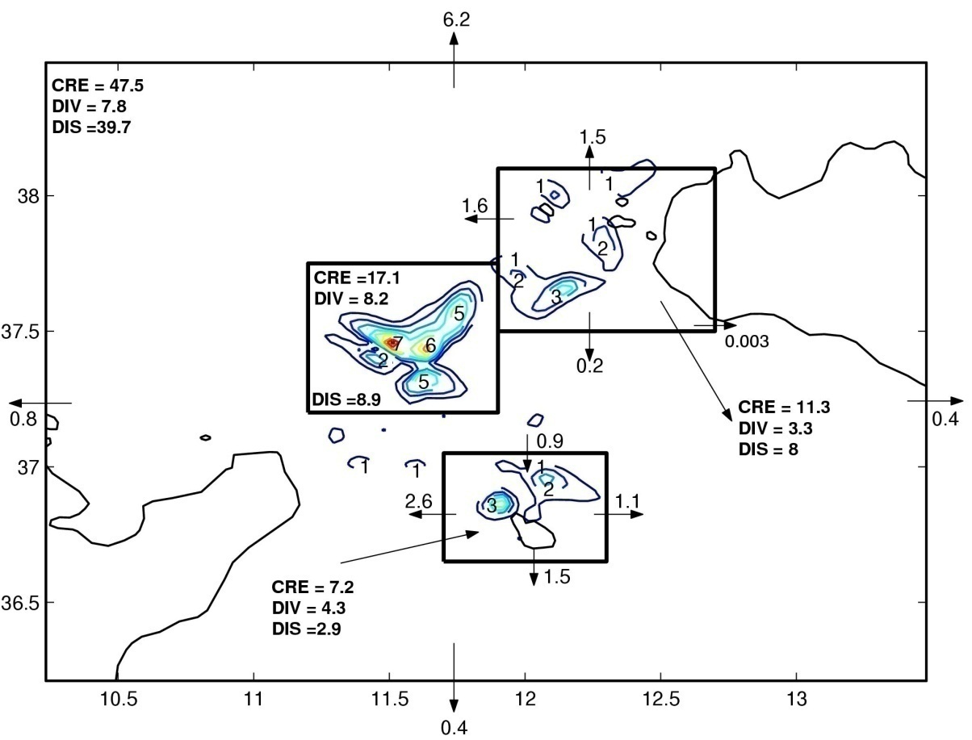
Model-predicted distribution of the depth-integrated energy conversion rate from the M₂ surface to internal tide. Integrated M₂ baroclinic energy flux across the bounding transects is given in MW. Conversion (CRE), dissipation (DIS) and flux divergence (DIV) are given in MW.
5.5
0.3
0.6
3.0
The M₂ mode energy conversion integrated over these prominent topographic features sums up to 35.6 MW, which is 75% of that integrated over the Sicilian strait
42 % of the M₂ baroclinic energy generated in the Sicilian Strait is dissipated in close proximity to the baroclinic M₂ generation sites.
9

Slide 10
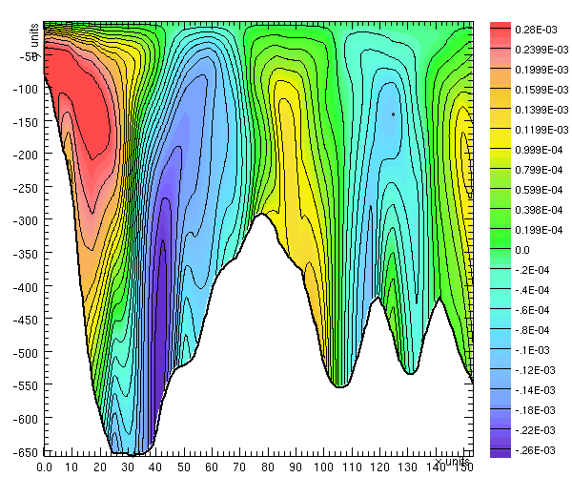
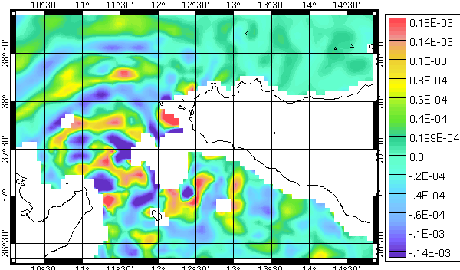
Reconstructed vertical velocity at the M₂ frequency
Reconstructed M2 vertical
velocity at 100m depth by
wavelet decomposition
Horizontal section at 100 m depth
λ_{sim}=66 Km
Vertical section from (11.70°,37.5°) to (10.40°,38.40°)
λ_{sim}≈ λ_{theo}= 64.6 Km (second mode)
10

Slide 11
transect
Sicily strait
TUNISIA
The chosen transect corresponds to the prominent direction of propagation of the M₂ internal tides from the most efficient generation site.
11

Slide 12
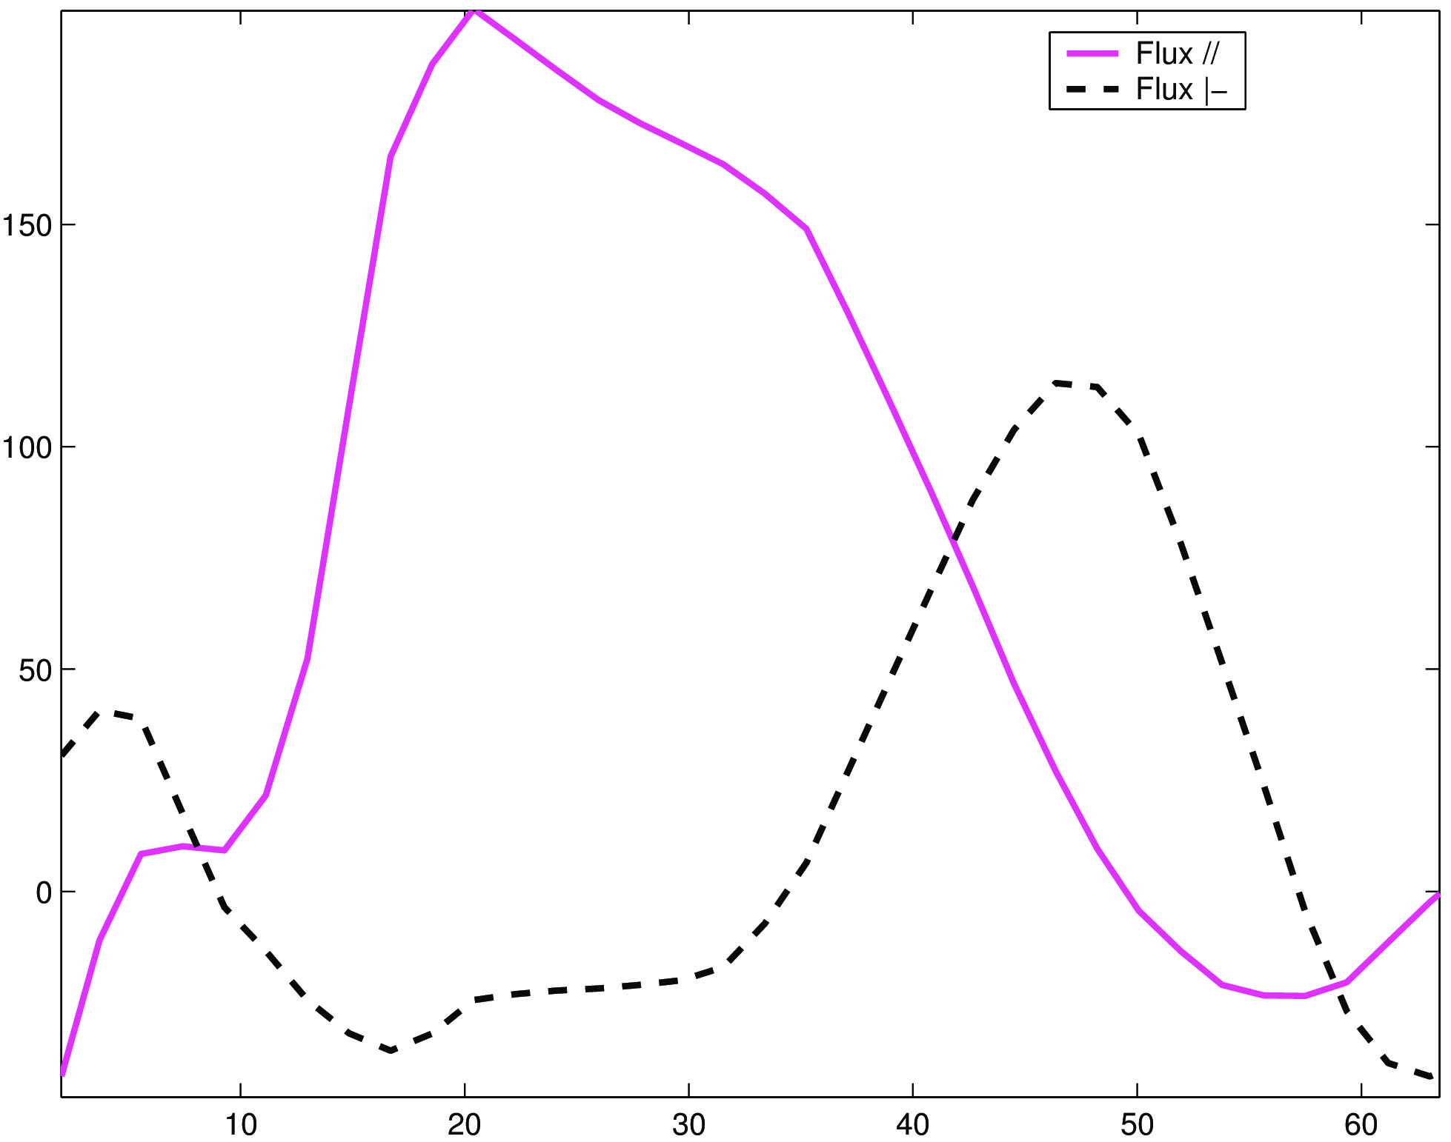
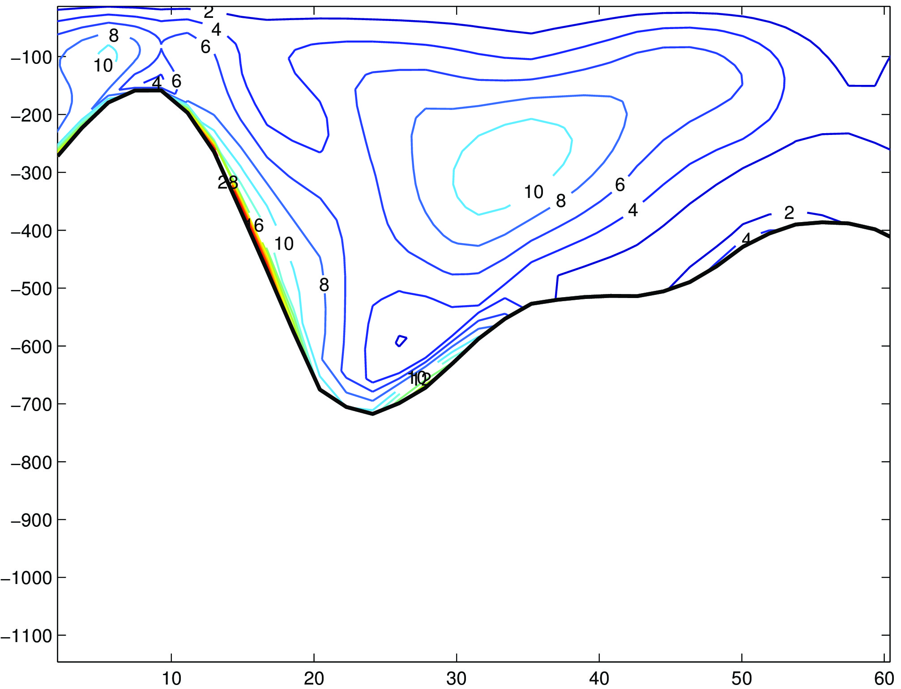
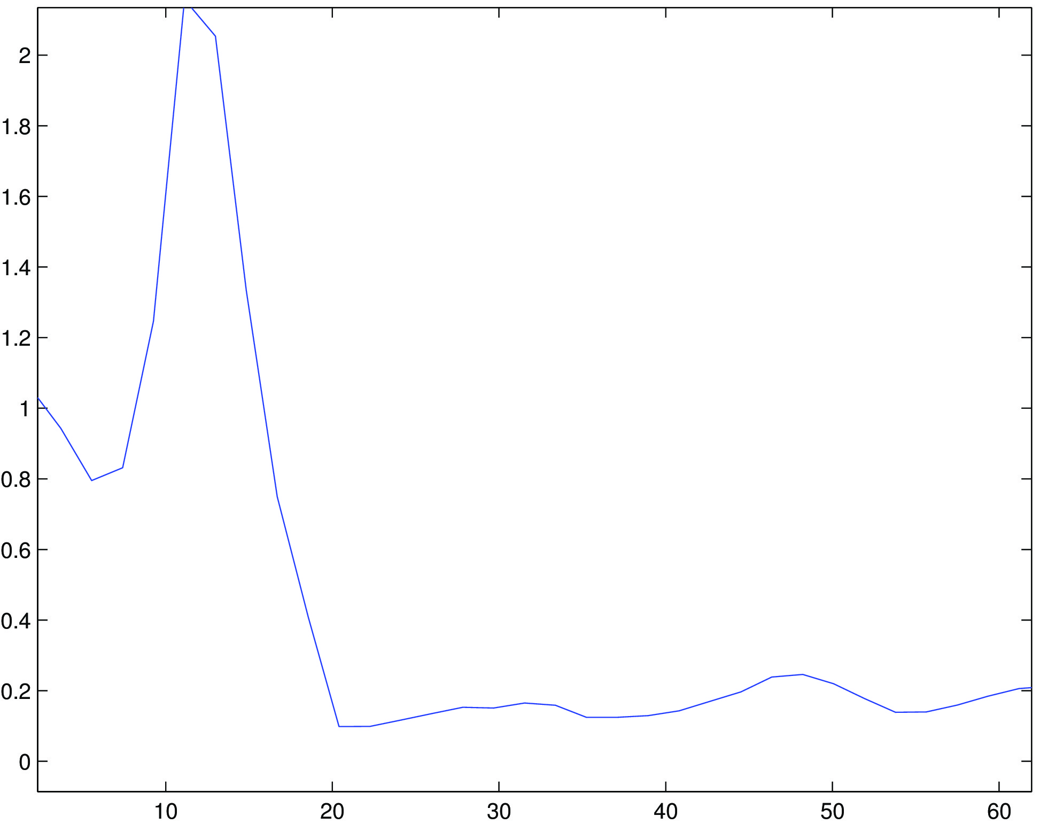
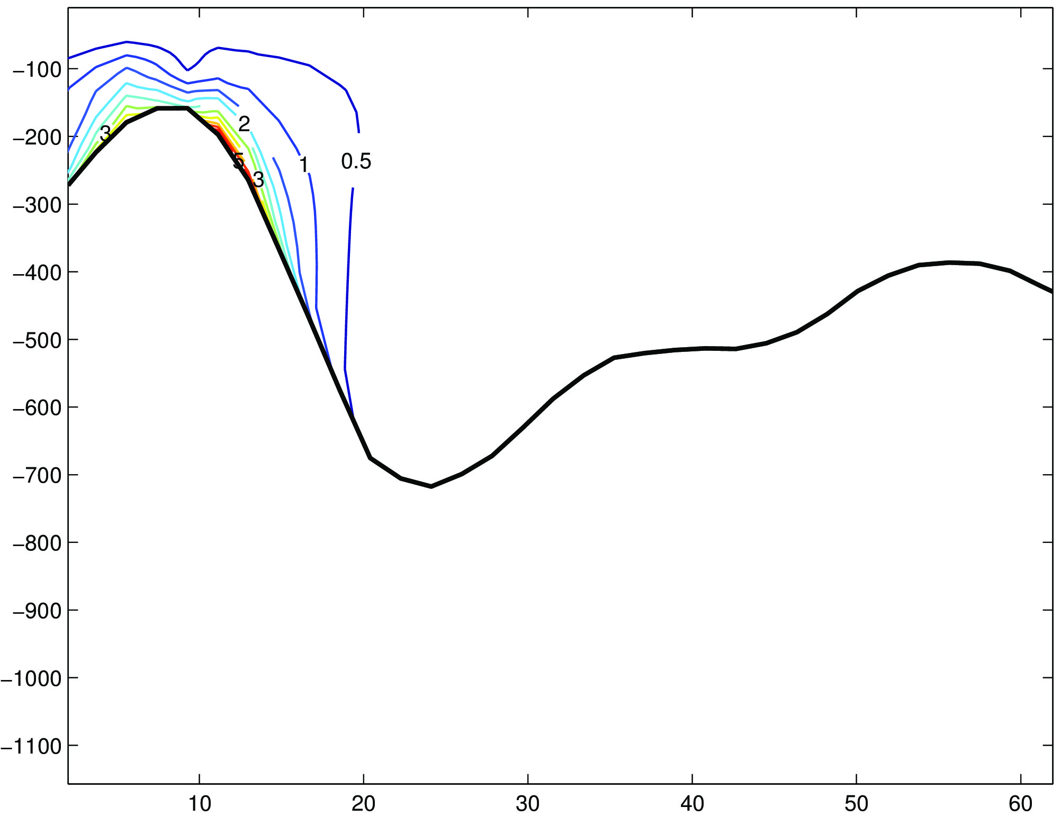
Internal generation criteria parameter γ
M₂ internal vertical displacement amplitude (m)
M₂ depth integrated internal energy flux along (Flux //) and across (Flux |-) component (W.m⁻¹)
M2 internal vertical displacement amplitude (IDA) larger than 29 m occurs in the generation site , noticeable IDA are present elsewhere (at the seabed and deep regions)
Strong conversion occurs over the steepest parts of the continental slope (shelf edge of the AB) which is characterized by a supercritical slope as reveals the plot of the internal generation criteria parameter γ.
The cross and along shelf components of the M2 depth integrated energy flux reveal a seaward propagation as suggested by Sherwin (1991)
M₂ internal energy conversion rate
(10⁻⁴ W.m⁻²)
12

Slide 13
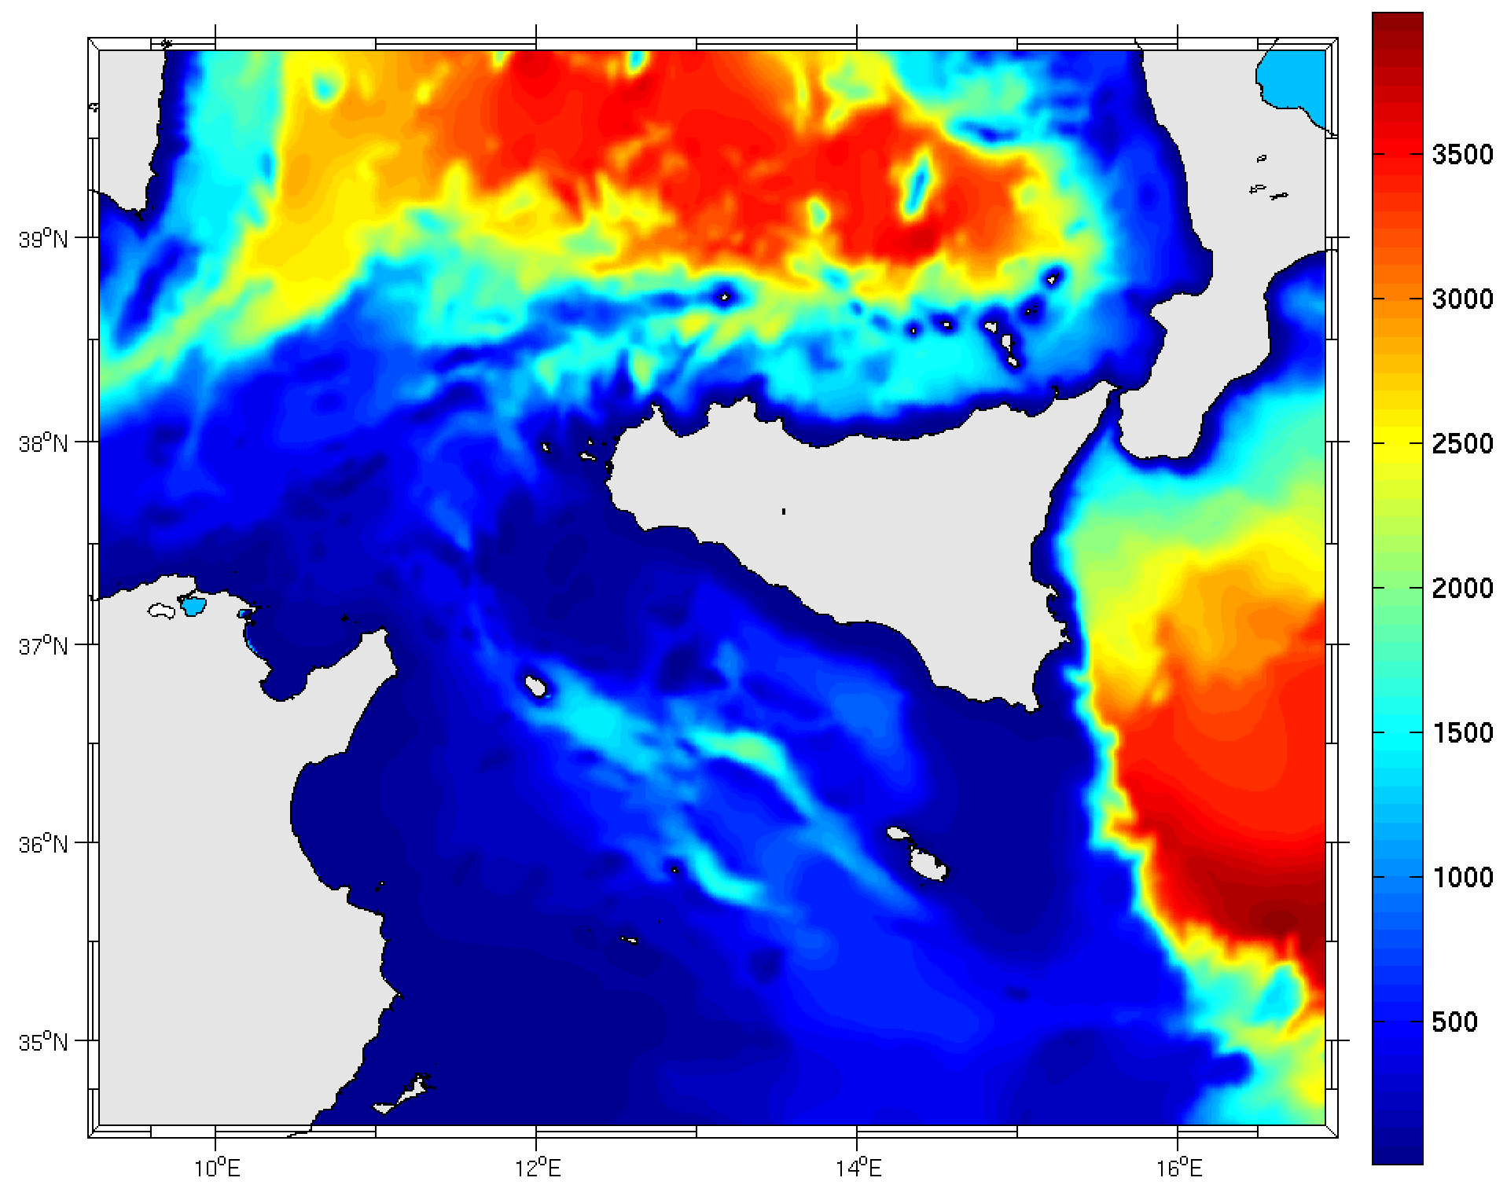
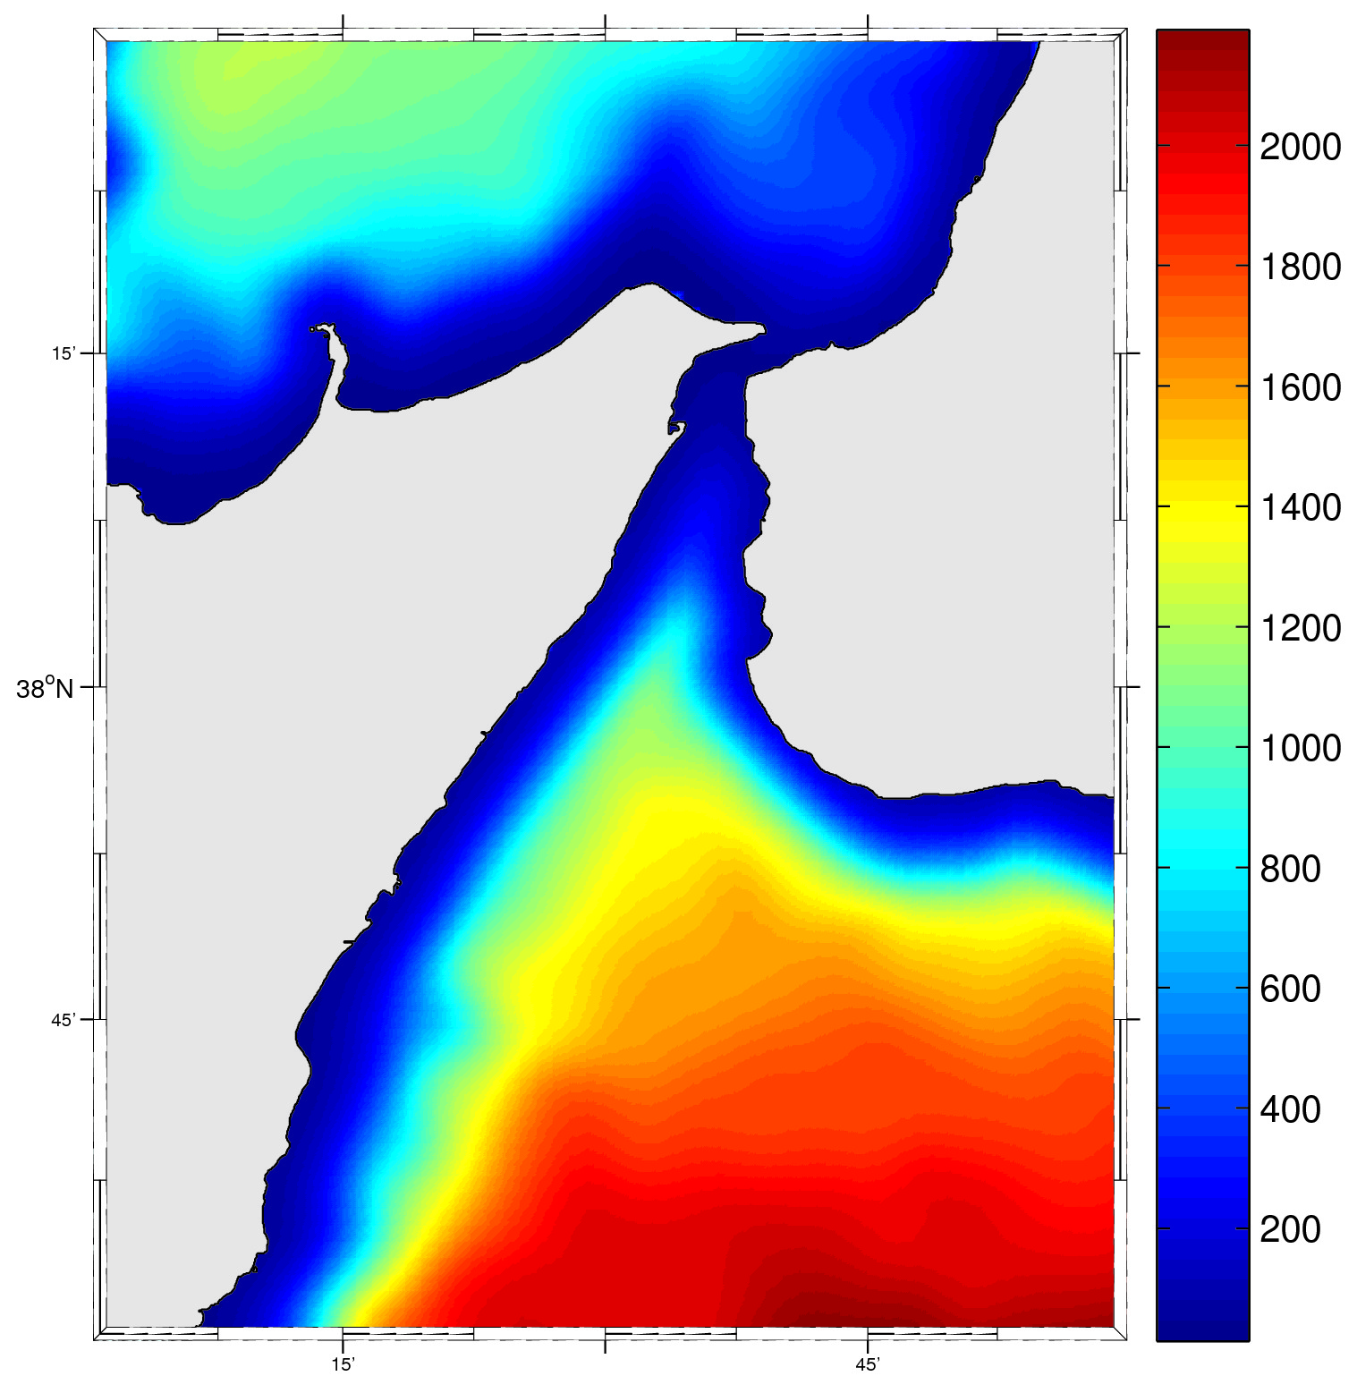
M₂ internal tide in
the Messina Strait
SICILY
TUNISIA
13

Slide 14
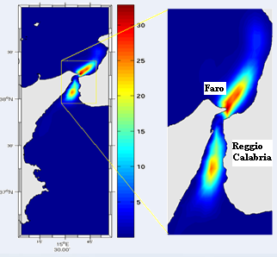
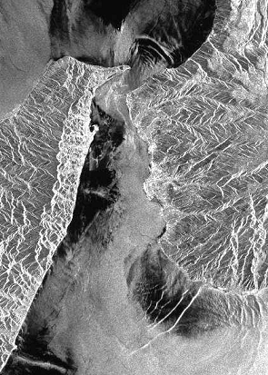
M₂ internal tides in the Messina strait
Radar image
M₂ internal energy conversion rate
(10⁻² W.m⁻²).
14

Slide 15
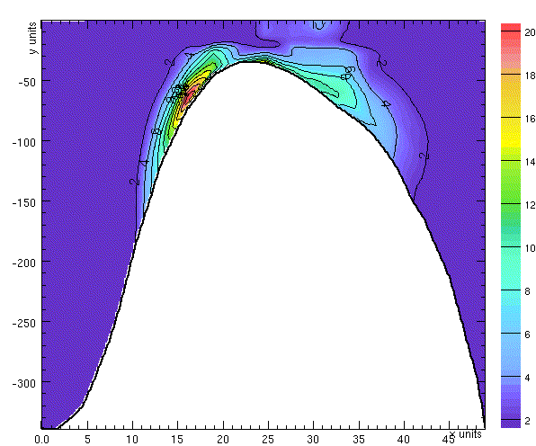
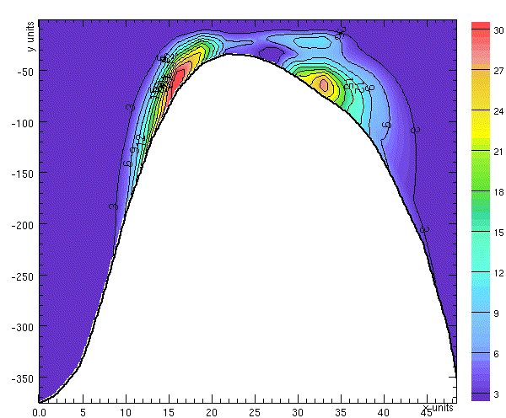
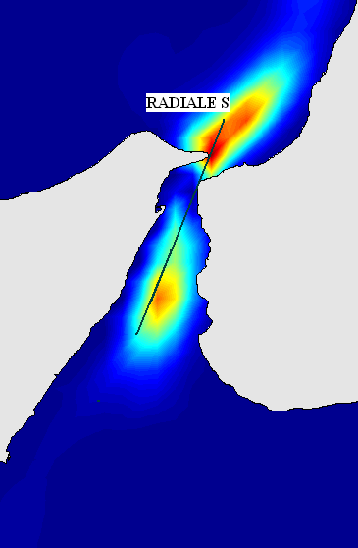
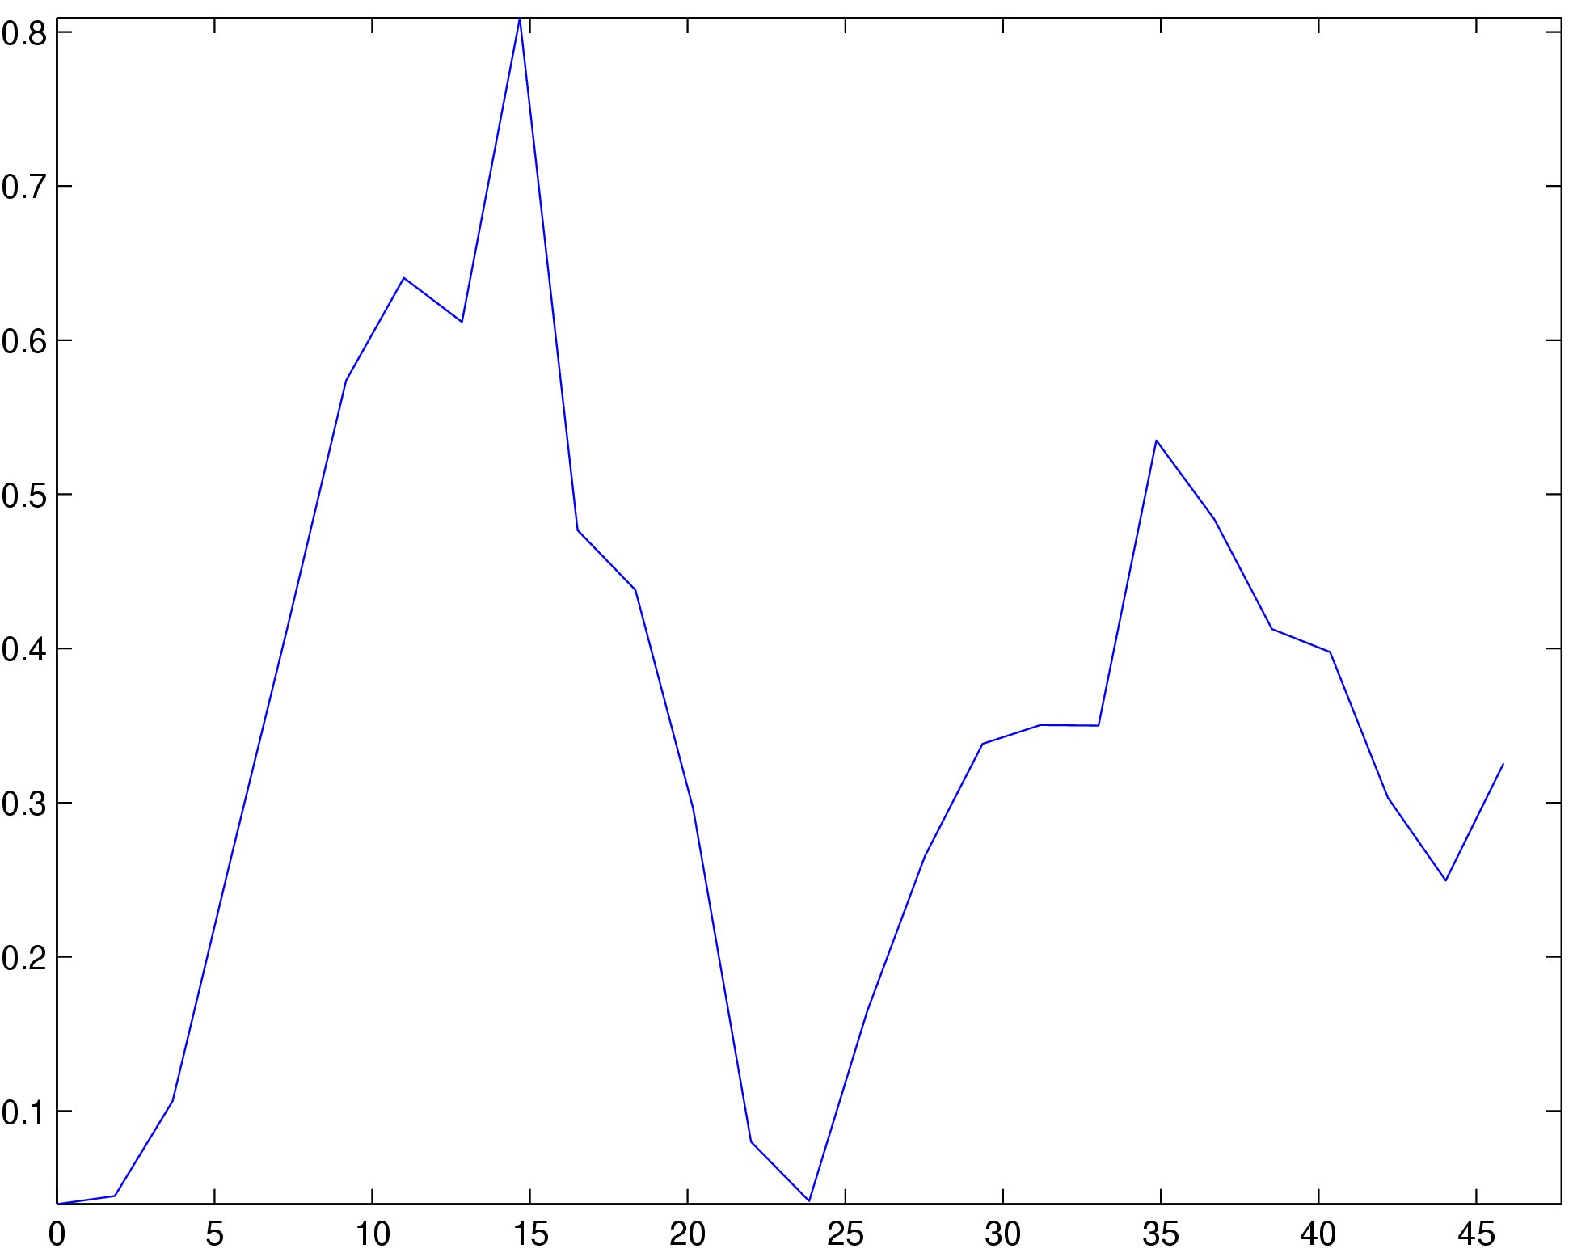
M₂ internal density
energy (J.m⁻³)
M₂ internal energy conversion
rate (10⁻⁴ W.m⁻³)
Near critical
The value of the internal wave generation criteria parameter is near critical at 15 Km from the origin transect leading to strong internal tide signal
The second generation site (subcritical slope) generates weak internal tide
subcritical
M₂ internal wave generation criteria parameter
15

Slide 16
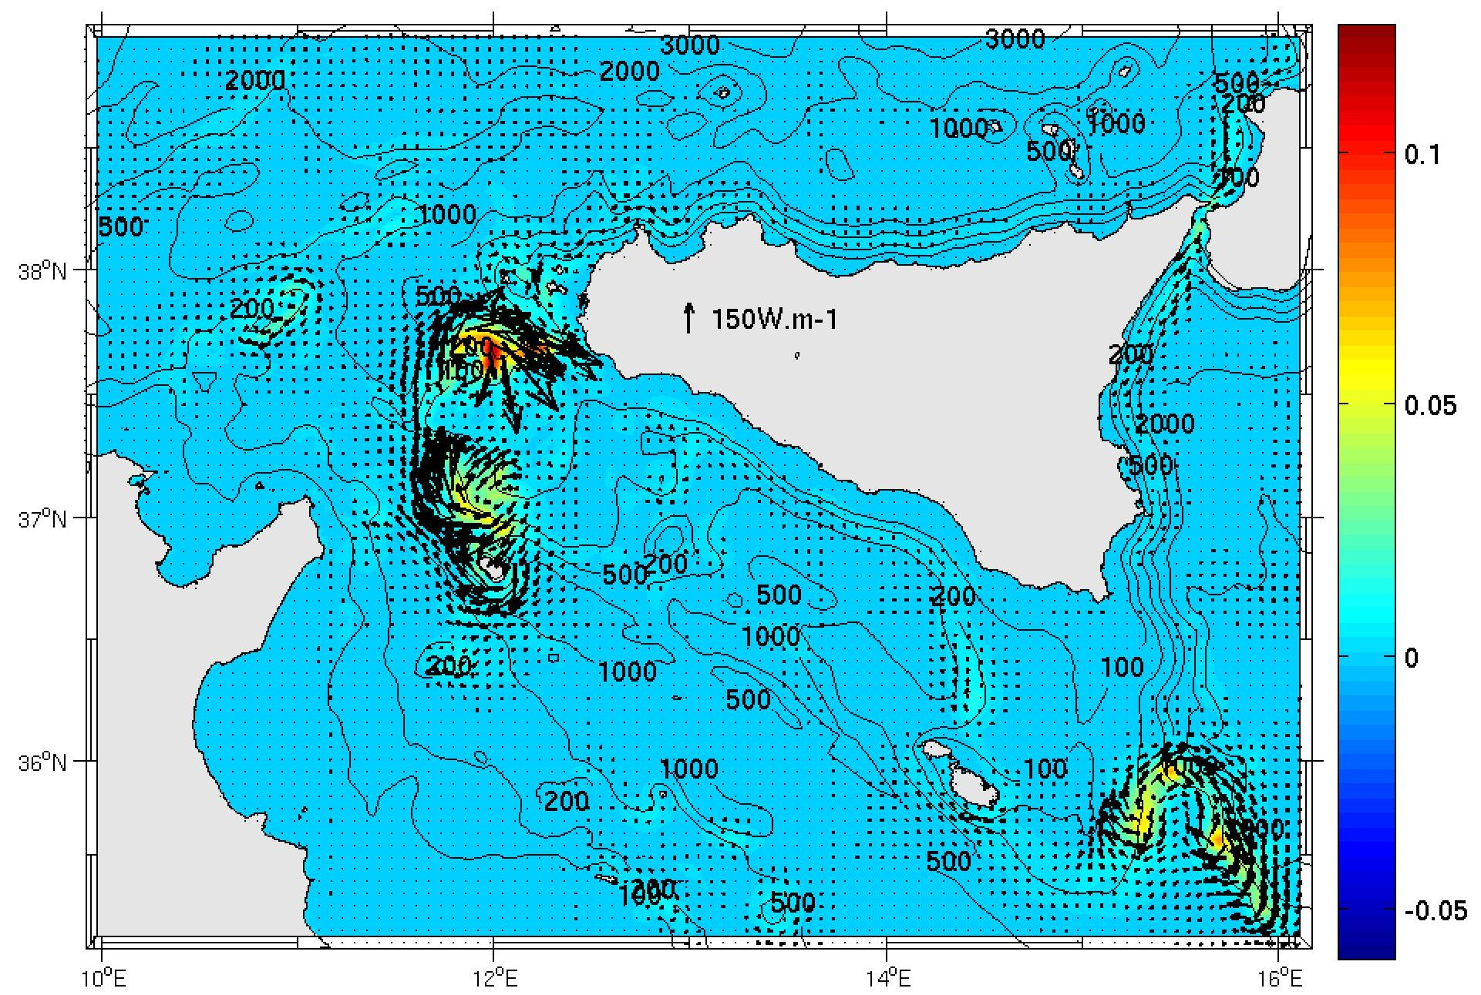
K₁ Internal tide generation
SICILY
TUNISIA
The depth-integrated K₁ baroclinic energy flux and the energy conversion rate (W.m⁻²)
The K₁ internal tide is generated over the Adventure Bank’s edge, the surrounding of Pantelleria isle and the south east of the Malta plateau.
16

Slide 17
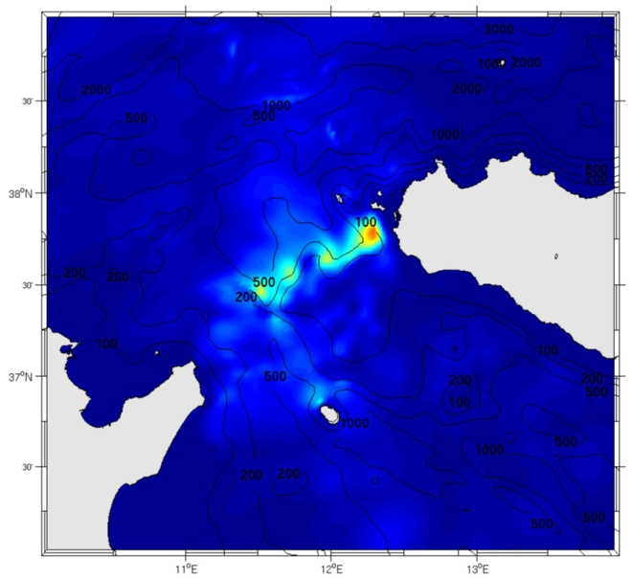
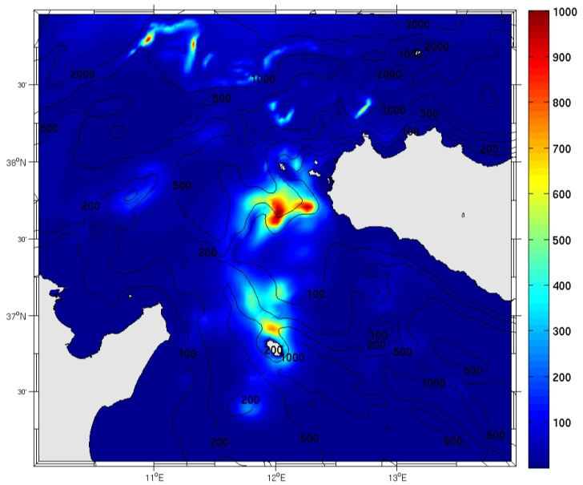
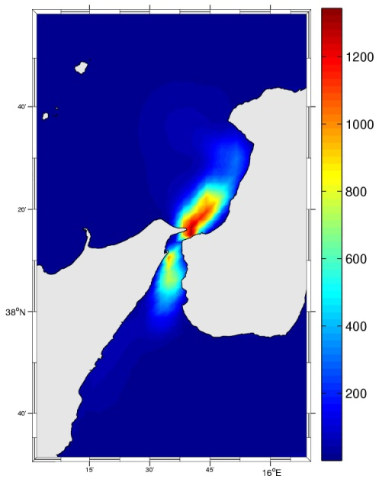
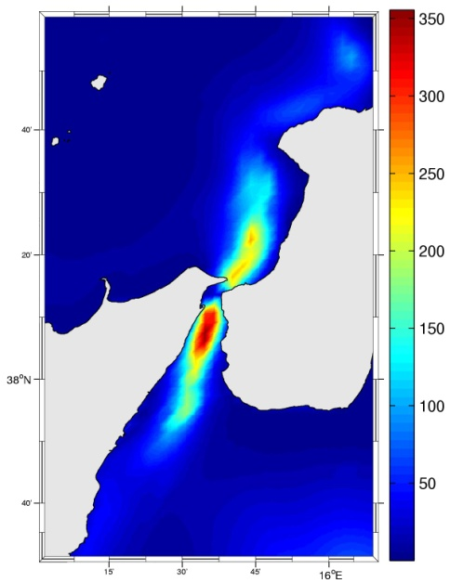
Depth integrated internal energy (J.m⁻²) of M₂ and K₁
M₂
K₁
M₂
K₁
17

Slide 18
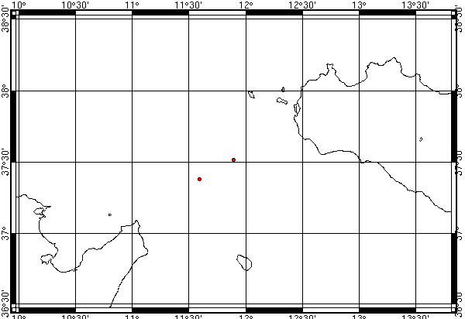
Sicily
AT
C01
Tunisia
C01 : currentmeter station (Gasparini et al., 2004)
AT: station of in-situ temperature measurement (Artale et al., 1889)
18

Slide 19
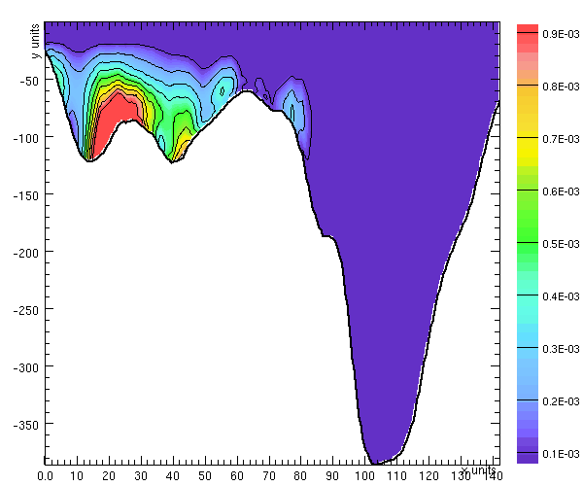
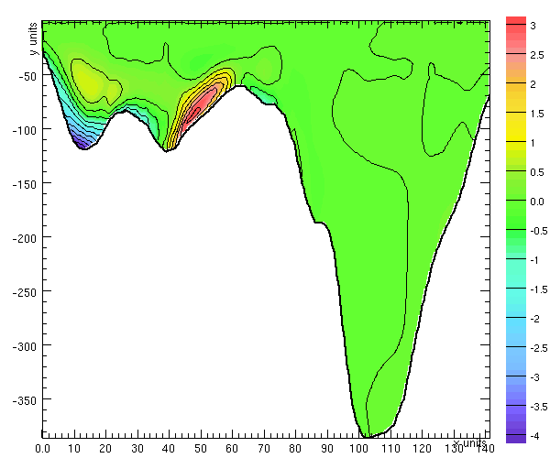
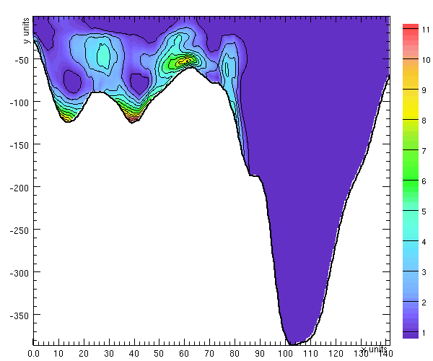
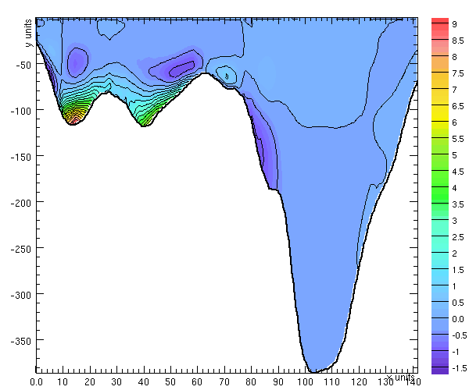
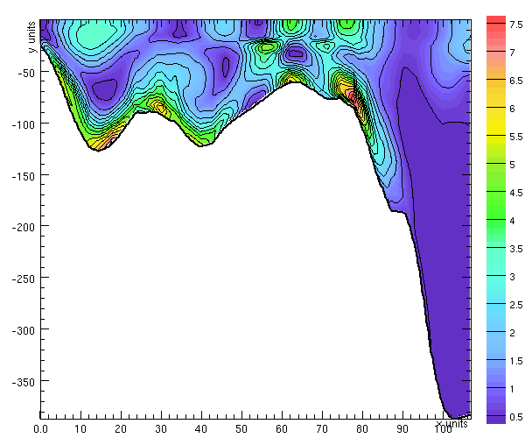
AT
C01
K₁ internal energy flux (component along transect)
(W.m-1)
K₁ internal energy
conversion rate
(W.m⁻³)
K₁ internal
density
energy
(J.m⁻³)
K₁ internal energy is topographically trapped
AT
C01
K₁ internal energy flux (component across the transect)
(W.m⁻¹)
M₂ internal density energy
(J.m⁻³)
19

Slide 20
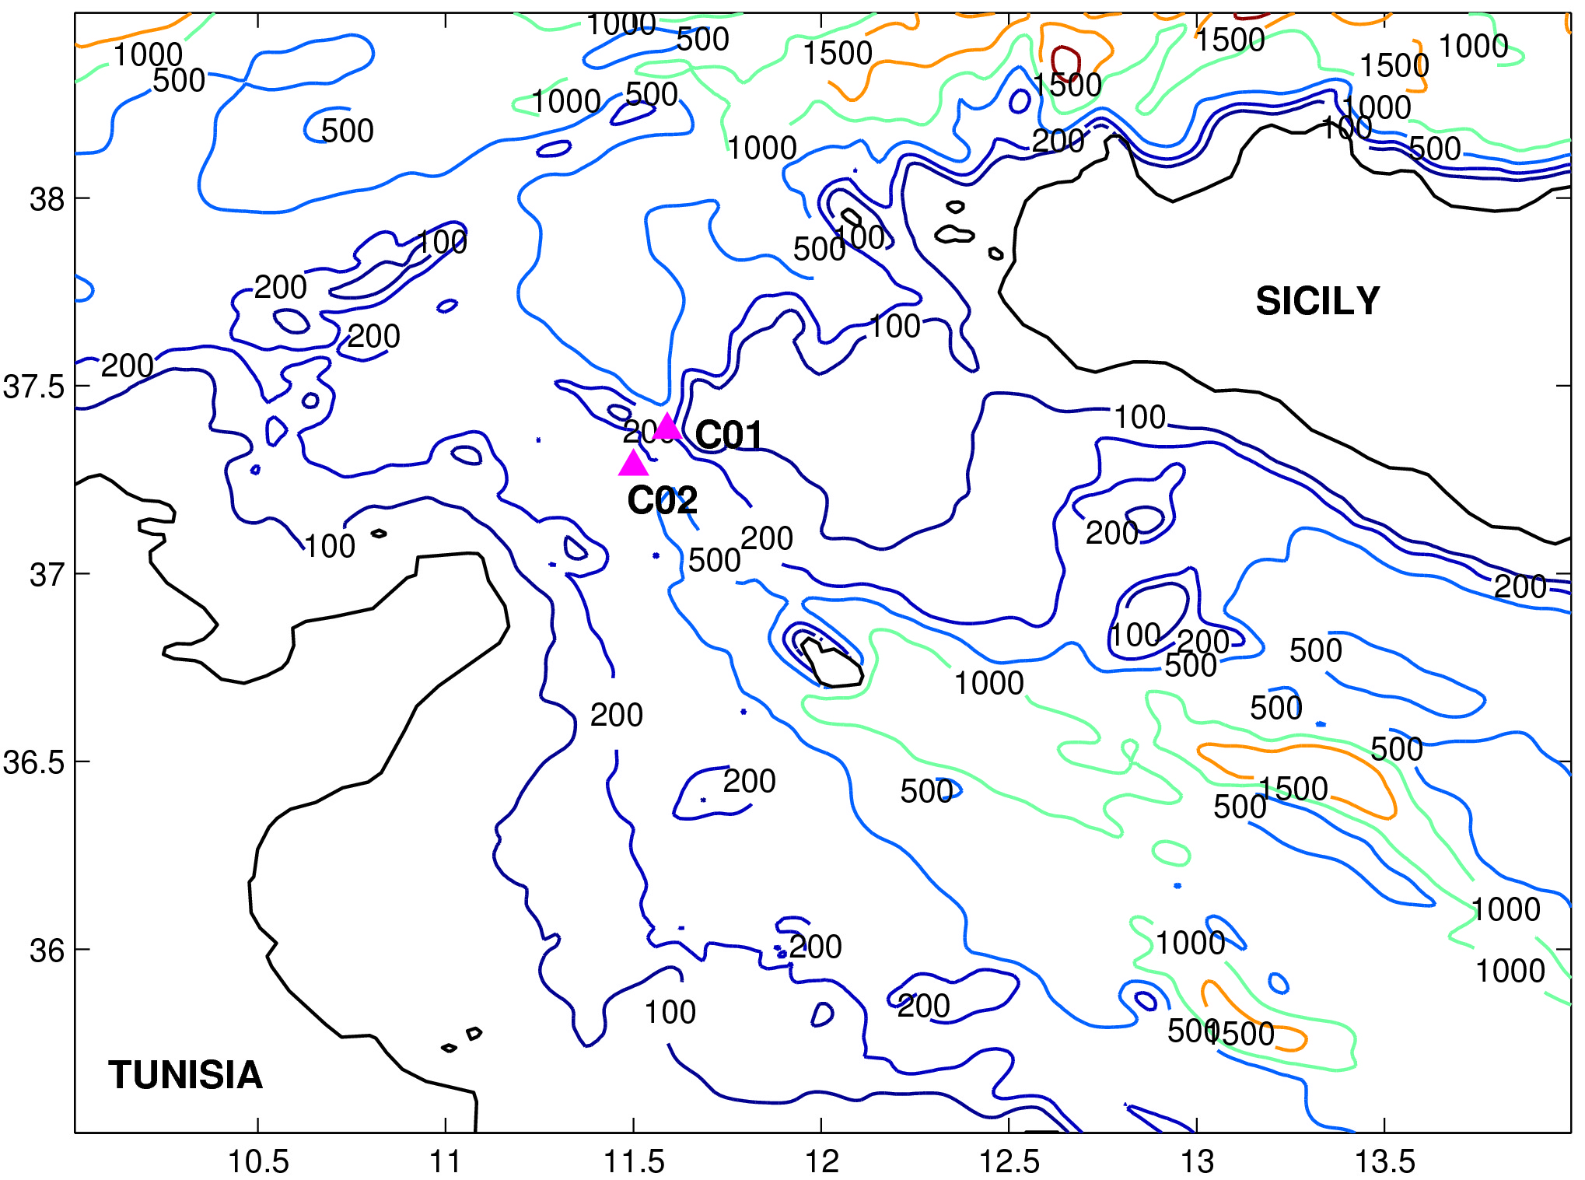
Validation
C01and C02 : currentmeter stations (Gasparini et al., 2004)
20

Slide 21
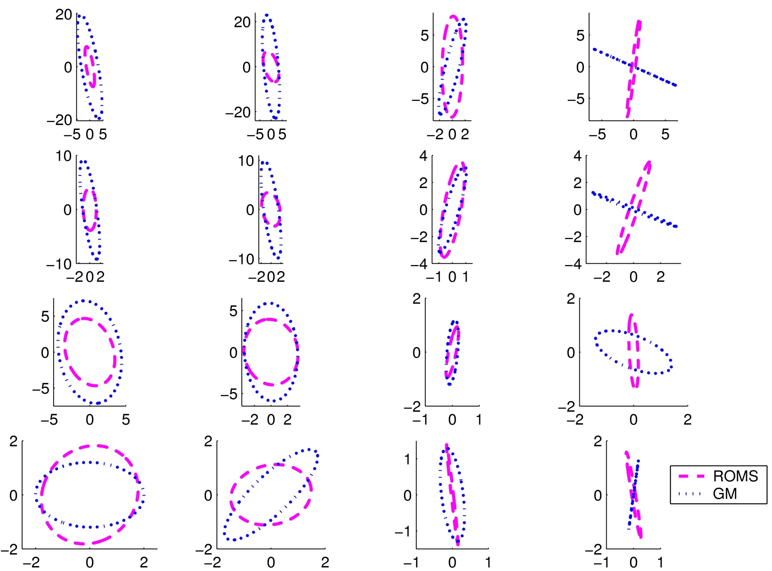
Current ellipses at C01 station
M₂
S₂
K₁
O₁
21
53 m
93 m
285 m
380 m

Slide 22
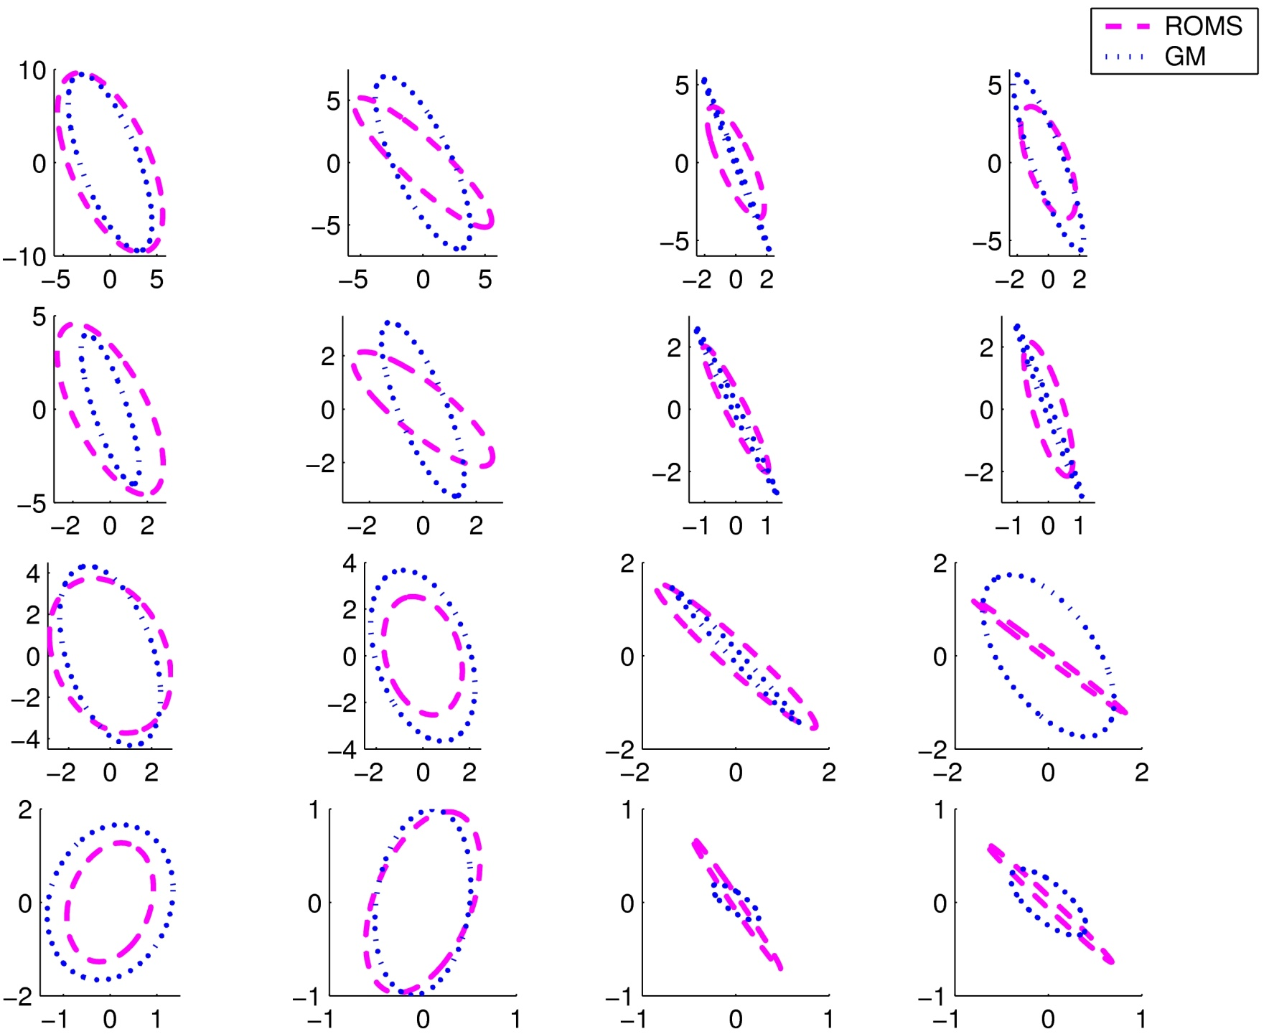
Current ellipses at C02 station
M₂
S₂
K₁
O₁
22
46 m
103 m
289 m
408 m

Slide 23
Test of three advection schemes
23

Slide 24
Sicily strait
TUNISIA
24

Slide 25
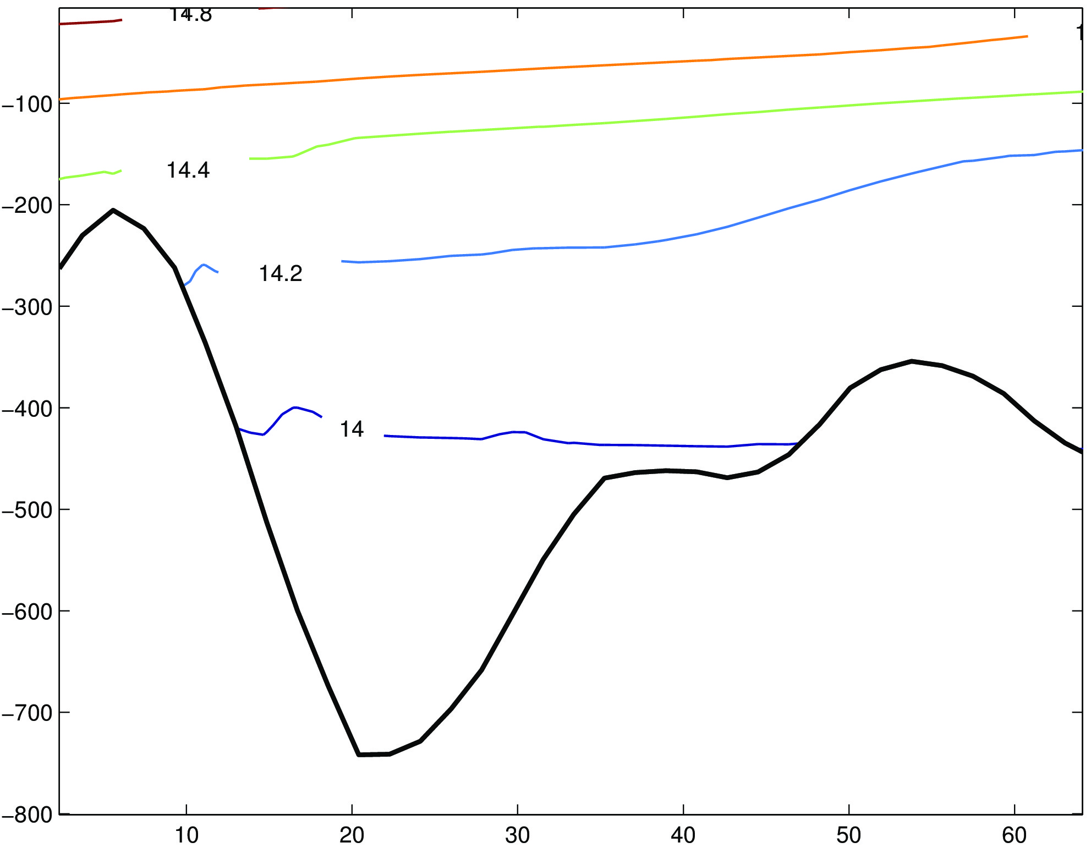
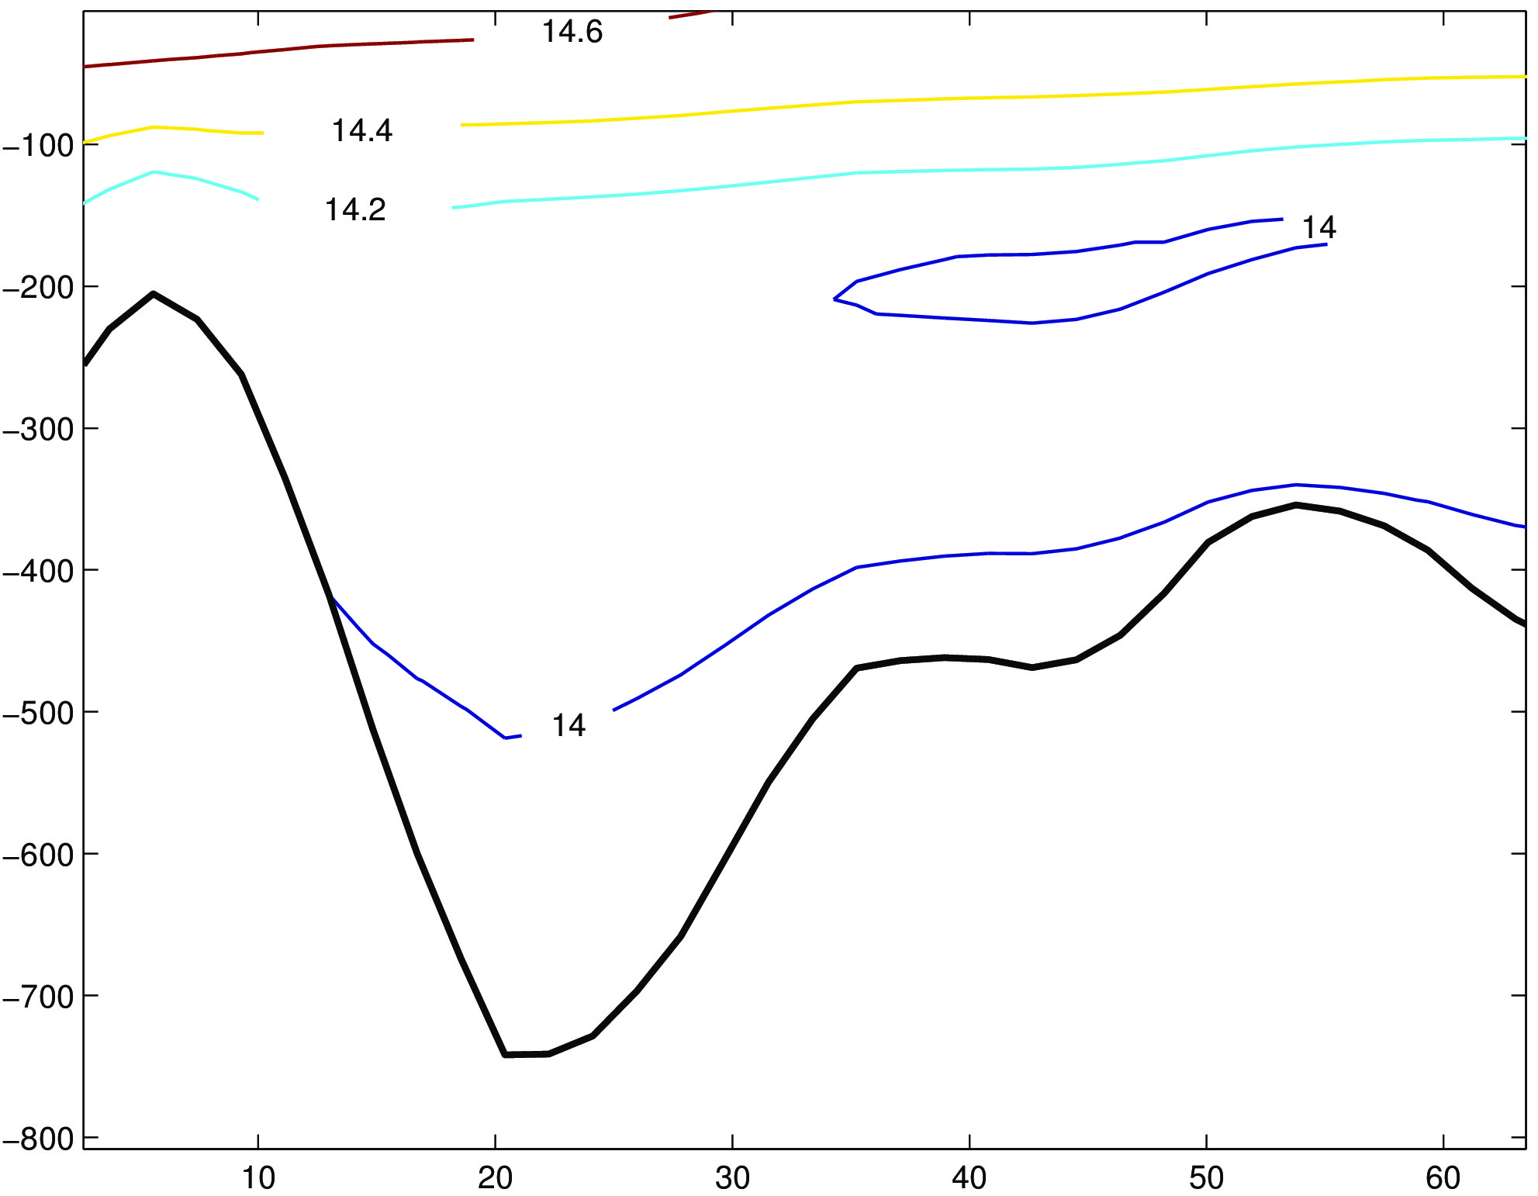
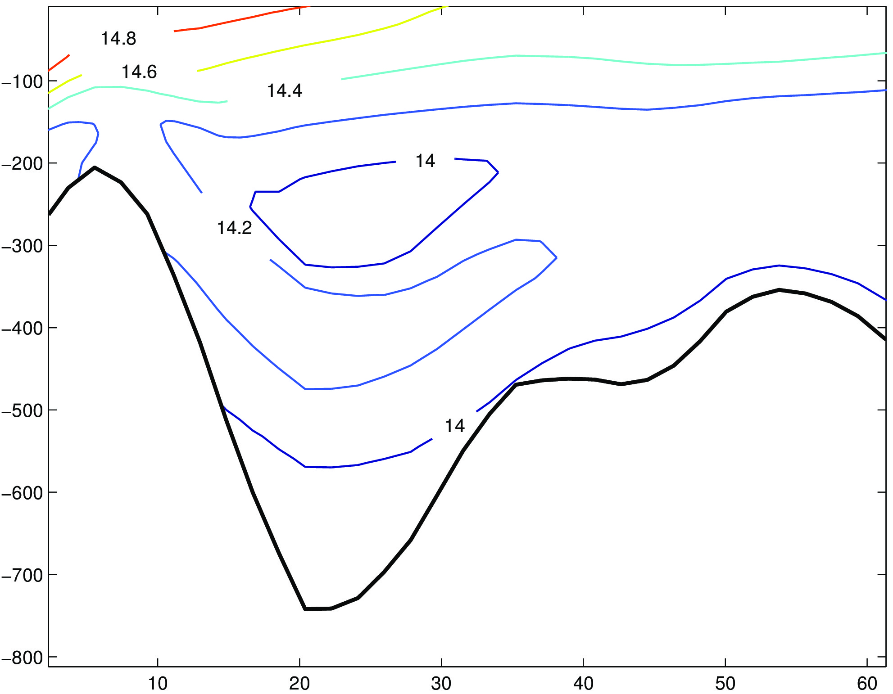
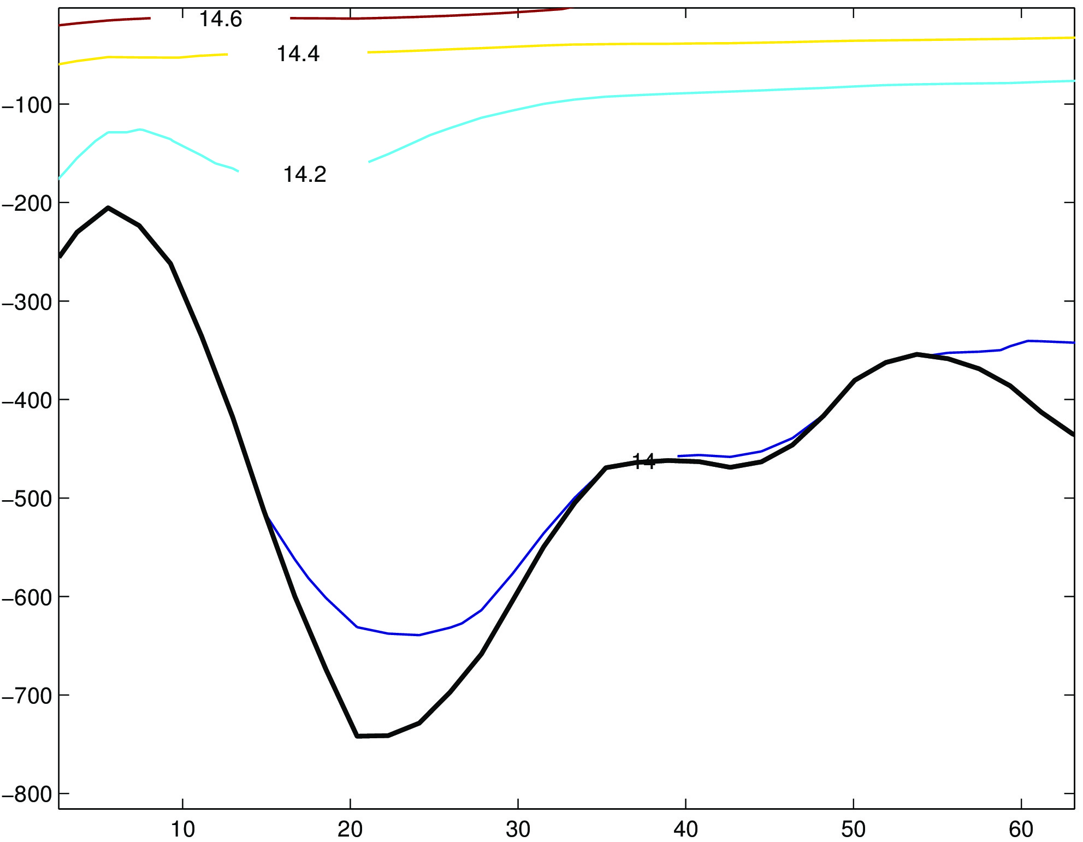
Potential temperature (vertical section)
Initial state
4th order Akima (TS)
4th order centered(UV)
3rd order upstream
split advection (UV,TS)
3order upstream scheme (horizontal)
C4 on the vertical
25

Slide 26
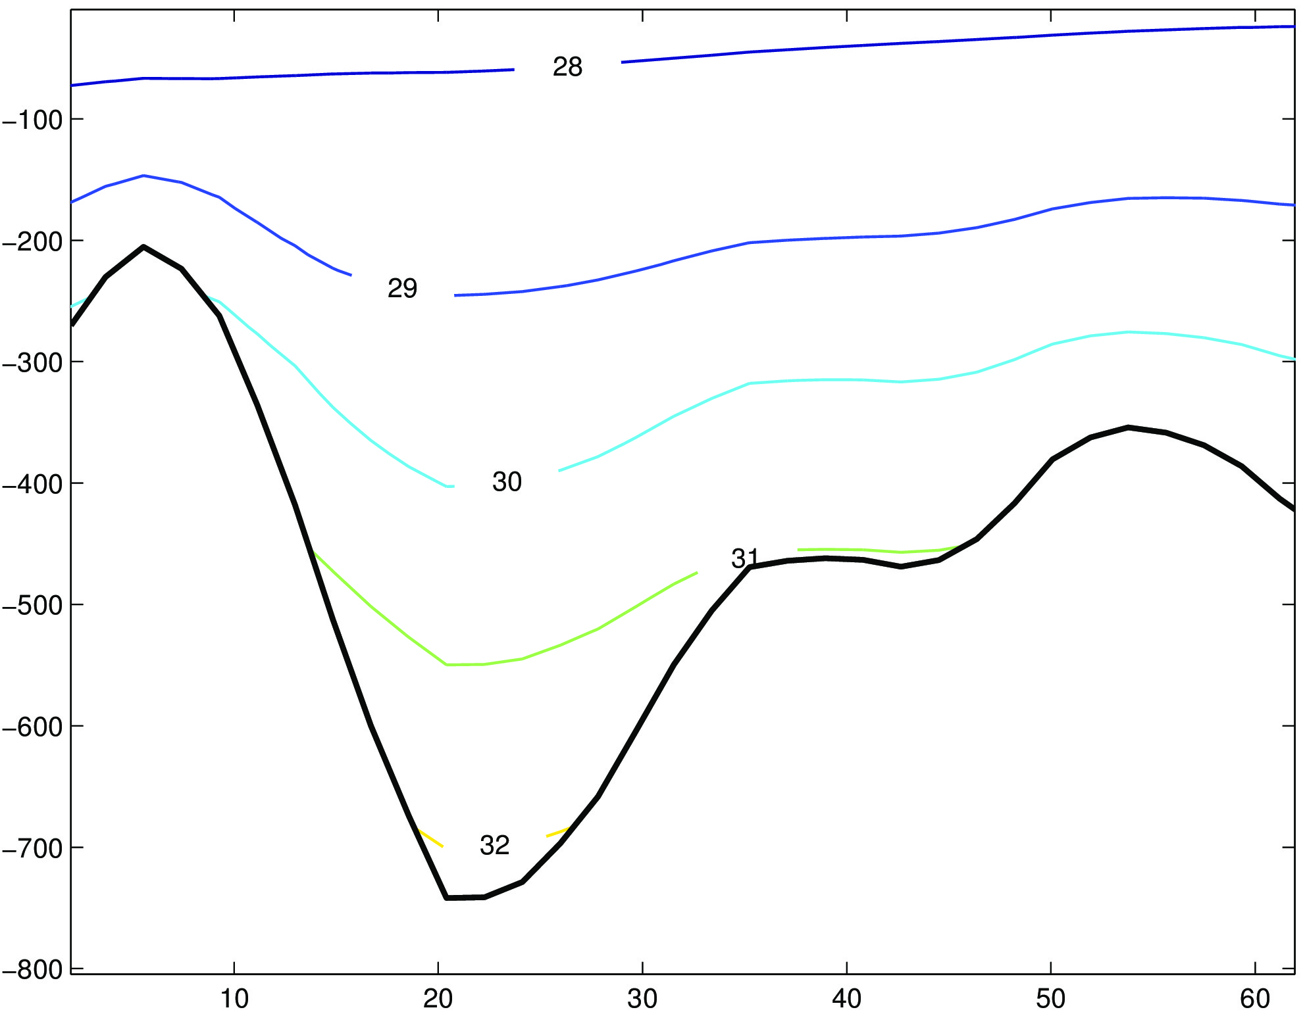
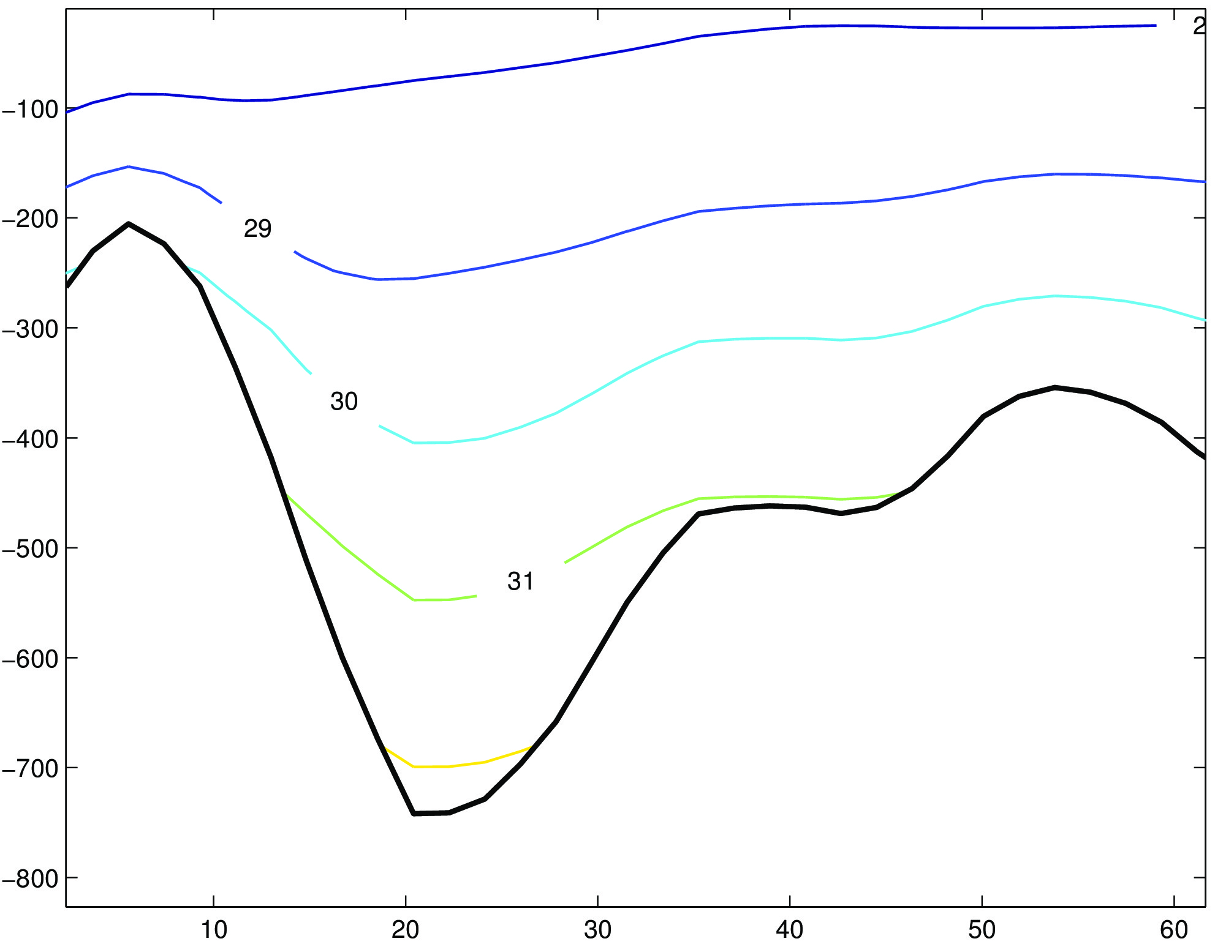
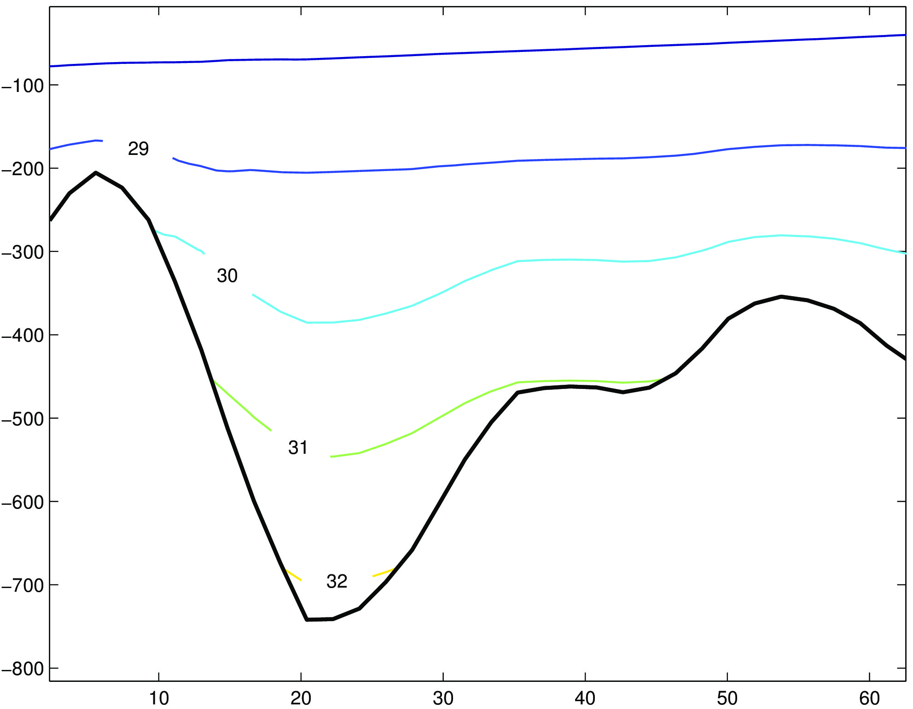
Density anomaly
The vertical isopycnal displacement differs slightly from an advection scheme to another
Which suitable advection scheme to use ?
4th order Akima (TS)
4th order centered(UV)
3order upstream scheme (horizontal)
C4 on the vertical
3rd order upstream
split advection (UV,TS)
26

Slide 27
CONCLUSIONS
Three potential sites of M₂ internal tide are identified in the Sicily Strait and two in the Messina Strait
The propagation of M₂ internal tide is to the north and toward the Tunisian coast from the most efficient generation site
The M₂ internal tide signal is stronger in the Messina Strait
The K₁ internal tide is globally less energetic than M₂
The K₁ energy is totally dissipated close to the generation sites
27

