Slide 1
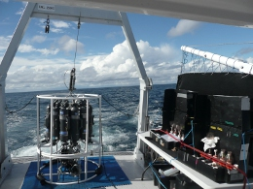
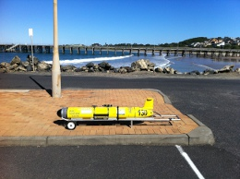
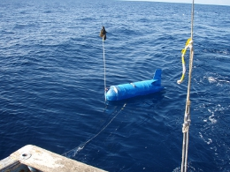
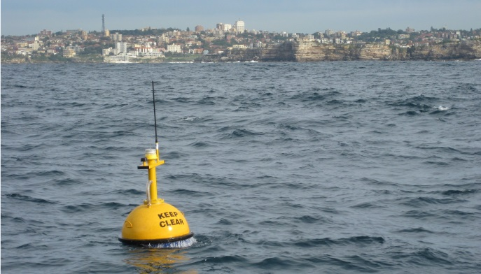
Cold Core Frontal Eddies in the East Australian Current: Formation, Entrainment and Biological Significance
Moninya Roughan Helen Macdonald, John Wilkin, Mark Baird, Jason Everett
UNSW Coastal and Regional Oceanography Group
www.oceanography.unsw.edu.au
Notes:
3- yr mean at coffs and sydney. V, U, T.
Cross Shelf Processes and the East Australian Current.
The East Australian Current flows poleward along the coast of south eastern Australia, generally separating at about 31Deg S before heading eastward to form the Tasman Front. The current has the potential to dominate the physical structure of continental shelf waters as it encroaches upon the continental shelf and drive upwelling in what is typically an oligotrophic region. Before the commencement of the IMOS programme observational process studies were limited in both time and space. Since 2008, the deployment of significant oceanographic infrastructure in NSW shelf waters
has allowed for an in depth investigation into significant cross shelf processes.
In particular we have new understanding of the: Temporal and spatial variability of EAC intrusions and shelf circulation, the Impact of EAC eddy encroachments (both cyclonic and anticyclonic) on shelf waters, the pwelling events, their forcing mechanisms and impacts the prevalence of submesoscale features and their impact on the shelfiological response to EAC forcing.
These processes will be discussed in the context of the IMOS observations and new results presented.

Slide 2
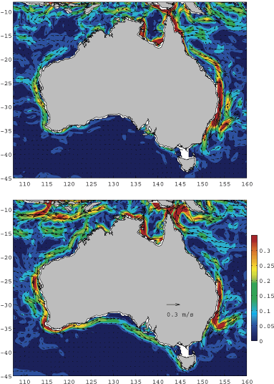
Circulation around Australia
Poleward flowing currents along east and west coast
  Leeuwin Current (West Coast)
  East Australian Current (East Coast)
Major transport of heat and freshwater anomalies;
Seasonality in poleward penetration
Influence climate conditions and processes downstream
Summer
Winter

Slide 3
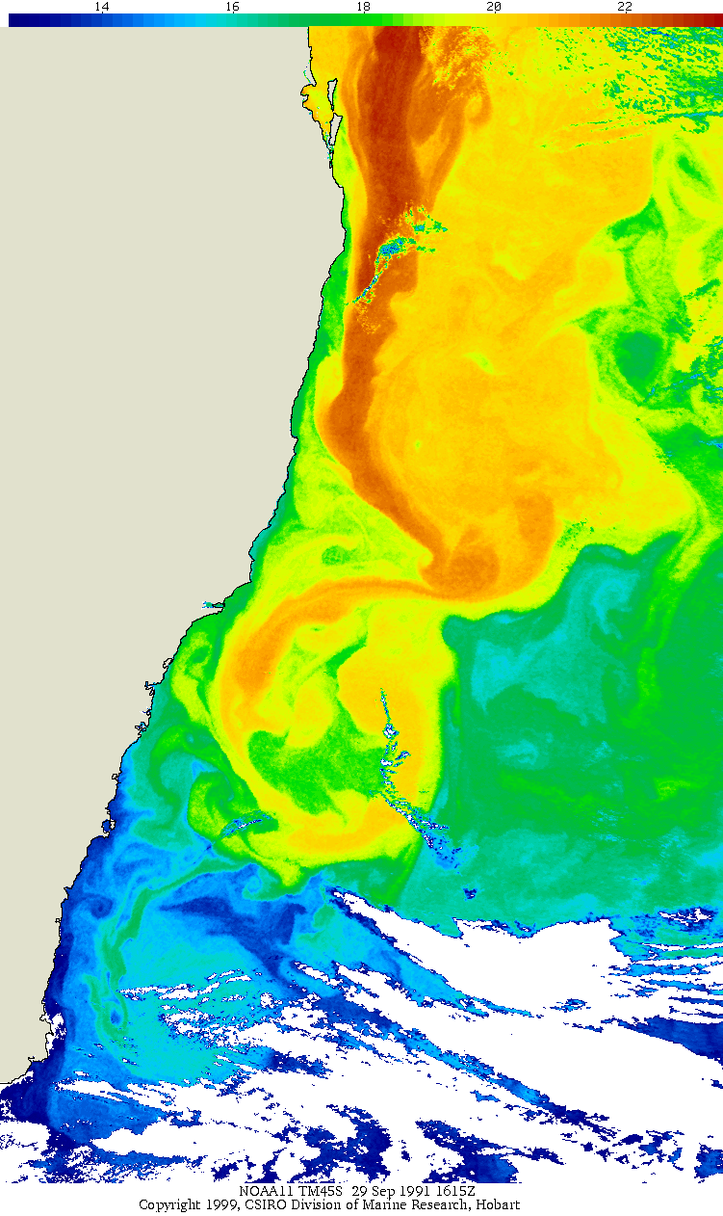
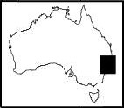
The EAC – A Vigorous WBC
Strong WBC > 2m/s, up to 7ºC temp gradient
Separates around 30.5-32.5ºS
The main jet has a seasonal cycle – stronger in summer
Intense Eddy field (Meso Scale and Sub Mesoscale) - periodic eddy shedding Cyclonic and anticyclonic. Related to separation. (Baird et al., 2011, Macdonald et al 2012, Everett 2011, Cetina Heredia 2014 sub)
Transports heat poleward - moderates climate of SE Australia.
Shelf dominated by EAC or its eddy field
Tasman Sea (WBC extension) is warming rapidly 2.2ºC/100y
Transports tropical species poleward -Tropicalisation of temperate regions (coral/kelp)
EAC
Coffs Harbour
EAC Separation
Sydney
Batemans Bay
EAC Eddy
Tasman Sea
SST 29/9/91
Notes:
Either this one or the next slide, not both.

Slide 4
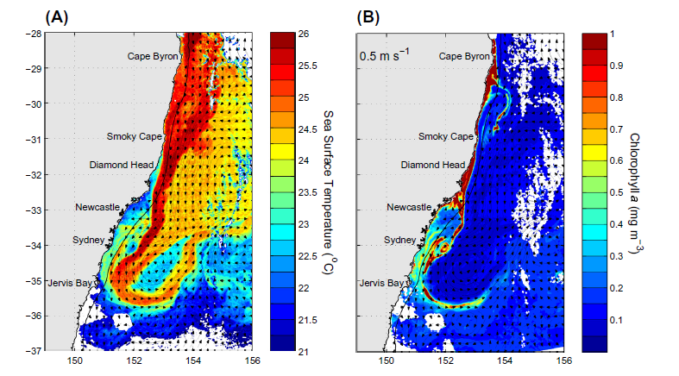
Productivity Paradox – Nutrient devoid WBC
High chlorophyll concentrations (productivity) evident as a consequence of:
Topographic Acceleration (Cape Byron 29ºS, Smoky Cape 31ºS)
EAC Separation (30.5-32.5ºS),
Cold Core Eddy (34ºS),
Entrainment of shelf waters, into EAC retroflection
Everett et al PiO 2014

Slide 5
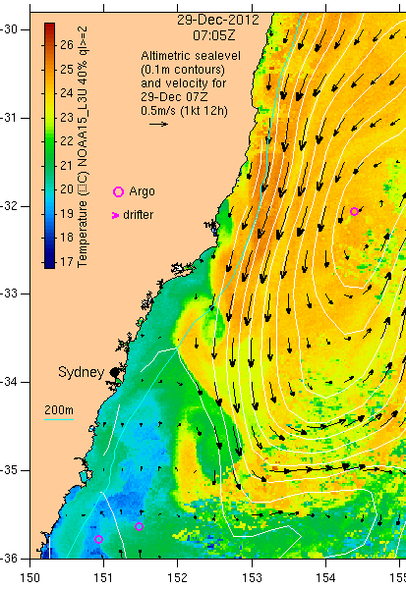
Cold Core Eddies – Sub Mesoscale Coherent Flow Structures
Have been hard to find, measure and observe (resolution)
More Ubiquitous than once thought.
Captured in SST/ MODIS and HF Radar
Some are short lived - < 24 hrs, Others evolve lasting from 1 to many months, growing in size.
MODIS Imagery suggests that these eddies are high in chlorophyl conc.
Aid fish larvae recruitment and survival.
SST (°C)
HF radar residual currents
cold core eddy
(diameter ∼25 km)

Slide 6
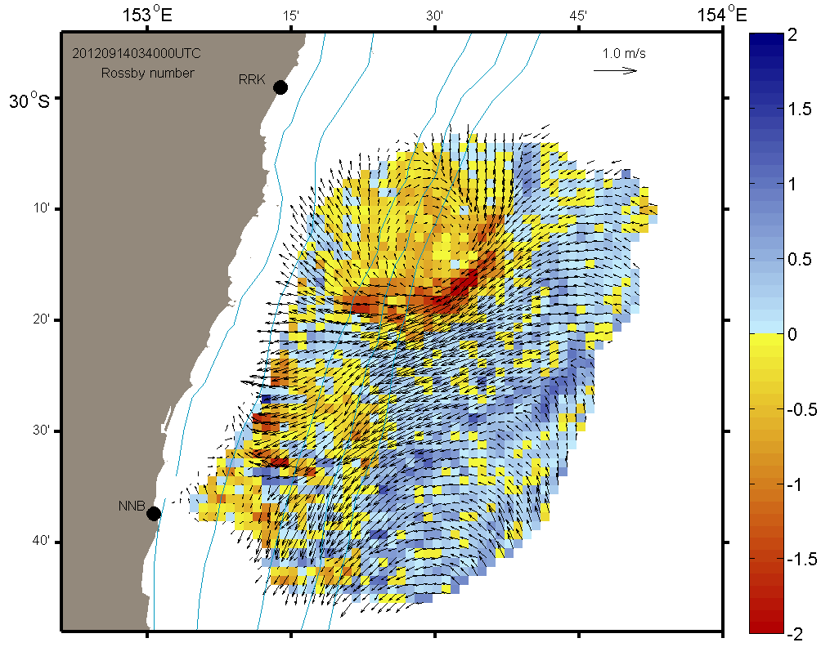
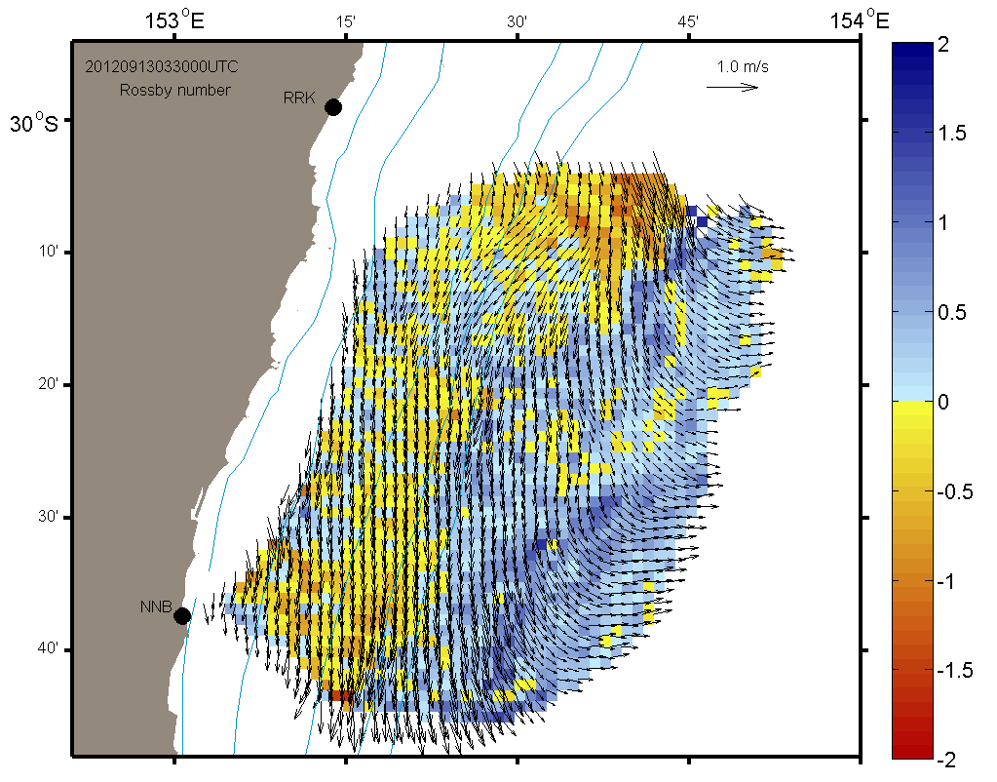
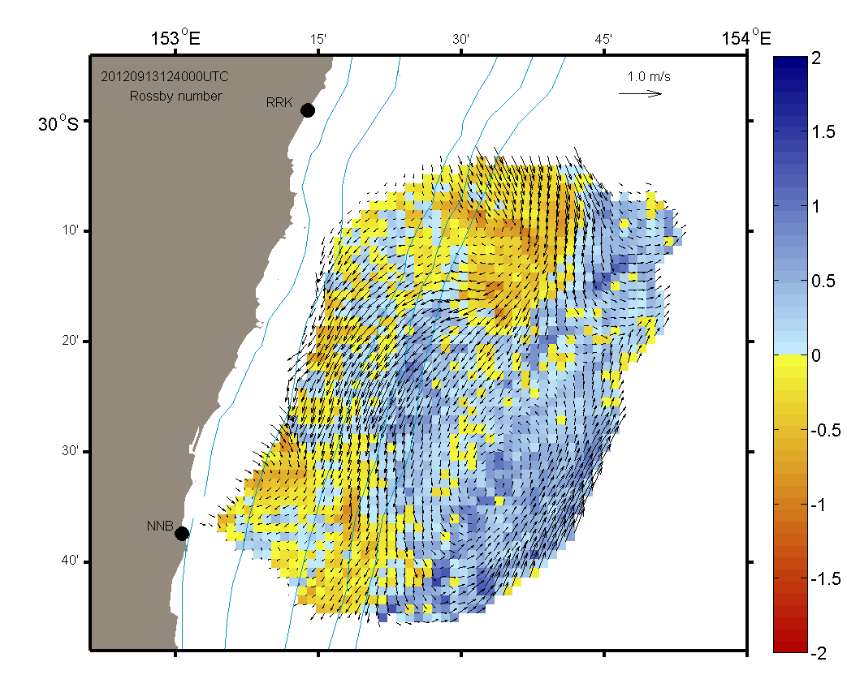
Radar obs of Cold Core Eddy Formation
Mantovanelli et al.
Radar captures short lived (3-7 days) transient features.
Instability in the WBC with the addition of wind forcing drives a cyclonic flow.
1. Strong southward wind stress
Intrusion of a frontal jet (cyclonic vorticity) on the NE portion of the domain (beginning of day 13)
Ro Red cyclonic, Blue anticyclonic, |Ro| > 1 highly ageostrophic
3. The CCE is fully formed under northward wind stress and starts to decay when winds weaken (end of day 14)
cold core eddy formation (CCE)
wind stress (N m⁻²)
7 days: CCE decays/ moves southward, WCE forms
Currents reverse on the shelf.
2. As the wind reverses, an onshore flow starts to form and deflects the jet towards the shore, a saddle point occurs in the middle of the turning flow region (middle of day 13)
Northward
CCE
Southward
-0.2 N m⁻²
2
time (days)
1
3
Mantovanelli et al. Sub Prog In Oceanography

Slide 7
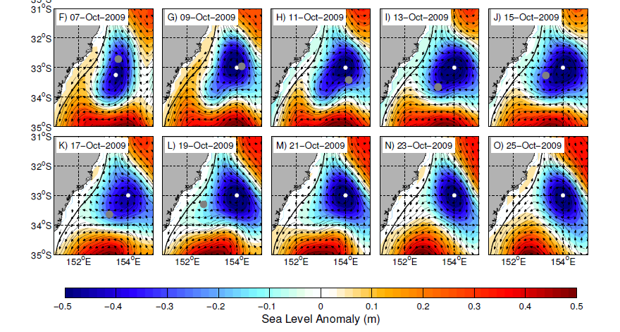
Can we use ROMS to model a Cold Core Eddy?
What causes them to form?
What is the impact of wind forcing on formation? Evolution?
What is the sub surface structure?
What is the impact on entrainment?
Are they significant biologically?

Slide 8
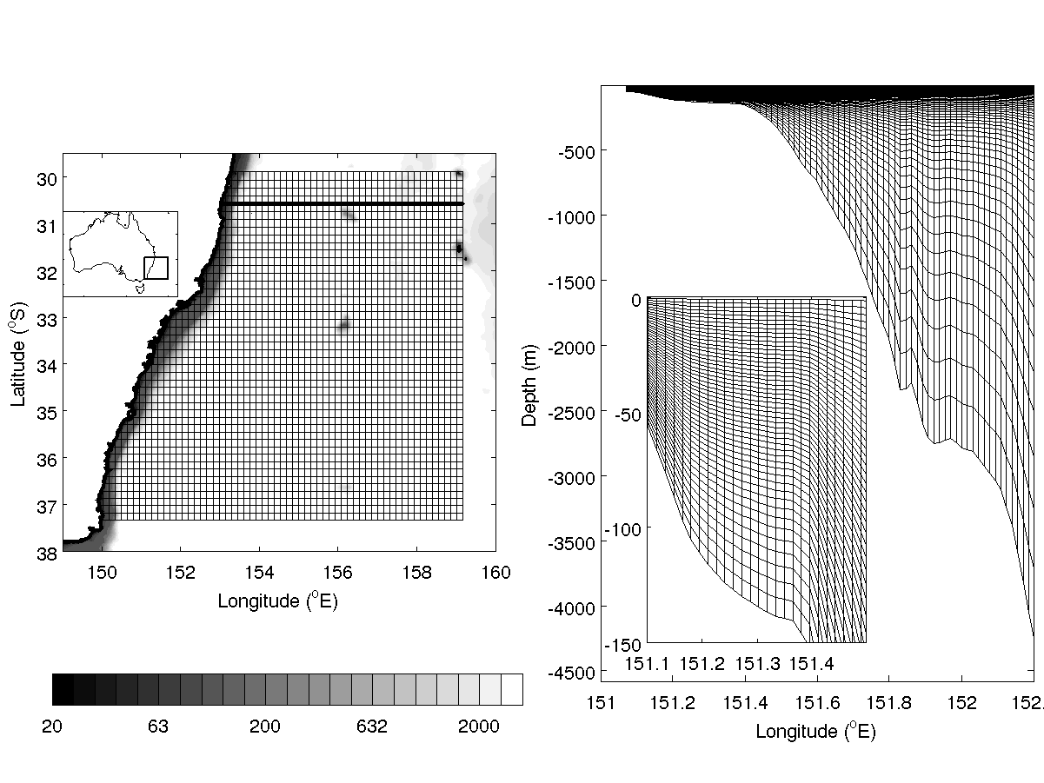
ROMS configuration for the East Australian Current
Horizontal resolution ~ 1.75 by 2.15 km (828 x 684 grid cells)
Bathy from NRL, DBDB2 V3 - 2x2 min
50 vertical layers – stretched for increased resolution in top 250m
Initial and Boundary conditions from CSIRO SynTS product (daily, 3D Synthetic Temp Sal product – from SST and interpolated ARGO data).
Geostrophic currents calculated from T/S field assuming a level of no motion at 2000m
Below 2000m initial T/S conditions from CARS – climatology.
Surface wind field – NOAA / NDBC Blended 6 hrly 0.25 degree Sea Surface Winds.
Surface fluxes from NCEP 2.5 degree (6 hr)
Boundary Conditions –
Northern boundary Barotropic - (Flather)
Baroclinic velocity field and tracers are nudged to external estimates – 4 days
Southern Eastern and western - Radiative.

Slide 9
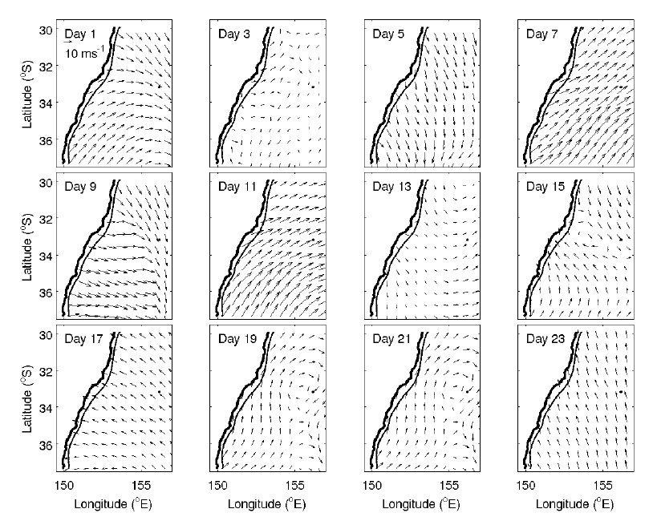
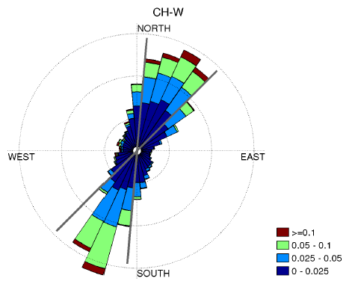
Wind Field
October 2009
Downwelling
Realist Wind Scenario (RWS).
The NOAA/NCDC Blended 6-hourly 0.25-degree Sea Surface Winds.
Typically, winds are weak but significant upwelling and downwelling winds occur < 20%
During the simulation this wind field tends to be more downwelling favorable than upwelling favorable
Upwelling
Downwelling

Slide 10
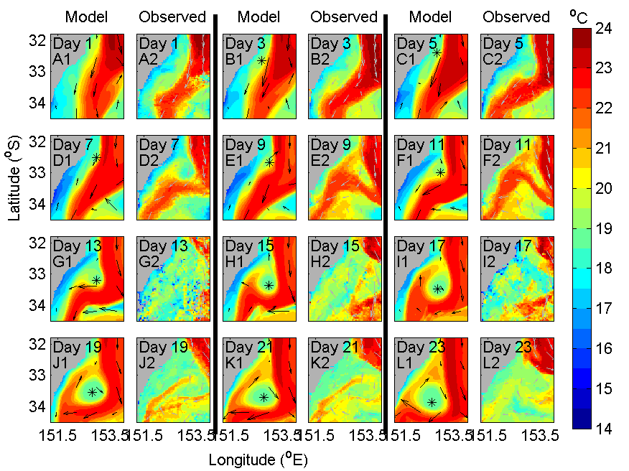
The Evolution of a CCE
Formed in Sep 2009 on the front between the EAC and cooler coastal waters
The model captures this formation
The eddy forms as a small billow of water that cuts into the EAC

Slide 11
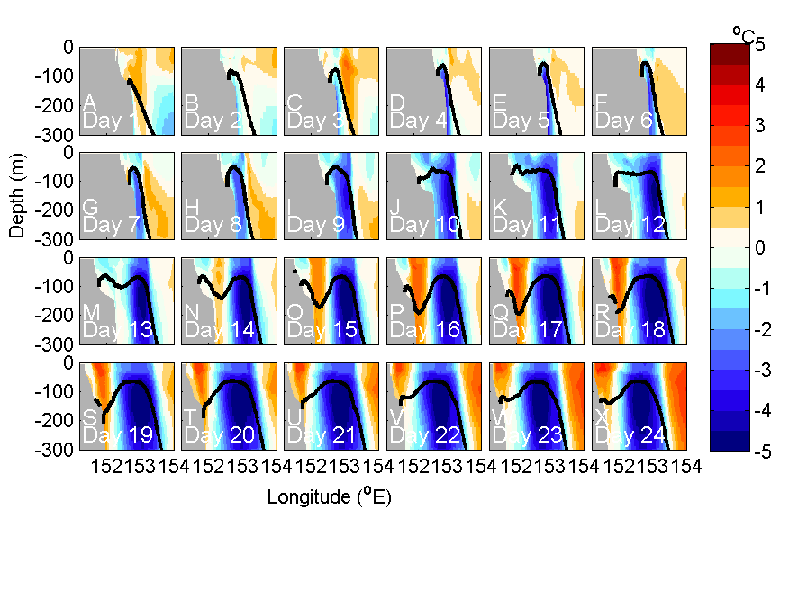
Vertical Temperature Structure
The eddy initially forms up against the shelf.
During the simulation it grows and moves away from the shelf
The shelf watesr and the EAC curls around the eddy and warm water appears on the western side
Vertical profiles of temperature anomaly through the middle of the eddy (blue means it is cooler than the simulation mean)

Slide 12
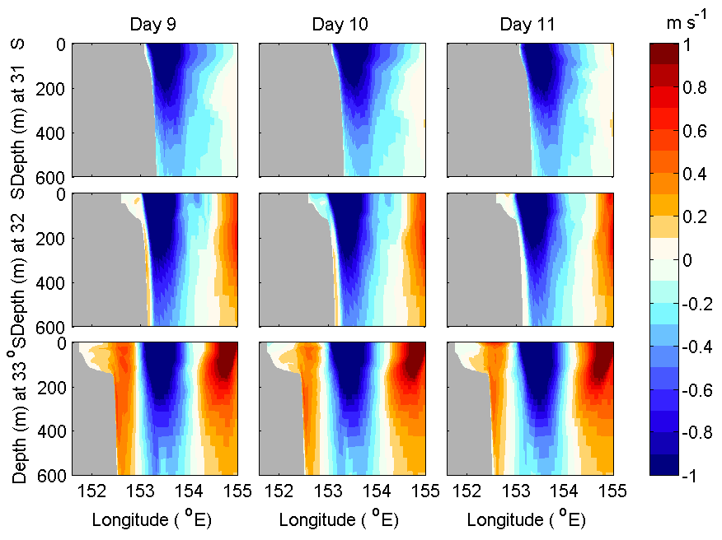
Cross Shelf Velocity Shear
In the lead up to eddy formation there are northward currents on the shelf and slope.
Velocity shear increases in the lead up to eddy formation, northward velocities on the shelf increase, and form the west side of the eddy (red = north).

Slide 13
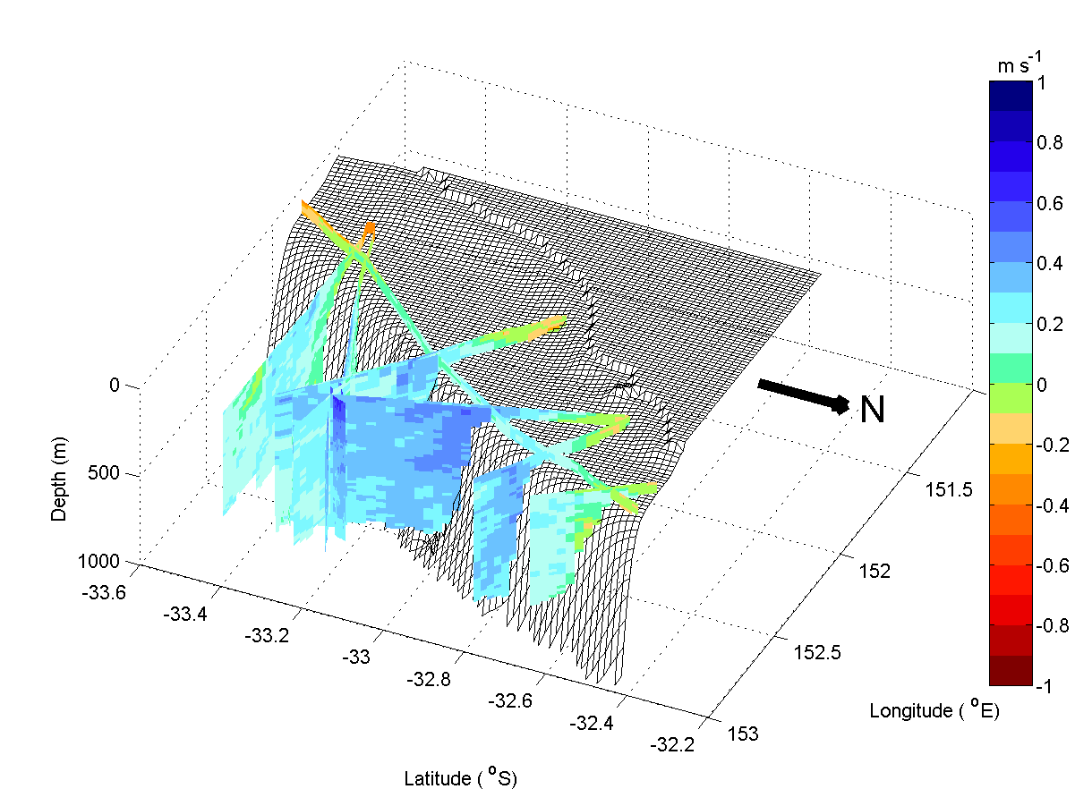
Observations of Equatorward Shelf Flows
This northward flow on the shelf and slope is seen in velocity data from a shipboard ADCP during the eddy formation.
Blue indicates
northward flow.
This flow
extends down to
below 1000 m

Slide 14
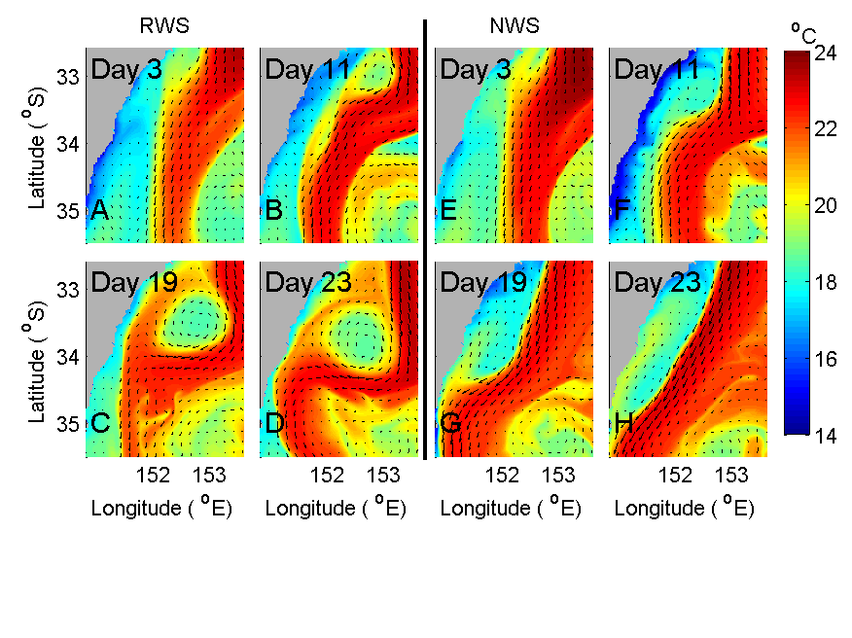
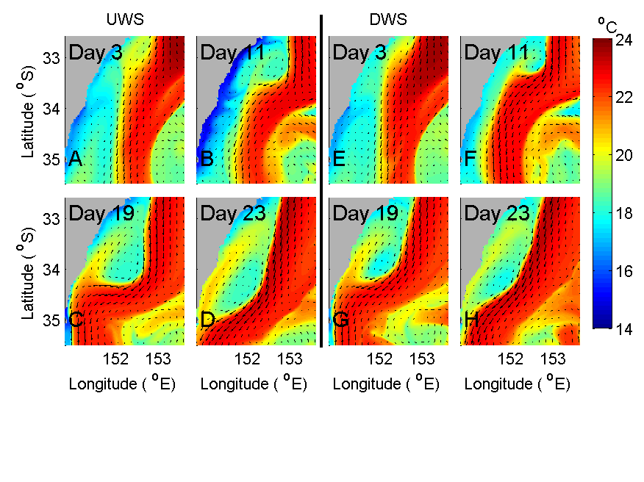
Sensitivity to wind forcing during formation
eddy grows
eddy shrinks
4 Scenarios RWS-realistic UWS-Upwelling, DWS- Downwelling NWS- No Wind
In all scenarios an eddy formed.
But the wind-field did affect the evolution of the eddy.
After spin up, UWS eddy grows, DWS eddy shrinks.
Notes:
From day 15 onwards the UWS eddy grows and the DWS eddy shrinks. By day 22 the UWS eddy has a radius of 75 km and the DWS eddy has a radius of 40 km, making the UWS almost twice as large as the DWS.
A further 3 simulations are performed. An upwelling wind scenario
200 (UWS) is created by changing the wind eld so that realistic winds from
201 a period of intense upwelling (Jan 2006) are used to force the model (Fig 3).
202 Model day 1 coincides with Jan 6. A synthetic downwelling favorable wind
203 scenario (DWS) is created from this upwelling wind eld by reversing the
204 direction of the meridional component of the velocity for the rst two weeks
205 of the simulation (Fig.4). This two weeks coincide with the period when the
206 eddy is forming. A fourth simulation (the no wind scenario; NWS) is per207
formed whereby the wind eld is set to zero during the rst two week period.
208 For the remainder of the simulation the upwelling, downwelling and no wind
209 scenarios are forced with the same wind eld from January 2006 so that the
210 longer term (2 weeks after eddy formation) eects of the wind eld applied
211 during eddy formation can also be investigated.

Slide 15
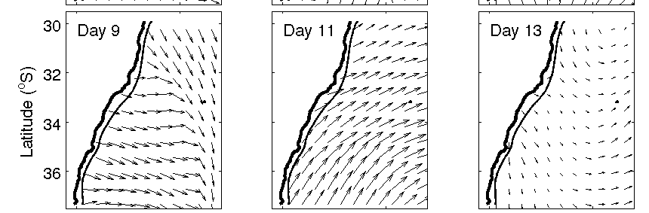
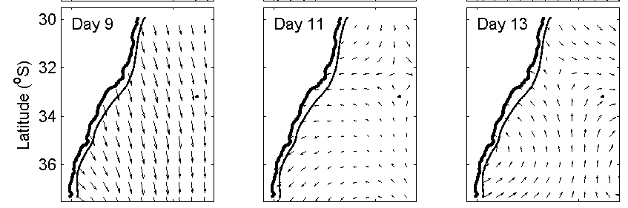
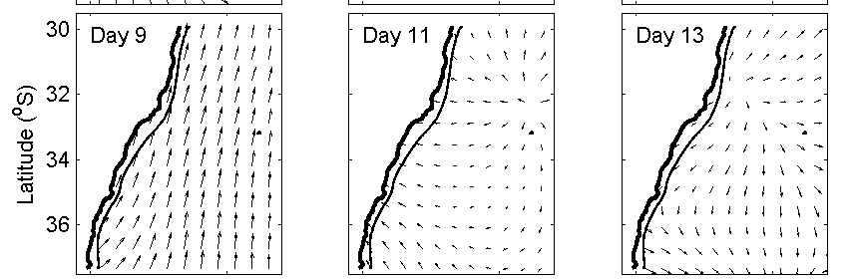
Wind / Eddy Day 11
During Spin up, equatorward alongshelf winds play a role in eddy spin up.
(CF HF Radar)
RWS
UWS
DWS

Slide 16
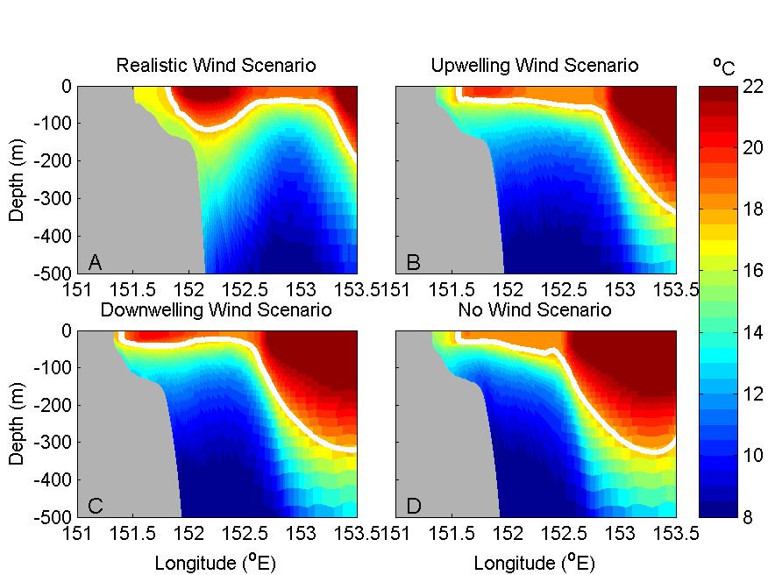
Uplift within the eddy- Sensitivity to Wind Forcing
White =16 Deg Isotherm
Down welling winds on the shelf, drive northward along shore jet – enhancing the strength of the eddy.
Greater uplift occurs in the core.
Notes:
Of the 2 opposite scenarios (UWS and DWS), the largest uplift occurs in the DWS where the 16oC isotherm is
359 lifted up to the surface (Fig.12C). In the UWS the 16oC isotherm is lifted
360 up to 70 m below the surface (Fig.12B). In these scenarios the winds which
361 produce downwelling on the continental shelf enhance the uplift within the
362 eddy by up to 70 m

Slide 17
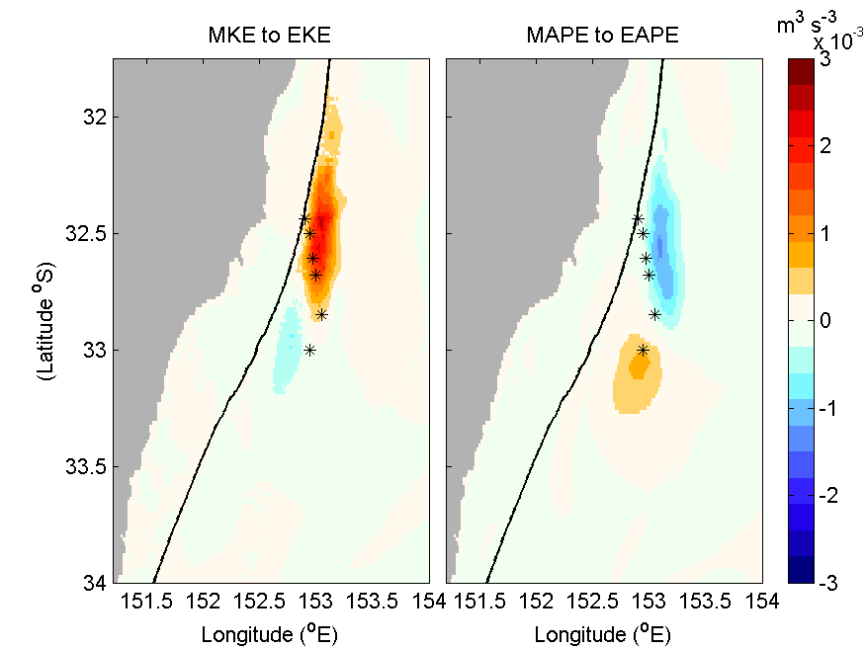
Barotropic or Baroclinic Instabilities as a driver
Barotropic instability
Transfers of energy from mean to eddy kinetic and potential energy are calculated (Rubio et al. 2009)
Shows the contribution to eddy generation, of momentum transfers or density gradients.
Initially the eddy gains its energy from the kinetic energy of the EAC (associated with a region of high strain).
Large relative velocity shear between EAC and northward coastal waters.
Mean Kinetic to Eddy Kinetic ➔ If positive, this shows a transfer of energy due to a Barotropic instability, Reynolds stresses against the mean flow.
Mean Available Potential to Eddy Available Potential ➔ If positive indicates Baroclinic Instability as a driver
Notes:
The transfer of mean kinetic energy (MKE) and mean available potential
energy (MAPE) to eddy kinetic energy (EKE) and eddy available potential
energy (EAPE) respectively can be investigated to determine whether density
gradients or momentum transfers contribute to eddy generation.

Slide 18
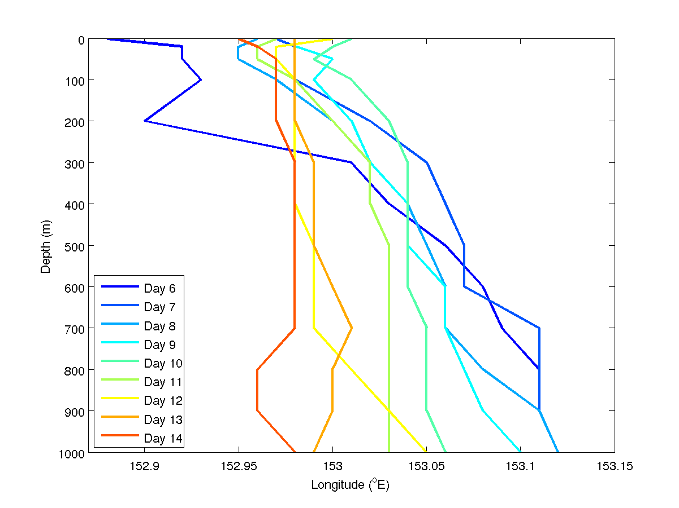
Eddy Tilt - Evolution
The eddy initially forms up against the shelf.
Forcing it to tilt
Initially the eddy leans on the shelf (blue day 6).
The eddy stands up during the formation as it moves off the shelf (Red day 14)
Profiles of the center point of the eddy

Slide 19
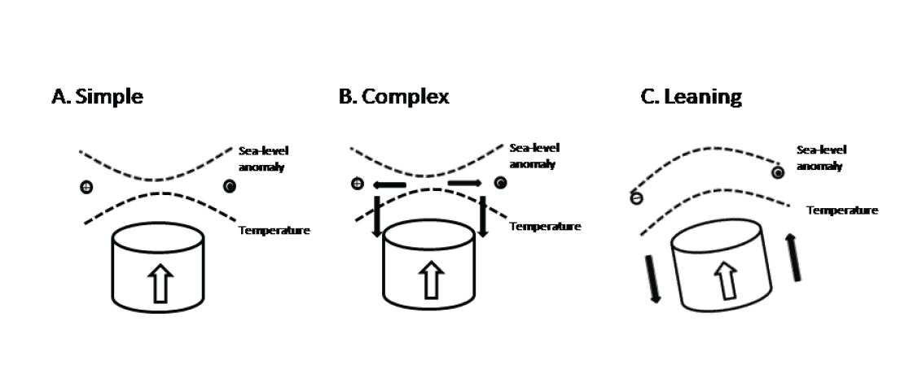
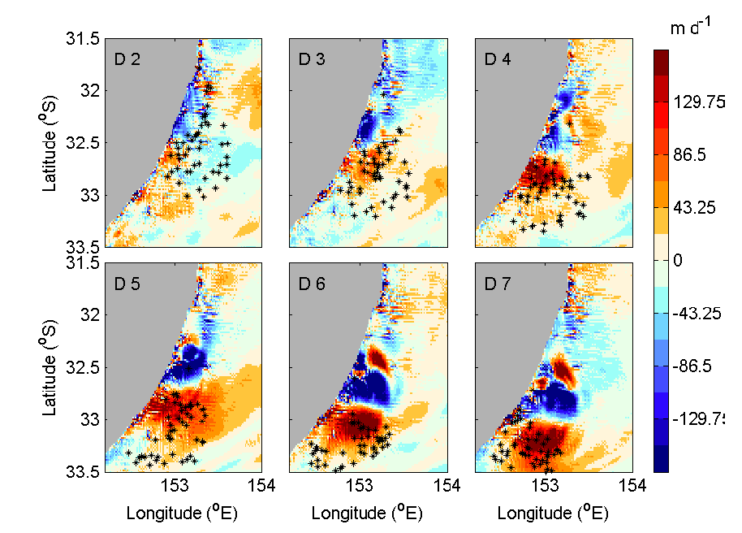
Vertical Movement in the Eddy
Theoretical simple circulation within a cold core eddy.
BUT – we see
Intense upwelling in the south of the eddy (esp at depth), downwelling on the northern edge
Complex Circulation Structure in a leaning Eddy
Vertical movement at 500m depth
Red = Upwelling, Blue = downwelling
Stars represent daily position of particles released below 500m that are entrained (and raised) into the eddy.

Slide 20
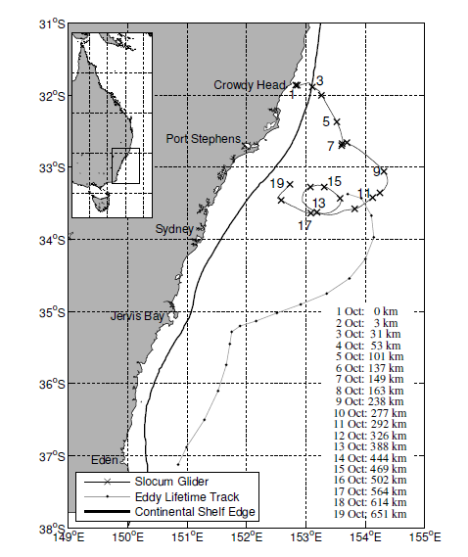
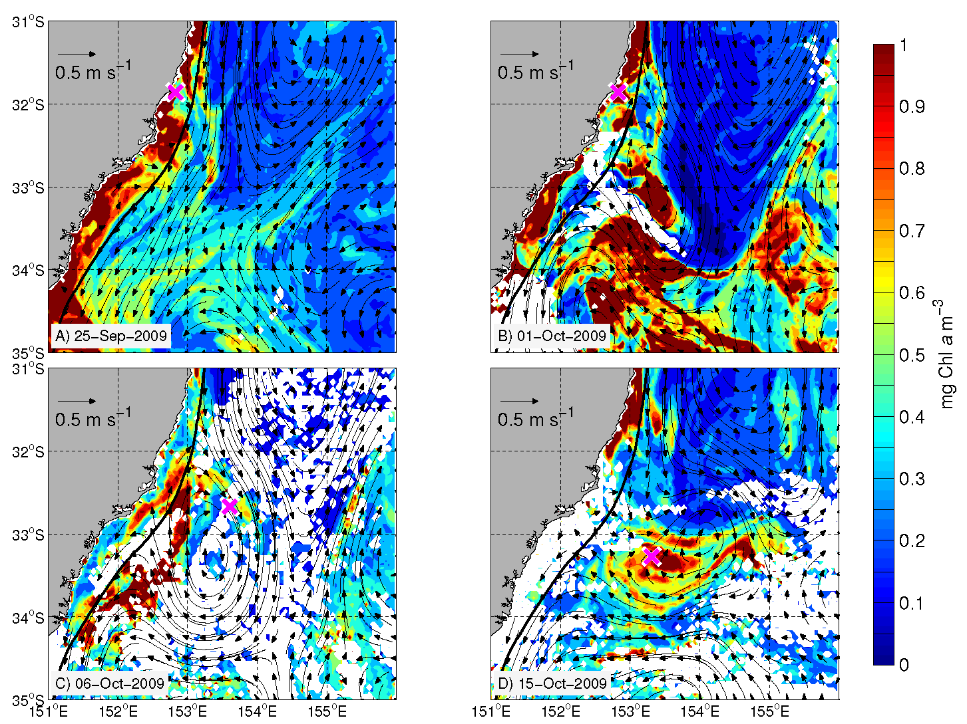
Entrainment of Shelf waters into a CCE
Cold Core Frontal Eddies have been seen to be high in surface chlorophyll.
Possibly because they entrain (nutrient rich) shelf waters
Grey dots (pink cross)
show location of glider on SLA (Chl) images

Slide 21
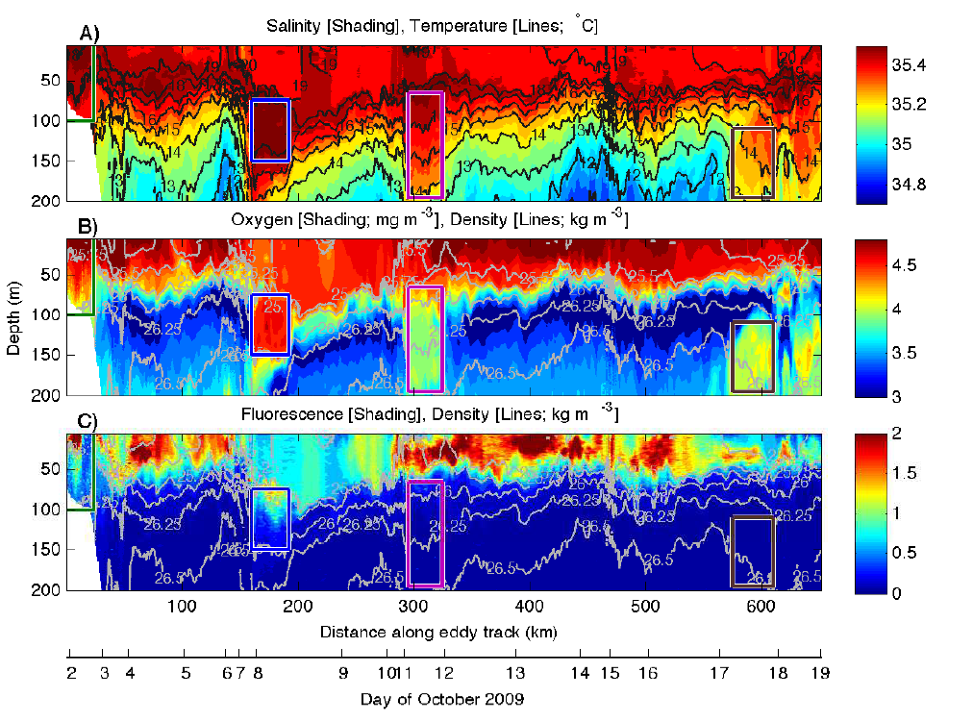
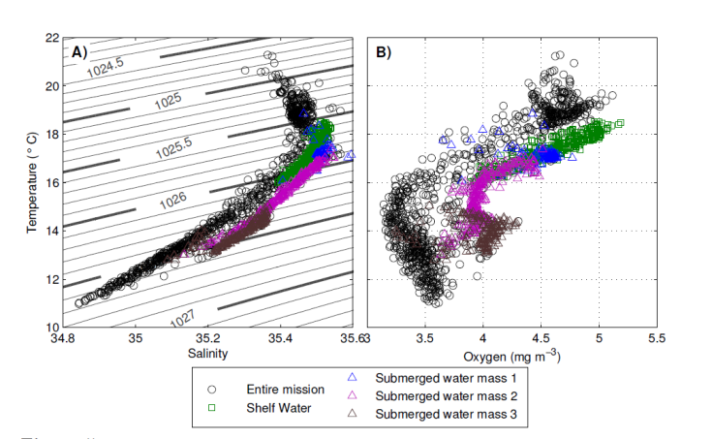
Observations of Entrained Shelf Water
A glider mission around the eddy shows
High chlorophyll where filaments are entrained off the shelf, wrapping around the northern portion of the eddy (day 8)
Evidence of entrained shelf waters (high in oxygen and salinity below SML ~75-150m e.g day 8, 11, 17)

Slide 22
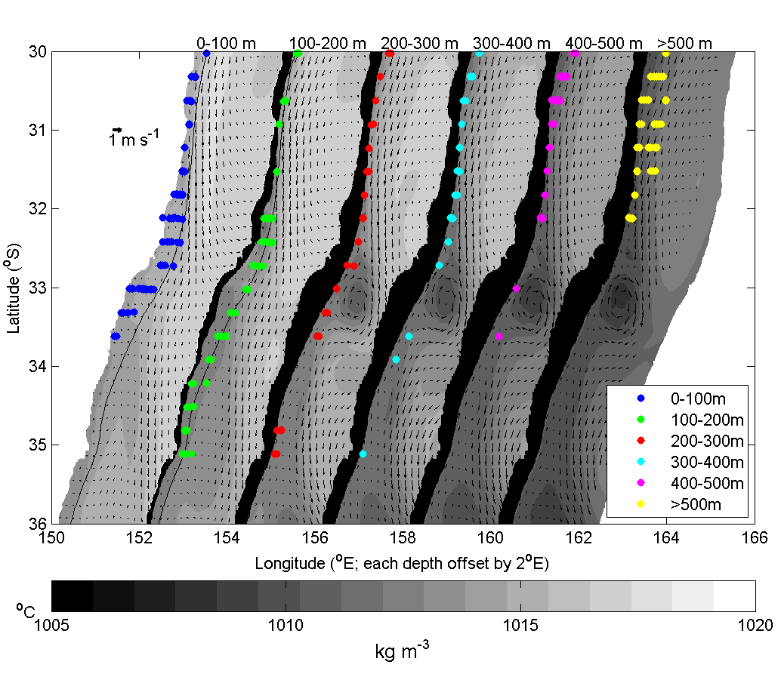
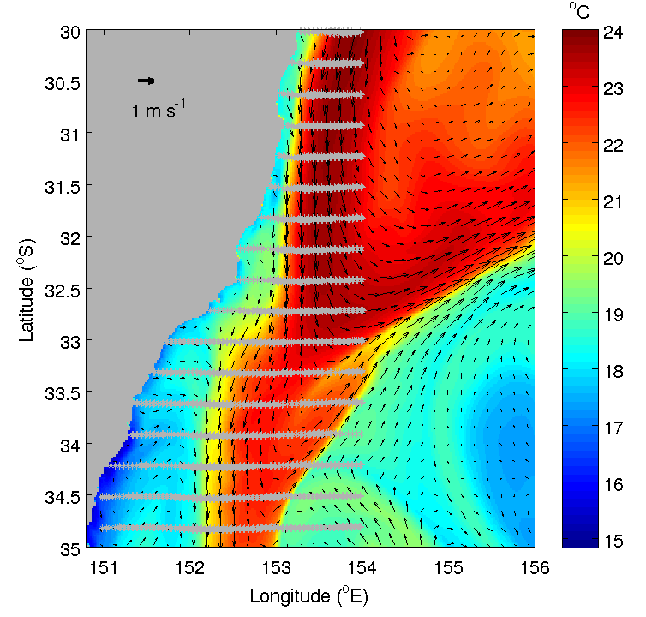
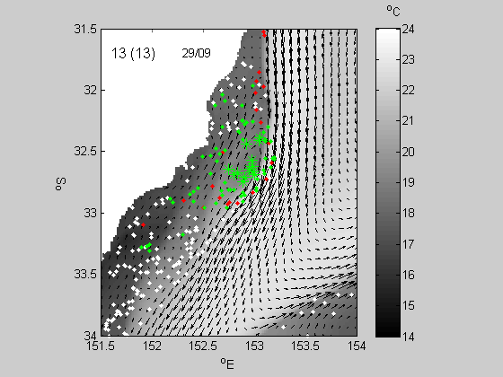
Simulations of Entrainment of Shelf waters
Particles are released every 0.3º of latitude, 0.05º of longitude and 50 m depth.
Particles are entrained from north and south of the eddy formation region
Southward flowing particles – Entrainment comes from all depths.
Northward flowing particles – Entrainment tends to be from the surface layer only
Initial position of entrained particles
Macdonald et al in prep

Slide 23
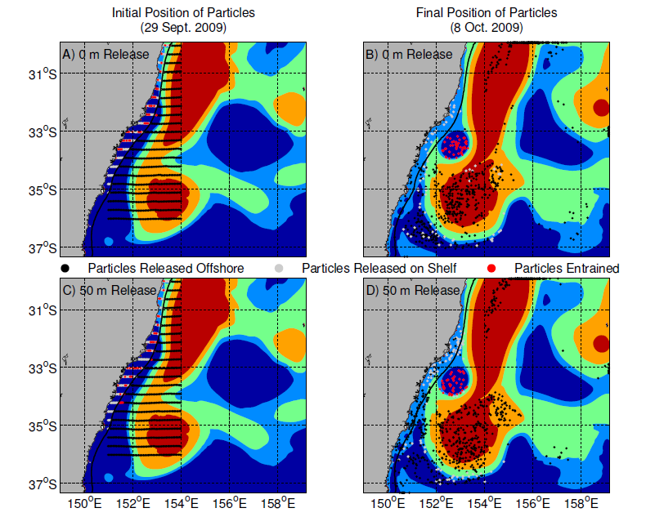
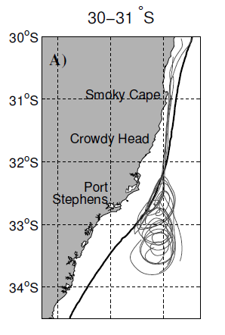
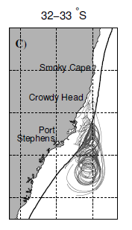
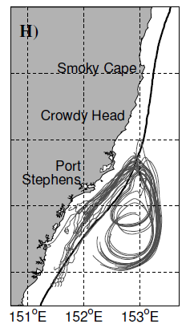
Entrainment of Shelf waters into a CCE
The initial (A,C; 29th September 2009) and final (B,D; 9th October 2009) position of released particles.
The particles were released at two depths: 0 m (A,B) and 50 m (C,D).
Released on the shelf (Grey) offshore (black), Eventually entrained (Red)
Shading is modelled sea level anomaly (SLA), blue ( negative SLA) , red (positive SLA).
35% (0m) and 27% (50m) of shelf particles entrained.
Some particles travel long distances (2º) prior to entrainment, both in the surface (A) and at 50m (H)
Notes:
The initial (A,C; 29th September 2009) and final (B,D; 9th October 2009) position of released particles.
The particles were released at two depths: 0 m (A,B) and 50 m (C,D). The particles released on the shelf are coloured
grey and the particles entrained into the eddy on the 9th October 2009 are coloured red. The remaining particles are
black. Particles which leave the domain prior are located at their final location on the north, east and south axes. The
background color is modelled sea level anomaly (SLA), with blue indicating a negative SLA, and red a positive SLA.

Slide 24
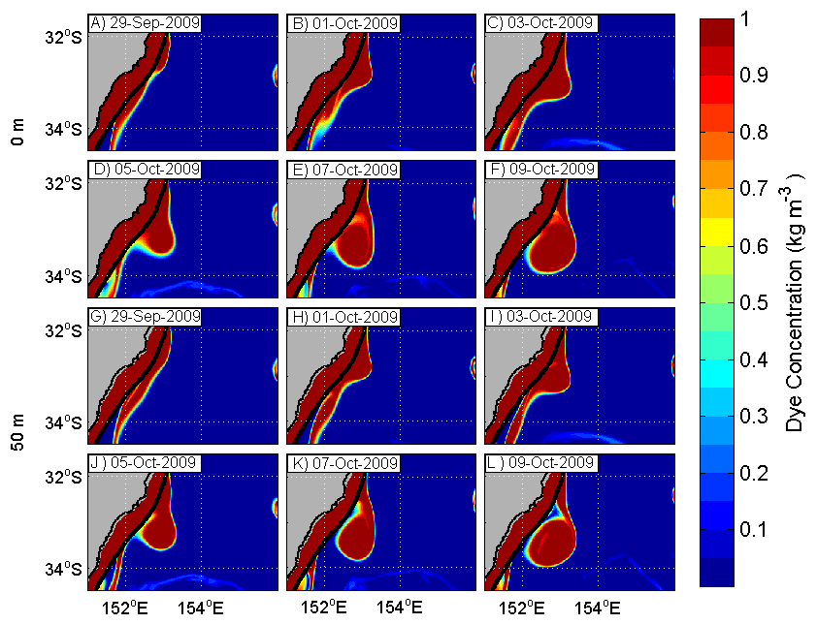
Dye Tracer Experiments Simulating Entrainment
Shelf waters given a conc of 1kg/m3and held constant throughout the sim. Offshore waters given a conc of 0kg/m3 and allowed to evolve
Dye evolves as a passive tracer (similar to T or S)
Entrained waters spiralled into centre of eddy – As seen in MODIS
Surface waters (0-50m) in the eddy are 95% continental shelf origin
At depth (50-200m) the eddy entrains waters from both the cont. shelf and open ocean. Spiralling inwards to the centre.
Below 200m, eddy is 60% cont. shelf waters.
Volume flux of entrainment is up to 43% per day in the surface (equal to the change in the surface area of the eddy – indicating predominantly shelf water being entrained.
Proximity to the shelf is a critical factor in the entrainment of coastal water.
Rate of entrainment drops from 14-38% (volume flux per day) to < 6% as the eddy moves offshore (bottom row).
Notes:
The volume flux of entrainment prior to the 9th October for the surface waters
267 occurs at a rate of up to 43 % a day, calculated from the dye tracer (Table 2). The volume
268 flux of the dye-tracer is equal to the change in surface area of the eddy, further indicating
269 that it is predominantly shelf waters which are being entrained into the surface waters of
270 the eddy.
.

Slide 25
Summary
Sub meso scale Cold Core Eddies
Prolific on inshore edge of the EAC , previously hard to observe.
Formed through combination of northward (downwelling) wind forcing, cross shelf velocity shear, strong horizontal thermal gradients, and barotropic instability in the EAC.
Complex structure of tilting, upwelling in centre and southern portion, downwelling and subduction in northern sector.
Can entrain biologically rich shelf waters,
Direct observations (from gliders) of entrainment of surface waters enrichment, and subduction down to ~200m
Recent research has shown the planktonic and fisheries potential of submeso scale eddies.

Slide 26
Future Work
Ongoing Work -
Quantifying the impact of the observations in the context of the dynamical processes Data Assimilation Modelling – ARC DP, Roughan, Powell, Oke
High resolution connectivity Modelling (1km) in SIMP- Nectar/Marvl
Connectivity and Climate Change in EAC (Coleman Kelaher Byrne) – Natural Variability and forecasts. Impact of velocity field versus temperature.
Biological Impacts of Submesoscale Coherent Flow Structures – FSLEs to identify fronts in HF radar and Seawifs Imagery and
Notes:
Paulina – natural variability within EAC. Volume transport and temperature correlation? During El nino? La nina?

Slide 27

Announcements
Fellowships available for Central Europeans (e.g Croatia, Slovenia) to work at Australian Universities (UNSW, UWA) for 6 months.
Speak to Hrvoje (UWA).
Next ROMS meeting possibly in Australia!
April or Sep 2015?

Slide 28






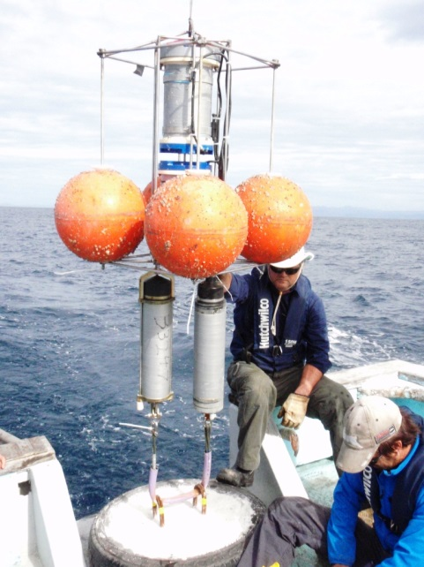
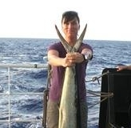
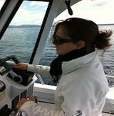



Acknowledgements
The Integrated Marine Observing System is supported by the Australian
Government through the National Collaborative Research Infrastructure Strategy and the Super Science Initiative. We thank the NSW-IMOS Moorings Team, Clive Holden OFS The glider and radar team and the
The Coastal and Regional Oceanography Group at UNSW
Oceanography.unsw.edu.au
mroughan@unsw.edu.au
All Data freely available http://imos.aodn.org.au/imos/
Julie
Paulina
Alessandra
Helen
Amandine
Stuart
Gordon
Nina
Linda
Sotiris
Vincent
Brad
Tim

