Slide 1

Improving Model ENSO Validation by Constraining Isotopic Signatures of Extreme Events
Samantha Stevenson, NCAR/UH
Brian Powell, UH

Slide 2
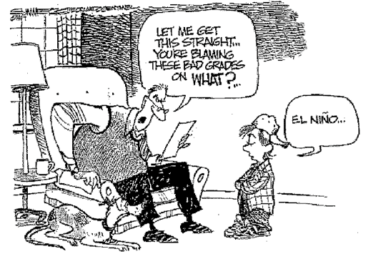

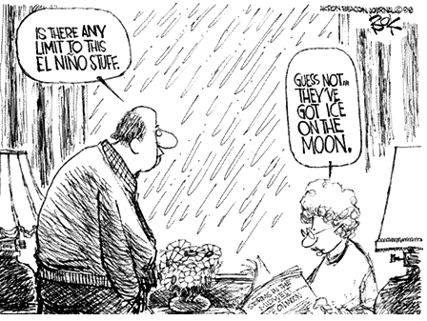

Slide 3
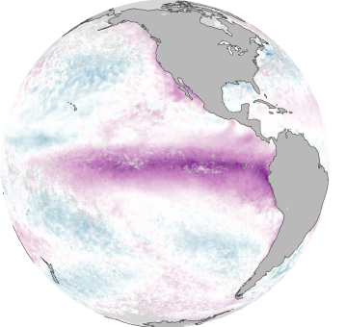
Notes:
ENSO is the dominant source of climate variability and influences the global atmosphere and ocean
As we know, the El Nino phase (when the thermocline tilt levels out) brings warm water to the eastern Pacific

Slide 4
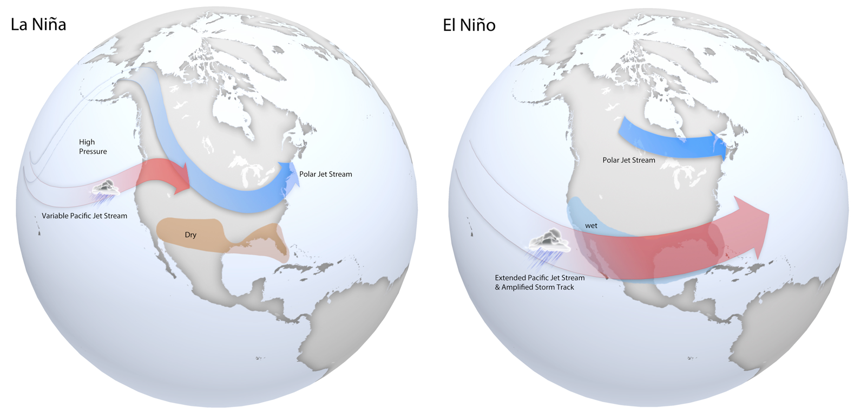
Notes:
This changes the N Pacific atmospheric configuration, which brings warm, wet storm track to the SW of the US making it wetter than usual

Slide 5
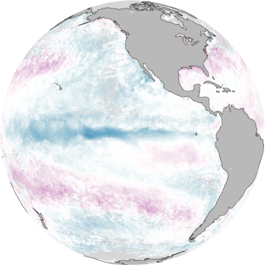
Notes:
The normal phase (La Nina is the return to this normal phase) is eastern upwelling with a strong, deep western warm pool

Slide 6
Notes:
This pushes the warm, wet air further north and creates dry, drought conditions in the SW/south of US

Slide 7
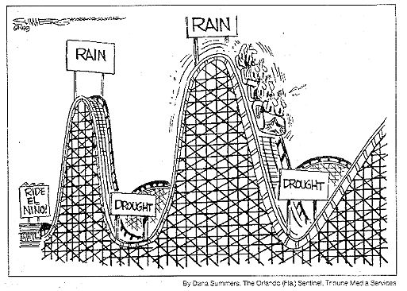

Slide 8
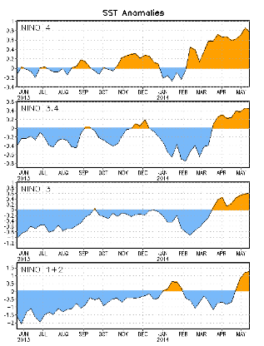
NOAA CDC, 26 May, 2014
Notes:
These plots show the past 17 months of SST anomalies across the Pacific. Until Feb of this year, we have been in La Nina (or normal) conditions since 2010
Sea surface temperatures (SST) are above-average across the equatorial Pacific Ocean.
Chance of El Niño increases during the remainder of the year, exceeding 65% by summer.*

Slide 9
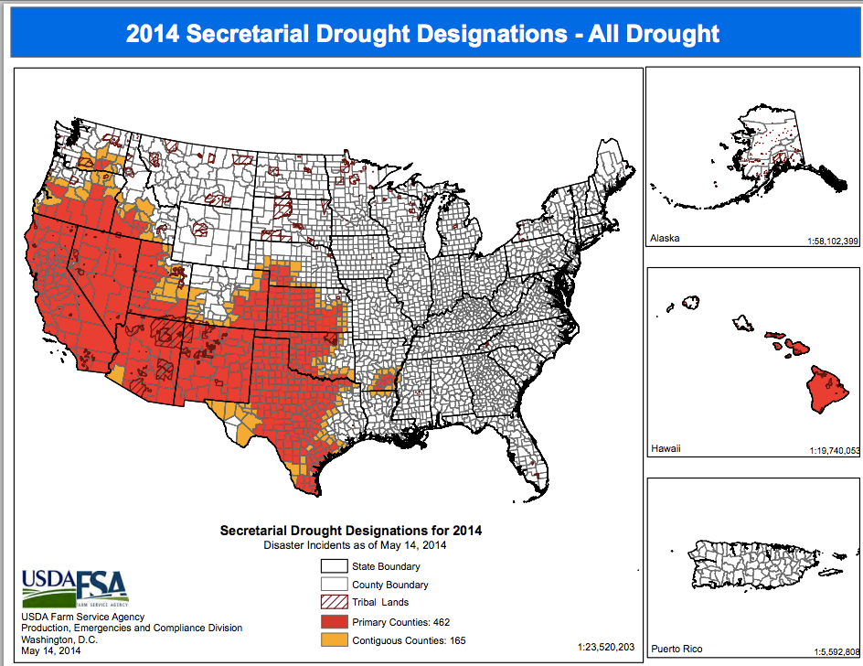
Notes:
Ocean Nino Index (ONI) has been on the La Nina since 2010, which has brought sever drought to the SW US and California. Even parts of Hawaii are under this as well.

Slide 10
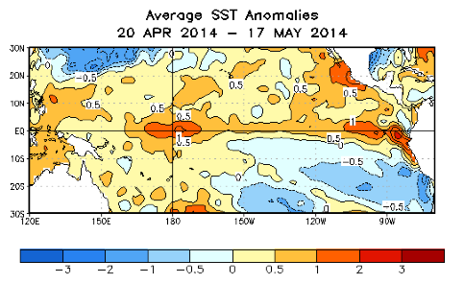
Notes:
The temperatures across the eastern Pacific are up 1degree over the past month, so we may be in the formation of El Nino, and if it is strong enough, may bring some relief to the SW US.

Slide 11
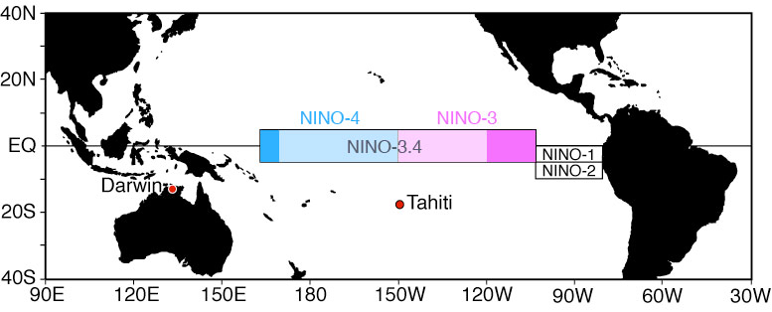
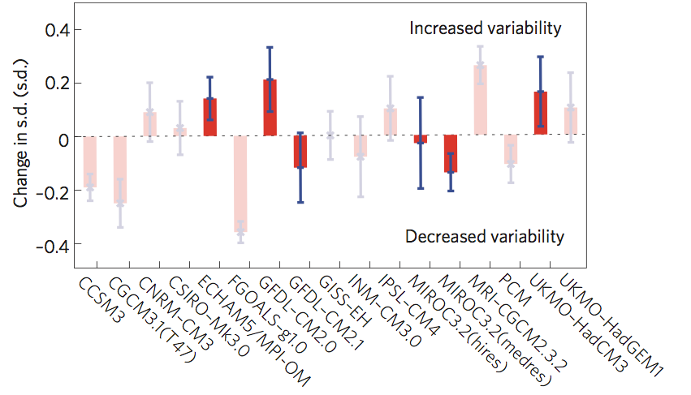
Notes:
ENSO is crucially important (I’ve highlighted the SW US, but the effects are more dramatic across eastern Asia, etc.)
So, how will the strength of ENSO be affected by future climate change?
Models are inconsistent at best. Positive (negative) changes show stronger (weaker) ENSO. The highlighted red values are models whose hindcasts do “well” in reproducing recent past ENSO events (but, we don’t have a long time-series—30 years to determine the bad and good). Still a wide spread in prediction; hence, ability to recreate ENSO does not guarantee consistency in prediction.
Because of these vastly differing predictions, we need to understand the mechanisms that affect our long time-series of ENSO data.

Slide 12
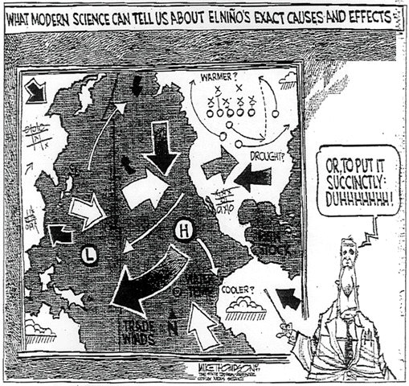

Slide 13
McGregor, et al. (2011)
Notes:
delta-18 O can be used as a proxy to temperature; however, the mismatches are greatest during El Nino events (82/98) so the salinity signal can cause significant departures.

Slide 14
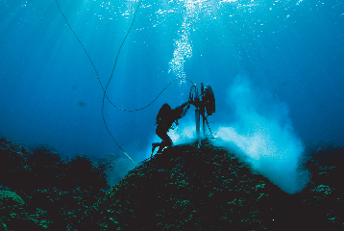
Lough (2010)
Notes:
It can be collected from living corals for recent records

Slide 15
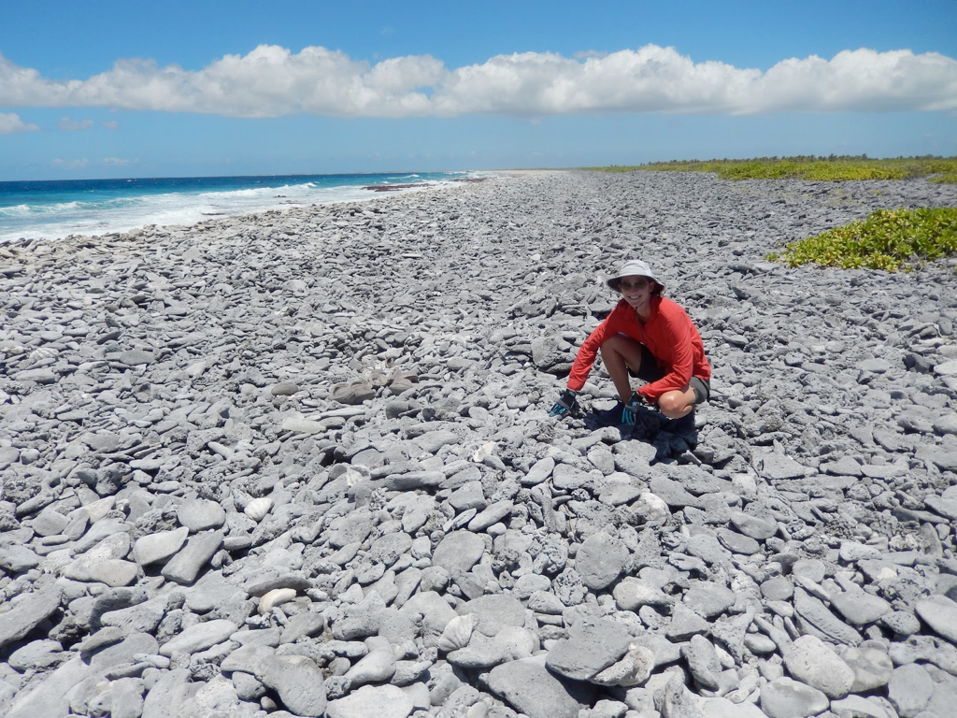
photo credit: Pamela Grothe, Kim Cobb
cobblab.blogspot.com
Notes:
Or from fossilized corals brought onto land to go back thousands of years.

Slide 16
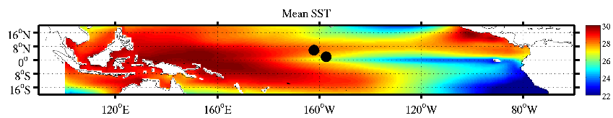
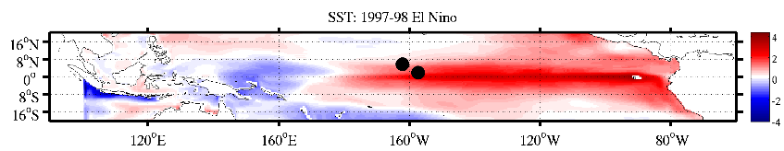
Notes:
However, Palmyra and Kiritimati (Christmas) islands are part of the line islands, near each other, but different ENSO dynamics.

Slide 17
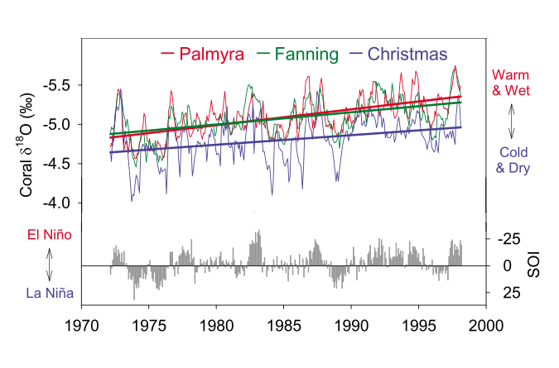
Nurhati et al. (2009)
Notes:
delta 18 O records from the recent past suggest that we are moving towards decreasing delta 18 O which corresponds to warmer and wetter El Nino.

Slide 18
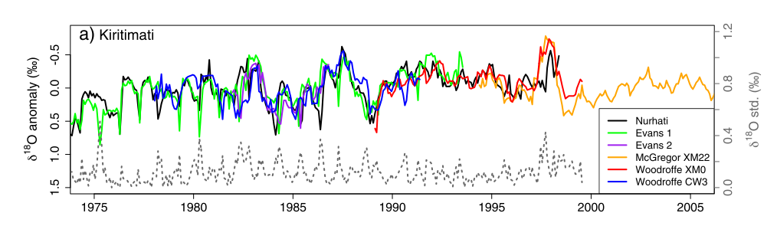
Stevenson et al. (2013)
Notes:
Not only are there differences between islands, but significant differences at the same island. The dashed line shows the std between them, often as large as the signal. [Green spikes are biological in nature]

Slide 19
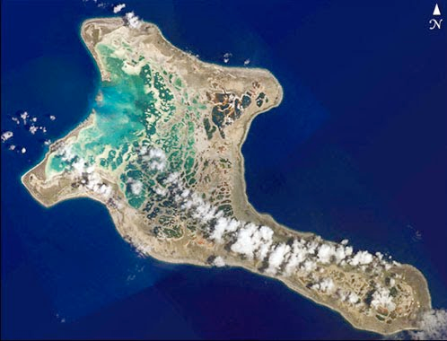
Stevenson et al. (2013)
Samples collected from various reefs
Notes:
Not only are there differences between islands, but significant differences at the same island. The dashed line shows the std between them, often as large as the signal.

Slide 21
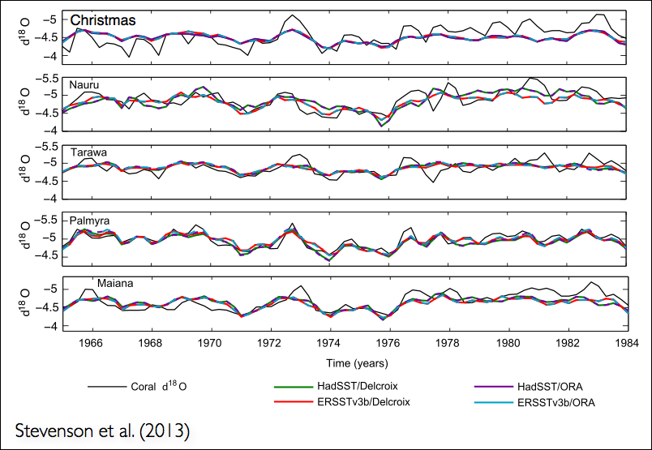
Notes:
These delta 18 O records are converted into T&S using simple linear regressions to reconstruct climate proxies in the past.

Slide 22
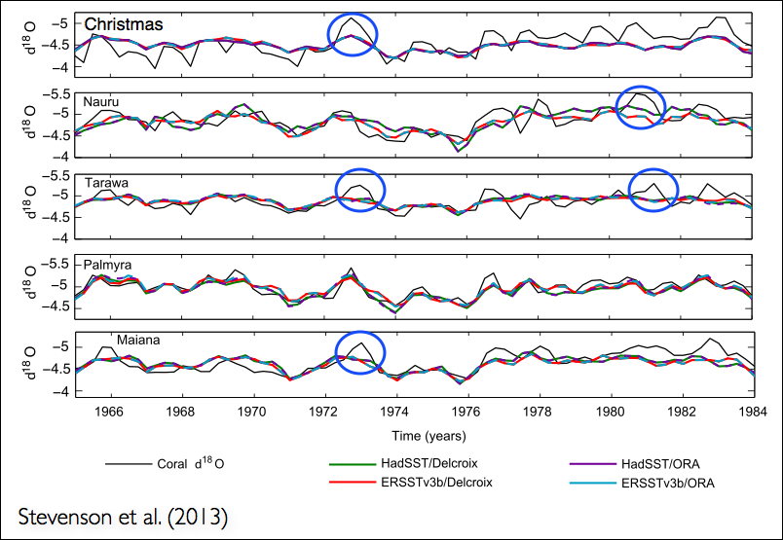
Notes:
These delta 18 O records are converted into T&S using simple linear regressions to reconstruct climate proxies in the past.

Slide 23
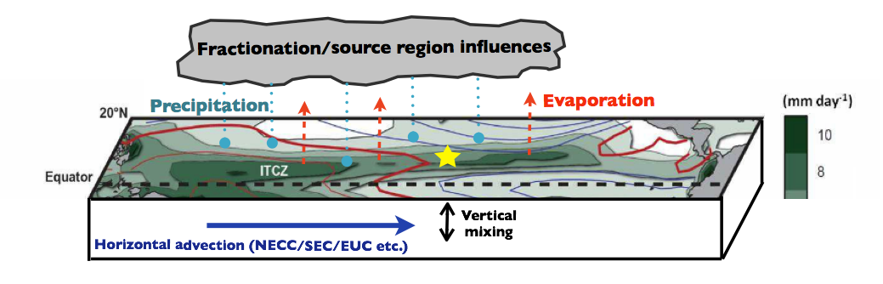
Notes:
In actuality, the delta 18 O is affected by atmospheric flux, advection, vertical mixing, local reef processes (tides, waves breaking), etc. The ideal relationship is made up of the advection, precipitation, evaporation, and diffusion of the isotopic tracer

Slide 24
Notes:
Can we use ROMS to simulate these processes at fine scales to examine what controls delta 18 O and later determine how we might use delta 18 O records to reconstruct ENSO?

Slide 25



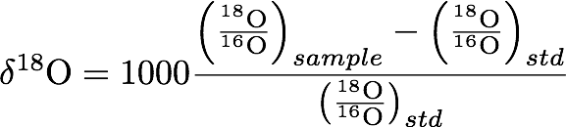
Passive Tracers
Atmospheric
Merlivat and
Jouzel (1979)
Notes:
Make slide: we simulate O18 and O16. Use mass fractionation from the atmosphere (IsoCAM) to compute fluxes (Merlivat and Jouzel, 1979).
Need delta 18 O = f(O18, O16)

Slide 26
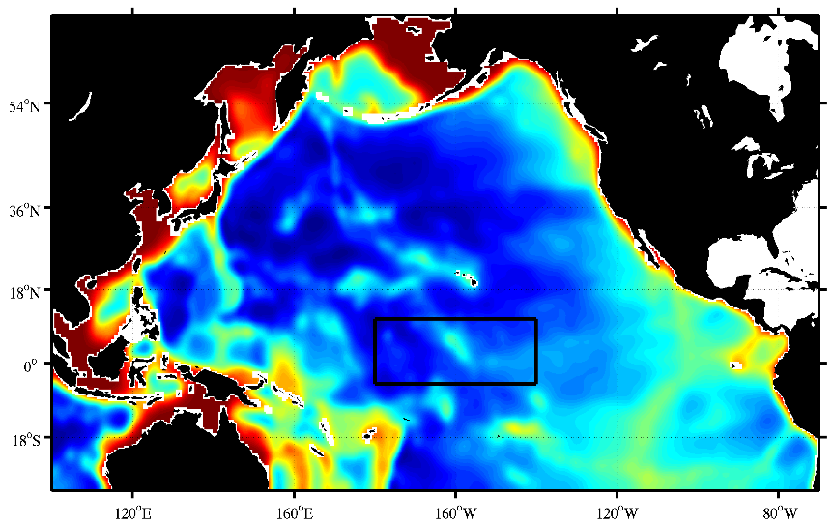
Notes:
Varying resolution Pacific grid from Enrique and Kate, nested a 10km grid around the line islands. Simulated from 1996 through 2009.

Slide 27
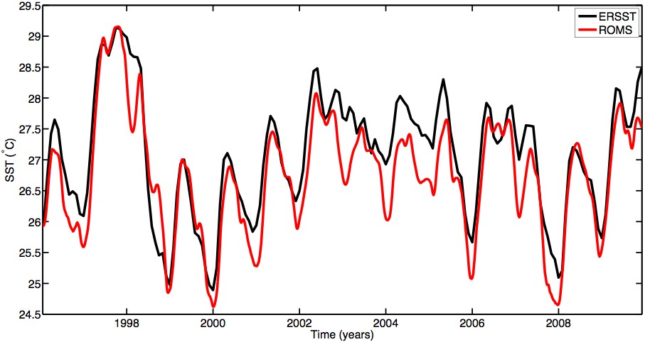
Notes:
CORE forcing Nino3.4 index versus the ERSST computation. 1996--2011

Slide 28
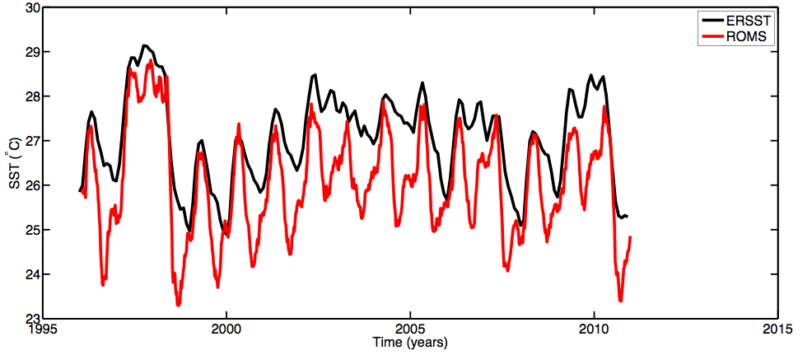
Notes:
Same with IsoCAM. We will utilize the mass fractionations from isoCAM, but use CORE forcing

Slide 29
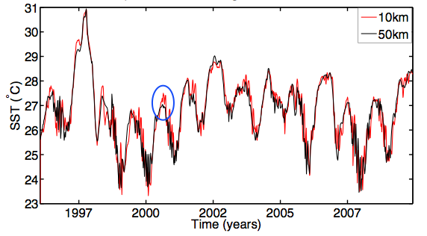
Notes:
We do detect deviations away from the larger scale at Christmas Island that would be captured in the del 18 O record in both temperature (0-50m)…

Slide 30
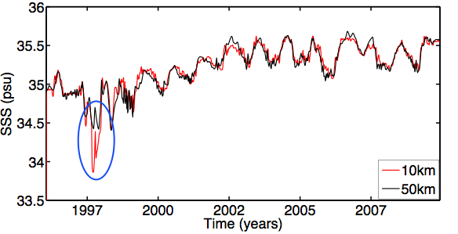
Notes:
And salinity (0-50m)

Slide 31
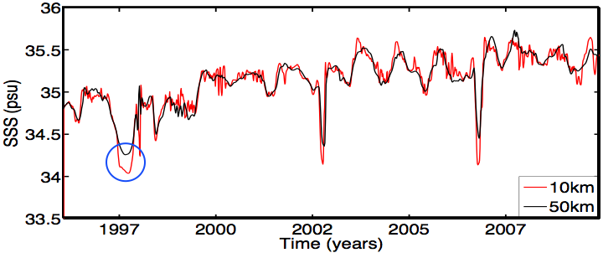
Notes:
But what of Palmyra, which is at the nodal point as we saw earlier?
Both in salinity and temp.

Slide 32
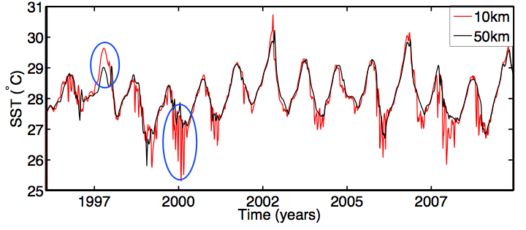
Notes:
These deviations are far more significant
But what are controlling these high frequency, cold-fluctuations?

Slide 33
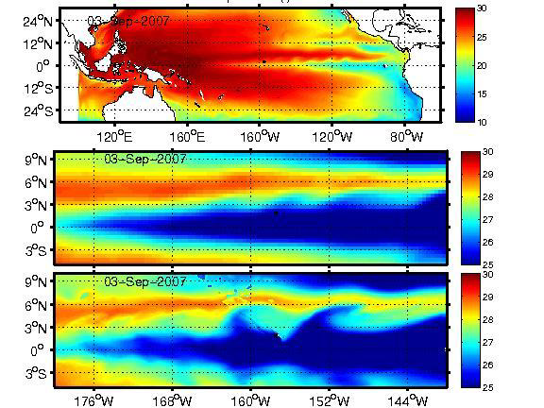
Notes:
INSERT Movie of TIWs
The high-frequency are on the order of 30 day period, which corresponds to the literature.
Marchessielo (2012) stated that we require at least 10km resolution to properly resolve the TIWs, and we see that in clear evidence here. Christmas does not suffer from this issue as the TIW pass by, but the northern extend with the strongest gradients impacts Palmyra depending upon the resolution. This is critical for understanding the delta 18 record.

Slide 34
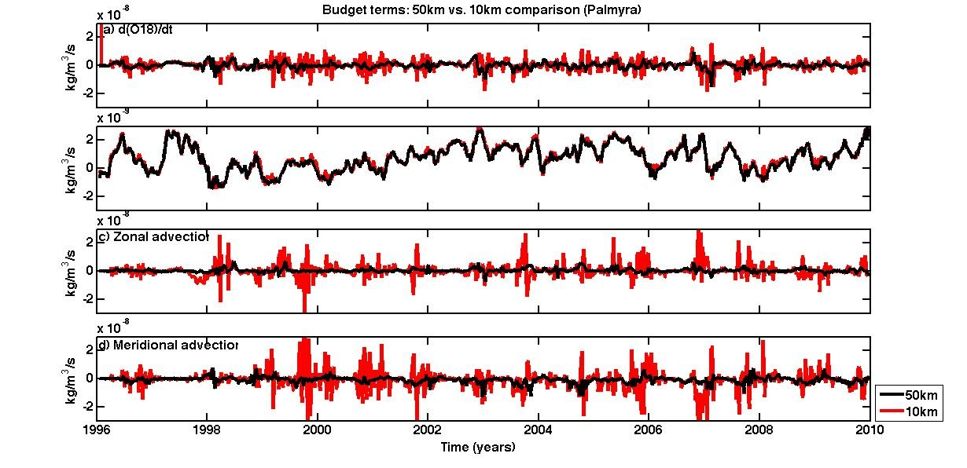
Notes:
The O18 budget for Palmyra shows these significant shifts in advection.
O18 budget for the various models, we see that there are significant differences that correspond to our hypothesis that local delta 18 O is not necessarily representative of the larger-scale

Slide 35
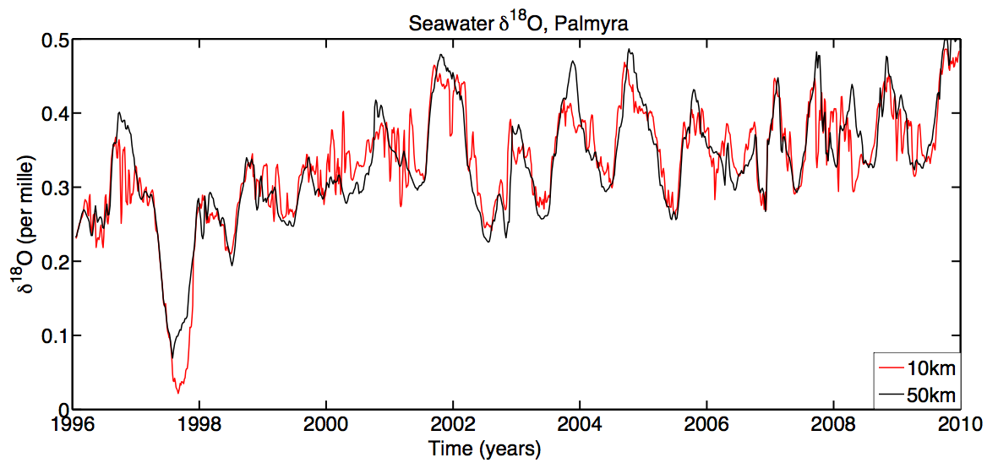
Notes:
The seawater delta 18 O reveals significant differences between the grids

Slide 36
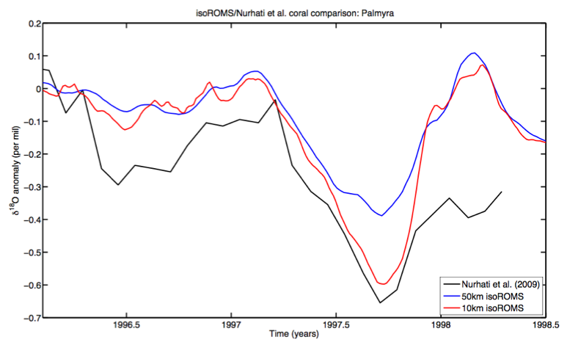
Notes:
How does this all translate into delta 18 O coral records?
We see that the model compares very well with the coral record at Palmyra, but we require the higher-resolution and TIW signal to capture the significant 1997 event

Slide 37
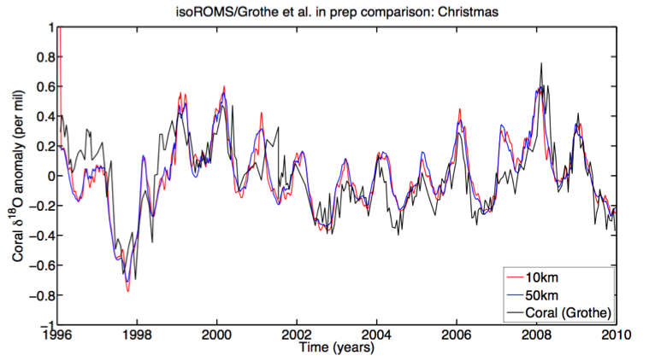
Notes:
Whereas in comparison to Christmas, the larger-scale is sufficient because of the certainty in passing TIWs.

Slide 38
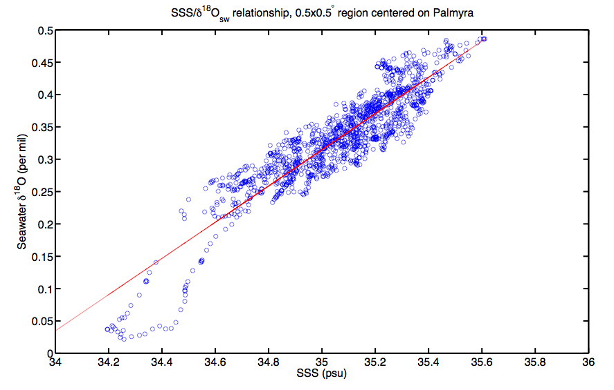
Notes:
This reveals that the linear relationship does not hold at Palmyra.

Slide 39
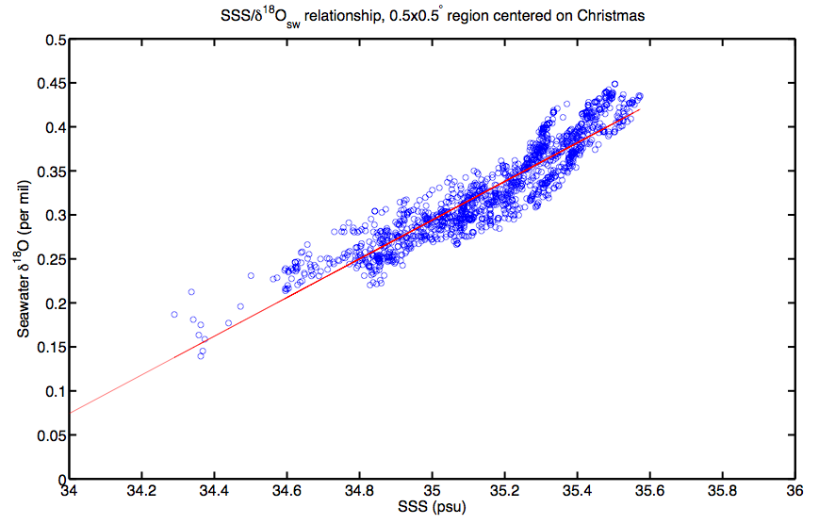
Notes:
But is better represented at Christmas

Slide 40
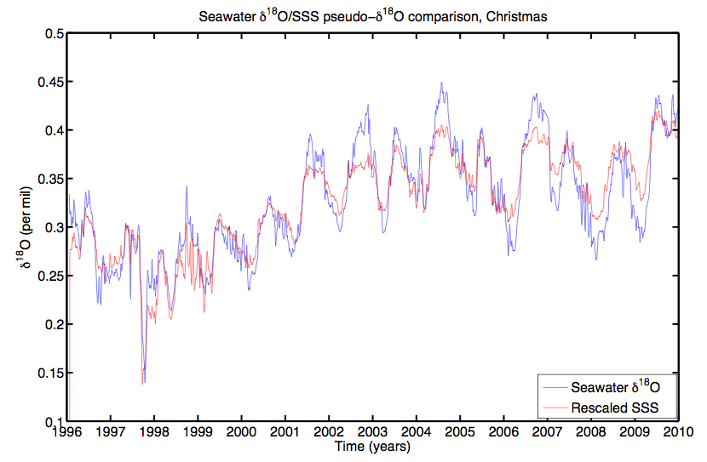
Notes:
But the proxies do not capture significant events and should not be used. We aim to use the isoROMS solutions to understand the dynamically-based diagnostics for ENSO strength based on d18O, rather than compare sampled d18O with GCMs.

Slide 41

To-do
Use new 2-way nesting of ROMS
Cover the full period of CORE forcing (1940s—)
What are the dynamical mechanisms for El Nino intensification at Palmyra
Continued downscaling: capture fine-scale dynamics (complete freshening of Christmas lagoon).
Develop dynamical relationship between and ocean state.

Slide 42
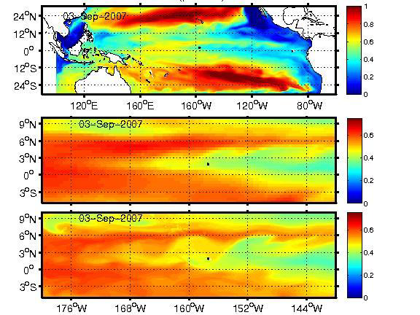
Notes:
INSERT 18O movie

Slide 43
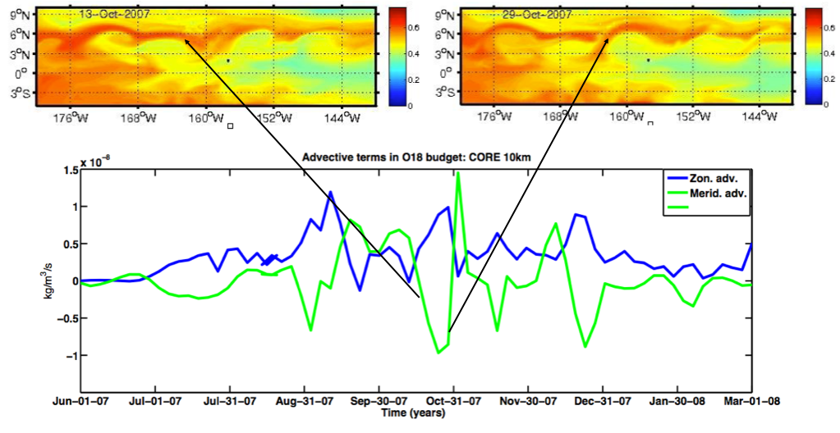
Notes:
We see two sides of the TIW, altering the meridional advection of O18

Slide 44
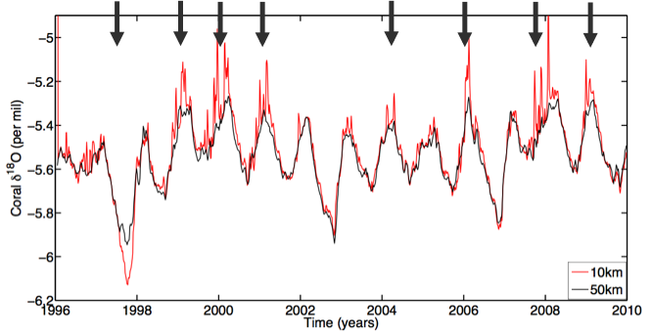
Notes:
The differences between the two models would be revealed in the corals showing larger amplitudes and significant variability at Palmyra.

Slide 45
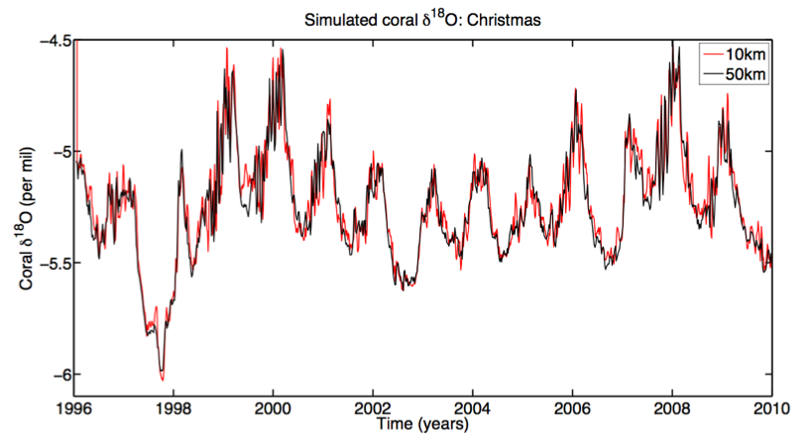
Notes:
But not at Christmas.

