Slide 1

Coastal Mean Dynamic Topography Computed Using ROMS Variational Assimilation of Long-Term Mean
Observed Currents and Hydrography
John Wilkin
Julia Levin, Javier Zavala-Garay and Naomi Fleming
Institute of Marine and Coastal Sciences
Rutgers, the State University of New Jersey
jwilkin@rutgers.edu
http://marine.rutgers.edu/wilkin
ROMS User Workshop, Rovinj, Croatia
26-29 May 2014

Slide 2
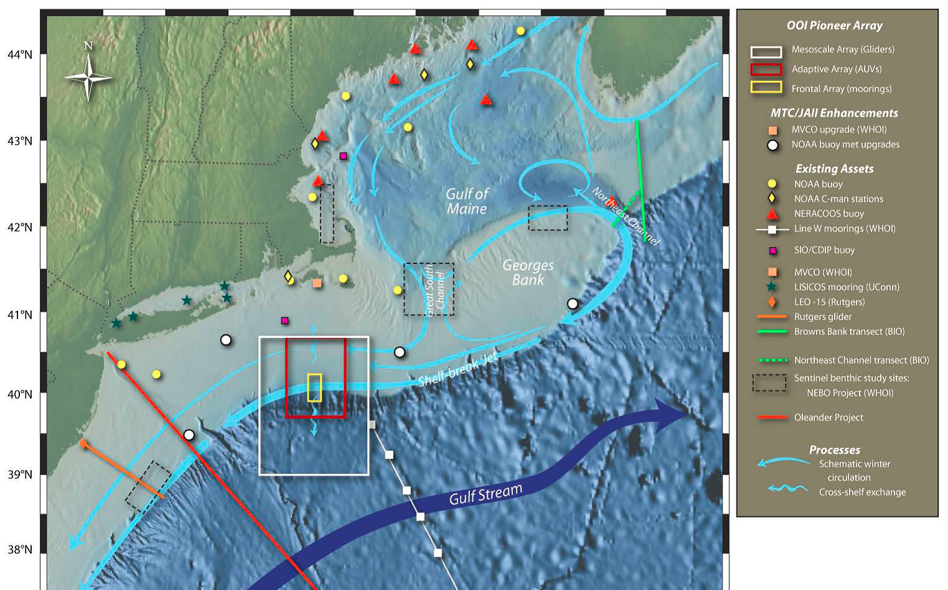
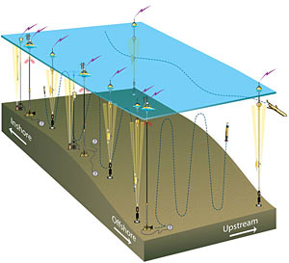
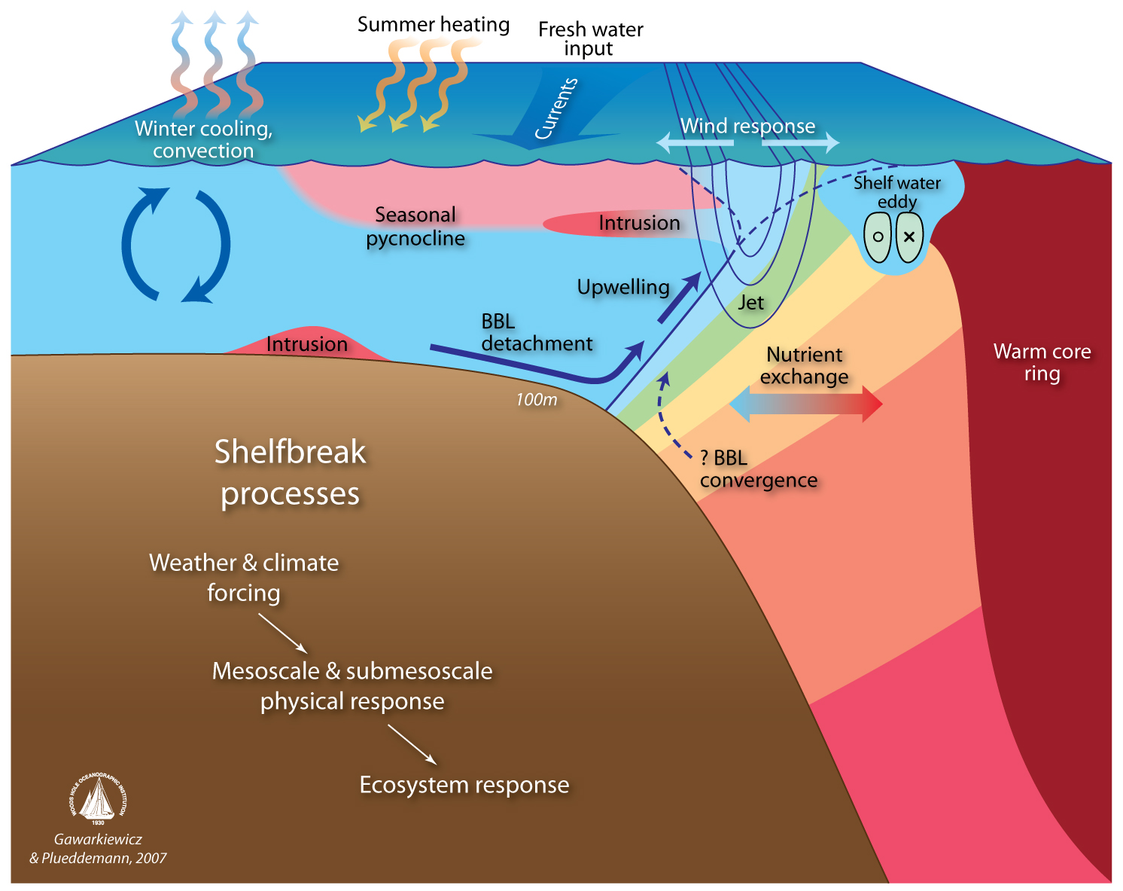
NSF Ocean Observatories Initiative Pioneer Array
OOI Pioneer Array focuses on shelf-sea/deep-ocean exchange at the shelf-break front

Slide 3
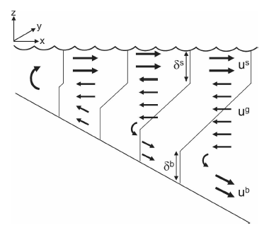
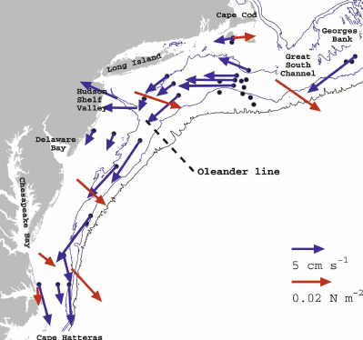
Mean circulation from an idealized 2-D model of MAB shelf dynamics (Lentz, 2008)
Along-shelf momentum includes significant along-shelf pressure gradient.
Lentz (2008) estimates slope of
3.7 x 10⁻⁸ = 0.03 m in 800 km
Lentz (JPO, 2008)
100 m
Lentz, S., 2008: Observations and a model of the mean circulation over the Middle Atlantic
Bight continental shelf, JPO, 38, 1203-1221

Slide 4
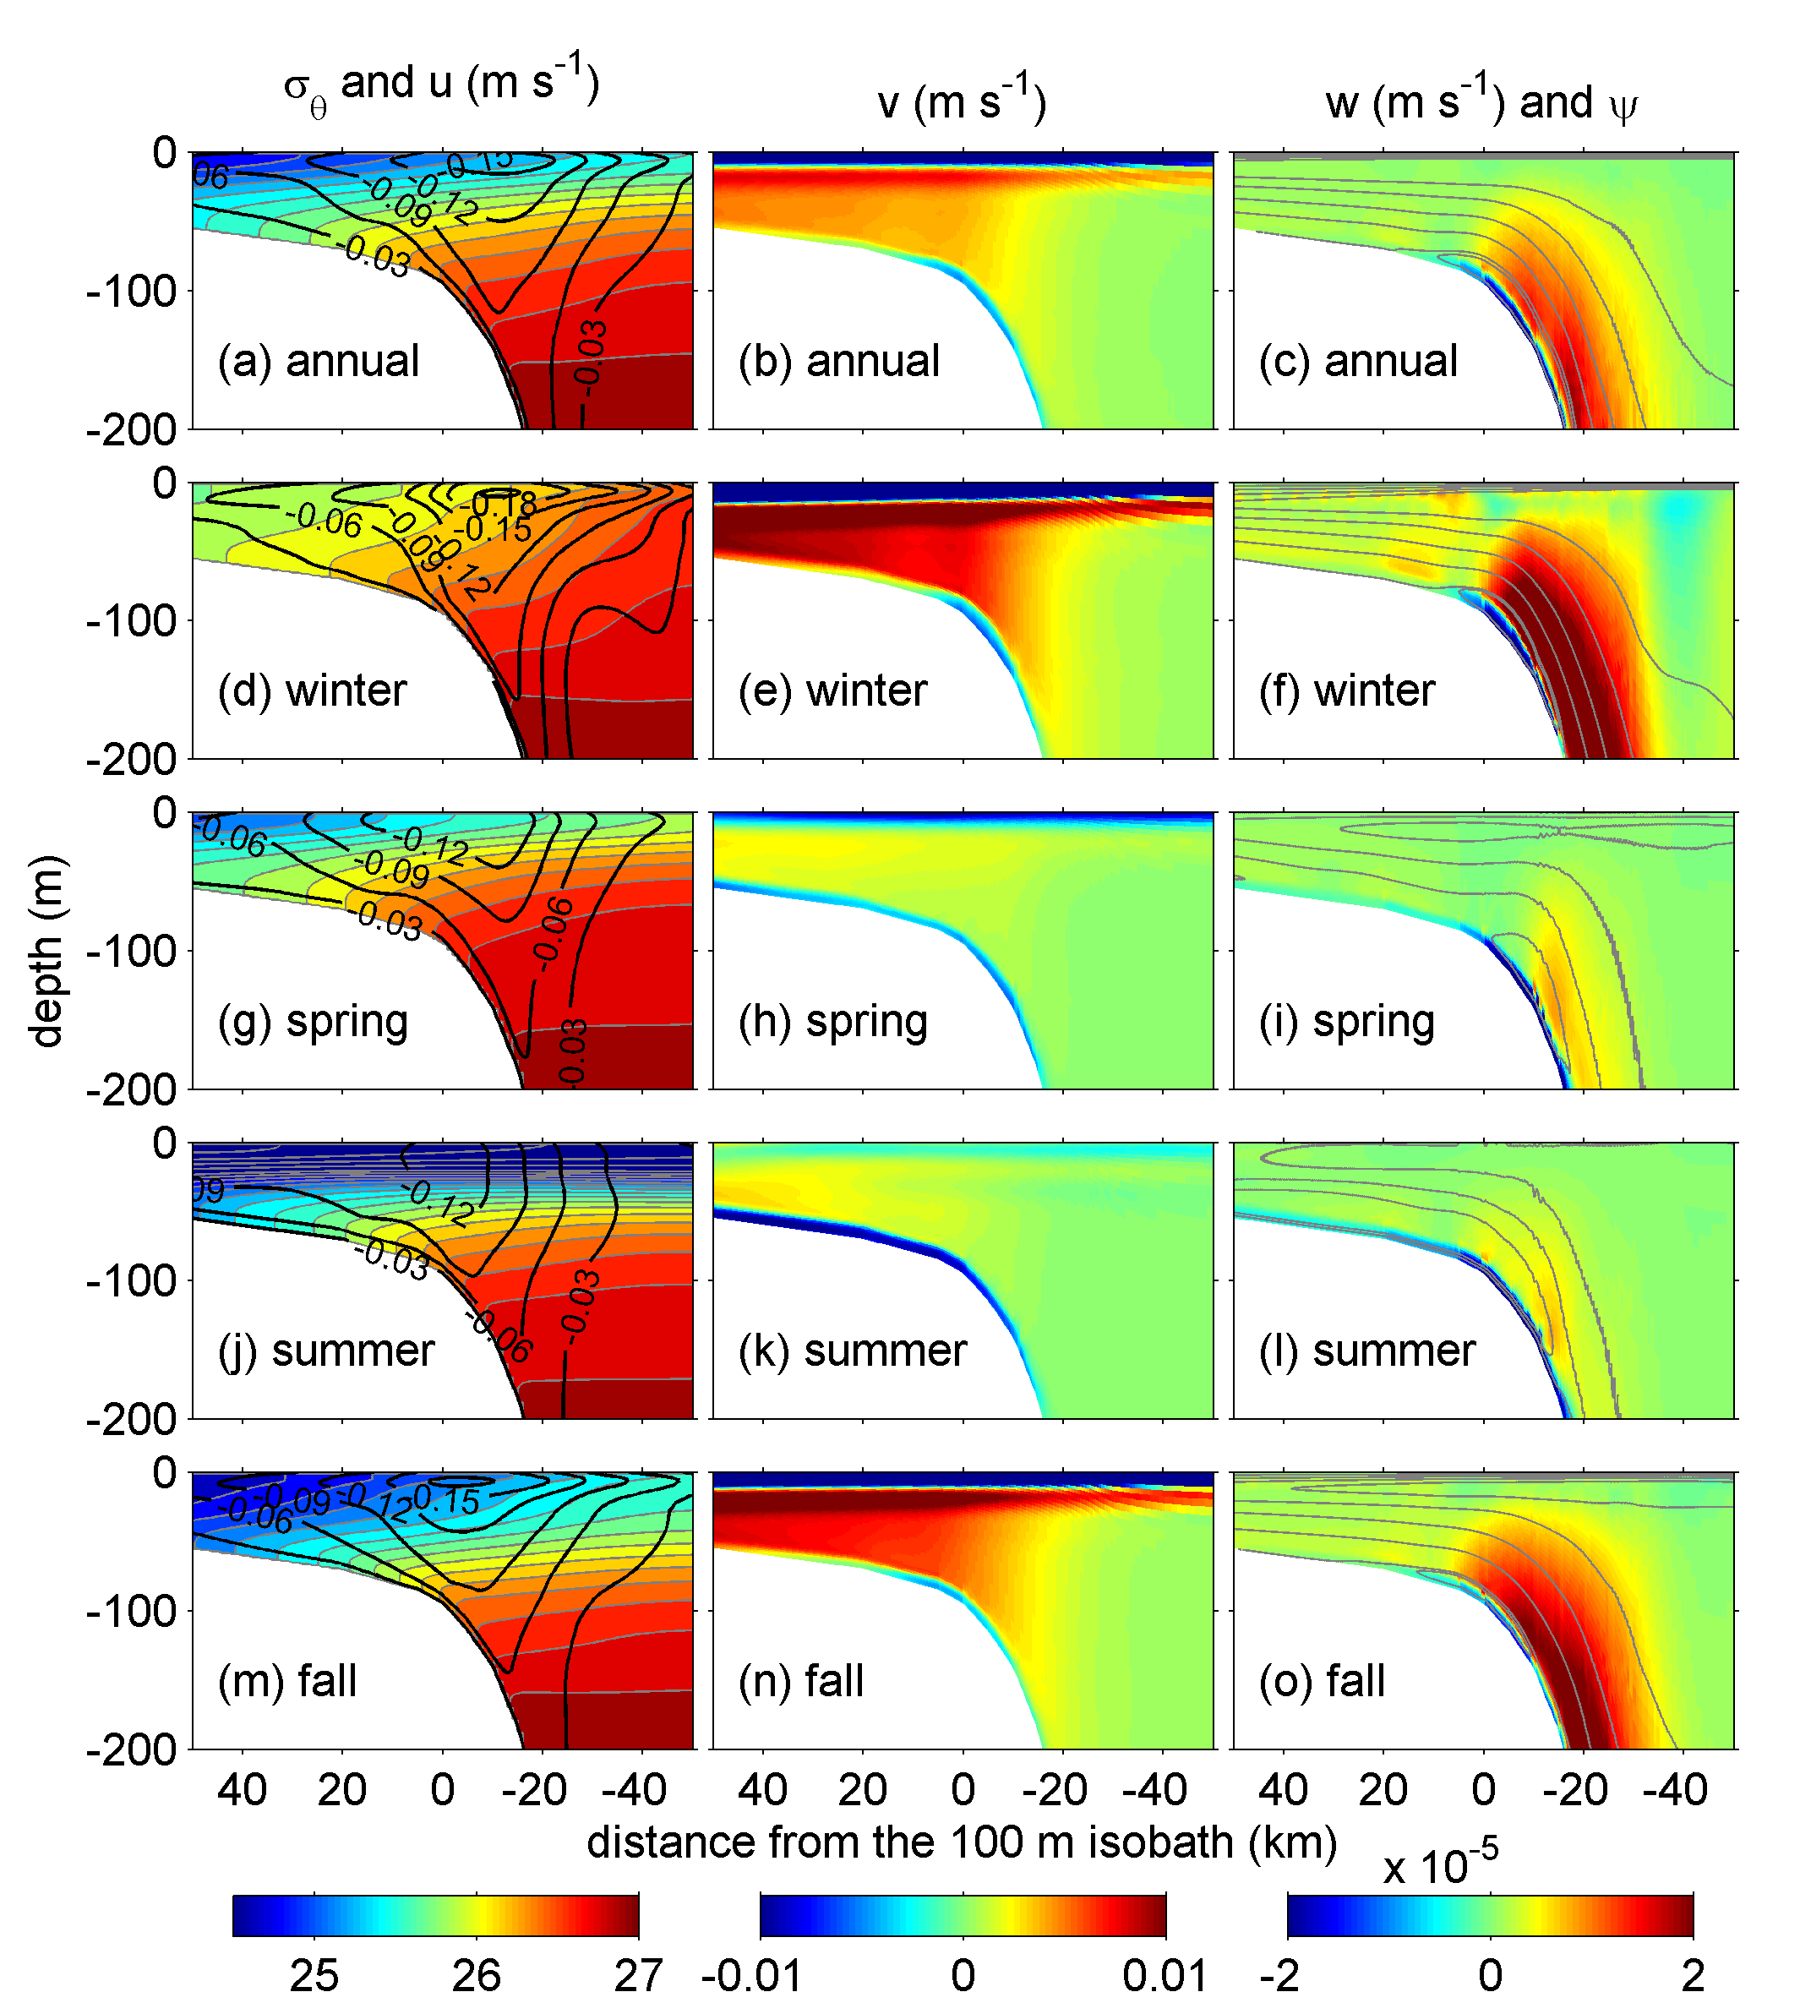
ROMS 2-dimensional climatological simulation (Zhang et al. 2011)
Simple nudging to along-shelf average of regional 3-D climatology “MOCHA” (Fleming and Wilkin) and imposed along-shelf pressure force equivalent to a mean sea level tilt
Offshore flow near surface and bottom in all seasons, balanced by onshore flow at mid-depth
Mean flow is similar to long-term mooring measurements
Persistent upwelling near shelf-break
Zhang, W. G., G. Gawarkiewicz, D. McGillicuddy and J. Wilkin, 2011, Climatological mean
circulation at the New England shelf break, J. Phys. Oceanogr., 41, 1874-1893, doi: 10.1175/2011JPO4604.1

Slide 5
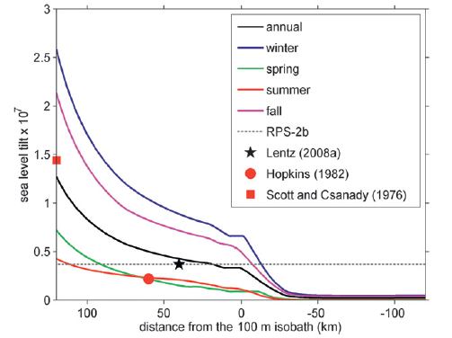
ROMS 2-dimensional climatological
simulation
(Zhang et al. 2011)
sea level tilt x 10⁻⁷
distance from 100-m isobath (km)
Cross-shelf distribution of the along-shelf sea level tilt imposed in simulations. Symbols show previous estimates of annual mean (★) and summer mean (, ) tilt.
•
Zhang, W. G., G. Gawarkiewicz, D. McGillicuddy and J. Wilkin, 2011, Climatological mean
circulation at the New England shelf break, J. Phys. Oceanogr., 41, 1874-1893, doi: 10.1175/2011JPO4604.1

Slide 6
Mean circulation from an idealized 2-D model of MAB shelf dynamics (Lentz, 2008)
Along-shelf momentum includes significant along-shelf pressure gradient.
Lentz (2008) estimates slope of
3.7 x 10⁻⁸ = 0.03 m in 800 km
Lentz (JPO, 2008)
MDT from
ROMS 4D-Var of climatological data
Lentz, S., 2008: Observations and a model of the mean circulation over the Middle Atlantic
Bight continental shelf, JPO, 38, 1203-1221

Slide 7
MDT
from
4D-Var

Slide 8
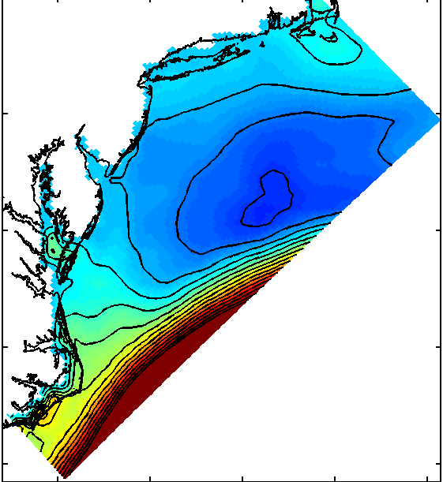

Slide 9
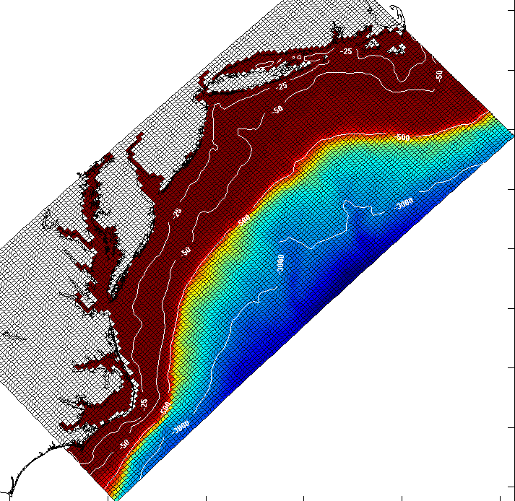
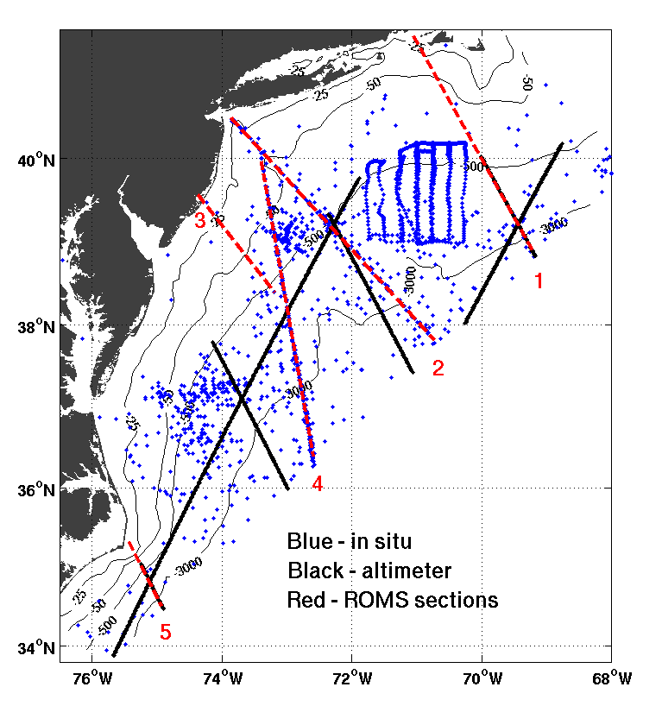
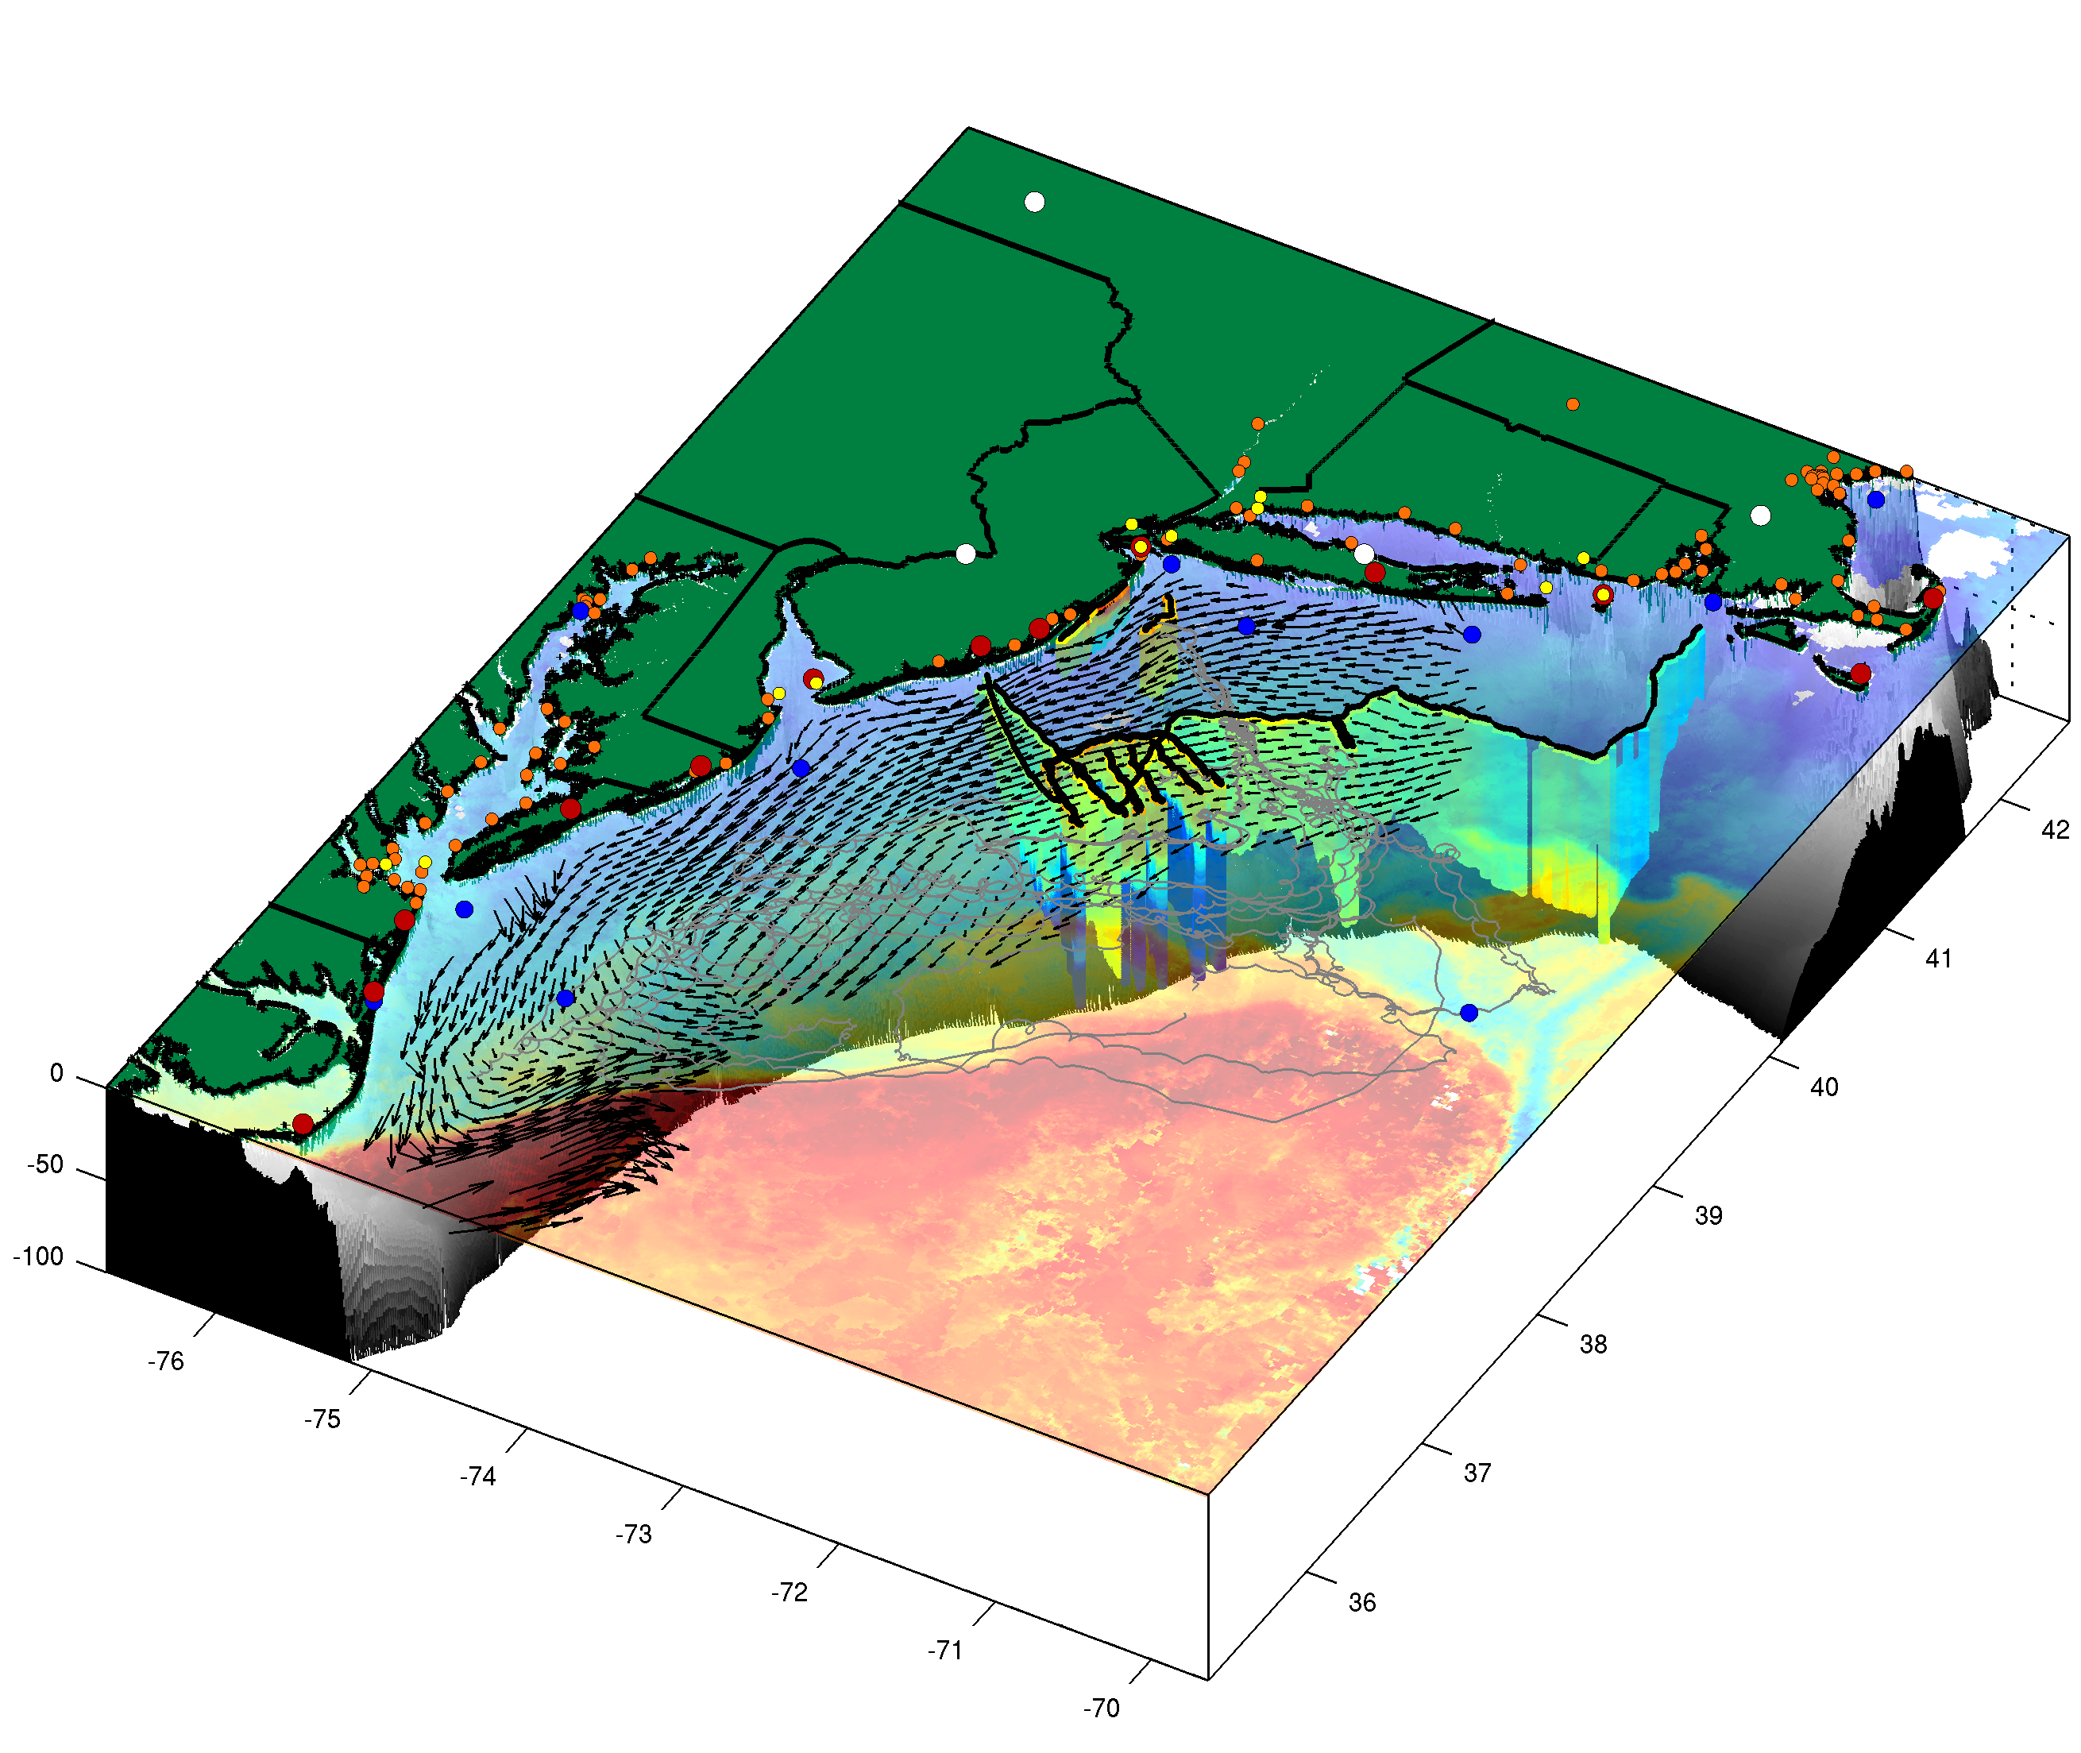
Climatological model configuration is the same as the “ESPreSSO” real-time ROMS system
myroms.org/espresso
model domain
maracoos.org
MARACOOS Observing System

Slide 10
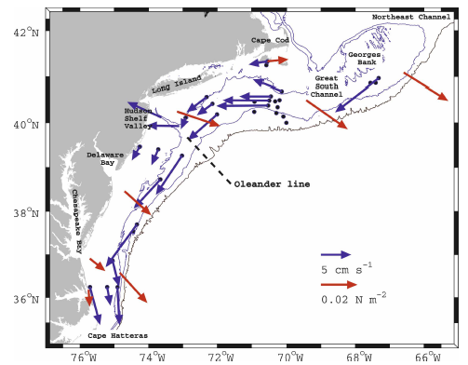
Data assimilated in the mean circulation analysis
Mean velocity from long-term moorings (> 200 days)
Mean depth-averaged current (blue), and mean wind stress (red) from current time series longer than 200 days. Light lines are 50-, 100-, and 1000-m isobaths.
Lentz, S., 2008: Observations and a Model of the Mean Circulation over the Middle Atlantic Bight Continental Shelf, JPO, 38(6), 1203.

Slide 11
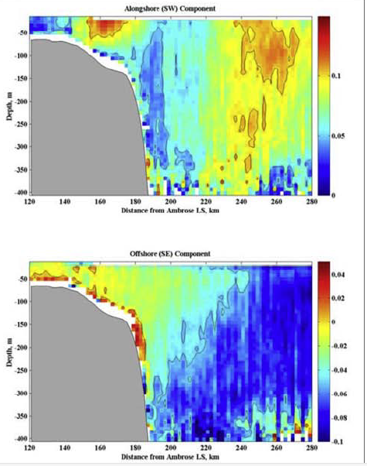
Data assimilated in the mean circulation analysis
Long-term mean velocity from
M/V Oleander ADCP transect
(Flagg et al. 2006)
Along-shelf velocity
20
ADCP mounted on vessel making
monthly transits from NY to Bermuda
Mean shelf-break jet 13 cm/s,
max 35 cm/s, 30 km jet width
Vertical scale of jet is 50 m,
relative vorticity/f ~ 0.2
Data shows offshore flow near bottom consistent with observations
Jet core is over the 120 m isobath but varies from 80 to 150 m isobaths
400
120
Cross-shelf Distance (km)
280
Across-shelf Velocity
Flagg, C., M. Dunn, D.-P. Wang, H. Rossby, and R. Benway,
2006: A study of the currents of the outer shelf and upper
slope from a decade of shipboard ADCP observations in the Middle Atlantic Bight, J. Geophys. Res., 111, C06003.
120
Cross-shelf Distance (km)
280

Slide 12
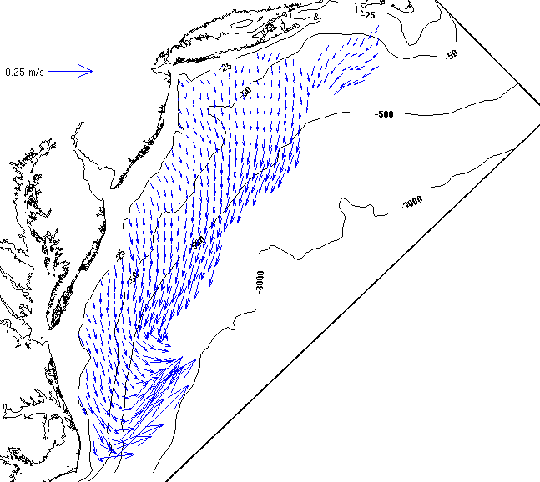
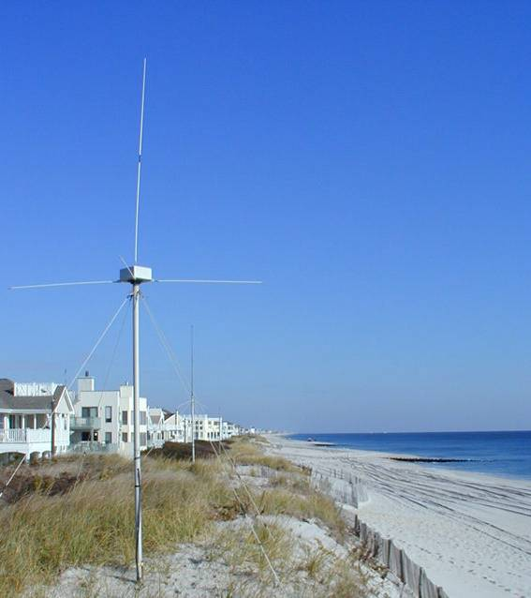
Data assimilated in the mean circulation analysis
Long-term mean surface current from HF radar (CODAR) velocity

Slide 13
Data assimilated in the mean circulation analysis

Slide 14
Model configuration for climatological simulations
Data Assimilation experiments
IS4DVAR: 2-day analysis window:
Control variables
  initial conditions, boundary conditions, and surface forcing
Data:
  T/S 3-D climatology, and velocity
  data are repeated in the analysis interval to constrain time evolution of solution
Annual mean DA analysis:
MDT becomes prior for subsequent seasonal mean experiments
Seasonal DA experiments:
TS, TSV and TSVH …
7 km horizontal grid;
36 s-levels
surface stress and air-sea fluxes from mean of 1998-2007 NCEP NARR reanalysis
mean USGS river discharge
no tides
Prior solution:
average of 12 short forward (no DA) simulations
  initial and boundary T/S from climatology, sea level and velocity from HYCOM

Slide 15
Seasonal Data Assimilation experiments
Analyses for each month using that month’s average of surface forcing and data (T/S velocity, and Jason SLA)
TS: 3-D temperature and salinity climatology only
TSV: T/S and velocity (current-meters, Oleander and CODAR)
TSVH: T/S, velocity and monthly altimetry
Compute new annual mean fields from monthly mean analyses (best estimate of MDT)
Compute seasonal means for analysis of seasonal cycle of MAB dynamics

Slide 16
DA fit to data: mean velocity

Slide 17
DA fit to data:
velocity seasonal
variance

Slide 18
TSV
Summer-winter cycle of SSH along Jason ground-tracks
compared to 2006-2011 mean of Jason
6
3
2
1
5
4

Slide 19
TSVH
Summer-winter cycle of SSH along Jason ground-tracks
compared to 2006-2011 mean of Jason
6
3
2
1
5
4

Slide 20
Seasonal cycle in dynamic topography

Slide 21
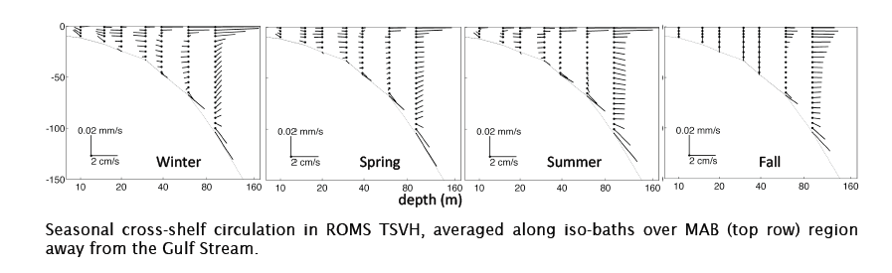
Seasonal cycle across-shelf flow and stratification

Slide 22
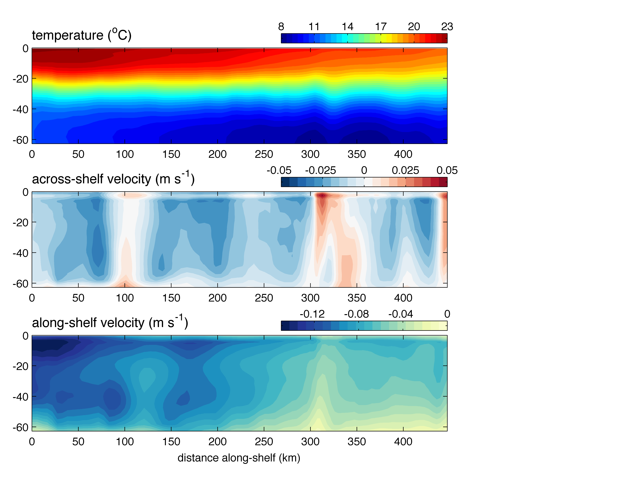
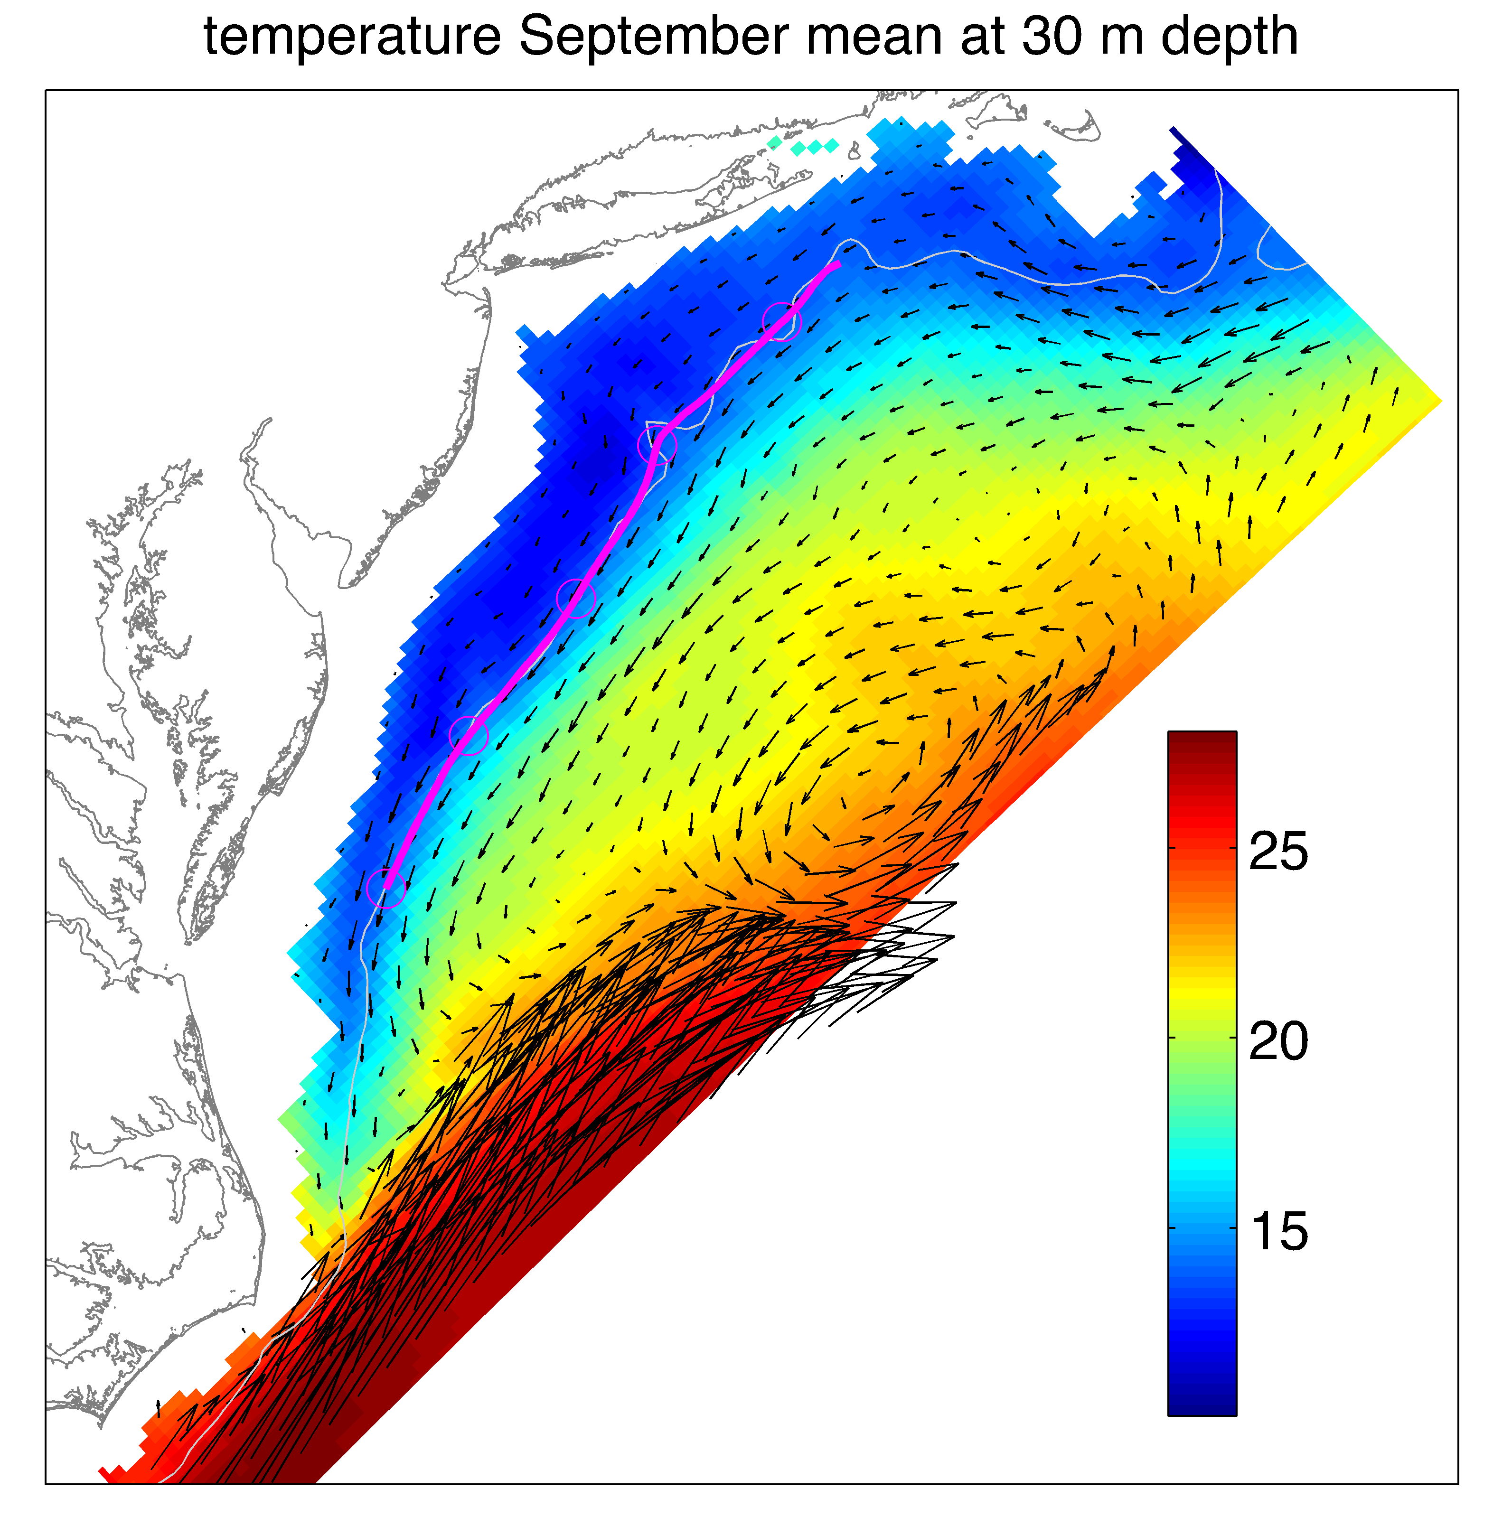
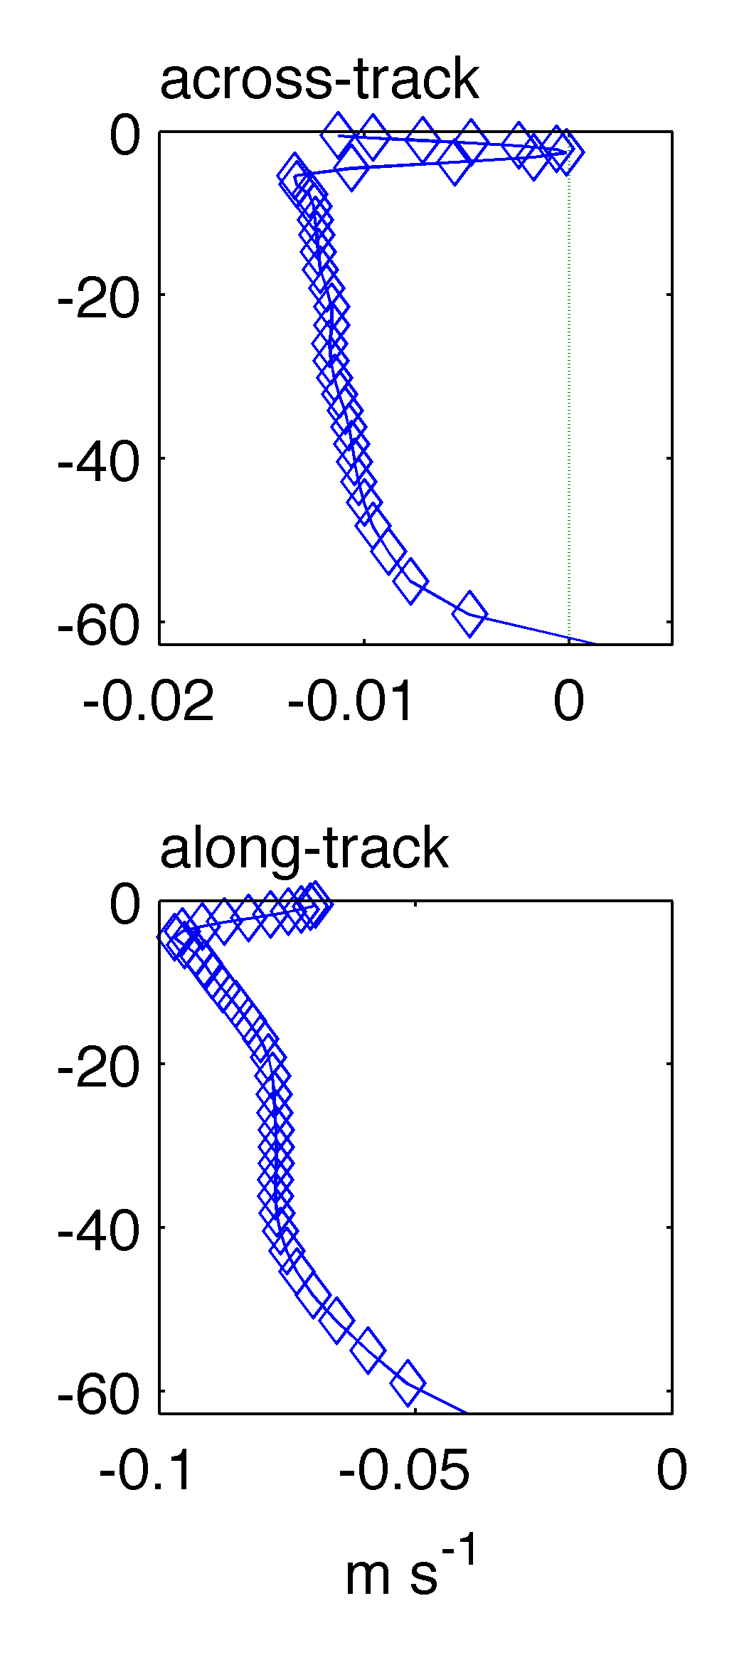

Slide 23
Computing MDT to combine with coastal altimetry in a real-time coastal ocean forecast system
4D-Var with boundary sea level and velocity in control variables
Data: Regional hydrographic climatology of temperature and salinity; surface current from HF-Radar; mean of monthly shipboard ADCP currents (the Oleander Line) and Line W; ~40 moored current-meter deployments (> 200 days)
Annual mean and seasonal mean analyses (seasonal analyses included Jason SLA in the assimilated data)
Best estimate MDT derived from mean of monthly analyses
MDT recovers along-shelf mean slope absent from boundary conditions adopted from a global data assimilative model.
Forecast model improves using new MDT in altimetry DA, and freely running simulations improve with MDT in open boundary conditions
ROMS User Workshop, Rovinj, Croatia
26-29 May 2014

