Slide 1
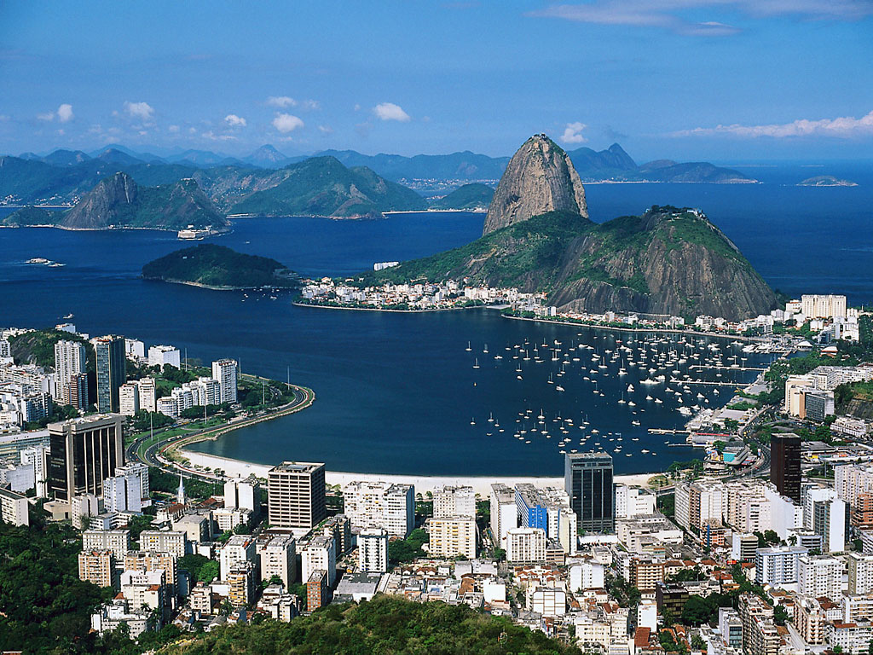
ROMS effective resolution
Patrick Marchesiello, IRD
ROMS Meeting, Rio, Octobre 2012

Slide 2
Physical closure and turbulent cascade
Is the turbulent cascade consistent with our numerical methods for solving the discretized primitive equations?

Slide 3
Kinetic energy spectrum in QG theory
Kinetic Energy
r_{D}=NH/f
Internal deformation radius
k^{-5/3}
Dissipation
Energy
Source
Enstrophy
k⁻³
r_{D}⁻¹
Wavenumber k

Slide 4
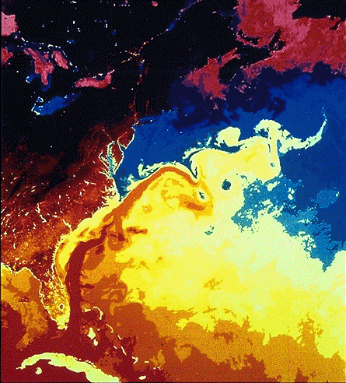
The Munk layer in western borders?
The Munk layer can be seen as an artifact of models that are not fully resolving the topographic effect on the flow.

Slide 5
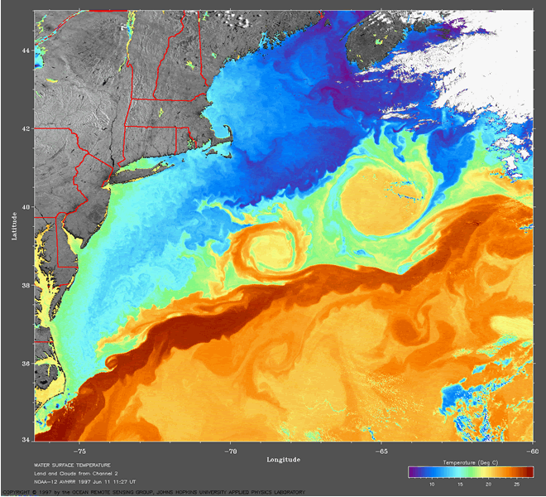

Slide 6
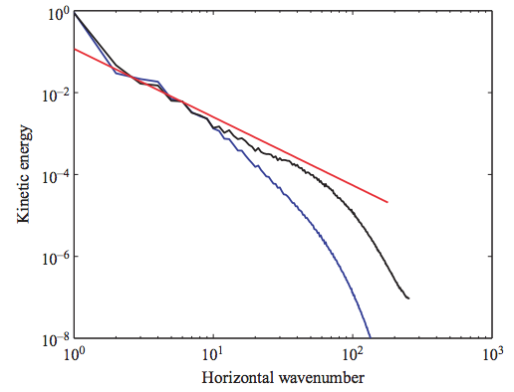
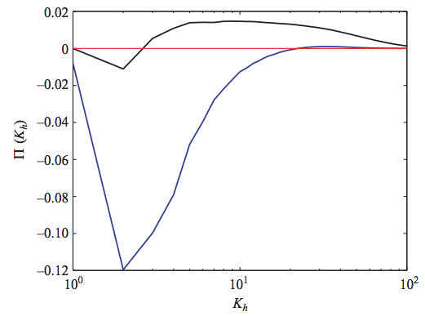
Alternative closure: direct energy cascade Ocean dynamics becomes 3D near the surface at fine scales Capet et al., 2008
Direct cascade
PE
Injection
k⁻²
Dissipation
QG
submeso
meso
PE
spectral flux (positive for direct cascade)
QG
Comparison of QG and PE spectra for the eady problem (Molemaker et al., 2010)

Slide 7
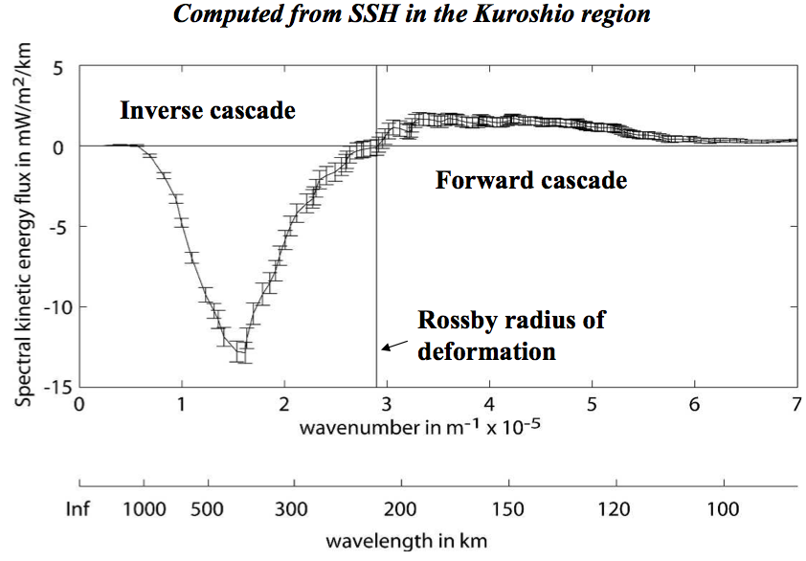
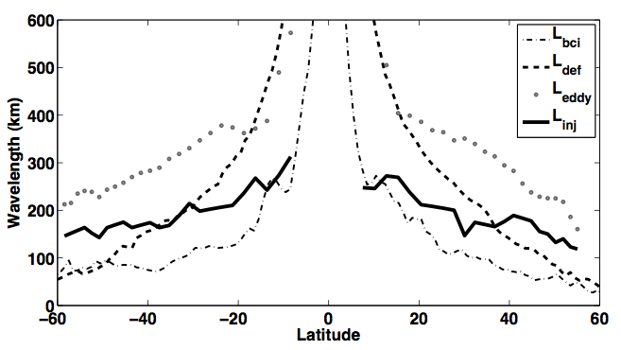
Eddy injection scale
Altimetry measurements of spectral fluxes are consistent with a direct cascade at submesoscale starting at the injection scale of baroclinic instability:
It is crucial to resolve this injection scale for getting at least part of the spectrum right
Injection scale L_{I}
Scott and Wang, 2005
The injection scale varies with latitude but:
It is not the deformation radius length scale (larger at low latitude)
It is about twice smaller than the mesoscale eddy scale.
L_{eddy}
L_{D}
L_{I}
Tulloch et al. 2011

Slide 8
Numerical closure
Effective resolution

Slide 9
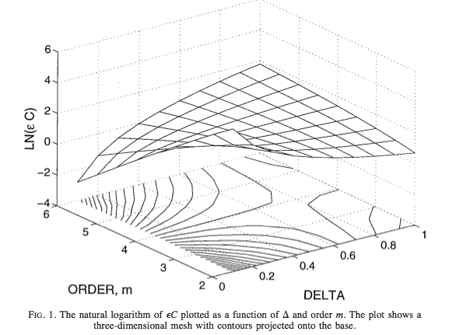
Order and resolution Brian Sanderson (JPO, 1998)
Truncation errors
Computational cost
Increasing resolution is inefficient
Increasing resolution is efficient
5th order of accuracy is optimal for a 3D model !!!
Considering the problem of code complexity, the 3rd order is a good compromise

Slide 10
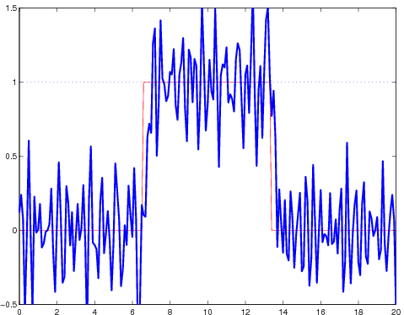
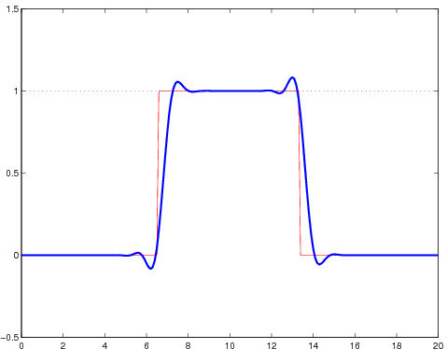
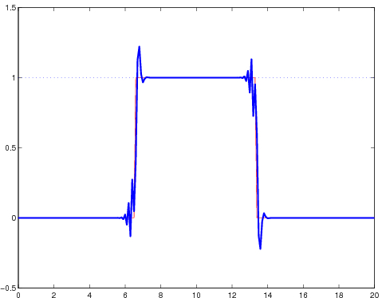
Numerical Diffusion/dispersion
C4
UP3
Hyperdiffusion
UP3 scheme
Phase error
Amplitude error

Slide 11
Effective resolution estimated from dispersion errors of 1D linear advection problem
For UP1 and UP3 (general law?):
C4
C2
The role of model filters is to dissipate dispersive errors.
If they are not optimal, they dissipate too much or not enough.
Upwind schemes present some kind of optimality
Effective Resolution :
- Order 1-2 schemes: ~ 50 Δx
- Order 3-4 schemes: ~ 10 Δx

Slide 12
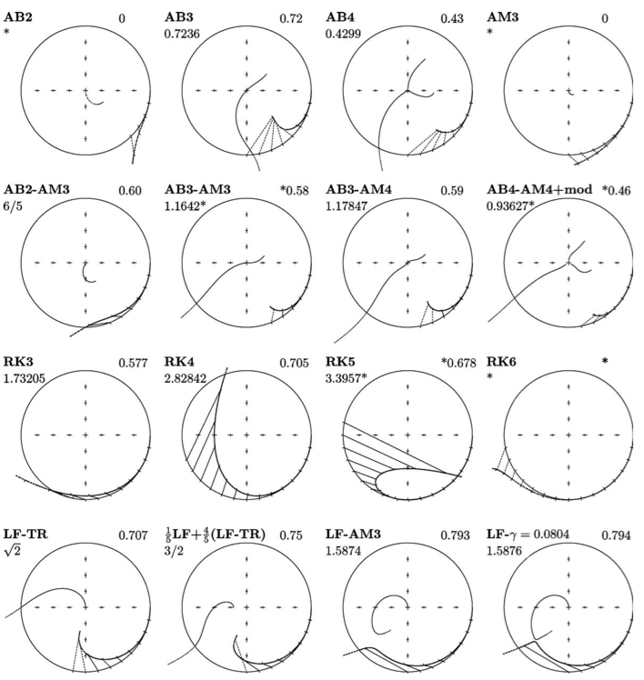
TEMPORAL SCHEME: the way out of LF + Asselin filter
2 schemes are standing out :
RK3 (WRF)
LF-AM3 (ROMS)
With these we can suppose/hope that numerical errors are dominated by spatial schemes.
But non are accurate for wave periods smaller than
10 Δt
… internal waves are generally sacrificed
Shchepetkin and McWilliams, 2005

Slide 13
Global estimation of diffusion et practical definition of effective resolution
Skamarock (2004): effective resolution can be detected from the KE spectrum of the model solution

Slide 14
Towards a more accurate evaluation of effective resolution
Marchesiello, Capet, Menkes, Kennan, Ocean Modelling 2011
LEGOS/LPO/LOCEAN

Slide 16
ROMS | Rutgers | AGRIF | UCLA
Origin | UCLA-Rutgers | UCLA-IRD-INRIA | UCLA
Maintenance | Rutgers | IRD-INRIA | UCLA
Realm | US East Coast | Europe-World | US West coast
Introductory year | 1998 | 1999 | 2002
Time stepping algorithms and stability limits
Coupling stage |  | Predictor | Corrector
2D momentum | LF-AM3 with FB feedback | Generalized FB (AB3-AM4)
3D momentum | AB3 | LF-AM3
Tracers | LF-TR Explicit geopotential diffusion | LF-AM3 Semi-implicite isopycnal hyperdiffusion (no added stability constraint)
Internal waves | Generalized FB (AB3-TR) | LF-AM3 with FB feedback
Cu_max 2D | 1.85 | 1.78
Cu_max 3D advection | 0.72 | 1.58
Cu_max Coriolis | 0.72 | 1.58
Cu_max internal waves | 1.14 | 1.85
Storage | 4,3 | 3,3
Miscellaneous code features and related developments
Parallelization | MPI or OpenMP | MPI or OpenMP (hybrid version) | Hybrid MPI+OpenMP
Nesting | On-line at baroclinic level | On-line at barotropic level | Off-line
Data assimilation | 4DVAR | 3DVAR
Wave-current interaction | Mellor | none | McWilliams
Air-sea coupling | MCT | Home-made + OASIS | none

Slide 17
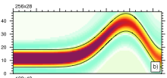
Rotated Isopycnal hyperdiffusion Lemarié et al, 2012; Marchesiello et al., 2009
Temporal discretization : semi implicit scheme with no added stability constraint (same as non-rotated diffusion for proper selection of κ)
Spatial discretization: accuracy of isopycnal slope computation (compact stencil)
Method of
stabilizing correction
Lemarié et al. 2012

Slide 18
Completion of 2-way Nesting Debreu et al., 2012
Accurate and conservative 2-way nesting performed at the barotropic level (using intermediate variables).
➦
proper collocation of barotropic points

Slide 19
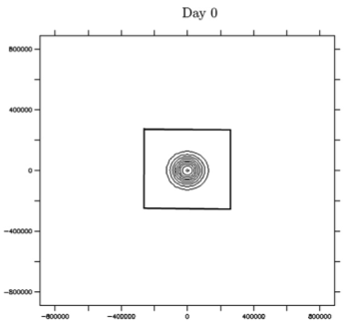
Update schemes
High order interpolator is needed (the usual Average operator is unstable without sponge layer)
Conservation of first moments and constancy preservation
Update should be avoided at the interface location
Baroclinic vortex test case
Excellent continuity at the interface
properly specified problem that prevents drifting of the solution

Slide 20
Tropical instability waves at increasing resolution
Temperature
Marchesiello et al., 2012
Eddies ~100km
Vorticity
Vertical velocities
36 km
12 km
4 km

Slide 21
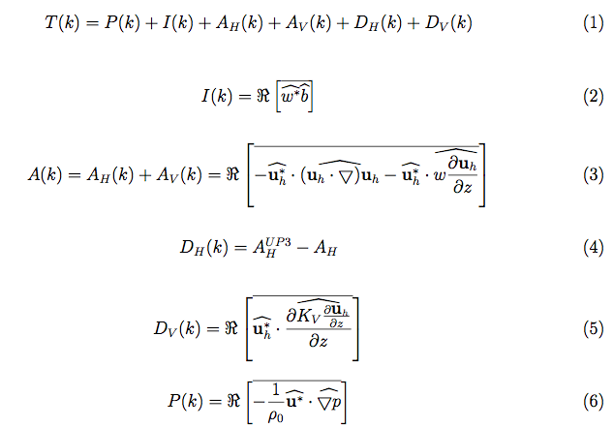
Diagnostics: spectral KE budget Capet et al. 2008
C4

Slide 22
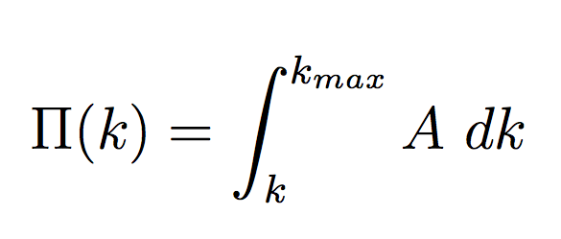
TIW spectral KE budget
L_{I} ~ ½L_{D} ~ ½L_{Eddy}
(Tulloch et al 2011)
Injection
cascade
direct
Cascade
K⁻²
K⁻³
Injection
Dissipation
Dissipation

Slide 23
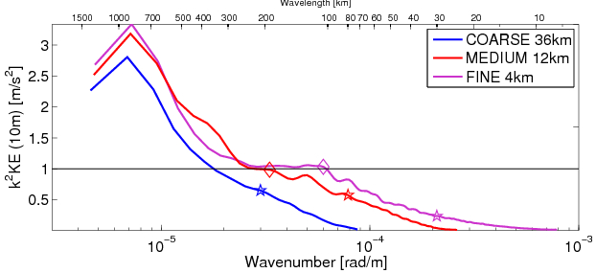
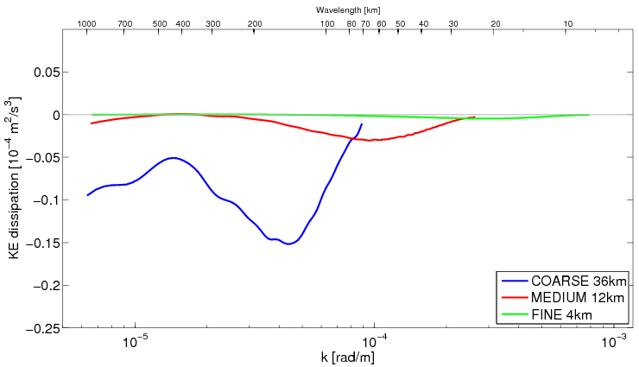
Compensated spectrum
Linear analysis
Skamarock criterion
injection
Dissipation spectrum

Slide 24
Conclusions
We need to solve the injection scale otherwise our models are useless for all scales of the spectrum
The numerical dissipation range determine the effective resolution of our models (assuming dispersive modes are efficiently damped)
Numerical diffusion may reach further on the the KE spectrum than expected from the analysis of simplified equations
The Skamarock approach may overestimate effective resolution
going further requires more idealized configurations
COMODO project

Slide 25
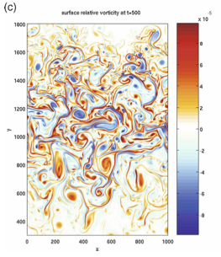
COMODO 2012-2016: A French project for evaluating the numerical kernels of ocean models
Estimate the properties of numerical kernels in idealized or semi-realistic configurations using a common testbed
Test higher order schemes (5th order)
Make a list of best approaches, best schemes (accuracy/cost) and obsolete ones
Propose platforms for developing and testing future developments … probably in the spirit of the WRF Developmental Testbed Center
Baroclinic jet experiment
Klein et al. 2008

