Slide 1








An overview of the shelf and shelf/slope regional modeling initiatives along the Brazilian coast: the REMO contribution towards operational oceanography and environmental monitoring
Mauro Cirano, Marta-Almeida M, Oliveira HB, Pereira J, Amorim FN, Soares ID, Martins RP, Lima JAM, Tanajura CAS
2012 ROMS User Workshop
22th to 25th Oct 2012 – Rio de Janeiro, Brazil

Slide 2
Outline
Introduction
Study region
Oceanic models adopted
Regional Modeling Grids
Summary and Future plans

Slide 3
Goals
Introduction
Oceanographic Modeling and Observation Network (Portuguese acronym REMO) main goal is to undertake research and technological development in physical and operational oceanography with focus on the South Atlantic Ocean and regions along the Brazilian coast using assimilative models and observational data
Our key focus areas include:
Support of maritime activities and engineering projects of the petroleum and gas industry with products ranging from daily oceanic forecasts to hydrodynamic databases
Support of environmental licensing activities via the provision of hydrodynamic databases used for environmental assessment and generation of oil spilling trajectory scenarios
Support military activities of the Brazilian Navy (e.g. search and rescue, ship routes)
Release results from ocean simulations, forecasts and validation through the internet for any user of oceanographic information as part of the ocean services by the Brazilian Navy Hydrographic Center (CHM)

Slide 4
REMO´s Workflow
Introduction
Universities, CENPES and Brazilian Navy
REMO web-page (forecasts, model runs, data)
Regional modeling
Basin and large-scale modeling
Brazilian Navy
Hydrodynamic databases
(by request)
Data Assimilation
Satellite products (SST and SSH)
Human Resources Training & Development
Support to observational programs
Scientific and Technological Development
Operational component
Results

Slide 5

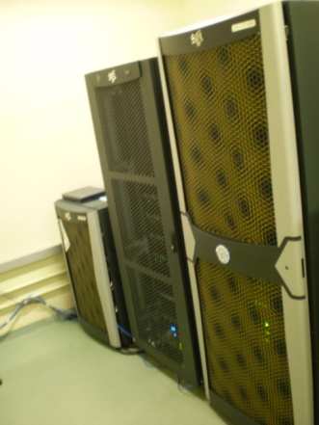
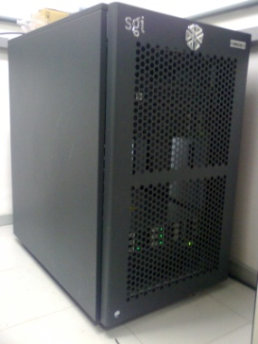
Computational Resources
Introduction
REMO’s oceanic models heavily rely on High Performance Computers (HPC), such as:
Share Cluster (Netuno): 256 nodes (Dell Server with two 2.6 GHz Xeon Quad-core) with a total of 2048 processors and 4.1 TB of distributed memory. The cluster was built in a partnership with the Research Network in Applied Geophysics
Navy Cluster (SGI Altix ICE 8200): 32 nodes (SGI Server with two 3 GHz Xeon Quad-core) with a total of 256 processors and 512 GB of distributed memory.
Local Cluster (SGI): 9 nodes (SGI Server with two eight core 2.4 GHz Intel Xeon) with a total of 144 processors and 704 GB of distributed memory. UFBA has a storage of 54 TB

Slide 6
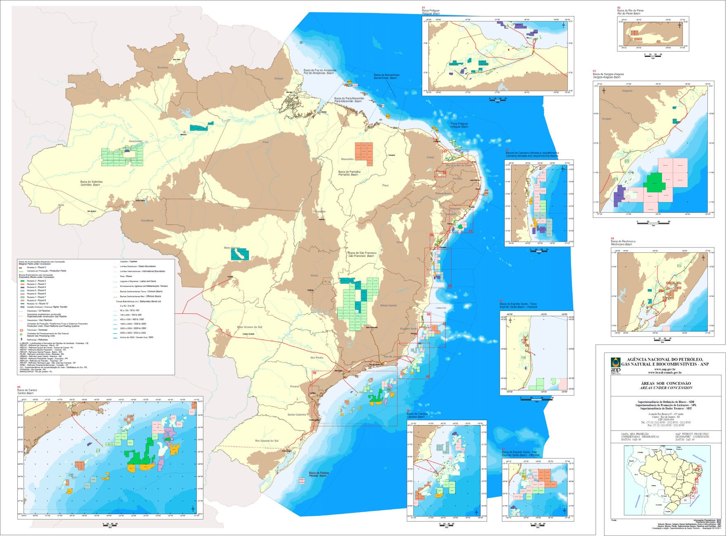

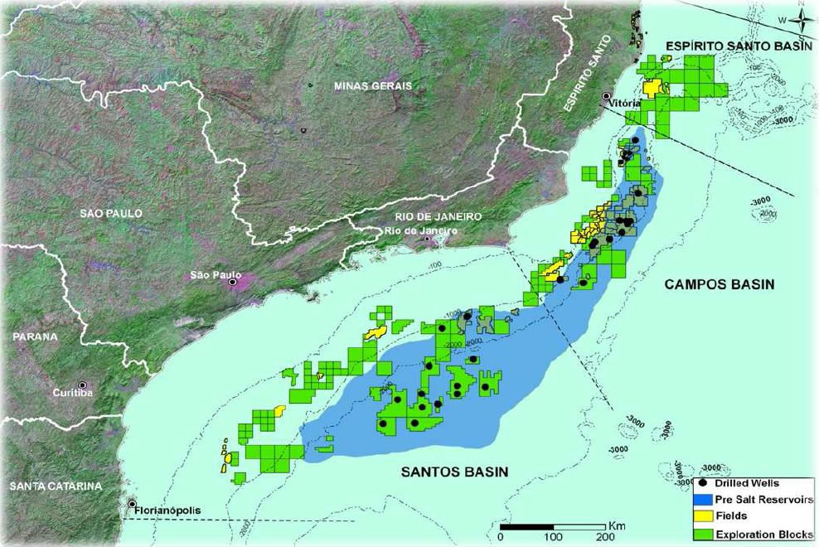
Oil activity (exploratory blocks and production fields, updated December 2011)
Region of study
Notes:
Troquei a cor para aparcer mais a indicacao da area

Slide 7
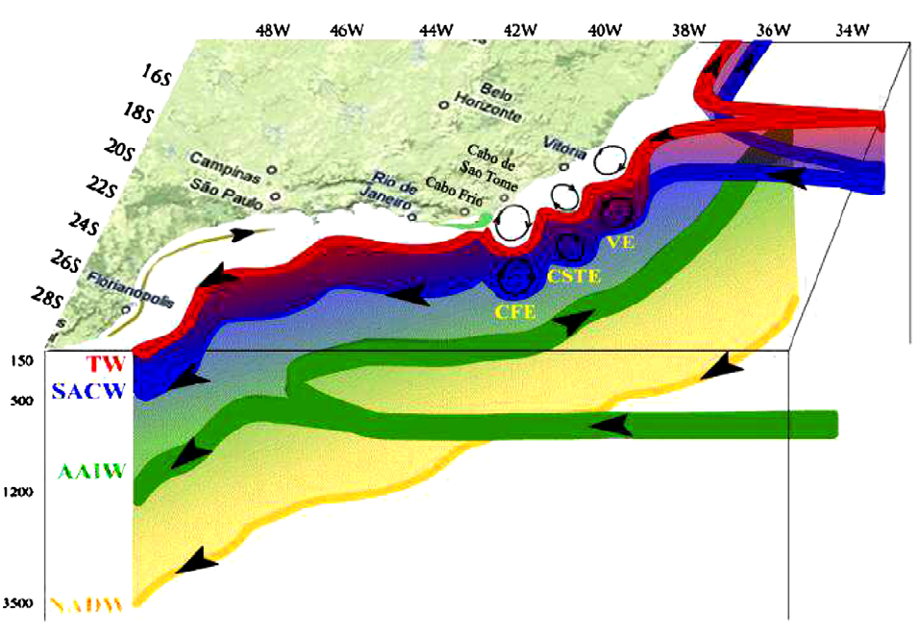
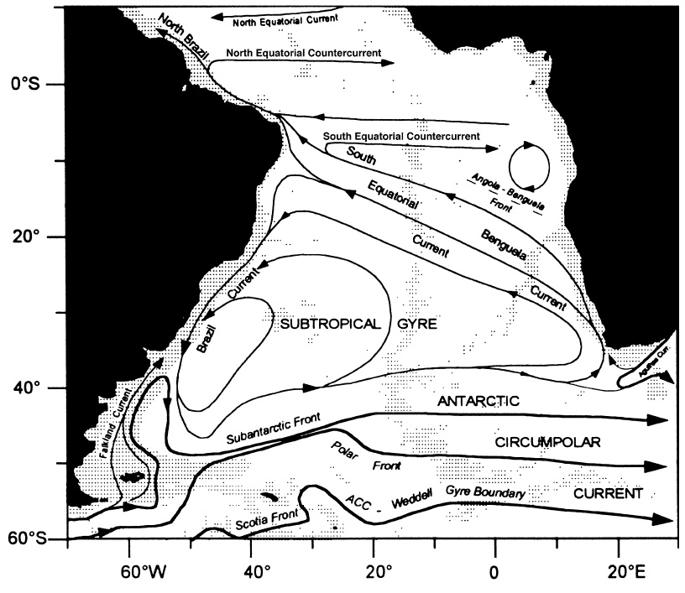
Oceanographic Features
Region of study
Extracted from Calado et al (2008)
SEC bifurcation: i) latitudinal excursion with depth and ii) seasonal cycle at surface
Water Mass flow directions vary with latitude: TW, SACW, AAIW, NADW, AABW
WBC dynamics: meso-scale activity associated with BC (southward flow) and NBC/NBUC (northward flow)
Brazil-Falklands Confluence
Passage of atmospheric frontal system
Tides and River inflow
Surface circulation extracted from Peterson & Stramma (1991)
Notes:
Acho que os grigos não conhecem como Malvinas e sim como Falklands. Estou certo!?

Slide 8
Oceanic Model Adopted
Global/Basin Scale Ocean Models
Regional Ocean Models
A hierarchy of numerical models are being tested as part of the efforts to implement an operational modeling system for the South Atlantic Ocean
Versions of the Hybrid Coordinate Ocean Model (HYCOM) from 1/4° (whole Atlantic Ocean) to 1/12° (Equatorial and South Atlantic) are implemented at REMO
Outputs from global OCCAM l/12 (no data assimilation) and HYCOM/NCODA 1/12° (with data assimilation) are used to provide initial and boundary conditions for the regional models
Focus on particular details of the ocean circulation such as the interaction of the Brazil Current eddies with tidal and wind-driven circulation on the continental shelf/slope
Versions of ROMS and HYCOM with tides (not discussed here) with few km of resolution are implemented along the Brazilian coast

Slide 9
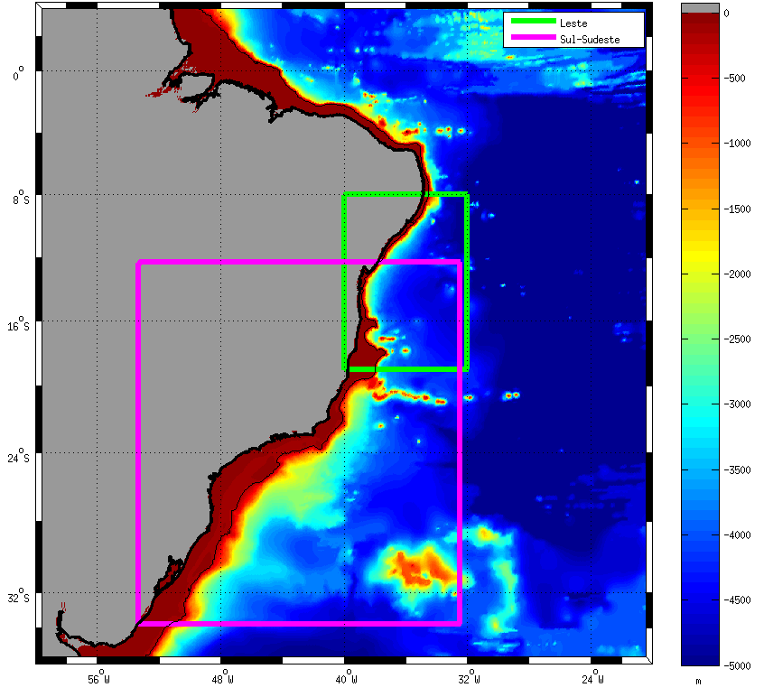
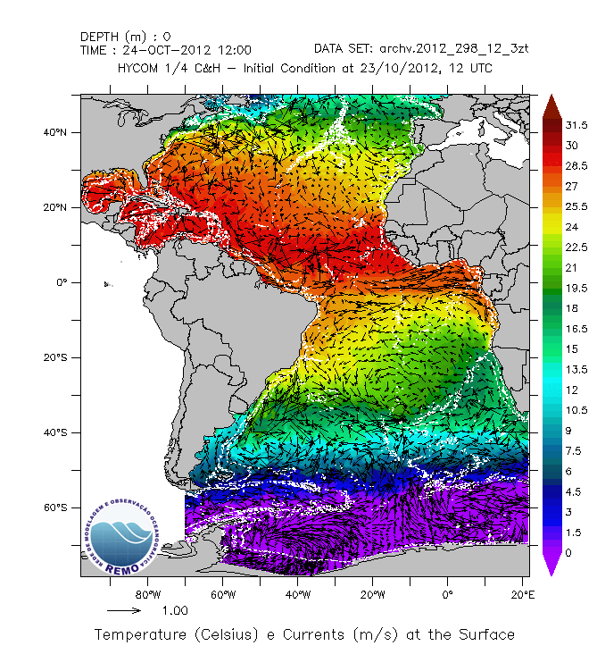
Regional Grids – METAREA V
--- N/NE grid
--- E grid
--- S/SE grid
METAREA V - Brazilian responsibility (WMO-IOC/JCOMM) for marine forecasts and warnings
Notes:
Troquei a ordem dos nomes somente e deixei a ultima grade, que ainda não esta sendo utilizada separada das outras

Slide 10
ROMS General Configurations
Oceanic Model Adopted
Long runs (5 to 10 years) are used to assess results before the models become operational
Grids can have variable horizontal resolution (pilot) or fixed horizontal resolution (E, S-SE, N-NE)
Global Models (varying from monthly climatology to daily outputs) provide initial and boundary conditions for the thermohaline and velocity fields
Synoptic (3 to 6 hours intervals) atmospheric forcing from Quickscat, NCEP and GFS
Heat and evaporation-precipitation fluxes are prescribed via Bulk formulation
Tidal forcing from TPXO
Validation performed at supra-inertial (mainly tides) and sub-inertial bands

Slide 11
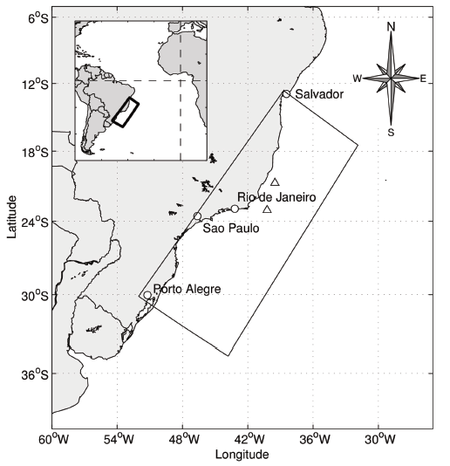
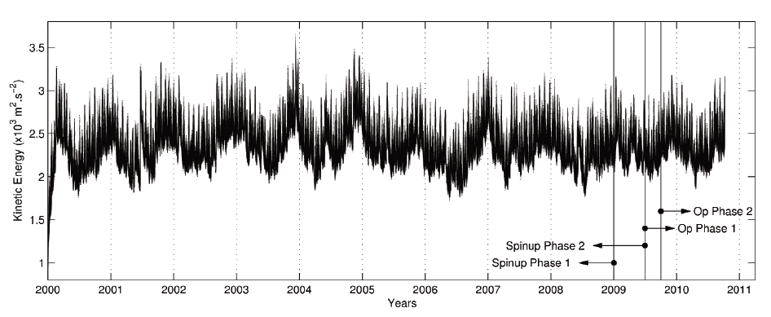
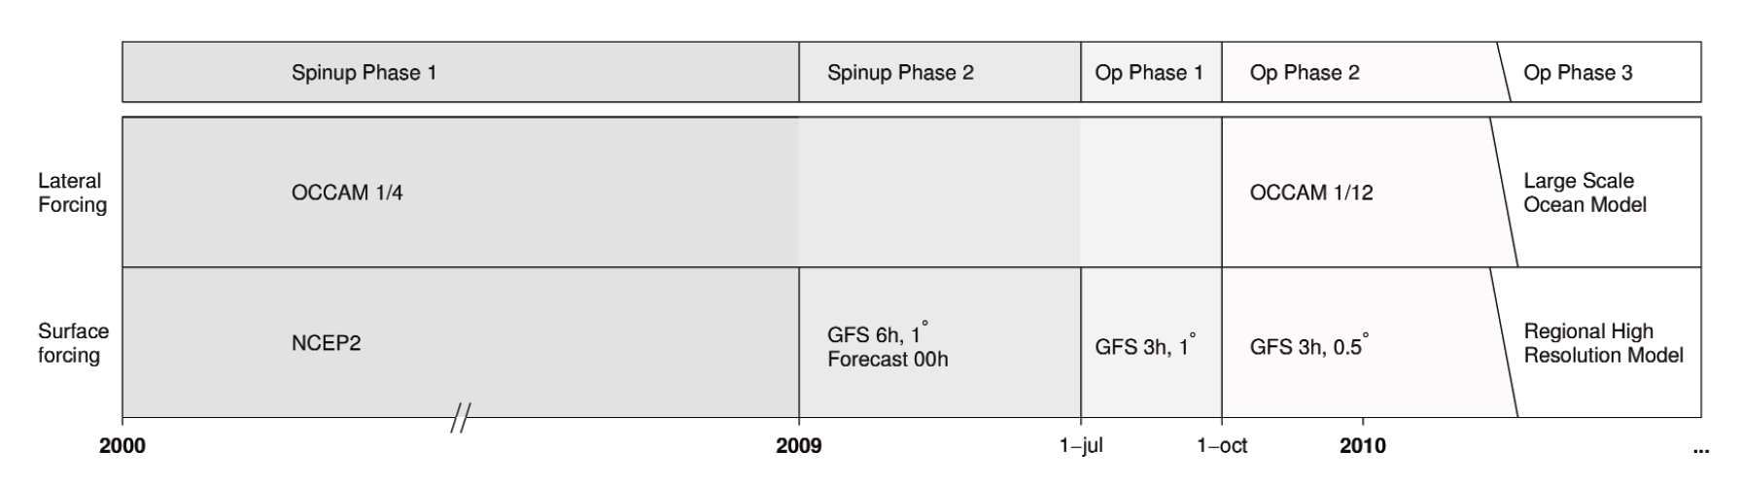
ROMS Pilot grid
Regional Modeling Grids
Detailed results presented in Marta-Almeida et al (2011a, b) – JOO/EMS
HYCOM/
NCODA 1/12
HY-NCODA
Notes:
Coloquei um bloco em branco sobre o “High Resolution Atm model” para esconder

Slide 12
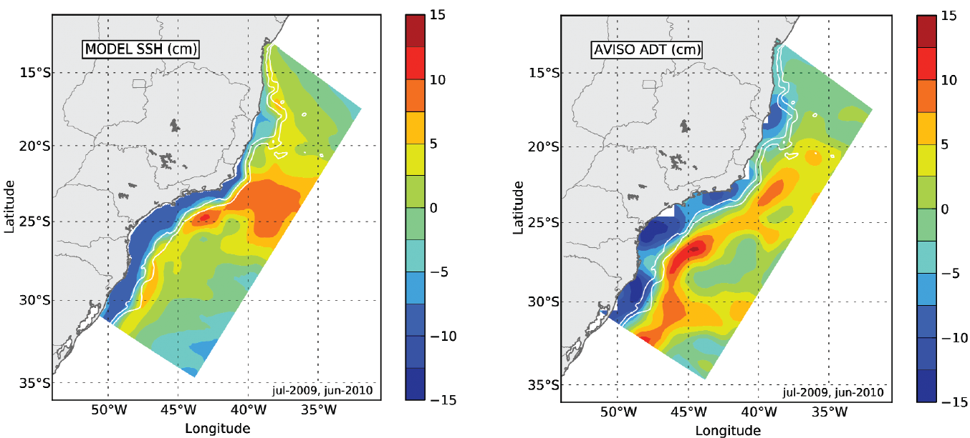
ROMS Pilot grid
Regional Modeling Grids
Comparison between the modeled SSH during a one year period and the AVISO absolute dynamic topography with the spatial mean removed

Slide 13
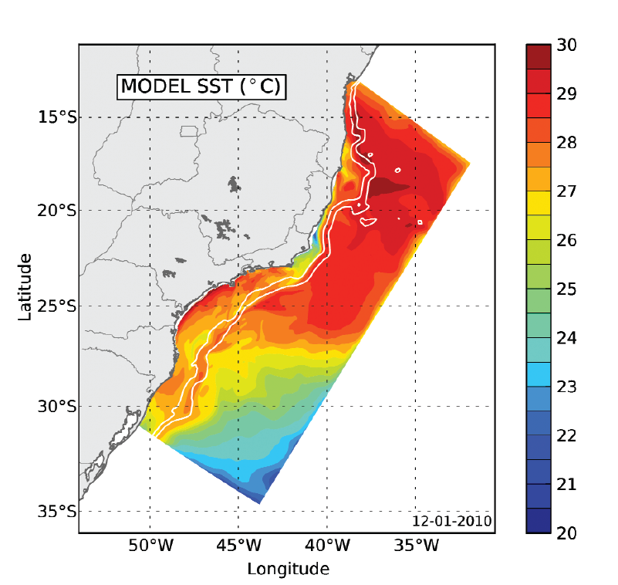
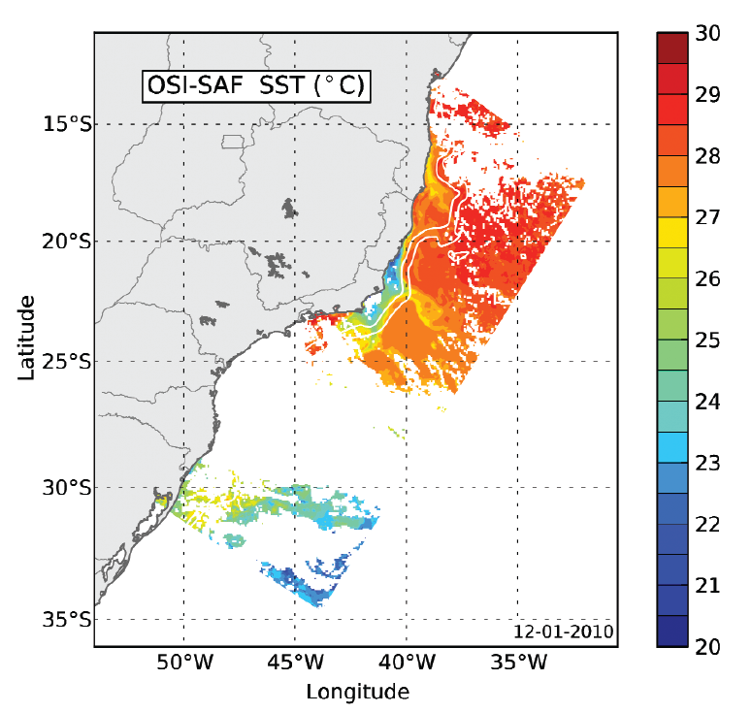
ROMS Pilot grid
Regional Modeling Grids
Comparison of the modeled SST during an upwelling event (12/01/2010) and the SST from satellite (OSI-SAF). The black circle at 21°S represents a coastal site where a time series of SST was extracted

Slide 14
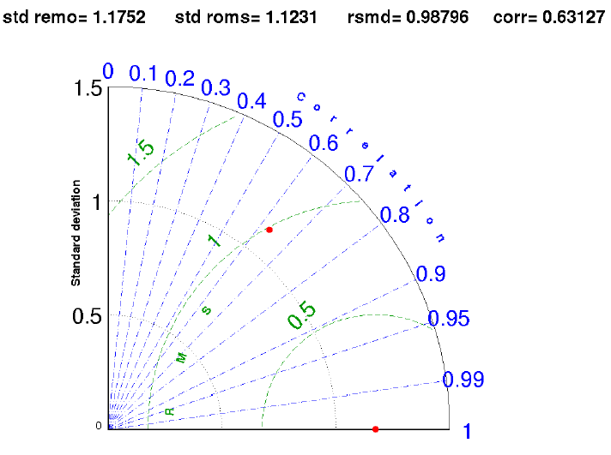
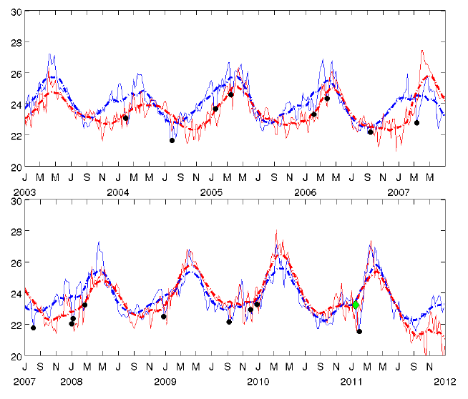
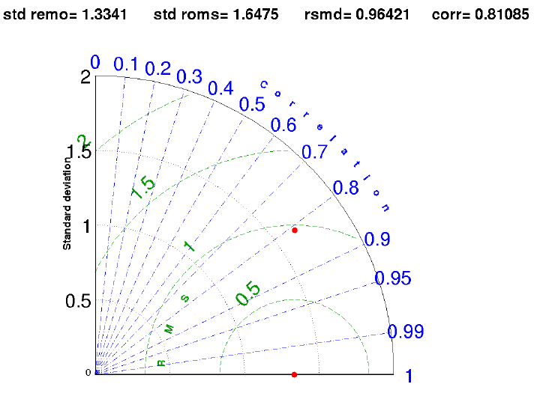
ROMS Pilot grid
Regional Modeling Grids
ROMS
SST-REMO
2003-2008
2009-2011
Time series of modeled SST (5 day averages) in red compared with the satellite SST product from REMO (in blue). The Taylor diagrams show the improvement of the model statistics after the operational phase.

Slide 15
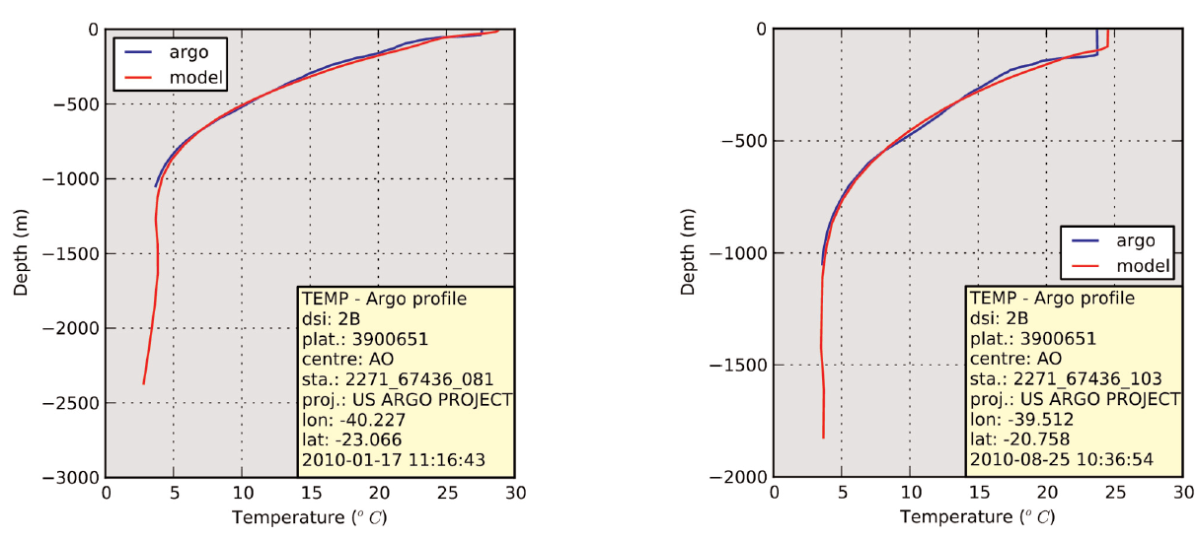
ROMS Pilot grid
Regional Modeling Grids
summer
winter

Slide 16
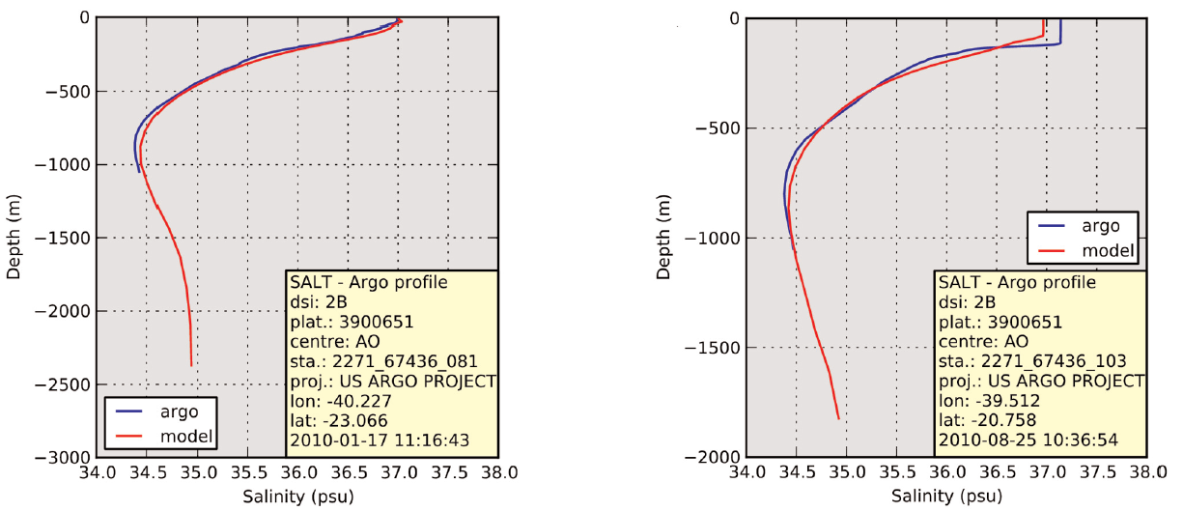
ROMS Pilot grid
Regional Modeling Grids
summer
winter

Slide 17
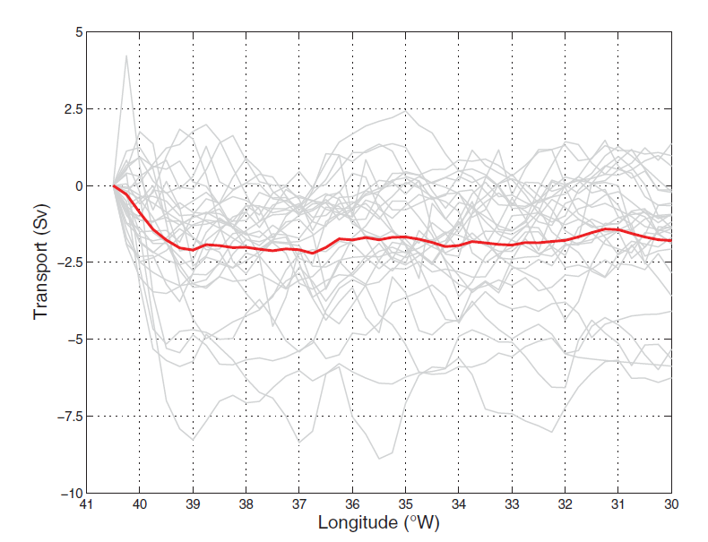
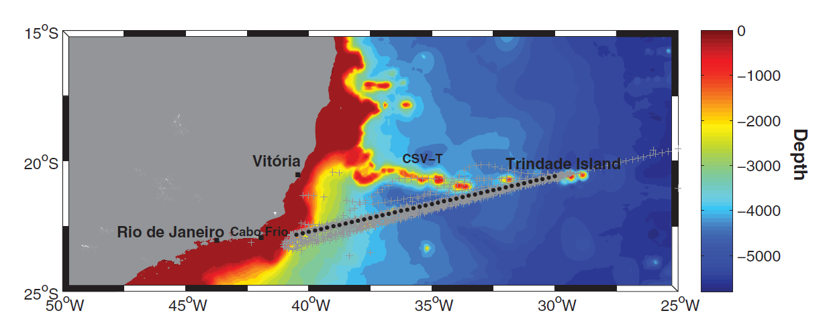
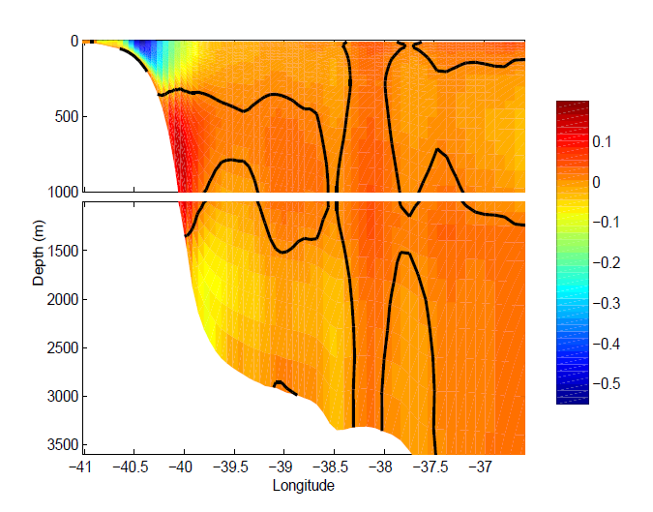
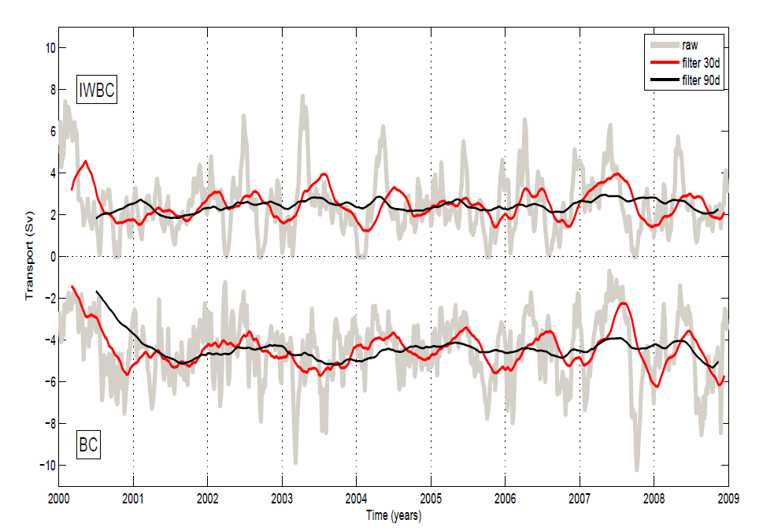
AX97 – 2004-2011(29 events)
NOAA AX97 XBT line - Mata et al (2012)
BC
IWBC

Slide 18
ROMS 1/36° E grid
Regional Modeling Grids
The region has the narrowest shelf along the Brazilian coast ( up to 7 km)
It is influenced by the latitudinal excursion of the SEC bifurcation, the seasonal winds, the passage of frontal systems and the tides
The model was nudged to daily outputs of HYCOM/NCODA and was run from 2004-2009
The shelf break is represented by the 70 m isobath (bold black line), followed by the 200 m, 1000 m and 3000 m isobaths (ligth black lines)
See Poster section for more details

Slide 19
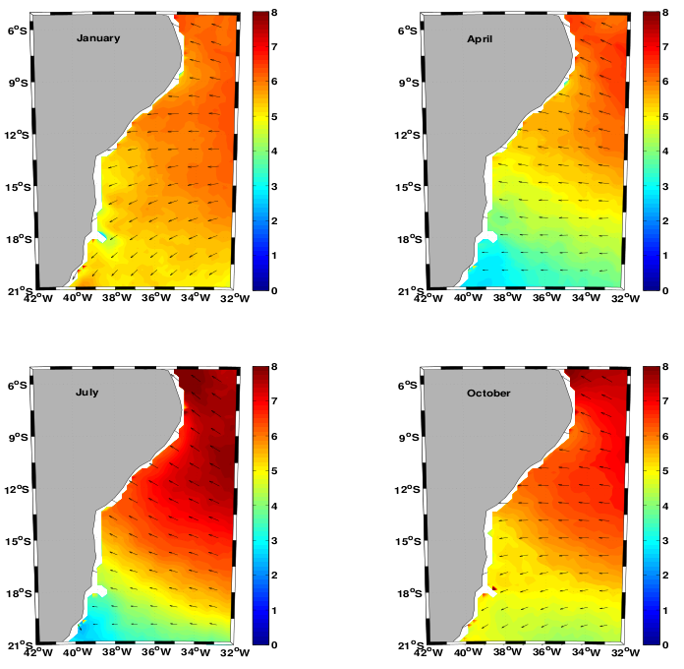
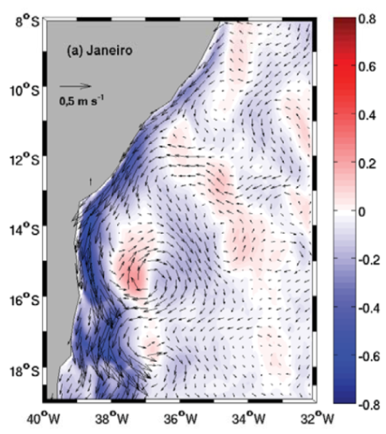
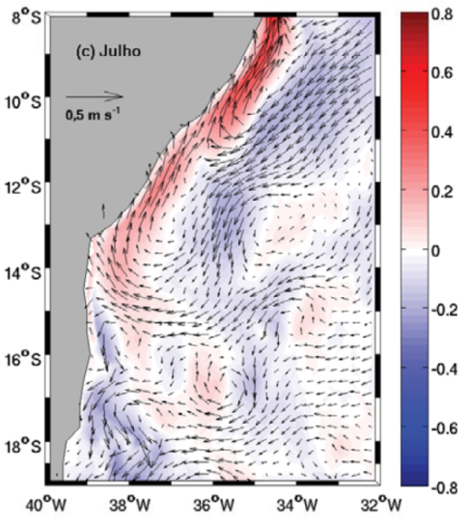
ROMS 1/36° E grid
Regional Modeling Grids
Averaged QUICKSCAT wind fields (2006-2009) for January and July show the importance of the seasonal cycle
Averaged surface currents (2006-2009) show the reversion of the continental shelf circulation, driven by the wind field and WBC dynamics
January
July
Notes:
Coloquei quickscat em preto para a referencia no proximo slide de vento ser associada ao quickscat

Slide 20
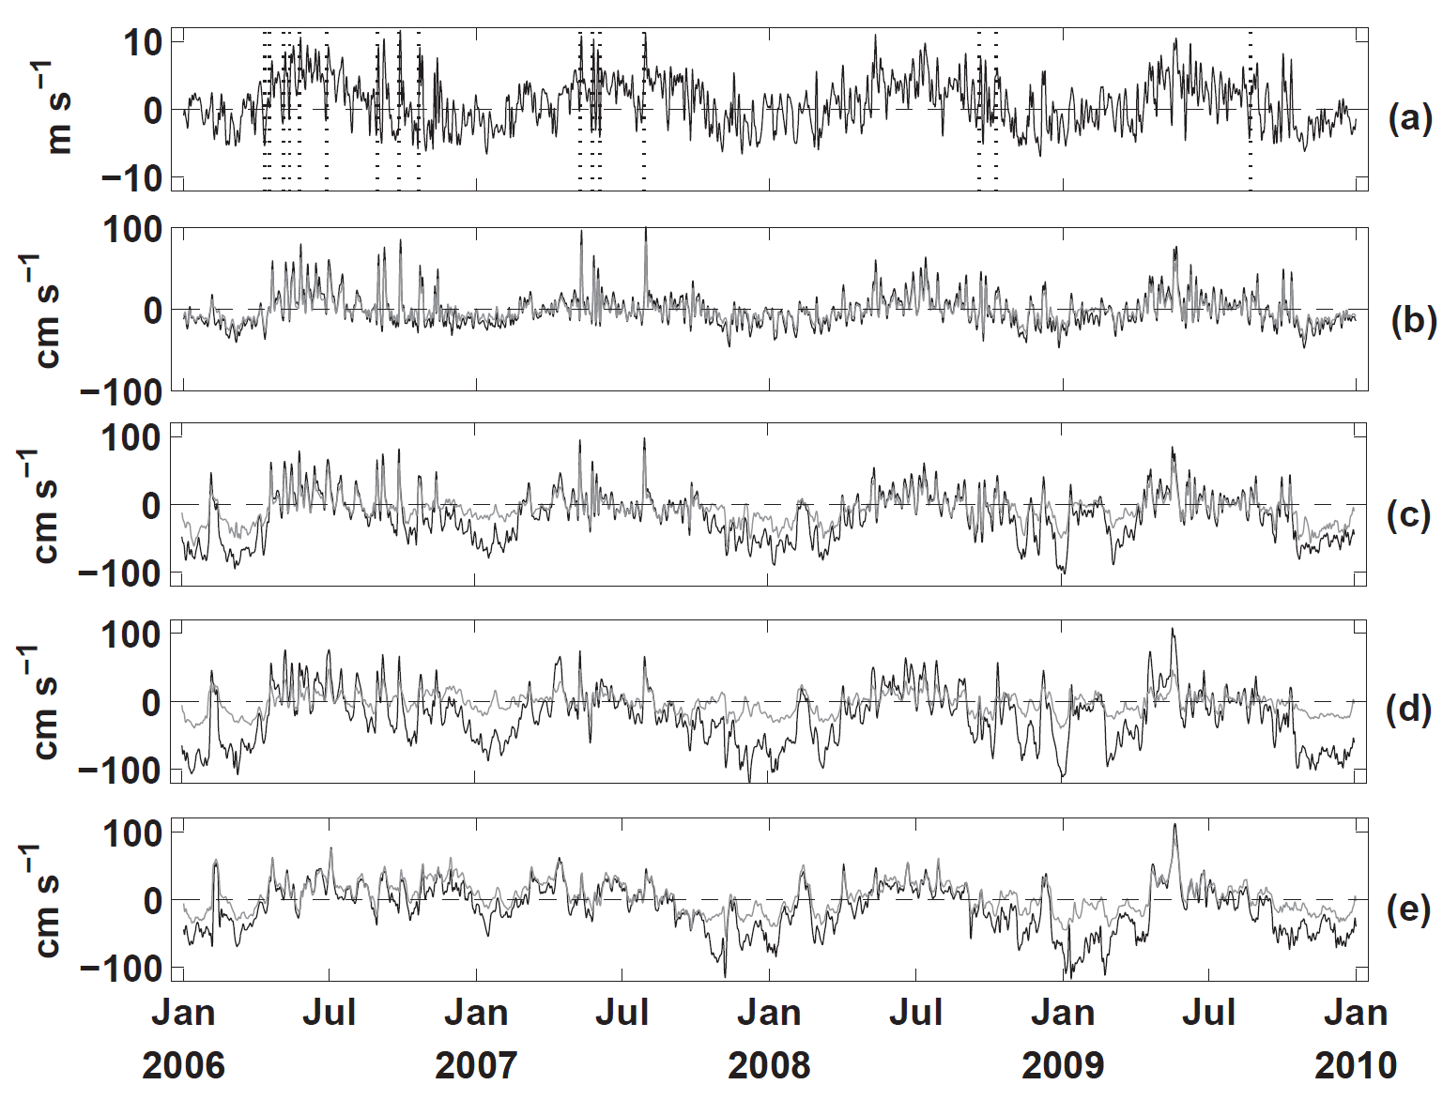
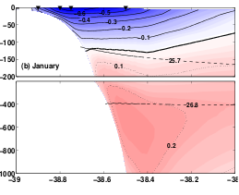
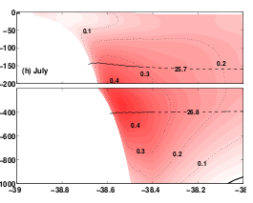
ROMS 1/36° E grid
Regional Modeling Grids
IS
SB
wind
January
Inner shelf
Shelf
break
Mean alongshore currents (2006-2009) at 14°S show the BC (top 150 m) and NBUC (below) during January and an upper reverse circulation during July
Time series of the currents (surface in black and bottom in gray) show that the system is more baroclinic during summer and influenced by winds and WBC dynamics at the shelf-break
July
Notes:
Wind preto = quickscat

Slide 21
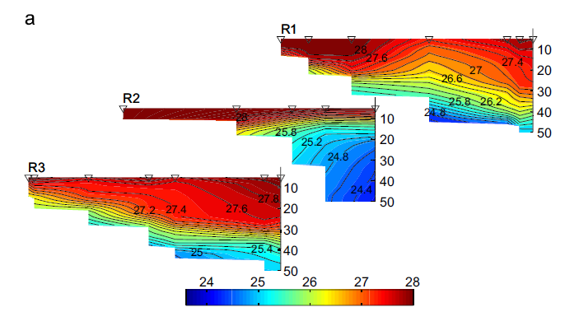
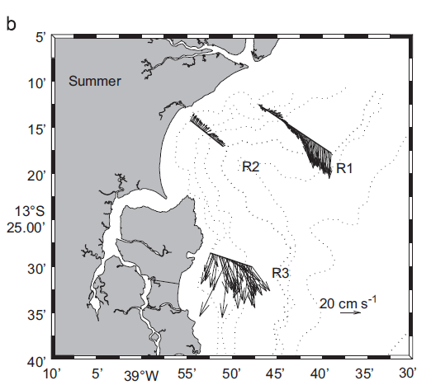
ROMS 1/36° E grid
Regional Modeling Grids
Cross-sections of CTD hydrographic stations and ADCP during summer (Amorim et al 2012) - CSR
Notes:
Wind preto = quickscat

Slide 22

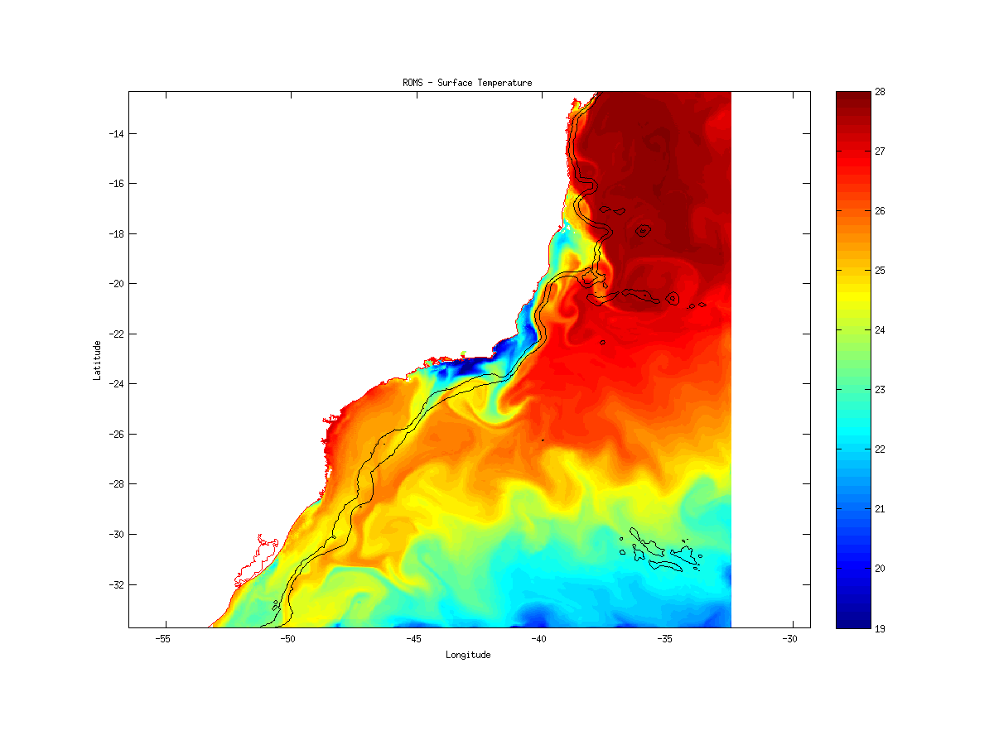
ROMS 1/24° S-SE grid
Regional Modeling Grids
Grid within the Pre-Salt area and WBC development
Similar to HYCOM/REMO 1/24º grid – intercomparisons and evaluations
Skill assessments (OSTIA; AVISO; Moorings)
2004-2010 – Climatology to generate Correlation Coef. ( NCEP + HYCOM/NCODA)
2011-Present – GFS 0.5 + Ezer & Mellor (1991) – Migrated from POM model
Snapshot of SST on the S-SE Grid – Strong variability and changes in BC behavior
See Poster section for more details
Notes:
Fixei as datas

Slide 23
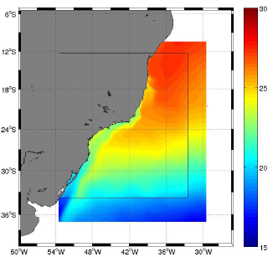
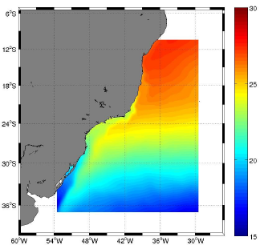
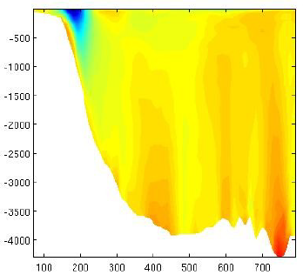
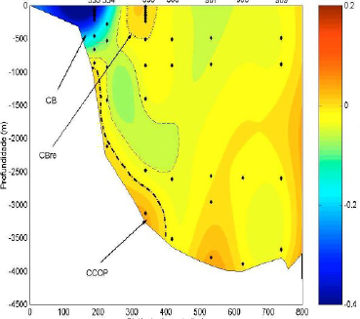
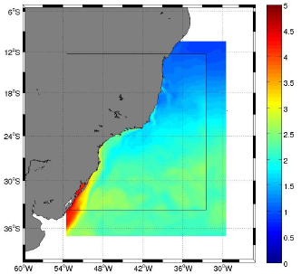
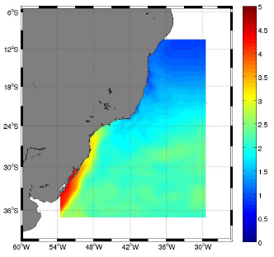
ROMS 1/24° S-SE grid
Regional Modeling Grids
Good Representation of SST and MLD without assimilation 2004-2010
Brazil Current and patterns
OSTIA
ROMS
Comparison of the modeled SST during 2003-2009 and SST-OSTIA.
ROMS
OSTIA
BC
RBC
ROMS
DOBC
WOCE
Mean Cross section alongshore velocity at 30º - Model Vs Data
Comparison of the modeled SST Variance during 2004-2009 and SST-OSTIA.
Notes:
Posicao corrigida, nomes alterados

Slide 24
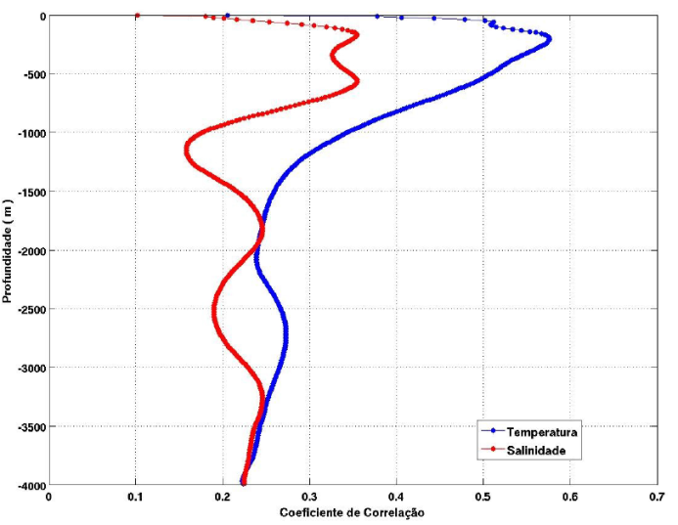
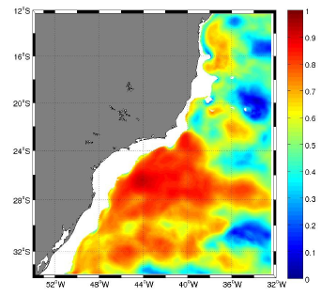
ROMS 1/24° S-SE grid
Regional Modeling Grids
, Assimilation, Present and Future
Using REMO products (SSH) for DA
Assimilation of Sintetic TS Fields with Corr. Coef. ~ 8 yrs
Tests using only TS and SSH+TS
Improving model correlation with AVISO/OSTIA
Defining “global” assessments and comparisons between REMO models
Methods for assimilation with the tides (tidal removal)
Operational runs – Brazilian Navy
300m

Slide 25
Summary
REMO started in 2008 and in 2011 it has joined the GODAE Oceanview. The project is now renewed for a 3-year period (2012-2014), but the budget is limited and alternative ways of funding future developments should be evaluated (joint industry projects, joint scientific funds or other research funding mechanisms)
Long and realistic runs are requested in pre-operational models, not only to evaluate the performance of the models, but also to compute the correlation coefficients for the data assimilation and to provide hydrodynamic databases used for environmental assessment
The coupling (via initial and boundary conditions) between Global/basin scale models and regional models is very important and requires various sensitivities studies (changes in global products like NCODA, Atm. Models)
In order to have autonomy and not to rely only on global model runs released by other operational centers, the REMO models are run in both regional (with tides) and large scale (without tides) domains.
Notes:
Retirada a parte de “REMO´s aims are constantly evaluated in periodic meetings of the Scientific Committee, every 3-6 months” e adicionado o ultimo bullet do future plans

Slide 26
Future Plans
Operational phase for the fixed regional grids along the Brazilian coast: i) E (2012), ii) S-SE (2013) and iii) N-NE (2014)
Final configuration and release of the hydrodynamic databases for the above grids with validations based on the GODAE Oceanview metrics
Improve the HYCOM/REMO (Basin) and ROMS/REMO (Regional) operational models, with better data assimilation schemes (e.g. 4DVAR, EnOI). That would give us full autonomy to provide our own models initial and BCs.
Notes:
Alterei o 3 bullet da apresentacao anterior , tornando-o ultimo bullet para citar que pretendemos melhorar os esquemas de assimilacao em geral

Slide 27
References
Marta-Almeida M, Pereira J, Cirano M. Development of a pilot Brazilian regional operational ocean forecast system, REMO-OOF. Journal of Operational Oceanography, 2011, 4(2), 3-15.
Marta-Almeida M, Ruiz-Villarreal M, Otero P, Cobas M, Peliz A, Nolasco R, Cirano M, Pereira J. OOFε: A Python engine for automating regional and coastal ocean forecasts. Environmental Modelling & Software, 2011, 26, 680-682.
Amorim FN, Cirano M, Marta-Almeida M, Campos EJD. The Seasonal Circulation of the Eastern Brazilian Shelf between 10°S and 16°S: a modeling approach. Continental Shelf Research (submitted).
Aguiar AL, Cirano M, Pereira, J & Marta-Almeida M Upwelling Processes along a Western Boundary Current: the Abrolhos-Campos Region, Brazil. Continental Shelf Research (submitted).
França GB, Oliveira AN, Paes RCOV, Ruivo BC, Gaspar RLR, Dutra H, Sartori A. Applying Barnes’ technique for daily SST (AVHRR and TRMM/microwave) images composition. Brazilian Journal of Geophysics REMO SI (submitted).
Lima JA, Martins RP, Tanajura CAS, Paiva AM, Campos EJD, Soares ID, Cirano M, França GB, Obino RS. Design and implementation of the Oceanographic Modeling and Observation Network (REMO) for physical oceanography and ocean forecasting. Brazilian Journal of Geophysics REMO SI (submitted).
Pereira J, Cirano M, Marta-Almeida M & Amorim FN. A numerical study of the Brazilian shelf/slope region south of 13°S using a regional ocean model. Brazilian Journal of Geophysics REMO SI (submitted).
Monteiro I, Soares I, Piovesan R, Oliveira H, Lima JAM & Martins RP. An application of the Mellor & Ezer Method for Data Assimilation in the South Atlantic Ocean. Brazilian Journal of Geophysics REMO SI (submitted).

Slide 28
Thank you
GODAE OceanView Coastal Oceans and Shelf Seas Task Team (COSS-TT)
4-7 Feb 2013 Lecce, Italy - dead-line Nov 16, 2012

