Slide 1


An evaluation of real-time forecast models of Middle Atlantic Bight continental shelf waters
John Wilkin
Julia Levin, Javier Zavala-Garay, Eli Hunter,
Naomi Fleming and Hernan Arango
Institute of Marine and Coastal Sciences,
Rutgers, The State University of New Jersey
ESPreSSO
*Experimental System
for Predicting
Shelf and
Slope Optics
jwilkin@rutgers.edu
http://marine.rutgers.edu/wilkin
http://myroms.org/espresso
ROMS User Workshop: Modern Observational and Modeling Systems
Rio de Janeiro, Brazil, October 3-4. 2012

Slide 2
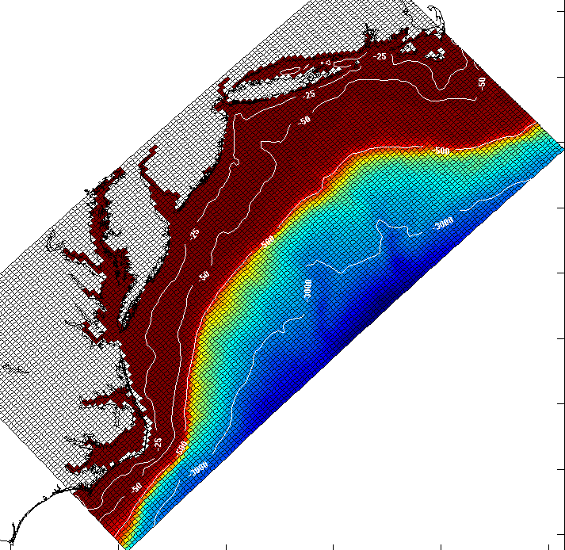
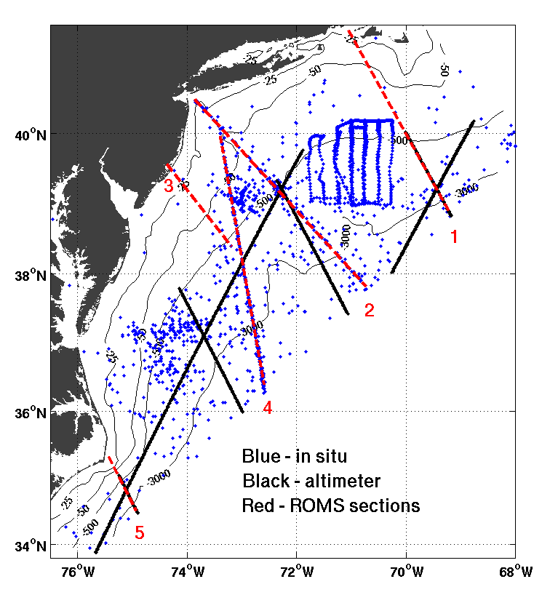
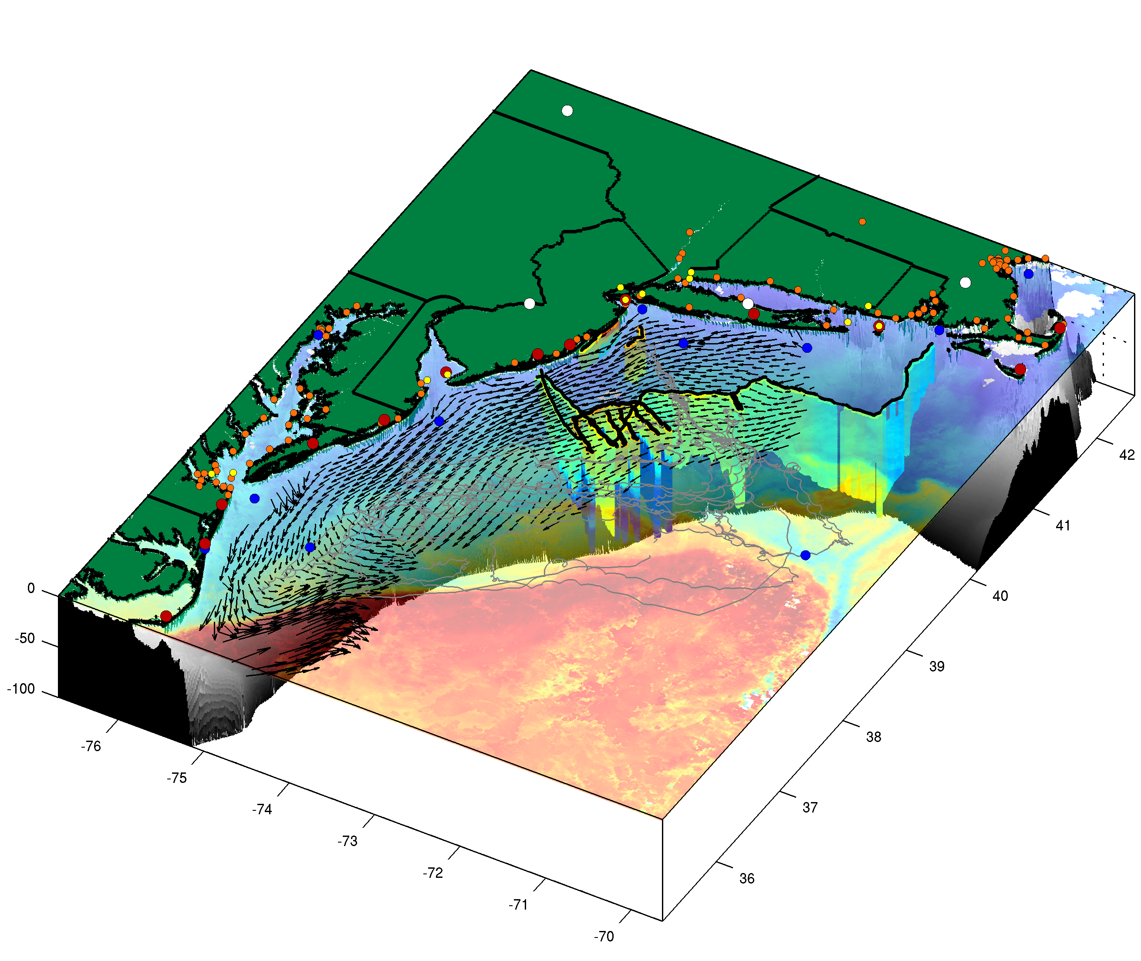
ESPreSSO real-time ROMS system
http://myroms.org/espresso
Integrating modern modeling
and observing systems
in the coastal ocean
Data assimilation for reanalysis and prediction
Quantitative skill assessment
Observing system design and operations
http://maracoos.org
MARACOOS Observing System

Slide 3
ESPreSSO real-time ROMS system
http://myroms.org/espresso
http://maracoos.org
MARACOOS Observing System

Slide 4
ESPreSSO* real-time ROMS system
http://myroms.org/espresso
*Experimental
System for Predicting
Shelf and Slope Optics
28

Slide 5
http://maracoos.org
MARACOOS Observing System

Slide 6
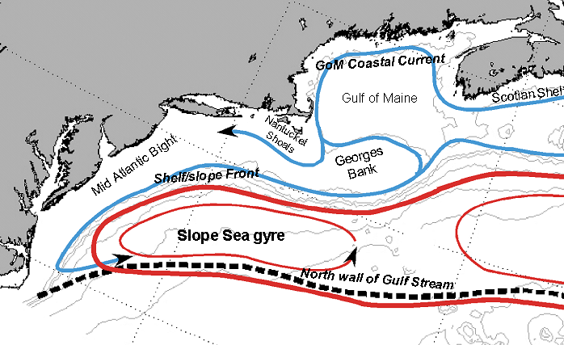
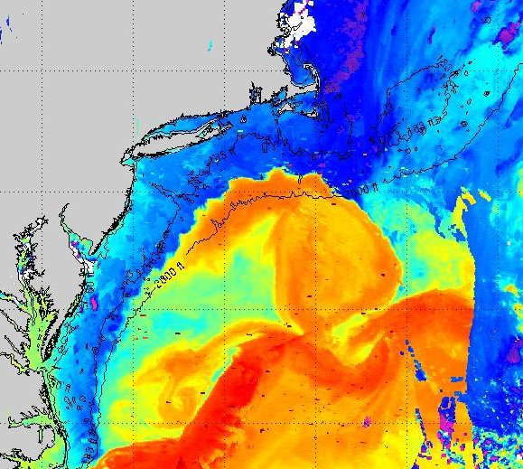
General circulation of the Mid-Atlantic Bight (MAB)

Slide 7
ROMS includes three variants of 4D-Var data assimilation*
A primal formulation of incremental strong constraint 4DVar (I4DVAR)
A dual (W4DVAR) formulation based on a physical-space statistical analysis system (4D-PSAS)
A dual formulation Representer-based variant of 4DVar (R4DVar)
4DVar can adjust initial, boundary, and surface forcing.
In the real-time ESPreSSO system we adjust only the initial conditions using primal IS4DVAR
* Moore, A. M., H. Arango, G. Broquet, B. Powell, A. T. Weaver, and J. Zavala-Garay (2011), The Regional Ocean Modeling System (ROMS) 4-dimensional variational data assimilations systems, Part I - System overview and formulation, Prog. Oceanog., 91(34-39).
27

Slide 8
Data streams used:
72-hour forecast NAM-WRF meteorology 0Z cycle
available 2 am EST
RU CODAR hourly - with 4-hour latency delay
AVHRR IR passes 6-8 per day (~ 2 hour delay)
REMSS blended SST (microwave, GOES, MODIS, AVHRR)
(daily, with cloud gaps)
USGS daily average river flow available – persist in forecast
HyCOM NCODA 7-day forecast (daily update) for open boundary conditions
Jason-2 along-track SLA via RADS (~4 delay for OGDR)
Regional high-resolution T,S climatology (MOCHA*)
Not presently used, but ROMS-ready
  RU glider T,S when available (~ 1 hour delay)
  SOOP XBT/CTD, Argo floats, NDBC buoys via GTS from AOML
Work flow for operational ESPreSSO 4D-Var
ESPreSSO
* Mid-Atlantic Ocean
Climatology Hydrographic
Analysis

Slide 9
Work flow for operational ESPreSSO 4D-Var
Daily schedule for real-time system
All times local U.S. EST
03:30: 4D-Var assimilation of last 3 days of observations
07:30: Forecast for next 58 hours
09:00: Forecast is complete and transferred to OPeNDAP
10:00: Get HyCOM output for OBC
10:15 and 22:15: UNH pushes altimeter data from RADS via ftp to RU
11:00: Get NAM surface meteorology forcing from NCEP NOMADS
23:00: Get 1-day composite REMSS blended SST (B-SST)
00:00: Get daily average river discharge from USGS
03:00: Get IR SST passes; process and combine with B-SST
03:00: Get CODAR surface currents; process tide adjustment
03:10: Prepare Jason-2 altimeter along-track data
ESPreSSO

Slide 10
Work flow for operational ESPreSSO 4D-Var
Input pre-processing
RU CODAR de-tided (harmonic analysis) and binned to 5km
  variance within bin & OI combiner expected u_err (GDOP) used for QC
    >> ROMS tide added to de-tided CODAR – reduces tide phase error contribution to cost function
AVHRR IR individual passes 6-8 per day
  U. Del cloud mask; bin to 5 km resolution
  REMSS daily SST OI combination of AVHRR, GOES, AMSR-binned data
Jason-2 along-track 5 km bins (with coastal corrections) from RADS
  MDT from 4DVAR on climatological observations:3D T,S, velocity (moorings, Oleander, CODAR), mean τ^{wind}
    >> add ROMS tide solution to SSH
USGS daily river flow is scaled to account for un-gauged watershed
RU glider T,S averaged to ~5 km horiz. and 5 m vertical bins
  need thermal lag salinity correction to statically unstable profiles
26

Slide 11
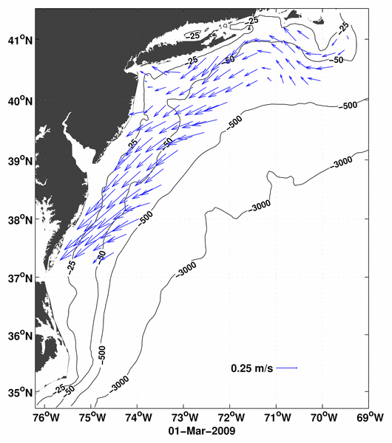
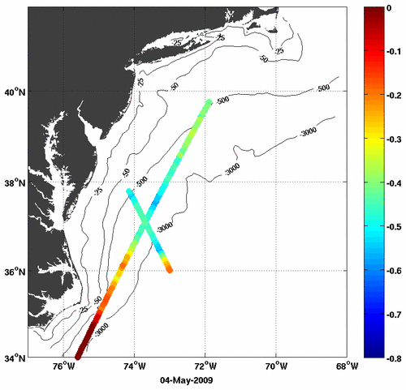
Example of CODAR data after quality control, binning and decimation to achieve a set of independent observations.
Example of Jason-2 along-track altimeter sea level anomaly data during a single 2-day analysis window.

Slide 12
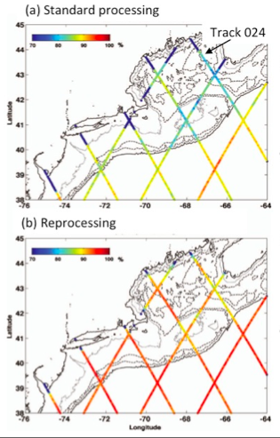
Coastal altimetry
Along-track data is re-processed from RADS using customized coastal corrections in order to extend the data coverage as close as possible to the coast.
Feng, H. and D. Vandemark, 2011. Altimeter Data Evaluation in the Coastal Gulf of Maine and Mid-Atlantic Bight Regions (Marine Geodesy)
% good data for (a) standard and (b) re-processed
25

Slide 13
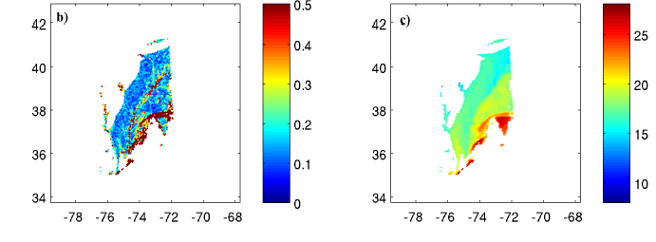
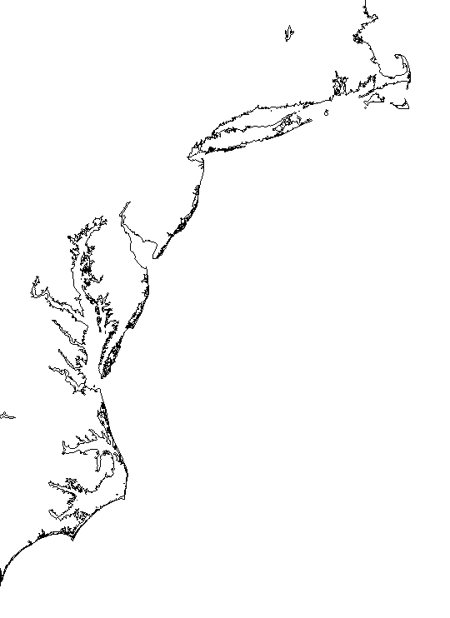
(a) Standard deviation of satellite SST within each model grid cell
(b) Cloud-cleared individual AVHRR SST pass assimilated
Example of individual pass of AVHRR SST in the MAB. (a) Standard deviation of all valid observations with a model grid cell. (b) Mean of valid SST observations in each model grid cell. An observational error weighting proportional to (a) is used in the assimilation system.

Slide 14
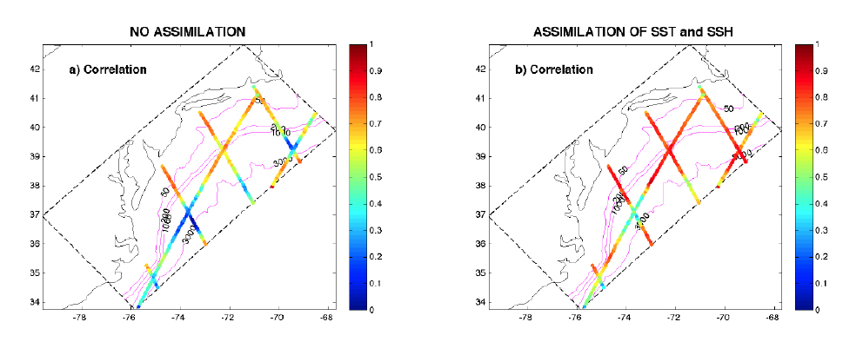
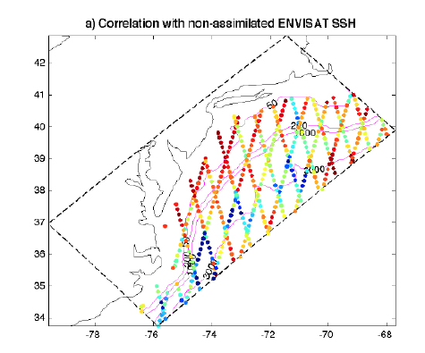
Analysis skill for SSH
Correlation after assimilation of
SSH and SST
ESPreSSO SSH variability correlation improves with assimilation, and predicts variance in withheld observations from ENVISAT
Correlation when no
assimilation
Correlation with ENVISAT SSH
not assimilated

Slide 15
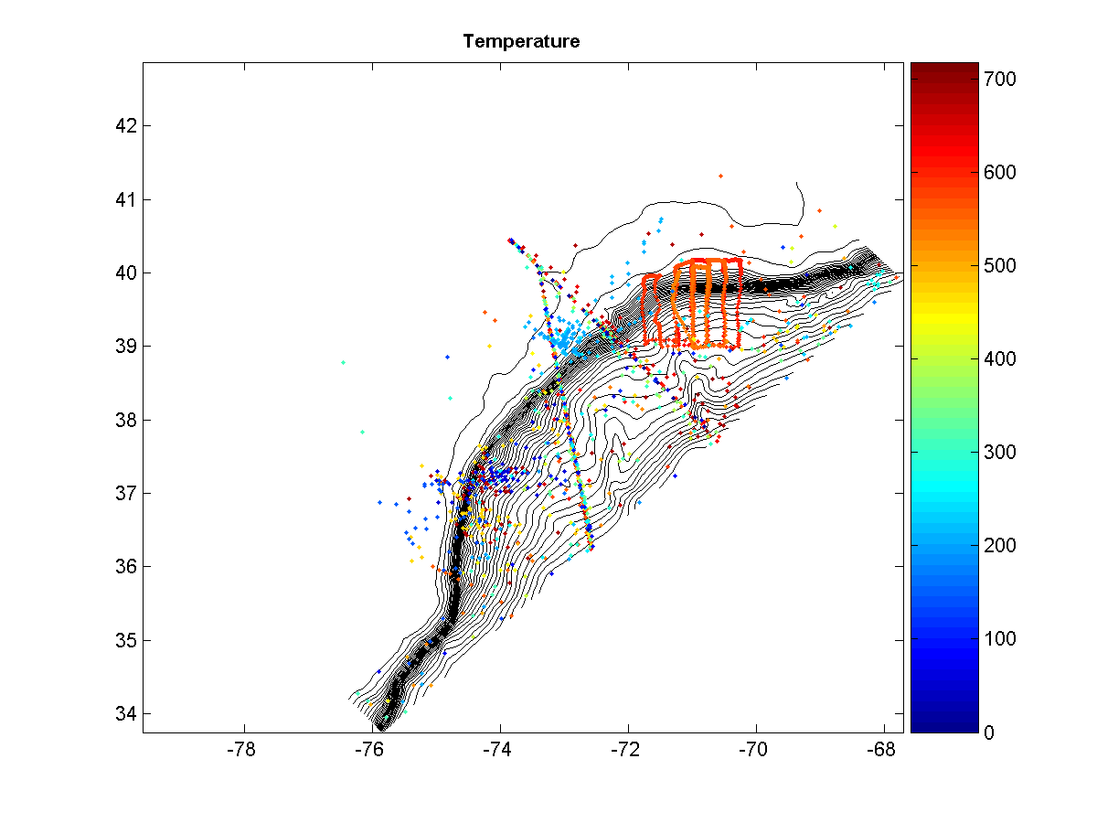
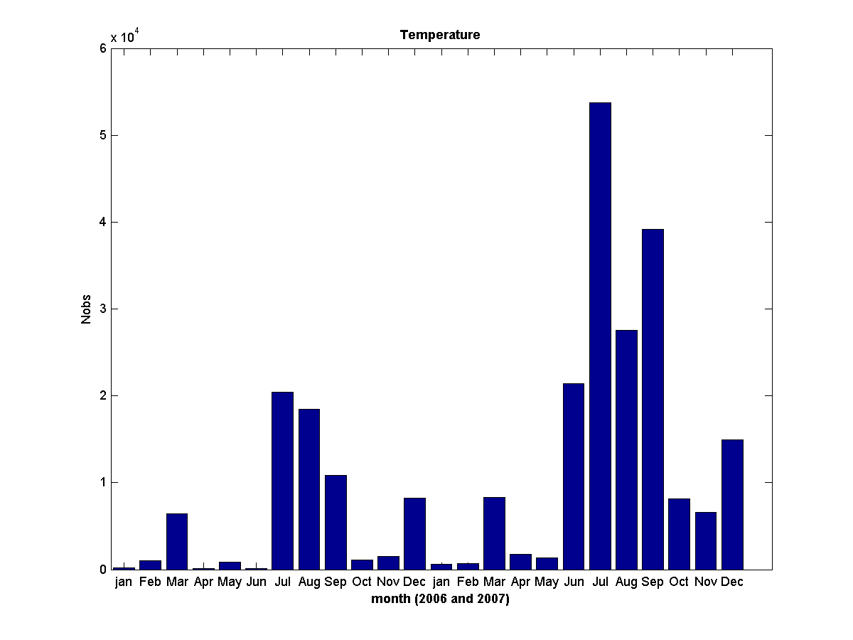
Sub-surface T/S analysis and forecast skill
In situ T and S observations are not assimilated so offer independent skill assessment
There is a sizeable archive of observatory data from CTD, gliders and XBTs for 2006 (SW06) and 2007
days since 01-Jan-2006
24

Slide 16
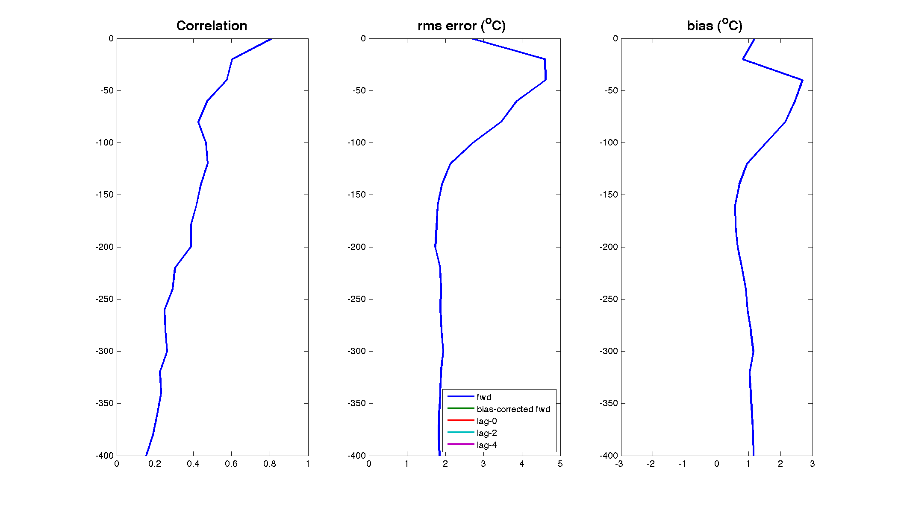
Analysis/forecast skill with respect to subsurface OBS that are NOT assimilated
Temperature
Forward model

Slide 17
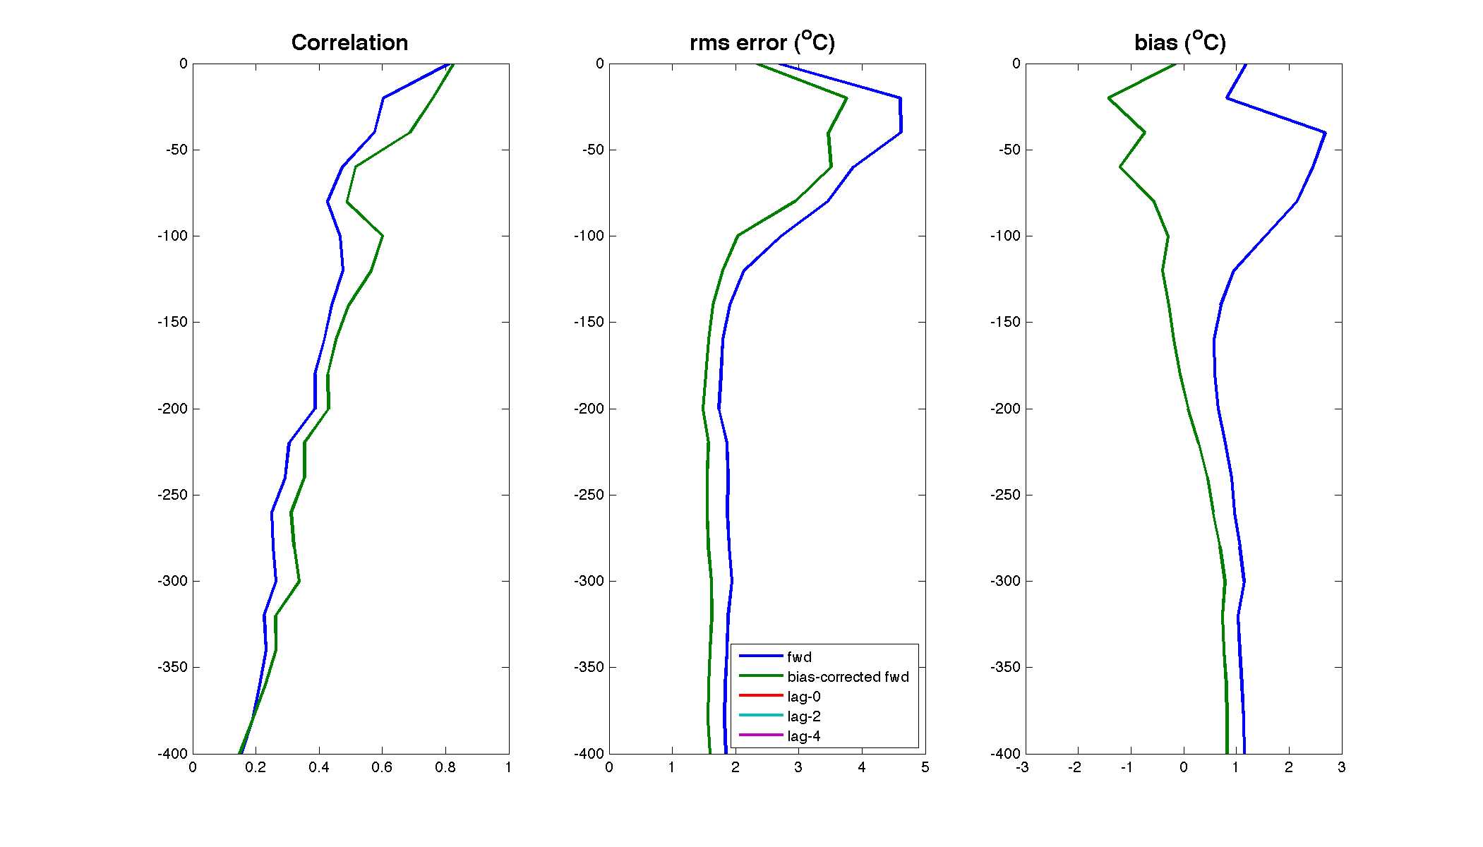
Analysis/forecast skill with respect to subsurface OBS that are NOT assimilated
Temperature
Forward model after bias removal

Slide 18
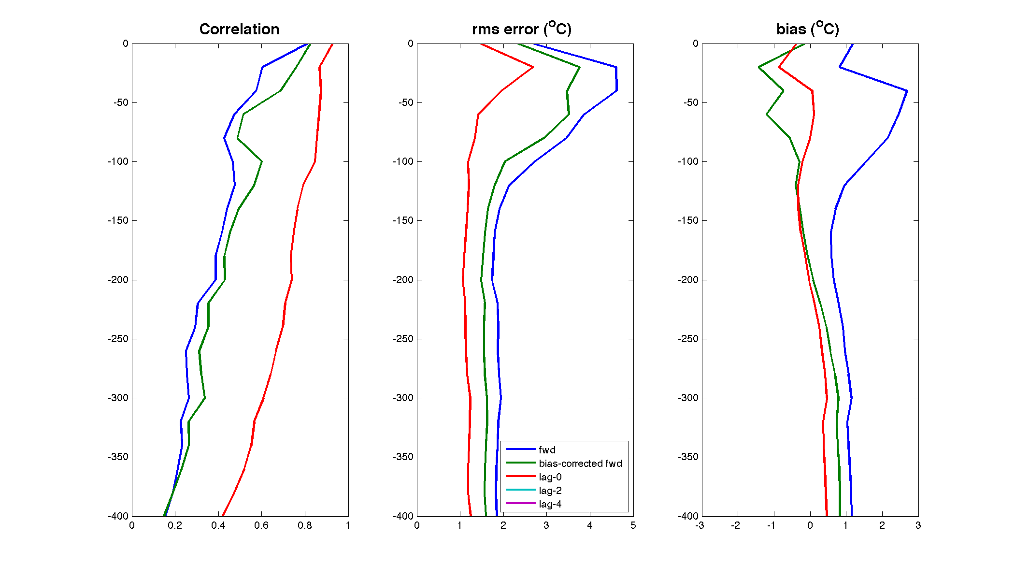
Analysis/forecast skill with respect to subsurface OBS that are NOT assimilated
Temperature
Data assimilation analysis/hindcast
23

Slide 19
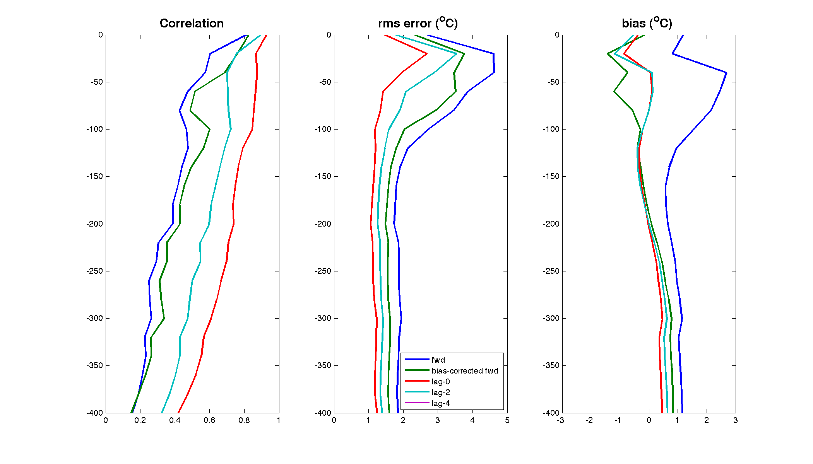
Analysis/forecast skill with respect to subsurface OBS that are NOT assimilated
Temperature
2-day forecast

Slide 20
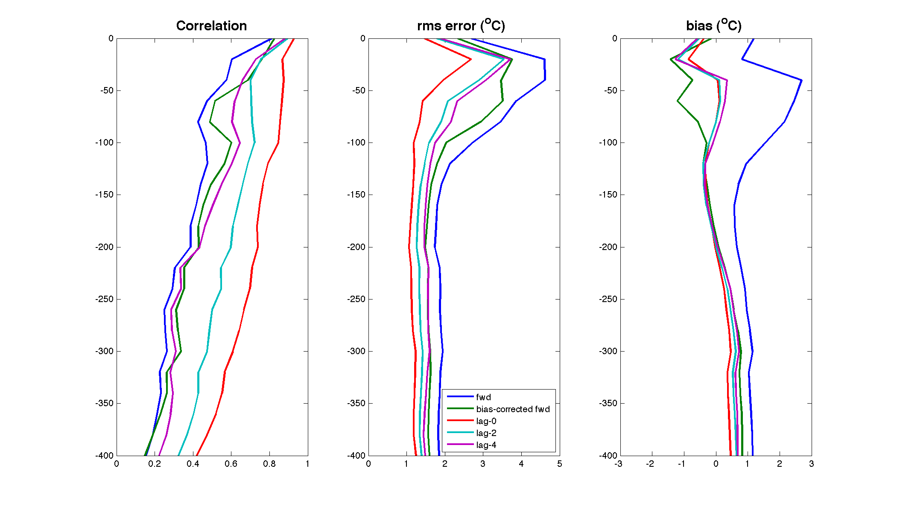
Analysis/forecast skill with respect to subsurface OBS that are NOT assimilated
Temperature
4-day forecast
22

Slide 21
Analysis/forecast skill with respect to subsurface OBS that are NOT assimilated
Temperature
Decrease in forecast skill is consistent with de-correlation time scales in the shelf-break front of o(1 day) derived from observations
Gawarkiewicz et al., 2004, and Todd et al. (draft) for the Spray data used here
20

Slide 22
Bias removal
Some details …
Removing bias from boundary conditions and data is crucial
4D-Var will not converge if it cannot reconcile model and data error
Co-variances embodied in the Adjoint and Tangent Linear physics are incorrect if the background state is biased

Slide 23
Bias removal
Some details …
Removing bias from boundary conditions and data is crucial
4D-Var will not converge if it cannot reconcile model and data error
Co-variances embodied in the Adjoint and Tangent Linear physics are incorrect if the background state is biased
We correct open boundary data (T and S) from HyCOM by adjusting mean to match regional climatology (MOCHA)

Slide 24
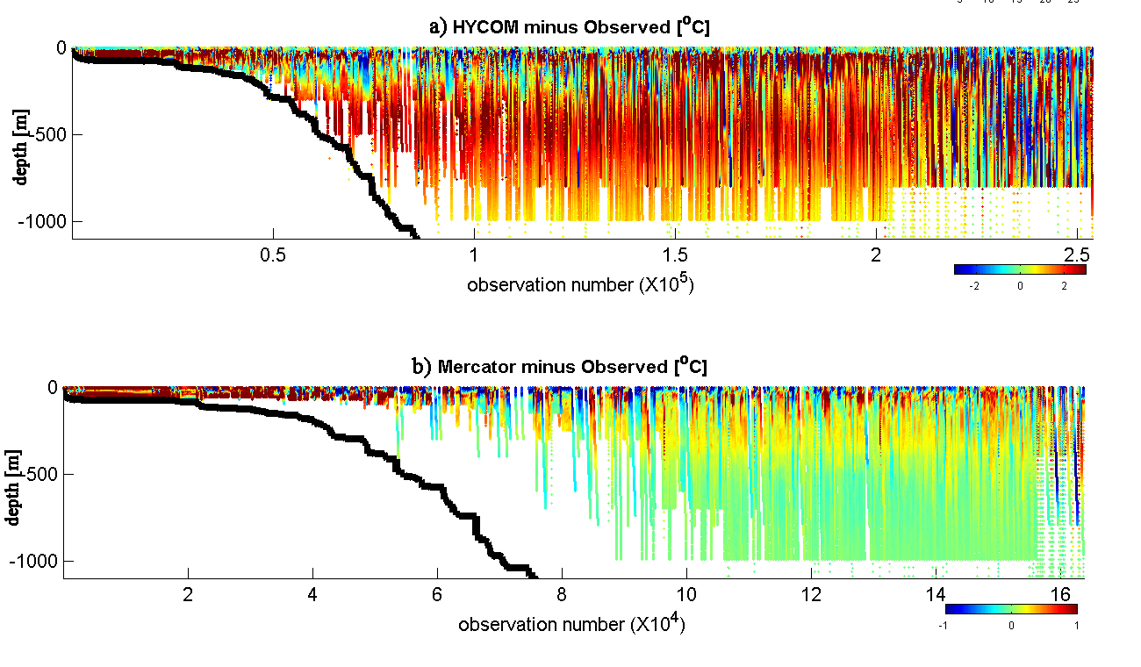
Bias is problematic for down-scaling with data assimilation
Bias in global data assimilating models compared to a regional climatology:
Data (obs. number) sorted by ocean depth in ESPreSSO domain
-2 0 2 ºC
-1 0 1 ºC

Slide 25
Bias removal
Some details …
Removing bias from boundary conditions and data is crucial
4D-Var will not converge if it cannot reconcile model and data error
Co-variances embodied in the Adjoint and Tangent Linear physics are incorrect if the background state is biased
We correct open boundary data (T and S) from HyCOM
by adjusting mean to match regional climatology (MOCHA)
We compute un-biased open boundary sea level and velocity, and Mean Dynamic Topography (MDT) for altimetry using 4D-Var with annual mean data

Slide 26
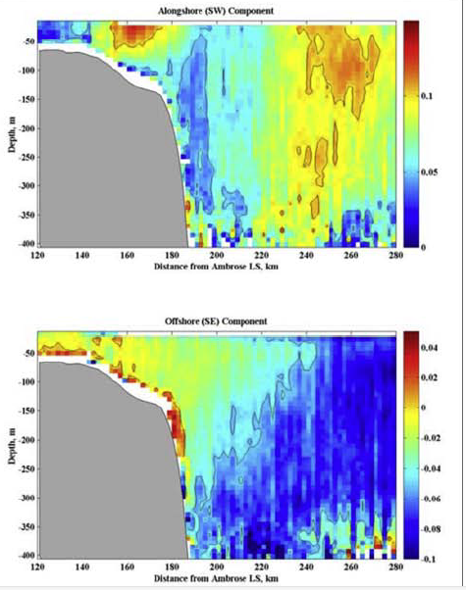
18

Slide 27
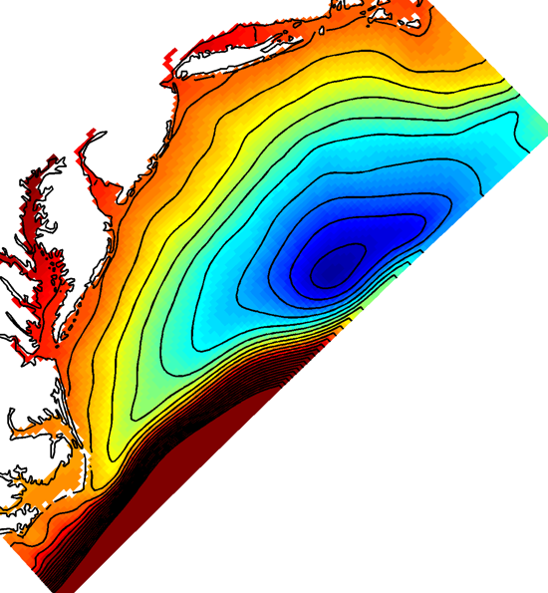
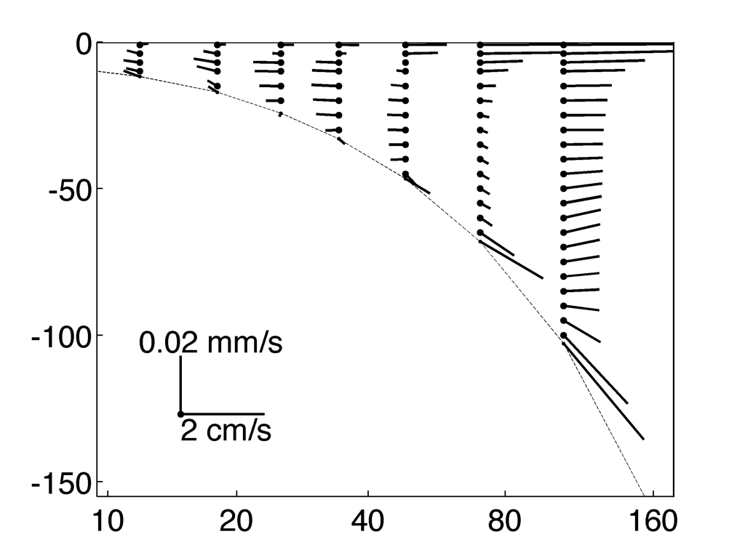
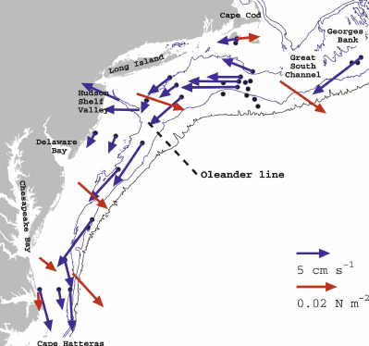
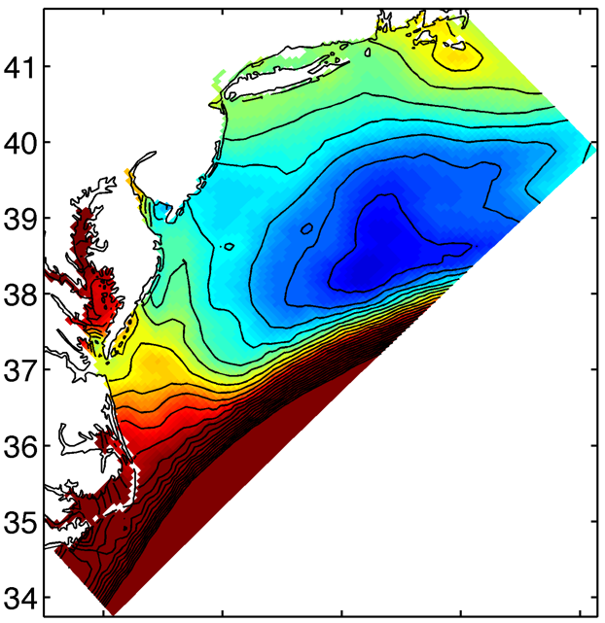
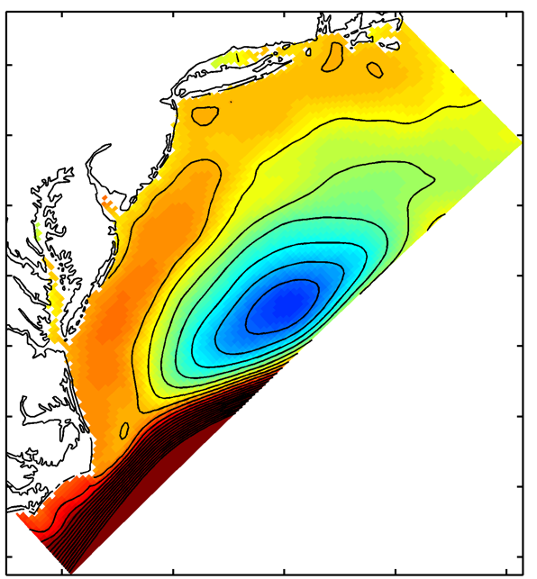
Some details …
Mean Dynamic Topography
from 4D-Var applied to climatology of T/S, mean surface fluxes, & mean velocity obs (CODAR, moorings, vessel ADCP)
Some details …
Some details …
Also gives dynamically adjusted mean circulation to complement T/S climatology
AVISO MDT HyCOM

Slide 28
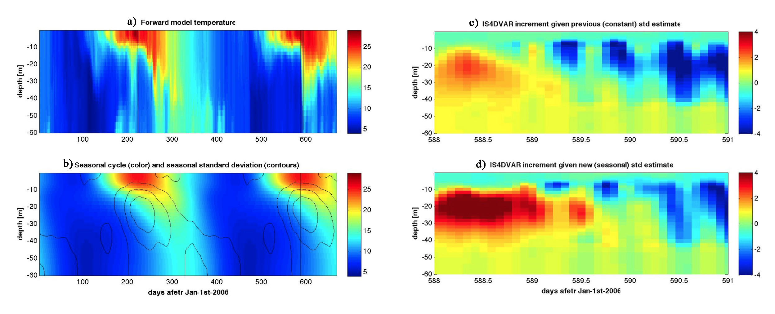
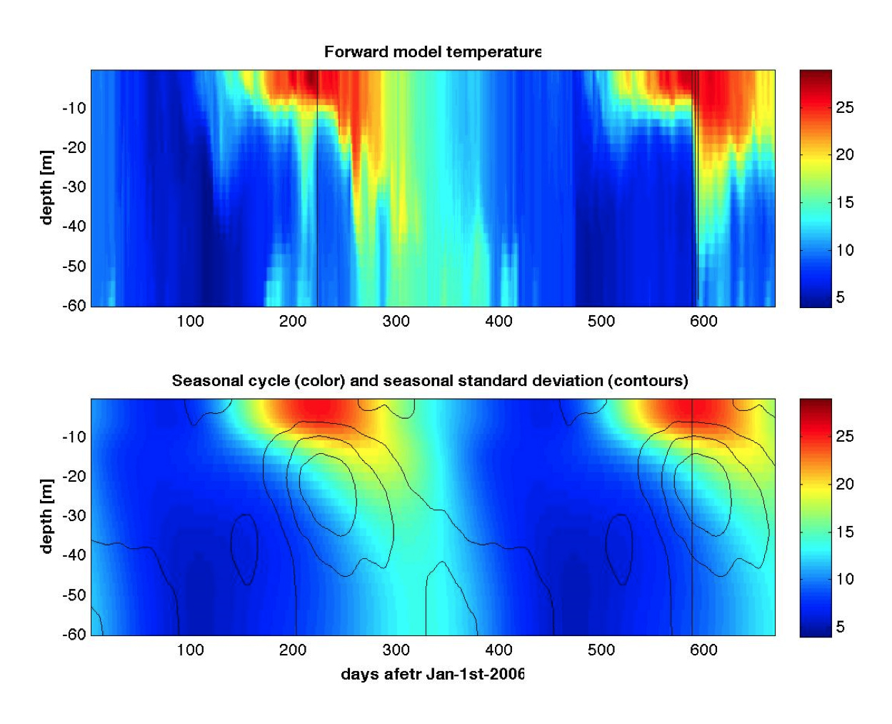
Some details …
Background error covariance is scaled by a standard deviation file.
Strong seasonality in the MAB shelf background field demands inclusion of significant seasonality in the standard deviations.
Impact of seasonal Background Error Covariance on a single analysis cycle:

Slide 29
Multi-model Skill Assessment using Coastal Ocean Observing System Data
Comparison of observatory data (gliders and CODAR) to MAB forecast systems
  3 global (HyCOM, Mercator, NCOM)
  4 regional (ESPreSSO, NYHOPS, UMassHOPS, COAWST)
  1 climatology (MOCHA)
Quantify bias, centered RMS error, cross-correlation
  regional subdivisions (inner and outer shelf)
  summer/winter
  vertical structure
15

Slide 30
Multi-model Skill Assessment
using Coastal Ocean Observing System Data
  global: HyCOM, Mercator, NCOM
  regional: ESPreSSO, NYHOPS, UMassHOPS, COAWST
  climatology: MOCHA
Model | THREDDS URL | Resolution in MAB | Output interval | Surface forcing | Tides | Rivers | Assimilation method | Data
HyCOM | http://tds.hycom.org/thredds/dodsC/ glb_analysis.html | 7 km 10 z-levels in h<100m | Daily average | NOGAPS | No | Monthly climatology | MVOI | SSH, SST, T/S profiles
NCOM | http://edac-dap.northerngulfinstitute.org/ thredds/dodsC/ncom_reg1_agg/NCOM_Region_1_Aggregation_best.ncd.html | 11 km 19 TF-levels in h<100m | 3-hour snapshots | NOGAPS | Yes | Monthly climatology | Weighted sum | SSH, SST, T/S profiles
MERCATOR | Register at myocean.eu. Python scripts for direct access | 7 km 12 z-levels in h<100m | Daily average | ECMWF | No | ? | SEEK filter | SSH, SST, T/S profiles
NYHOPS | http://colossus.dl.stevens-tech.edu:8080/ thredds/dodsC/fmrc/NYBight/NYHOPS_ Forecast_Collection_for_the_New_York_Bight_best.ncd.html | 4 km 10 TF-levels | 10-min snapshots | NCEP NAM | Yes | Hydrologic forecast and point sources | Nudging | CODAR currents
ESPreSSO | http://tds.marine.rutgers.edu:8080/thredds/ dodsC/ roms/espresso/2009_da/his.html | 5 km 36 TF-levels | 3-hour snapshots | NCEP NAM | Yes | Daily observed | 4D-VAR | SSH, SST, CODAR
UMassHOPS | http://aqua.smast.umassd.edu:8080/thredds/ dodsC/pe_shelf_ass/fmrc/HOPS_PE_SHELF_ASS_Forecast_Model_Run_Collection_best.ncd.html | 15 km 16 TF-levels | Daily average | NCEP GFS | No | ? | Feature model OI | SSH, SST
COAWST | http://geoport.whoi.edu/thredds/dodsC/ coawst_2_2/fmrc/coawst_2_2_best.ncd.html | 5 km 16 TF-levels | 2-hour snapshots | NCEP NAM | Yes | None | None | N/A
MOCHA climatology | http://tds.marine.rutgers.edu:8080/thredds/ dodsC/ other? | 5 km 50 z-levels in h<100m | Monthly | N/A | N/A | N/A | Weighted least squares | T/S profiles

Slide 31
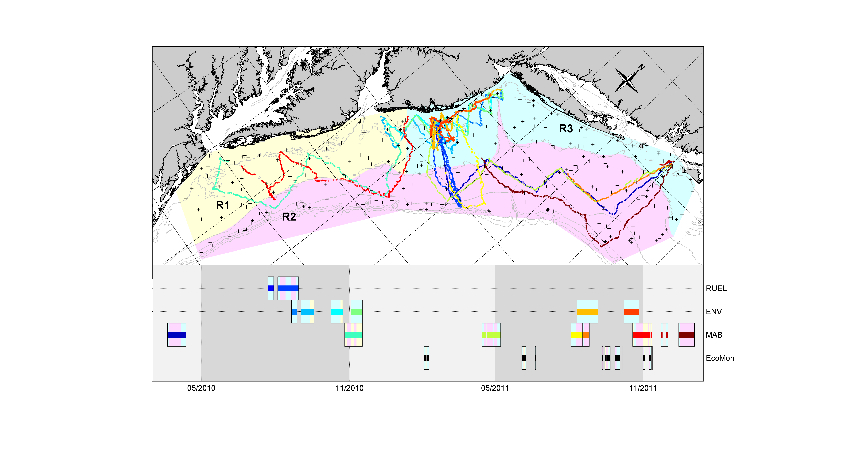
MARACOOS glider data, and NMFS EcoMon surveys in 2010-2011
10 months of data in 2 years
RUEL
ENV
MAB
EcoMon
summer
winter
summer
Notes:
Figure 1: Map of glider tracks and EcoMon stations, and timeline. Definition of 3 regions. Seasons.

Slide 32
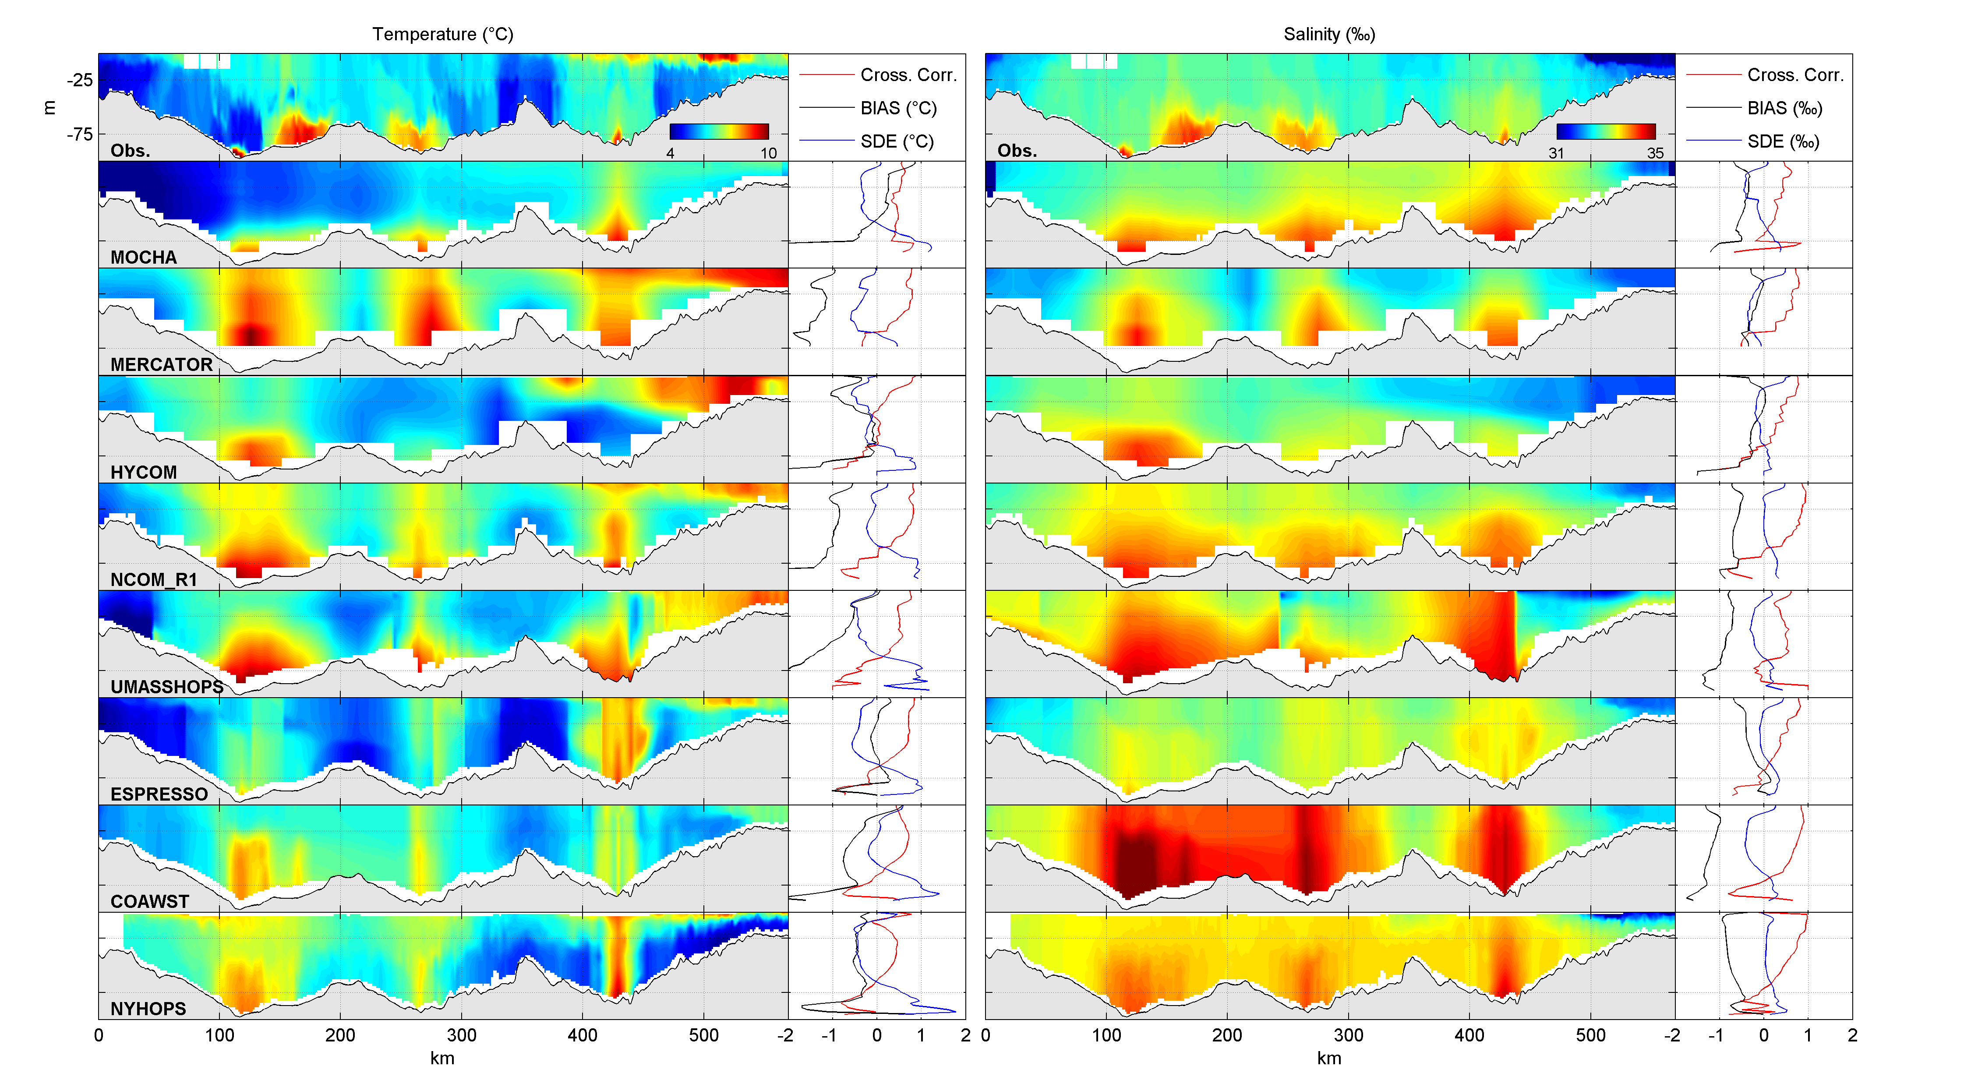
MAB 03/2010

Slide 33
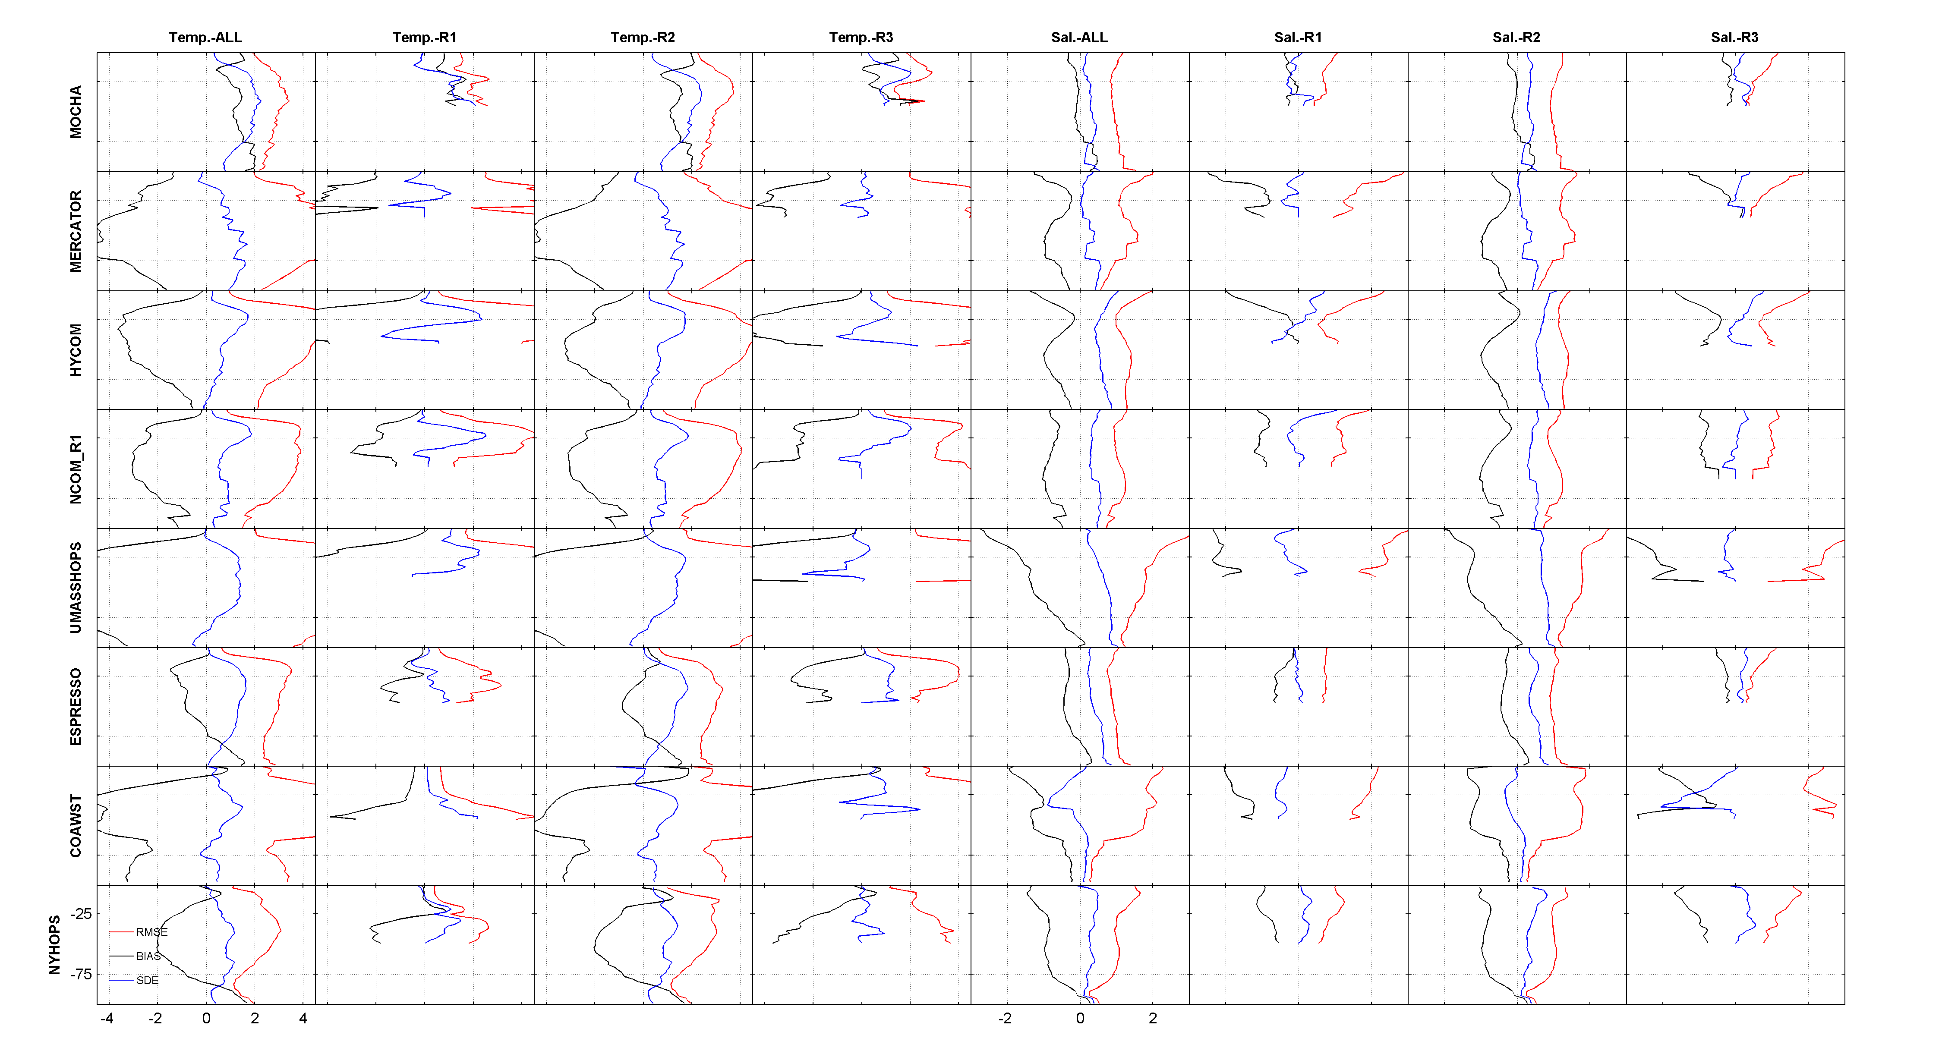

Slide 34
Skill assessment
Mean BIAS (x-axis) and Centered RMS error (y-axis)
Distance from origin is Root Mean Squared Error (RMSE)
(This is one quadrant of a “target” diagram)
RMS error
Centered RMS error
Mean BIAS

Slide 35
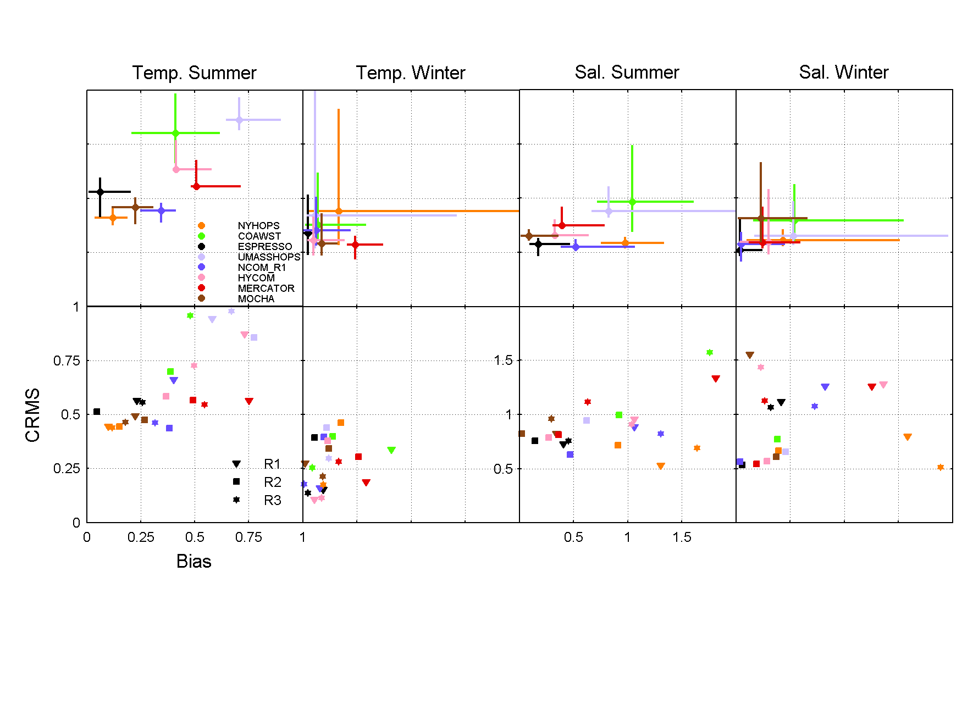
Skill assessment
Mean BIAS (x-axis) and Centered RMS error (y-axis)
Distance from origin is Root Mean Squared Error (RMSE)
Results by sub-region R1 – R3
not appreciably different
R3
R2
R1
Centered RMS error
Mean BIAS
10

Slide 36
Skill assessment
Ensemble Mean BIAS (x-axis) and Centered RMS error (y-axis)
Distance from origin is Root Mean Squared Error (RMSE)
Centered RMS error
Mean BIAS
9

Slide 37
Skill assessment
Ensemble mean BIAS (x-axis) and Centered RMS error (y-axis)
Distance from origin is Root Mean Squared Error (RMSE)
[Error bars are 95% conf.]
1
0.75
0.5
0.25
0
Centered RMS error
☑
☑
☑
☑
☑
☑
☑
☑
☑
☑
☑
☑
0 0.25 0.5 0.75 1
Mean BIAS
7

Slide 38
Skill assessment
Ensemble mean BIAS (x-axis) and Centered RMS error (y-axis)
Distance from origin is Root Mean Squared Error (RMSE)
[Error bars are 95% conf.]
1
0.75
0.5
0.25
0
Centered RMS error
☑
☑
☑
☑
☑
☑
☑
☑
☑
☑
☑
☑
0 0.25 0.5 0.75 1
Mean BIAS
7

Slide 39
Skill assessment
radius: std. dev. MODEL / std. dev. OBS
azimuth: cos θ = Correlation coefficient
Distance from (1,0) is Centered RMS error
(This is a “Taylor” diagram) BIAS is not depicted
ratio std. dev.
Centered RMS error
θ = cos⁻¹ R
0 1

Slide 40
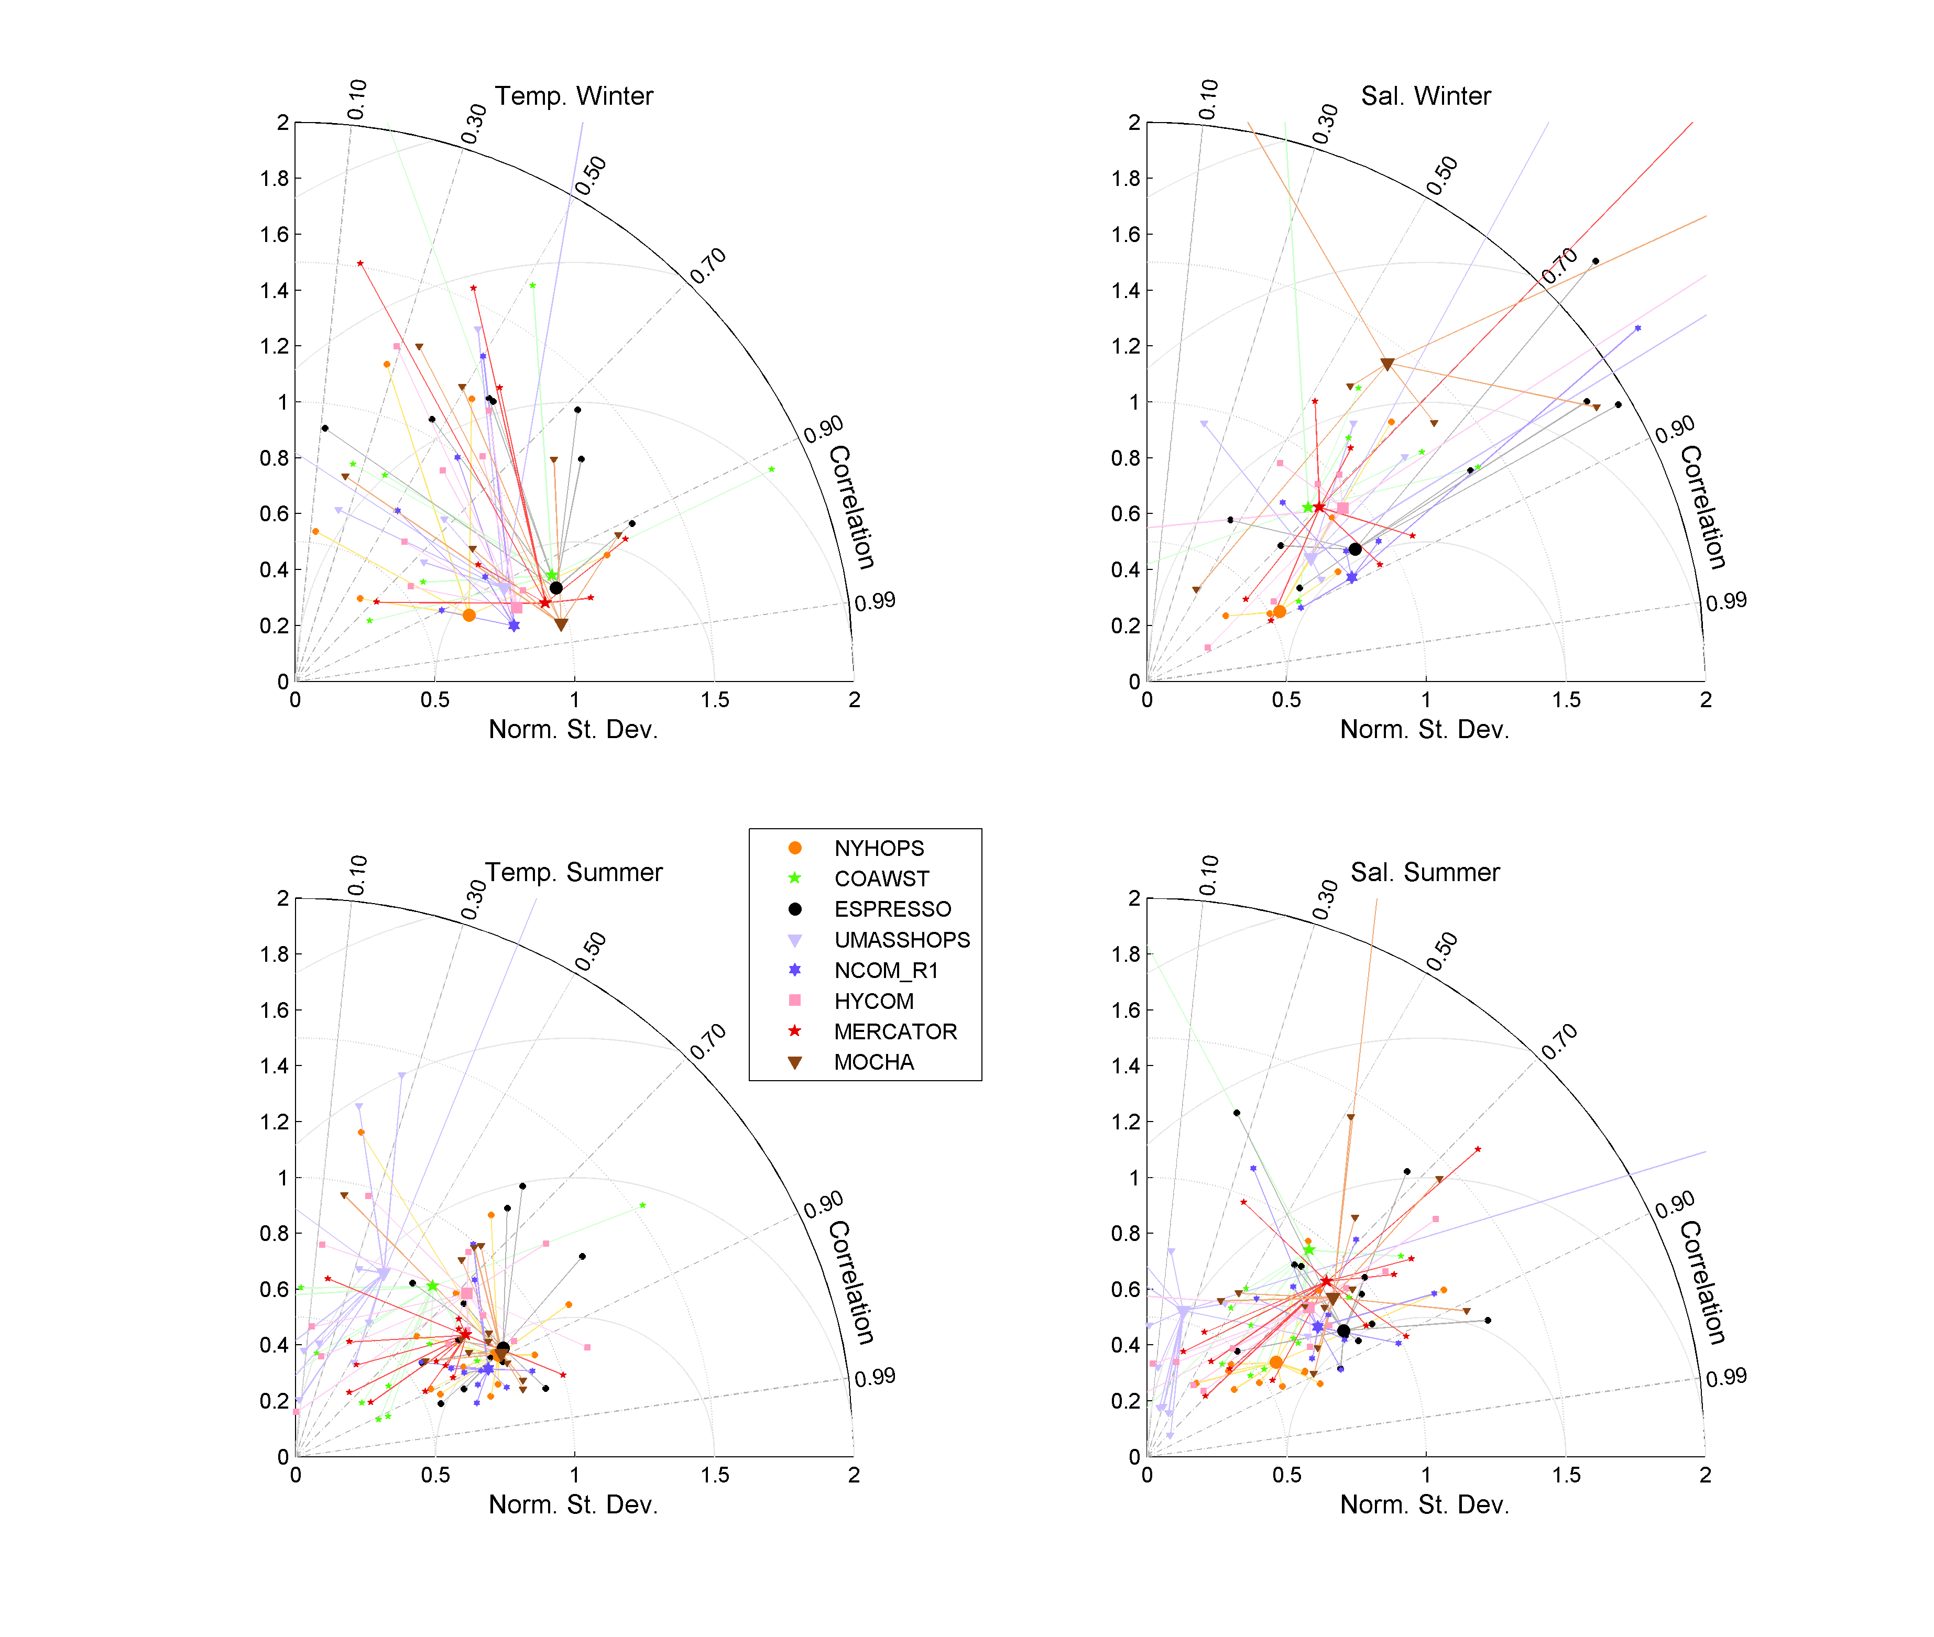
Skill assessment
Mean BIAS (x-axis) and Centered RMS error (y-axis)
Distance from origin is Mean Squared Error (MSE)
Results by sub-region R1 – R3
not appreciably different
5

Slide 41
Skill assessment
Model mean surface current compared to CODAR
Note: ESPRESSO and NYHOPS assimilate these data
Next slide …
magnitude of vector complex correlation

Slide 42
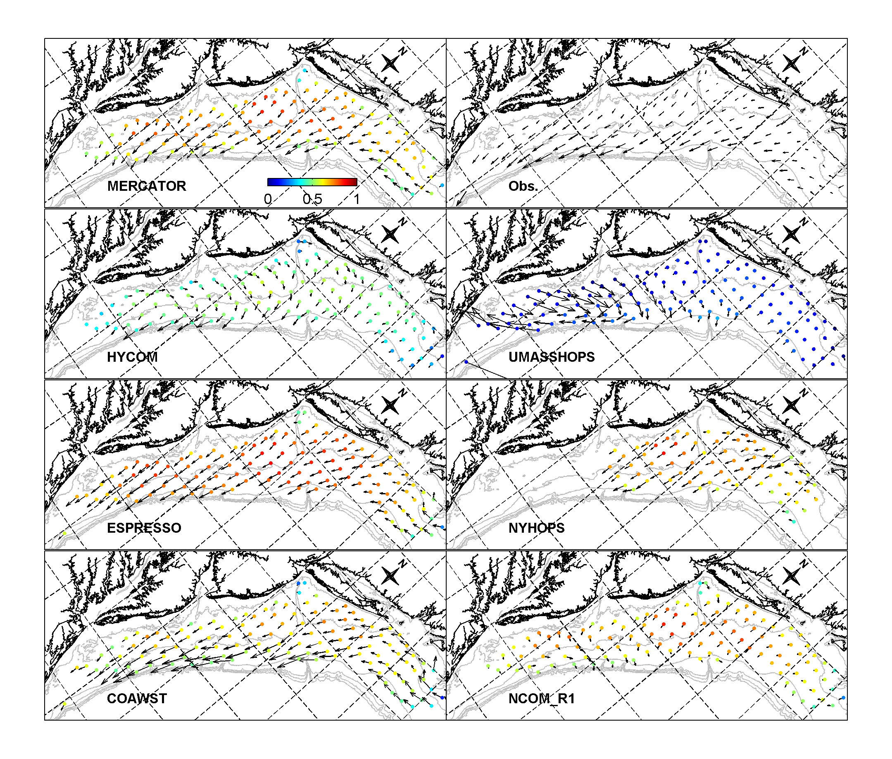
Color shows magnitude of vector complex correlation (daily average data)
Notes:
Figure 6: Mean (2010-2011) surface velocity from (a) HF-radar and (b)-(h) the respective models at 2 m below surface. For the models, colored dots show the magnitude of the complex correlation between daily HF-radar and model.

Slide 43
Observing system design, control, analysis and optimization
Software drivers based on variational methods (Adjoint and Tangent Linear models) allow quantitative analysis of model sensitivity, data assimilation sensitivity, and information content of the observation network
e.g. sensitivity of forecast to uncertainty in initial
conditions, forcing, and boundary conditions
e.g. impact on forecast of particular data streams
satellite SSH/SST, HF-radar, gliders, floats, ships …
3

Slide 44
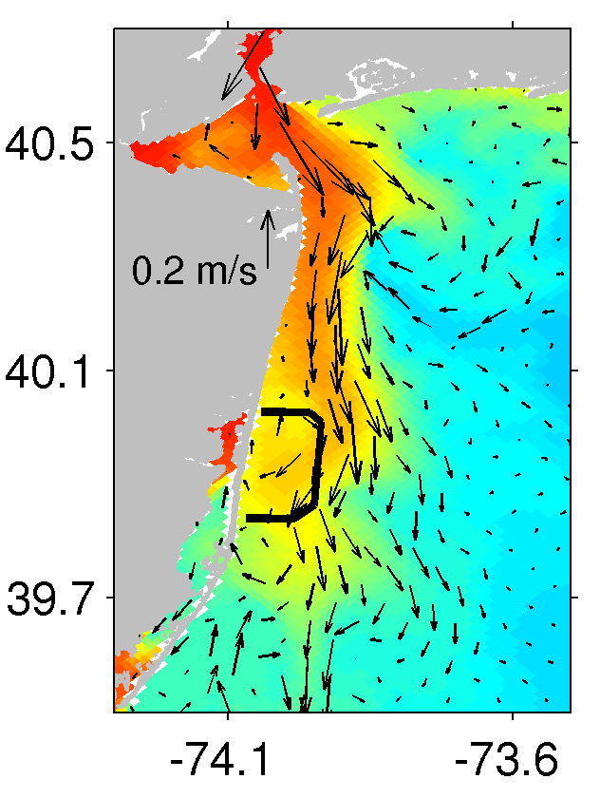
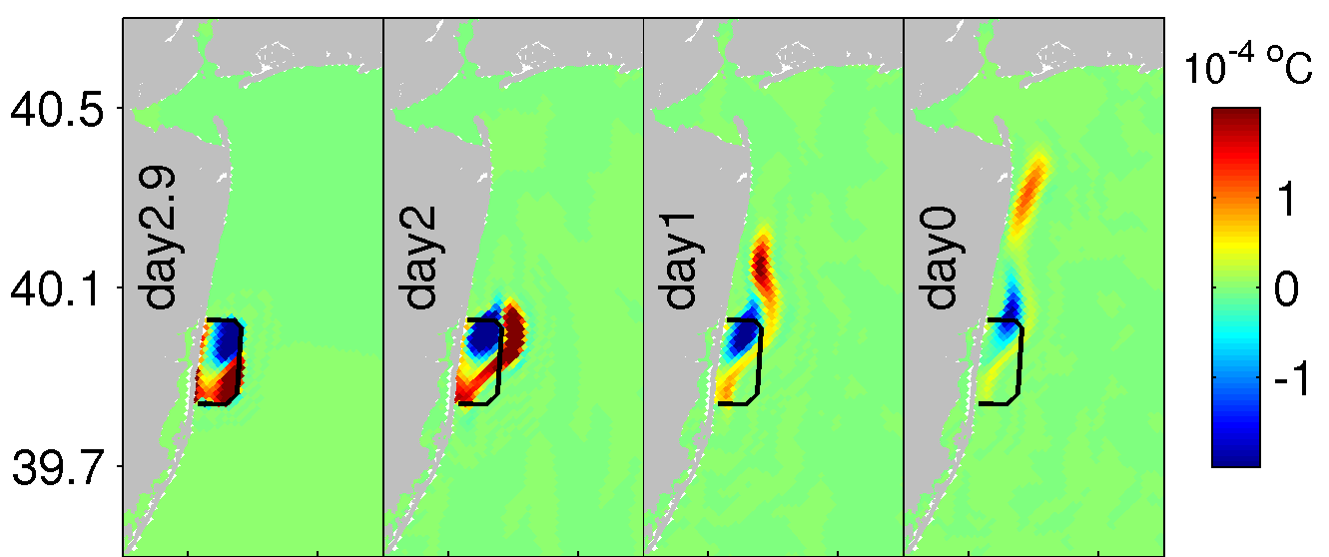
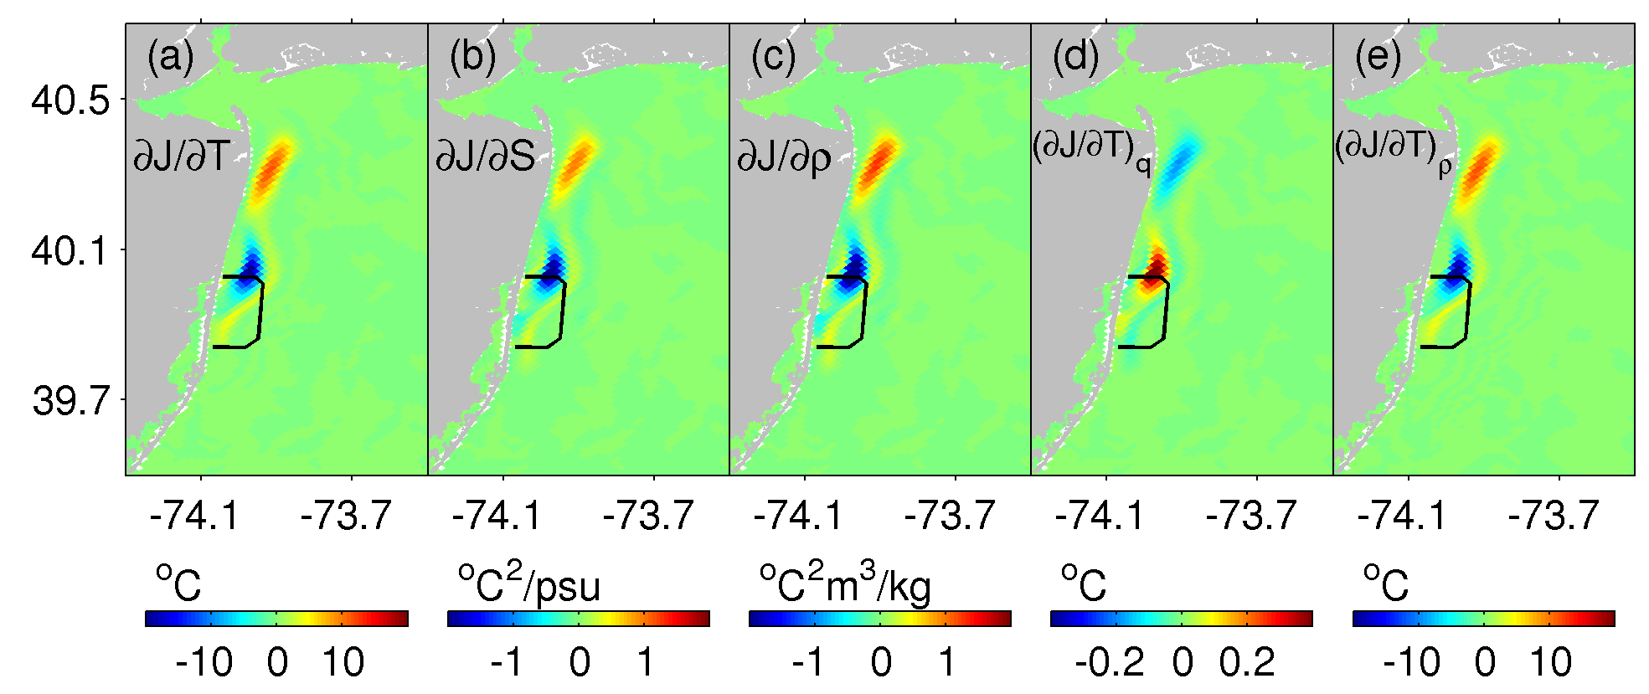
Adjoint model: sensitivity, observing system control
day 0
 | Upstream temperature | Density | Surface current | SSH | Viscosity | Diffusion
 |  |  |  |  | 1 | 0.3
 | 2 | 1
Zhang, W., J. Wilkin, J. Levin, and H. Arango (2009), An Adjoint Sensitivity Study of Buoyancy- and Wind-driven Circulation on the New Jersey Inner Shelf, JPO, 39, 1652-1668.

Slide 45
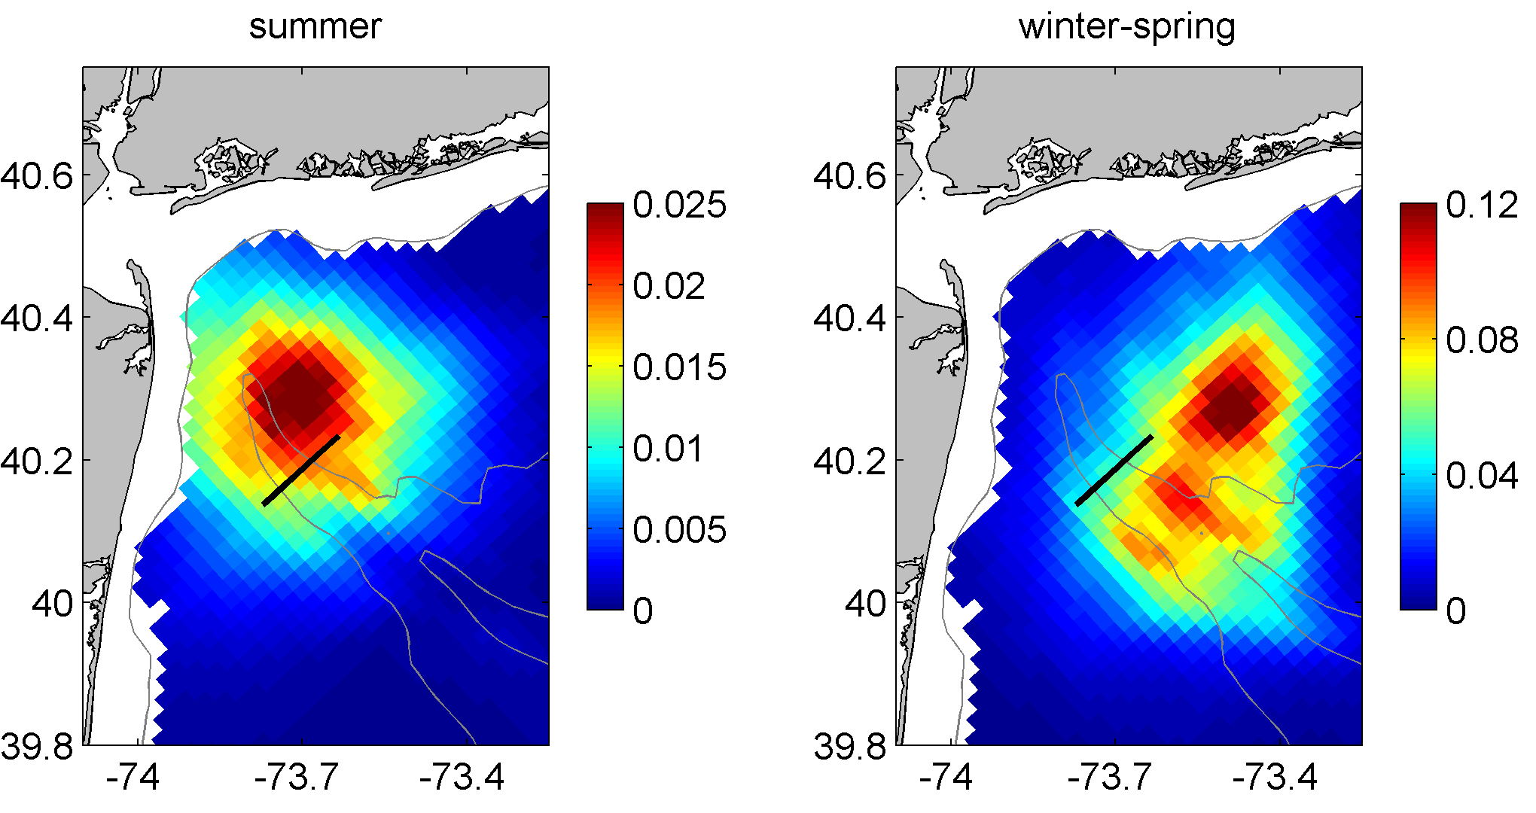
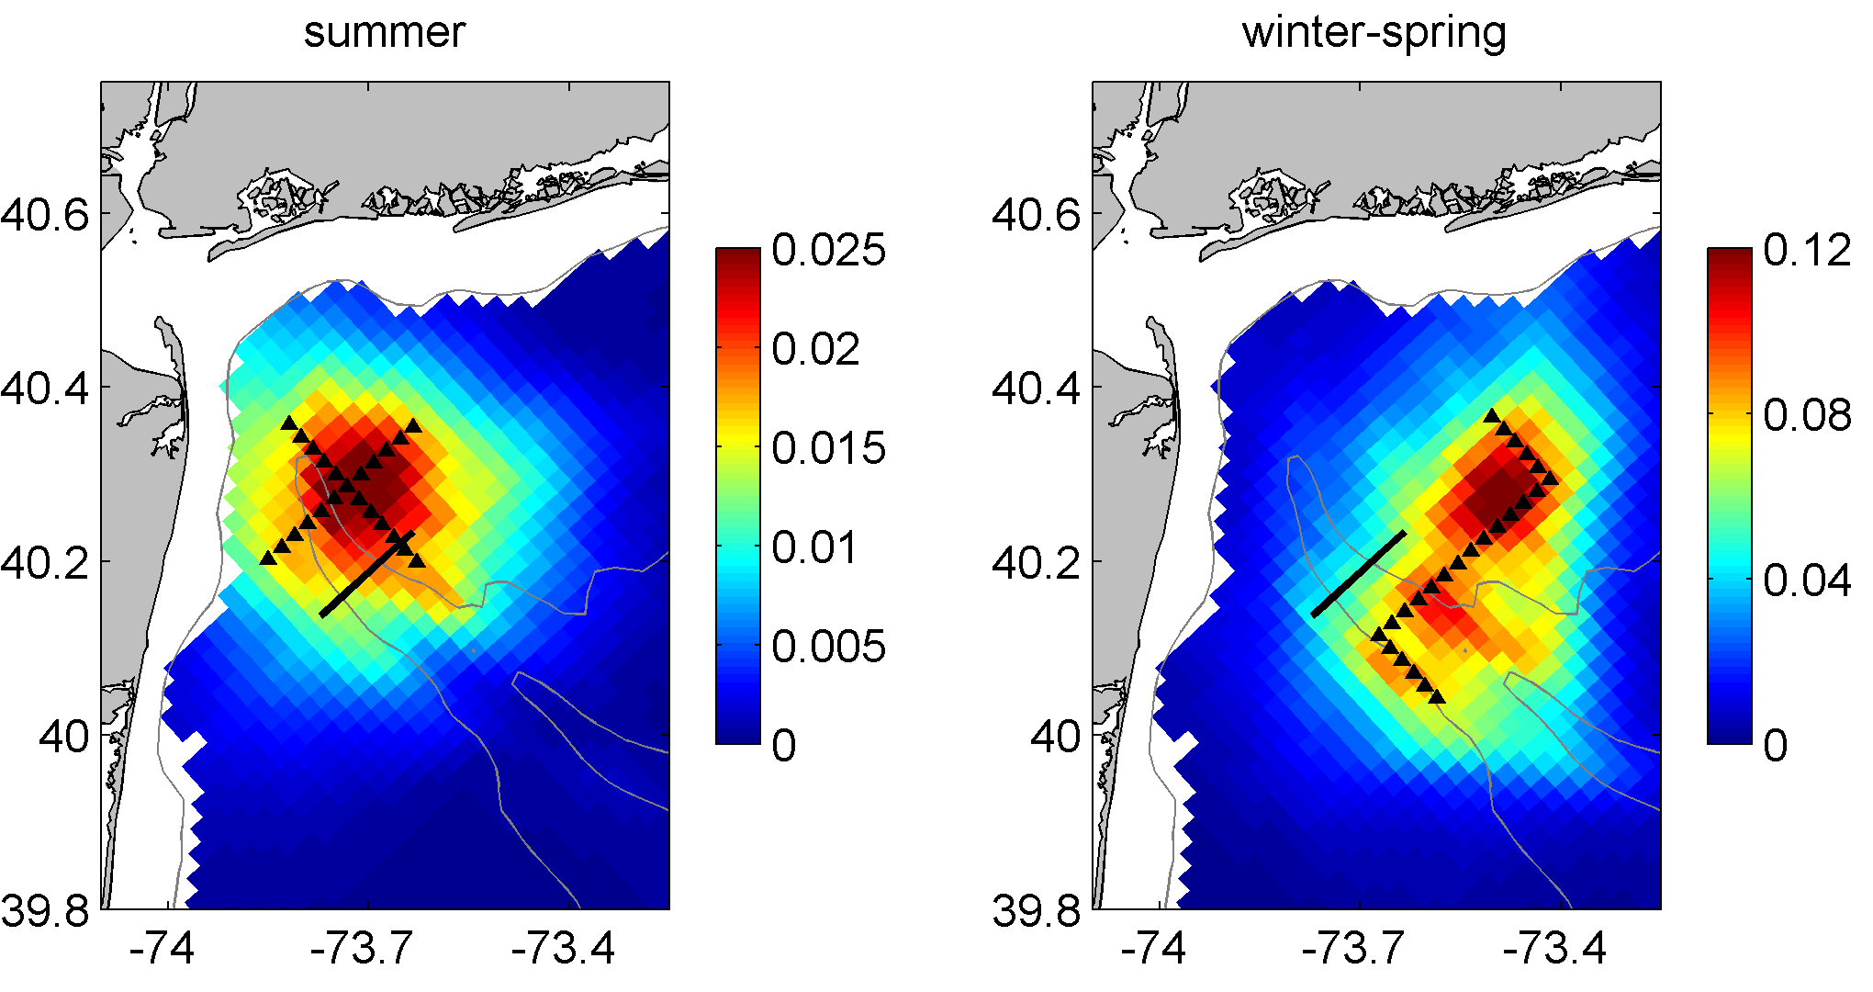
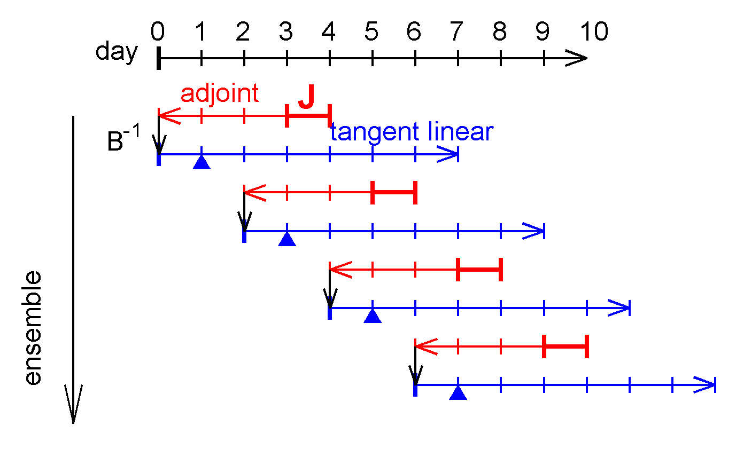

Observing system design experiments
gives the covariance between and model state
Ensemble average of correlation with salinity at 20m
e.g. a function J that describes anomaly salt flux through a section:
optimal
traditional
Zhang, W. G., J. L. Wilkin, and J. Levin (2010), Towards an integrated observation and modeling system in the New York Bight using variational methods, Part II: Representer-based observing system design, Ocean Modelling, 35, 134-145.
2

Slide 46
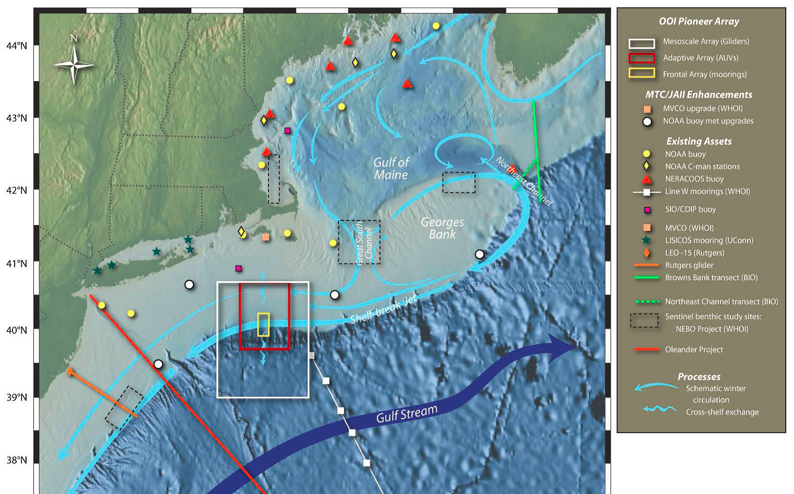
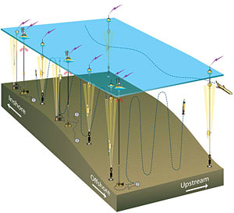
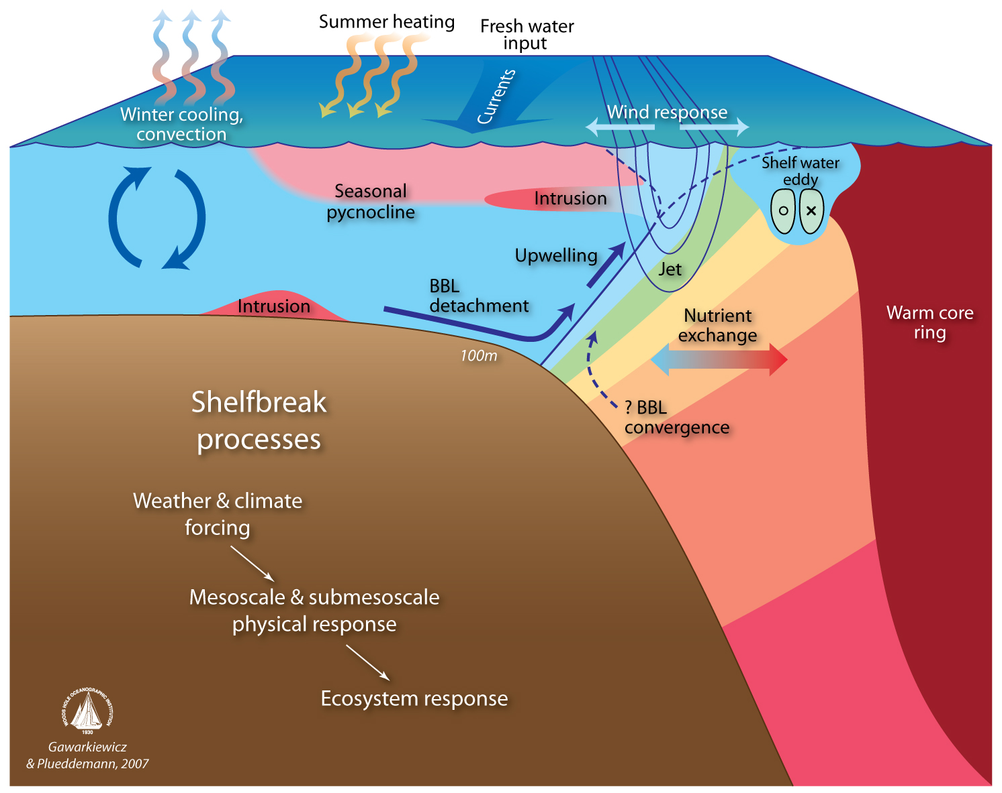
NSF Ocean Observatories Initiative Pioneer Array
Where would you deploy AUVs to measure a particular feature of the flow?
OOI Pioneer Array focuses on shelf-sea/deep-ocean exchange at the shelf-break front

Slide 47
Summary
ROMS 4D-Var DA adds skill in coastal regimes:
Broad shelf; strong tides; significant spatial gradients in T and S;
pronounced fronts; deep-sea influence from mesoscale
Useful sub-surface for ~ 3days to depths greater than 200 m
Provides 3-D estimate of ocean state
  initial conditions to a real-time forecast
  re-analysis for ocean science (e.g. biogeochemical, ecosystem studies)
Real-time 4D-Var systems:
Require investment in configuration, data pre-processing steps, and skill assessment
Our experience:
modest nested coastal domains at high resolution are good test-beds for building experience and knowledge on DA
Global models can be biased: down-scaling requires bias removal
Variational methods are powerful tools for obs. system design & operation
ROMS User Workshop: Modern Observational and Modeling Systems
Rio de Janeiro, Brazil, October 3-4. 2012

