Slide 1



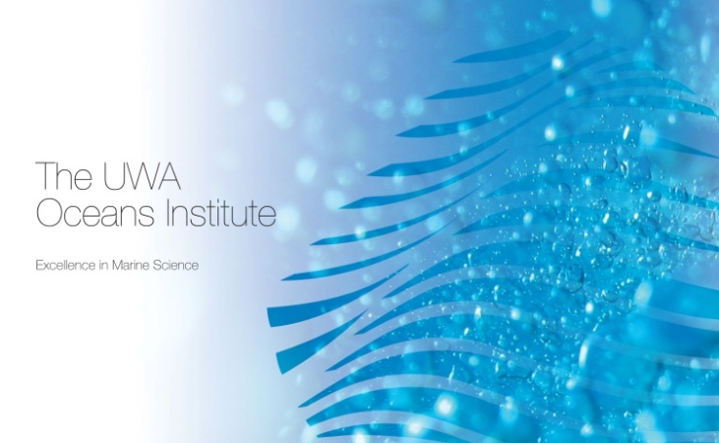

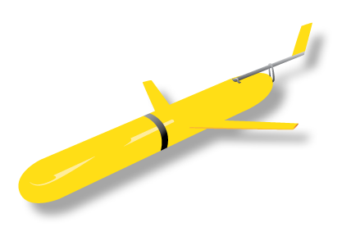
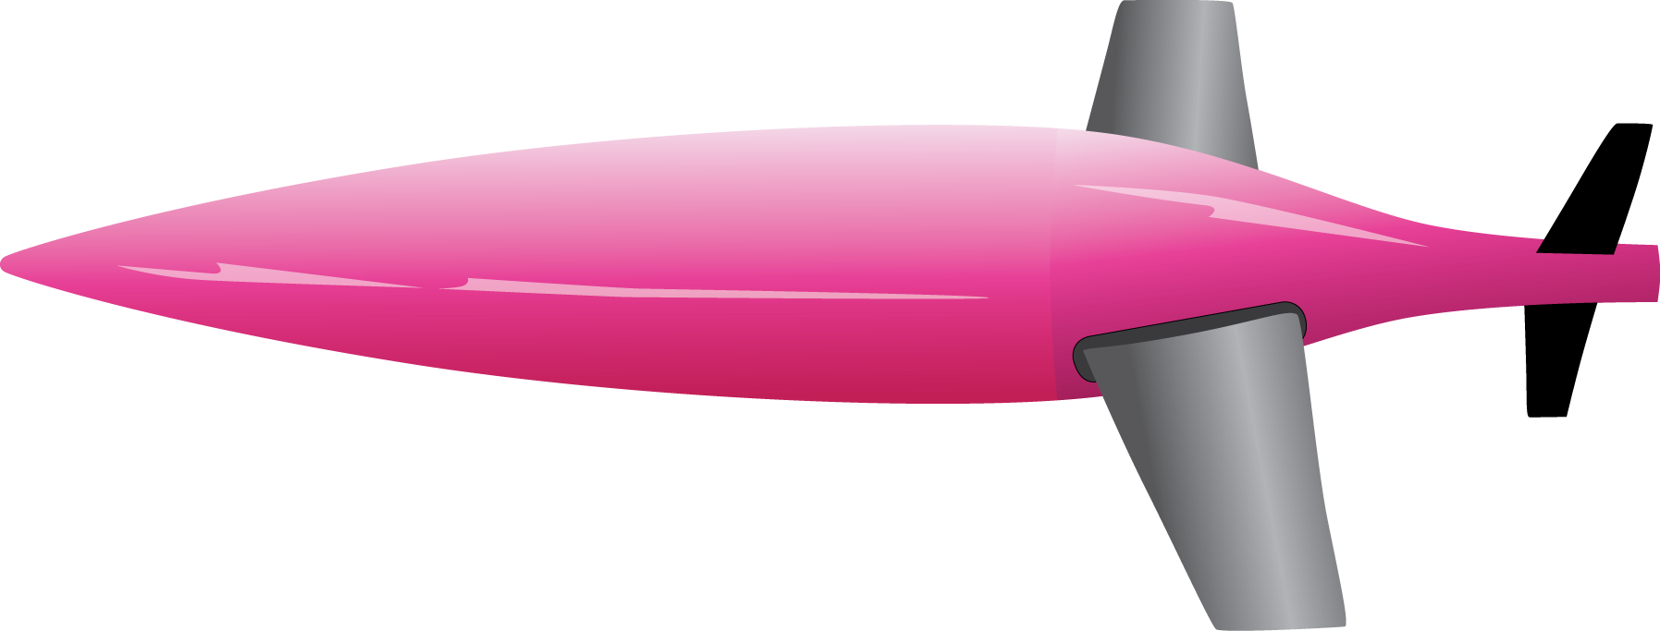
School of Environmental Systems Engineering
The University of Western Australia
Coastal Ocean Observations in Western Australia
Charitha Pattiaratchi
School of Environmental
Systems Engineering

Slide 2


OUTLINE
Part 1: IMOS Coastal Ocean Observations in Western Australia
Part 2: Peddies to Dense Shelf Water Cascades
ACKNOWLEGEMENTS
IMOS Facilities
Individual contributions acknowledged
Hrvoje Mihanovic, Thisara Welhena, Cyprien Bosserelle, Flo Kaempf, Olga Bondarenko

Slide 3
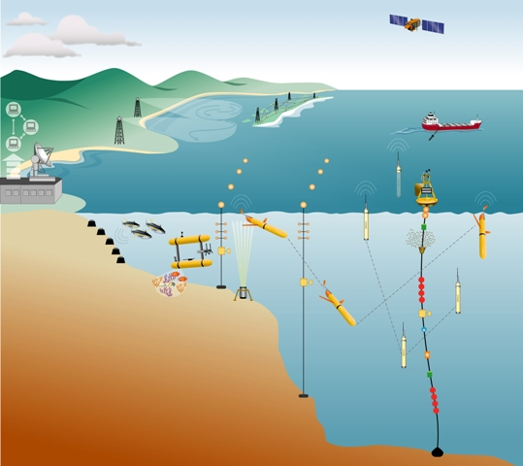
$ 102 million Initiative
(2007-2013)
Western Australia
$ 32 million
WA Govt co-investment
$6 million

Slide 4
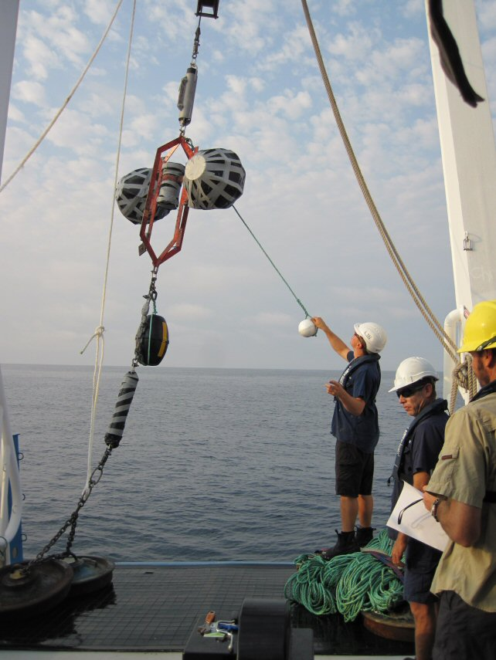
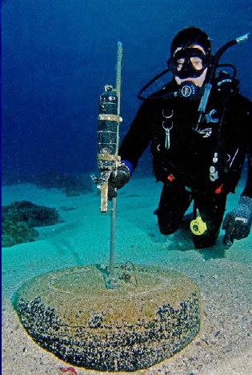
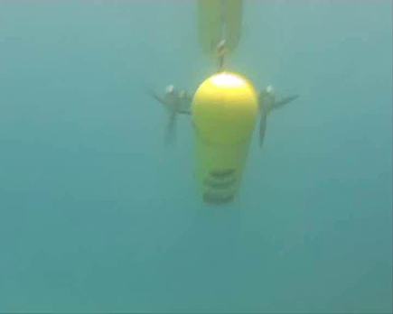
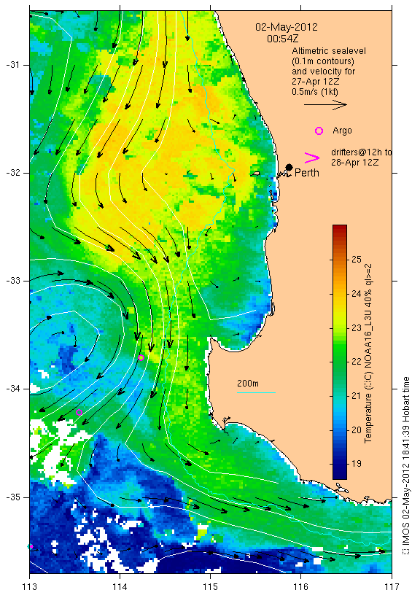
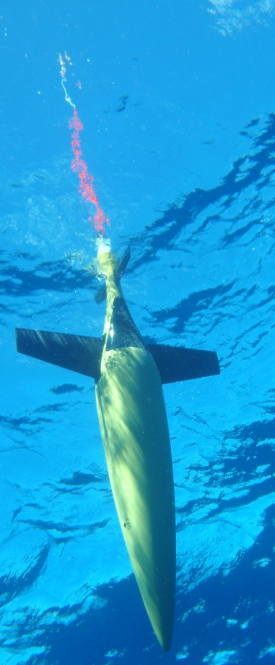
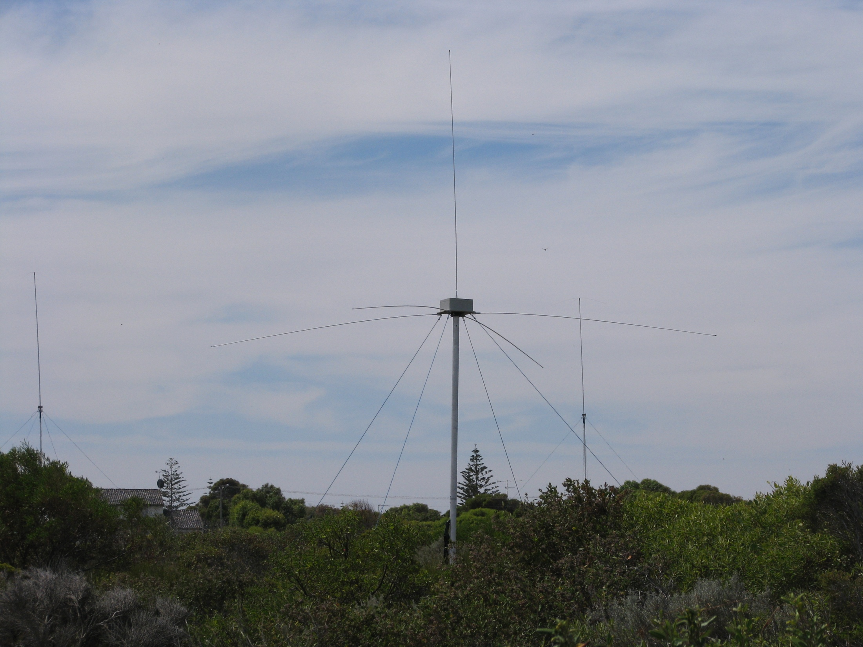
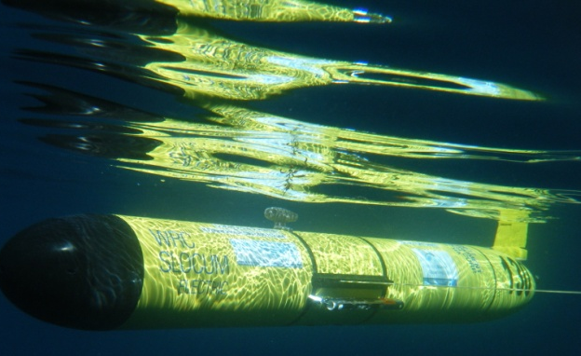
All data collected through IMOS is FREE
Ocean Current

Slide 5
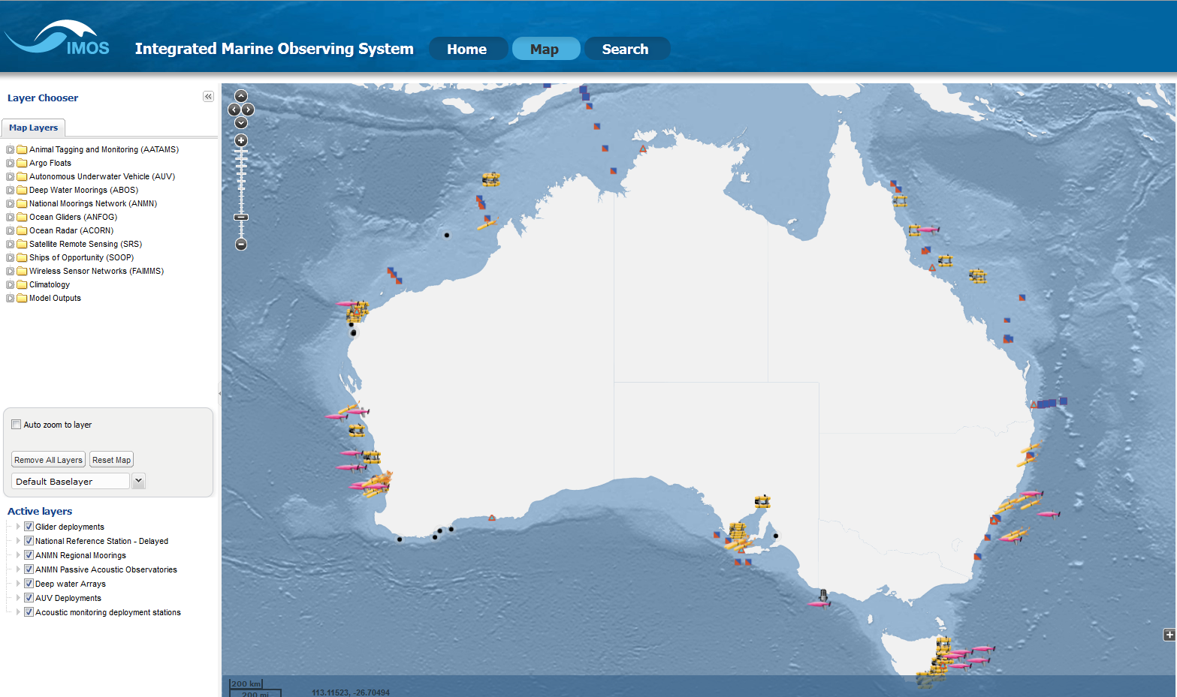
http://imos.aodn.org.au/

Slide 6
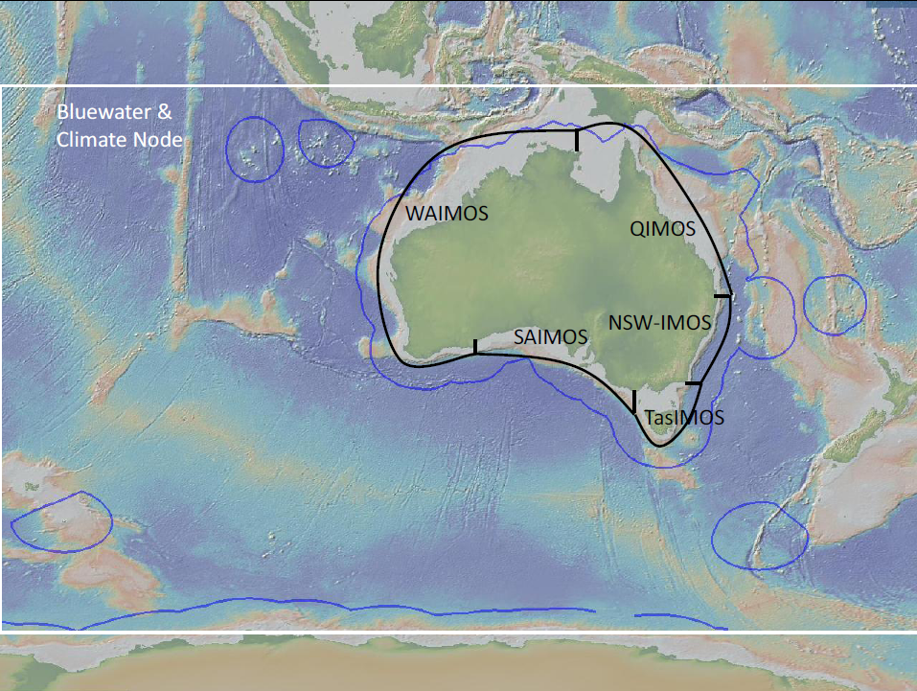
Nodes

Slide 7
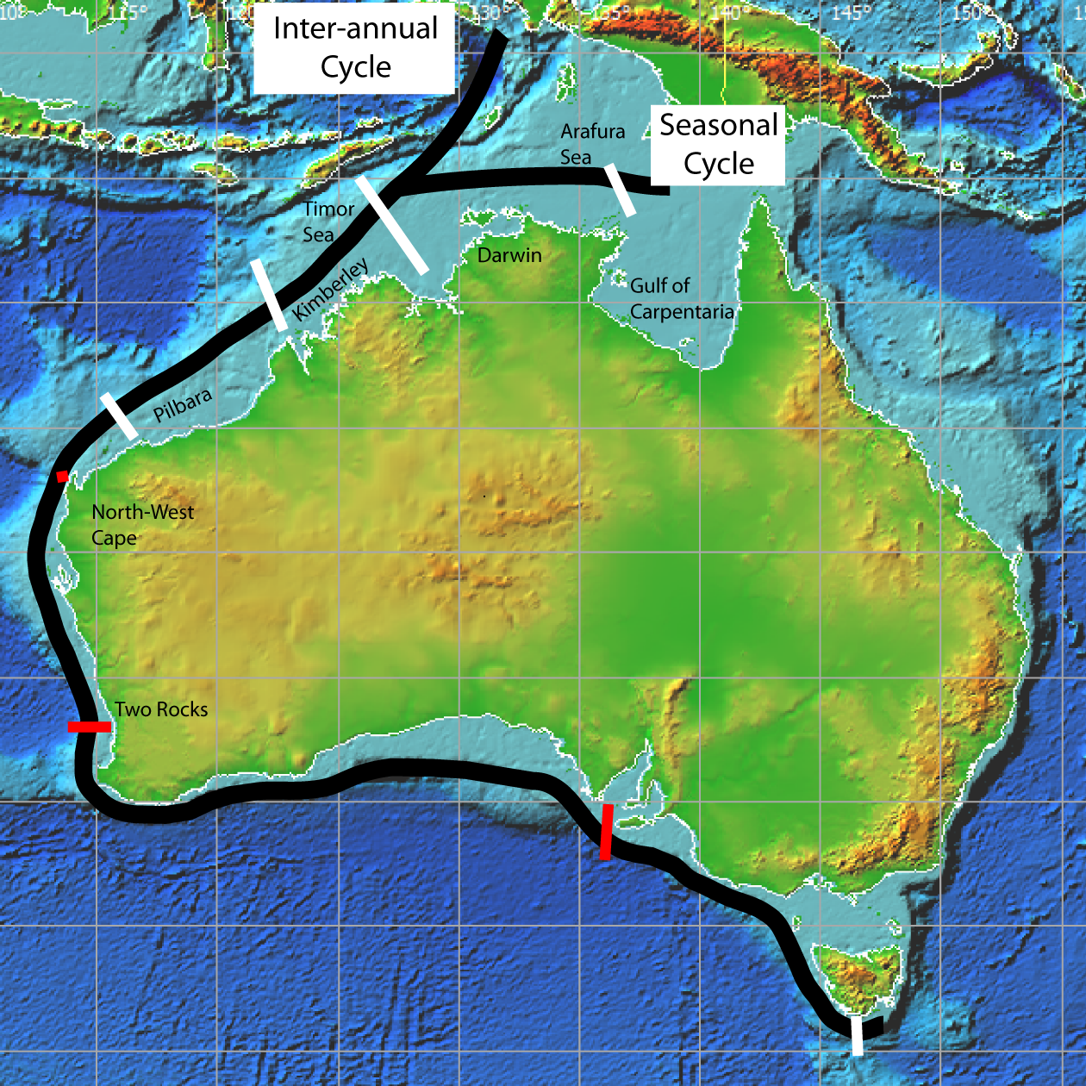
Node Science and Implementation Plan
Leeuwin Current
‘Influence’
Seasonal Cycle signal originates from Gulf of Carpentaria
Inter-annual variation derived from Indonesian Throughflow
~ 8000 km
cf 2700 km for EAC
2/3 of Australia

Slide 8
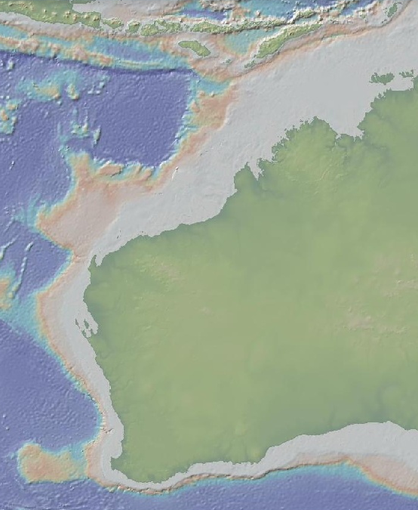

ITF
Western Australian Integrated Marine Observing System
WAIMOS
Kimberley
Leeuwin
Current
Pilbara
Capes
Current
South-west

Slide 9
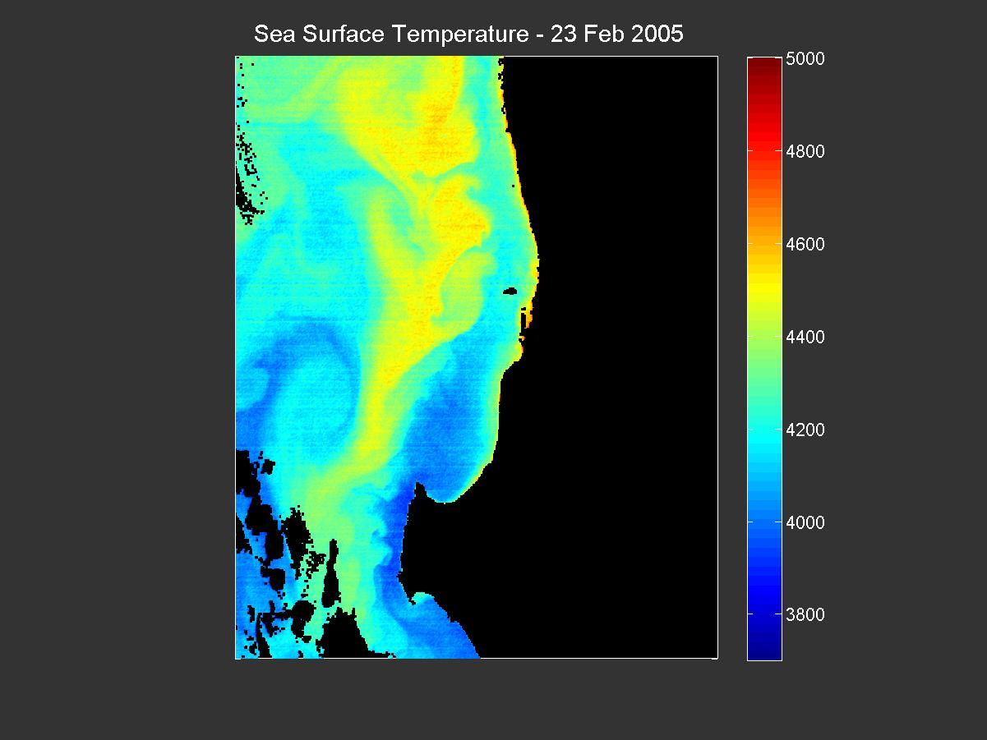
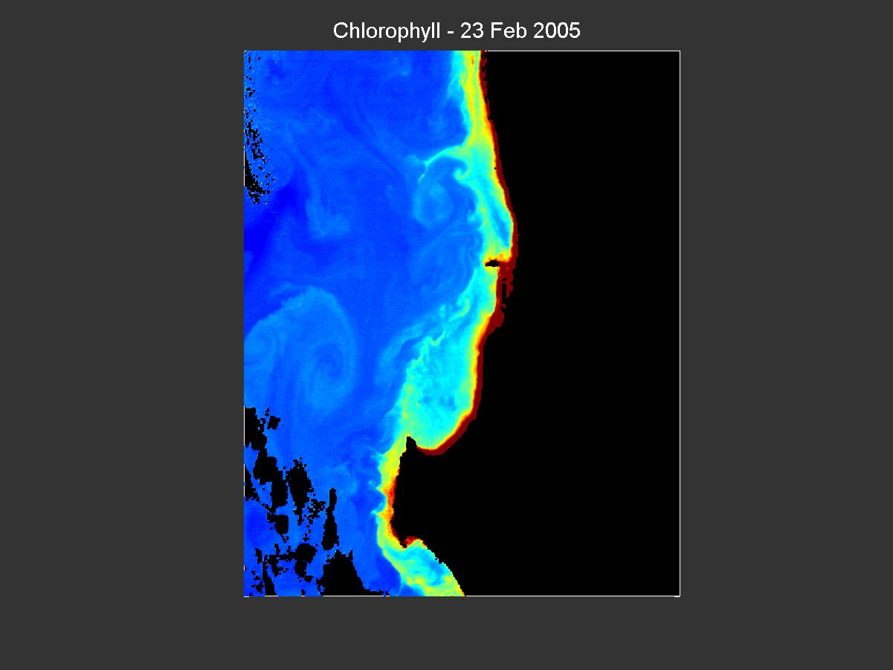
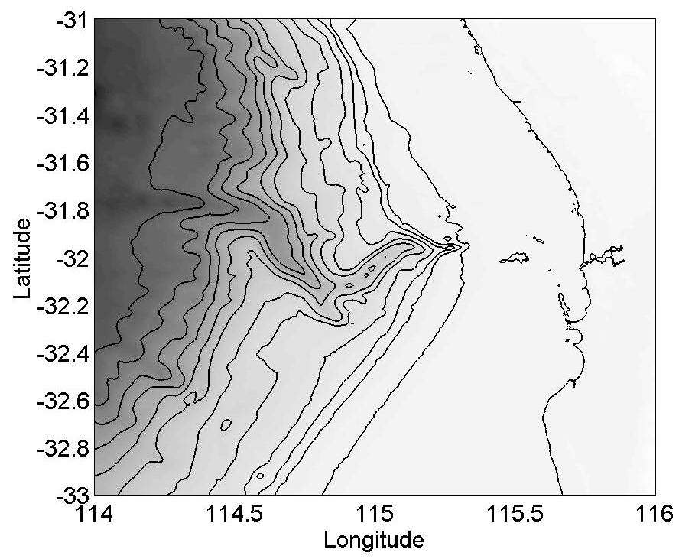
WAIMOS: South-west
Leeuwin
Current
Perth Canyon
Capes
Current

Slide 10
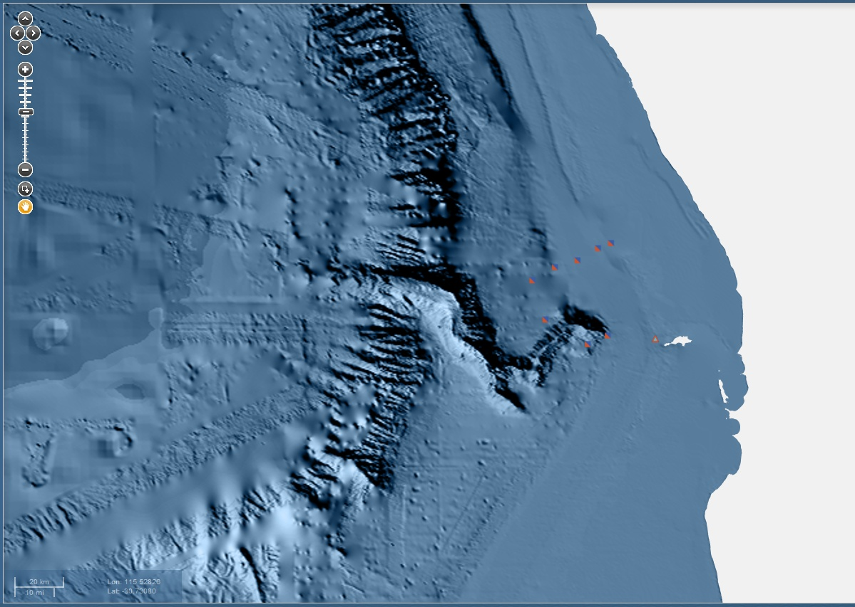
Moorings
WATR (50, 100, 150, 200, 500)
WACA (200, 500N, 500S)

Slide 11
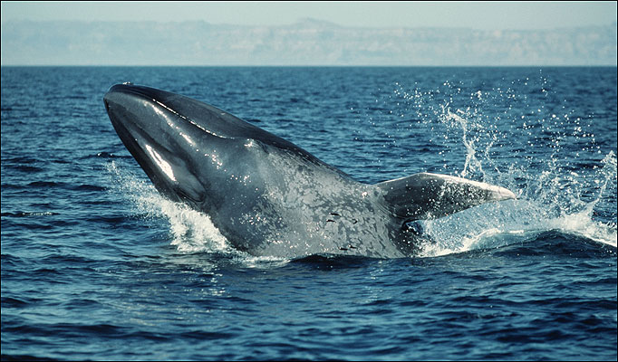
Pygmy blue whale tracking from Perth Canyon passive observatory
1400
1200
1000
800
Number of detections per week
600
400
200
0
01/12/09
01/01/10
01/02/10
01/03/10
01/04/10
01/05/10
01/06/10
01/07/10

Slide 12
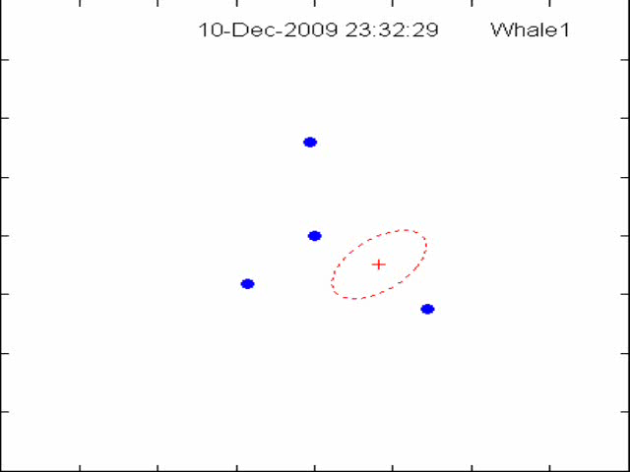
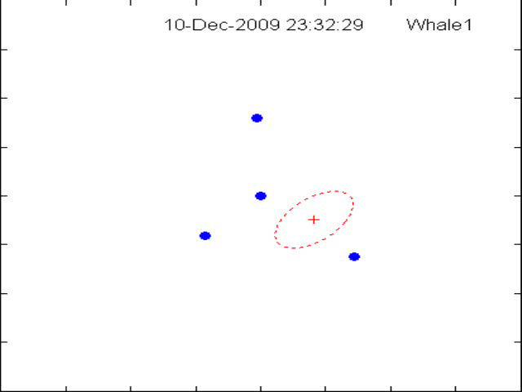
Pygmy blue whale tracking from Perth Canyon passive observatory
N
Noise loggers
95% confidence ellipses
-8 km 0 8 km
S
-8 km 0 8 km
Motion is sped up by a factor of about 80

Slide 13
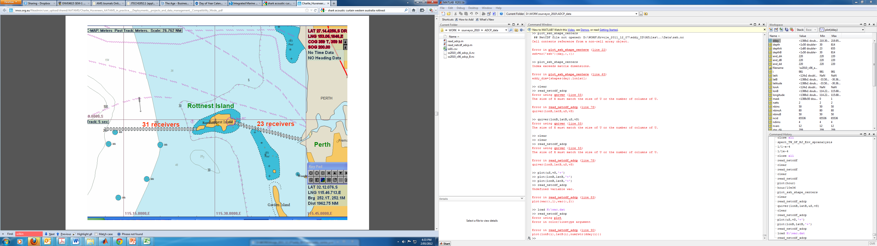
AATAMS: Rottnest
Shark Tagging

Slide 14
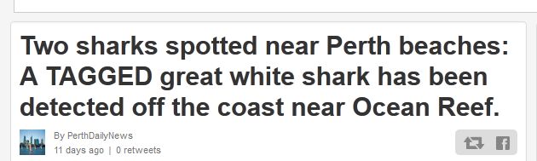
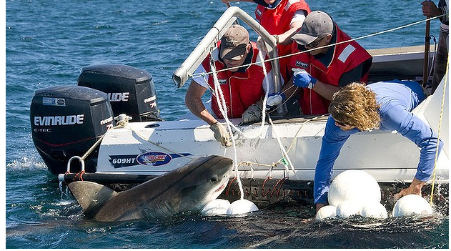
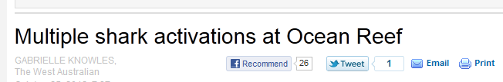
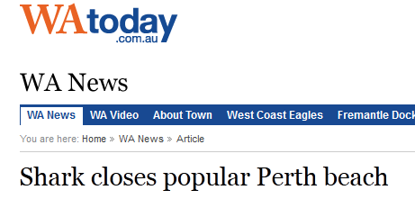

Slide 15

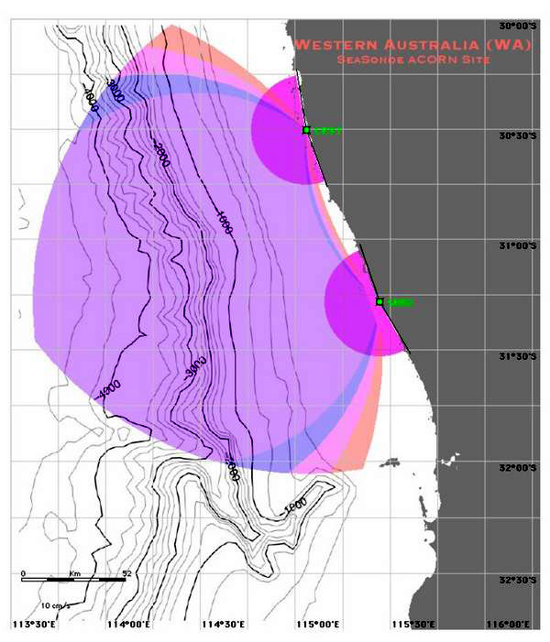
TURQUOISE COAST
2 CODAR long range (Seasonde)
Coverage for Turquoise Coast (TURQ) CODAR radars at Cervantes (CRVT) and Seabird (SBRD).

Slide 16
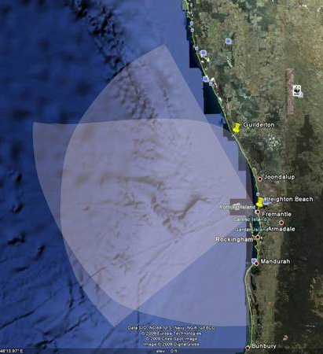
ROTTNEST SHELF (PERTH CANYON)
4-element antenna array as a transmitter and a section of 12-element antenna system as a receiver (spaced ~ 17.6 m apart)
Coverage for Rottnest Shelf (ROT) WERA radars at Guilderton (GUI) and Fremantle (FRE)

Slide 17
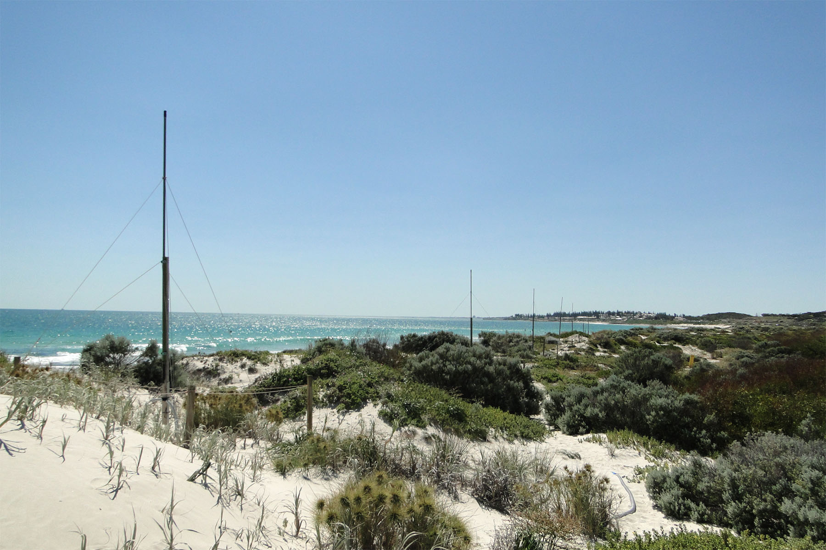
WERA : Leighton Beach
Phased Array - 8.5125 MHz (λ ~ 35.2 m)

Slide 18
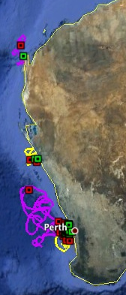
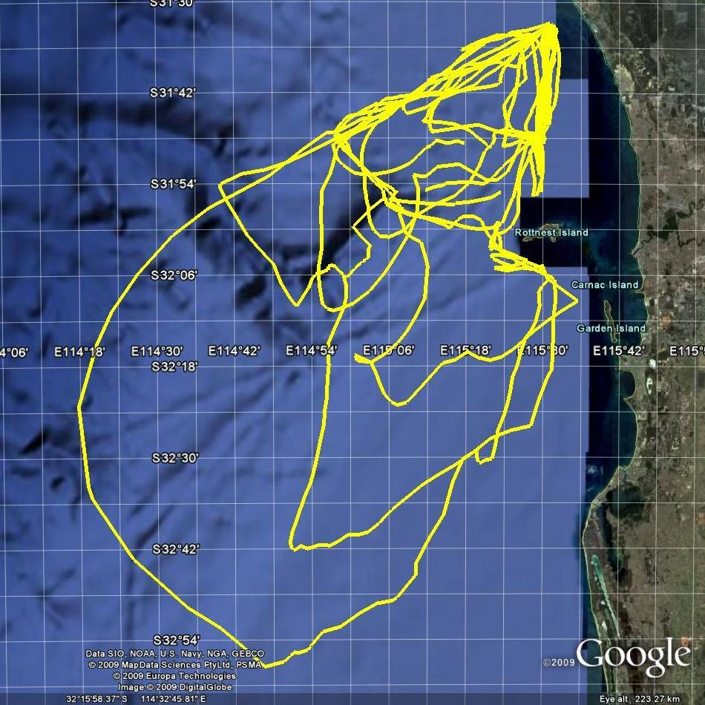
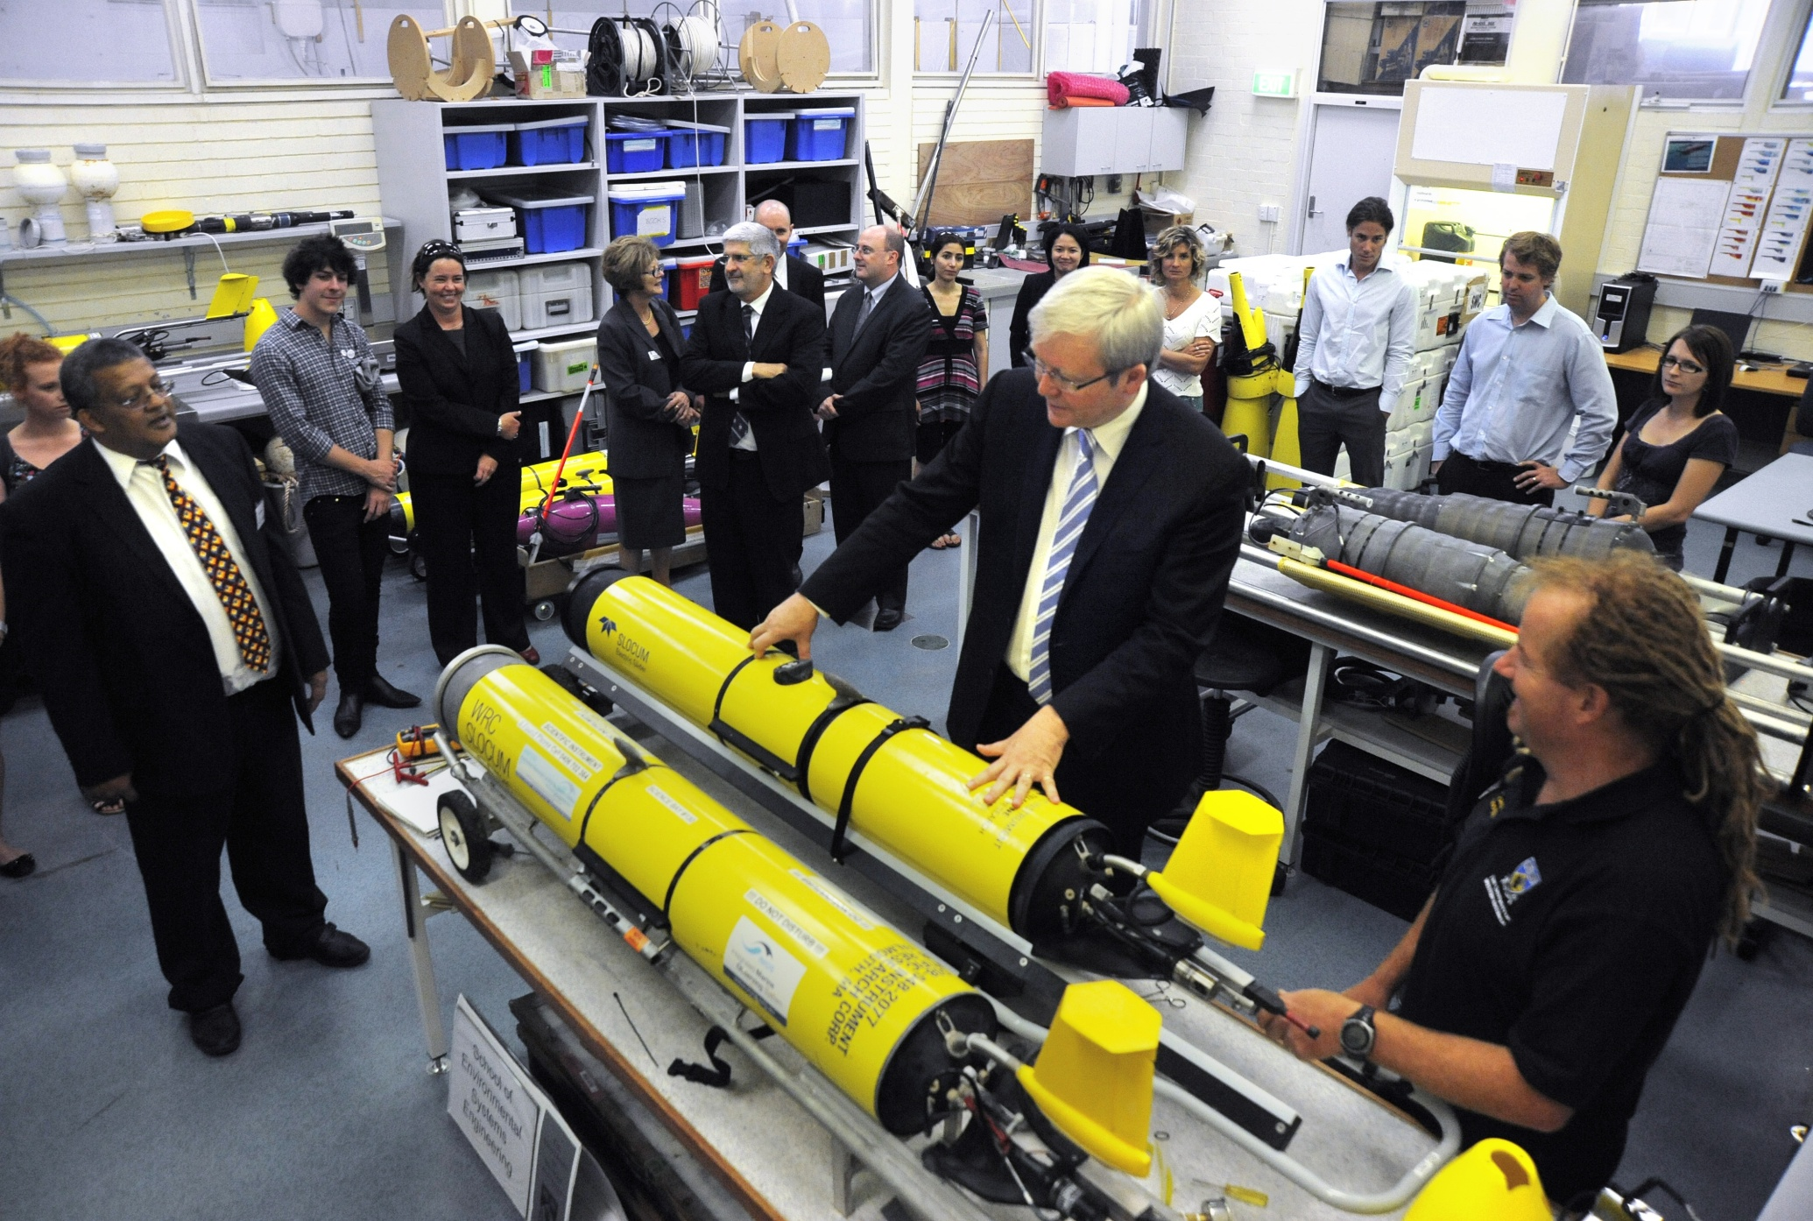
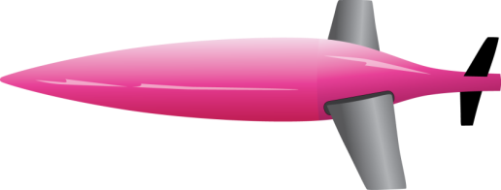

Ocean glider deployments
40 Missions to date since Jan 2009
38 Slocum deployments (Two Rocks)
(> 50 transects); Kimberley, Pilbara
12 Seaglider Deployments (between North-West Cape and Rottnest

Slide 19
ITF
Western Australian Integrated Marine Observing System
WAIMOS
Kimberley
Leeuwin
Current
Pilbara
Capes
Current
South-west

Slide 20
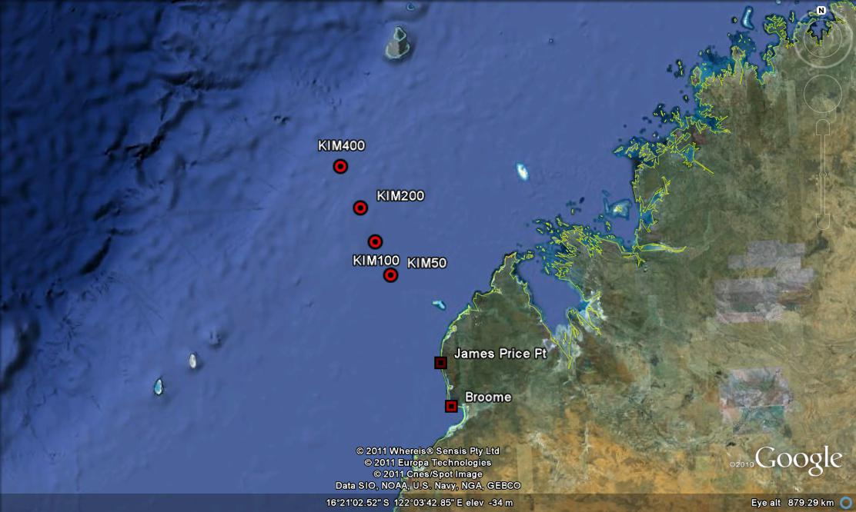
WAIMOS Kimberley Array
Deployed: Jan 28 – Feb 5 2012
Service: Jul 18-29 2012

Slide 21
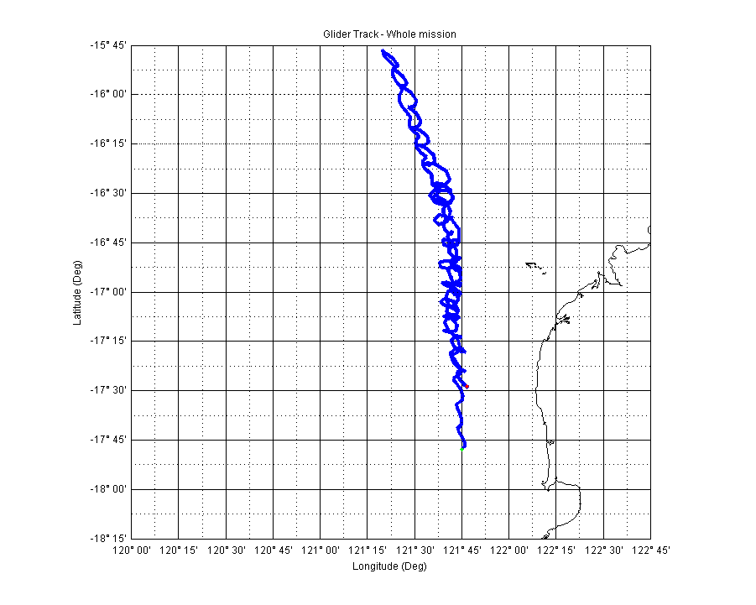
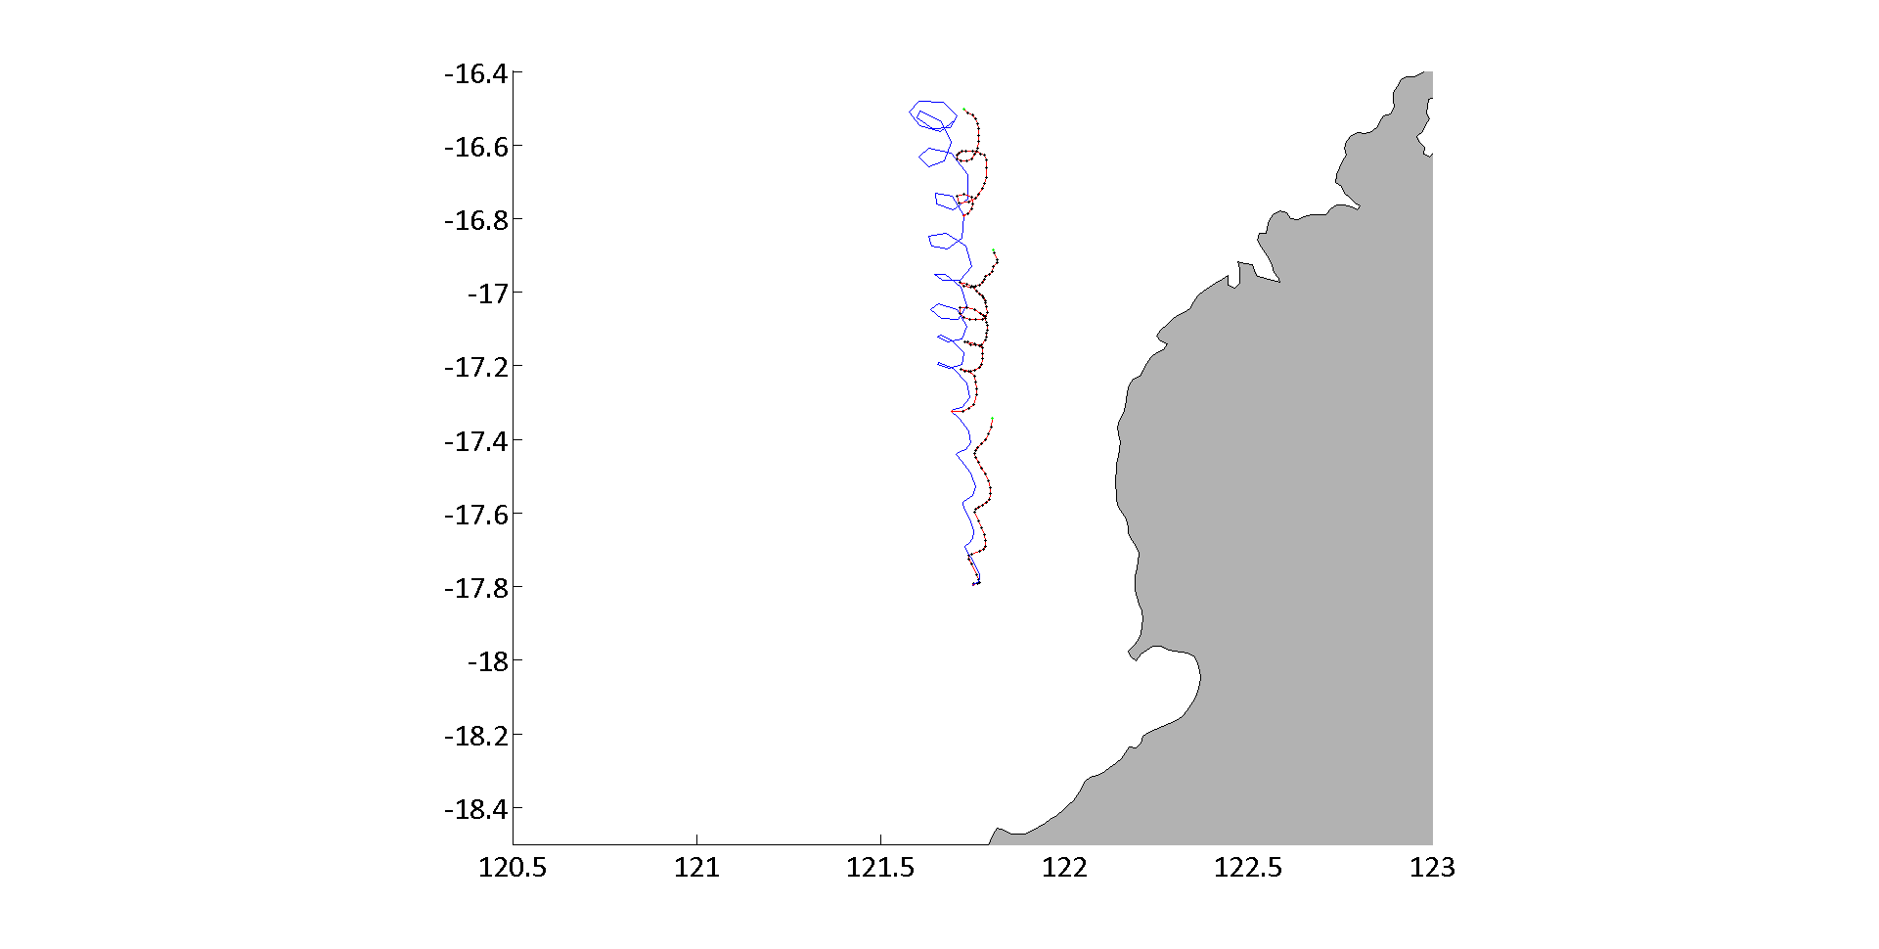
Kimberley Slocum deployment

Slide 22
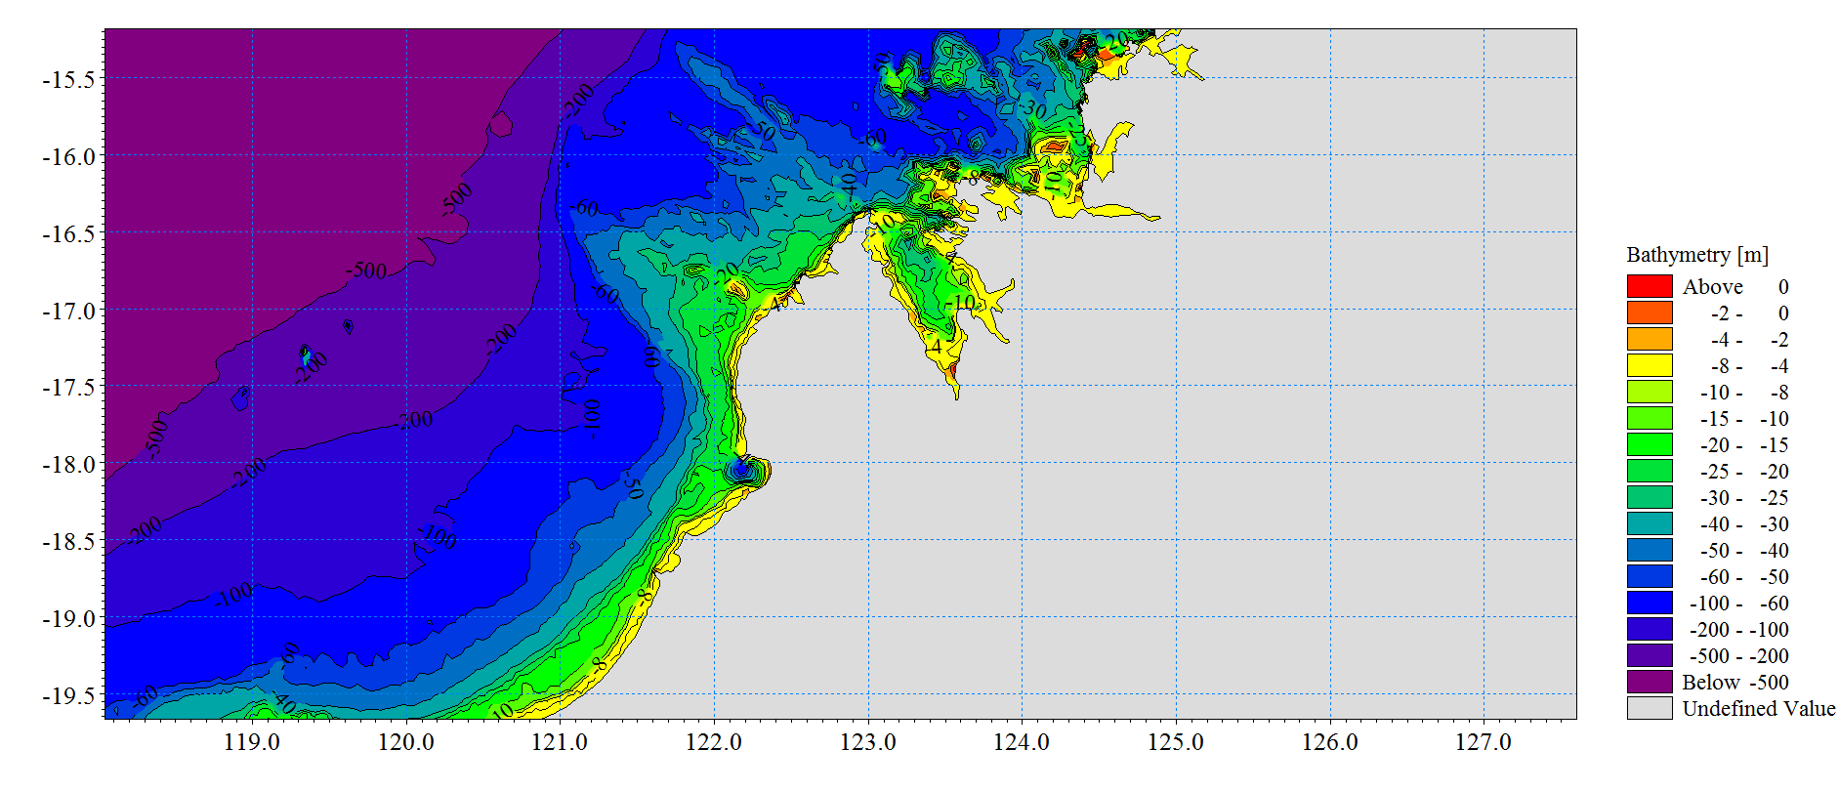
Kimberley Glider deployment

Slide 23
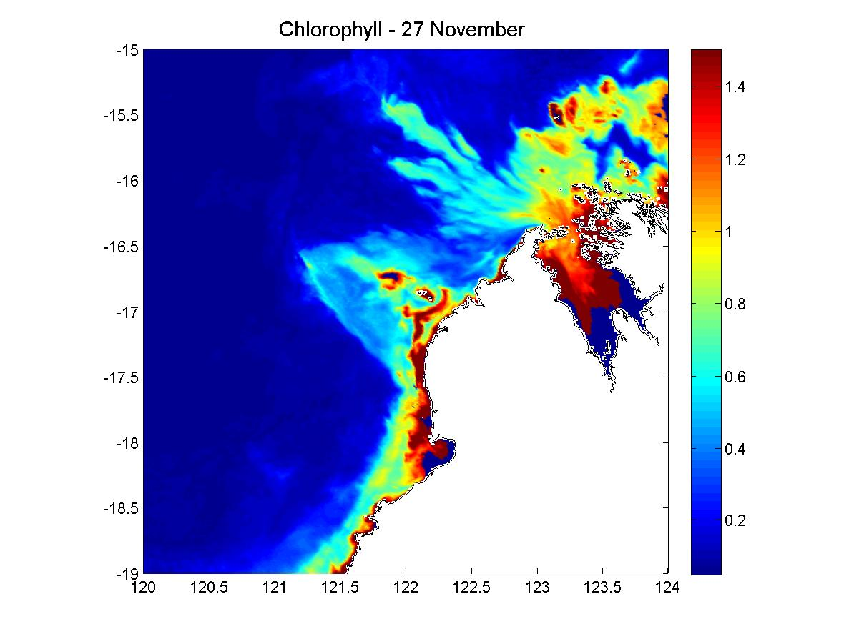
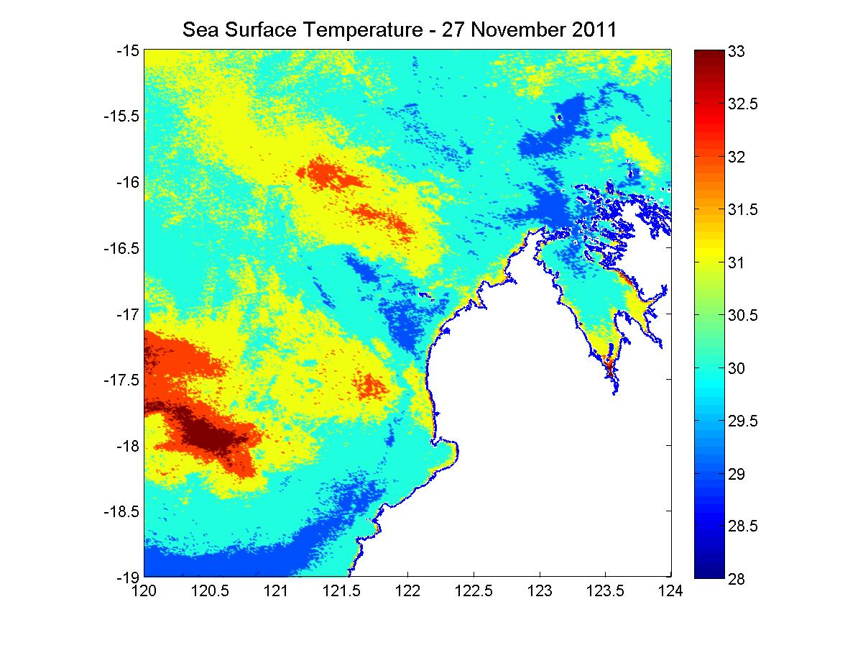
Kimberley Glider deployment

Slide 24
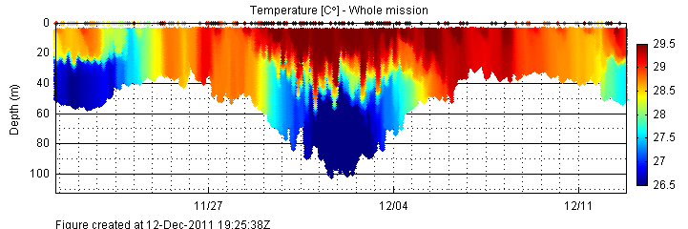
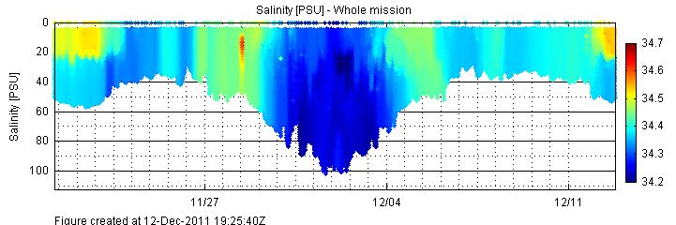
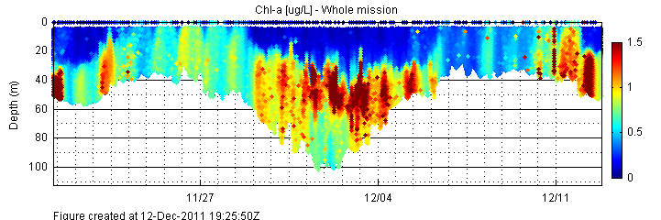
Kimberley Glider deployment

Slide 25
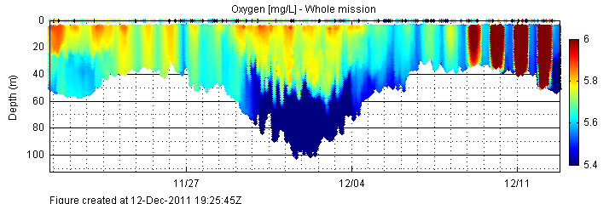
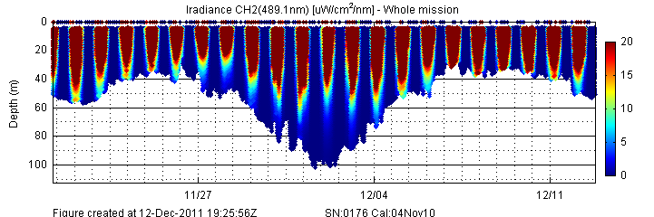
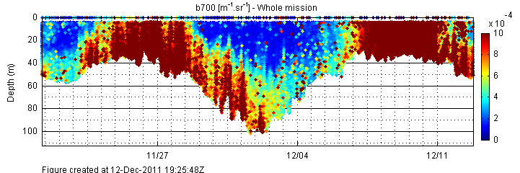
Kimberley Glider deployment

Slide 26
WAIMOS: South-west
Leeuwin
Current
Perth Canyon
Capes
Current

Slide 27
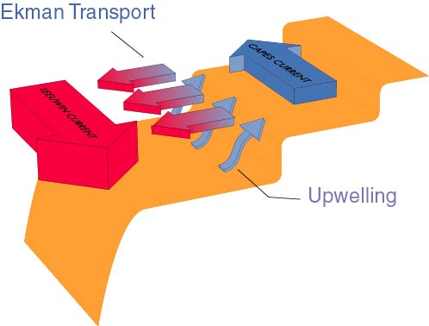
Leeuwin Current System
Capes Current
Leeuwin Under Current
Leeuwin Current
Gersbach et al., (1999)

Slide 28
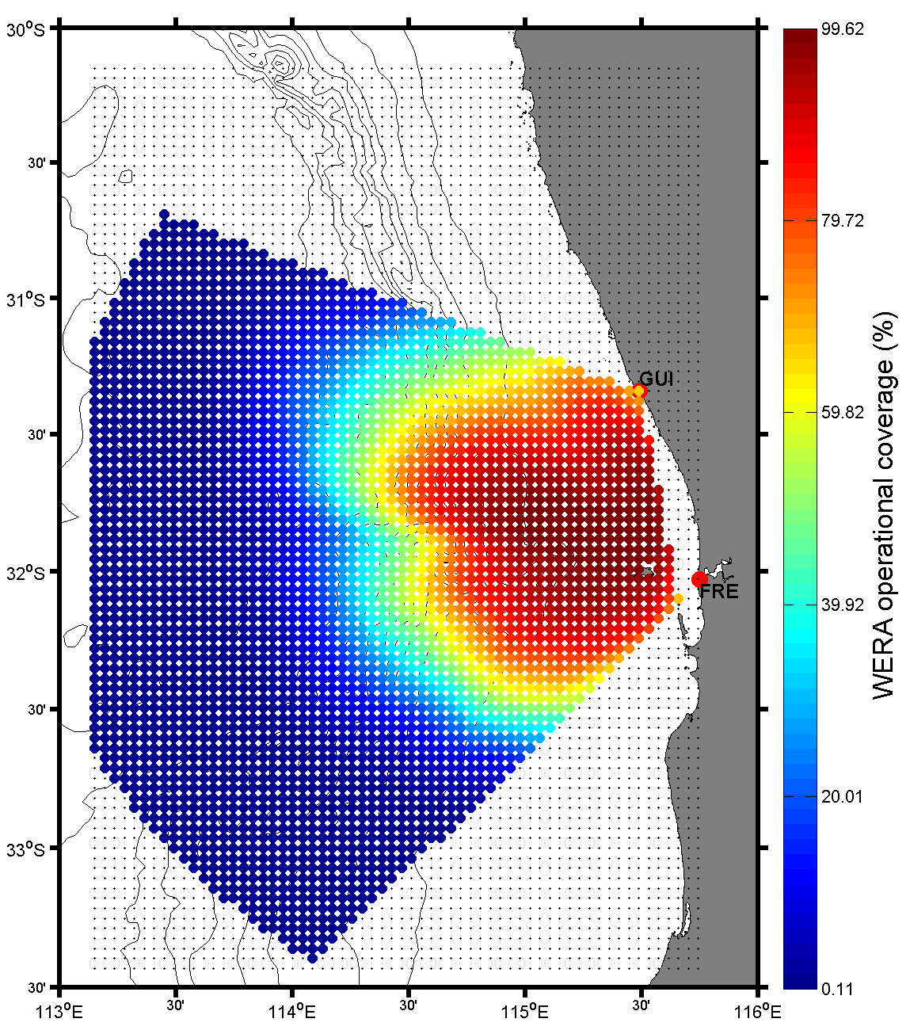

WERA : Coverage
Analise 13 months of data (10,000 hours)
10 March 2010-31 May 2011

Slide 29
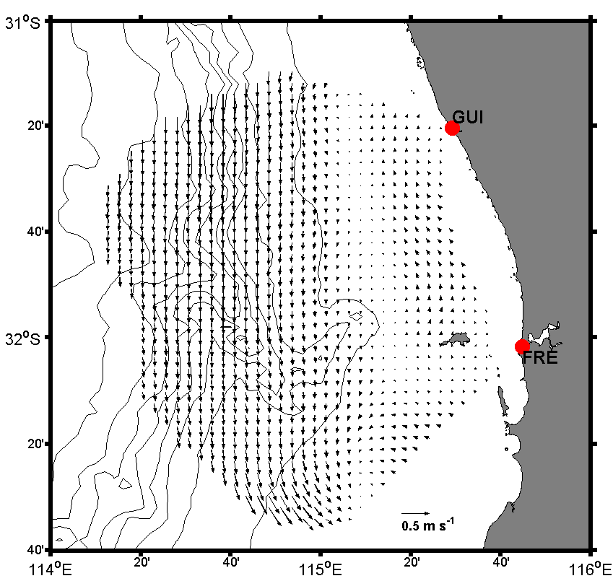
Mean Currents:
10 March 2010 to 30 April 2011

Slide 30
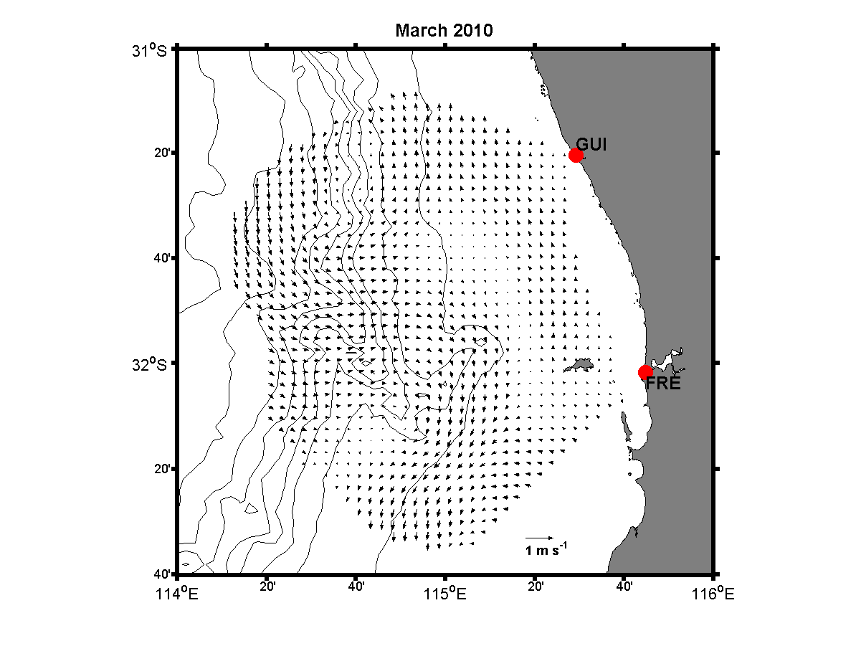
Mean Currents: March 2010

Slide 31

Mean Currents: May 2010

Slide 32

Mean Currents: August 2010

Slide 33

Mean Currents: Sep 2010

Slide 34

Self-organizing maps (SOMs)
Identify most common flow patterns in the HF Radar data (10,000 hours)

Slide 35

Self-organizing maps (SOMs)
Moderate southerly winds
Strong southerly winds
Eddy ‘spin-up’

Slide 36

Capes Current

Slide 37

Capes Current

Slide 38

Capes/Leeuwin Current
Interaction:
Fronts and ‘Peddies’ (Petite eddies)
2-16 February 2011

Slide 39

Capes/Leeuwin Current
Interaction:
Fronts and ‘Peddies’ (Petite eddies)

Slide 40

Capes/Leeuwin Current
Interaction:
Fronts and ‘Peddies’ (Petite eddies)
Front - initiation

Slide 41
Capes/Leeuwin Current
Interaction:
Fronts and ‘Peddies’ (Petite eddies)
Front - initiation
Capes Current

Slide 42

Capes/Leeuwin Current
Interaction:
Fronts and ‘Peddies’ (Petite eddies)
Front

Slide 43

Capes/Leeuwin Current
Interaction:
Fronts and ‘Peddies’ (Petite eddies)

Slide 44

Capes/Leeuwin Current
Interaction:
Fronts and ‘Peddies’ (Petite eddies)
Front - dissipated

Slide 45

Capes/Leeuwin Current
Interaction:
Fronts and ‘Peddies’ (Petite eddies)

Slide 46

Development of small scale features (fronts/eddies)
+ Capes Current

Slide 47

Capes/Leeuwin Current
Interaction:
Fronts and ‘Peddies’ (Petite eddies)
Front - reforming

Slide 48

Development of small scale features (fronts/eddies)
+ Capes Current
Front – established with eddy

Slide 49

Capes/Leeuwin Current
Interaction:
Fronts and ‘Peddies’ (Petite eddies)
Front

Slide 50

Peddies: ‘Petite’ eddies
(sub-meso scale eddies)

Slide 51

‘Petite’ eddies

Slide 52

‘Petite’ eddies

Slide 53

‘Petite’ eddies- 15 Apr

Slide 54

‘Petite’ eddies- 17 Apr

Slide 55

‘Petite’ eddies- 18 Apr

Slide 56

‘Petite’ eddies- 21 Apr
Timescale ~6 days

Slide 57

‘Petite’ eddies: August 2011

Slide 58

‘Petite’ eddies: August 2011

Slide 59


‘Petite’ eddies

Slide 60



‘Petite’ eddies
Temperature
ADCP currents

Slide 61

Previous workm – ROMS
solution
Rennie et al. 2009

Slide 62


Slide 63

Particle tracking

Slide 64



Automated eddy tracking
Nencioli et al., 2010

Slide 65

Automated eddy tracking

Slide 66

Automated eddy tracking

Slide 67

Automated eddy tracking

Slide 68

Continental Shelf Waves

Slide 69

TC Jacob - 1996

Slide 70

Storm Surges & Shelf Waves
Tropical cyclones occur during summer months
Extra-tropical storms occur all year, with more frequent during winter

Slide 71

Continental Shelf Waves
1
2
3
Sea level
Tropical low

Slide 72

HYCOM plots

Slide 73


Slide 74


Slide 75


Slide 76


Slide 77


Slide 78


Slide 79

Continental Shelf Waves

Slide 80





Tropical low 06U

Slide 81

Annual Evaporation

Slide 82

Annual Evaporation

Slide 83

Dense shelf water cascades
Evaporation
Cooling

Slide 84

Dense shelf water cascades
Evaporation
Cooling

Slide 85


The Two Rocks Transect
Monthly Slocum deployments since Jan 2009
Observe the seasonal evolution of the Leeuwin Current and shelf system and associated bio-optical properties
  Pattiaratchi et al. (2011) Geophysical Res. Letters:
  DSWC is a common occurrence throughout the year except during the summer months when winds vertically mix the water column
  Cross-shore water flux is 25% of the alongshore flux on shelf

Slide 86


DSWC – south-west Australia

Slide 87


DSWC – south-west Australia

Slide 88



DSWC – Two Rocks Transect
Feb 2009
Mar 2009
April 2009
Mar 2009

Slide 89



DSWC – Two Rocks Transect
April 2009
May 2009
Temperature
June 2009

Slide 90



Seasonal Changes in Temperature & Salinity
Summer
Autumn
Winter
Vertically mixed
Upwelling of cold dense water onto the shallow shelf
Salinity dominates initially, then temp.,
Maximum cross shelf density gradient
Temperature dominates
Densities are higher though cross-shelf density gradient reduced

Slide 91

Rottnest Island Winds
Summer: upwelling favourable

Slide 92

Upwelling/downwelling
Southerly winds (> 10ms⁻¹) – upwelling
Mar 2010
Weak winds (~ 5 ms⁻¹) – downwelling
Mar 2009

Slide 93
Interaction with upwelling
2010 January 28 ~30
Notes:
This is peak of summer, January. We can clearly see the effects of high evaporation in salinity plot. Also we can see it from the temp data. Again we can find the same formation of dense water masses. But density of shalow water masses are not as high as March 2009 . But we can see a higher dense water masses off the shallow shelf.

Slide 94
Interaction with upwelling
2010 February 02 ~05
Notes:
This is an extraordinary even. Where the winds were very high, almost a gale. We can clearly see that shallow waters are well mix. Further we can see strong upwelling of cold dense water masses onto shallow shelf. This is an good example of coastal upwelling.

Slide 95
Interaction with upwelling
2010 February 05 ~08
Notes:
This is an extraordinary even. Where the winds were very high, almost a gale. We can clearly see that shallow waters are well mix. Further we can see strong upwelling of cold dense water masses onto shallow shelf. This is an good example of coastal upwelling.

Slide 96
Interaction with upwelling
2010 January 28 ~30
150m
2010 February 02 ~05
80m
2010 February 05 ~08
120m
Notes:
This is an extraordinary even. Where the winds were very high, almost a gale. We can clearly see that shallow waters are well mix. Further we can see strong upwelling of cold dense water masses onto shallow shelf. This is an good example of coastal upwelling.

Slide 97
Interaction with upwelling
upwelling
speed
direction
upwelling
relaxation
Notes:
From the wind data, we can clearly see the effect of strong sea breeze. There is no density gradient, which is almost dialuted. Also we can see how far the glider is drifted by the strong southerly current. This should be the Capes current.

Slide 98

Interaction with upwelling
10-12 March 2011
13-15 March 2011
15-17 March 2011
18-19 March 2011
19-22 March 2011

Slide 99

Two Rocks 23 March 2009
Salinity
Backscatter

Slide 100





Two Rocks 06 Aug 2012

Slide 101


Pilbara 01 Aug 2012

Slide 102




Integrated observations:
GREAT POTENTIAL
Moorings + Gliders + HF Radar + Remote sensing

