Slide 1
Inertial Currents on the Caspian Sea
James Farley Nicholls, Ralf Toumi and Paul Budgell
With support from BP Environmental Technology Program and Colin Grant

Slide 2
Overview
Caspian Sea
Near-inertial oscillations
Measured current oscillations
ROMS simulation
Results
Validation of ROMS
Spatial distribution
Explanation
Conclusions

Slide 3
Caspian Sea
World’s largest lake
Very few modelling studies
No inertial oscillation studies
Few available measurements
Caspian salinity approximately a third of that of the oceans
North Caspian freezes in winter

Slide 4
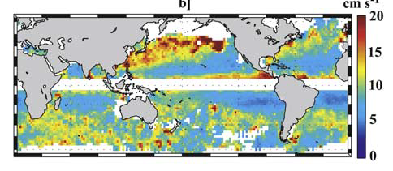
Near-Inertial Oscillations (NIOs)
Rotation near the inertial frequency due to Coriolis force
Driven by short duration wind events (<1/2 inertial period)
Widely observed in currents, temperature and salinity perturbations
Events generally of duration <10days

Slide 5
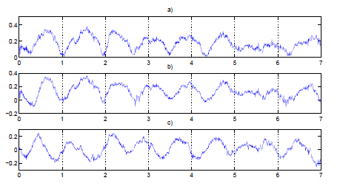
Measured current oscillations
Timeseries of measured near-surface currents
Current magnitude variation dominated by oscillations
East-west currents follow
North-south currents by ¼ period

Slide 6
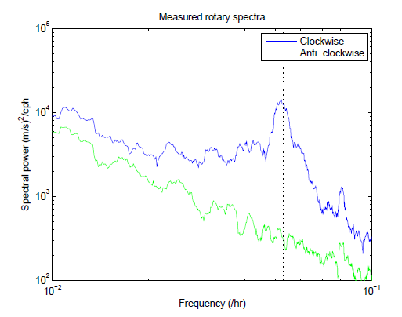
Measured current oscillations
Rotational frequency spectra of near-surface measurements
Clear inertial peak present in clockwise spectrum, not in anti-clockwise spectrum

Slide 7
ROMS simulation
1 year simulation (1st Dec 2007 – 1st Dec 2008)
4km horizontal resolution with 32 vertical levels
LMD vertical mixing scheme
Using sea-ice module
Atmospheric forcing from simulation of WRF limited area model at 4km and 3 hourly resolution
Initialised from WOCE mean profiles of T and S, zero velocities
Spun-up with 40 years of ERA-40

Slide 8
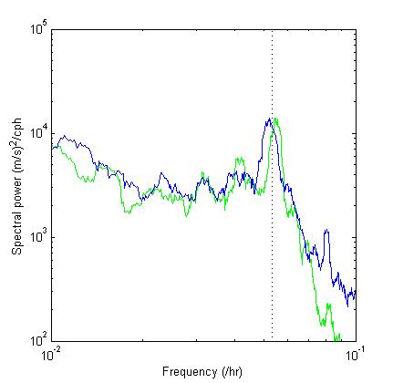
ROMS results - validation
ROMS clockwise spectrum closely matches measurements
Peak in ROMS at slightly higher frequency (0.054/hr cf 0.052/hr)
Measured data
Model output

Slide 9
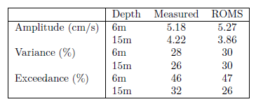
ROMS results - validation
Comparison of mean inertial amplitude; percentage of variance in the inertial band; percentage of the time inertial amplitude exceeds 5cm/s
ROMS closely matches observations

Slide 10
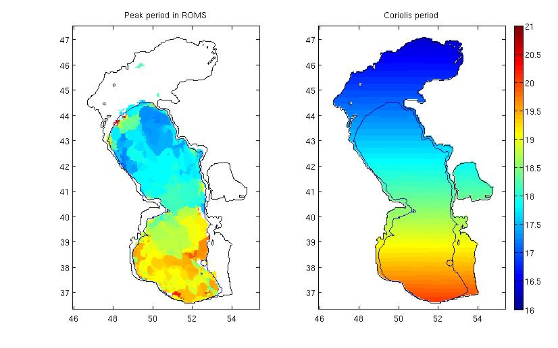
ROMS results – peak period

Slide 11
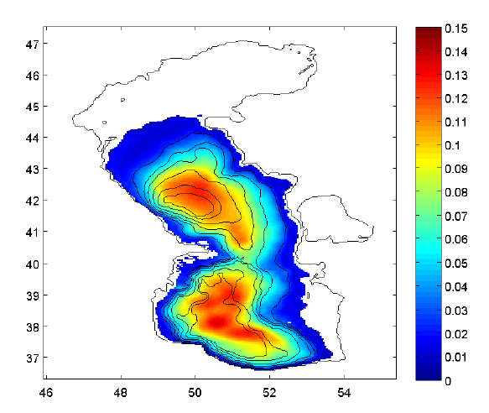
ROMS results – inertial amplitude
Mean inertial amplitude at 15m
Large spatial variations
Amplitudes seem to increase with water depth (contours shown)

Slide 12
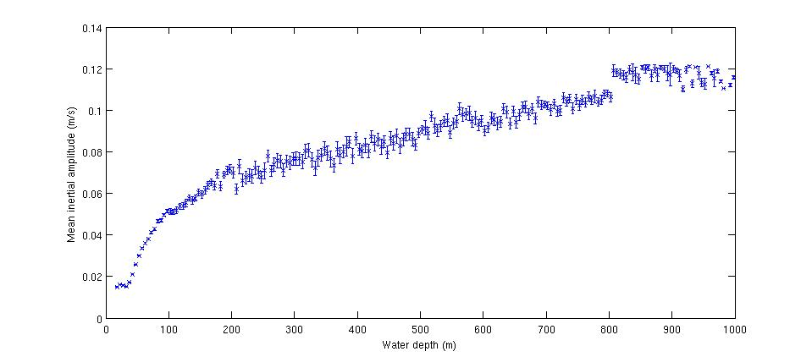
ROMS results - depth dependence of NIOs
Group points in terms of water depth
Amplitude increases with water depth

Slide 13
Flat bottom experiment
Model bathymetry capped at 300m
Re-initialised and spun-up with 2 years of WRF forcing
Simulation as before with the same atmospheric forcing

Slide 14
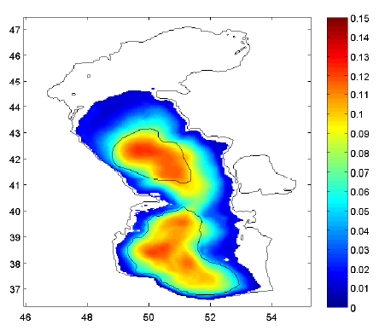
ROMS results - flat bottom experiment
Mean inertial amplitudes with capped depths
Largely unchanged from previous simulation
Still have amplitudes increasing towards centre of flat bottom areas
Implies depth doesn’t control oscillations

Slide 15
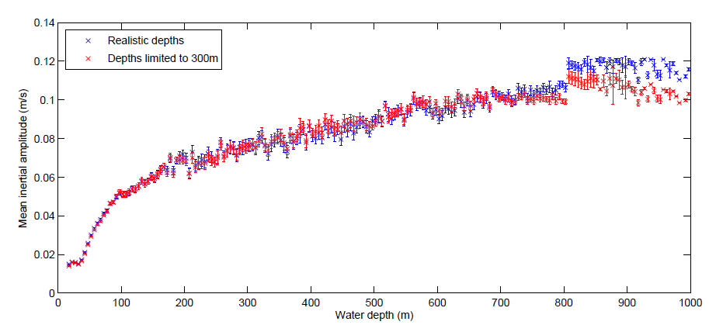
ROMS results - flat bottom experiment
Grouping amplitudes in terms of ‘real’ water depth
Amplitudes still seem to increase with water depth beyond 300m, therefore this result is not robust

Slide 16
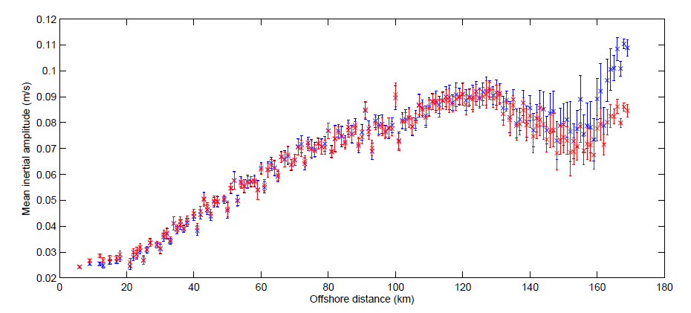
ROMS results - dependence of NIOs on distance
Group points instead in terms of distance from the coastline (blue)
Amplitudes increase with off-shore distance
Result not changed with flat-bottom (red), so not bathymetry dependent

Slide 17
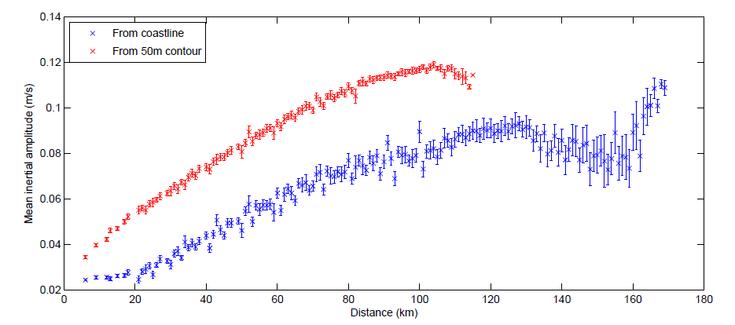
ROMS results - dependence of NIOs on distance
A stronger relationship seen when grouped in distance from 50m depth contour

Slide 18
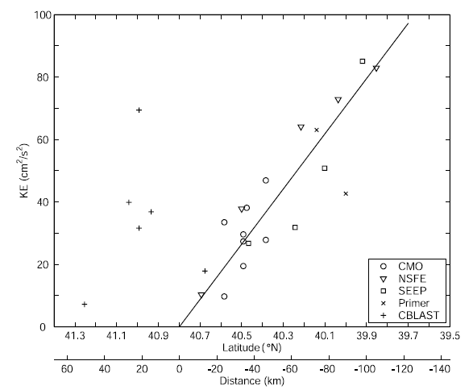
Dependence of NIOs on distance
Observed in other studies, (e.g. Shearman JGR 2005)
On New England shelf, zero-crossing not found at the coast, but about 50km offshore – corresponding to a depth ~40-70m
Mirrors results seen with ROMS in the Caspian

Slide 19
Possible explanations?
Mixed layer depth variation?
Wind speed variation?
Barotropic and baroclinic wave propagation (e.g. Kundu et al. 1983)?

Slide 20
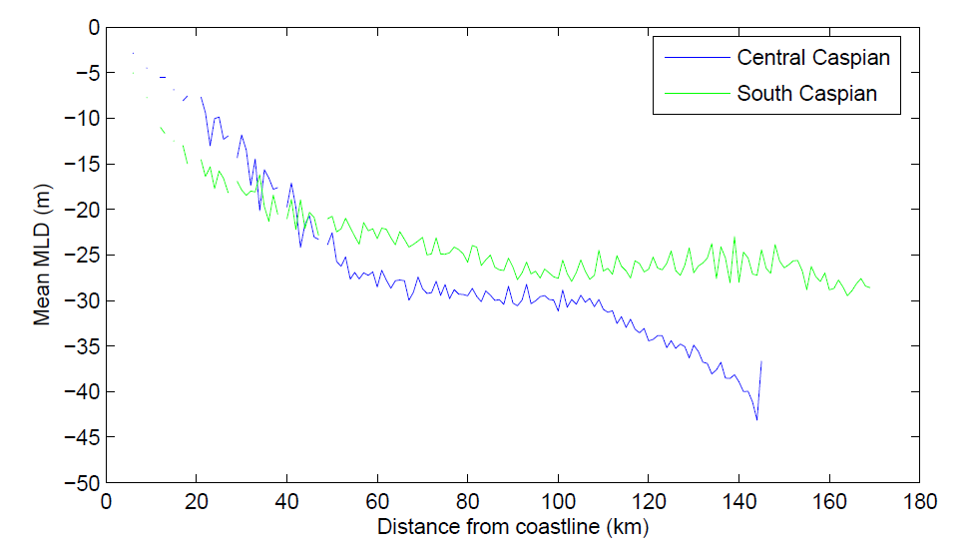
Mixed layer depths
Mixed layer depth calculated daily (as in Levitus 1982)
Mixed layer depth seems to increase with offshore distance
As NIOs decrease with MLD, this would imply a decrease in NIOs with offshore distance

Slide 21
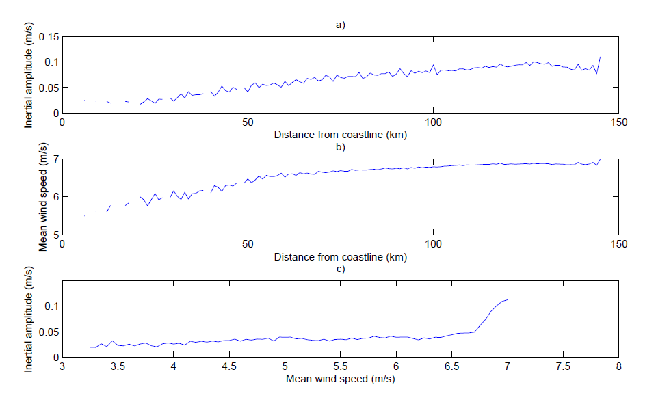
Wind speeds?
Amplitude increase with distance in Central Caspian (0.008 m/s/km)
Winds increase from coastline (0.01 m/s/km)
NIOs increase with wind speed (max 0.24)
The combined increase in wind with distance, and amplitude with winds (0.0024 m/s/km) is much less than the observed increase in amplitude with distance (0.008 m/s/km)

Slide 22
Wave propagation from the coast
Following Kundu et al. [1983]
Flat bottom model, with well-mixed surface layer and vertical diffusion
Coastal wall at x=0, and no variation in y-direction
Step function wind forcing to a state at rest
No flow condition at the coast generates barotropic and baroclinic waves propagating outward
These waves eventually combine to cancel the NIO

Slide 23
Wave propagation from the coast
Solutions found by summing over vertical modes:
Then, for small x/ct (i.e long after passage of a particular wave mode)
Oscillating term increases with distance from the coast

Slide 24
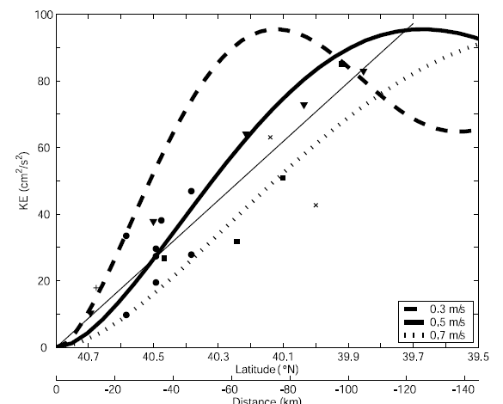
Wave propagation from the coast
The simple model is able to qualitatively explain the observations of Shearman.

Slide 25
Wave propagation from the coast
Solutions given by:
Oscillation above inertial frequency (f), decreasing monotonically to f
Barotropic response already at f, when the baroclinic wave arrives at >f
Therefore beat behaviour after baroclinic wave passage leads to temporary increase in amplitude (Pettigrew [1980])
So maximum oscillation occurs after wave passage ∴ later further from coast

Slide 26
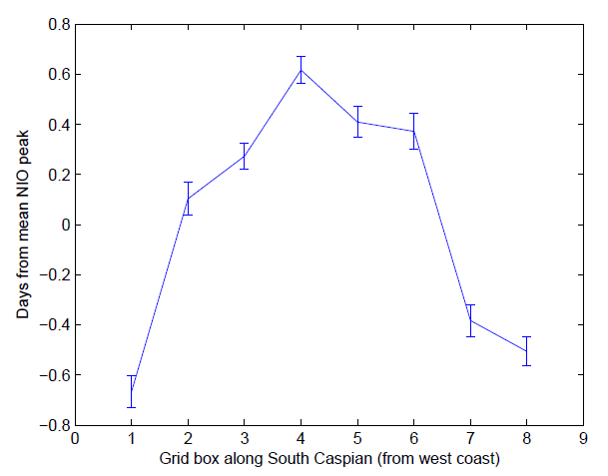
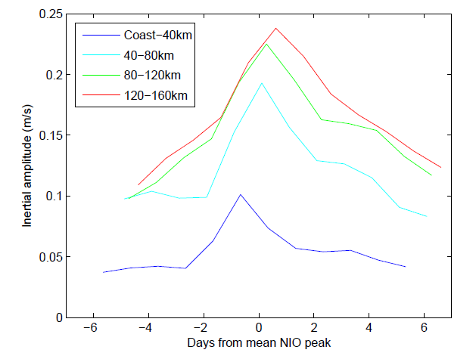
Wave propagation from the coast
As expected, the peak inertial amplitude for a given event occurs later moving away from the coastline and towards the centre of the South Caspian

Slide 27
Possible explanations?
Mixed layer depth variation?
Wind speed variation?
Barotropic and baroclinic wave propagation (e.g. Kundu et al. 1983)

Slide 28
Conclusions
Near-inertial oscillations dominate the variability of currents in the measurements in the Caspian Sea
ROMS model accurately represents the observed NIOs
ROMS shows increase in amplitude of oscillations towards the deeper central parts of the basin
This cannot be explained by increasing water depth, or spatial structure of wind field or mixed layer depths
The relationship between NIOs and distance from a coast agrees with previous observations and simple models
Suggests mechanism of barotropic and baroclinic wave propagation, caused by no-flow condition at a coastline, controls NIOs and is captured in ROMS

Slide 29
Thank you

Slide 30
